Slide 1

MODULE 3 · MACHINE LEARNING · DAY 34
More Than
One Column
Multiple linear regression — and the trap that comes with it.
Boston University
5
16
1
sections
worked pictures
number per column
Prepared & presented by Srinivasa Sai Chava
Notes:
Yesterday: one input column. Today: as many as you like. The machinery is identical - but reading the answer gets genuinely harder, and that is where the day's real content is.

Slide 2
WHERE WE ARE
Yesterday one column. Today, as many as you like.
1
Day 33
2
TODAY
3
The catch
One input column. Find the slope and the intercept.
Many input columns. Find one number for each of them.
The numbers become much harder to READ correctly.
Everything from yesterday still holds
The error is still actual − prediction. We still square the errors and add them up. We still find the numbers that make that total smallest. R² still compares the model with guessing the average. And you must still split before you fit, still check the errors for a pattern, and still refuse to predict outside your data.
The maths is a small step. The hard part today is INTERPRETATION — what one coefficient means when five other columns are in the room with it.
Srinivasa Sai Chava · Boston University
Notes:
Set the expectation early: the new material is not the fitting, it is the reading.

Slide 3
SECTION 1 OF 5
Adding a second column
Six flats, two facts
A line becomes a plane
One number per column, and nothing else changes.
Each column alone
Who finds the numbers?
Srinivasa Sai Chava · Boston University

Slide 4
1 / 5 Adding a second column
THE PROBLEM
Six flats. This time you know two things about each.
EXAMPLE
Yesterday you had area alone. Now you also know how many bedrooms each flat has.
flat | area (100s of sqft) | bedrooms | rent (₹ thousands)
1 | 5 | 1 | 14
2 | 7 | 1 | 16
3 | 9 | 2 | 21
4 | 11 | 2 | 27
5 | 13 | 3 | 31
6 | 9 | 3 | 23
Look at flats 3 and 6: the same 900 sqft, but one has two bedrooms and the other three — and the rents differ by ₹2,000.
Area alone cannot tell those two flats apart. If bedrooms matter at all, we need a model that can use both.
Srinivasa Sai Chava · Boston University
Notes:
Flats 3 and 6 are the hook. Same area, different rent, and area alone must predict the SAME number for both - so it is guaranteed to be wrong on at least one.

Slide 5
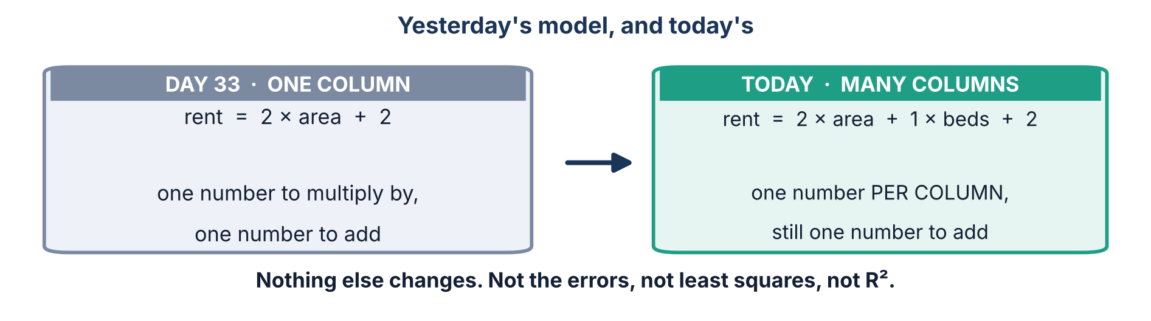
1 / 5 Adding a second column
THE IDEA
One number per column. That is the whole change.
In general: answer = w₁ × column₁ + w₂ × column₂ + … + wₙ × columnₙ + intercept
Ten columns means ten of those w numbers, plus one intercept. Eleven numbers, and the model is complete.
Srinivasa Sai Chava · Boston University
Notes:
Those w numbers have several names: coefficients, weights, parameters, betas. All the same thing. Say all four out loud once so they are not thrown by a textbook later.

Slide 6
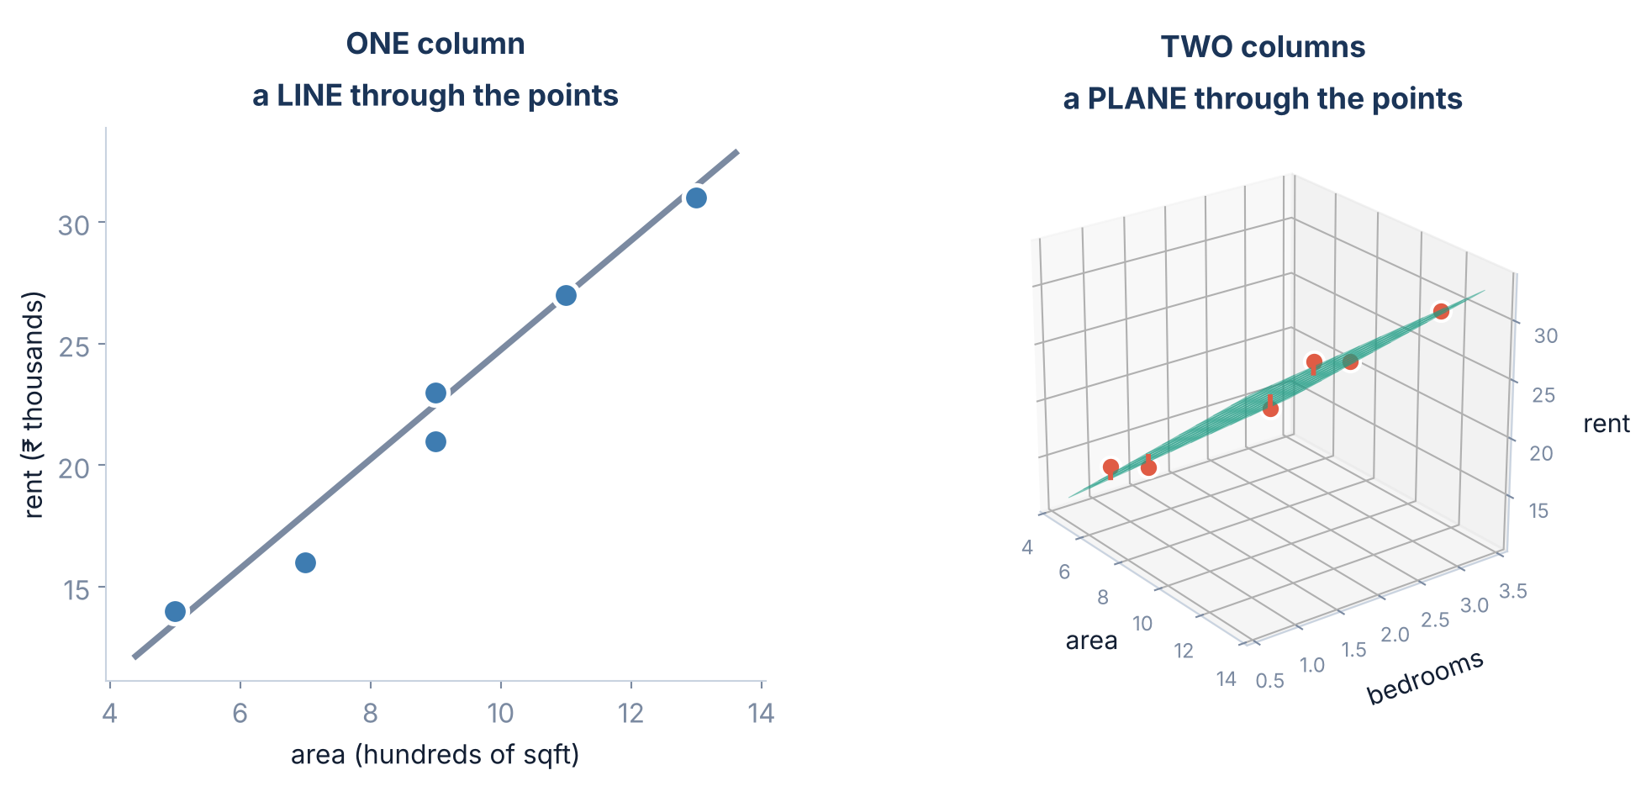
1 / 5 Adding a second column
WHAT IT LOOKS LIKE
A line becomes a flat sheet
With three columns it becomes a shape in 4 dimensions that nobody can draw. The arithmetic does not care — but this is the last slide where you can SEE the model.
Srinivasa Sai Chava · Boston University
Notes:
Be honest that the picture runs out at two inputs. From here on they must reason about the numbers, which is exactly why sections 2 and 3 exist.

Slide 7
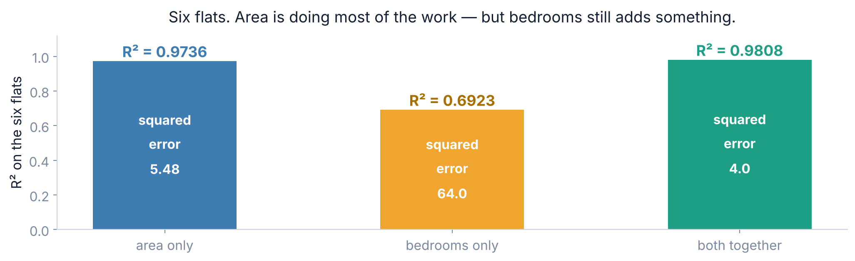
1 / 5 Adding a second column
DOES THE SECOND ONE HELP?
Each column alone, and the two together
Area alone already gets 0.9736. Adding bedrooms takes it to 0.9808 — a real improvement, but a small one. Most of the signal was in area all along.
Srinivasa Sai Chava · Boston University
Notes:
Resist the urge to call bedrooms useless. It cut the squared error from 5.48 to 4.0, which is a 27% reduction. Small is not nothing.

Slide 8
1 / 5 Adding a second column
BY HAND
The best numbers, and how to check them
rent = 2 × area + 1 × bedrooms + 2
area | beds | 2 × area | 1 × beds | + 2 | model says | actual | error
5 | 1 | 10 | 1 | 2 | 13 | 14 | +1
7 | 1 | 14 | 1 | 2 | 17 | 16 | −1
9 | 2 | 18 | 2 | 2 | 22 | 21 | −1
11 | 2 | 22 | 2 | 2 | 26 | 27 | +1
13 | 3 | 26 | 3 | 2 | 31 | 31 | 0
9 | 3 | 18 | 3 | 2 | 23 | 23 | 0
errors add to 0
→
squares add to 4
→
R² = 0.981
as always, for the best fit
nothing beats this
that is 1 − 4/208
Srinivasa Sai Chava · Boston University
Notes:
Do rows 1 and 6 with them, then let them finish. The point is that a multi-column model is still just multiply-and-add - they can check every prediction by hand.

Slide 9
1 / 5 Adding a second column
FINDING THE NUMBERS
So who works out the 2, the 1 and the 2?
THE FORMULA
GRADIENT DESCENT
Still exists — but it is now a matrix calculation, not something you do on paper. sklearn runs it for you, and it is still exact.
Works unchanged. Yesterday you nudged two numbers downhill. Now you nudge as many as you have columns — the loop is identical.
X = flats[["area", "bedrooms"]] # a TABLE with two columns now
model = LinearRegression().fit(X, rent)
print(model.coef_, model.intercept_) # [2. 1.] 2.0
The only thing that changed in the code is that X has two columns instead of one. The .coef_ attribute now returns a list — one number per column, in the order you supplied them.
Srinivasa Sai Chava · Boston University
Notes:
Stress the ORDER of .coef_. It matches the column order of X, and mixing them up is the single most common bug in reading a multi-column model.

Slide 10
SECTION 2 OF 5
What each number means
Holding things constant
Reading a real model
Where the real difficulty starts.
One flat, by hand
When a sign flips
Srinivasa Sai Chava · Boston University

Slide 11
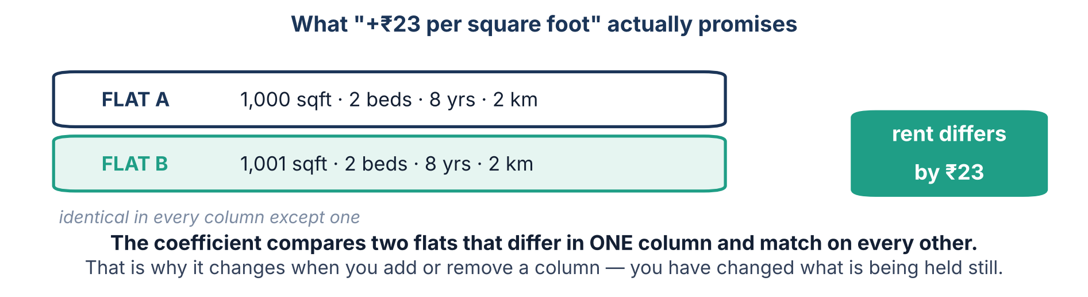
2 / 5 What each number means
READING THE MODEL
A coefficient is a promise about two flats
“+₹23 per square foot” does NOT mean bigger flats cost ₹23 more per foot. It means: take two flats identical in bedrooms, age and distance, and the extra foot is worth ₹23.
Srinivasa Sai Chava · Boston University
Notes:
This is the definition they must be able to state. Make them say it: 'holding everything else constant'. Every misreading later in the day comes from forgetting this clause.

Slide 12
2 / 5 What each number means
READING THE MODEL
A real model: 500 flats, four columns
column | coefficient | what it says, in English
sqft | +23.41 | one more square foot, everything else equal, is worth ₹23 a month
bedrooms | −1,449.71 | one more bedroom AT THE SAME AREA costs ₹1,450 a month
age_years | −224.25 | each year of age knocks ₹224 off the rent
metro_km | −944.65 | each kilometre further from the metro costs ₹945
intercept | +7,882.88 | where the arithmetic starts — not a flat anybody could rent
R² on rows it studied 0.835 · on rows it never saw 0.811 · average miss ₹2,288 a month
Read the bedrooms row again. It is NEGATIVE — more bedrooms, less rent. That cannot be right, and the next four slides are about why it is.
Srinivasa Sai Chava · Boston University
Notes:
Pause on the bedrooms row and let the class object. Someone will say it must be a bug. Tell them it is not, and that the explanation is the most important idea of the day.

Slide 13
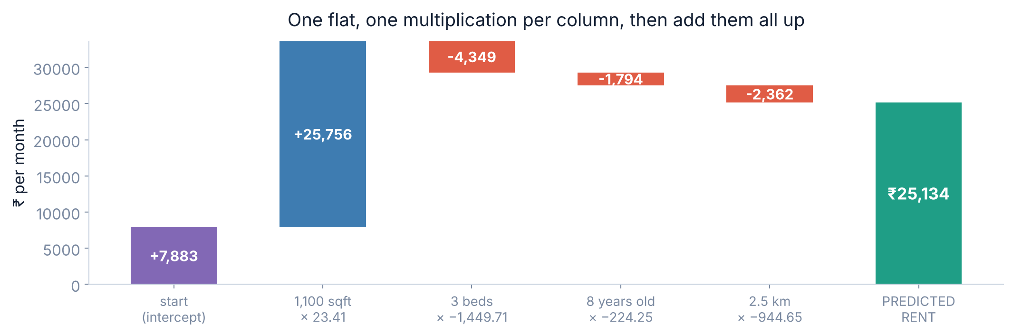
2 / 5 What each number means
USING THE MODEL
Predicting one flat: multiply, multiply, add
1,100 sqft · 3 beds · 8 years old · 2.5 km from the metro → ₹25,134 a month. Five multiplications and one addition. That is all a prediction ever is.
Srinivasa Sai Chava · Boston University
Notes:
Have them do it on a calculator alongside you. Seeing the hand total match sklearn exactly is worth more than another explanation.

Slide 14
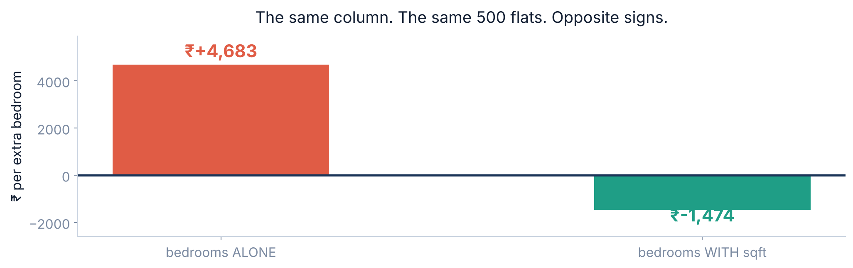
2 / 5 What each number means
THE TRAP
The same column, opposite signs
Fit bedrooms on its own and it says +₹4,683. Fit it alongside sqft and it says −₹1,474. Nothing was changed in the data. No bug. Both numbers are correct.
Srinivasa Sai Chava · Boston University
Notes:
Let the discomfort sit for a moment before you explain. This is the slide students remember.

Slide 15
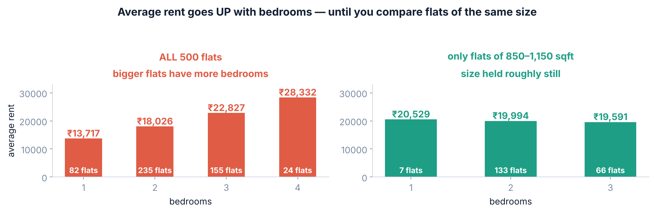
2 / 5 What each number means
THE EXPLANATION
Because the two questions are not the same question
Ask “do 3BHK flats cost more than 2BHK?” and the answer is yes — because they are bigger. Ask “at 1,000 sqft, is a 3BHK worth more than a 2BHK?” and the answer is no — the rooms are poky.
Srinivasa Sai Chava · Boston University
Notes:
The right-hand chart is the whole explanation. Among flats of 850-1,150 sqft, more bedrooms genuinely means LOWER rent. The model found a real effect, not an error.

Slide 16
2 / 5 What each number means
THE RULE
What that flip actually teaches you
A COEFFICIENT IS NOT A PROPERTY OF THE COLUMN
SO ALWAYS SAY WHAT ELSE IS IN THE MODEL
It is a property of the column AND every other column in the model. Change the company it keeps and the number changes.
“Bedrooms are worth −₹1,450” is meaningless on its own. “−₹1,450, once area is accounted for” is a finding.
This has a name outside machine learning: Simpson's paradox. A pattern that holds for the whole group can reverse inside every subgroup. It is behind a great many wrong headlines, and multiple regression is the standard tool for not falling for it.
This is why multiple regression exists. One column at a time tells you what LOOKS true. All of them together tells you what is still true once the obvious explanation is taken out.
Srinivasa Sai Chava · Boston University
Notes:
Name-drop Simpson's paradox once; do not teach it formally. The flats example is the version they will remember.

Slide 17
SECTION 3 OF 5
When columns overlap
The same column twice
Coefficients go wild
Two columns saying the same thing confuse the answer.
The score is fine
What to do
Srinivasa Sai Chava · Boston University

Slide 18
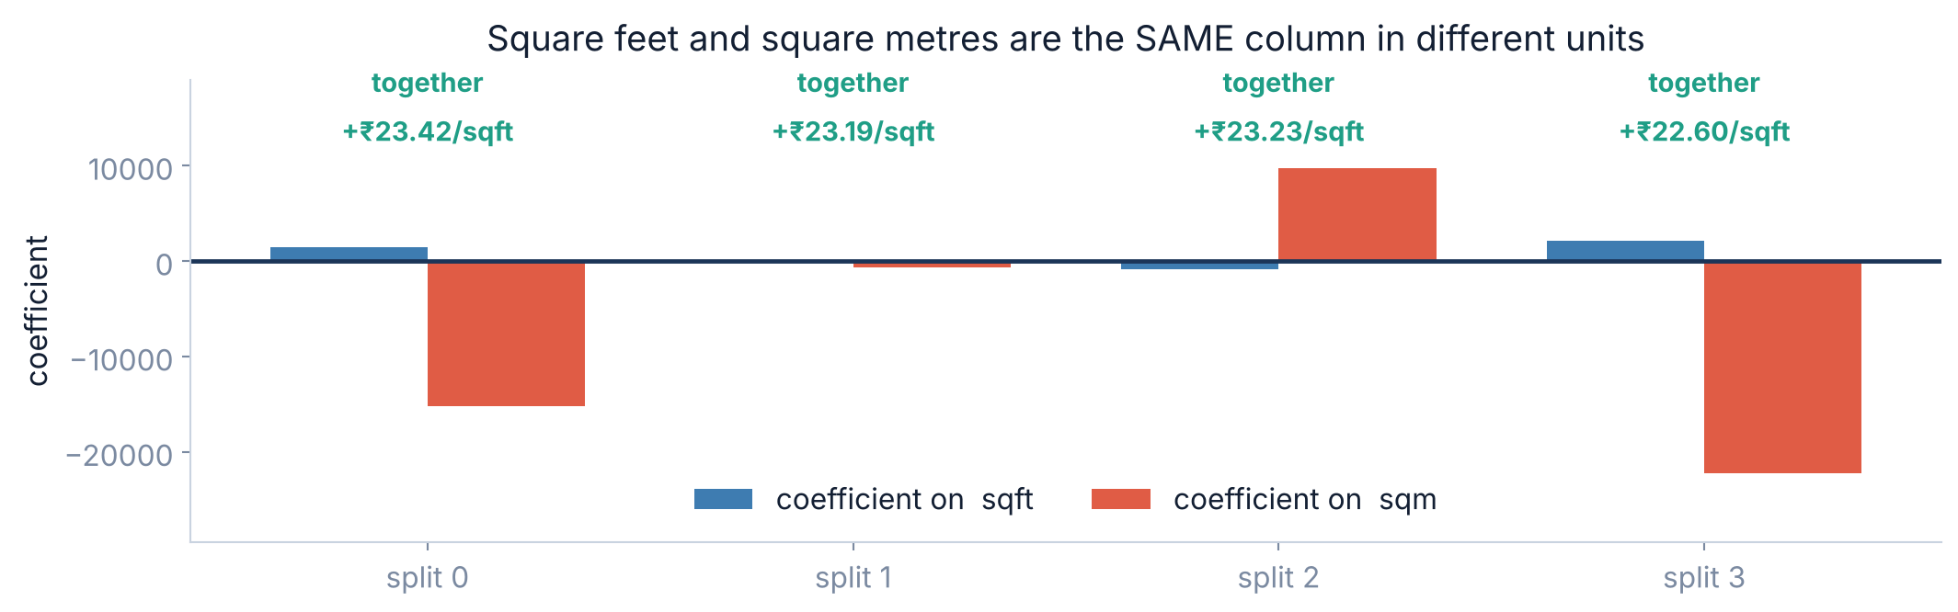
3 / 5 When columns overlap
THE EXTREME CASE
What if two columns say exactly the same thing?
EXAMPLE
Somebody adds a sqm column — the area again, in square metres. Nothing new, just divided by 10.76.
Four different splits of the same data. The two coefficients swing from +1,435 to −883. But look at the top row: their COMBINED effect is +₹23 per sqft every single time.
Srinivasa Sai Chava · Boston University
Notes:
The model is not broken. It genuinely cannot tell which of two identical columns deserves the credit, so it splits it arbitrarily - and differently each time.

Slide 19
3 / 5 When columns overlap
WHAT IS ACTUALLY DAMAGED
The predictions are fine. The explanation is ruined.
 | without sqm | with sqm | damaged?
R² on hidden rows | 0.811 | 0.811 | no
average miss | ₹2,288 | ₹2,288 | no
coefficient on sqft | +23.41 | swings ±2,000 | RUINED
can you explain it? | yes | no | RUINED
So does it matter? If you only want predictions — barely. If you want to tell somebody what drives rent, it matters completely, because your headline number is now whatever the split happened to pick.
The textbook name is MULTICOLLINEARITY. The plain version: two columns are telling the model the same thing, so it cannot decide which one to thank.
Srinivasa Sai Chava · Boston University
Notes:
Be precise about the harm. It is an interpretation problem, not a prediction problem. Students who learn it as 'collinearity breaks your model' will later be confused.

Slide 20
3 / 5 When columns overlap
THE FIX
How to spot it, and what to do
1
SPOT IT
2
OR SPOT IT
3
DROP ONE
4
OR COMBINE
Correlation between every pair of input columns. Anything above about 0.8 is worth a look.
Refit on a different split. If a coefficient swings wildly, two columns are competing.
Keep whichever is easier to explain. sqft or sqm — never both.
Two exam marks that move together? Use their total instead of both.
flats[["sqft", "bedrooms", "age_years", "metro_km"]].corr().round(2)
# sqft and bedrooms correlate 0.79 -> high, but they are NOT the same thing,
# and keeping both is exactly what revealed the bedroom effect. Judgement, not a rule.
0.79 between sqft and bedrooms did not stop us — dropping bedrooms would have thrown away the most interesting finding of the day. Correlation is a flag to investigate, not a rule to obey.
Srinivasa Sai Chava · Boston University
Notes:
Push back on the 0.8 rule of thumb they will read online. The decision depends on whether the two columns MEAN the same thing, not just whether they move together.

Slide 21
SECTION 4 OF 5
Is a column worth it?
R² can only go up
Adjusted R²
R² will always say yes. R² is lying.
The honest test
One at a time
Srinivasa Sai Chava · Boston University

Slide 22
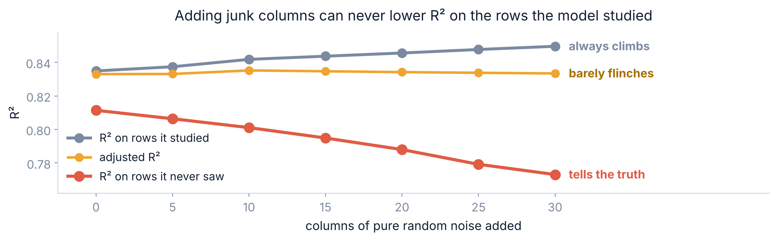
4 / 5 Is a column worth it?
THE PROBLEM
R² can never go down when you add a column
Thirty columns of pure random numbers. R² on the studied rows rose every single time. The model is not learning — it is being handed more ways to bend around the rows it already saw.
Srinivasa Sai Chava · Boston University
Notes:
Explain WHY it can never fall: the model can always set a useless column's coefficient to zero and be exactly as good as before. So the best it can do never gets worse.

Slide 23
4 / 5 Is a column worth it?
WHICH TO TRUST
Three ways to judge an extra column
PLAIN R²
ADJUSTED R²
HIDDEN-ROW R²
Always goes up. Tells you nothing about whether the column helped. Never use it to compare models with different numbers of columns.
Subtracts a penalty for each column. Better — but with 350 rows it barely moved: 0.8330 → 0.8334 while thirty junk columns were added.
Fell from 0.811 to 0.773, steadily, exactly as it should. This is the one that answers the question you actually asked.
Adjusted R² is a weak guard, not a safe one. It stopped the automatic climb and then barely flinched while the honest score fell by 0.04. Hide rows and measure.
Srinivasa Sai Chava · Boston University
Notes:
Be honest here. Most textbooks present adjusted R2 as the answer. On this data it is nearly useless, and the measured evidence is right there on the previous slide.

Slide 24
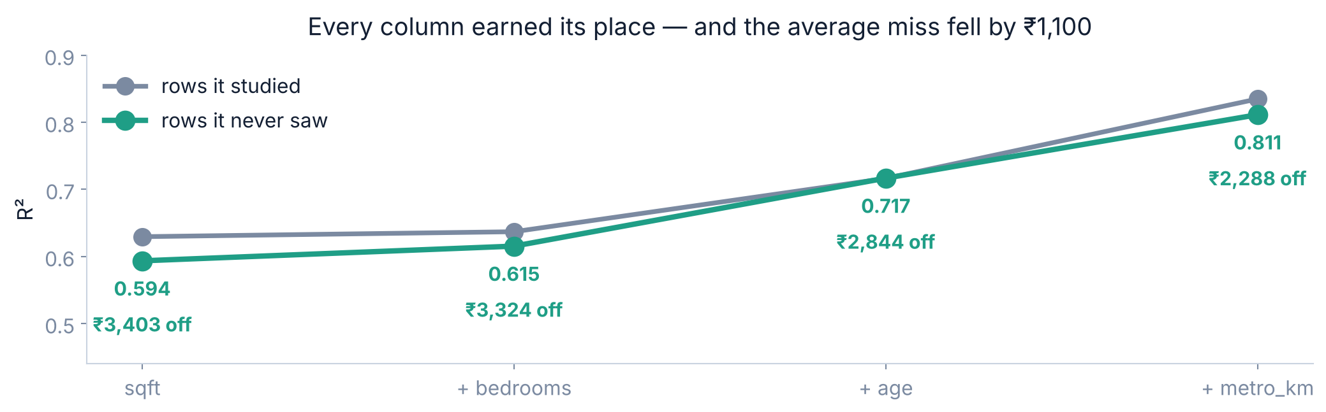
4 / 5 Is a column worth it?
THE METHOD
Add columns one at a time, and watch
All four earned their place. Note how uneven it is: bedrooms bought +0.02, but age bought +0.10. You would never have known which was which by adding them together.
Srinivasa Sai Chava · Boston University
Notes:
Same discipline as Day 32 feature engineering. One at a time, measure, keep what pays.

Slide 25
SECTION 5 OF 5
Doing it for real
One-hot, again
Comparing coefficients
Word columns, fair comparisons, and the usual traps.
Checking the errors
Four ranges at once
Srinivasa Sai Chava · Boston University

Slide 26
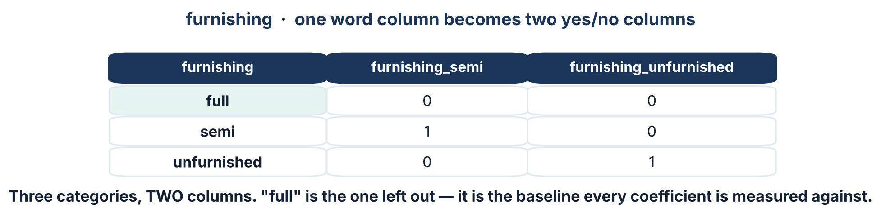
5 / 5 Doing it for real
DAY 31, AGAIN
A word column: back to one-hot encoding
EXAMPLE
We go back and collect one more fact about each flat: is it furnished, semi-furnished, or unfurnished?
Three categories become TWO columns, not three. One category is deliberately left out, and drop_first=True in pandas is what does it.
Srinivasa Sai Chava · Boston University
Notes:
If you keep all three columns they add up to 1 for every row, which is the same information twice - exactly the sqft/sqm problem from section 3. Dropping one is the cure.

Slide 27
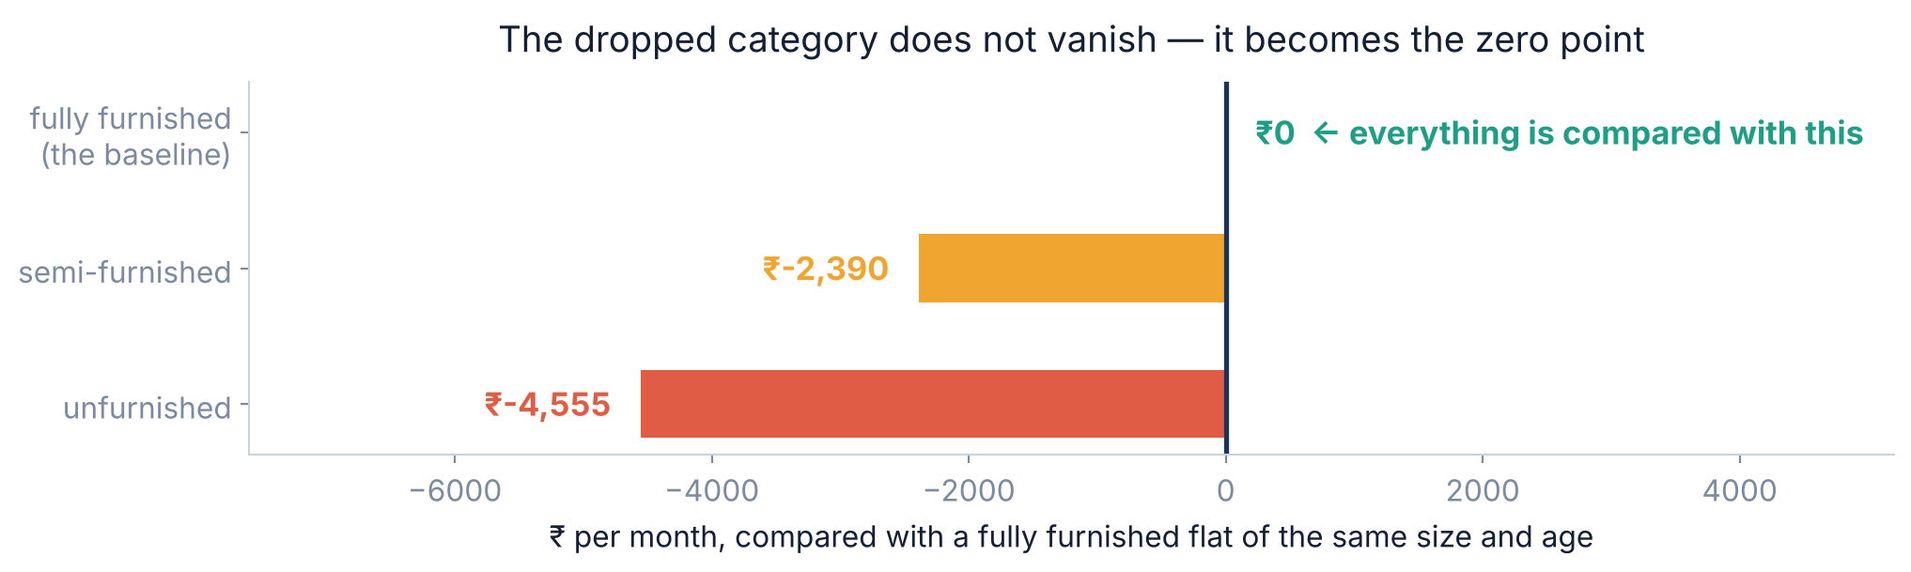
5 / 5 Doing it for real
THE BASELINE
Reading a one-hot coefficient
Every furnishing coefficient is measured against the one that was dropped. Change which category you drop and all the numbers change — but every PREDICTION stays identical.
Srinivasa Sai Chava · Boston University
Notes:
Common exam question: 'why is there no coefficient for fully furnished?' Answer: there is - it is zero, by construction, and everything else is relative to it.

Slide 28
5 / 5 Doing it for real
MEASURE, DO NOT ASSUME
Did the furnishing column earn its place?
0.772
→
0.830
→
+0.058
four columns, no furnishing
with furnishing added
the gain, on hidden rows
And in money: the average miss fell from ₹2,636 a month to ₹2,278 — about ₹360 better per flat. That is the number to put in front of somebody who does not know what R² is.
the question | the answer that convinces people
Is the model any good? | It is wrong by about ₹2,278 a month on flats it has never seen
Is it better than nothing? | Guessing the average is wrong by far more — compare, always
Was that column worth collecting? | It cut the average miss by ₹360 per flat
Srinivasa Sai Chava · Boston University
Notes:
Train them to translate R2 into money or units. Nobody outside the room cares about 0.058.

Slide 29
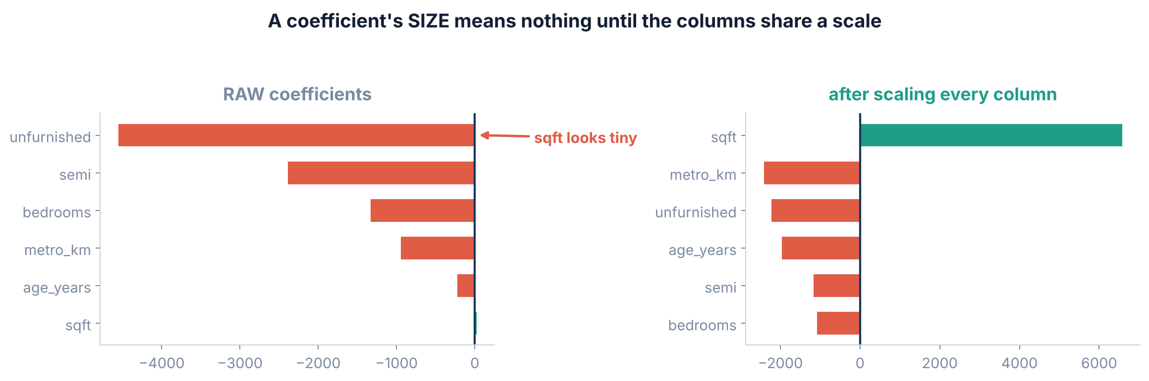
5 / 5 Doing it for real
COMPARING COLUMNS
Which column matters most? Not the biggest coefficient.
Raw, sqft looks like the smallest effect in the model at +23. Scaled, it is three times bigger than anything else. A coefficient's size depends entirely on the units of its column.
Srinivasa Sai Chava · Boston University
Notes:
This is the Day 32 payoff. Scaling does not change the predictions at all for a linear model - it changes whether the coefficients can be compared with each other.

Slide 30
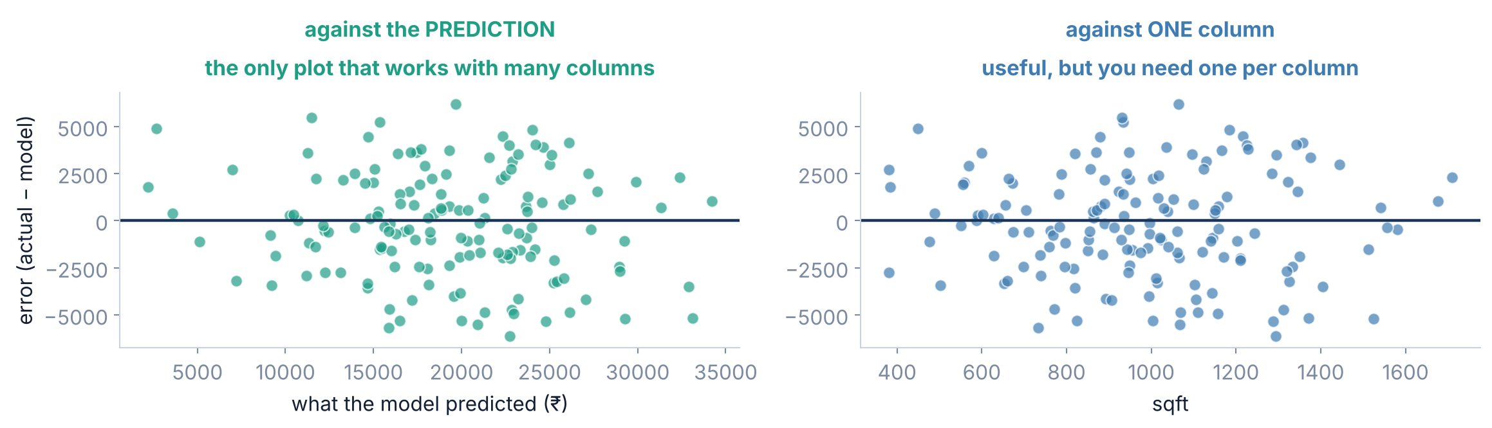
5 / 5 Doing it for real
THE RESIDUAL PLOT, UPDATED
Checking the errors, with four columns
With one column you plotted errors against that column. With four, plot them against the PREDICTION — one chart that covers the whole model at once.
Srinivasa Sai Chava · Boston University
Notes:
Both are useful. Errors vs prediction catches the model being wrong at one end of the range; errors vs a single column catches that column being the wrong shape.

Slide 31
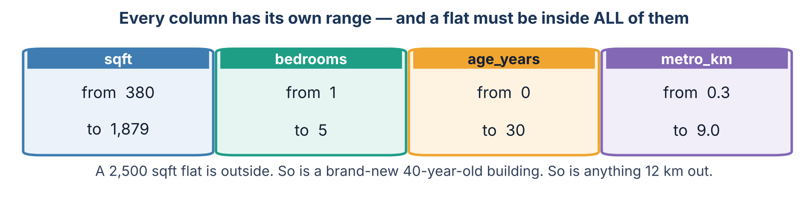
5 / 5 Doing it for real
EXTRAPOLATION, AGAIN
Four columns means four ways to walk off the edge
And a flat can be inside every single range and still be impossible: 400 sqft with 5 bedrooms. No row like that existed, so the model has never seen the combination.
Srinivasa Sai Chava · Boston University
Notes:
This is genuinely harder than yesterday. With one column you check an interval. With four you must also ask whether that COMBINATION ever occurred.

Slide 32
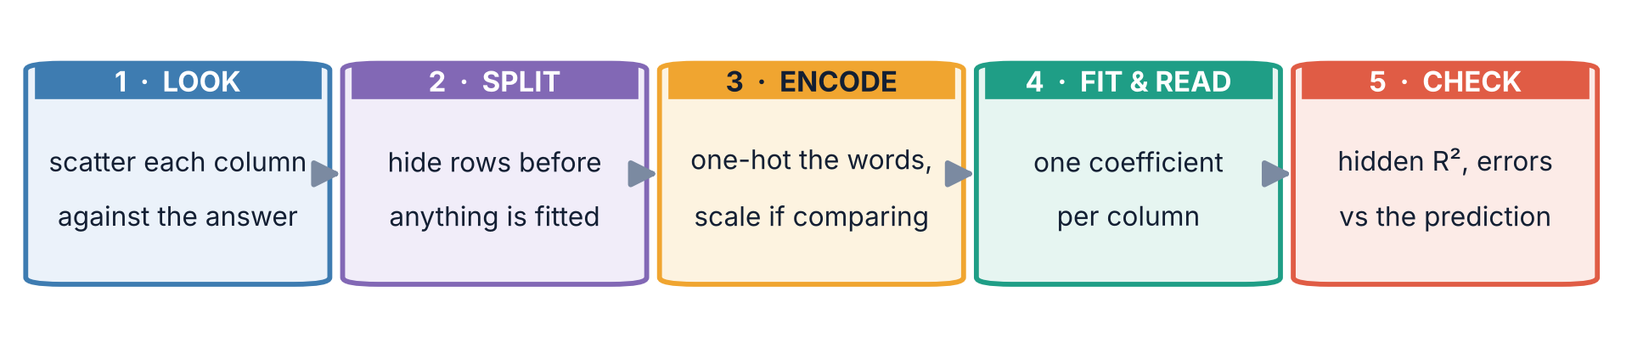
5 / 5 Doing it for real
PUT IT TOGETHER
The five steps, updated for many columns
Step 1 grew. With one column you drew one scatter plot. With six you draw six — plus the correlation table between the inputs, which is what catches two columns secretly saying the same thing.
Srinivasa Sai Chava · Boston University
Notes:
`sns.pairplot` or a correlation heatmap does step 1 in one line. Show it if there is time.

Slide 33
5 / 5 Doing it for real
BEFORE YOU GO
Five mistakes everybody makes once
# | the mistake | what you will see | the fix
1 | Reading a coefficient on its own | “Bedrooms are worth −₹1,450” | Always say what else is in the model
2 | Comparing raw coefficient sizes | “sqft barely matters, it is only 23” | Scale the columns first
3 | Judging a column by plain R² | Every column looks like it helped | Hide rows and measure there
4 | Keeping two columns that mean the same | Coefficients that swing between splits | Drop one, or combine them
5 | Predicting an impossible combination | A confident number for a 400 sqft 5BHK | Check the combination, not just each range
Number 1 is the one that ends up in reports. A coefficient without its context is not a finding — it is a number that happens to be true of one particular model.
Srinivasa Sai Chava · Boston University
Notes:
If they take one thing from today it is mistake 1.

Slide 34
5 / 5 Doing it for real
SUMMARY
What to remember from today
One number per column | answer = w₁x₁ + w₂x₂ + … + intercept. Nothing else about yesterday changed.
Coefficients hold the rest still | “+₹23 per sqft” compares two flats identical in every other column. That clause is not optional.
A sign can legitimately flip | Bedrooms: +₹4,683 alone, −₹1,474 beside area. Both correct. They answer different questions.
Overlapping columns ruin the story | sqft and sqm left the predictions untouched and made the coefficients meaningless. Drop one.
R² always rises | Thirty junk columns raised it every time. Adjusted R² barely flinched. Only the hidden rows told the truth.
Scale before you compare | Raw, sqft looked like the smallest effect. Scaled, it was three times the next one.
Srinivasa Sai Chava · Boston University
Notes:
Six lines. If they leave with these, the day worked.

Slide 35
5 / 5 Doing it for real
19 QUESTIONS
Tonight's practice
A
Work it out
8 questions
Predict by hand, read coefficients, and explain a sign flip
B
Find the mistake
4 questions
Four programs: a misread coefficient, a duplicate column, a fake gain
C
Write the code
5 tasks
Build, encode, scale, compare and diagnose a six-column model
D
Challenge
2 tasks
Build it from scratch, then dismantle a model that blames the wrong thing
Part D hands you a hospital model that blames nurses for patient deaths, and asks you to find the column that explains it.
Srinivasa Sai Chava · Boston University
Notes:
Part A is pen and paper. Part D is the day's big idea applied to a case where getting it wrong would be genuinely harmful.

Slide 36
−₹1,474 per bedroom
…once you hold the area still. A number that is wrong on its own, correct in context, and useless unless you say which. That is multiple regression.
NEXT · DAY 35
Logistic regression — the same machinery, but the answer is yes or no.
Slides & notebooks by Srinivasa Sai Chava · Boston University
Notes:
Tomorrow: predicting a category instead of a number. The inputs work exactly the same way.

