Slide 1

MODULE 2 · STATISTICS & PROBABILITY · TOPIC 2.9
Correlation
Day 29 — one number for “do these move together?”, and four ways it misleads you
1
4
4
Boston University
Number, measuring one thing only
Pictures it cannot tell apart
Reasons for a correlation, one of which is cause
Prepared & presented by Srinivasa Sai Chava
Notes:
Day 29. Everyone already knows the slogan 'correlation is not causation'. Almost nobody can name the four things that produce a correlation. That gap is the session.

Slide 2
WHY THIS SESSION
Everyone knows the slogan. Almost nobody knows the four reasons.
“Correlation is not causation”
The useful version
True, and almost useless on its own. It tells you what the answer is NOT. It does not tell you what else could be going on, so people repeat it and then quietly believe the causal story anyway.
If X and Y are correlated, there are exactly four explanations, and you should be able to name all four and argue about which applies.
By the end of today you will be able to. Only one of the four is “X causes Y”.
Four things that will happen today
1
Four completely different pictures will produce the identical r = 0.816
2
One extra data point will turn r = −0.14 into r = +0.64, with p = 0.00000000000047
3
Two variables with zero relationship will correlate at −0.73
4
Women will be admitted more often in every department, and less often overall
Slides by Srinivasa Sai Chava
Notes:
All four claims are demonstrated on real computed data later in the deck. Promising them up front turns the session into a series of payoffs.

Slide 3
WARM-UP · 5 MINUTES
Four questions from Day 28
1
What is a p-value, exactly?
→ P(data this extreme | nothing is happening).
2
Which scipy default is dangerous?
→ equal_var=True. Use Welch.
3
20 tests on noise — chance of a “finding”?
→ 64%.
4
What should you report besides p?
→ Effect size, interval, n, and how many tests.
Hold on to question 3. A dataframe with 20 numeric columns contains 190 possible correlations, and today you will watch someone “discover” one in data that has nothing in it.
Slides by Srinivasa Sai Chava
Notes:
Yesterday's multiplicity lesson reappears today in its most common real-world form: scanning a correlation matrix.

Slide 4
SESSION PLAN
How today's two hours are structured
What r measures
15 min
What r cannot see
25 min
1
2
And the two things it does not
Curves, outliers, and Anscombe
How well do you know r?
15 min
The four explanations
25 min
3
4
The interval, and tiny r at big n
Only one of them is cause
Searching for correlations
10 min
Practice notebook
30 min
5
6
190 pairs and nothing real
You code, I walk around
Section 4 is the one worth the whole session. It is the difference between repeating a slogan and being able to argue about a causal claim.
Slides by Srinivasa Sai Chava
Notes:
Section 4 contains two things most introductory courses skip entirely: collider bias and Simpson's paradox. They are the ones students will actually be fooled by.

Slide 5
1
What r Measures
What the values look like
r is not a slope
r squared
One number, one job · 15 minutes
Slides by Srinivasa Sai Chava

Slide 6
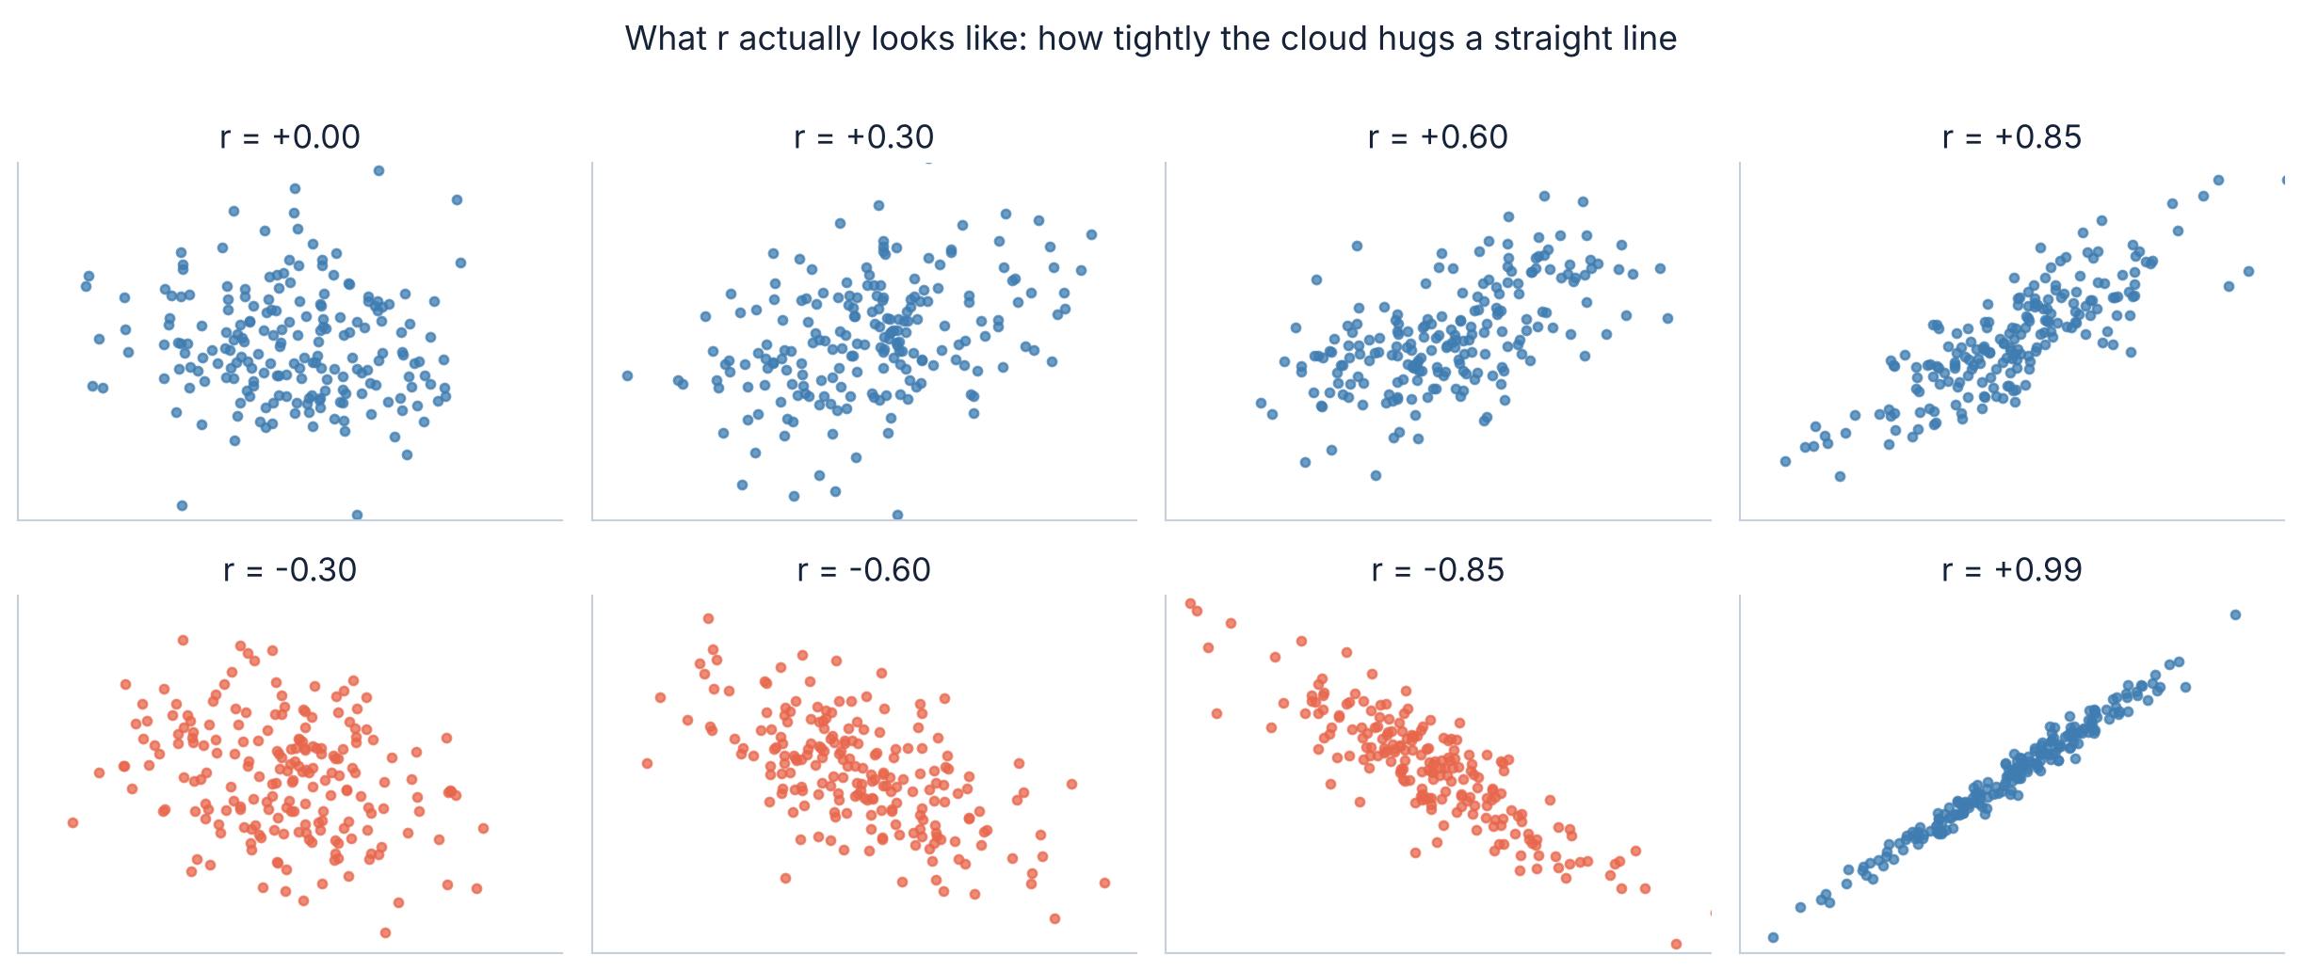
1.1 · THE GALLERY
What the numbers actually look like
Pearson's r runs from −1 to +1. The sign says which way the cloud leans; the size says how tightly it hugs a straight line. r = 0 is a shapeless blob and r = ±1 is a perfect line. Note that r = 0.3 — which sounds like “some relationship” — looks like almost nothing.
Slides by Srinivasa Sai Chava
Notes:
Ask the room to guess r for each panel before you reveal the labels. Most people badly overestimate weak correlations and underestimate strong ones.

Slide 7
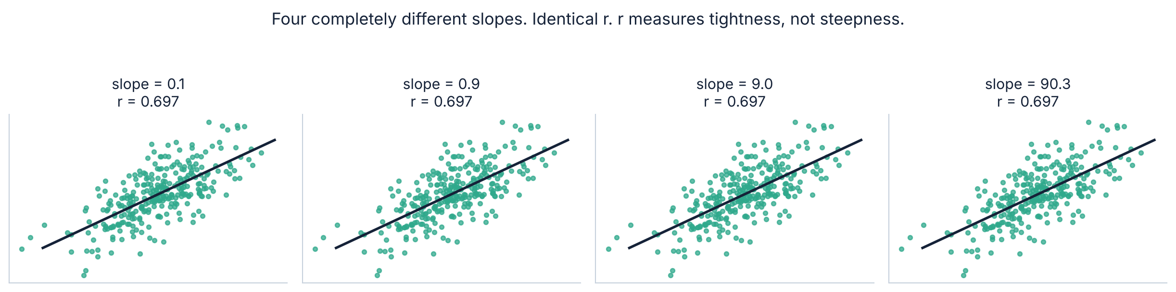
1.2 · NOT A SLOPE
⚠ r tells you nothing about how big the effect is
Same r, slopes spanning 1000×
So what does r mean?
All four panels have r = 0.697. One of them gains 0.09 units of y per unit of x; another gains 90. r cannot tell them apart, because it is computed after both variables are standardised.
Only: how predictable y is from x. Not how much y changes. If someone asks “how much does revenue rise per extra salesperson?”, r is the wrong number — you want the slope, which is Module 3.
Slides by Srinivasa Sai Chava
Notes:
This is the most common confusion in practice: people report r when the question needs a slope. Flag it now, because Module 3 is regression.

Slide 8
1.3 · r SQUARED
r² — the number that keeps you honest
Square it, and it becomes meaningful
r | r² | reads as
0.10 | 1% | essentially nothing
0.30 | 9% | weak
0.50 | 25% | moderate
0.70 | 49% | strong
0.90 | 81% | very strong
r² is the share of the variation in y that x accounts for. It is the number to quote when somebody sounds impressed by a correlation.
r = 0.5 sounds like half a relationship.
It accounts for 25% of the variation,
which leaves 75% unexplained.
The honest habit
Whenever you report an r, report r² next to it. “Hours studied correlates with marks at r = 0.3” sounds like a finding worth acting on. “Hours studied accounts for 9% of the variation in marks” is the same fact, and it is the version that stops anyone redesigning a syllabus around it.
These adjectives are conventions, not laws — in physics r = 0.9 is disappointing, and in psychology r = 0.3 is a strong result. What counts as strong depends entirely on the field.
Slides by Srinivasa Sai Chava
Notes:
The field-dependence caveat matters - students who memorise 'r>0.7 is strong' will misjudge results in every field that does not match that convention.

Slide 9
2
What r Cannot See
Anscombe's quartet
Curves
Ranks
One bad point
Four pictures, one number · 25 minutes
Slides by Srinivasa Sai Chava

Slide 10
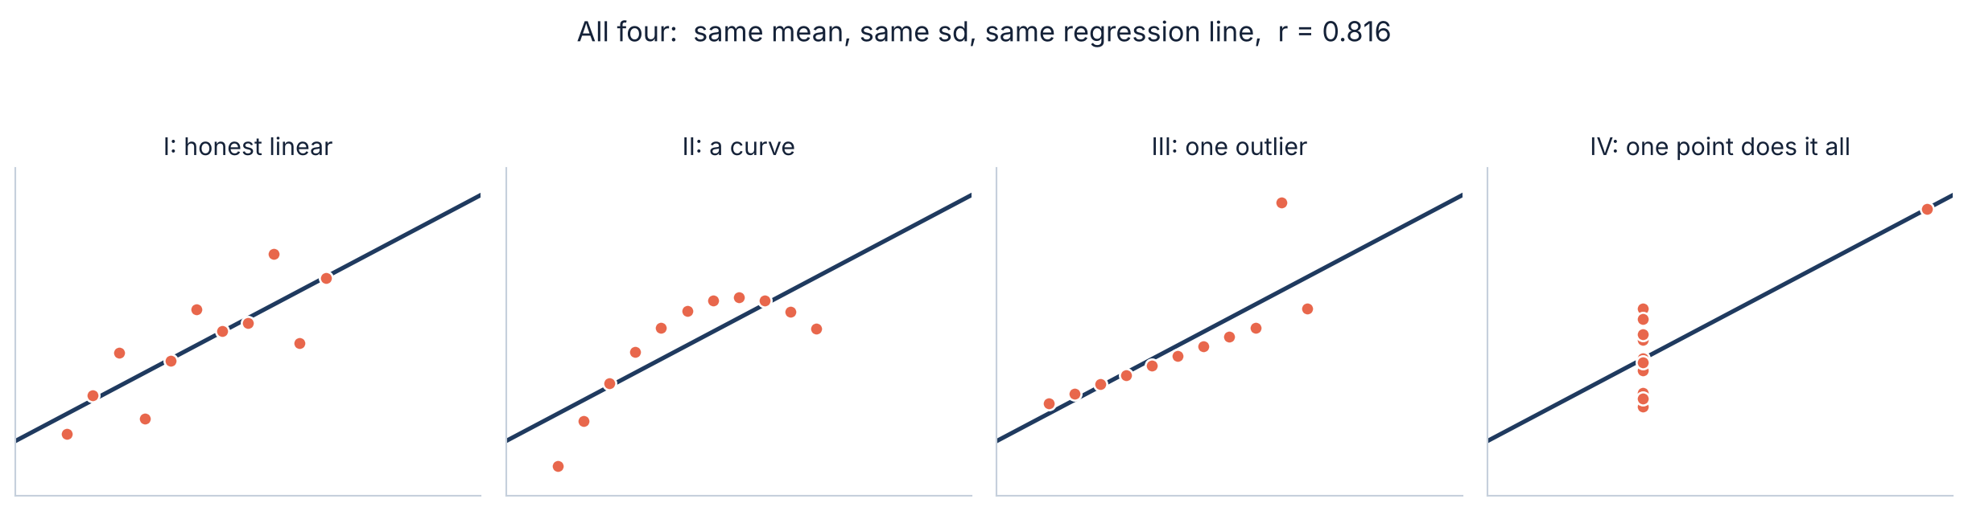
2.1 · ANSCOMBE
⭐ Four datasets. Every summary statistic identical.
What is the same in all four
Mean of x = 9.00. Mean of y = 7.50. sd of y = 2.03. Regression line y = 3 + 0.5x. And r = 0.816 in all four (they differ in the fourth decimal place).
Only one of them is a relationship you would want to model. Francis Anscombe built these in 1973 to make a single point: ALWAYS PLOT THE DATA. Every number you could compute agrees, and the pictures do not.
Slides by Srinivasa Sai Chava
Notes:
Show the numbers first, ask whether the four datasets are the same, then reveal the pictures. The gap between the two moments is the lesson.

Slide 11
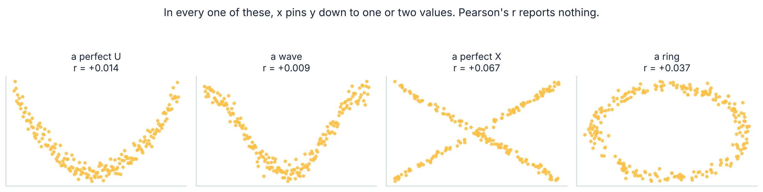
2.2 · CURVES
r only ever asks about straight lines
All four are near-perfect relationships
Where you meet this for real
In every panel, x pins y down to one or two values. Every r comes back under 0.07, because r asks one narrow question: as x goes up, does y go up in a STRAIGHT LINE?
Dose and effect (too little does nothing, too much harms). Price and demand. Practice and performance. Age and almost anything. U-shapes are everywhere, and r = 0.01 on a U-shape reads as “no relationship”.
Slides by Srinivasa Sai Chava
Notes:
The real-world examples matter more than the shapes. U-shaped dose responses are the standard case in medicine and the standard way r misleads.

Slide 12
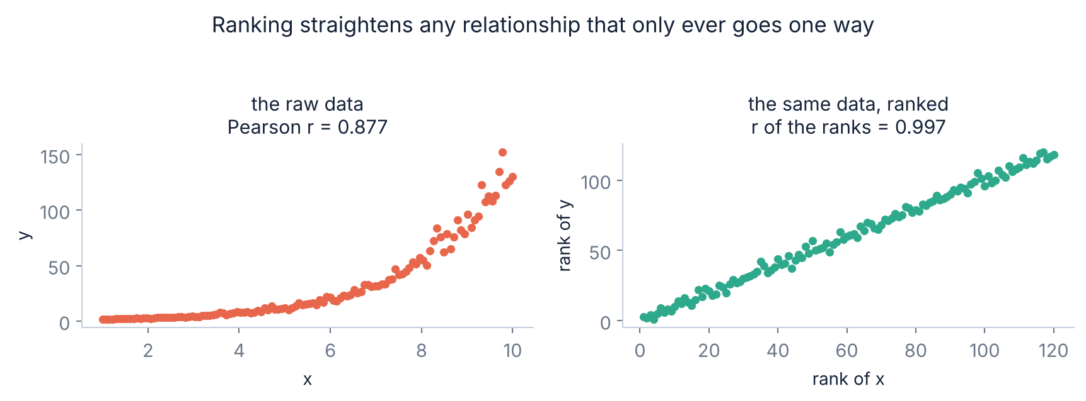
2.3 · RANKS
Spearman: the fix when the curve only goes one way
Spearman
= Pearson's r, computed on the RANKS instead of the values.
It asks: when x goes up, does y go up?
Not: does it go up in a straight line?
stats.spearmanr(x, y)
What ranking does
When to reach for it
Replace every value by its position in the order. Pearson saw 0.877 on the curve; r on the ranks comes out at 0.997 — the relationship is essentially perfectly monotonic, and ranking is what reveals that.
A curved but one-directional relationship · heavy outliers · ordinal data like star ratings. But Spearman still cannot see a U-shape: it goes up then down, so the ranks do not line up either.
Slides by Srinivasa Sai Chava
Notes:
Be explicit that Spearman is not a general fix. It handles monotonic curves and outliers. Nothing that goes up and then down is rescued by ranking.

Slide 13
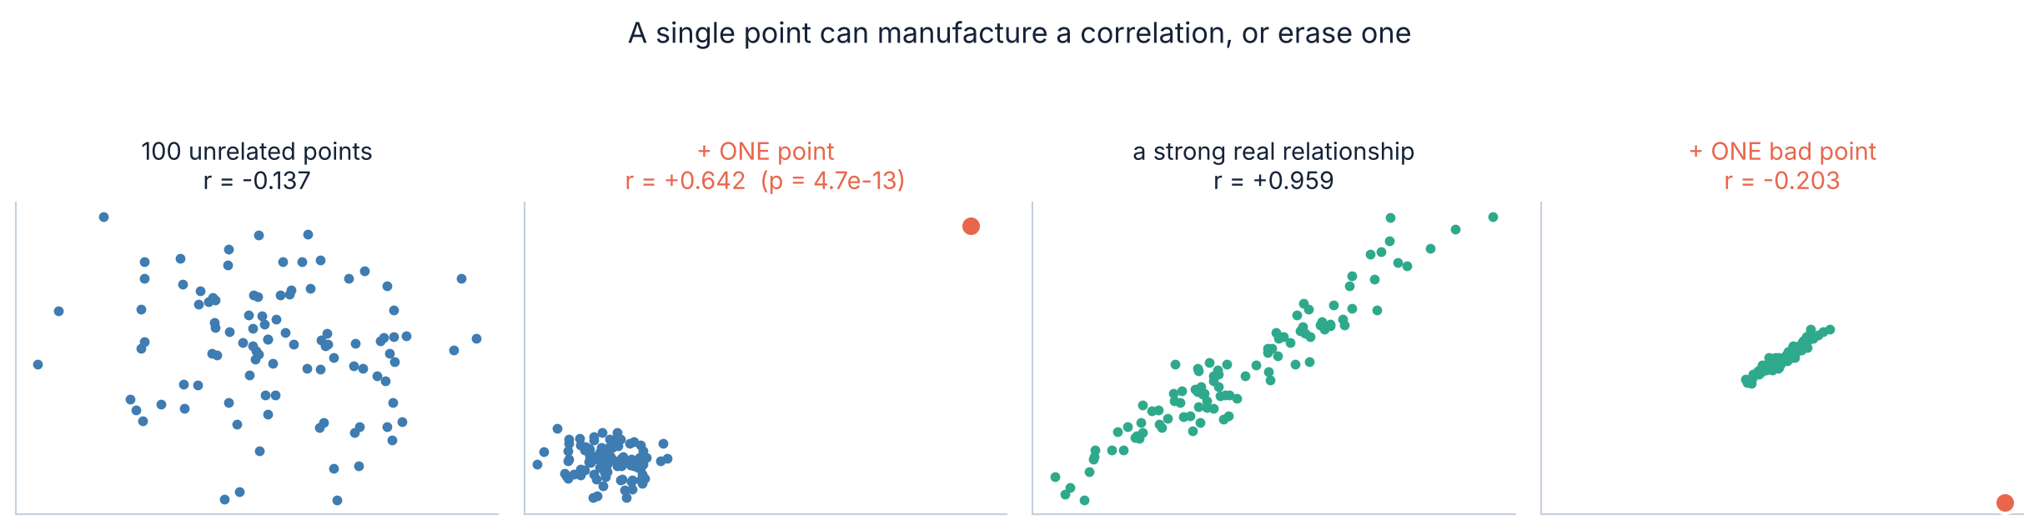
2.4 · OUTLIERS
⚠ One point can manufacture a correlation, or erase one
Left pair: inventing a relationship
Right pair, and the fix
100 unrelated points give r = −0.14. Add one point at (200, 200) — a typo, a different unit, a test record — and r becomes +0.64 with p = 0.00000000000047.
A genuine r = 0.96 collapses to −0.20 from one bad point. Spearman barely moves in either case, because a rank cannot run away. Plot first; compare Pearson and Spearman second.
Slides by Srinivasa Sai Chava
Notes:
The p-value of 5e-13 from a single typo is the number to dwell on. It shows a tiny p is no protection against a data-quality problem.

Slide 14
3
How Well Do You Know r?
The interval for r
Tiny r at large n
The number has error bars too · 15 minutes
Slides by Srinivasa Sai Chava

Slide 15
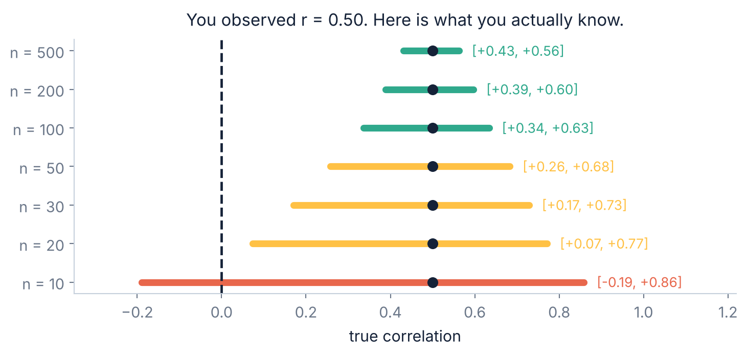
3.1 · THE INTERVAL
r is an estimate, and estimates have intervals
r = 0.50 from 10 points
is compatible with the true correlation being anywhere from −0.19 to +0.86. It includes zero, and it includes almost perfect.
You have learned essentially nothing, and the number 0.50 hides that completely.
How to get it
res = stats.pearsonr(x, y)
res.confidence_interval()
Correlations from small samples are far less stable than they look. Below about n = 30, treat any r as a hint rather than a measurement — and always print the interval beside it.
Built into scipy. One extra line, and it stops you over-reading a small sample.
Slides by Srinivasa Sai Chava
Notes:
Students routinely compute r on 12 rows and report it to three decimals. This slide is the antidote.

Slide 16
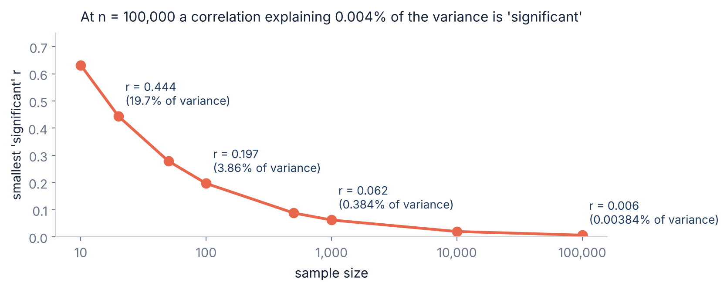
3.2 · THE OTHER END
⚠ At large n, a meaningless r is “significant”
The same trap as yesterday
With 100,000 rows, any correlation above 0.006 reaches p < 0.05. That is an r² of 0.004% — a relationship so faint it is indistinguishable from nothing.
The p-value says “real”. The r² says “irrelevant”. Both are right.
Which is why r² goes next to p
In a dataset of any real size, “statistically significant correlation” carries almost no information. The question that matters is how much of the variation it accounts for — and that is r².
Note the two ends of this section together: with too little data r is unstable, and with a great deal of data its p-value stops meaning anything. Neither problem is solved by looking harder at r itself.
Slides by Srinivasa Sai Chava
Notes:
Tie it to yesterday explicitly. This is the same 'significant but trivial' slide in a new costume.

Slide 17
4
The Four Explanations
Chance
Confounding
Reverse causation
Selection
Only one of them is cause · 25 minutes
Slides by Srinivasa Sai Chava

Slide 18
4.1 · THE LIST
X and Y are correlated. There are four reasons.
1
Chance
You looked at enough pairs that one came up. Section 5.
2
Confounding
Something else causes both. Ice cream and drownings.
3
Reverse causation
Y causes X, not the other way round.
4
Selection
The way the data was collected created the link.
5
X really does cause Y
The one everybody assumes. Last on the list for a reason.
Five, not four — because “X causes Y” is one item on the list, not the default. When you meet a correlation, your job is to argue about which of these it is.
Slides by Srinivasa Sai Chava
Notes:
The slide is titled 'four reasons' and lists five on purpose - the fifth is the one they came in assuming. If anyone notices the mismatch, that is the moment to make the point.

Slide 19
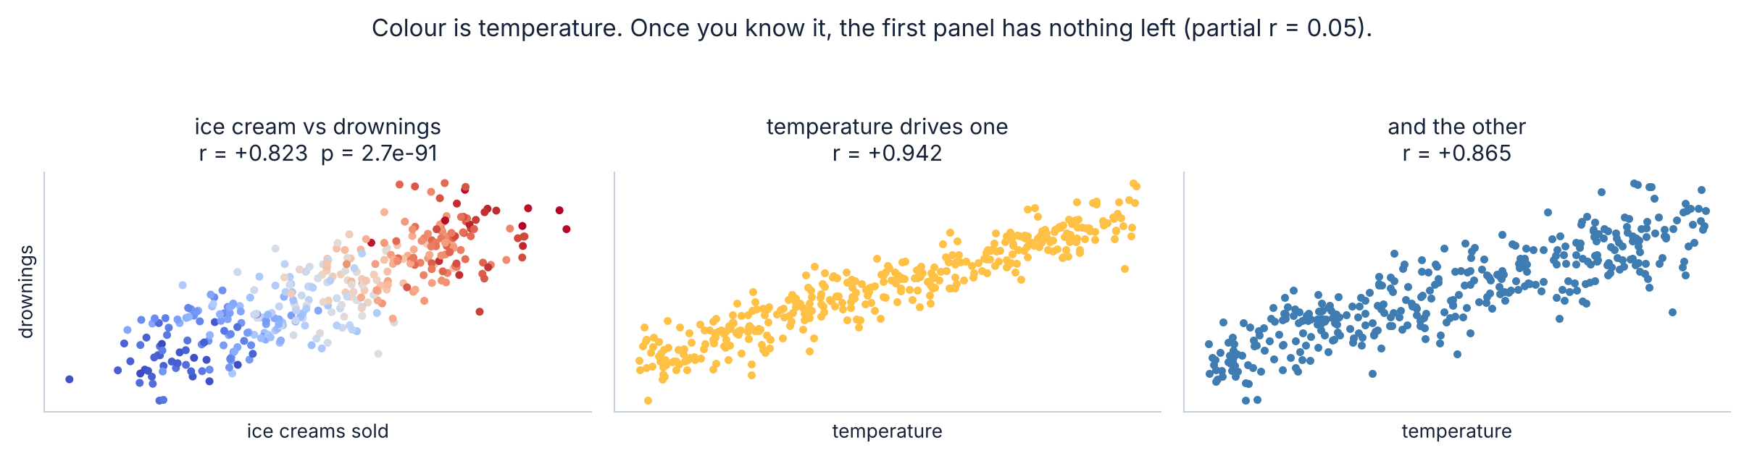
4.2 · CONFOUNDING
Confounding: something else causes both
r = 0.82, p = 3 × 10⁻⁹¹
What to do about it
That is about as strong and as significant as correlations get in real data. Ice cream does not drown anyone. Hot days sell ice cream and hot days put people in the water.
Hold the confounder still. Compare ice cream and drownings WITHIN days of the same temperature and the correlation drops from 0.82 to 0.05. That is a partial correlation, and it is Module 3's main business.
Slides by Srinivasa Sai Chava
Notes:
The 0.82 -> 0.05 collapse is the payoff. It also previews why multiple regression exists, which is where Module 3 starts.

Slide 20
4.3 · REVERSE
Reverse causation: the arrow points the other way
A correlation is symmetric. r(x, y) = r(y, x), exactly. The data cannot tell you which way the arrow points — that information is simply not in it.
“Hospitals with more staff have more deaths”
→ Bigger hospitals take the sicker patients. Severity drives both.
“People who diet weigh more”
→ Weighing more is why they started dieting.
“Firms using more consultants perform worse”
→ Struggling firms hire consultants.
“Heavier police presence, more crime”
→ Crime draws police to the area.
The test: ask whether the story works just as well backwards. If it does, your data cannot distinguish them, and you need either a time ordering or an experiment.
Slides by Srinivasa Sai Chava
Notes:
The hospital example is the one that makes people uncomfortable, which is why it works. It has been used to argue for closing hospitals.

Slide 21
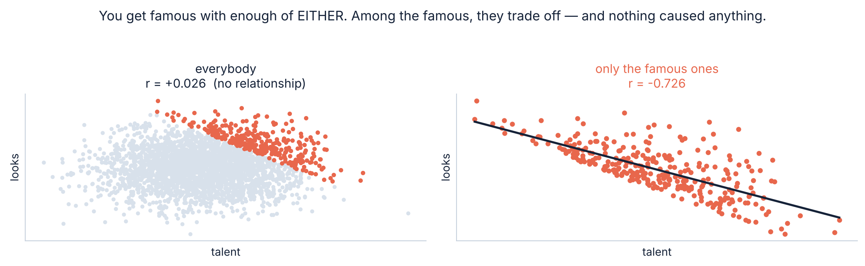
4.4 · COLLIDER BIAS
⭐ Selection: when collecting the data creates the link
Nobody caused anything
Where it bites you
Talent and looks are independent in the population. Among famous people they correlate at −0.73, because you need enough of one or the other to get in.
Any analysis on people who were admitted, hired, diagnosed, subscribed or survived. The selection rule itself writes correlations into the data.
Slides by Srinivasa Sai Chava
Notes:
This is the one almost no introductory course teaches, and it is the one that quietly ruins analyses of customer, patient and admissions data. Conditioning on a common effect of two variables induces a correlation between them.

Slide 22
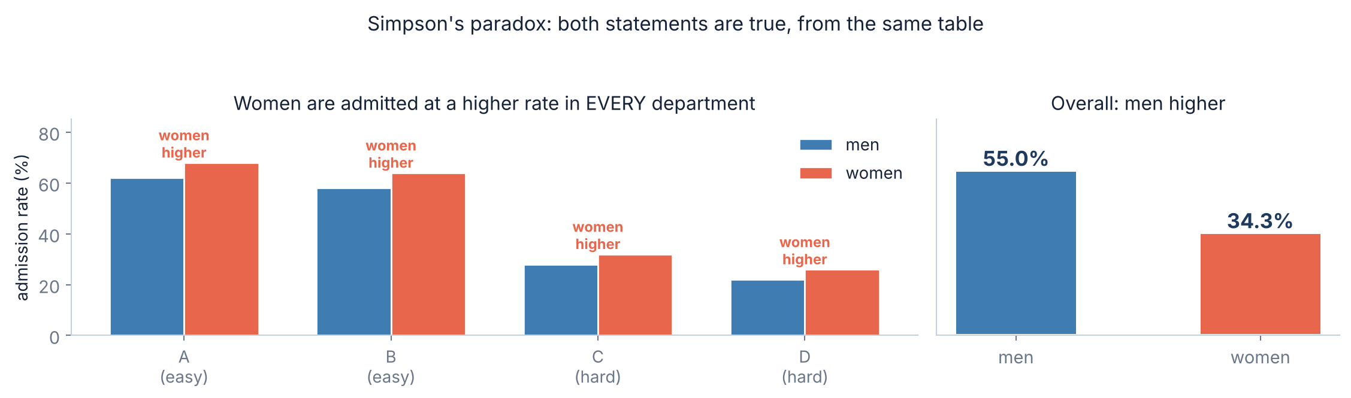
4.5 · SIMPSON
⚠ Simpson's paradox: the reversal
Both statements are true
Why: where people applied
Women are admitted at a higher rate in every single department, and at a lower rate overall (34.3% vs 55.0%). Both come from the same table, with no arithmetic error anywhere.
85% of the men applied to the easy departments; only 14% of the women did. The overall rate mostly measures which doors people knocked on, not what happened at the door.
Slides by Srinivasa Sai Chava
Notes:
Based on the 1973 Berkeley admissions case. The lesson is not 'always split by subgroup' - it is that you must decide which grouping answers your actual question, and that decision is not statistical.

Slide 23
4.6 · THE CHECKLIST
What to ask before believing any correlation
1
Did I plot it?
Anscombe. Non-negotiable, and it takes four seconds.
2
How many pairs did I look at?
If it was 190, this one means nothing on its own.
3
What is r², and the interval?
Not just r. Both ends: is it big, and do I know it?
4
What else could cause both?
Name a specific confounder, then try to control for it.
5
Does the story work backwards?
If yes, the data cannot tell you which way it goes.
6
Who is in this dataset, and why?
Selection. Admitted, hired, survived, subscribed.
Questions 4, 5 and 6 cannot be answered from the data. They need you to know where the numbers came from — which is why a domain expert beats a bigger dataset.
Slides by Srinivasa Sai Chava
Notes:
Tell them to photograph this. It is the practical output of the whole session.

Slide 24
5
Searching for Correlations
190 pairs
What to report
Yesterday's lesson, today's costume · 10 minutes
Slides by Srinivasa Sai Chava

Slide 25
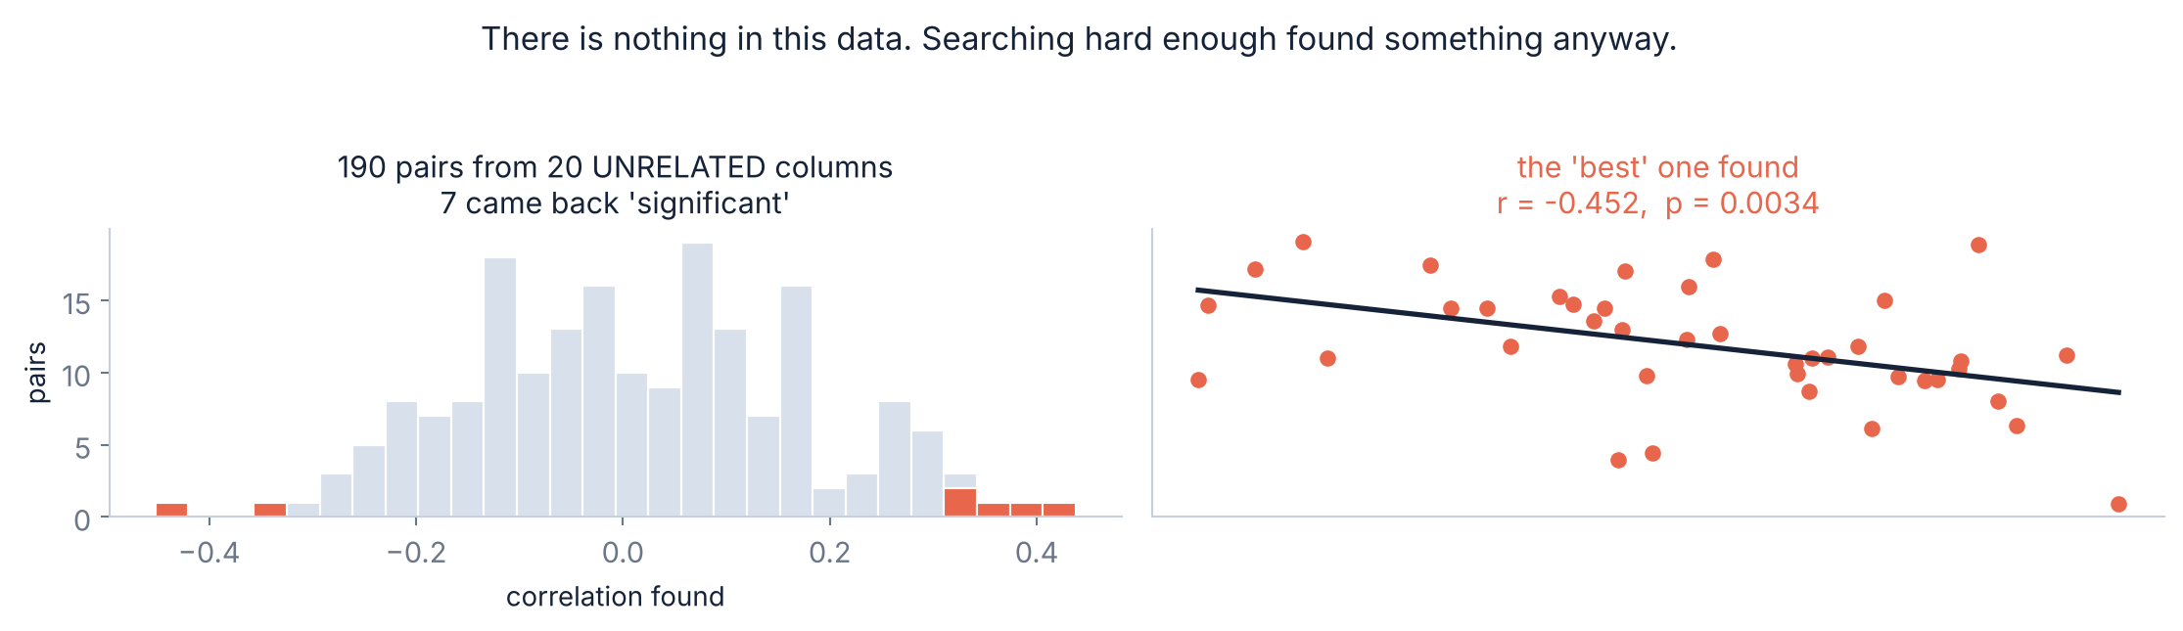
5.1 · THE MATRIX
⚠ df.corr() on 20 columns runs 190 tests
There is nothing in this data
The honest handling
20 independent random columns, 40 rows. Seven pairs came back p < 0.05, and the strongest reached r = 0.45 with p = 0.003. It looks like a finding.
The Bonferroni threshold for 190 pairs is 0.00026. Nothing survives it, correctly. A heatmap is a tool for generating hypotheses — never for confirming one.
Slides by Srinivasa Sai Chava
Notes:
Every student will run df.corr(). Make sure they leave knowing it is 190 silent hypothesis tests, not one picture.

Slide 26
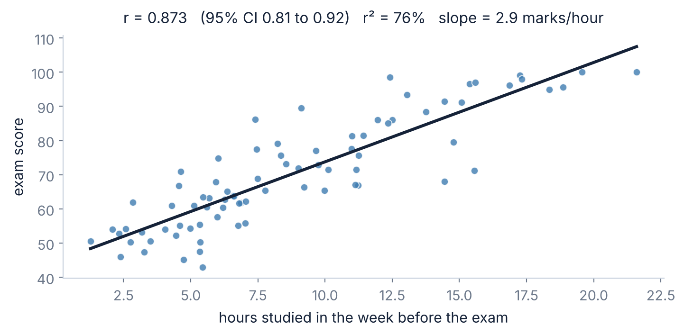
5.2 · A FULL EXAMPLE
Worked through: study hours and exam scores
What we can say
r = 0.873, 95% CI 0.81 to 0.92, n = 80. Spearman agrees at 0.883, so it is not an outlier artefact. r² = 76% of the variation in scores.
The slope says about 2.9 marks per extra hour.
⚠ What we cannot say
That studying causes the marks. Motivation plausibly drives both (confounding). Students who find it easy may study more because it is rewarding (reverse). And this is one class — who dropped out before the exam?
The sentence to write: “Hours studied and exam score are strongly related (r = 0.87, 95% CI 0.81–0.92, n = 80; r² = 0.76). This is observational, so we cannot separate studying from the motivation that drives it.”
Slides by Srinivasa Sai Chava
Notes:
Note how short the caveat sentence is. Honesty about causation costs one clause, not a paragraph.

Slide 27
5.3 · REFERENCE
Which correlation, and what to report
Situation | Use | scipy
Straight-line relationship, no wild outliers | Pearson | stats.pearsonr(x, y)
Curved but always one direction | Spearman | stats.spearmanr(x, y)
Heavy outliers you cannot remove | Spearman | stats.spearmanr(x, y)
Ordinal data (star ratings, grades) | Spearman or Kendall | stats.kendalltau(x, y)
Small sample with many ties | Kendall's tau | stats.kendalltau(x, y)
U-shaped or non-monotonic | none of them — plot it | plt.scatter(x, y)
Need the size of the effect | regression slope | np.polyfit(x, y, 1)
Always report together: r, its 95% confidence interval, r², n, and whether you checked Spearman. Five numbers, one line of output, and a reader can judge everything that matters.
Slides by Srinivasa Sai Chava
Notes:
The last row matters: when the relationship is non-monotonic, no correlation coefficient is the right tool, and saying so is the correct answer.

Slide 28
RECAP
Debug corner — eight correlation mistakes
You did | What goes wrong | Fix
computed r without plotting | Anscombe: four pictures, one r | plot it, every time
read r as the size of the effect | slopes 0.09 and 90 share r = 0.697 | report the slope too
reported r = 0.3 as a relationship | that is 9% of the variation | report r² beside it
used Pearson on a U-shape | r ≈ 0 on a perfect relationship | plot it; Spearman will not help either
left one typo in the data | r went from −0.14 to +0.64 | compare Pearson with Spearman
computed r on 10 rows | 95% CI was −0.19 to +0.86 | report the interval
scanned df.corr() for the biggest | 190 silent tests | Bonferroni, or pre-specify the pair
concluded X causes Y | four other explanations exist | work the checklist
Row 1 prevents rows 2, 4 and 5 on its own. If your students only change one habit this session, make it that one.
Slides by Srinivasa Sai Chava
Notes:
Row 1 really does catch most of the others. Say so explicitly - a single enforceable habit beats eight rules.

Slide 29
6 · MINI BUILD
Putting it together — a correlation you can trust
It plots before it prints
import numpy as np
import matplotlib.pyplot as plt
from scipy import stats
def correlate(x, y, n_pairs=1, labels=("x", "y")):
"""Report a correlation with everything needed to judge it."""
x, y = np.asarray(x, float), np.asarray(y, float)
# 1. always plot. This single line prevents most mistakes.
plt.scatter(x, y, s=18, alpha=.7)
plt.xlabel(labels[0]); plt.ylabel(labels[1]); plt.show()
# 2. both coefficients - a gap between them means outliers
pe = stats.pearsonr(x, y)
sp = stats.spearmanr(x, y)
lo, hi = pe.confidence_interval()
print(f"n = {len(x)}")
print(f"Pearson r = {pe.statistic:+.3f} 95% CI [{lo:+.3f}, {hi:+.3f}]")
print(f"Spearman r = {sp.statistic:+.3f}")
print(f"r^2 = {pe.statistic**2:.1%} of the variance")
print(f"slope = {np.polyfit(x, y, 1)[0]:+.3f} {labels[1]} per {labels[0]}")
print(f"p = {pe.pvalue:.4f} threshold {0.05/n_pairs:.5f} "
f"({n_pairs} pair(s) examined)")
if abs(pe.statistic - sp.statistic) > 0.15:
print(" !! Pearson and Spearman disagree - check for outliers")
the habit that catches Anscombe
Both coefficients, always
a gap between them IS the warning
The interval, not just r
n = 10 is a hint, not a number
r² next to r
9% sounds different to 0.3
The slope, for size
r cannot answer “how much?”
n_pairs is a required thought
df.corr() is 190 tests
What it cannot do is tell you whether X causes Y. No function can. That is the checklist, and it needs you.
Slides by Srinivasa Sai Chava
Notes:
The disagreement warning between Pearson and Spearman is the cheapest outlier detector there is, and almost nobody uses it.

Slide 30
OVER TO YOU
Practice session — 30 minutes
A
Predict the output
8 questions
Your notebook
r vs slope, curves, ranks, outliers
Day29_Practice_
Questions.ipynb
B
Spot & fix the bug
4 questions
The unplotted r, the matrix scan, a causal leap
Plot it before you compute it
Pearson AND Spearman
How many pairs did I look at?
Solutions shared after class
C
Write the code
5 tasks
Diagnose, control, and report
D
Challenge
2 tasks
Build a fake finding, then break a real one
Part D gives you a dataset with a strong, highly significant correlation in it and asks you to work out which of the five explanations it is. There is a right answer, and it is not “X causes Y”.
Slides by Srinivasa Sai Chava
Notes:
Part D is a diagnosis exercise rather than a computation one, which is the right final test for this topic.

Slide 31
TODAY IN TWELVE LINES
Recap
1
r runs −1 to +1 and measures one thing: tightness around a STRAIGHT line.
7
⚠ One point moved r from −0.14 to +0.64, at p = 4.7e-13.
2
⚠ r is not a slope. Slopes of 0.09 and 90 both gave r = 0.697.
8
⚠ r = 0.5 from n = 10 has a CI of −0.19 to +0.86. You learned nothing.
3
r² is the share of variance. r = 0.3 is 9%, which is almost nothing.
9
⚠ At n = 100,000, r = 0.006 is “significant” and explains 0.004%.
4
⭐ Anscombe: four different pictures, all with r = 0.816. Plot the data.
10
Five explanations: chance, confounding, reverse, selection — and cause.
5
⚠ r sees only straight lines. A perfect U-shape gives r ≈ 0.
11
⚠ Selection manufactured r = −0.73 between two independent variables.
6
Spearman = r on the ranks. Fixes curves and outliers, not U-shapes.
12
⚠ df.corr() on 20 columns is 190 hypothesis tests, not one picture.
Homework
Next class — Topic 2.10
Run correlate() on three pairs of columns from your Day 21 project and report all five numbers · Find a news headline built on a correlation and work the checklist on it · Take one correlation you believe is causal and name the confounder you would need to rule out
The statistics mini project. Everything from Day 23 onwards, applied end to end on a real dataset — describe it, test something, and report it honestly enough that someone could check you.
Slides by Srinivasa Sai Chava
Notes:
End on the checklist rather than the formula. r takes a minute to teach; knowing what it cannot tell you is the session.

