Slide 1

MODULE 2 · STATISTICS & PROBABILITY · TOPIC 2.5
Binomial &
Poisson
Day 25 — the distributions for COUNTING things
Boston University
2
6
1
Distributions
Worked examples
Question that picks between them
Prepared & presented by Srinivasa Sai Chava
Notes:
Day 25. Everything so far has been about MEASURING a quantity. Today is about COUNTING events. The whole session is built from two worked examples - coin flips and a call centre - developed slowly.

Slide 2
THE SHIFT
Everything so far measured. Today we count.
Days 23 – 24 · MEASURING
Today · COUNTING
How tall is this person? 171.3 cm
What is this salary? 42,500
How long did delivery take? 18.4 min
How many of 20 items are defective? 3
How many clicked the ad? 47
How many calls arrived this hour? 5
The answer can be ANY number, including fractions.
These are CONTINUOUS.
The answer is always a WHOLE number: 0, 1, 2, 3…
These are DISCRETE.
Why this needs different tools
You cannot have 2.7 defective items. So instead of a smooth curve where we ask “what fraction falls between 85 and 115?”, we get separate BARS and ask “what is the probability of exactly 3?” — a question that was meaningless yesterday, because the chance of a height being exactly 171.30000… cm is zero.
Two distributions cover almost all counting problems. Today you learn both, and the one question that tells you which to use.
Slides by Srinivasa Sai Chava
Notes:
The 'probability of exactly 3' point is important: that question has a real answer for discrete data and is always zero for continuous data. It is the cleanest way to feel the difference.

Slide 3
WARM-UP · 5 MINUTES
Four questions from Day 24
1
What are the three bands?
→ 68% · 95% · 99.7% within 1, 2, 3 sd.
2
Where does 1.96 come from?
→ ppf(0.975) — it leaves 2.5% in each tail.
3
Two exams, which mark is better?
→ Compare z-scores, not raw marks.
4
The 2σ check passed. Is it normal?
→ Not necessarily. One pass proves nothing.
Hold on to the normal curve — by the end of today you will see BOTH of today's distributions turn into it. That is not a coincidence, and Day 27 explains why.
Slides by Srinivasa Sai Chava
Notes:
Planting the 'both become normal' promise early gives the session an arc and sets up the CLT on Day 27.

Slide 4
SESSION PLAN
How today's two hours are structured
What makes it binomial
20 min
Building the binomial
25 min
1
2
Four conditions, with examples that fail
From 8 coin flips to the formula
Using it
20 min
Poisson
25 min
3
4
pmf, cdf, mean and spread
When n is huge and p is tiny
Choosing between them
10 min
Practice notebook
30 min
5
6
One question decides it
You code, I walk around
Section 2 builds the formula from scratch. If you have ever been handed it and told to memorise it, today is the session that explains where every piece comes from.
Slides by Srinivasa Sai Chava
Notes:
Promise the derivation explicitly. Students who have met the binomial formula before have almost always been asked to memorise it without explanation.

Slide 5
1
What Makes It Binomial
The four conditions
Examples that qualify
Examples that do NOT
Four conditions · 20 minutes
Slides by Srinivasa Sai Chava

Slide 6
1.1 · THE CONDITIONS
A binomial needs all four of these
1
A FIXED number of trials
You decide n before you start. 20 items, 10 flips, 500 visitors.
2
Each trial has TWO outcomes
Defective or not. Clicked or not. We call them success and failure.
3
The SAME probability every time
p does not drift. Every item has the same 5% chance.
4
Trials are INDEPENDENT
One result tells you nothing about the next.
Miss any one of the four and the binomial formula gives you a wrong answer — confidently, with no error message.
Slides by Srinivasa Sai Chava
Notes:
Four conditions is a lot to hold. Say them, then immediately test them against examples on the next slide - that is where they stick.

Slide 7
1.2 · DOES IT QUALIFY?
Test the four conditions on real situations
✓ YES, binomial
✗ NO, not binomial
Flip a coin 10 times, count heads
Flip until you get a head
n=10 fixed · H or T · p=0.5 always · flips independent
n is NOT fixed — you stop when it happens. Condition 1 fails.
Inspect 20 items from a large batch
Draw 5 cards from one deck, count aces
n=20 · defective or not · p=5% each · batch big enough that removing one barely changes p
p changes after each draw: 4/52, then 3/51… Condition 3 fails.
500 visitors see an ad, count clicks
Did 3 family members catch flu?
n=500 · click or not · same p · visitors do not influence each other
Not independent — they infect each other. Condition 4 fails.
Notice each failure breaks a DIFFERENT condition. That is how to diagnose a situation: walk the four in order and find the first one that fails.
Slides by Srinivasa Sai Chava
Notes:
The card-drawing example is the subtle one. Point out that WITH replacement it would be binomial - it is the non-replacement that breaks p.

Slide 8
2
Building the Binomial
List every outcome
Spot the pattern
The three pieces
What n and p do
From 8 coin flips to the formula · 25 minutes
Slides by Srinivasa Sai Chava

Slide 9
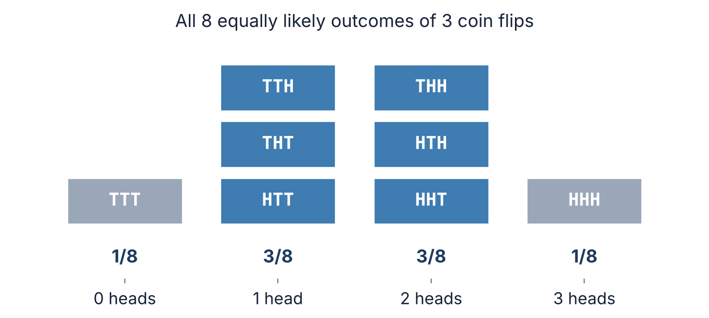
2.1 · LIST EVERY OUTCOME
Start small: flip a coin three times
Count the ways
There is only ONE way to get zero heads: TTT.
But THREE ways to get exactly one head — the head can be in any of the three positions.
That is the whole idea.
1 3 3 1
out of 8
Every one of these 8 sequences is equally likely. So the probability of a given number of heads is just: how many sequences give that number, divided by 8.
Slides by Srinivasa Sai Chava
Notes:
Do this one on the board first if you can. Writing out all eight by hand takes 30 seconds and makes the 1-3-3-1 pattern feel discovered rather than told.

Slide 10
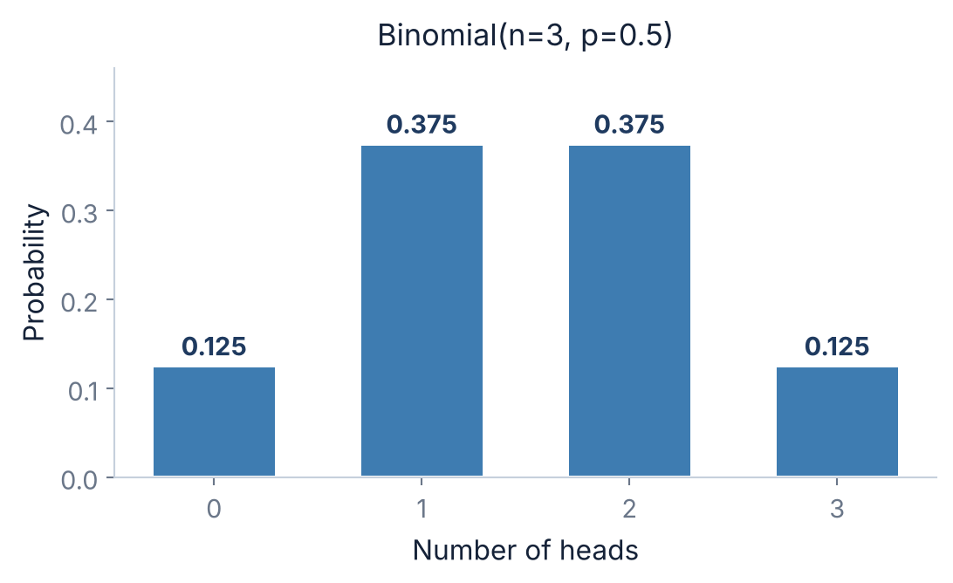
2.2 · THE DISTRIBUTION
The same eight outcomes, drawn as probabilities
Read it carefully
Each BAR is a separate possible count. There is nothing between them — you cannot get 1.5 heads, so there is no bar there.
The heights add to exactly 1.000, because one of these four things must happen.
This is what “discrete distribution” means in practice: a finite list of outcomes, each with its own probability.
1/8 = 0.125 and 3/8 = 0.375. The chart is just the counting from the previous slide, divided by 8.
stats.binom.pmf([0,1,2,3], n=3, p=0.5)
-> [0.125, 0.375, 0.375, 0.125]
Slides by Srinivasa Sai Chava
Notes:
Emphasise that the bars sum to 1. Students often treat a pmf as a set of unrelated numbers rather than a complete accounting of possibilities.

Slide 11
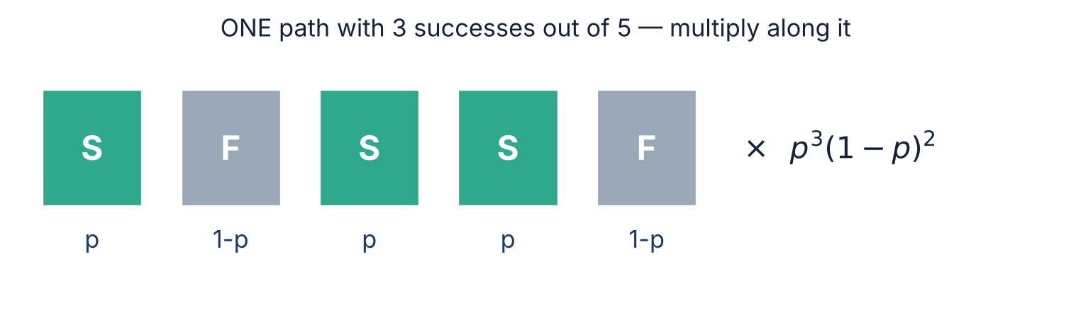
2.3 · WHERE THE FORMULA COMES FROM
Now the formula. Piece one: the probability of ONE path.
Multiply along the path
And here is the key observation
The trials are independent, so the probability of this exact sequence is the product of the individual probabilities:
p × (1−p) × p × p × (1−p)
Any OTHER path with 3 successes and 2 failures gives exactly the same product — multiplication does not care about order.
So every such path has probability p³(1−p)². We just need to know how many there are.
which tidies up to p³ (1−p)²
Slides by Srinivasa Sai Chava
Notes:
The order-does-not-matter observation is the hinge of the whole derivation. Give it a beat.

Slide 12
2.4 · THE COUNTING PIECE
Piece two: how many paths are there?
“Choose k positions out of n”
Written out
With 3 flips and 1 head, the head can sit in position 1, 2 or 3 — three ways. That is exactly what C(3,1) = 3 means.
C(n, k) = n! / ( k! × (n−k)! )
You will see it called “n choose k”, and written as nCk or with a big bracket. They all mean the same thing: the number of different ways to pick k items from n when the order does not matter.
from math import comb
comb(3, 0), comb(3, 1), comb(3, 2), comb(3, 3)
-> 1, 3, 3, 1 ← our counts!
Put the two pieces together and you have the binomial formula
P(k) =
C(n, k)
×
p^k
×
(1−p)^(n−k)
how many paths
k successes
the rest are failures
Slides by Srinivasa Sai Chava
Notes:
Build this on the board in three chunks, naming each as you write it. The formula is unmemorable as a whole and obvious in pieces.

Slide 13
2.5 · PUTTING NUMBERS IN
Work one through by hand: 7 heads in 10 flips
n = 10, k = 7, p = 0.5
Check it in code
C(10, 7)
= 120
there are 120 different orders with 7 heads
stats.binom.pmf(7, 10, 0.5)
-> 0.1171875
0.5⁷
= 0.0078125
the 7 heads
About an 11.7% chance of getting exactly 7 heads in 10 flips.
You will always use the library in practice. Doing it once by hand is so that the library is not a black box.
0.5³
= 0.125
the 3 tails
120 × 0.0078125 × 0.125 = 0.1172
A useful sanity check: 7 out of 10 is above the expected 5, so the probability should be smallish but not tiny. 11.7% feels right. If you had got 0.9 or 0.001 you would know something was wrong.
Slides by Srinivasa Sai Chava
Notes:
The sanity check habit matters more than the arithmetic. Ask the room whether 11.7% sounds plausible BEFORE showing the computation.

Slide 14
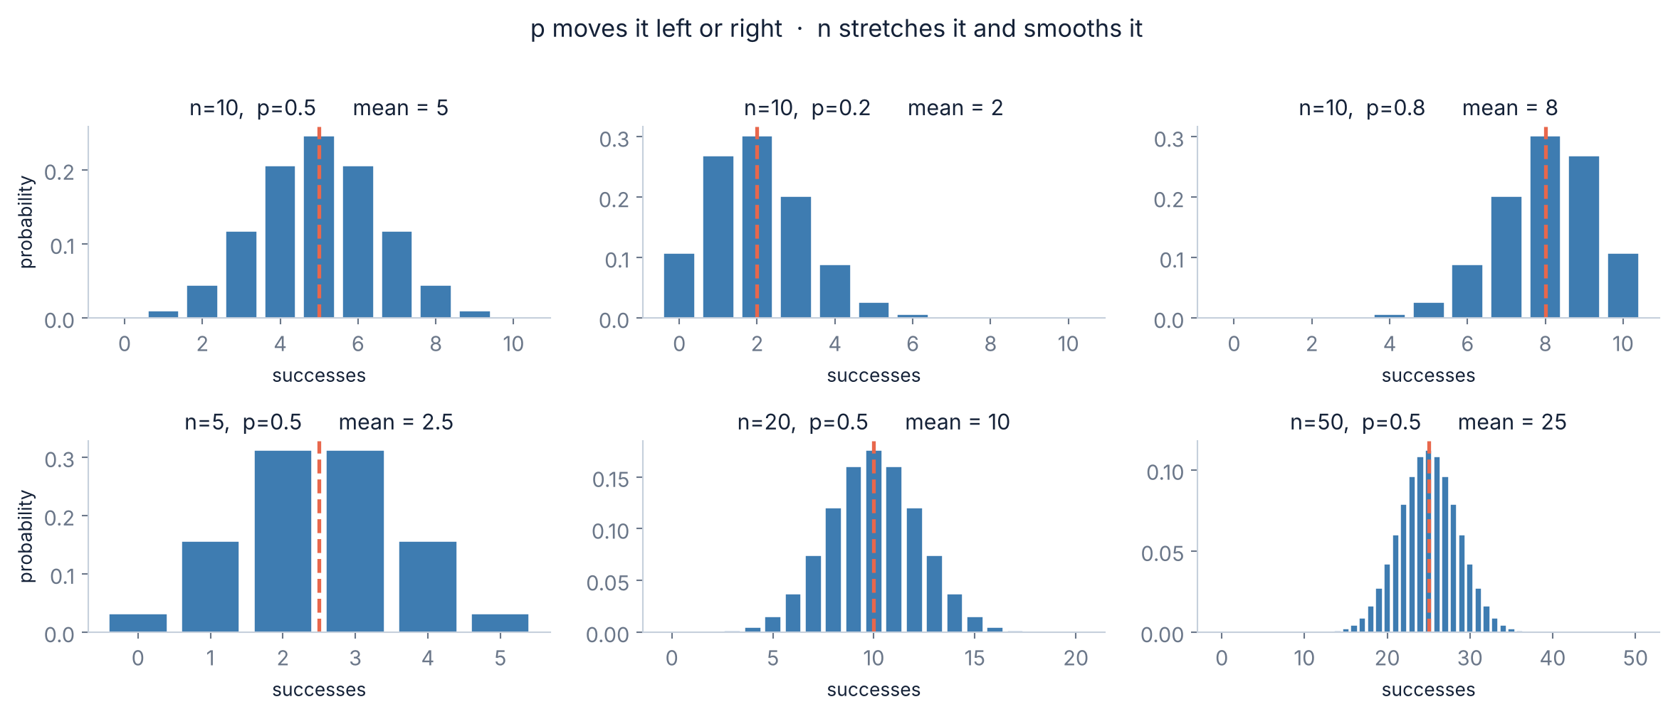
2.6 · n AND p
What the two settings actually do to the shape
Top row: p moves the peak
Bottom row: n widens and smooths
Low p pushes it left, high p pushes it right. The peak sits at n×p.
Look at n=50: that is starting to look like a bell curve. Remember that.
Slides by Srinivasa Sai Chava
Notes:
The n=50 panel is the first hint that the binomial becomes normal. Do not explain it yet - just make them notice.

Slide 15
3
Using the Binomial
pmf vs cdf
A worked quality-control problem
Mean and spread
Exactly, at most, at least · 20 minutes
Slides by Srinivasa Sai Chava

Slide 16
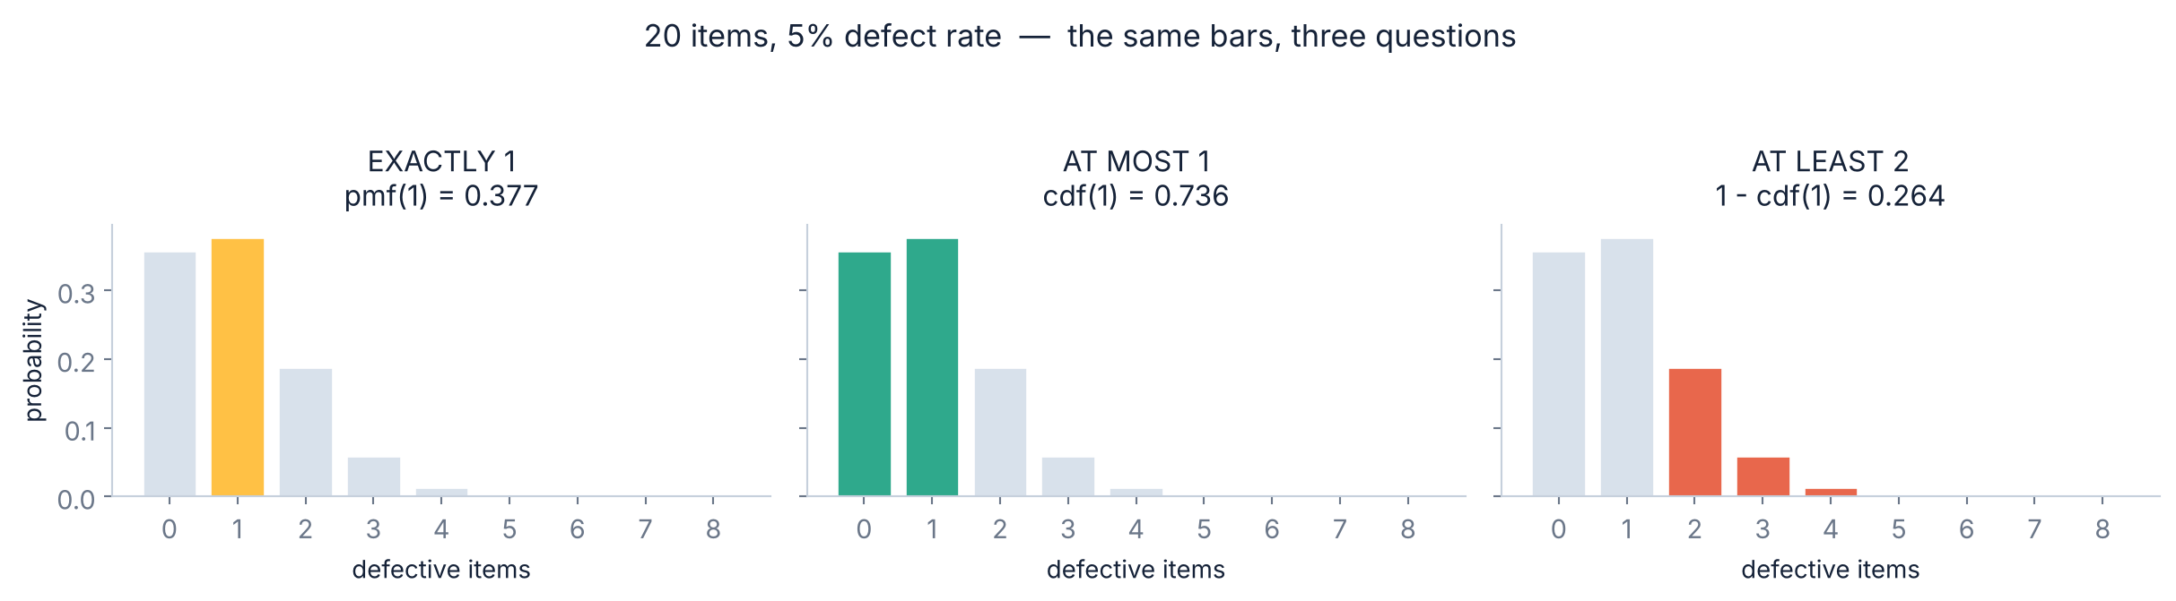
3.1 · pmf AND cdf
Three different questions, the same set of bars
The question | In words | Code | Answer
EXACTLY 1 defective | just that one bar | binom.pmf(1, 20, .05) | 0.377
AT MOST 1 | add up bars 0 and 1 | binom.cdf(1, 20, .05) | 0.736
AT LEAST 2 | everything else | 1 - binom.cdf(1, 20, .05) | 0.264
Slides by Srinivasa Sai Chava
Notes:
The three-panel figure does the teaching here. Point at each highlighted region as you read the table row.

Slide 17
3.2 · AT LEAST
⚠ The mistake almost everyone makes once
“At least 2” is NOT 1 − cdf(2)
The rule that always works
1 - binom.cdf(2, 20, .05) -> 0.0755
1 - binom.cdf(1, 20, .05) -> 0.2642
# which one is 'at least 2'?
P(at least k) = 1 − cdf(k − 1)
Say it out loud: “at least 2 means NOT 0 and NOT 1”. So subtract everything up to and including 1.
When in doubt, draw the bars and shade the ones you want. It takes ten seconds and removes all doubt.
cdf(2) already INCLUDES the bar at 2. Subtracting it removes the very outcome you wanted to keep.
Why this matters more than it looks
0.0755 and 0.2642 are both plausible-looking probabilities. Nothing errors, nothing warns you, and the wrong one is off by a factor of three and a half. This is the discrete-distribution equivalent of Day 16's loc-versus-iloc: an off-by-one that produces a confident, wrong number.
Slides by Srinivasa Sai Chava
Notes:
The Day 16 callback helps: students already know off-by-one errors in labels. This is the same failure in a new place.

Slide 18
3.3 · MEAN AND SPREAD
What to expect, and how much it varies
Two formulas worth knowing
Our quality-control example
mean = n × p
n = 20, p = 0.05
mean = 20 x 0.05 = 1.00
sd = sqrt(20x.05x.95) = 0.97
sd = √( n × p × (1−p) )
The mean is obvious once you say it aloud: 20 items with a 5% defect rate should give about 1 defect.
So: expect about 1 defect, give or take 1.
Use these for a sanity check before you compute anything
If a batch of 20 comes back with 8 defects, you do not need a p-value to be suspicious: that is 7 above the expected 1, which is about seven standard deviations out. Day 24's ruler, applied to counts.
And notice the spread is largest when p = 0.5 and shrinks as p approaches 0 or 1 — which makes sense, because an event that almost never happens, or almost always happens, is predictable.
Slides by Srinivasa Sai Chava
Notes:
The 8-defects example ties Day 24's z-score ruler to today's counting. It also previews hypothesis testing without naming it.

Slide 19
4
Poisson
The problem binomial cannot solve
The rate idea
A worked example
The shape
When n is huge and p is tiny · 25 minutes
Slides by Srinivasa Sai Chava

Slide 20
4.1 · THE PROBLEM
A question the binomial cannot answer
“How many calls will arrive this hour?”
Other questions with the same problem
Try to force it into a binomial and the first question is: what is n?
How many trials are there? Every second is a chance for a call — so 3,600? Every millisecond — so 3,600,000? There is no natural answer.
And what is p? Whatever makes the numbers work out, which is not a definition.
Typos per page of a book
Accidents at a junction per month
Customers entering a shop per 10 minutes
Server errors per day
Rainfall events per season
What they all have in common
Events happen at some average RATE over a continuous interval of time or space. There are no countable trials — there is just an interval, and events landing in it. You know the average; you want the probability of a particular count.
That is exactly what the Poisson distribution is for.
Slides by Srinivasa Sai Chava
Notes:
Letting them fail to find n is the point. Ask the room for n before revealing - someone will say 3600 and someone else will say it depends, which is the answer.

Slide 21
4.2 · LAMBDA
One number is all you need: the average rate
λ (lambda) = the average count per interval
The formula
If the call centre averages 3 calls an hour, then λ = 3.
That single number fixes the whole distribution — there is no second parameter to find. Compare the binomial, which needs both n and p.
P(k) = e⁻λ × λᵏ / k!
You will use scipy rather than this. But notice what is NOT in it: no n, no p. Only λ and the count you are asking about.
⚠ λ must match your interval. 3 per hour means λ=3 for an hour, λ=1.5 for 30 minutes, λ=72 for a day.
stats.poisson.pmf(k, mu=3)
The three Poisson conditions
· Events are independent
· The rate is constant
· Two cannot land at the same instant
one call does not cause another
3 an hour all through the interval
events are separable
The constant-rate condition fails more often than people expect: a call centre at 9am and at 3am do not share a λ.
Slides by Srinivasa Sai Chava
Notes:
The interval-matching warning catches people constantly. Ask: if lambda is 3 per hour, what is lambda for a 20-minute window?

Slide 22
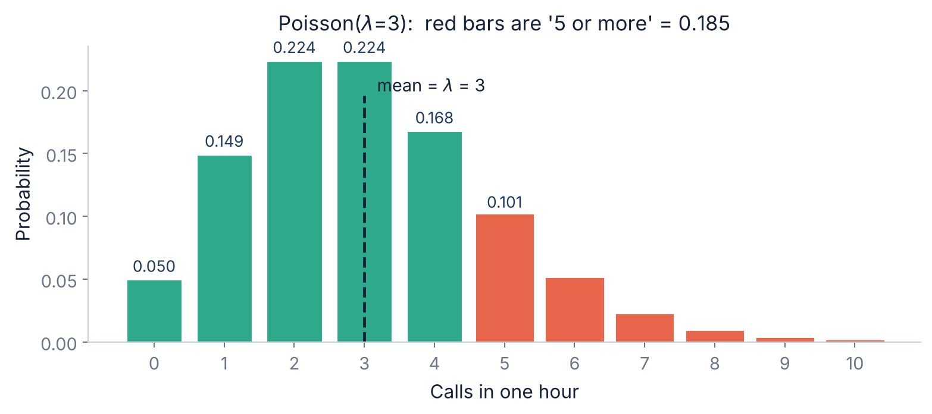
4.3 · A FULL EXAMPLE
Worked through: a call centre averaging 3 an hour
Reading the chart
Question | Answer
no calls at all | 0.050
exactly 3 | 0.224
at most 2 | 0.423
5 or more | 0.185
Note 2 and 3 are equally likely — that happens whenever λ is a whole number.
poisson.pmf(3, 3) = 0.224
The staffing question this answers: 18.5% of hours will bring 5 or more calls. If you staff for the average of 3, you will be overwhelmed roughly one hour in five — which is exactly the kind of decision a distribution is for, and an average alone cannot tell you.
Slides by Srinivasa Sai Chava
Notes:
The staffing conclusion is the payoff. An average tells you nothing about how often you will be overwhelmed; the distribution does.

Slide 23
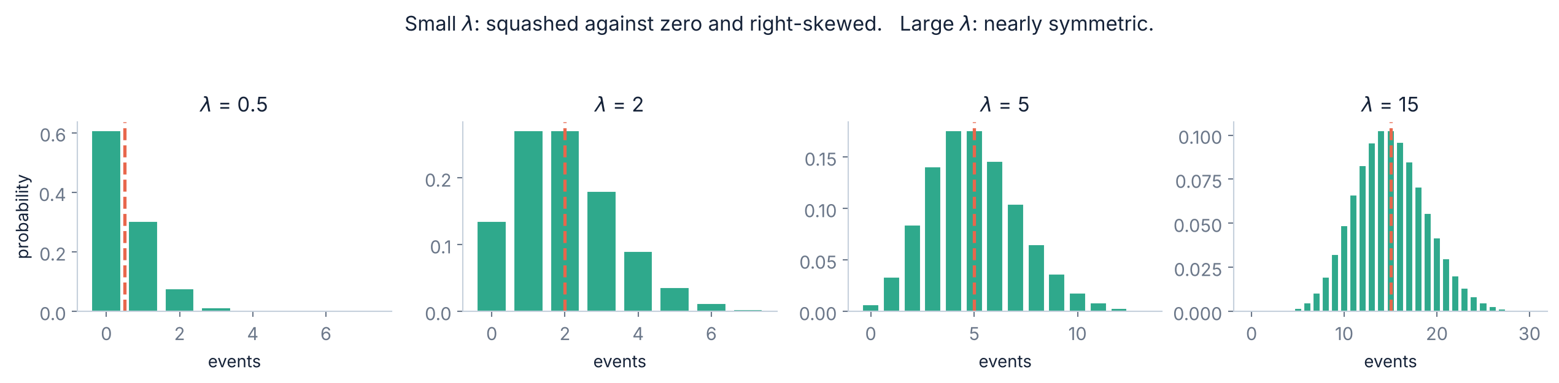
4.4 · THE SHAPE
How λ changes the shape
Small λ: squashed against zero
Large λ: almost symmetric
Counts cannot go below zero, so with λ = 0.5 the distribution piles up at 0 and 1 and has a long right tail. Strongly skewed.
At λ = 15 the floor at zero is far away and the shape is nearly a bell curve. We will make that precise before the end of the session.
Slides by Srinivasa Sai Chava
Notes:
The floor-at-zero explanation for the skew is the intuitive one: skew exists because counts cannot be negative and the mean is close to the floor.

Slide 24
4.5 · MEAN = VARIANCE
The Poisson's strangest property
mean = variance = λ
Why this is genuinely useful
It gives you a free diagnostic. Take any count data, compute the mean and the variance, and compare them.
If the variance is much BIGGER than the mean, the data is “overdispersed” — something is clustering the events, and Poisson is the wrong model.
so sd = √λ
One number fixes both the centre AND the spread. No other common distribution does this.
The check, in one line
ratio = counts.var() / counts.mean()
# near 1 -> Poisson is plausible
# well above 1 -> events are clustering
Example: website visits per minute usually fail this badly. Visits arrive in bursts when a link is shared, so the variance dwarfs the mean. Earthquakes fail it too — aftershocks cluster. Both violate the independence condition, and the mean-variance ratio is how you catch it without any formal test.
Slides by Srinivasa Sai Chava
Notes:
The overdispersion check is the most practically useful thing on this slide. Students will meet it again in any count-regression work.

Slide 25
5
Choosing Between Them
One question decides
Binomial → Poisson
Both → Normal
And where both lead · 10 minutes
Slides by Srinivasa Sai Chava

Slide 26
5.1 · CHOOSING
One question tells you which to use
“Can I count the number of trials?”
Everything else follows from the answer.
YES, there is a clear n → BINOMIAL
NO, just a rate → POISSON
20 items inspected — n = 20
10 coin flips — n = 10
500 visitors shown an ad — n = 500
A class of 60 sitting an exam — n = 60
Calls per hour — no n
Typos per page — no n
Accidents per month — no n
Emails per day — no n
A useful tell: if the question says “out of”, it is binomial. If it says “per”, it is Poisson.
Slides by Srinivasa Sai Chava
Notes:
The out-of versus per tell is crude but works almost every time, and students remember it.

Slide 27
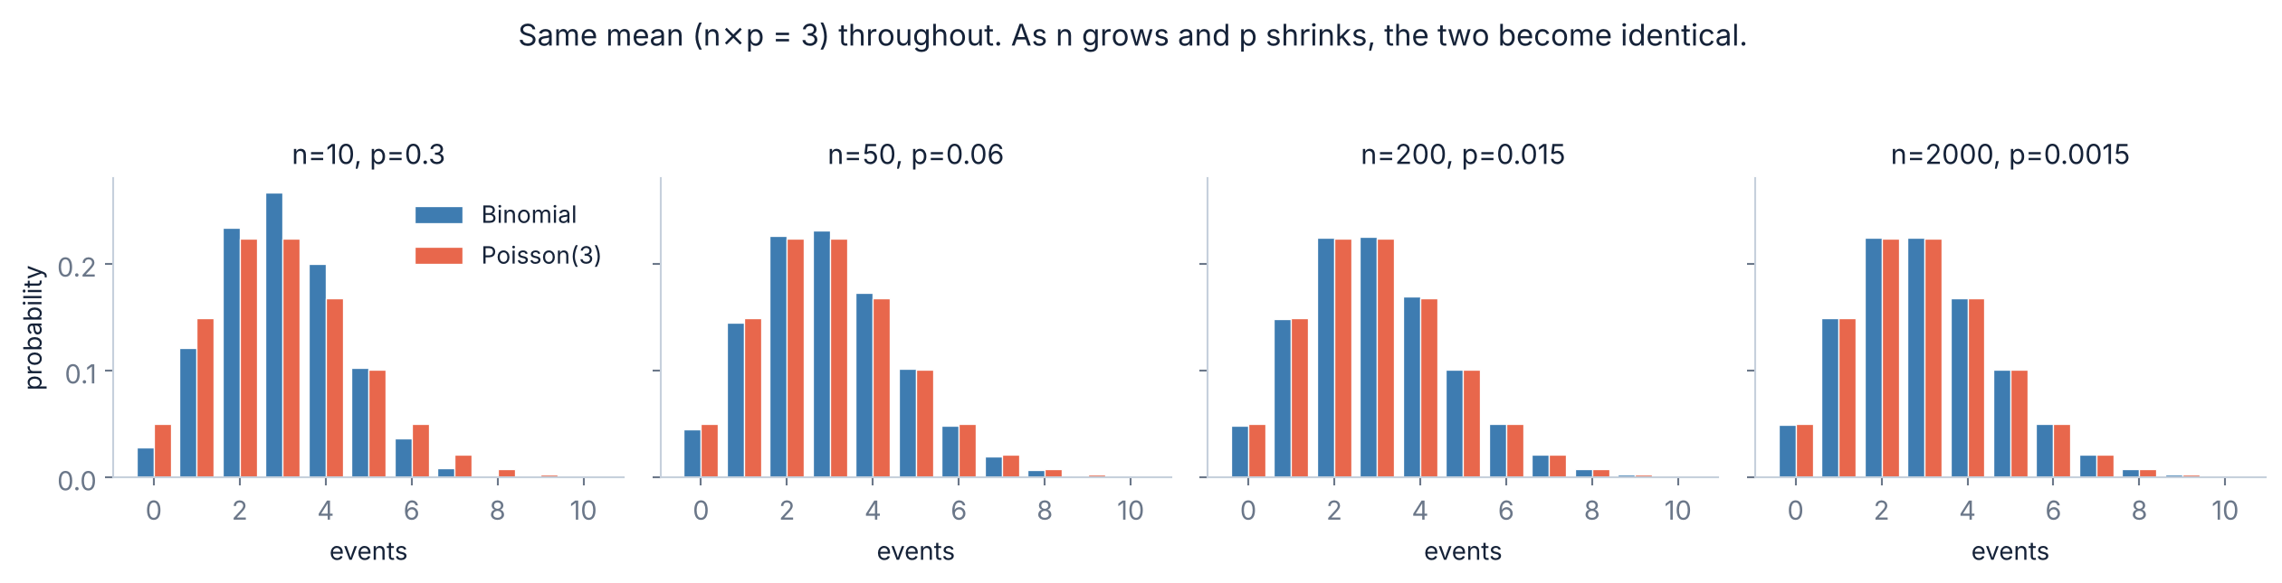
5.2 · BINOMIAL → POISSON
They are not really two different things
Watch the orange and blue bars merge
Which is why the rule of thumb exists
At n=10 they differ visibly. By n=2000 they are indistinguishable. Poisson is what the binomial BECOMES when n grows and p shrinks with n×p held fixed.
If n > 50 and p < 0.05, you may use Poisson with λ = n×p. In practice you will just use the binomial — computers do not care — but it explains why Poisson works for rare events at all.
Slides by Srinivasa Sai Chava
Notes:
Be honest that the approximation is now mostly of historical and conceptual interest - its value is showing the two distributions are one family.

Slide 28
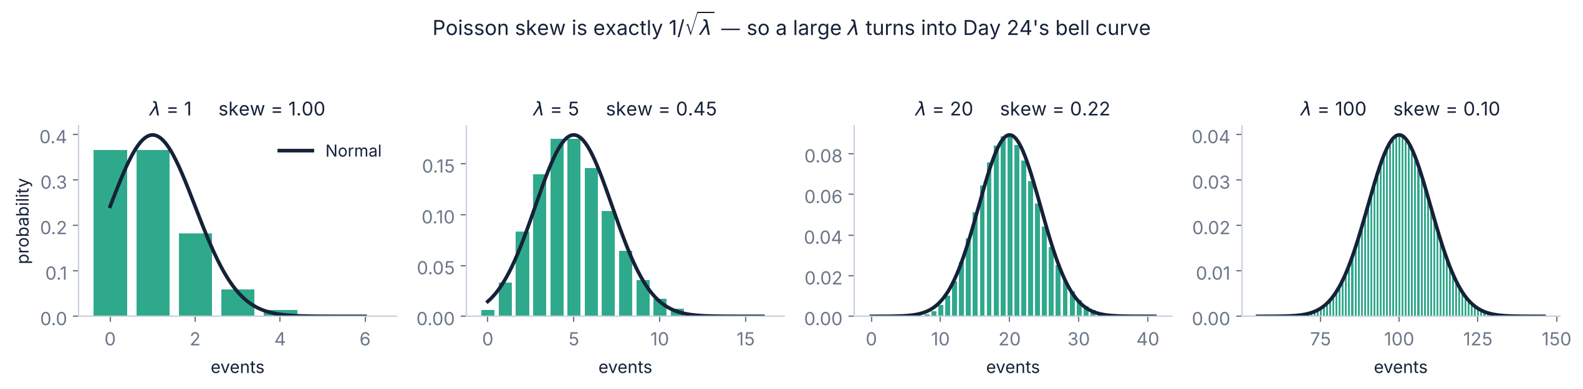
5.3 · → NORMAL
And both of them become yesterday's bell curve
The skew of a Poisson is exactly 1 / √λ
At λ=1 the skew is 1.00 — badly skewed. At λ=100 it is 0.10 — all but symmetric, and the black normal curve sits right on top of the bars. The same thing happens to the binomial as n grows, which is what you noticed in the n=50 panel earlier.
That is twice in one session that the normal curve has turned up uninvited. Day 27 explains why it keeps happening.
Slides by Srinivasa Sai Chava
Notes:
Closing the loop opened in the warm-up. The students were told to watch for this; now they have seen it twice.

Slide 29
5.4 · REFERENCE
The two distributions side by side
 | Binomial | Poisson
Question it answers | how many successes OUT OF n? | how many events PER interval?
Parameters | n and p | λ only
Possible values | 0 to n | 0 upward, no limit
Mean | n × p | λ
Variance | n × p × (1−p) | λ (same as the mean)
scipy | stats.binom | stats.poisson
Exactly k | binom.pmf(k, n, p) | poisson.pmf(k, lam)
At most k | binom.cdf(k, n, p) | poisson.cdf(k, lam)
At least k | 1 - binom.cdf(k-1, ...) | 1 - poisson.cdf(k-1, ...)
Both are discrete, so both use pmf for “exactly” and cdf for “at most”. Neither has a pdf — that is for continuous distributions like yesterday's normal.
Slides by Srinivasa Sai Chava
Notes:
Tell them to photograph this slide. It is the reference they will actually use.

Slide 30
RECAP
Debug corner — eight counting mistakes
You did | What goes wrong | Fix
used 1 - cdf(k) for “at least k” | off by one — excludes k itself | 1 - cdf(k-1)
binomial on cards without replacement | p changes every draw | hypergeometric distribution
binomial when n is not fixed | “flip until a head” has no n | geometric distribution
λ for the wrong interval | 3/hour is not 3 per 20 minutes | scale λ to your window
Poisson when events cluster | variance far exceeds the mean | check var/mean before modelling
pdf on a discrete distribution | there is no such method | pmf for counts, pdf for continuous
forgot p in binom.pmf(k, n) | TypeError, or a silent default | always pass n AND p
asked P(exactly 2.5) | counts are whole numbers | the question is malformed
Row 1 is the one that will cost you marks. Row 4 is the one that will cost you a production incident.
Slides by Srinivasa Sai Chava
Notes:
Row 2 and 3 name the right distributions without teaching them, so students know they exist.

Slide 31
6 · MINI BUILD
Putting it together — a staffing decision
λ matches the interval
from scipy import stats
# A support desk averages 3 calls an hour.
# One agent can handle 4 calls an hour.
# QUESTION: how often are we overwhelmed?
lam = 3
# --- 1. the risk with one agent
overwhelmed = 1 - stats.poisson.cdf(4, lam)
print(f"P(5 or more calls) = {overwhelmed:.3f}")
# 0.185 -> about one hour in five
# --- 2. what would two agents give us?
# two agents handle 8 an hour
print(1 - stats.poisson.cdf(8, lam))
# 0.0038 -> about one hour in 260
# --- 3. express it as hours per month
hours = 8 * 22 # a working month
for agents in (1, 2, 3):
cap = 4 * agents
risk = 1 - stats.poisson.cdf(cap, lam)
print(f"{agents} agent(s): overwhelmed {risk*hours:5.1f} hours/month")
3 per hour, asked per hour
cdf(4), not cdf(5)
“5 or more” = 1 - cdf(4)
A probability, not a count
0.185 of hours, not 0.185 calls
Translate to a unit people feel
“hours per month” beats 0.185
Compare the options
the decision needs alternatives
The average alone is useless
3 < 4, so “we are fine” — wrong
The last note is the real lesson: the average load is 3 and capacity is 4, so an average-based answer says “no problem”.
Slides by Srinivasa Sai Chava
Notes:
This is the single most convincing argument for distributions over averages. Run it live and let the 'one hour in five' land.

Slide 32
OVER TO YOU
Practice session — 30 minutes
A
Predict the output
8 questions
Your notebook
pmf, cdf, at-least, mean, λ scaling
Day25_Practice_
Questions.ipynb
B
Spot & fix the bug
4 questions
Off-by-one, wrong interval, wrong model
Ask: “out of” or “per”?
Draw the bars when unsure
Raise a hand — I am walking around
Solutions shared after class
C
Write the code
5 tasks
Build, compute, compare, decide
D
Challenge
2 tasks
A staffing decision, and a model that fails
For every answer, say what it means in words. “0.185” is not an answer; “about one hour in five” is.
Slides by Srinivasa Sai Chava
Notes:
Forcing the plain-English translation is what turns a probability into a decision.

Slide 33
TODAY IN TWELVE LINES
Recap
1
Days 23–24 measured quantities. Today we COUNT events.
7
⚠ “At least k” is 1 − cdf(k−1). Using cdf(k) is the classic error.
2
Counts are whole numbers, so we get bars, not a curve.
8
Poisson is for a RATE with no countable n: calls per hour, typos per page.
3
Binomial needs four things: fixed n, two outcomes, same p, independence.
9
It needs one number, λ — and λ must match your interval.
4
Its formula is C(n,k) × p^k × (1−p)^(n−k) — paths × successes × failures.
10
Poisson mean = variance = λ. If var ≫ mean, events are clustering.
5
C(n,k) is just “how many orders give k successes”. For n=3: 1, 3, 3, 1.
11
The deciding question: “out of” → binomial, “per” → Poisson.
6
Binomial mean = np, sd = √(np(1−p)).
12
Binomial → Poisson as n grows; both → Normal. Day 27 says why.
Homework
Next class — Topic 2.6
Write out all 16 outcomes of 4 coin flips and check they give C(4,k) · Find three situations at your own workplace or studies, one binomial and one Poisson, and say which condition decided it · Redo the staffing build with λ = 8
The uniform distribution — when every outcome is equally likely. The simplest distribution of all, and the one every random number generator is built on.
Slides by Srinivasa Sai Chava
Notes:
Read the twelve lines aloud. Tomorrow is a lighter session - uniform is the simplest distribution there is, which makes it a good place to consolidate.

