Slide 1

MODULE 3 · MACHINE LEARNING · DAY 36
Honest Scores
Train/test split, cross-validation, pipelines
Today is not about building a better model.
It is about finding out whether you have one.
5
19
0
sections
worked pictures
new models
Srinivasa Sai Chava · Boston University

Slide 2
WHERE WE ARE
Two things yesterday left unfinished
Practice B4
Every single day so far
You split 52 patients six different ways. The accuracy came out anywhere from 0.5625 to 0.8125 — on the same model and the same data.
The honest conclusion was: one split of a small dataset is not a measurement.
You have written train_test_split at the top of every notebook since Day 32, because I told you to.
Today you find out what it is actually protecting you from — and where it is not enough.
Today's five sections
1
Marking your own homework
No new model today.
2
One split is a lottery
Everything here applies just as much to linear regression from Day 33 as to the trees and forests coming next week. These are the habits, and you will use them for the rest of the course.
3
Give every row a turn
4
The leak you cannot see
5
One object, no leaks
Srinivasa Sai Chava · Boston University

Slide 3
A score is a claim about rows
you have not seen yet.
Every number you have reported so far was supposed to answer one question: if I use this model tomorrow, on somebody new, how often will it be right? Today is about measuring that honestly.
Srinivasa Sai Chava · Boston University

Slide 4
SECTION 1 OF 5
Marking your own
homework
A tree that was 100% right
and worse than guessing
Why a score on the rows the model studied is not a score at all
overfitting, measured
Srinivasa Sai Chava · Boston University

Slide 5
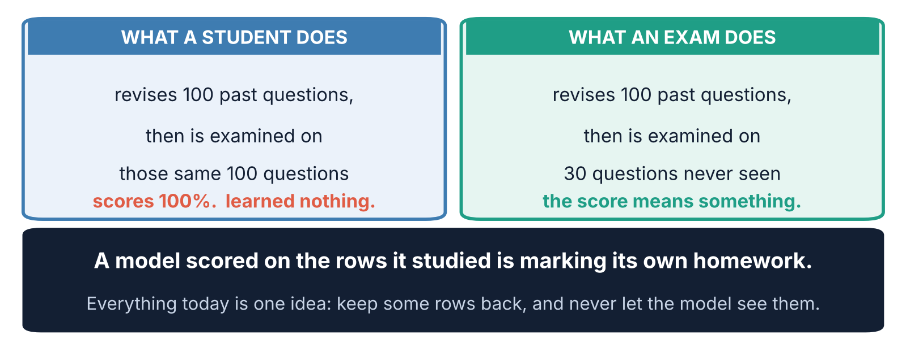
1 / 5 Marking your own homework
THE PICTURE
The whole idea, before any code
This is not an analogy that breaks down later. It is exactly what happens: a flexible model can store the answers instead of learning the pattern.
Srinivasa Sai Chava · Boston University

Slide 6
1 / 5 Marking your own homework
120 STUDENTS
The data we will use all morning
rng = np.random.default_rng(3601)
n = 120
hours = rng.uniform(0, 20, n).round(1)
attendance = rng.uniform(40, 100, n).round(0)
prev_score = rng.normal(62, 14, n).clip(25, 98).round(0)
# passed = 1 if the student passed the exam
120
Small on purpose
120 rows is a realistic size for a class project, a pilot study, or the first month of any new product.
It is also small enough that every problem in today's lecture shows up clearly. On 200,000 rows most of them hide — which is exactly why people never learn them.
students
3
columns about them
75%
of them passed
75% of these students passed, so 'everybody passes' is already right three times in four. Hold on to that number.
Srinivasa Sai Chava · Boston University

Slide 7
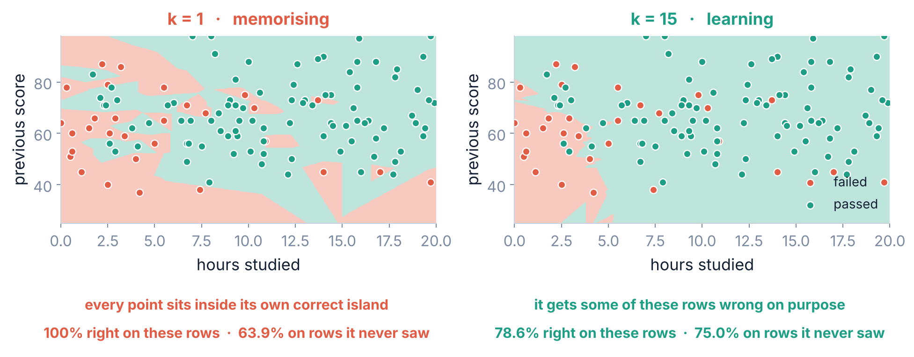
1 / 5 Marking your own homework
TWO MODELS, SAME ROWS
Memorising and learning look different
k = 1 asks 'who is my single closest classmate?' — so every student is trivially right about themselves. k = 15 asks fifteen, and has to accept being wrong about some of them.
Srinivasa Sai Chava · Boston University

Slide 8
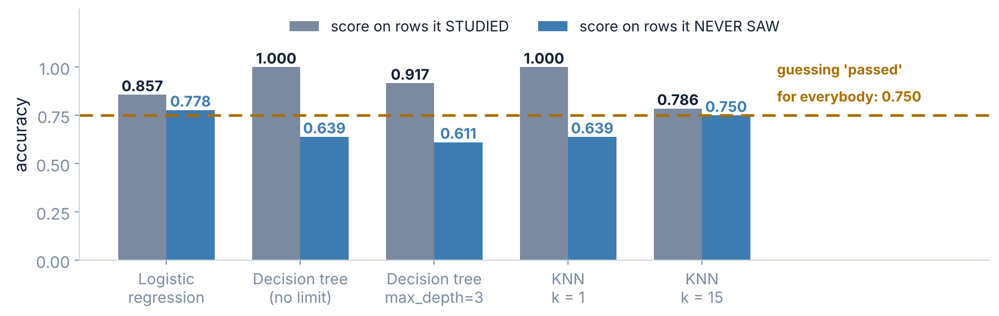
1 / 5 Marking your own homework
THE GAP IS THE STORY
Five models, two scores each
Read the grey bars alone and the decision tree is the best model in the room. Read the blue bars and it is the worst — beaten by having no model at all.
Srinivasa Sai Chava · Boston University

Slide 9
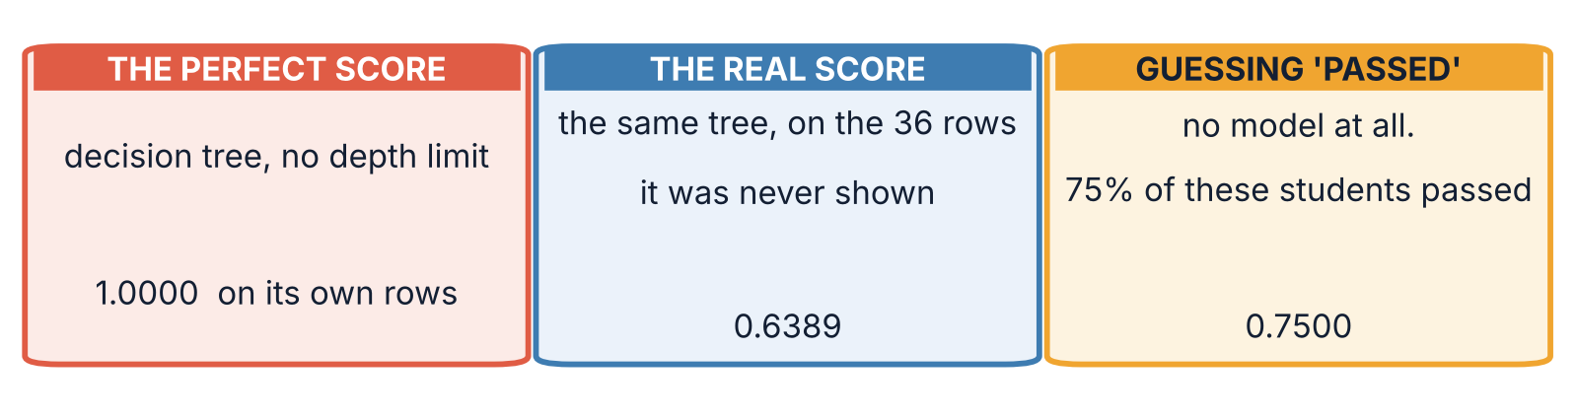
1 / 5 Marking your own homework
100% THAT MEANS NOTHING
The same tree, three ways of asking
The tree grew one branch for every student it was shown. Asked about those same students it looks them up and is never wrong. Asked about anybody else it has nothing to go on.
A model that scores 1.0000 on its own rows has told you nothing except that it was flexible enough to memorise them.
Srinivasa Sai Chava · Boston University

Slide 10
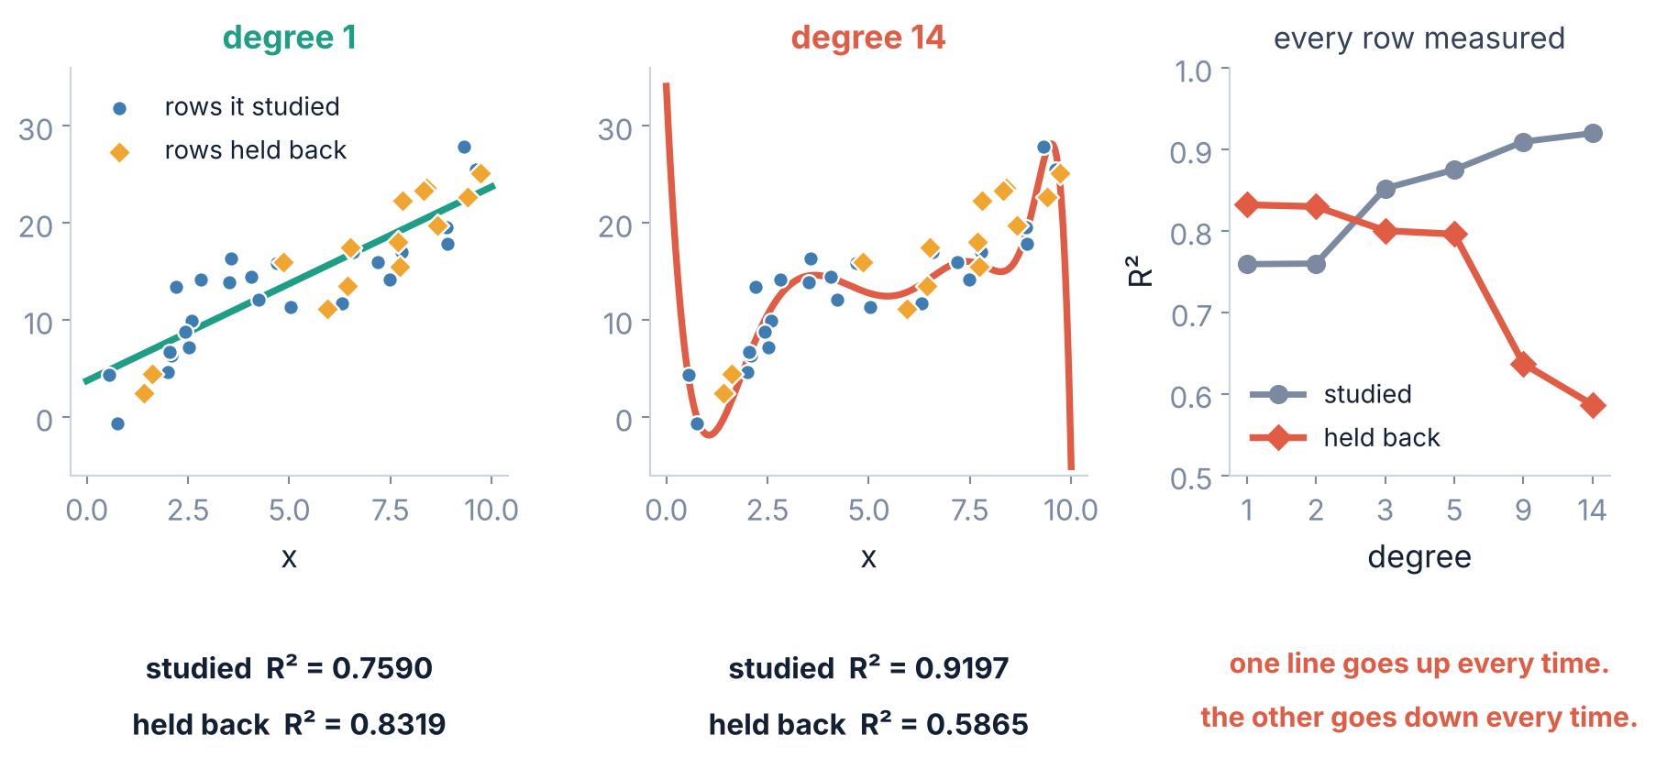
1 / 5 Marking your own homework
DEGREE BY DEGREE
The same thing in regression
Add flexibility and the score on the studied rows rises every single time. That is not evidence of anything. The held-back score fell every single time.
Srinivasa Sai Chava · Boston University

Slide 11
1 / 5 Marking your own homework
THE DEFINITION
Overfitting, in plain words
A model overfits when it has learned things that are true of the rows it studied and not true of anything else.
What makes it more likely
How you detect it
What you do about it
a flexible model (deep tree, k = 1, degree 14)
few rows
many columns
noisy data
score the rows it studied
score rows it never saw
look at the gap
there is no other way
a simpler model
more rows
fewer columns
regularisation — a day of its own, later
Notice the middle column. Detecting overfitting costs you nothing but discipline, and no amount of cleverness replaces it.
Srinivasa Sai Chava · Boston University

Slide 12
1 / 5 Marking your own homework
AND WHAT IT DOES
The line you have been writing since Day 32
from sklearn.model_selection import train_test_split
X_train, X_hidden, y_train, y_hidden = train_test_split(
X, y, test_size=0.3, random_state=0, stratify=y)
argument | what it does | what happens without it
test_size=0.3 | holds back 30% of the rows | defaults to 0.25
random_state=0 | makes the split repeatable | a different split every run, so your results change
stratify=y | keeps the class mix the same on both sides | the mix drifts, badly on small or imbalanced data
shuffle=True | mixes the rows first (the default) | a sorted file splits into two different worlds
Three of these four arguments exist to stop the split itself from lying to you. That is the subject of the next two sections.
Srinivasa Sai Chava · Boston University

Slide 13
SECTION 2 OF 5
One split is
a lottery
17 points from a seed
which number do you report?
The split protects you from overfitting, but it brings a problem of its own
why more rows help
Srinivasa Sai Chava · Boston University

Slide 14
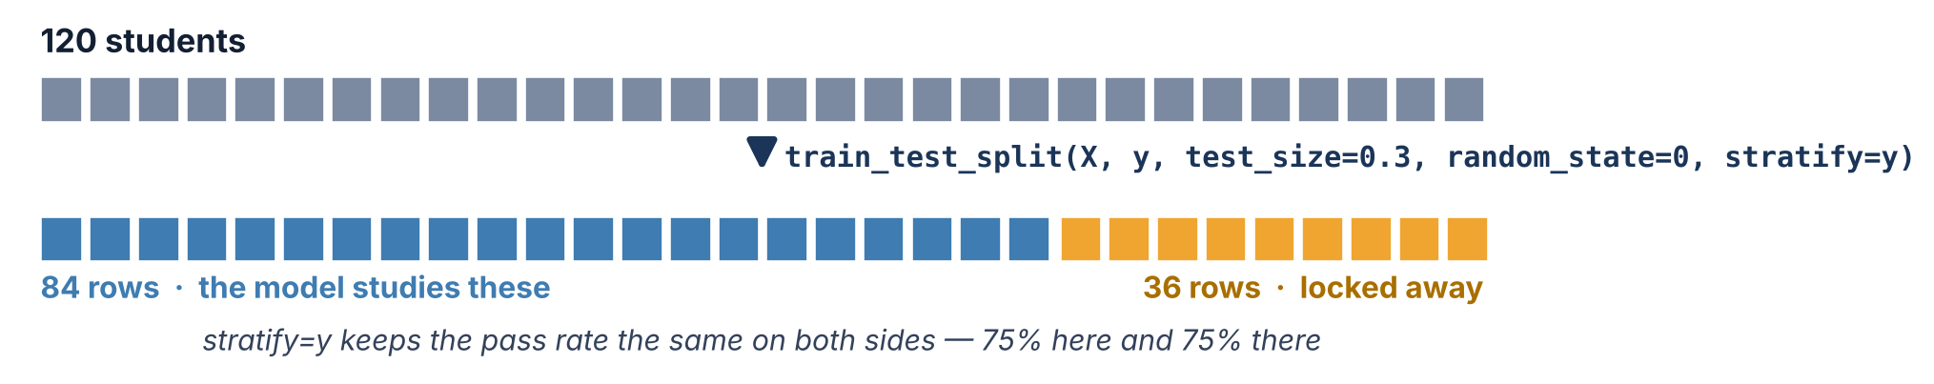
2 / 5 One split is a lottery
120 ROWS, CUT IN TWO
What the split actually does
The 36 held-back rows are the entire basis for everything you will claim about this model. Thirty-six rows.
Srinivasa Sai Chava · Boston University

Slide 15
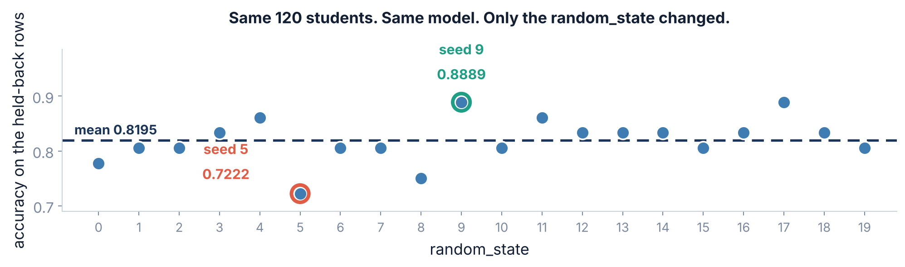
2 / 5 One split is a lottery
THE LOTTERY
Run it twenty times. Change nothing but the seed.
Nothing about the model changed between these twenty dots. Not one coefficient, not one row of data. Only which 36 students happened to land in the held-back pile.
Srinivasa Sai Chava · Boston University

Slide 16
2 / 5 One split is a lottery
AN UNCOMFORTABLE QUESTION
So which number do you report?
Report 0.8889
Report 0.7222
Report 0.8194
Pick the best seed. This is how a great many published results happen, usually without anyone intending it — you try a few splits, one looks good, you stop trying.
Pick the worst seed. Honest in spirit, but you are now throwing away a model that is probably better than that.
The average of all twenty. Closer to the truth — and the idea behind everything in the next section.
The real problem is not which one to pick.
It is that a single split gives you one number and no idea how much to trust it. 0.8056 might mean "about 0.80" or it might mean "somewhere between 0.72 and 0.89". One split cannot tell you which.
You are not choosing between honest and dishonest here. You are choosing between a measurement and a guess.
Srinivasa Sai Chava · Boston University

Slide 17
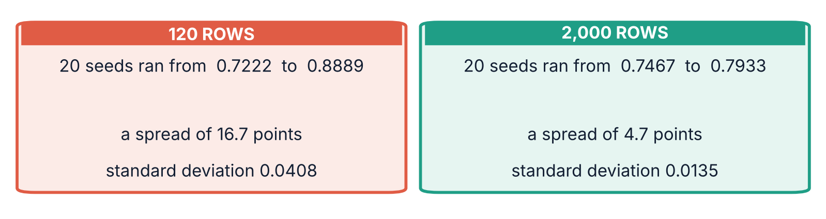
2 / 5 One split is a lottery
THE ARITHMETIC
Why 36 rows swing so hard
One student is worth 2.8 points
And the training half moves too
With 36 held-back rows, every single student the model gets right or wrong moves the reported accuracy by 1/36 = 0.0278.
Six students' difference is the whole 16.7-point spread. Six students, out of a hundred and twenty.
It is not only the exam that changes. Each seed also hands the model a different 84 students to learn from, so you are measuring a slightly different model each time.
Both halves are rolling dice at once.
More rows is the only fix that needs no new technique — and the one you usually cannot have. Everything else today works with the rows you already own.
Srinivasa Sai Chava · Boston University

Slide 18
SECTION 3 OF 5
Give every row
a turn
k-fold, drawn out
how many folds
If one exam is unreliable, sit five of them and average the marks
the sorted-file disaster
Srinivasa Sai Chava · Boston University

Slide 19
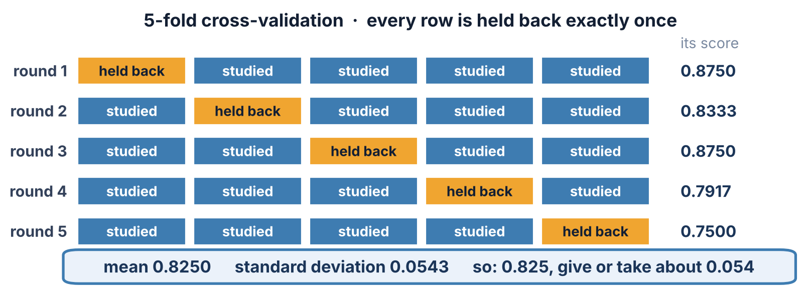
3 / 5 Give every row a turn
FIVE ROUNDS
Cross-validation, drawn out in full
Every row is held back exactly once and studied four times. Nothing is wasted, and no row is ever scored by a model that saw it.
Srinivasa Sai Chava · Boston University

Slide 20
3 / 5 Give every row a turn
CROSS_VAL_SCORE
Three lines of code
from sklearn.model_selection import cross_val_score, StratifiedKFold
cv = StratifiedKFold(n_splits=5, shuffle=True, random_state=0)
scores = cross_val_score(LogisticRegression(max_iter=2000), X, y, cv=cv)
scores -> [0.8750 0.8333 0.8750 0.7917 0.7500]
Note what you pass in
How to report it
All of X and all of y — not X_train. Cross-validation does its own splitting, five times over, and you must not have split the data yourself first.
It also fits five separate models and throws all five away. What you keep is the five numbers.
mean 0.8250
standard deviation 0.0543
Say it out loud as: "about 0.83, give or take about 0.05." Never quote the mean on its own — the spread is half the result.
Five numbers, not one. If they disagree wildly with each other, that is the result telling you something.
Srinivasa Sai Chava · Boston University

Slide 21
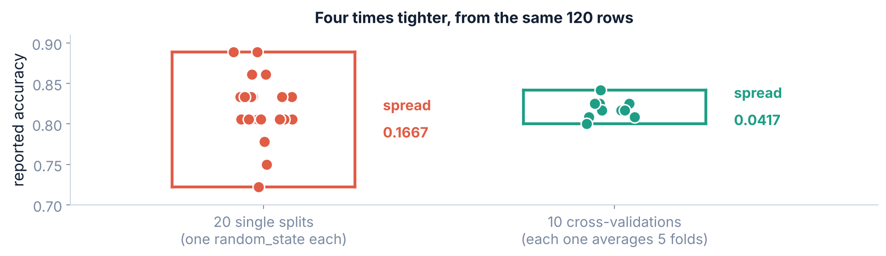
3 / 5 Give every row a turn
CV AGAINST SINGLE SPLITS
Is it actually more reliable? Measure it.
Twenty single splits ranged over 16.7 points. Ten cross-validations of the same 120 rows ranged over 4.2 — four times tighter, from exactly the same data.
Srinivasa Sai Chava · Boston University

Slide 22
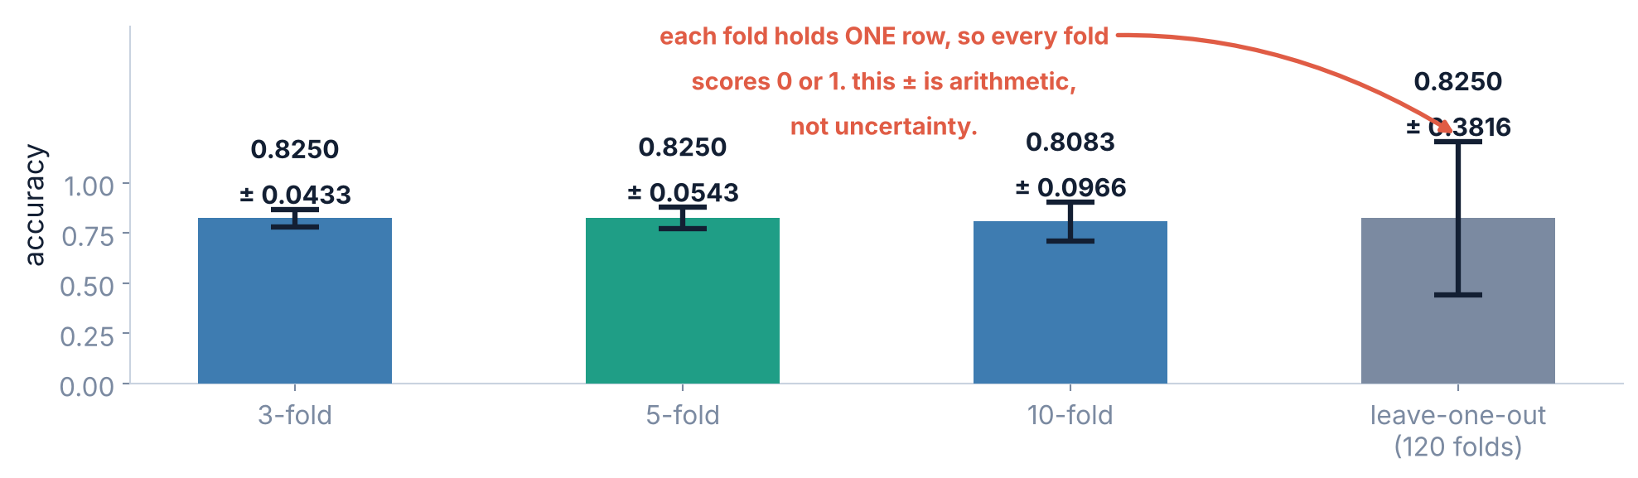
3 / 5 Give every row a turn
3, 5, 10 OR 120
How many folds should you use?
5 is the default for good reason. 10 holds back only 12 rows per fold here, so each fold's score is noisier — look at how the error bar grows.
Srinivasa Sai Chava · Boston University

Slide 23
3 / 5 Give every row a turn
A WARNING
Leave-one-out, and why its ± is a lie
WHY THE ± 0.3816 IS MEANINGLESS
What it does
120 folds. Each one trains on 119 students and is tested on the single remaining one.
So each fold's "accuracy" is either 1.0 (got that student right) or 0.0 (got them wrong). There is no third possibility.
It got 99 of the 120 right, giving a mean of 0.8250.
The standard deviation of a list of 0s and 1s is fixed by the mean. With 99 ones and 21 zeros it has to be 0.38 — it would be 0.38 for any model that got 99 right, however stable or unstable that model was.
It is not measuring uncertainty. It is measuring the fact that 0 and 1 are far apart.
When leave-one-out is worth it: when you have so few rows (under about 50) that holding back 20% leaves nothing to test on. Even then, quote the mean and say nothing about the spread. The honest default for anything larger is 5-fold or 10-fold.
Every number that comes out of a tool means something specific. Quoting one without knowing what it measures is how wrong claims get made.
Srinivasa Sai Chava · Boston University

Slide 24
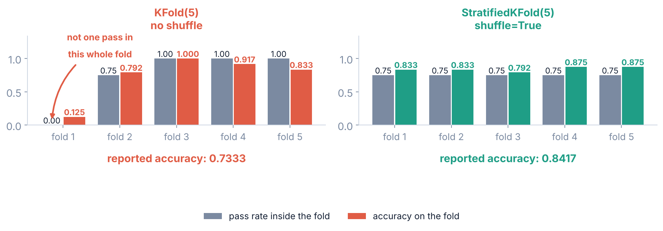
3 / 5 Give every row a turn
SHUFFLE AND STRATIFY
What happens when the file arrives sorted
Exports are sorted. By date, by customer, by region — or, as here, by the outcome itself. The rows have not changed; only their order has.
Fold 1 contained no passes at all, so the model scored 0.1250 on it. Nothing was wrong with the model. The folds were built wrong.
Srinivasa Sai Chava · Boston University

Slide 25
3 / 5 Give every row a turn
A REFERENCE
Which splitter, and when
use this | when | why
StratifiedKFold (shuffle=True) | classification — almost always | keeps every fold's class mix matching the whole dataset
KFold (shuffle=True) | regression, where there are no classes to balance | shuffle is still essential; a sorted file is just as dangerous
GroupKFold | several rows belong to the same person, patient or shop | keeps all of one group on one side, so the model cannot study a person and then be tested on them
TimeSeriesSplit | the rows are in time order and you predict the future | always trains on the past and tests on the future — never shuffle time
The last two exist because 'rows it never saw' has to mean genuinely never saw. Two visits from the same patient are not two independent rows.
Srinivasa Sai Chava · Boston University

Slide 26
SECTION 4 OF 5
The leak you
cannot see
81% on coin flips
which steps leak
Cross-validation done correctly, on data that was already spoiled
the rule that explains it
Srinivasa Sai Chava · Boston University

Slide 27
4 / 5 The leak you cannot see
AND THE TRAP IN IT
A reasonable-sounding plan
1
Clean the data
2
Cross-validate
3
Report the mean
fill the gaps, scale the columns, pick the columns worth keeping
5-fold, stratified, shuffled — everything you just learned
with its standard deviation, exactly as told
Every step is correct. The order is wrong, and the order is everything.
Step 1 looked at all 200 rows. By the time step 2 hides 40 of them, the preparation has already carried information out of those 40 and into the model.
This is called leakage. It does not throw an error, it does not look wrong in the code, and it makes your score better — which is why it survives review.
Srinivasa Sai Chava · Boston University

Slide 28
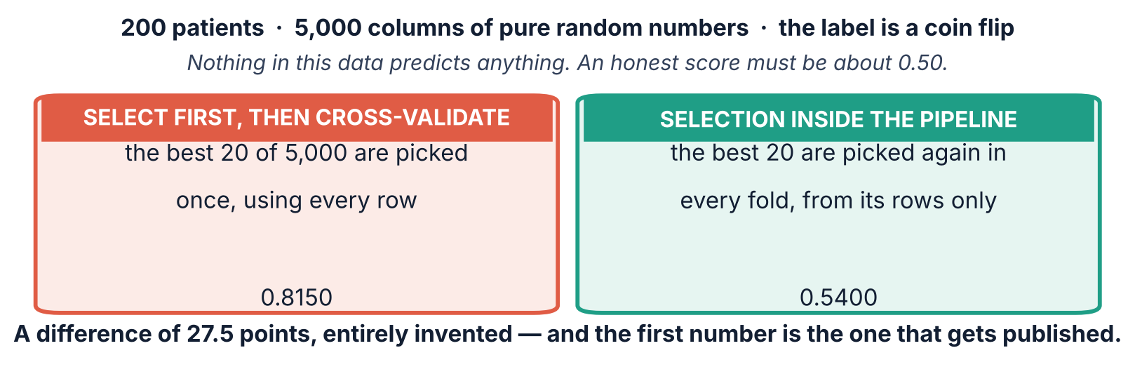
4 / 5 The leak you cannot see
A CONTROLLED EXPERIMENT
Proof, with data that cannot be predicted
There is no signal in this data. There cannot be — the labels are coin flips. 0.8150 is the sound of the selection step reading the answers.
Srinivasa Sai Chava · Boston University

Slide 29
4 / 5 The leak you cannot see
STEP BY STEP
How the 0.8150 is manufactured
1
5,000 noise columns
2
Pick the best 20
3
Hide 40 rows
4
Score 0.8150
by pure chance some of them line up with the coin flips
chosen using all 200 rows, labels included
but those 40 helped choose the columns
on columns picked to fit the very rows being scored
Why the pipeline version gets 0.5400 instead
Inside each fold the 20 columns are chosen again, using only that fold's 160 training rows. The columns that happened to fit the 40 hidden rows are no longer in the running — so the fiction disappears, and the score falls back to roughly the coin flip it should be.
0.5400 is not quite 0.5000 either. With five folds of 40 rows, that is ordinary noise — and the honest answer is 'this data predicts nothing'.
Srinivasa Sai Chava · Boston University

Slide 30
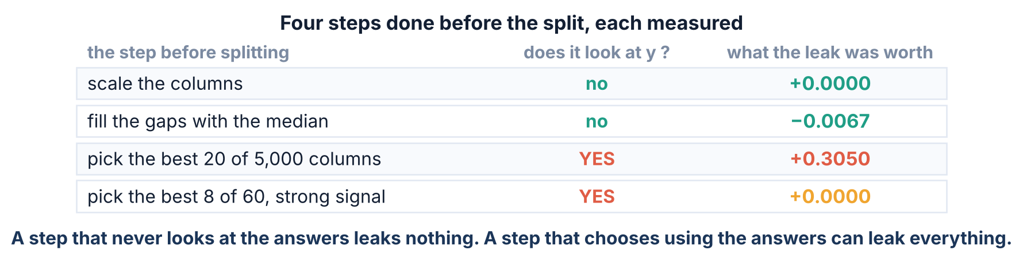
4 / 5 The leak you cannot see
FOUR STEPS, FOUR ANSWERS
Does every step leak? No. Measured.
Scaling leaked exactly nothing. This matters: if you tell students everything leaks, they stop believing any of it. Only one of these four was a disaster.
Srinivasa Sai Chava · Boston University

Slide 31
4 / 5 The leak you cannot see
LOOK AT Y
The rule that predicts which ones are dangerous
A step that never looks at y leaks almost nothing. A step that makes a choice using y can leak everything.
Never looks at y
Chooses using y
StandardScaler · SimpleImputer · OneHotEncoder · PolynomialFeatures · VarianceThreshold
Adding 20% more rows barely moves a mean, a median or a standard deviation, so the leaked information is negligible.
SelectKBest · RFE · "drop the columns that don't correlate with the target" · SMOTE and other resampling · tuning any setting
The choice is itself part of the model, and it was made using the answers.
Note the last item on the right. Choosing max_depth by trying values and keeping the best is a choice made using y — which is why tuning gets its own day, and its own extra split.
Srinivasa Sai Chava · Boston University

Slide 32
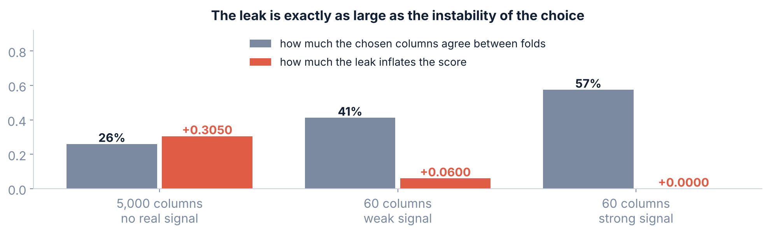
4 / 5 The leak you cannot see
THE HONEST NUANCE
And it is only as big as the choice is unstable
When the signal was strong the same 8 columns were picked in every fold, so there was nothing left to leak — and the leak was exactly zero. The danger lives where the evidence is weakest.
Srinivasa Sai Chava · Boston University

Slide 33
4 / 5 The leak you cannot see
NO — AND THAT IS THE POINT
So do you have to judge every step?
You could reason it out every time: does this step look at y, is the choice stable, how many rows do I have.
Or you could put every step inside one object that refits all of them in every fold, and stop thinking about it.
judge each step
→
Pipeline
slow, and you will be wrong once
right by construction
This is the real argument for pipelines, and it is not about scores. It is that correctness stops depending on you remembering.
Srinivasa Sai Chava · Boston University

Slide 34
SECTION 5 OF 5
One object,
no leaks
mixed columns handled
900 loan applications
Pipelines, ColumnTransformer, and a real model built end to end
one file to deploy
Srinivasa Sai Chava · Boston University

Slide 35
5 / 5 One object, no leaks
THE IDEA
A Pipeline is a list of steps that behaves like a model
from sklearn.pipeline import Pipeline
pipe = Pipeline([("scale", StandardScaler()),
("model", LogisticRegression(max_iter=2000))])
pipe.fit(X_train, y_train) # fits BOTH steps
pipe.predict(X_new) # scales X_new, then predicts
1
It has .fit and .predict
so anywhere a model goes, a pipeline goes — including straight into cross_val_score
2
Transformers are fitted on train only
then applied to whatever comes next, with the numbers learned from train
3
Order is guaranteed
you cannot scale after predicting, or forget the scaler on new data
"Fitted on train only" is the whole trick. A Pipeline inside cross_val_score refits every step, in every fold, without being asked.
Srinivasa Sai Chava · Boston University

Slide 36
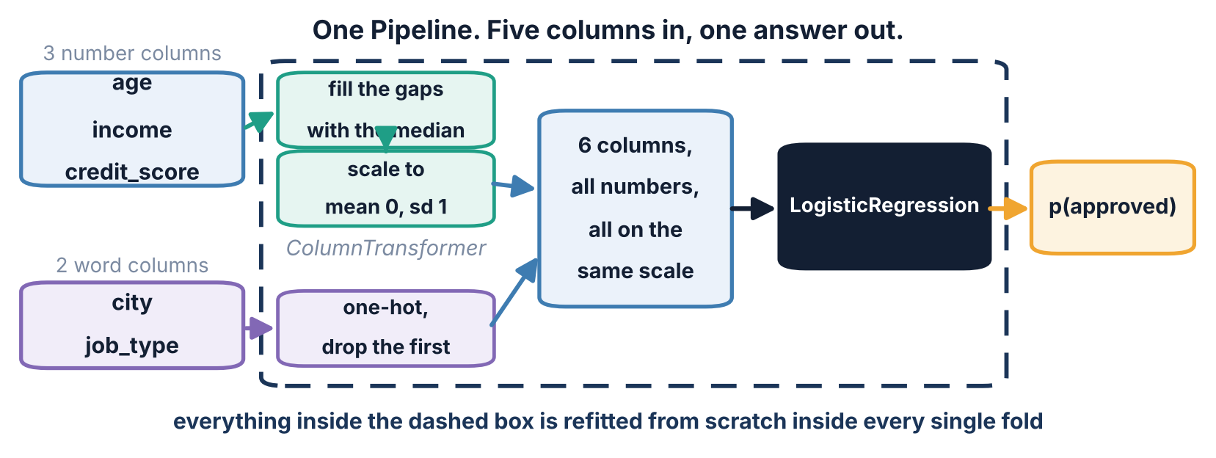
5 / 5 One object, no leaks
COLUMNTRANSFORMER
Real data has number columns and word columns
The numbers need filling and scaling. The words need one-hot encoding. ColumnTransformer sends each group down its own route and glues the results back together.
Srinivasa Sai Chava · Boston University

Slide 37
5 / 5 One object, no leaks
THE CODE YOU WILL REUSE
The whole thing, written out
num = ["age", "income", "credit_score"]
cat = ["city", "job_type"]
prep = ColumnTransformer([
("num", Pipeline([("imp", SimpleImputer(strategy="median")),
("sc", StandardScaler())]), num),
("cat", OneHotEncoder(drop="first"), cat)])
full = Pipeline([("prep", prep),
("model", LogisticRegression(max_iter=2000))])
cv = StratifiedKFold(5, shuffle=True, random_state=0)
scores = cross_val_score(full, X, y, cv=cv)
That last line fits the imputer, the scaler, the encoder and the model five separate times, each on four-fifths of the data. You wrote none of that loop.
Srinivasa Sai Chava · Boston University

Slide 38
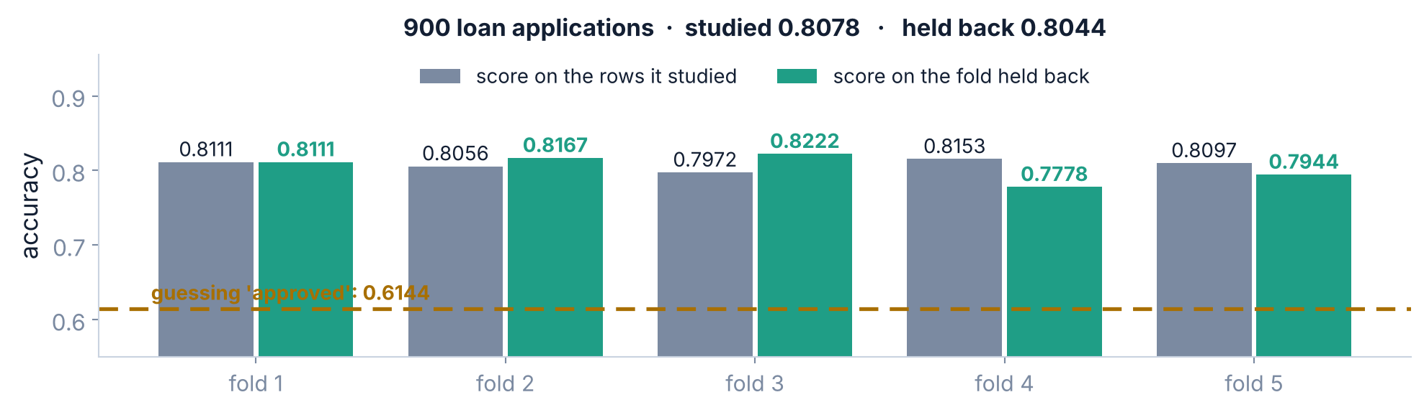
5 / 5 One object, no leaks
THE RESULT
900 loan applications, end to end
Studied 0.8078 · held back 0.8044 · the gap is 0.0034. This model is not overfitting — and that sentence only means something because of everything in the first four sections.
0.8044 against a baseline of 0.6144 — a gain of 19 points, with 76 missing incomes filled and two word columns encoded, all inside the folds.
Srinivasa Sai Chava · Boston University

Slide 39
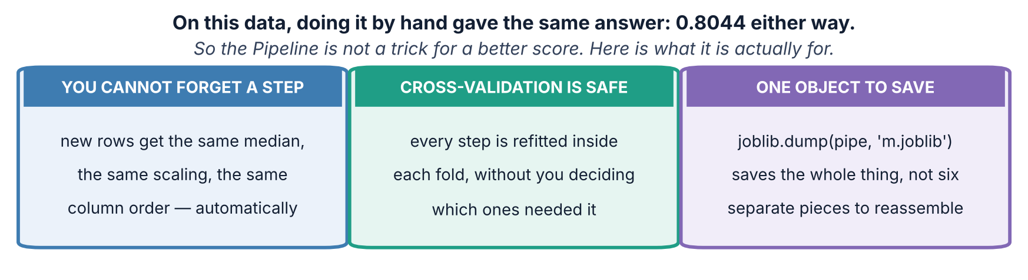
5 / 5 One object, no leaks
SO WHY BOTHER?
On this data, by hand gave the same answer
I could have hidden this slide and told you pipelines protect your score. They sometimes do. Mostly they protect you from yourself, and that is worth more.
Srinivasa Sai Chava · Boston University

Slide 40
5 / 5 One object, no leaks
JOBLIB
Fit it once, save it, use it tomorrow
import joblib
full.fit(X, y) # now fit on every row you have
joblib.dump(full, "loan_model.joblib")
# next week, in a completely different program:
model = joblib.load("loan_model.joblib")
model.predict_proba(new_applications)[:, 1]
Why fit on everything at the end
WHAT GOES IN THE FILE
Cross-validation was the measurement — it told you to expect about 0.80. The five models it built have done their job and are gone. The model you ship is fitted on all 900 rows.
The median income used for filling (57.9), every column's mean and standard deviation, the category list, the column order, and the coefficients. Save the model alone and every one of those is lost.
A model on its own is not deployable. A pipeline is.
Srinivasa Sai Chava · Boston University

Slide 41
5 / 5 One object, no leaks
ONE MORE SPLIT
So do you still need a test set?
If you only FIT
If you also CHOOSE
Cross-validation is enough on its own. You made no choices using the scores, so the mean is an honest estimate.
Trying five models, or ten values of max_depth, and keeping the best CV score — that is a choice made using y. Section 4 applies to it.
all your rows
→
80% working set
→
20% final test
everything you have
cross-validate inside here as much as you like
opened once, at the very end
Best of twenty is not an average of twenty. If you pick the highest of twenty cross-validated scores, that winner is high partly on merit and partly on luck — and only rows nothing has touched can tell you how much of each.
You are fitting only, for now, so cross-validation alone is honest. Keep this slide for the tuning day, when you start choosing.
Srinivasa Sai Chava · Boston University

Slide 42
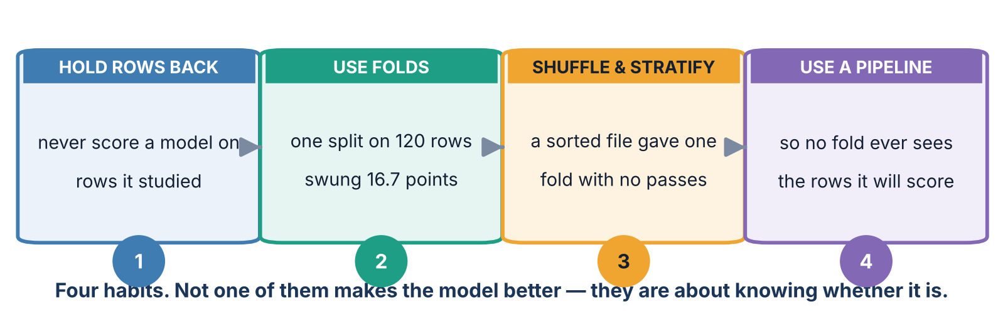
5 / 5 One object, no leaks
ALL OF TODAY ON ONE PAGE
The four habits
You will use all four for the rest of this course and the rest of your career. Nothing after today changes them — the models get cleverer, the measuring does not.
Srinivasa Sai Chava · Boston University

Slide 43
5 / 5 One object, no leaks
A CHECKLIST
Mistakes this lecture should stop you making
if you catch yourself... | what is wrong | do this instead
reporting .score(X_train, y_train) | that is the studied rows | score the held-back rows, or cross-validate
trying seeds until one looks good | you are picking the lottery ticket | cross-validate and report mean ± sd
scaling before train_test_split | harmless here, but a bad habit that will bite with other steps | put the scaler in a Pipeline
picking columns before cross-validating | the leak that was worth 27.5 points | put the selector in the Pipeline
KFold on a file you did not shuffle | a fold with no positives in it | StratifiedKFold(shuffle=True)
quoting a mean with no spread | half the result is missing | always quote both
Every one of these makes your number go up. That is what makes them hard to spot — nobody ever double-checks a disappointing result.
Srinivasa Sai Chava · Boston University

Slide 44
5 / 5 One object, no leaks
WHAT TO DO
Tonight's practice
A
Work it out
Fold arithmetic, reading a cross-validation result, spotting the leak on paper
8 questions
B
Find the mistake
Four programs that all report a number that is too good
4 questions
C
Write the code
Cross-validate properly, then build a full ColumnTransformer pipeline
5 tasks
D
Challenge
Write k-fold yourself from scratch, then audit a model a company is already using
2 tasks
Part D asks you to write the k-fold loop yourself — slicing the row numbers into five groups by hand — and confirm it gives the same five scores scikit-learn gives.
Srinivasa Sai Chava · Boston University

Slide 45
WHAT TO REMEMBER
Five numbers from today
1.0000
a decision tree on the rows it studied — and 0.6389 on rows it had not, below the 0.7500 you get by guessing
16.7 points
the spread across twenty train/test splits of the same 120 students, with nothing changed but the seed
0.1250
what one fold scored when the file arrived sorted and nobody passed shuffle
0.8150
accuracy on labels that were literally coin flips, because the columns were picked before the folds
0.0000
the leak from scaling before splitting — not every warning you read online is worth the same
Next: evaluation metrics for classification — what to measure once you know how to measure it honestly.
Srinivasa Sai Chava · Boston University

