Slide 1

MODULE 3 · MACHINE LEARNING · DAY 37
What Right Means
Evaluation metrics for classification
Yesterday you learned to measure honestly.
Today: measure what.
5
17
1
sections
worked pictures
confusion matrix
Srinivasa Sai Chava · Boston University

Slide 2
WHERE WE ARE
Yesterday ended on a model nobody should ship
The HR model from Day 36's practice
90.6% accurate. Exactly its own do-nothing baseline. It flagged 4 people out of 2,000 and caught 2 of the 187 who actually left.
You found three faults in how it was measured. But the deepest problem was not the measurement — it was that accuracy was the wrong question from the start.
Today's five sections
1
Four numbers, not one
Precision and recall
Still no new model.
2
Back down to one number
Day 36 was about whether your number is honest. Today is about whether it is the right number to be asking for.
These two days together are what separates somebody who can fit a model from somebody you would let deploy one.
3
4
The whole curve
5
Putting a price on it
Srinivasa Sai Chava · Boston University

Slide 3
Accuracy answers a question
almost nobody is asking.
"How often is the model right?" sounds like the obvious question. It is the obvious question only when both kinds of mistake cost the same and both answers are equally common — which, in the problems worth solving, is almost never true.
Srinivasa Sai Chava · Boston University

Slide 4
SECTION 1 OF 5
Four numbers,
not one
6,000 card payments
95.8% accurate
The confusion matrix, and what accuracy throws away
223 frauds let through
Srinivasa Sai Chava · Boston University

Slide 5
1 / 5 Four numbers, not one
THE PROBLEM
Today's data: 6,000 card payments
amount how much the payment was for
hour 0 to 23
night 1 if between 1am and 5am
recent_txns payments on this card in the last hour
foreign 1 if the merchant is overseas
channel chip / online / contactless
fraud 1 if the payment was fraudulent
290
What the data already says
of them fraud
online payments are fraudulent 9.8% of the time; chip payments 1.0%
foreign merchants: 21.0% against 3.2%
the median fraud is ₹90.61; the median honest payment ₹35.34
4.83%
of all payments
0.9517
accuracy of 'never block'
Every number today comes from cross-validated predictions on all 6,000 rows — yesterday's lesson, applied without comment from here on.
Srinivasa Sai Chava · Boston University

Slide 6
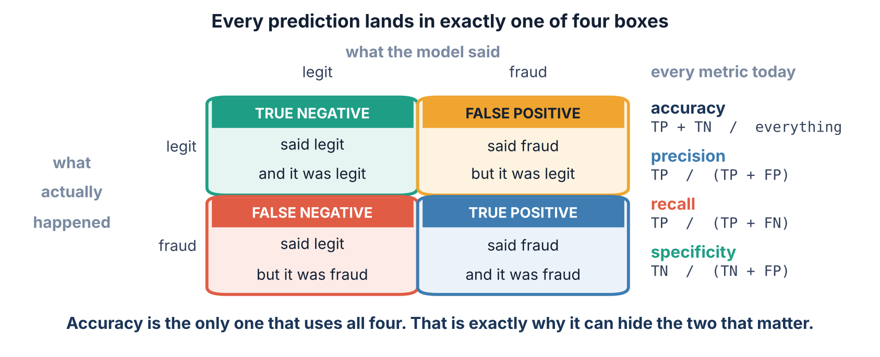
1 / 5 Four numbers, not one
THE CONFUSION MATRIX
Every prediction lands in one of four boxes
Learn these four names properly today. Every metric for the rest of the course is built out of them, and most arguments about models are really arguments about which box matters.
Srinivasa Sai Chava · Boston University

Slide 7
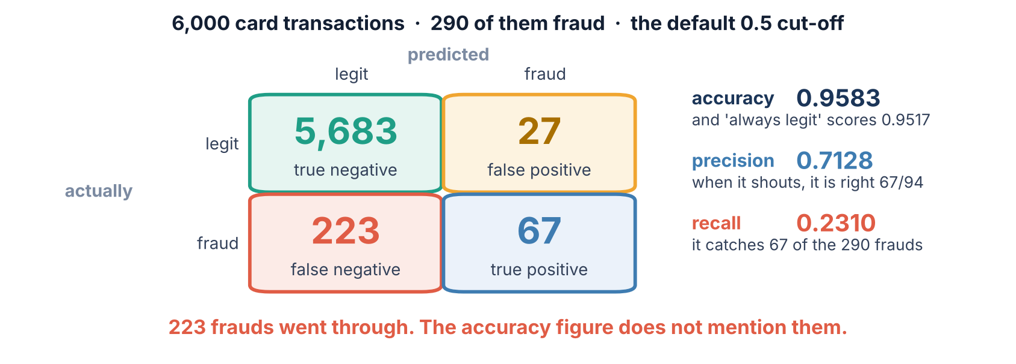
1 / 5 Four numbers, not one
MEASURED
The same four boxes, with our numbers in them
Read the bottom-left box. 223 frauds went through, and not one of the headline numbers you would normally quote mentions them.
Srinivasa Sai Chava · Boston University

Slide 8
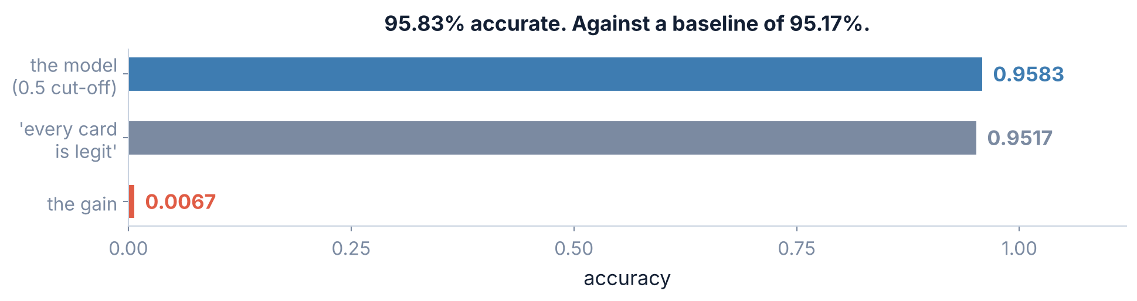
1 / 5 Four numbers, not one
ACCURACY AGAINST ITS BASELINE
95.83% accurate. And almost worthless.
The 'always legit' model needs no data, no columns and no training. It is right 95.17% of the time because 95.17% of payments are legitimate.
Two thirds of a percentage point. That is the entire contribution of the model, measured the way most people measure.
Srinivasa Sai Chava · Boston University

Slide 9
1 / 5 Four numbers, not one
SKLEARN.METRICS
The four numbers, in code
from sklearn.metrics import confusion_matrix, classification_report
tn, fp, fn, tp = confusion_matrix(y, pred).ravel() # <- note the order
accuracy = (tp + tn) / (tp + tn + fp + fn) # 0.9583
precision = tp / (tp + fp) # 0.7128
recall = tp / (tp + fn) # 0.2310
specificity = tn / (tn + fp) # 0.9953
Watch the unpacking order
SPECIFICITY — THE ONE NOBODY QUOTES
The .ravel() call gives tn, fp, fn, tp — reading the matrix left to right, top to bottom. Get this backwards and precision and recall swap places silently.
0.9953 of honest payments got through untouched. On imbalanced data this is almost always near 1 and almost always useless — it is dominated by the enormous tn box.
classification_report(y, pred) prints most of this in one line. Use it, but know where each number came from.
Srinivasa Sai Chava · Boston University

Slide 10
SECTION 2 OF 5
Precision
and recall
when we act, are we right?
how much did we catch?
Two fractions with the same numerator and different denominators
and why you cannot have both
Srinivasa Sai Chava · Boston University

Slide 11
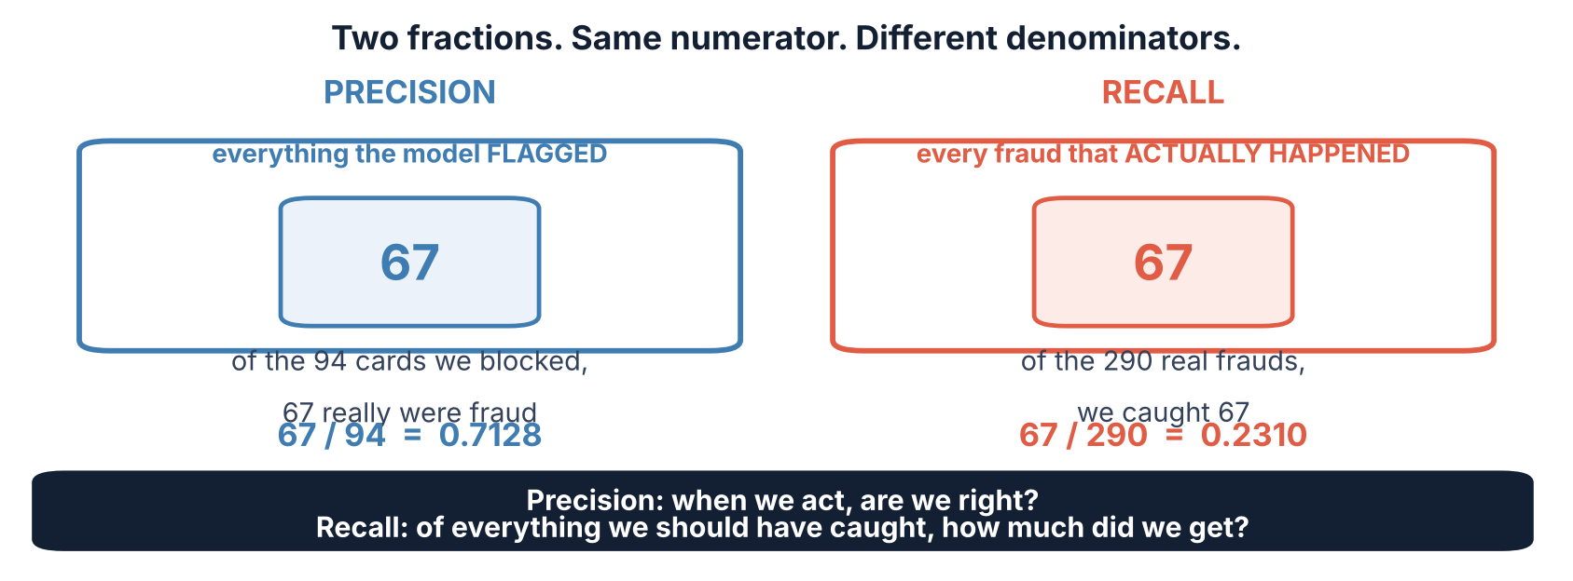
2 / 5 Precision and recall
SAME TOP, DIFFERENT BOTTOM
The only two metrics you must never confuse
A way to keep them straight: precision is about the model's claims, recall is about the world's cases. Precision asks about the 94; recall asks about the 290.
Srinivasa Sai Chava · Boston University

Slide 12
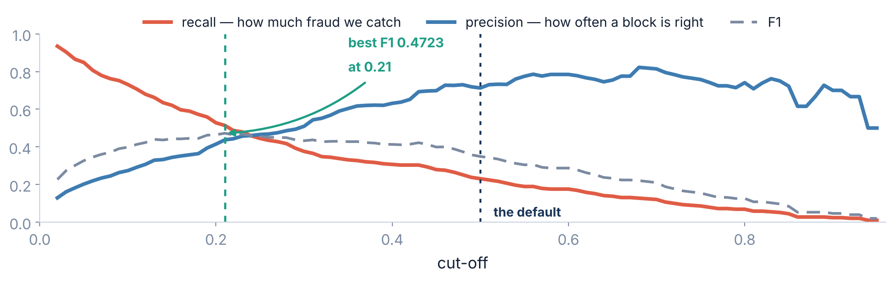
2 / 5 Precision and recall
THE TRADE-OFF
Move the cut-off and they move in opposite directions
This is not a flaw to be engineered away. Blocking more cards must catch more fraud and must be wrong more often. The curve is the shape of the choice itself.
Srinivasa Sai Chava · Boston University

Slide 13
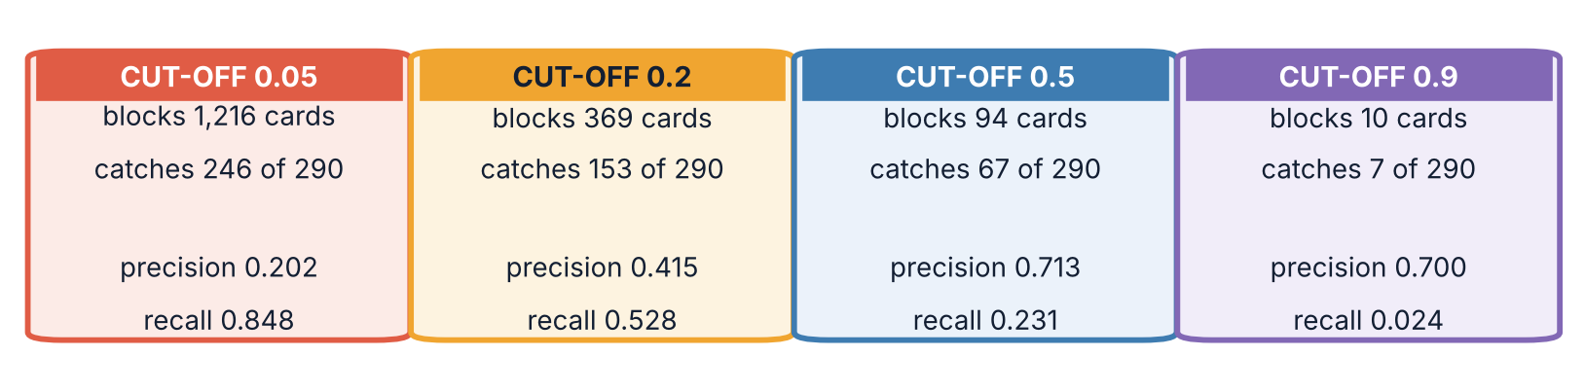
2 / 5 Precision and recall
SAME MODEL THROUGHOUT
Four cut-offs. Four completely different banks.
Nothing about the model changed between these four. Not a coefficient, not a row of data. Only the number you compare the probability against.
At 0.90 precision actually FALLS, to 0.700. With only 10 cards flagged, one mistake moves it ten points — precision is noisy when the flagged set is tiny.
Srinivasa Sai Chava · Boston University

Slide 14
2 / 5 Precision and recall
PICK A ROW
The whole sweep, as a table
cut-off | cards blocked | fraud caught | fraud missed | precision | recall | accuracy
0.05 | 1,216 | 246 | 44 | 0.2023 | 0.8483 | 0.8310
0.10 | 774 | 212 | 78 | 0.2739 | 0.7310 | 0.8933
0.15 | 523 | 180 | 110 | 0.3442 | 0.6207 | 0.9245
0.20 | 369 | 153 | 137 | 0.4146 | 0.5276 | 0.9412
0.30 | 214 | 109 | 181 | 0.5093 | 0.3759 | 0.9523
0.50 | 94 | 67 | 223 | 0.7128 | 0.2310 | 0.9583
0.70 | 43 | 35 | 255 | 0.8140 | 0.1207 | 0.9562
0.90 | 10 | 7 | 283 | 0.7000 | 0.0241 | 0.9523
Accuracy is highest at 0.50 — the row that misses 223 of the 290 frauds. Maximising accuracy on imbalanced data is a way of asking the model to do nothing.
Srinivasa Sai Chava · Boston University

Slide 15
2 / 5 Precision and recall
IT DEPENDS ON THE MISTAKE
So which one do you actually want?
RECALL MATTERS MORE
PRECISION MATTERS MORE
a cancer screen · fraud on a large account · a safety alert on a machine
Missing a case is catastrophic and a false alarm costs a review. Accept the false alarms.
blocking a card · auto-rejecting a job application · flagging a customer to the police
Acting wrongly does real harm to a real person. Be sure before you act.
Card fraud is genuinely both, which is why it is a good example.
Miss a fraud and the bank refunds it. Block a real customer and they are stranded at a till. Section 5 settles it with money, because nothing else can.
You cannot answer 'which metric' by looking at the model. You answer it by asking who gets hurt by each kind of mistake.
Srinivasa Sai Chava · Boston University

Slide 16
SECTION 3 OF 5
Back down to
one number
F1 and why it is harmonic
balanced accuracy
When you really do have to report a single figure
three rules, three answers
Srinivasa Sai Chava · Boston University

Slide 17
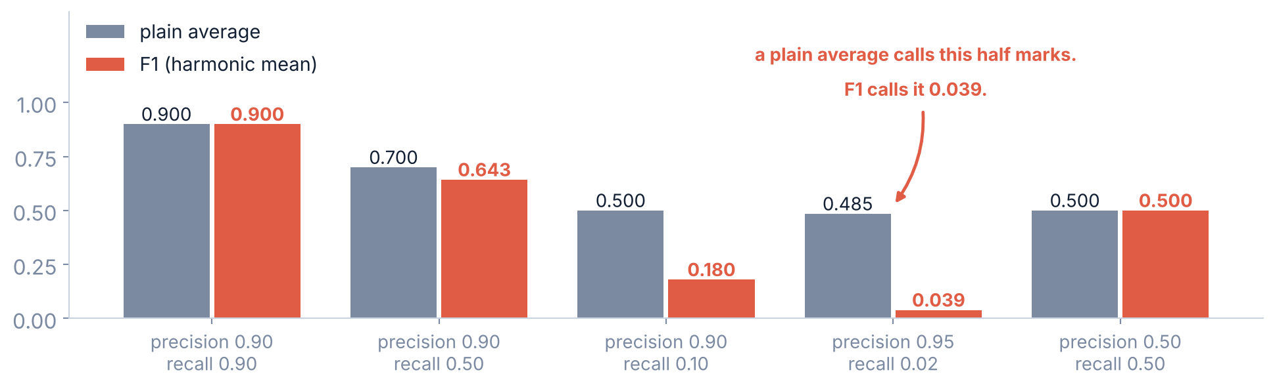
3 / 5 Back down to one number
NOT A PLAIN AVERAGE
F1 is a harmonic mean, and that is the whole point
Precision 0.95 with recall 0.02 is a model that blocks four cards a year and is usually right. A plain average calls that 0.485. F1 calls it 0.039.
Srinivasa Sai Chava · Boston University

Slide 18
3 / 5 Back down to one number
F1 AND F-BETA
The formula, and the one knob on it
2 · precision · recall
F1 = ——————————————————————— = 0.3490 at our 0.5 cut-off
precision + recall
from sklearn.metrics import f1_score, fbeta_score
f1_score(y, pred) # 0.3490
F0.5
precision counts double
use when a false alarm is the expensive mistake
F1
they count equally
the default, and the one people mean by 'F score'
F2
recall counts double
use when a miss is the expensive mistake
beta is how many times more you care about recall than precision. Choosing it is the same decision as choosing a cut-off, moved one step earlier.
Srinivasa Sai Chava · Boston University

Slide 19
3 / 5 Back down to one number
BALANCED ACCURACY AND MCC
Two more one-number summaries
Balanced accuracy
Matthews correlation (MCC)
The average of recall on each class — here (0.2310 + 0.9953) / 2 = 0.6132.
It asks: how would you score if the two classes were equally common? A model that always says 'legit' scores exactly 0.5000, however rare the fraud is. That is its whole value.
The only common single number that uses all four boxes and is not fooled by imbalance. Runs from −1 to +1, where 0 is chance.
Statisticians like it. Managers do not understand it. Report it alongside something plainer, never instead.
The honest warning about every number on this slide
Each one squeezes a two-dimensional trade-off into one dimension, and to do that it has to assume something about what you care about. F1 assumes precision and recall matter equally. Balanced accuracy assumes the classes do. Neither assumption is likely to be true for your problem.
Use them to compare models on a level field. Do not use them to choose a cut-off — section 5 has a better way.
Srinivasa Sai Chava · Boston University

Slide 20
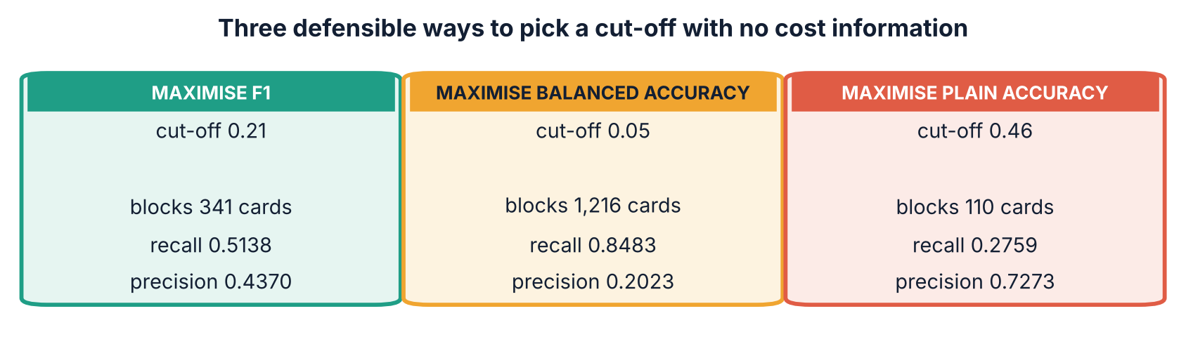
3 / 5 Back down to one number
AND NONE OF THEM IS RIGHT
Three sensible rules. Three different banks.
Each rule sounds defensible in a meeting. They block 341, 1,216 and 110 cards. The disagreement is not a technical detail — it is the entire business decision.
Srinivasa Sai Chava · Boston University

Slide 21
SECTION 4 OF 5
The whole curve,
not one point
ROC and AUC
what AUC really means
Scoring a model across every cut-off at once
and when it lies to you
Srinivasa Sai Chava · Boston University

Slide 22
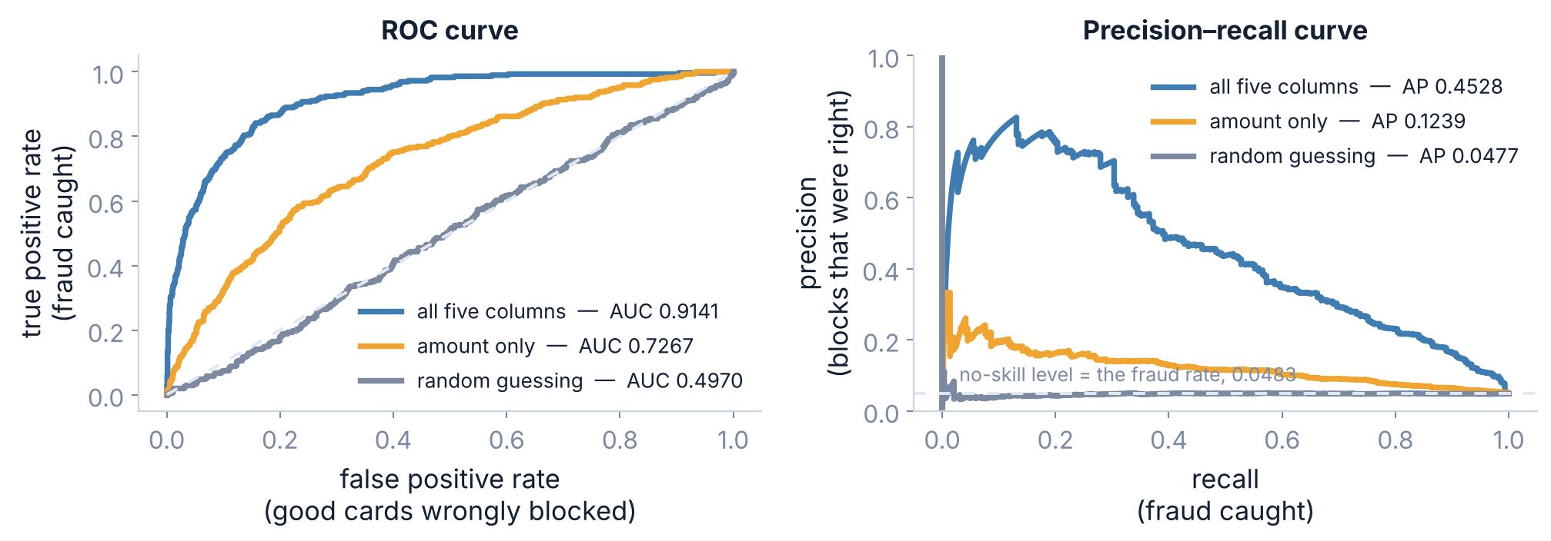
4 / 5 The whole curve
ROC AND PRECISION-RECALL
Two curves, three models
Each point on each curve is one cut-off. The curves say nothing about which cut-off to pick — they summarise how good the ordering is, whatever you pick.
Srinivasa Sai Chava · Boston University

Slide 23
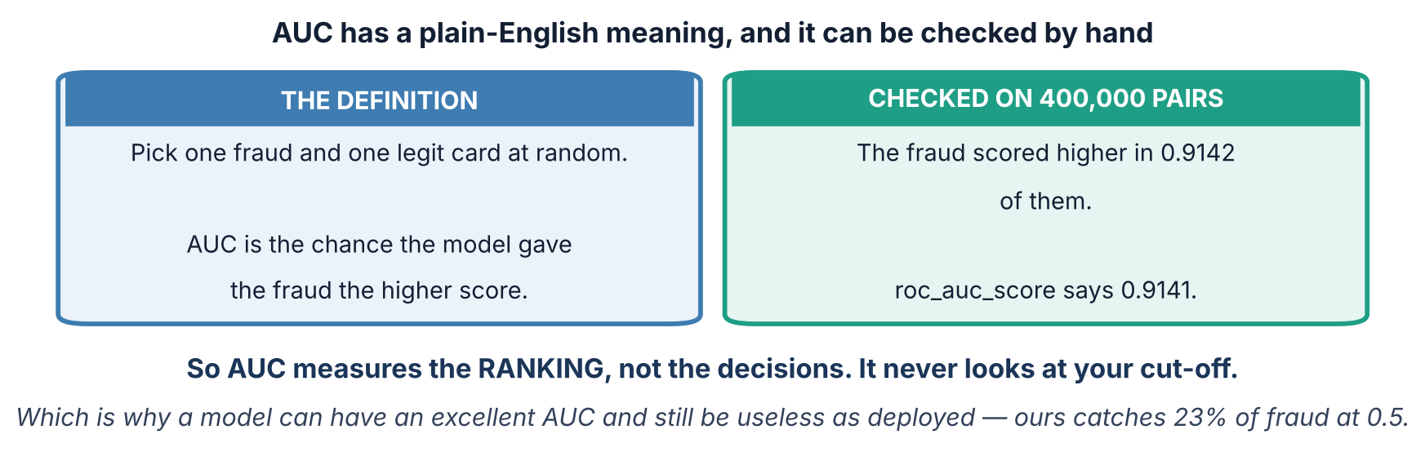
4 / 5 The whole curve
AND HOW TO CHECK IT
What the AUC number actually means
0.5 means the ranking is a coin flip. 1.0 means every fraud outranks every honest payment. Our 0.9141 means it gets the pair right nine times in ten.
Srinivasa Sai Chava · Boston University

Slide 24
4 / 5 The whole curve
TWO IMPORTS
Drawing them, in code
from sklearn.metrics import (roc_curve, roc_auc_score,
precision_recall_curve, average_precision_score)
probs = model.predict_proba(X)[:, 1] # NOT .predict()
fpr, tpr, cuts = roc_curve(y, probs)
roc_auc_score(y, probs) # 0.9141
prec, rec, cuts = precision_recall_curve(y, probs)
average_precision_score(y, probs) # 0.4528
Every one of these takes probabilities, not predictions.
Pass .predict() output by mistake and the function still runs — it just draws a curve through a single point and reports a meaningless number. No error, no warning.
If an AUC ever comes back suspiciously round or low, check what you passed in first.
Srinivasa Sai Chava · Boston University

Slide 25
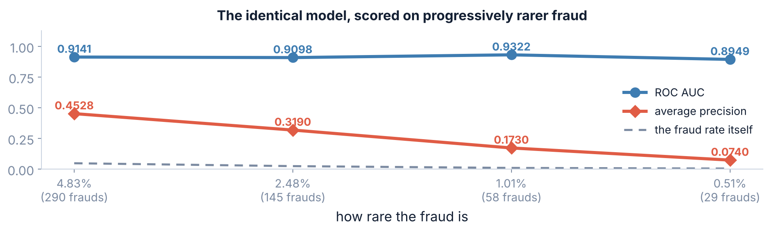
4 / 5 The whole curve
THE IMBALANCE TRAP
Where ROC quietly flatters you
The same model, every time. Only the share of fraud in the test set changed. ROC AUC held near 0.91; average precision fell from 0.4528 to 0.0740.
Srinivasa Sai Chava · Boston University

Slide 26
4 / 5 The whole curve
THE DENOMINATOR AGAIN
Why that happens, in one line of arithmetic
ROC's false positive rate divides by the number of honest payments — and on imbalanced data that number is enormous.
at this cut-off | false alarms | false positive rate | precision
0.05 | 970 | 0.1699 — looks small | 0.2023 — four blocks in five are wrong
0.10 | 562 | 0.0984 — looks tiny | 0.2739
0.20 | 216 | 0.0378 — looks excellent | 0.4146
970 wrongly blocked cards is 17% of honest payments and sounds forgivable. It is also four out of every five blocks the bank makes, and that is what the customer feels.
Srinivasa Sai Chava · Boston University

Slide 27
4 / 5 The whole curve
A RULE YOU CAN KEEP
So which curve
USE ROC / AUC
USE PRECISION-RECALL / AP
USE NEITHER
comparing models on the same data
the classes are roughly balanced
you want one number that does not depend on the cut-off
one class is rare — under about 10%
you care about the positives specifically
you want a curve that notices when most of your alarms are false
you already know what each mistake costs
then expected cost beats both, and section 5 shows it
A useful habit: whenever somebody shows you an AUC above 0.9 on a rare event, ask for the precision-recall curve too. It takes one line and it often changes the conversation.
Srinivasa Sai Chava · Boston University

Slide 28
SECTION 5 OF 5
Putting a price
on it
cost in rupees
the cut-off falls out
The only way to actually settle the question
and more than two classes
Srinivasa Sai Chava · Boston University

Slide 29
5 / 5 Putting a price on it
EXPECTED COST
Stop arguing about metrics. Count the money.
# a fraud we miss costs the bank the value of the payment
# a good card we block costs the bank COST_OF_A_BLOCK
missed = amount[(y == 1) & (pred == 0)].sum()
blocked = ((pred == 1) & (y == 0)).sum()
total = missed + COST_OF_A_BLOCK * blocked
What this needs from you
THE TWO ENDS, FOR SCALE
One number: what a wrongly blocked card costs. Support time, goodwill, the chance the customer moves bank.
Nobody enjoys estimating it. But picking a metric instead does not avoid the estimate — it just hides it, and makes it badly.
Block nothing: ₹44,478 of fraud succeeds.
Block everything: no fraud, and 5,710 furious customers.
Everything sensible lives in between.
Note what this calculation does NOT need: a metric. It needs the confusion matrix and a price list.
Srinivasa Sai Chava · Boston University

Slide 30
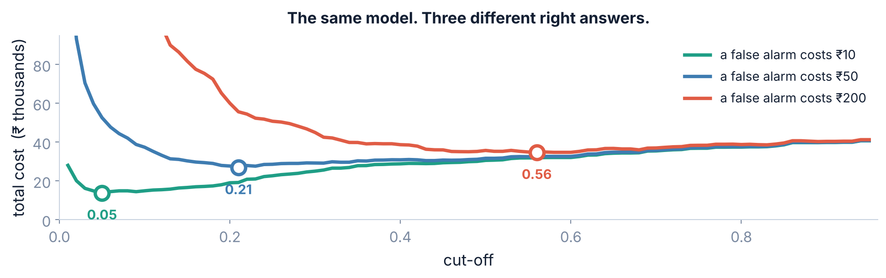
5 / 5 Putting a price on it
THREE PRICE LISTS
Total cost against the cut-off
Three curves, three minima: 0.05, 0.21 and 0.56. The model is identical in all three. Only what a blocked customer costs the bank is different.
Srinivasa Sai Chava · Boston University

Slide 31
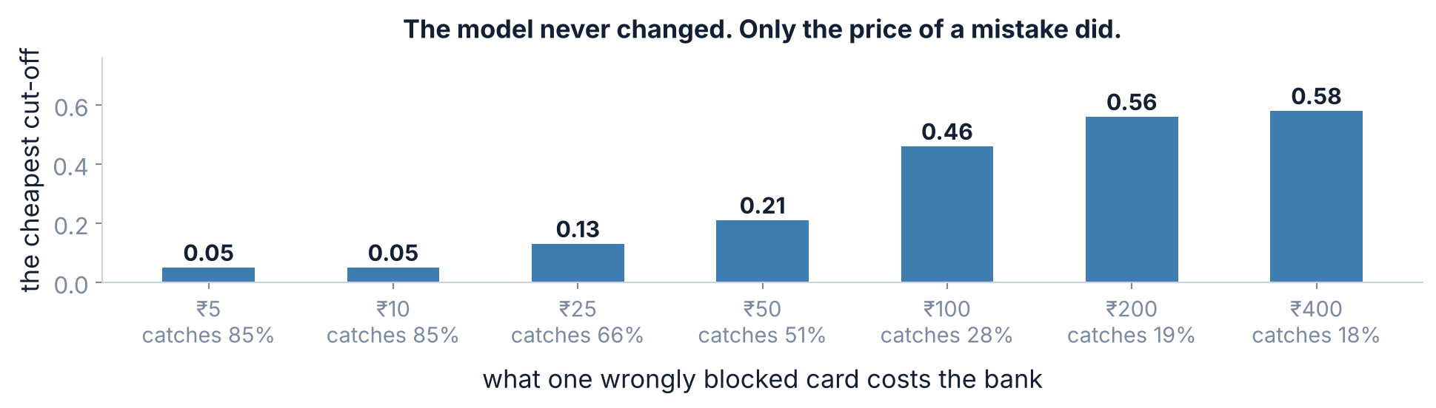
5 / 5 Putting a price on it
NOT OF THE MODEL
The cut-off is a property of the business
At ₹5 a block, take the 0.05 cut-off and catch 85% of fraud. At ₹400, take 0.58 and catch 18%. Both are correct. The question was never 'which cut-off is best'.
Srinivasa Sai Chava · Boston University

Slide 32
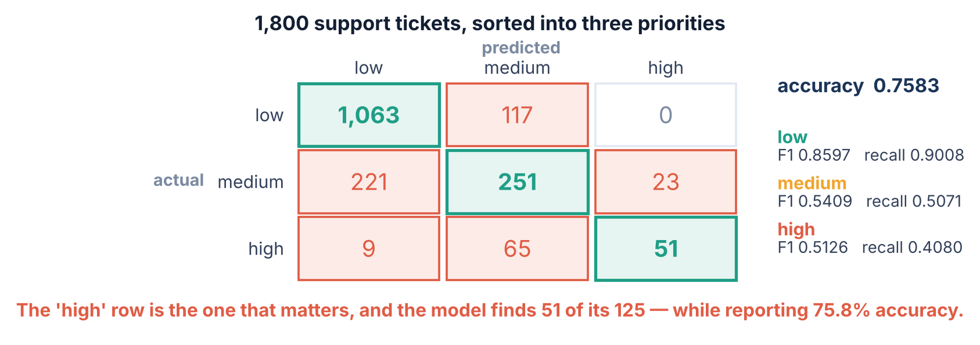
5 / 5 Putting a price on it
THE MATRIX GROWS
More than two classes
Precision and recall still work — they are just computed one class at a time, each class taking its turn as 'the positive one'.
Srinivasa Sai Chava · Boston University

Slide 33
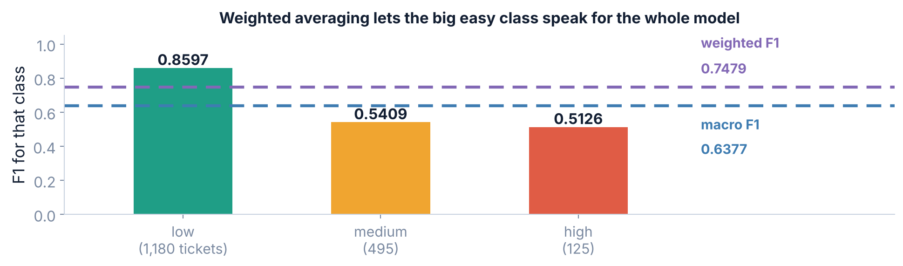
5 / 5 Putting a price on it
MACRO, WEIGHTED, MICRO
Averaging across classes: the choice that hides things
average | what it does | here
macro | the plain mean of each class's F1 — every class counts the same | 0.6377
weighted | weighted by how common each class is — big classes dominate | 0.7479
micro | pools all the predictions first — equals accuracy for single-label problems | 0.7583
Report macro when the rare class is the one you care about. 'High priority' is 7% of tickets, so weighted averaging lets the easy 'low' class answer for the whole model.
Srinivasa Sai Chava · Boston University

Slide 34
5 / 5 Putting a price on it
ONE CALL, EVERYTHING
classification_report, read properly
print(classification_report(y, pred, digits=4))
precision recall f1-score support
low 0.8221 0.9008 0.8597 1180
medium 0.5797 0.5071 0.5409 495
high 0.6892 0.4080 0.5126 125
accuracy 0.7583 1800
macro avg 0.6970 0.6053 0.6377 1800
weighted avg 0.7462 0.7583 0.7479 1800
Read it bottom-up
The three rows at the bottom are the summary everybody quotes.
The three rows at the top are where the problem actually is.
support is how many real cases of that class existed — always check it before trusting a rate computed from it.
'high' has recall 0.4080 on a support of 125. The model misses 74 of the 125 genuinely urgent tickets, and the accuracy line says 0.7583.
Srinivasa Sai Chava · Boston University

Slide 35
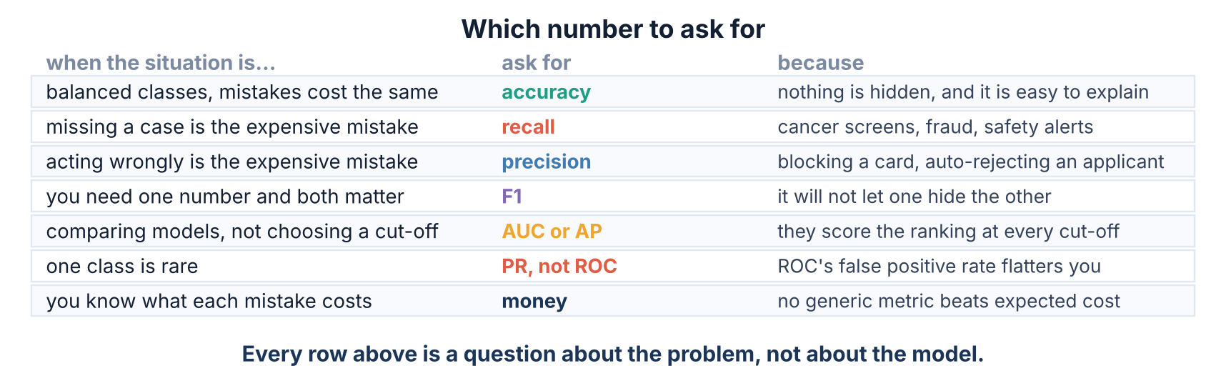
5 / 5 Putting a price on it
A REFERENCE YOU CAN KEEP
Which number to ask for
Notice that the left-hand column never mentions the model. Every one of these is a question about the problem you are solving.
Srinivasa Sai Chava · Boston University

Slide 36
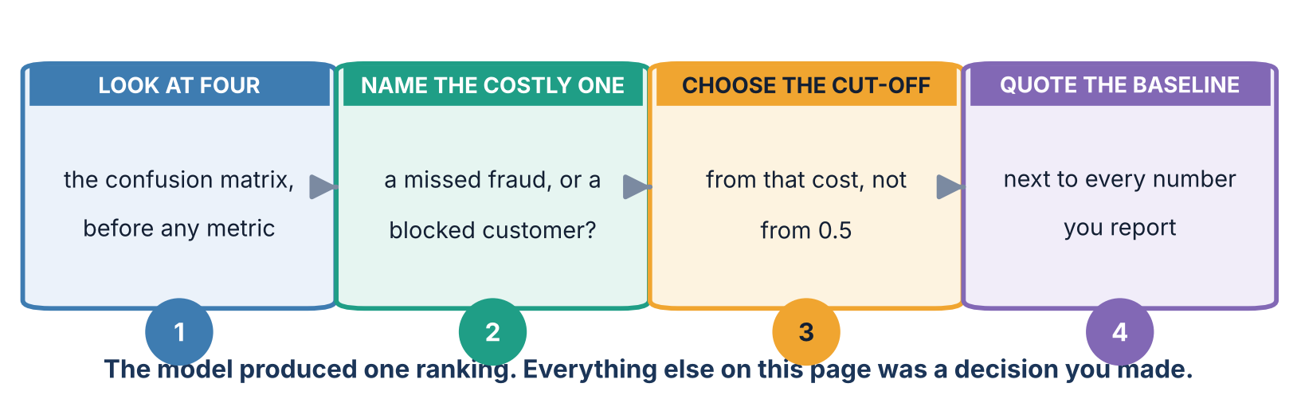
5 / 5 Putting a price on it
ALL OF TODAY ON ONE PAGE
The four habits
The model handed you one ranking of 6,000 payments. Everything after that — the cut-off, the metric, the number in the report — was a decision a person made.
Srinivasa Sai Chava · Boston University

Slide 37
5 / 5 Putting a price on it
A CHECKLIST
Mistakes this lecture should stop you making
if you catch yourself... | what is wrong | do this instead
reporting accuracy on rare events | 'never block' scored 0.9517 here | quote the baseline beside it, always
quoting precision without recall | or recall without precision | quote both, or F1, and say which cut-off
using .predict() for a curve | that is one point, not a curve | pass .predict_proba()[:, 1]
showing an ROC curve for a rare class | the false positive rate stays flatteringly small | show the precision-recall curve too
choosing the cut-off that maximises accuracy | on imbalanced data that is close to doing nothing | choose it from what each mistake costs
reporting weighted F1 on an imbalanced problem | the big easy class answers for the whole model | report macro F1, or per-class
Five of these six make your headline number go up. That is what makes them survive review.
Srinivasa Sai Chava · Boston University

Slide 38
5 / 5 Putting a price on it
WHAT TO DO
Tonight's practice
A
Work it out
Confusion matrices by hand, precision and recall from counts, reading a classification report
8 questions
B
Find the mistake
Four reports that quote a real number and mean something false
4 questions
C
Write the code
Build the curves, choose a cut-off from cost, and defend it in writing
5 tasks
D
Challenge
Write AUC from scratch by counting pairs, then referee a disagreement between two teams
2 tasks
Part D asks you to compute AUC by sampling random fraud/legit pairs and counting which scored higher — and to land on roc_auc_score's answer.
Srinivasa Sai Chava · Boston University

Slide 39
WHAT TO REMEMBER
Five numbers from today
0.9583
the accuracy of a fraud model that let 223 of 290 frauds through — against a 0.9517 baseline
0.7128 / 0.2310
its precision and its recall at the same cut-off, pointing in opposite directions
0.039
F1 for precision 0.95 with recall 0.02 — a plain average would have called it 0.485
0.9141
ROC AUC, which barely moved as the fraud rate fell to 0.51% while average precision collapsed to 0.0740
0.05 → 0.58
the cheapest cut-off as the price of a wrongly blocked card went from ₹5 to ₹400
Next: k-Nearest Neighbours — the first model that does not fit an equation at all.
Srinivasa Sai Chava · Boston University

