Slide 1

MODULE 3 · MACHINE LEARNING · DAY 38
Ask the Neighbours
k-Nearest Neighbours
The first model that fits no equation at all.
It just remembers, and looks things up.
3
9
1
sections
worked pictures
line that decides it
Srinivasa Sai Chava · Boston University

Slide 2
WHAT CHANGES TODAY
Every model so far learned an equation
 | what it learns | what it keeps | cost of training | cost of predicting
Linear regression | w and b | a few numbers | once | instant
Logistic regression | w and b | a few numbers | once | instant
k-Nearest Neighbours | nothing | the entire dataset | none at all | a search, every time
KNN does not learn. It memorises, and answers by looking things up.
To predict for a new applicant it finds the k most similar people it has already seen, and takes a vote. There is no formula to write down and no coefficient to interpret — which makes it the easiest model to explain and the easiest one to get badly wrong.
Because it keeps everything, the question 'which rows are closest?' becomes the whole model. Today is mostly about getting that one question right.
Srinivasa Sai Chava · Boston University

Slide 3
SECTION 1 OF 3
Ask the
neighbours
find the k closest
take a vote
The whole algorithm, and what k does to it
k = 1 to k = 101
Srinivasa Sai Chava · Boston University

Slide 4
1 / 3 Ask the neighbours
FOUR STEPS
The entire algorithm
1
Pick k
2
Measure the distance
3
Take the k closest
4
Vote
how many neighbours get a vote
from the new row to every row you stored
and look up what happened to them
majority wins — or average, for regression
from sklearn.neighbors import KNeighborsClassifier
model = KNeighborsClassifier(n_neighbors=15)
model.fit(X_train, y_train) # this just stores the data
model.predict(X_new) # this does all the work
Notice which line is slow. .fit() copies the data and stops. Every .predict() call searches the whole training set again.
Srinivasa Sai Chava · Boston University

Slide 5
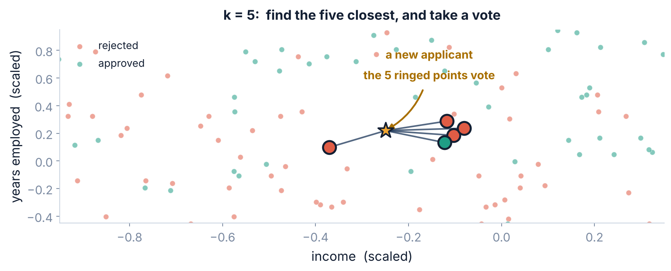
1 / 3 Ask the neighbours
THE PICTURE
One new applicant, five neighbours, one vote
Three of the five nearest were rejected, so the model rejects. Change k to 3 and you may get a different answer from the same data.
Srinivasa Sai Chava · Boston University

Slide 6
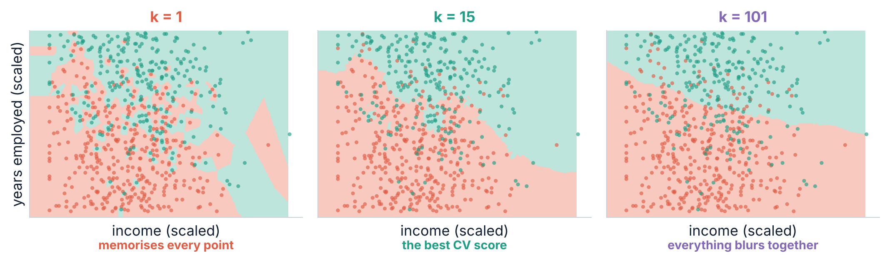
1 / 3 Ask the neighbours
THREE MODELS, SAME DATA
What k actually controls
k = 1 draws an island round every single point — that is memorising, and Day 36 told you what it costs. k = 101 asks so many neighbours that the local detail disappears.
Srinivasa Sai Chava · Boston University

Slide 7
SECTION 2 OF 3
Distance decides
everything
income in rupees, service in years
4,496 : 1
The one line of code that makes or breaks this model
the answer flips
Srinivasa Sai Chava · Boston University

Slide 8
2 / 3 Distance decides everything
AND THAT IS THE PROBLEM
Distance is just Pythagoras
distance = sqrt( (income_A - income_B)^2
+ (years_A - years_B)^2 )
26,041
So the distance is
the income gap
the spread of income
Because income is measured in numbers about four and a half thousand times larger, it swamps the other column completely.
The years column is still in the data. The model simply cannot hear it.
5.79
Two applicants
A: income 44,000 · 18 years
B: income 44,200 · 0 years
distance = sqrt(200² + 18²) = 200.8
Eighteen years of service moved it by 0.8.
the spread of years
4,496 : 1
the ratio between them
No other model in this course cares about units. Linear and logistic regression just learn a smaller coefficient. KNN has no coefficient to adjust.
Srinivasa Sai Chava · Boston University

Slide 9
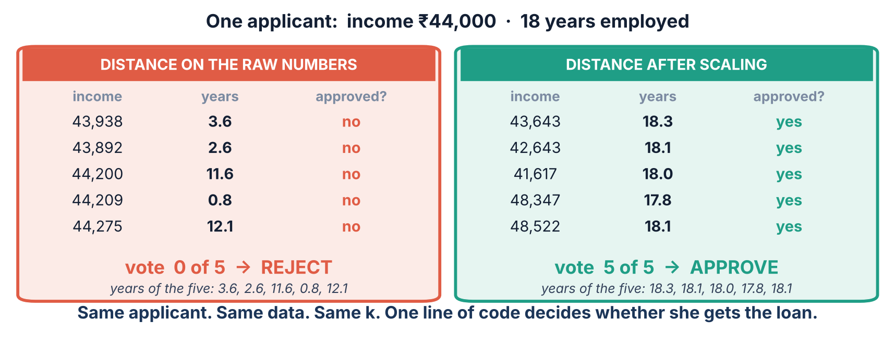
2 / 3 Distance decides everything
0 OF 5 AGAINST 5 OF 5
The same applicant, with and without one line
Unscaled, it found five people on the same salary and wildly different careers. Scaled, it found five on the same salary AND the same length of service.
Srinivasa Sai Chava · Boston University

Slide 10
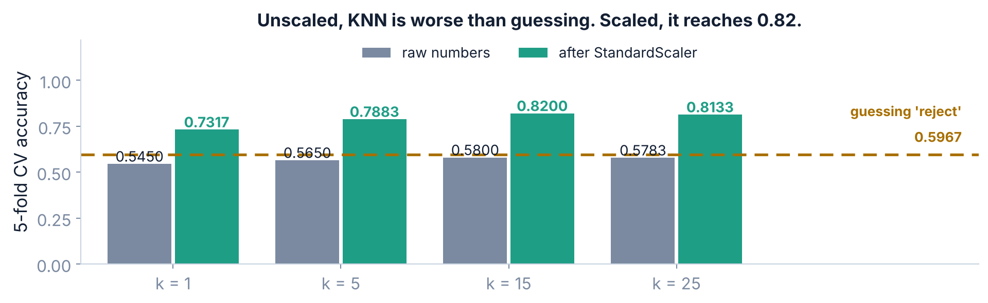
2 / 3 Distance decides everything
600 LOAN APPLICATIONS
What that costs, measured
Unscaled, KNN scores below 'reject everybody' at every k we tried. One line of code is worth 24 points of accuracy.
Srinivasa Sai Chava · Boston University

Slide 11
2 / 3 Distance decides everything
THE FIX
So it always goes in a Pipeline
from sklearn.pipeline import Pipeline
from sklearn.preprocessing import StandardScaler
knn = Pipeline([("scale", StandardScaler()),
("model", KNeighborsClassifier(n_neighbors=15))])
cross_val_score(knn, X, y, cv=cv).mean() # 0.8200
Why a Pipeline and not just scaling first
WHICH SCALER?
Day 36. The scaler is refitted inside every fold, so no fold ever sees the rows it is about to be scored on.
StandardScaler is the usual choice. Use MinMaxScaler if your columns have hard limits, and RobustScaler if a few extreme values would otherwise stretch everything.
If you remember one thing from today: KNN without a scaler is not a model, it is the column with the biggest numbers.
Srinivasa Sai Chava · Boston University

Slide 12
SECTION 3 OF 3
Choosing k
cross-validate it
it never forgets
And the two things KNN is quietly bad at
and it hates wide data
Srinivasa Sai Chava · Boston University

Slide 13
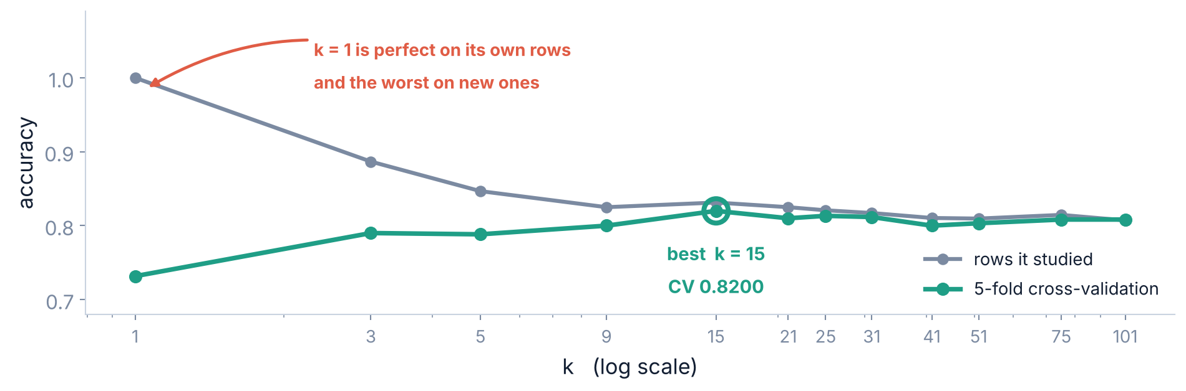
3 / 3 Choosing k
THE WHOLE CURVE
Cross-validate k. Do not guess it.
At k = 1 the model is perfect on its own rows and the worst of all on new ones — the clearest picture of overfitting you will see this term.
Srinivasa Sai Chava · Boston University

Slide 14
3 / 3 Choosing k
SMALL K, LARGE K
How to read that curve
SMALL k
LARGE k
IN BETWEEN
follows every point, including the noise
high variance — move one row and the boundary changes
k = 1 scored 1.0000 on its own rows and 0.7317 on new ones
averages over neighbours that are not really similar
high bias — the boundary goes smooth and stops fitting anything
k = 101 scored 0.8083, below the best
k = 15 won here, at 0.8200
Rules of thumb exist (√n is a common one, ≈ 24 here) but they are only a starting point
Use cross-validation
Two practical notes: use an odd k for two classes so a vote cannot tie · weights="distance" lets closer neighbours count for more
This is the bias-variance trade-off with a dial on it. Every model has one; KNN is the one where you can see it directly.
Srinivasa Sai Chava · Boston University

Slide 15
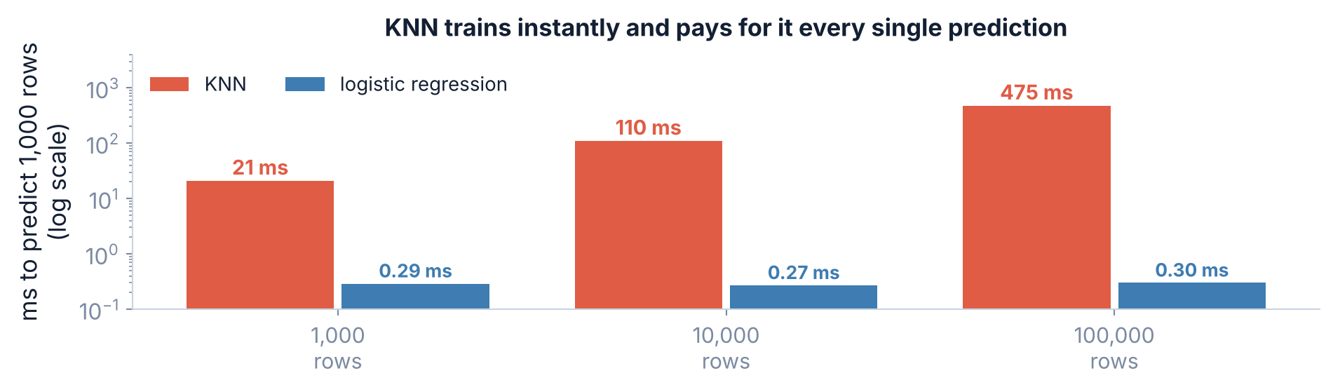
3 / 3 Choosing k
THE FIRST WEAKNESS
The bill arrives at prediction time
Training is free because nothing happens. Then every prediction searches the whole dataset — and for 100,000 stored rows that is 1,600 times slower than logistic regression.
Srinivasa Sai Chava · Boston University

Slide 16
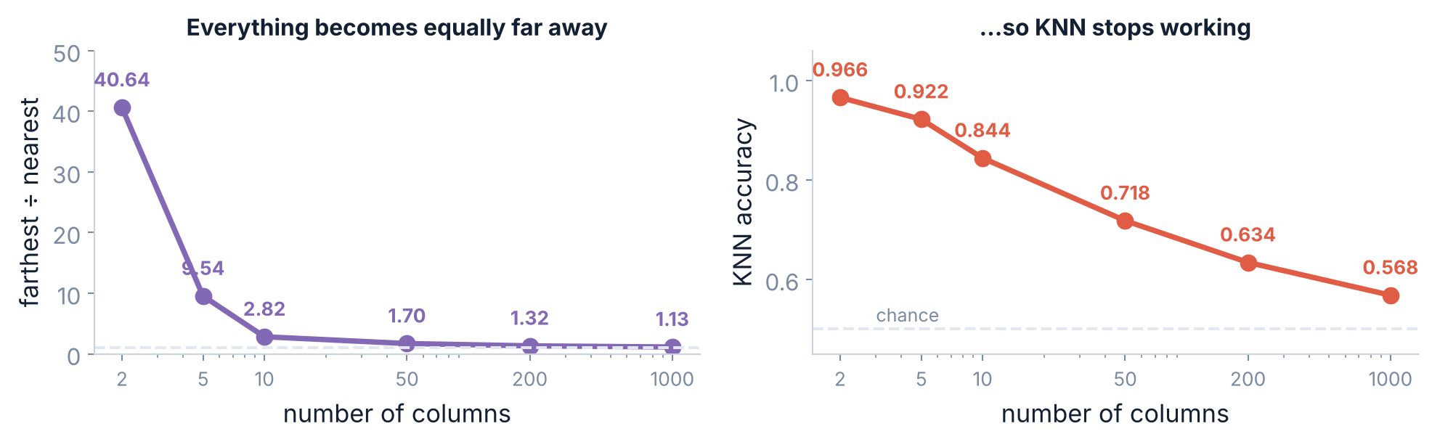
3 / 3 Choosing k
THE SECOND WEAKNESS
And it falls apart on wide data
Both panels use data where only the first two columns carry any signal. The rest is noise — and noise still counts towards the distance.
This is the curse of dimensionality. Add enough columns and every point is about as far away as every other, so 'nearest' stops meaning anything.
Srinivasa Sai Chava · Boston University

Slide 17
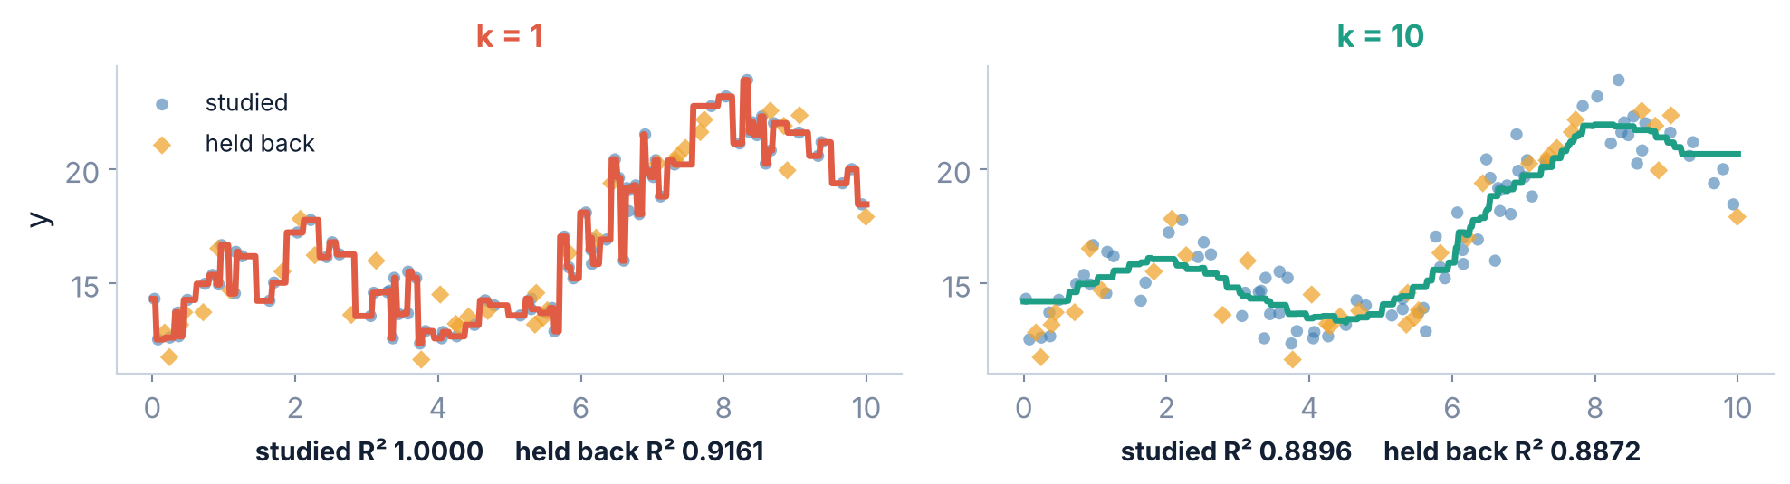
3 / 3 Choosing k
SWAP THE VOTE FOR AN AVERAGE
It does regression too
KNeighborsRegressor averages the k neighbours instead of voting. The steps in the k = 1 line are the model copying single points — no equation, so no smooth curve.
Srinivasa Sai Chava · Boston University

Slide 18
3 / 3 Choosing k
AND WHEN NOT TO
When to reach for it
GOOD FIT
BAD FIT
few columns, plenty of rows
the boundary is irregular and no equation would describe it
you want a baseline in two lines of code
recommendation-style problems: 'who is most like this customer?'
many columns — text, images, anything wide
very large datasets, or predictions needed in milliseconds
you need to explain WHY, to a regulator or a customer
missing values, which have no distance
On our loan data KNN scored 0.8200 against logistic regression's 0.8083 — a real win, on two columns. Add forty more columns and that result would reverse.
Srinivasa Sai Chava · Boston University

Slide 19
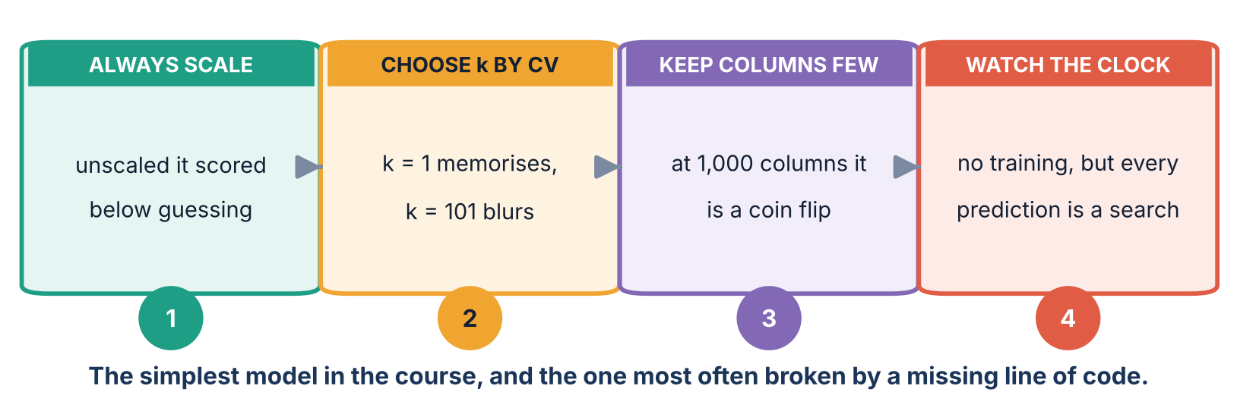
3 / 3 Choosing k
ALL OF TODAY ON ONE PAGE
The four habits
Nothing here is about making KNN cleverer. Three of the four are about the fact that it measures distance, and distance is easy to break.
Srinivasa Sai Chava · Boston University

Slide 20
3 / 3 Choosing k
WHAT TO DO
Tonight's practice
A
Work it out
Distances and votes by hand, and what scaling does to them
6 questions
B
Find the mistake
Three programs that forget what KNN needs
3 questions
C
Write the code
Scale it, cross-validate k, and compare against logistic regression
4 tasks
D
Challenge
Write KNN from scratch and match scikit-learn exactly
1 task
Part D is short: KNN is the one model you can write correctly in about fifteen lines, and doing so makes the scaling problem impossible to forget.
Srinivasa Sai Chava · Boston University

Slide 21
WHAT TO REMEMBER
Four numbers from today
0 of 5 → 5 of 5
the same applicant, rejected on raw numbers and approved after scaling
0.5800 → 0.8200
KNN at k = 15 before and after one line of StandardScaler; 'reject everybody' scores 0.5967
1.0000 / 0.7317
k = 1 on the rows it studied, and on rows it had never seen
40.64 → 1.13
farthest ÷ nearest as the columns go from 2 to 1,000 — and accuracy falls to 0.5680
Next: decision trees — a model that explains itself.
Srinivasa Sai Chava · Boston University

