Slide 1

MODULE 3 · MACHINE LEARNING · DAY 33
Drawing the
Best Line
Your first machine learning model — simple linear regression.
Boston University
5
17
2
sections
worked pictures
numbers to find
Prepared & presented by Srinivasa Sai Chava
Notes:
Day 31: what a model is. Day 32: getting the columns into shape. Today we actually BUILD one, and it is the simplest model there is - a straight line. Everything after this is a variation on today.

Slide 2
WHERE WE ARE
Today you build a model, not just talk about one
1
Day 31
2
Day 32
3
TODAY
What a model IS. Features, labels, and why we hide rows.
Getting the columns into a shape the model can read.
Build the simplest model that exists, from scratch, by hand.
Everything you need, you already have
No new maths. If you can read the equation of a straight line from school, you can follow every slide today. We will do the whole thing on FIVE students first, with numbers small enough to check in your head — and only then switch on the computer.
A straight line is a toy model. But every idea in it — error, best fit, R², overfitting — comes back unchanged in every model for the rest of the course.
Srinivasa Sai Chava · Boston University
Notes:
Reassure them. The maths today is school maths. The ideas are the real content.

Slide 3
SECTION 1 OF 5
What a line is for
A new student, no data
What a line really is
Five students, one question, and the rule that answers it.
Slope and intercept
Which line is best?
Srinivasa Sai Chava · Boston University

Slide 4
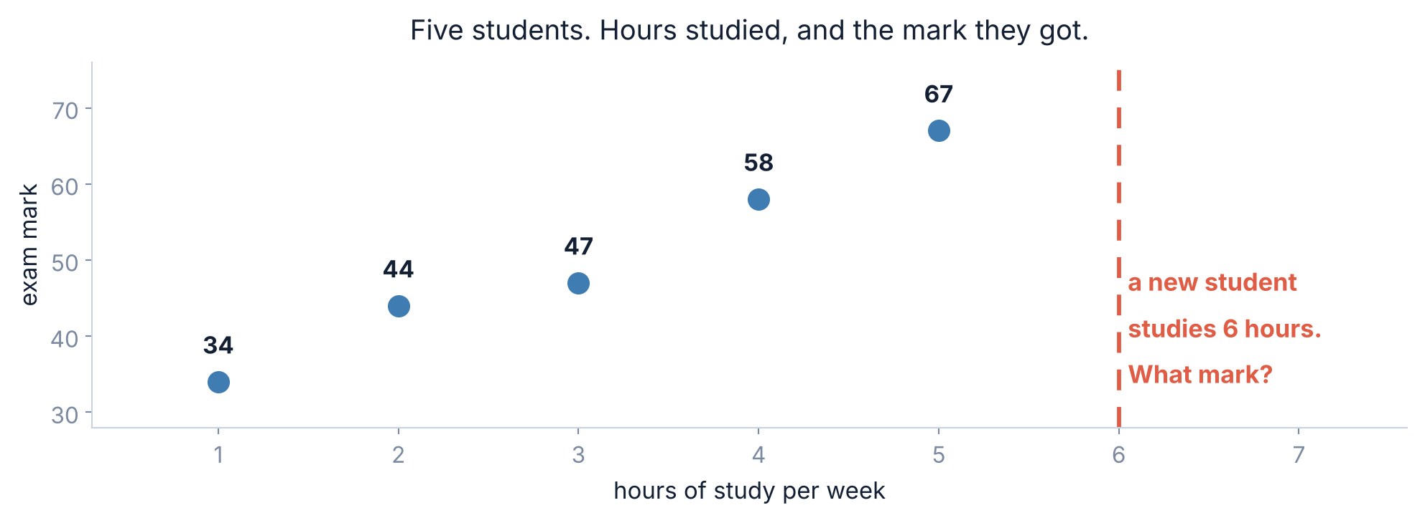
1 / 5 What a line is for
THE PROBLEM
Five students. One question.
EXAMPLE
You tracked five classmates: how many hours a week they studied, and what they scored.
You cannot look this student up in the table — she is not in it. You need a RULE that turns any number of hours into a mark.
Srinivasa Sai Chava · Boston University
Notes:
Pause here. Ask the class what they would guess for 6 hours. Most will say 'about 72'. That instinct IS the model - we are about to make it precise.

Slide 5
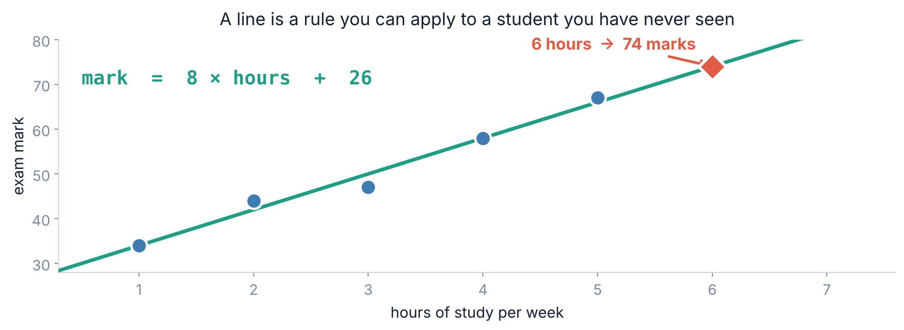
1 / 5 What a line is for
THE IDEA
A line is a rule you can carry around
Give the rule any number of hours and it gives you back a mark. It works for students who were never in your table. That is the whole point of a model.
Srinivasa Sai Chava · Boston University
Notes:
The diamond is the prediction. Stress: the line does not store the five students. It stores TWO NUMBERS, and those two numbers answer every question.

Slide 6
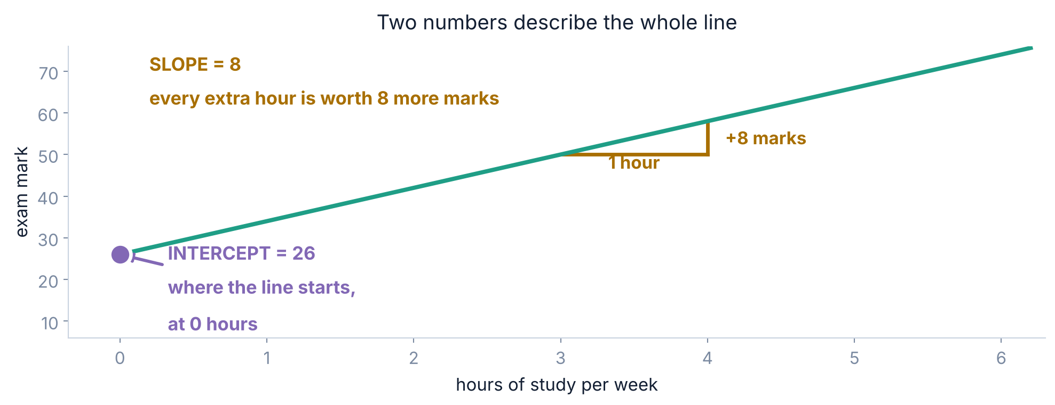
1 / 5 What a line is for
SLOPE AND INTERCEPT
The whole model is two numbers
SLOPE = 8
INTERCEPT = 26
how much the mark goes up for one extra hour
the mark the line predicts at zero hours
Srinivasa Sai Chava · Boston University
Notes:
Write mark = 8 x hours + 26 on the board. Ask: what does the 8 mean in PLAIN ENGLISH? Keep asking until someone says 'an extra hour is worth 8 marks'.

Slide 7
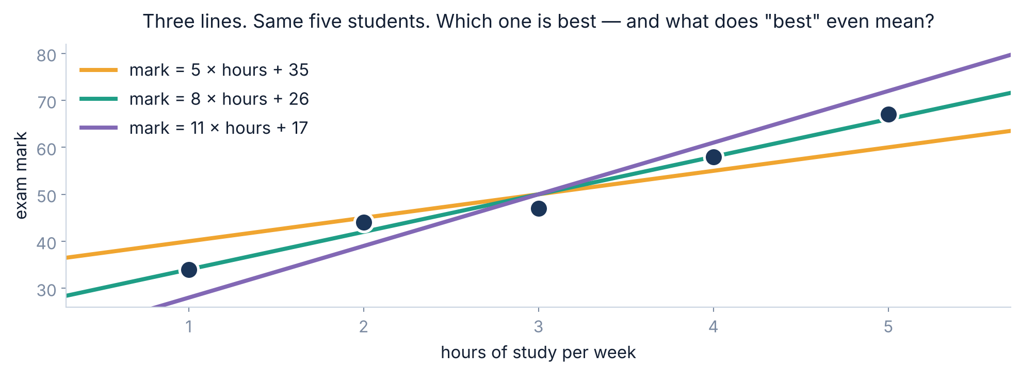
1 / 5 What a line is for
THE REAL QUESTION
But I could draw a hundred lines. Which one?
All three go through the middle of the dots. Before we can pick one, we need to agree on what "best" MEANS — as a number we can compute.
Srinivasa Sai Chava · Boston University
Notes:
Do not rush past this. The honest situation is that 'best' is undefined until we define it. The next section defines it.

Slide 8
SECTION 2 OF 5
How wrong is a line?
The error on one student
Why adding fails
Turn "best" from an opinion into a number.
Squaring
Least squares
Srinivasa Sai Chava · Boston University

Slide 9
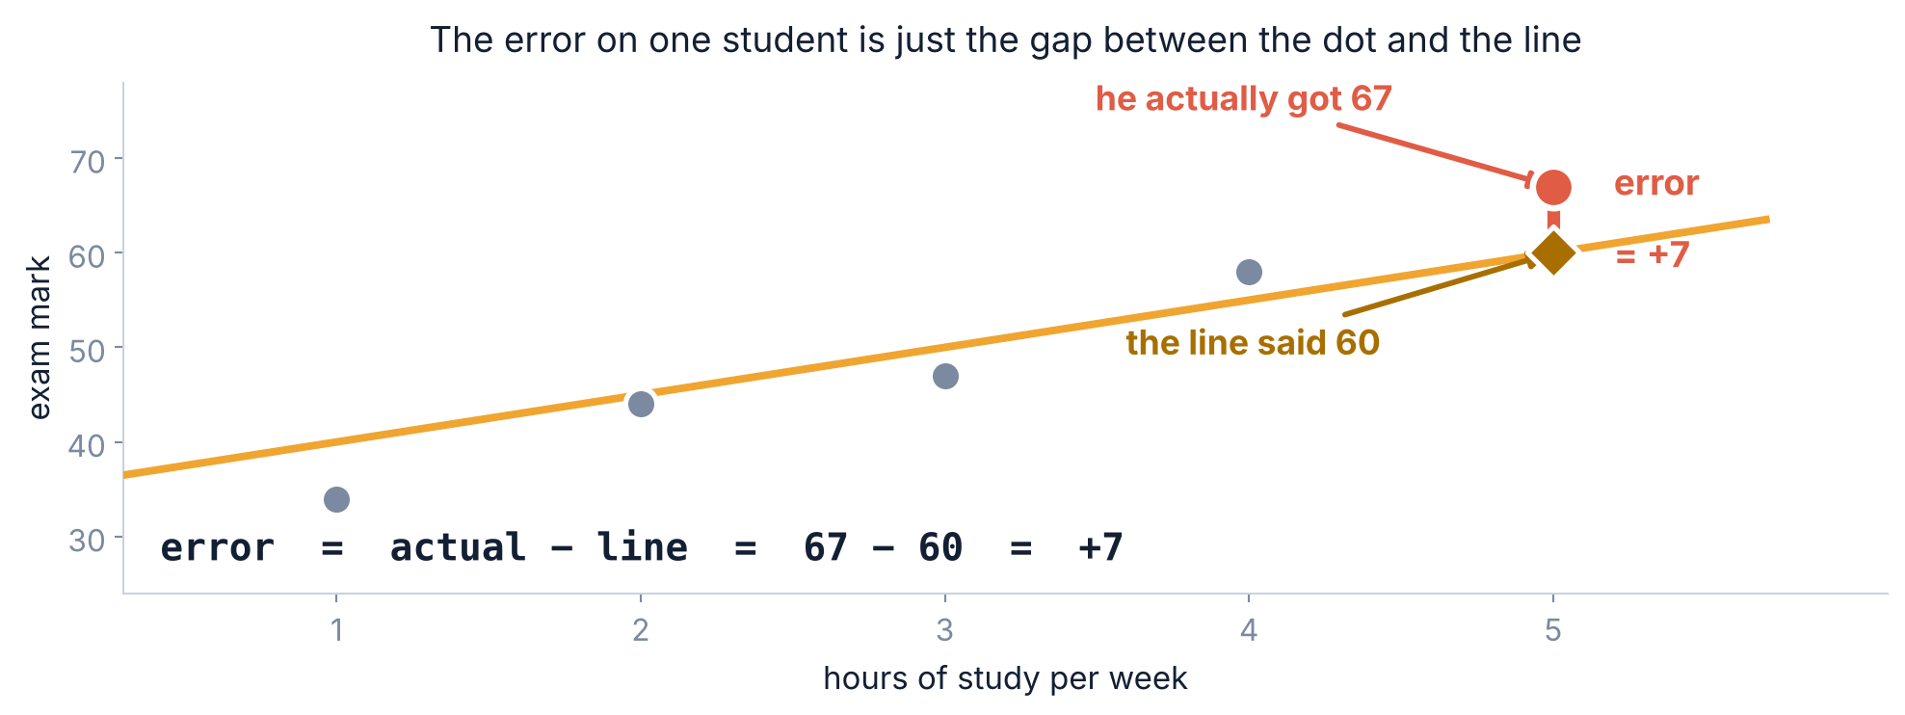
2 / 5 How wrong is a line?
MEASURING THE DAMAGE
Start with one student
One number per student: how far the dot sits from the line. Positive means the line guessed too low. That is all an error is.
Srinivasa Sai Chava · Boston University
Notes:
Always actual MINUS line, in that order, so that a positive error means we under-predicted. Be consistent or the signs will confuse them later.

Slide 10
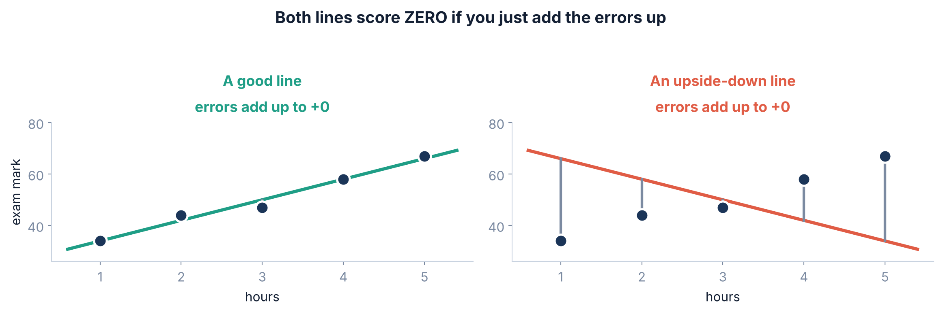
2 / 5 How wrong is a line?
THE FIRST IDEA, AND WHY IT FAILS
Adding the errors up does not work
The best line and the exactly-upside-down line BOTH score zero. The pluses and the minuses cancel, and the score tells you nothing at all.
Srinivasa Sai Chava · Boston University
Notes:
This is the slide to slow down on. Ask them WHY the second line scores zero before you explain. Someone will spot the cancellation.

Slide 11
2 / 5 How wrong is a line?
THE FIX
So square every error before adding
hours | actual mark | the line says | error | error squared
1 | 34 | 34 | 0 | 0
2 | 44 | 42 | +2 | 4
3 | 47 | 50 | −3 | 9
4 | 58 | 58 | 0 | 0
5 | 67 | 66 | +1 | 1
 |  | total | 0 | 14
Squaring throws away the sign. A miss of −3 and a miss of +3 both cost 9.
Total squared error = 14. Now "best" has a definition: the best line is the one with the SMALLEST total squared error. That name is literally "least squares".
Srinivasa Sai Chava · Boston University
Notes:
Point at the 0 in the error column and the 14 next to it. One column is useless, the other is a real score.

Slide 12
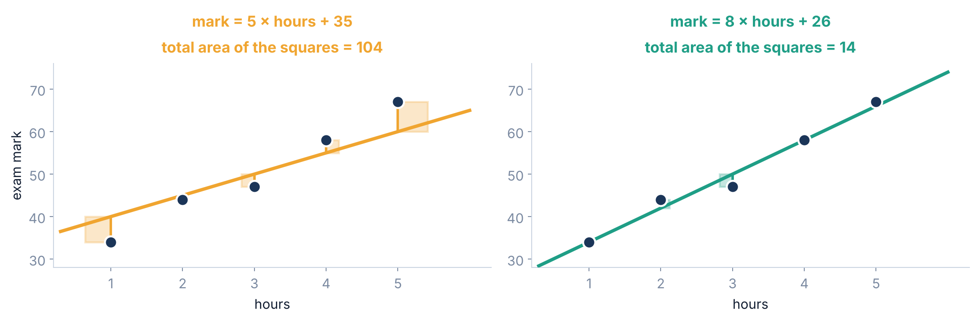
2 / 5 How wrong is a line?
THE PICTURE BEHIND THE NAME
Why it is called least squares
Each error becomes an actual square on the chart. Fitting a line means shrinking the total shaded area — from 104 down to 14.
Srinivasa Sai Chava · Boston University
Notes:
The squares are drawn to scale. Let them see that a long error makes a BIG square, not a slightly bigger one.

Slide 13
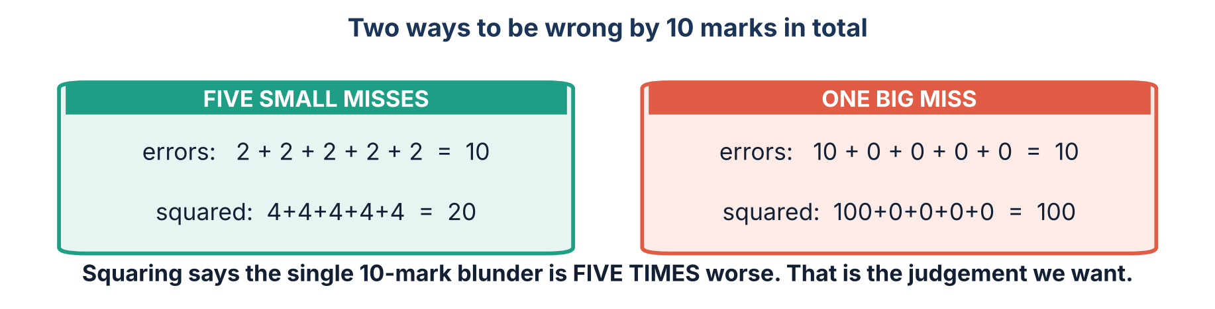
2 / 5 How wrong is a line?
A FAIR QUESTION
Why squaring, and not just ignoring the minus sign?
Both options remove the sign. Squaring goes further: it says a few small misses are forgivable, but one enormous miss is not. For predicting a mark, a model that is usually within 2 and occasionally out by 30 is worse than one that is always out by 5 — and squaring is what encodes that preference.
Srinivasa Sai Chava · Boston University
Notes:
There IS a method that just ignores the sign - it is called MAE, and we use it later for REPORTING. For FITTING, squares win because they are smooth and easy to minimise.

Slide 14
SECTION 3 OF 5
Finding the best one
The bowl
The formula, by hand
Two different routes. Exactly the same answer.
Gradient descent
Why both matter
Srinivasa Sai Chava · Boston University

Slide 15
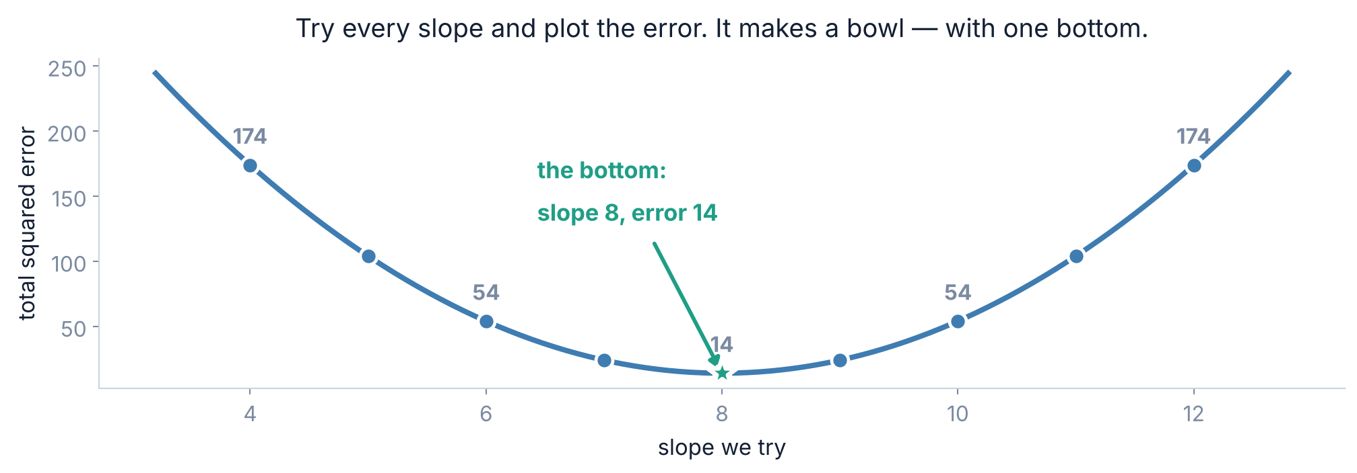
3 / 5 Finding the best one
WHAT WE ARE LOOKING FOR
Try every slope and the errors make a bowl
There is exactly one bottom, and no other dips to get stuck in. For a straight line this is always true — which is why the problem is solvable at all.
Srinivasa Sai Chava · Boston University
Notes:
Stress 'exactly one bottom'. In Day 38 onwards with bigger models this stops being true, and that is when things get hard.

Slide 16
3 / 5 Finding the best one
THE EXACT ANSWER
Route 1 · There is a formula
slope = sum of (hours − average hours) × (mark − average mark)
÷ sum of (hours − average hours)²
In words:
For every student, work out how far they sit from the average hours, and from the average mark.
Multiply those two gaps together. A student above average in both pushes the slope UP.
Add it all up, then divide by how spread out the hours were.
You will never type this formula in real life — one line of scikit-learn does it. Work through it once so that the answer is never magic.
Srinivasa Sai Chava · Boston University
Notes:
Do not derive it. Just make it readable. The point of the next slide is to make it CONCRETE.

Slide 17
3 / 5 Finding the best one
BY HAND
The same formula, worked on our five students
hours | mark | hours − 3 | mark − 50 | multiply | (hours − 3)²
1 | 34 | −2 | −16 | 32 | 4
2 | 44 | −1 | −6 | 6 | 1
3 | 47 | 0 | −3 | 0 | 0
4 | 58 | +1 | +8 | 8 | 1
5 | 67 | +2 | +17 | 34 | 4
 |  |  | total | 80 | 10
80 ÷ 10 = 8
→
50 − 8 × 3 = 26
the slope
the intercept
mark = 8 × hours + 26. The average student does 3 hours and gets 50, so the line is forced through that point — the intercept just follows.
Srinivasa Sai Chava · Boston University
Notes:
Average hours is 3, average mark is 50. Have them check one row with you, then let them do the rest.

Slide 18
3 / 5 Finding the best one
GRADIENT DESCENT
Route 2 · Guess, then walk downhill
THE IDEA, IN FOUR LINES
WHY BOTHER, IF A FORMULA EXISTS?
Start with any slope and intercept at all. Zero and zero will do.
Work out the total squared error.
Nudge both numbers in whatever direction makes that error smaller.
Repeat a few hundred times, and stop when it stops improving.
Because the formula only exists for simple cases like a straight line. A neural network has millions of numbers to choose and no formula at all that could ever give them to you.
Walking downhill still works there. It is how essentially every modern model is trained — including the ones behind the chatbots you use.
Route 1 is a shortcut that happens to exist for straight lines. Route 2 is the method that scales to everything else — which is why it is worth meeting on a problem small enough to check by hand.
Srinivasa Sai Chava · Boston University
Notes:
This is the single most transferable idea of the day. They will meet gradient descent again in every deep learning course they ever take.

Slide 19
3 / 5 Finding the best one
NO CODE YET
One step of gradient descent, done by hand
Start from the worst possible guess: slope 0, intercept 0 — a flat line along the bottom.
step | what you compute | on our numbers | result
1 | every error (line − actual) | −34, −44, −47, −58, −67 | all badly too low
2 | slope nudge = ⅖ × Σ(error × hours) | ⅖ × (−830) | −332
3 | intercept nudge = ⅖ × Σ(error) | ⅖ × (−250) | −100
4 | step a little way against each nudge | 0 − 0.03 × (−332) | slope → 9.96
5 | and the same for the intercept | 0 − 0.03 × (−100) | intercept → 3.00
That 0.03 is the LEARNING RATE — how big a step to take. Too small and it crawls; too big and it flies past the bottom.
One step took us from slope 0 to slope 9.96. The error fell from 13,154 to 1,518. Nothing clever happened — we just moved in the direction that helped.
Srinivasa Sai Chava · Boston University
Notes:
The nudge is a derivative, but you do not need to say so. 'The direction that makes the error smaller' is the honest description.

Slide 20
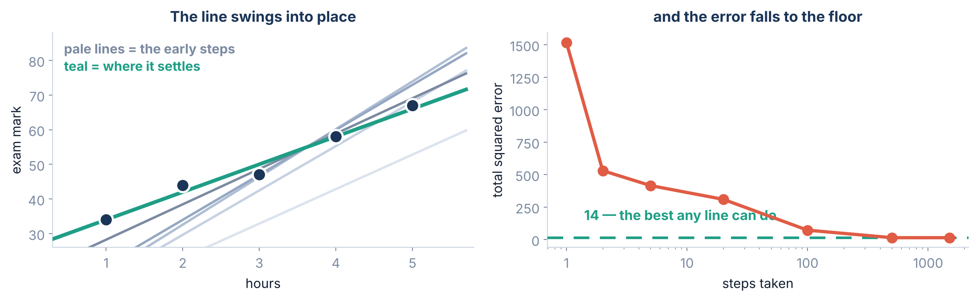
3 / 5 Finding the best one
GRADIENT DESCENT, RUNNING
Repeat it, and watch the line settle
after | 1 step | 2 | 5 | 20 | 100 | 500 | 1500
slope | 9.96 | 12.81 | 13.79 | 12.99 | 10.21 | 8.04 | 8.00
intercept | 3.00 | 4.03 | 5.00 | 7.98 | 18.03 | 25.86 | 26.00
total squared error | 1518 | 530 | 415 | 309 | 72 | 14.0 | 14.0
Srinivasa Sai Chava · Boston University
Notes:
Point at the slope row: it overshoots to 13.8 before coming back. Tell them to watch the ERROR, not the slope - the error only ever goes down.

Slide 21
3 / 5 Finding the best one
Two routes.
The same two numbers.
The formula gets there in one calculation. Gradient descent takes about 800 steps. Both land on slope 8 and intercept 26 — because there is only one bottom to the bowl.
Srinivasa Sai Chava · Boston University
Notes:
Breathe here. This is the end of the hard part.

Slide 22
SECTION 4 OF 5
Reading the model
What the slope means
The intercept trap
A line you cannot explain is not worth having.
R², honestly
Looking at the errors
Srinivasa Sai Chava · Boston University

Slide 23
4 / 5 Reading the model
READING THE MODEL
Say the slope out loud, in English
mark = 8 × hours + 26
THE SLOPE, 8
THE INTERCEPT, 26
“One extra hour of study a week is worth about 8 more marks.”
This is the sentence you would actually say to a student. It is the whole reason anyone fits a line instead of a black box.
“A student who studies zero hours would score 26.”
True of the LINE. But nobody in our five studied zero hours — the lowest was 1. So this number is an extrapolation, and you should not quote it.
If you cannot finish the sentence “one more unit of X is worth ___ of Y”, you have not understood your own model yet.
Srinivasa Sai Chava · Boston University
Notes:
Make them say it out loud. Seriously. 'One extra hour is worth eight marks.'

Slide 24
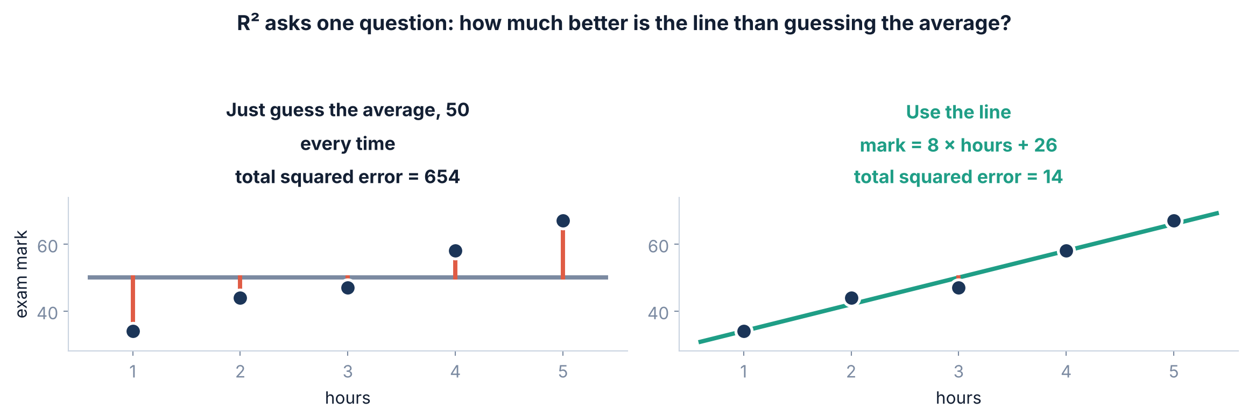
4 / 5 Reading the model
SCORING THE MODEL
R² · compared with just guessing the average
R² = 1 − ( 14 ÷ 654 ) = 0.979 the line removed 97.9% of the error that guessing the average would have left
Srinivasa Sai Chava · Boston University
Notes:
R2 = 1 means perfect. R2 = 0 means no better than the average. R2 BELOW zero means worse than the average, which does happen on hidden rows.

Slide 25
4 / 5 Reading the model
AND WHAT IT IS NOT
What R² is actually telling you
R² | what it means | should you be happy?
1.00 | every point sits exactly on the line | No — check for a mistake
0.98 | our five students | Yes, but five points is not evidence
0.60 | a real, noisy relationship | Often very useful
0.00 | no better than always guessing the average | The line found nothing
below 0 | worse than guessing the average | Something is wrong
A high R² does NOT mean the line is the right shape, that hours CAUSE marks, or that the model will work on new students. It only compares the line with the flat average.
A good R² is a reason to look closer, never a reason to stop looking. The next slide shows an R² of 0.75 hiding a line that is simply the wrong shape.
Srinivasa Sai Chava · Boston University
Notes:
The 1.00 row matters. On Day 31 a perfect training score meant memorising. Here it usually means the answer leaked into the inputs.

Slide 26
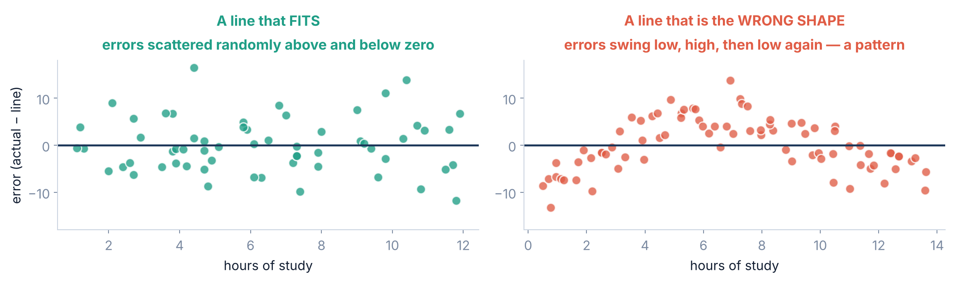
4 / 5 Reading the model
THE RESIDUAL PLOT
Always look at the errors, not just the score
Plot the errors against the input. If they scatter randomly around zero, the line fits. If they make a PATTERN, the line is the wrong shape — whatever R² says.
Srinivasa Sai Chava · Boston University
Notes:
This is the single most useful diagnostic in regression and it takes one line of code. Make them promise to draw it every time.

Slide 27
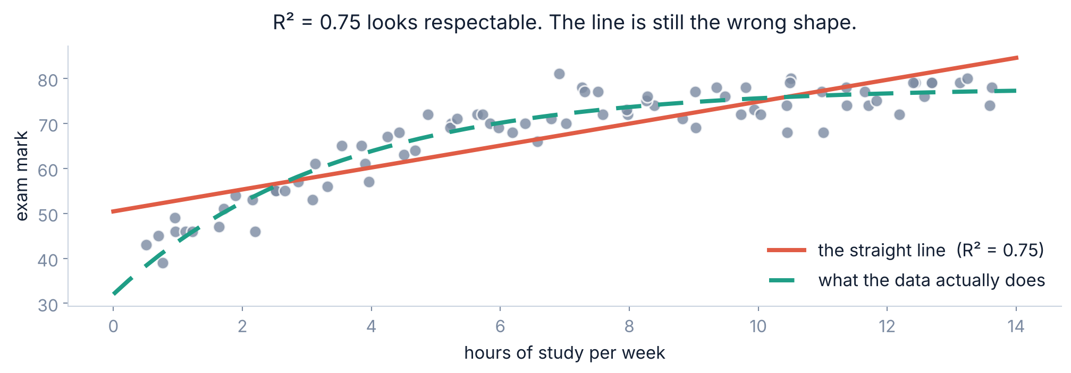
4 / 5 Reading the model
WHAT THE PATTERN MEANT
An R² of 0.75, and the line is still wrong
Studying helps a lot at first and then levels off. A straight line cannot level off, so it under-predicts at both ends and over-predicts in the middle — exactly the pattern in the errors.
Srinivasa Sai Chava · Boston University
Notes:
The fix is not a better line. The fix is a curve, or a different feature. We meet both later in the module.

Slide 28
SECTION 5 OF 5
Doing it for real
scikit-learn
Split first
Sixty students, three lines of code, and one trap.
Reading the output
Never extrapolate
Srinivasa Sai Chava · Boston University

Slide 29
5 / 5 Doing it for real
SCIKIT-LEARN
The entire thing, in three lines
from sklearn.linear_model import LinearRegression
model = LinearRegression().fit(hours, marks)
print(model.coef_[0], model.intercept_) # 8.0 26.0
.fit(X, y)
.coef_
.intercept_
.predict(X)
does all of it — the formula from slide 14, in one call
the slope. One per input column, so it is always a list
the intercept. A single number
run the rule on new students
It returns 8.0 and 26.0 — the same two numbers you worked out by hand. The computer is not doing anything you have not already done on paper.
Srinivasa Sai Chava · Boston University
Notes:
Show this running live if you can. The thrill is seeing the hand answer come back out of the machine.

Slide 30
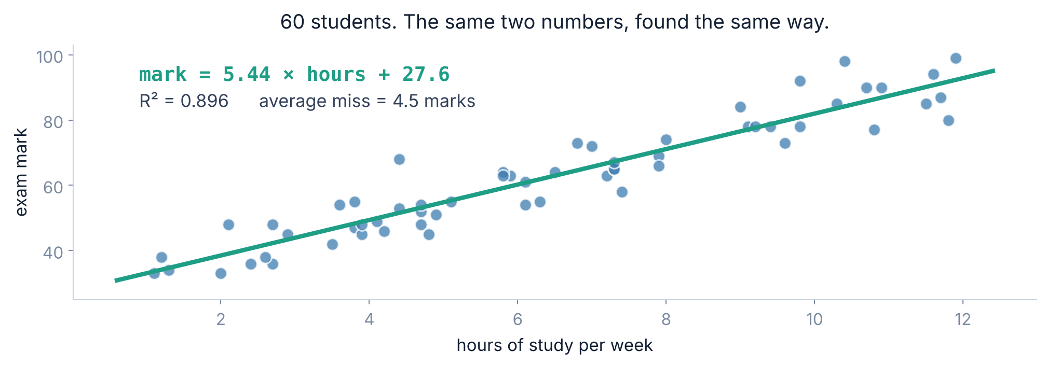
5 / 5 Doing it for real
A REAL-SIZED DATASET
Now sixty students instead of five
5.44
0.896
4.5
60
marks per extra hour
R² on the rows it studied
average miss, in marks
students
Srinivasa Sai Chava · Boston University
Notes:
The slope dropped from 8 to 5.44. Five students was never enough to pin it down - that is the real lesson of this slide.

Slide 31
5 / 5 Doing it for real
THE RULE FROM DAY 31, AGAIN
Hide some students before you fit
EXAMPLE
Fit on 70% of the students. Score on the 30% the model has never seen.
a, b, c, d = train_test_split(X, y, test_size=0.3, random_state=0)
model = LinearRegression().fit(a, c)
print(model.score(a, c), model.score(b, d)) # 0.900 0.883
0.900
0.883
0.017
on the rows it studied
on rows it had never seen
the gap between them
A gap of 0.017 is nothing. A straight line has only two numbers to adjust, so it is almost impossible for it to memorise — the opposite of the tree on Day 31 that scored a perfect 1.000 and then collapsed.
Srinivasa Sai Chava · Boston University
Notes:
Tie it back explicitly to Day 31. Simple models underfit; they rarely overfit. That trade-off is the whole of Day 36.

Slide 32
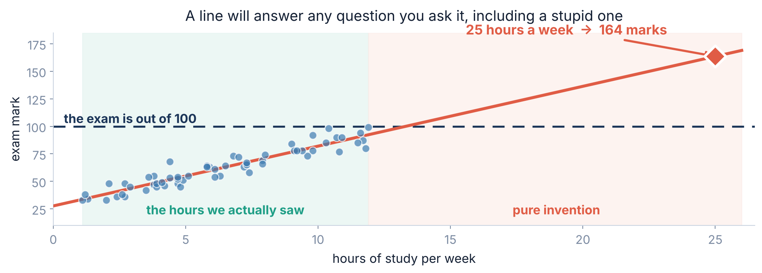
5 / 5 Doing it for real
THE TRAP
A line will answer a stupid question without blinking
Nobody in the data studied more than 11.9 hours. Ask about 25 and the line says 164 marks on a paper out of 100. The line has no idea the exam has a ceiling — or that a week has 168 hours.
Srinivasa Sai Chava · Boston University
Notes:
Rule for life: a model is only trustworthy inside the range of the data it saw. Outside it, you are not predicting, you are extending a pencil mark.

Slide 33
5 / 5 Doing it for real
JUDGEMENT
When is a straight line the right choice?
USE A LINE WHEN
DO NOT USE A LINE WHEN
the scatter plot genuinely looks like a band going up or down
you need to EXPLAIN the result to somebody
you have few rows
you want a baseline to beat
the scatter plot curves or levels off
the spread grows as x grows
there are a few extreme outliers dragging it
the real pattern is a step, not a slope
Always fit the line first anyway. It takes ten seconds and it gives you a number every fancier model has to beat. A gradient-boosted forest that scores 0.62 against a straight line's 0.60 was not worth the afternoon.
Srinivasa Sai Chava · Boston University
Notes:
The baseline habit is worth more to them than any single algorithm.

Slide 34
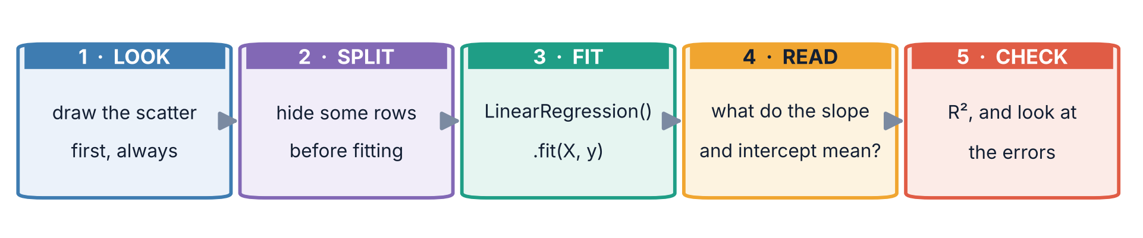
5 / 5 Doing it for real
PUT IT TOGETHER
The five steps, every time
Step 1 is the one people skip. Draw the scatter plot before you fit anything. Ten seconds of looking will tell you whether a straight line is even the right shape — and will save you from reporting an R² of 0.75 on data that curves.
Srinivasa Sai Chava · Boston University
Notes:
Walk the strip left to right. They will use this exact sequence for every model in the rest of the module.

Slide 35
5 / 5 Doing it for real
BEFORE YOU GO
Five mistakes everybody makes once
# | the mistake | what you will see | the fix
1 | Fitting without plotting first | A respectable R² on data that curves | Draw the scatter. Always
2 | Quoting the intercept | “Zero hours gives 26 marks” | Check 0 is inside your data
3 | Predicting outside the data | 164 marks out of 100 | Note your min and max, and stay inside
4 | Trusting R² on its own | A pattern hiding in the errors | Plot the errors against the input
5 | Saying hours CAUSE marks | A confident, unprovable claim | A line measures movement, not cause
Number 5 is the one that gets people into print. Students who study more may also sleep better, attend more, and start earlier — the line cannot separate any of that.
Srinivasa Sai Chava · Boston University
Notes:
Causation deserves its own minute. The line is agnostic about WHY the two move together.

Slide 36
5 / 5 Doing it for real
SUMMARY
What to remember from today
A line is two numbers | slope and intercept. That is the entire model — nothing else is stored.
“Best” had to be defined | Adding errors gives zero for the worst line imaginable. Squaring them first is what makes the score mean something.
Least squares, literally | Every error becomes a square on the chart. The best line is the one with the smallest total area: 14, not 104.
Two routes, one answer | A formula gives slope 8 in one calculation. Gradient descent walks there in 800 steps. Only the second survives into big models.
R² compares with the average | 0.979 means the line removed 97.9% of the error that guessing 50 every time would have left. It does not mean the line is the right shape.
Look at the errors | A pattern in the errors beats any score. And never ask the line about hours it has never seen.
Srinivasa Sai Chava · Boston University
Notes:
Six lines. If they leave with these, the day worked.

Slide 37
5 / 5 Doing it for real
19 QUESTIONS
Tonight's practice
A
Work it out
8 questions
Find the best line by hand, twice, with no computer
B
Find the mistake
4 questions
Four programs: wrong shape, bad extrapolation, leaked split
C
Write the code
5 tasks
Fit, read, score and diagnose a line on real data
D
Challenge
2 tasks
Build least squares from scratch, then catch a line that lies
Part D hands you a model with an R² of 0.93 and asks you to prove that its headline claim is worthless.
Srinivasa Sai Chava · Boston University
Notes:
Part A is deliberately pen-and-paper. The numbers are small enough to do in the margin.

Slide 38
mark = 8 × hours + 26
Two numbers, found by hand, confirmed by the computer. Every model you meet for the rest of this course is a bigger version of exactly this.
NEXT · DAY 34
Multiple linear regression — what happens when you have more than one input column.
Slides & notebooks by Srinivasa Sai Chava · Boston University
Notes:
Tomorrow: two inputs instead of one. The maths barely changes; the picture becomes a plane.

