Slide 1

MODULE 2 · STATISTICS & PROBABILITY · TOPIC 2.7
The Central
Limit Theorem
Day 27 — the result everything else in this module rests on
Boston University
3
1
2
Sessions have been setting this up
Distinction that decides everything
Ways it still fails
Prepared & presented by Srinivasa Sai Chava
Notes:
Day 27. This is the payoff session. Days 24, 25 and 26 each ended with a bell curve nobody explained. Today explains it, and then shows the two situations where the explanation does not hold.

Slide 2
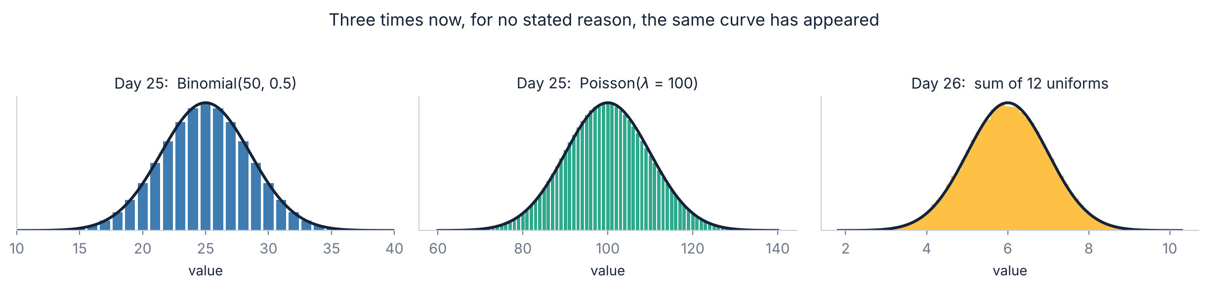
THE SETUP
You have already seen this happen three times
Three unrelated distributions, one curve
A binomial counts successes out of n. A Poisson counts events in an interval. A uniform is a flat line with nothing interesting about it at all. They share no mechanism, no shape and no parameters.
Each one turned into the same bell curve, and each time the session ended by saying “Day 27 explains why”. This is Day 27.
Slides by Srinivasa Sai Chava
Notes:
Spend a moment on how unrelated these three are. The strangeness of the pattern is what makes the explanation worth having.

Slide 3
WARM-UP · 5 MINUTES
Four questions from Day 26
1
Why is P(X = exactly 5) zero?
→ Probability is area, and a point has no width.
2
U(a, b) in scipy — write it.
→ uniform(a, b − a). The second argument is a width.
3
sd of U(0,1)?
→ 1/√12 = 0.2887.
4
Twelve uniforms added together gave…
→ A bell curve. Nobody said why.
Question 4 is today's whole session. And the answer is bigger than it looks: nearly every confidence interval, p-value and A/B test you will ever run is standing on it.
Slides by Srinivasa Sai Chava
Notes:
Raise the stakes here. The CLT is not a curiosity; it is the licence for almost every inferential method they will meet.

Slide 4
SESSION PLAN
How today's two hours are structured
The one distinction
20 min
The theorem
25 min
1
2
Your data is not your sample mean
What it says, and the √n law
How large is large enough?
20 min
When it fails
15 min
3
4
The n = 30 rule is not true
Infinite variance, and dependence
What it buys you
20 min
Practice notebook
30 min
5
6
A worked confidence interval
You code, I walk around
Section 1 is short and it is the one that matters. Almost every mistake people make with this theorem comes from confusing two things that the next slide separates.
Slides by Srinivasa Sai Chava
Notes:
Sections 3 and 4 are the ones that separate this session from a textbook treatment. Most courses state the theorem and stop.

Slide 5
1
The One Distinction
Two different distributions
What the theorem does NOT say
Your data is not your sample mean · 20 minutes
Slides by Srinivasa Sai Chava

Slide 6
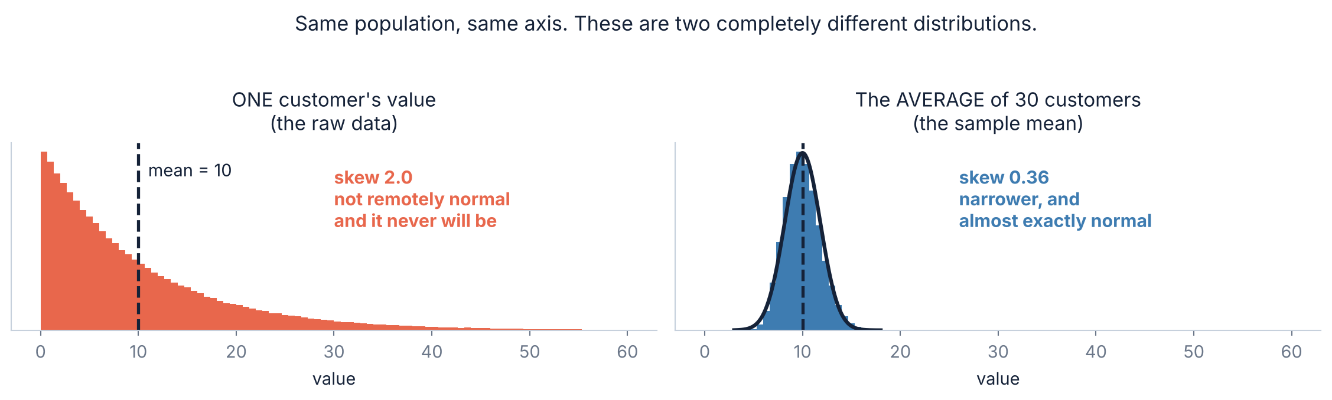
1.1 · THE DISTINCTION
⭐ Two different distributions, and people confuse them
Left: the distribution of the DATA
Right: the distribution of the MEAN
What a single observation looks like. Collect a million of them and this shape does not change.
What you would get if you took the average of 30, over and over. This is what the theorem is about.
Slides by Srinivasa Sai Chava
Notes:
Draw this on the board before showing it. One histogram of raw values, one histogram of averages. Students who hold these apart understand the rest of the module; students who do not will struggle with every confidence interval.

Slide 7
1.2 · THE MISCONCEPTION
⚠ What the theorem does NOT say
✗ The three wrong versions
✓ What it actually says
“Big samples are normally distributed”
Take a sample of n, compute its mean, and write that one number down. Do it again. And again.
The collection of those MEANS is normal — almost regardless of what the data looked like.
The data stays exactly as skewed as it always was. Nothing happens to it at all.
No. A million salaries are just as skewed as a hundred.
“With n > 30 I can assume normality”
Of the MEAN, sometimes. Never of the data.
“Everything in nature is normal”
Income, city size and file size are all famously not.
How to catch yourself making this mistake
If you ever find yourself running a normality test on your raw data and then citing the CLT when it fails — stop. The CLT was never a claim about your raw data. It would not have made that data normal, and it does not need to.
Slides by Srinivasa Sai Chava
Notes:
This exact mistake appears in published papers. Being able to name it is worth more than being able to state the theorem.

Slide 8
2
The Theorem
Watch it happen
The statement
Standard error
The √n law
What it says, and what it costs · 25 minutes
Slides by Srinivasa Sai Chava

Slide 9
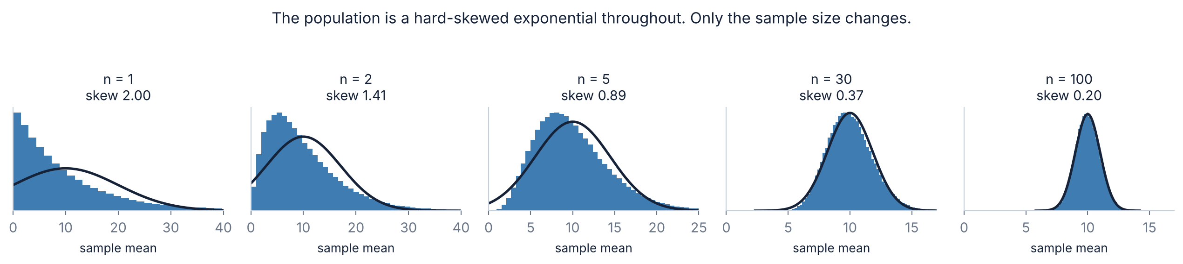
2.1 · THE DEMONSTRATION
Watch it happen, one sample size at a time
Nothing changes except n
Two things are happening at once
Every panel draws from the same hard-skewed exponential. At n = 1 you are just looking at the raw data again. By n = 30 the black normal curve lies on top of the bars.
And notice the width shrinking at the same time.
The shape becomes normal, AND the spread narrows. They are separate claims and the theorem makes both.
The skew number under each panel is not measured — it is predicted exactly, and section 3 gives the formula.
Slides by Srinivasa Sai Chava
Notes:
Ask them to watch two things separately: shape and width. Students usually notice only one.

Slide 10
2.2 · THE STATEMENT
The theorem, in one sentence
Take samples of size n from any population with a finite mean μ and a finite
standard deviation σ. Then the sample means are normal, centred on μ, with
standard deviation σ/√n.
any population
No normality assumed. Skewed, bimodal, discrete — it does not matter.
finite μ and σ
The one real condition. Section 4 shows what happens without it.
centred on μ
The sample mean is unbiased — it is not systematically too high or low.
σ / √n
The spread. This is called the STANDARD ERROR, and it is the price list.
Slides by Srinivasa Sai Chava
Notes:
Read the sentence aloud twice, then take the four phrases one at a time. 'Any population' is the astonishing part and 'finite sigma' is the part that gets forgotten.

Slide 11
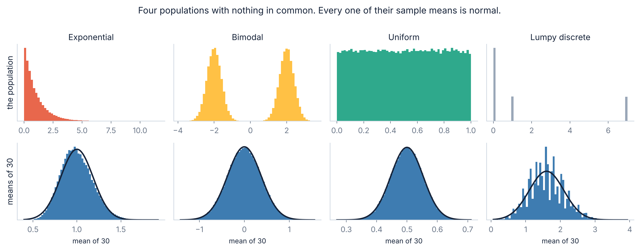
2.3 · FOUR POPULATIONS
“Any population” really does mean any
Look closely at the fourth column. That population takes only three values — 0, 1 and 7 — and its means at n = 30 are visibly ragged and sit slightly off the curve. The theorem is an APPROXIMATION that improves with n, not a switch that flips at some sample size.
Slides by Srinivasa Sai Chava
Notes:
Pointing at the worst panel rather than the best is the honest move, and it sets up section 3 perfectly.

Slide 12
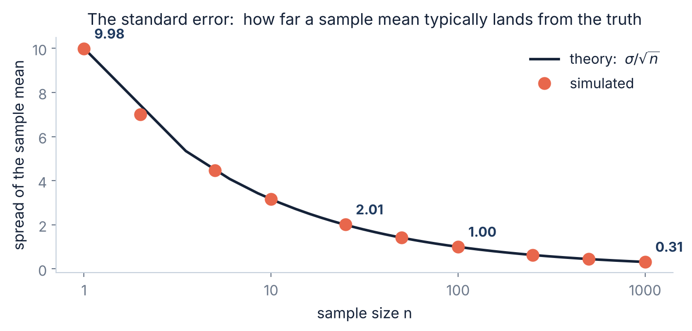
2.4 · σ / √n
The standard error — how wrong your average typically is
Two different numbers
σ is how spread out the DATA is. It does not change when you collect more.
SE = σ/√n is how spread out the MEANS are. It shrinks as you collect more.
Confusing the two is the second most common error in this topic.
In code
sd = data.std(ddof=1)
se = sd / np.sqrt(len(data))
ddof=1, because you are estimating σ from a sample — Day 23.
Slides by Srinivasa Sai Chava
Notes:
The sigma-versus-SE confusion shows up constantly in reported results. Ask: does this number describe the people, or describe how well we measured the average?

Slide 13
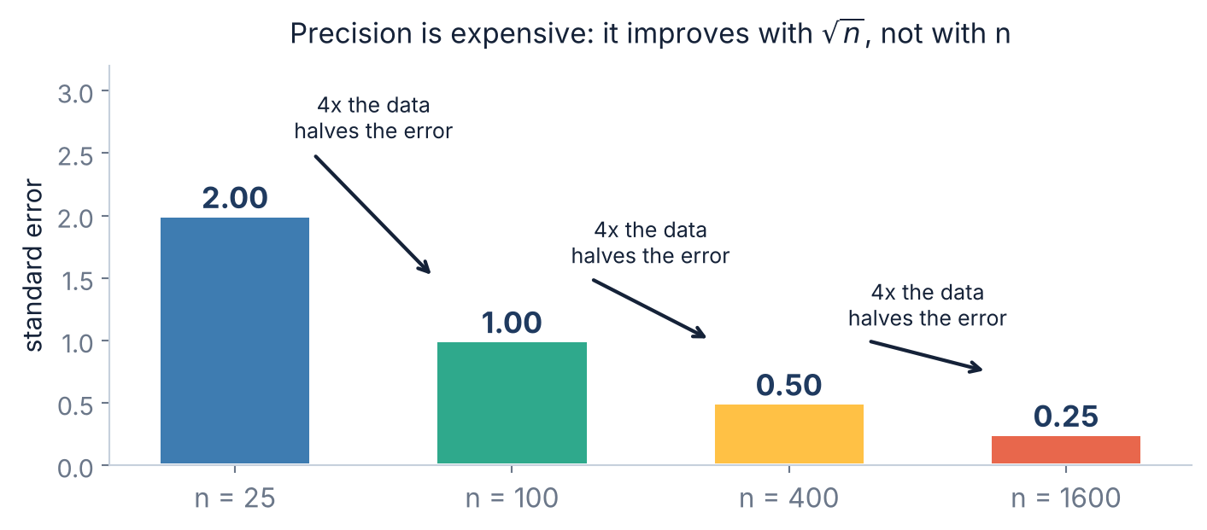
2.5 · THE √n LAW
Precision is expensive, and the price is fixed
Four times the data
buys you only twice the precision. Not four times.
To halve your error bars again you need another 4×, and then another. Going from n = 100 to n = 1600 is sixteen times the cost for four times the precision.
Why this is worth knowing
It is the arithmetic behind every “how many users do we need?” conversation. If someone asks you to halve the width of a confidence interval, the answer is four times the data — and that is a budget, not a detail.
Slides by Srinivasa Sai Chava
Notes:
This is the most immediately useful slide for anyone who will size an experiment. Make them say 'four times the data' out loud.

Slide 14
3
How Large Is Large Enough?
What the rule claims
What actually happens
The number that decides it
The n = 30 rule is not true · 20 minutes
Slides by Srinivasa Sai Chava

Slide 15
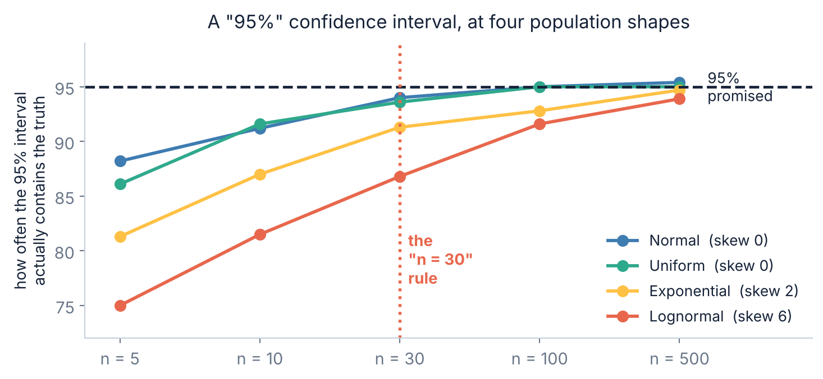
3.1 · THE TEST
⚠ “n = 30 is enough” is simply not true
What is being measured
Take a sample, build a 95% confidence interval, and check whether it actually contains the true mean. Repeat 4,000 times.
If the method works, 95% of them should.
At n = 30
Population | Covers
Normal | 94.0%
Uniform | 93.6%
Exponential | 91.3%
Lognormal | 86.8%
On lognormal data — which is what income, spend, file size and session length all look like — your “95%” interval is really an 87% interval. And even at n = 500 it has only reached 94%.
Slides by Srinivasa Sai Chava
Notes:
The lognormal line is the one to dwell on, because lognormal is the default shape of most business data students will actually meet.

Slide 16
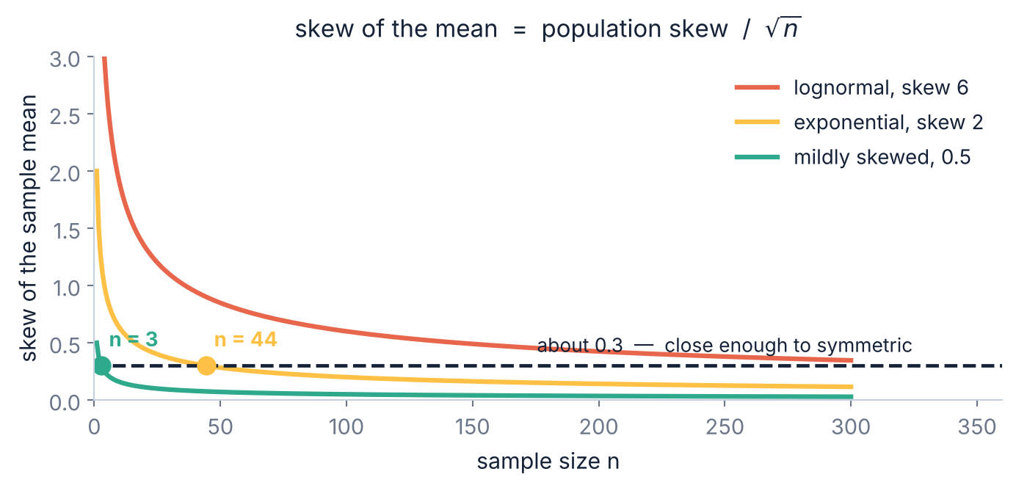
3.2 · THE SKEW RULE
The number that actually decides how big n must be
skew of the mean = skew / √n
This is exact, not a rule of thumb. The sample mean inherits the population's skew, divided by √n.
So “how large is large enough” has a real answer: large enough that this number is small.
Working backwards
Aim for a mean-skew near 0.3 and the required n falls out:
· skew 0.5 → n ≈ 3
· skew 2 → n ≈ 44
· skew 6 → n ≈ 400
So the honest rule is: measure your data's skew first, then pick n. A mildly skewed population is fine at a handful of observations; a heavily skewed one is still not fine at n = 100. The number 30 appears nowhere in this reasoning.
Slides by Srinivasa Sai Chava
Notes:
Give them the one-liner: scipy.stats.skew(data), then n = (skew/0.3)**2. It is crude but it is defensible, which 'n=30' is not.

Slide 17
4
When It Fails
Infinite variance
Dependence
The checklist
Two ways to lose the guarantee · 15 minutes
Slides by Srinivasa Sai Chava

Slide 18
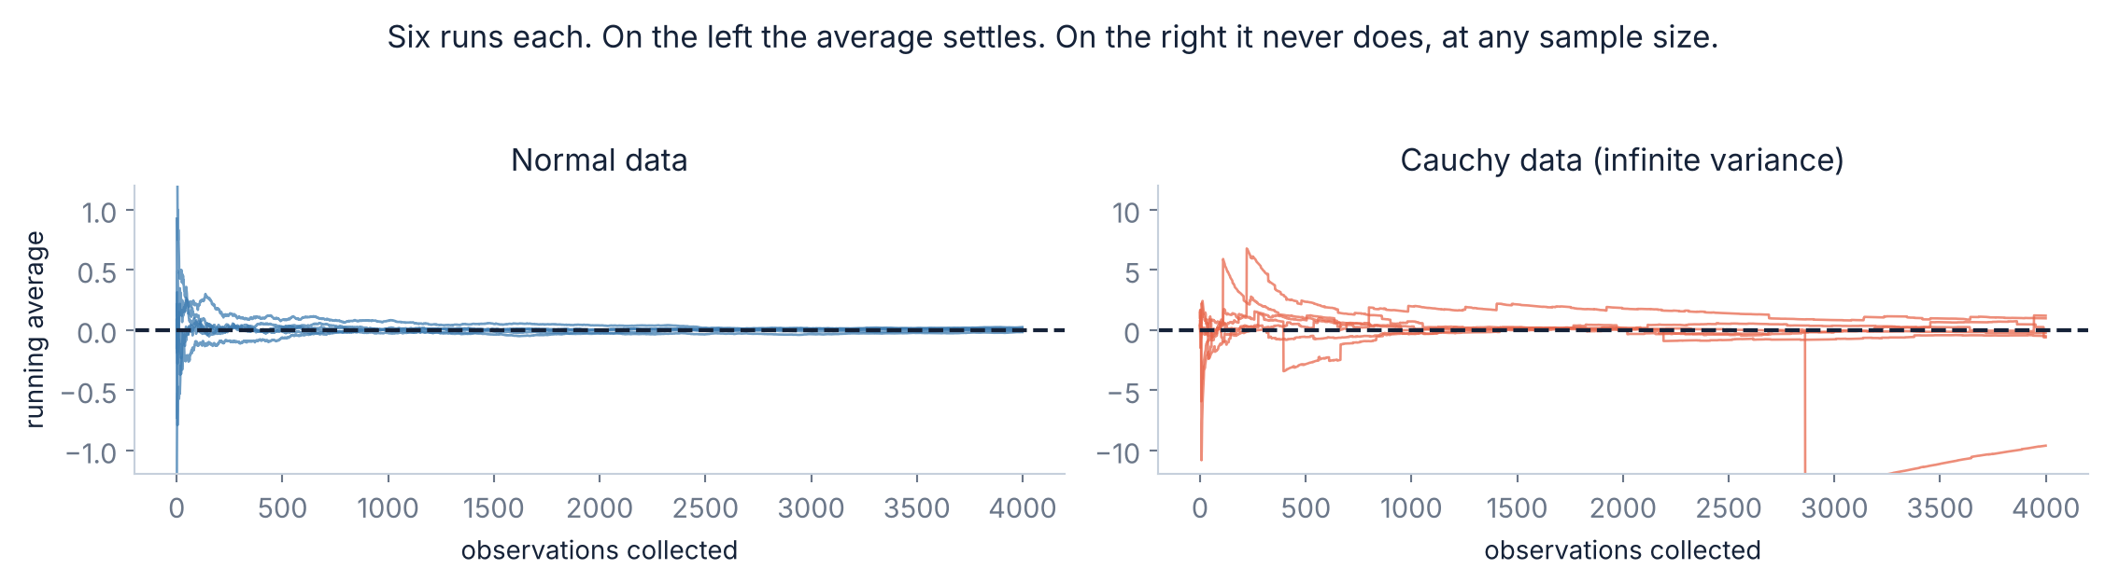
4.1 · INFINITE VARIANCE
First failure: when σ does not exist
The left panel is the law of large numbers
The right panel never settles, at any n
Collect more data and the running average settles down. This is what everyone expects averages to do.
The spread of a Cauchy mean is the SAME at n = 1 and at n = 10,000. Collecting more data buys you nothing at all.
Slides by Srinivasa Sai Chava
Notes:
The Cauchy looks harmless - it is symmetric and bell-shaped - which is what makes it such a good warning. The tails are the whole story.

Slide 19
4.2 · HEAVY TAILS
Why that happens, and where you would meet it
The theorem needed a finite σ
Real data that behaves like this
A Cauchy has a tail so heavy that its variance is infinite — not large, infinite. σ/√n is then ∞/√n, which is no promise at all.
What happens in practice: one enormous observation arrives and drags the average with it. Then a bigger one arrives. The average never converges because the next outlier is always big enough to move it.
Insurance claims — one hurricane dwarfs a decade
Wealth, and some income distributions
City and firm sizes
Financial returns in a crisis
File sizes and network traffic bursts
The practical test, and what to do instead
Plot the running mean of your own data as you add observations. If it is still jumping after thousands of points, the mean may not be a sensible summary at all — use the median, or a trimmed mean, and say so. Reporting “average claim size” for insurance is a well-known way to be confidently wrong.
Slides by Srinivasa Sai Chava
Notes:
The running-mean plot is a genuinely useful diagnostic and takes one line. Recommend it as a habit before quoting any average of heavy-tailed data.

Slide 20
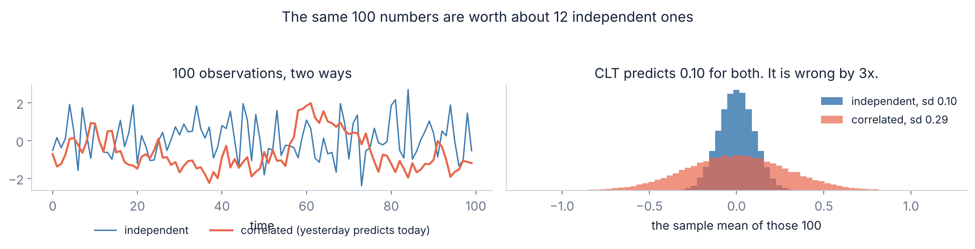
4.3 · DEPENDENCE
Second failure: when the observations are not independent
100 observations, worth about 12
If today's value partly repeats yesterday's, each new reading carries less new information than an independent one would. Here σ/√n says the standard error is 0.10; the truth is 0.29. Every confidence interval built on it is three times too narrow, and every p-value far too small.
Slides by Srinivasa Sai Chava
Notes:
This is the failure students will actually hit, because almost all time-series and repeated-measures data is correlated and nothing in the analysis warns you.

Slide 21
4.4 · THE CHECKLIST
Before you lean on the theorem, check four things
1
Is σ finite?
Plot the running mean. If it is still jumping after thousands of points, stop.
2
Are the observations independent?
Repeated measures on the same people, or anything over time, usually are not.
3
How skewed is the population?
stats.skew(data). Then n ≈ (skew / 0.3)² is a defensible starting point.
4
Am I talking about the data or the mean?
The theorem only ever licensed a claim about the mean.
Checks 1 and 2 are pass/fail — if they fail, the theorem gives you nothing. Check 3 is a dial, not a gate. Check 4 is free and catches the most common error of all.
Slides by Srinivasa Sai Chava
Notes:
Tell them to photograph this. It is the practical version of the whole session.

Slide 22
5
What It Buys You
The business question
The interval
What 95% actually means
A worked confidence interval · 20 minutes
Slides by Srinivasa Sai Chava

Slide 23
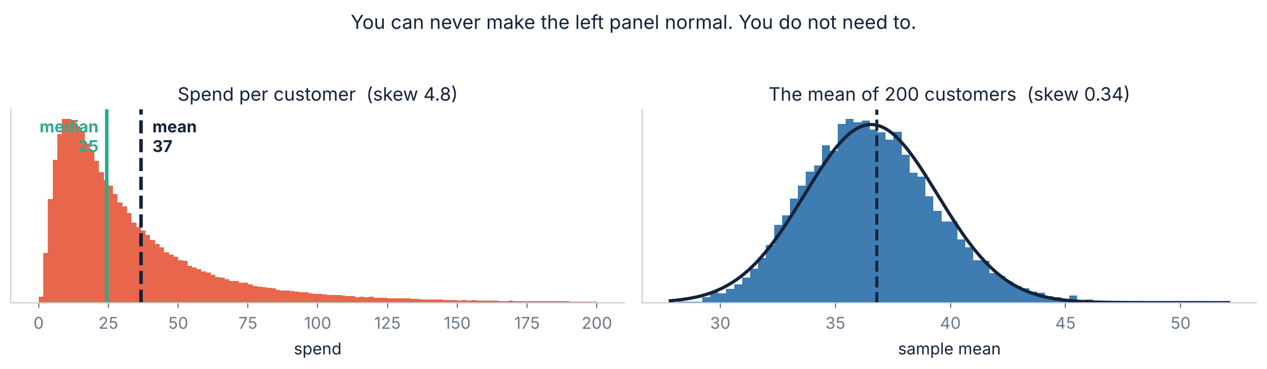
5.1 · A FULL EXAMPLE
Worked through: what is our average customer worth?
The data will never be normal
It does not need to be
Skew 4.75. The typical customer spends 25; the average is 37, pulled up by a long tail. A normality test on this returns p = 4e-18 and always will.
The mean of 200 has skew 0.34 — 4.75 divided by √200 — and sits almost exactly on the normal curve. That is the object we put an interval around.
Slides by Srinivasa Sai Chava
Notes:
Make the connection explicit: 4.8 / sqrt(200) = 0.34. The skew rule from section 3 predicts the right-hand panel before you draw it.

Slide 24
5.2 · THE ARITHMETIC
Building the interval, one line at a time
ddof=1
import numpy as np
from scipy import stats
# we surveyed 200 customers
n = 200
xbar = sample.mean() # 33.41
sd = sample.std(ddof=1) # 34.80
# --- 1. how wrong is this average likely to be?
se = sd / np.sqrt(n) # 2.460
# --- 2. the CLT says the mean is normal, so:
lo = xbar - 1.96 * se # 28.58
hi = xbar + 1.96 * se # 38.23
print(f"average spend: {xbar:.2f} (95% CI {lo:.2f} to {hi:.2f})")
# the sample itself is wildly non-normal:
stats.skew(sample) # 3.01
stats.shapiro(sample).pvalue # 3.6e-18
# and that does not matter here.
estimating σ from a sample — Day 23
÷ √n, not ÷ n
the single most common slip
1.96 is from Day 24
it leaves 2.5% in each tail
The CI is about the MEAN
not about where customers fall
Shapiro fails — and is irrelevant
it tested the data, not the mean
True mean is 36.78
the interval caught it, this time
Everything on the left rests on one assumption: that the mean of 200 is normal. The CLT is what lets you assume it, and section 3 is how you check whether 200 was enough.
Slides by Srinivasa Sai Chava
Notes:
The Shapiro line is the teaching point of this slide. Students instinctively test their data for normality; show them it failing and the interval still being right.

Slide 25
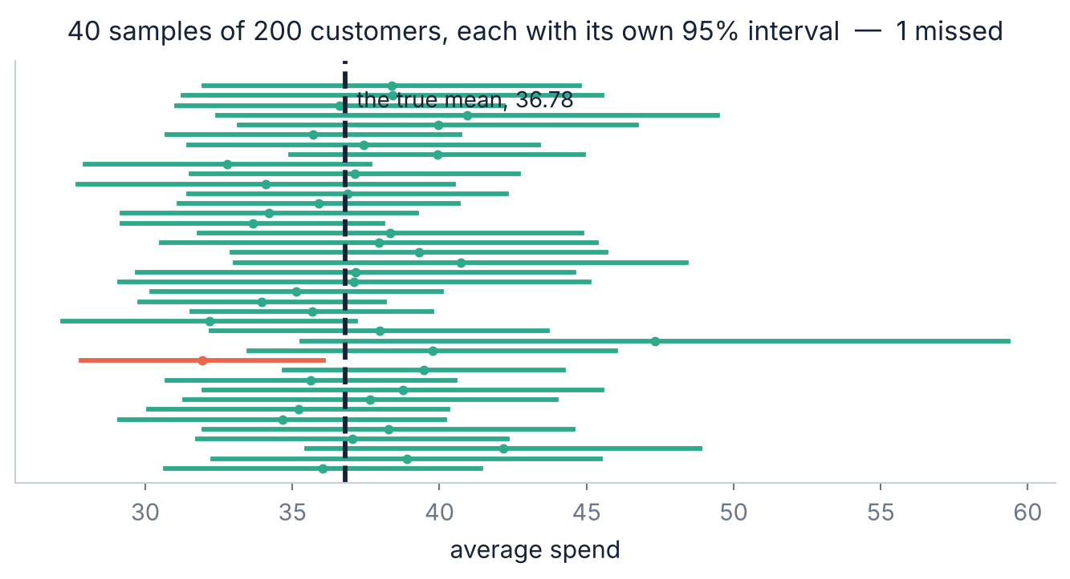
5.3 · READING IT HONESTLY
What “95% confident” actually means
Read it as a long-run property
Each green bar is one survey's interval. The dashed line is the truth, which in real life you never see.
“95% confident” means: if you repeated the whole survey forever, 95% of the intervals you built would contain it.
⚠ What it does NOT mean
Not “a 95% chance the true mean is in THIS interval”. Your interval either contains it or it does not — there is no chance left in it.
And not “95% of customers spend between 33 and 41”. That is a statement about people; this is a statement about an average.
One of these 40 intervals missed. That is the method working as advertised — at 95%, missing about 1 in 20 is the deal you signed. An interval that never missed would mean you were being too cautious.
Slides by Srinivasa Sai Chava
Notes:
The second misreading - confusing an interval for the mean with an interval for individuals - is the one that reaches newspapers. Name it explicitly.

Slide 26
5.4 · WHY IT MATTERS
Nearly everything ahead of you is standing on this
Confidence intervals
t-tests and z-tests
Every ± you have ever seen reported
“Is this difference real?” — Day 28
A/B testing
Polling margins of error
Day 25's checkout experiment, done properly
±3% is σ/√n with n ≈ 1,000
Quality control limits
Regression standard errors
Day 24's ±3σ charts, applied to batch means
Module 3, every coefficient
Which is why the failure cases are not academic
When the CLT quietly does not hold — heavy tails, correlated observations, a badly skewed population with a small n — none of these methods announce it. They all return a number, and the number is too confident. That is the whole reason section 4 exists.
Slides by Srinivasa Sai Chava
Notes:
Tie it back: every tool in the rest of the course inherits both the power and the failure modes of this one theorem.

Slide 27
RECAP
Debug corner — eight CLT mistakes
You did | What goes wrong | Fix
said “n > 30, so my data is normal” | the data never becomes normal | the theorem is about the MEAN
tested the raw data for normality | it fails, and it was never relevant | ask about the mean instead
divided σ by n | the error is far too small | divide by √n
used σ where you needed SE | σ describes people, SE describes the average | SE = σ/√n
trusted n = 30 on skewed data | a “95%” interval covering 87% | n ≈ (skew / 0.3)²
averaged heavy-tailed data | the mean never settles | plot the running mean; use a median
used a time series as if independent | intervals 3x too narrow | effective n, not n
read a CI as “95% of customers” | it is about the mean, not people | say “the average is between…”
Rows 1 and 2 are the same misunderstanding and between them they account for most of the trouble people have with this topic.
Slides by Srinivasa Sai Chava
Notes:
Rows 6 and 7 are the ones that produce confidently wrong published results. Rows 1 and 2 are the ones that produce confused students.

Slide 28
6 · MINI BUILD
Putting it together — a CLT health check
It checks, it does not assume
import numpy as np
from scipy import stats
def clt_check(data, n):
"""Can I trust a CLT-based interval from n of these?"""
d = np.asarray(data)
sk = stats.skew(d)
# 1. does the mean settle at all?
run = np.cumsum(d) / np.arange(1, len(d) + 1)
tail = run[len(d)//2:]
drift = (tail.max() - tail.min()) / abs(d.mean())
# 2. how skewed will the sample mean be?
mean_skew = sk / np.sqrt(n)
# 3. what n would this population actually need?
n_needed = (sk / 0.3) ** 2
print(f"population skew {sk:8.2f}")
print(f"running-mean drift{drift:8.2%}")
print(f"skew of mean(n={n}) {mean_skew:6.2f}")
print(f"n for skew 0.3 {n_needed:8.0f}")
print("verdict:", "OK" if abs(mean_skew) < 0.3 and drift < .05
else "use a bootstrap or a bigger n")
three numbers beat one rule
Drift catches heavy tails
a mean that will not settle
skew/√n is the real criterion
not the sample size alone
n_needed is actionable
tells you what to go and collect
It cannot see dependence
no single-sample check can
Run it before every interval
it costs one line
The fifth note matters: nothing you can compute from one sample will tell you whether your observations were independent. Only knowing how the data was collected will.
Slides by Srinivasa Sai Chava
Notes:
Being explicit that the function cannot check independence is important - otherwise students will treat a green verdict as full clearance.

Slide 29
OVER TO YOU
Practice session — 30 minutes
A
Predict the output
8 questions
Your notebook
SE vs σ, √n, skew of the mean
Day27_Practice_
Questions.ipynb
B
Spot & fix the bug
4 questions
÷n, the wrong distribution, a bad CI
Data, or the mean of the data?
√n, never n
Simulate before you trust
Solutions shared after class
C
Write the code
5 tasks
Simulate, measure, size an experiment
D
Challenge
2 tasks
Break the theorem, then rescue it
Part D asks you to construct a dataset where the CLT visibly fails, and then to produce a correct interval for it anyway. Both halves are the point.
Slides by Srinivasa Sai Chava
Notes:
Part D's second half introduces the bootstrap without naming it as a topic. It is the natural answer to 'what do I do when the CLT does not apply'.

Slide 30
TODAY IN TWELVE LINES
Recap
1
⭐ Your DATA and your SAMPLE MEAN are two different distributions.
7
⚠ “n = 30 is enough” is false. On lognormal data it gives an 87% interval.
2
The theorem is about the mean. It says nothing about the data.
8
skew of the mean = population skew / √n. Exact, and it decides n.
3
Sample means are normal, centred on μ, with sd σ/√n — from ANY population.
9
A defensible rule: n ≈ (skew / 0.3)².
4
σ/√n is the STANDARD ERROR. σ describes people; SE describes the average.
10
⚠ Fails with infinite variance — a Cauchy mean never settles, at any n.
5
√n law: 4x the data buys 2x the precision. That is a budget.
11
⚠ Fails with dependence — 100 correlated points were worth 12.
6
⚠ The data never becomes normal. A million salaries are still skewed.
12
Nearly every interval, p-value and A/B test ahead of you rests on this.
Homework
Next class — Topic 2.8
Run clt_check on every numeric column of your Day 21 project and say which ones you could safely build an interval from · Find a published ± figure and work out what n it implies · Take one skewed column and find the n its skew actually demands
Hypothesis testing. Today you learned how far a sample mean typically lands from the truth. Next class turns that into a decision procedure: is this difference real, or is it the √n noise we just measured?
Slides by Srinivasa Sai Chava
Notes:
The handover to Day 28 is tight: a hypothesis test is just this standard error with a decision rule attached.

