Slide 1

MODULE 3 · MACHINE LEARNING · TOPICS 3.1 + 3.2
What Machine Learning Is
… and how to feed it words
Day 31 — the first session of Module 3. Nothing is assumed. Every term is defined when it first appears.
1
3
5
Boston University
A new way of programming
Kinds of learning, drawn out
Ways to turn words into numbers
Prepared & presented by Srinivasa Sai Chava
Notes:
First ML session. Assume zero prior exposure. Define every term out loud the first time it appears, and keep coming back to the house-price example so there is always something concrete under the abstraction.

Slide 2
WELCOME TO MACHINE LEARNING
Module 3 starts here, and the job changes
Modules 1 and 2 — 30 days
Module 3 — from today
You wrote the rules yourself, in Python
You described data that already existed
You tested claims about a population
Every answer came from a formula you could write out by hand
The computer finds the rule, from examples
You judge it on data it has never seen
You will not be able to write the rule by hand — and that is the point
Your job becomes choosing, feeding and checking the model
Three promises for today
1
You will see a model learn a rule in front of you, with no magic in it
2
A model will score 100% on its homework and FAIL the exam — worse than guessing
3
Writing one word as a number the wrong way will double a model's error
Slides by Srinivasa Sai Chava
Notes:
Say plainly that nobody is expected to know any of this. The whole module is built from zero.

Slide 3
SESSION PLAN
How today's two hours are structured
What machine learning is
20 min
The three kinds of learning
25 min
1
2
The paradigm, and the vocabulary
Supervised, unsupervised, reinforcement
How a project actually runs
15 min
What a feature is
10 min
3
4
The pipeline, and train/test
And why models cannot read words
Encoding categorical data
20 min
Practice notebook
30 min
5
6
Label, one-hot, ordinal, and the traps
You encode, you split, you check
Stop me the moment a word goes past that you have not heard before. On the first day of a new module that is not an interruption — it is the lesson.
Slides by Srinivasa Sai Chava
Notes:
Mean this. The single biggest failure mode in a first ML session is a student who lost the thread in minute six and never said so.

Slide 4
1
What Machine Learning Is
The paradigm flip
A first example
The vocabulary
What “learning” means
A different way of writing programs · 20 minutes
Slides by Srinivasa Sai Chava

Slide 5
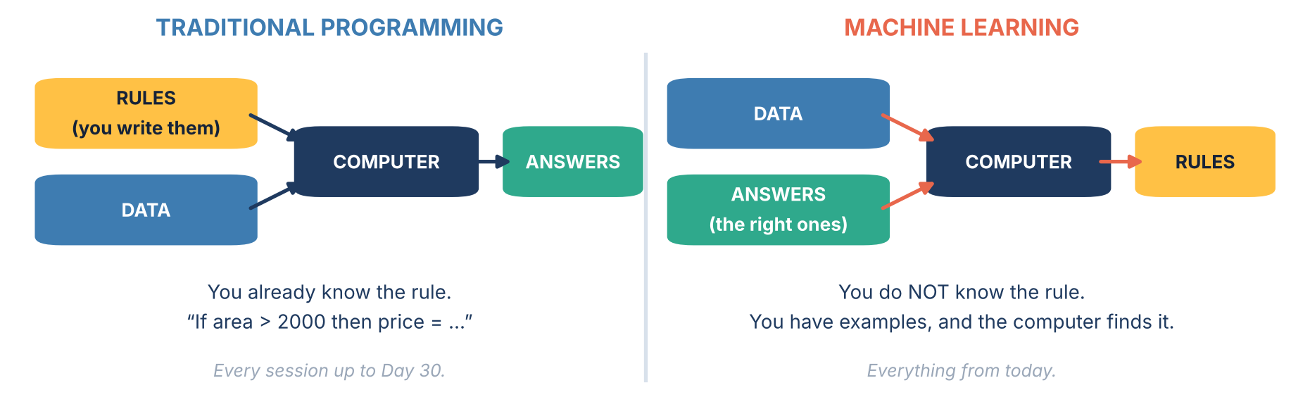
1.1 · THE PARADIGM FLIP
⭐ The whole idea, in one picture
Read the two diagrams and notice that RULES and ANSWERS have swapped places. That swap is the entire definition of machine learning. You hand the computer examples of the right answer, and it hands you back a rule — one you could not have written yourself, because you do not know it.
Slides by Srinivasa Sai Chava
Notes:
Spend real time here. If a student only remembers one slide from today, this should be it. Ask them to say the swap back to you in their own words before moving on.

Slide 6
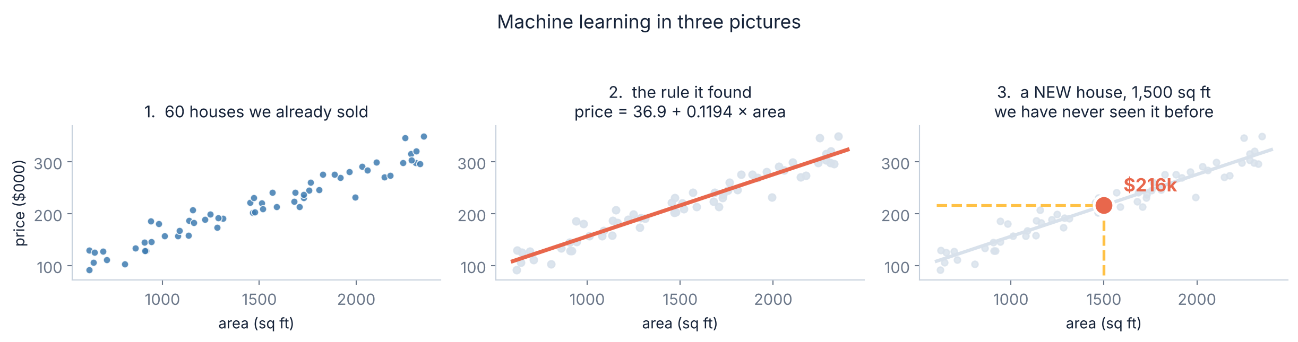
1.2 · A FIRST EXAMPLE
A real one: what is this house worth?
1. The examples
2. The rule it found
3. The point of it all
60 houses we already sold. For each one we know the area AND the price — the question and the answer together.
Nobody wrote this line. The computer tried millions of lines and kept the one that sat closest to the dots.
A house we have NEVER seen. The rule gives an answer anyway. That is the only thing we ever wanted.
Slides by Srinivasa Sai Chava
Notes:
Keep returning to this example all session. Concrete beats abstract on day one, every time.

Slide 7
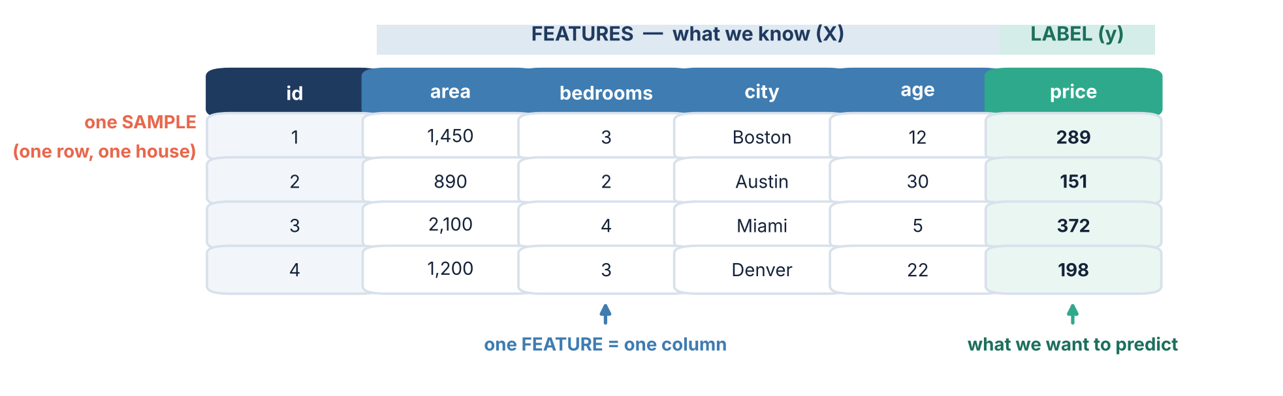
1.3 · THE VOCABULARY
The five words you need before anything else
sample
one row — one house, one customer, one email
feature
one input column (X)
label
the answer column (y)
model
the rule, once it is found
training
the act of finding it
Slides by Srinivasa Sai Chava
Notes:
Write these five on the board and leave them there for the whole session. Students will need to look back at them a dozen times today.

Slide 8
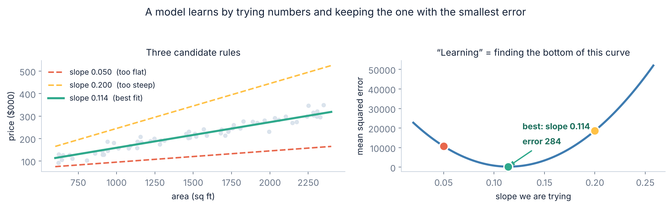
1.4 · HOW IT LEARNS
⭐ What “learning” actually means — there is no magic in it
The entire algorithm, in words
Here we tried every slope by brute force
Pick numbers. Measure how wrong you are. Change the numbers so you are less wrong. Repeat. That is it — for linear regression and, with more arithmetic, for a neural network too.
That works with one number to find. With a million, you need a smarter way down the curve — that is GRADIENT DESCENT, and we derive it step by step on Day 35.
Slides by Srinivasa Sai Chava
Notes:
This slide removes the mystery. A model is a set of numbers and a measure of wrongness. Everything else in the module is a variation on this.

Slide 9
2
The Three Kinds of Learning
Supervised
Unsupervised
Reinforcement
Which one is my problem?
What tells them apart · 25 minutes
Slides by Srinivasa Sai Chava

Slide 10
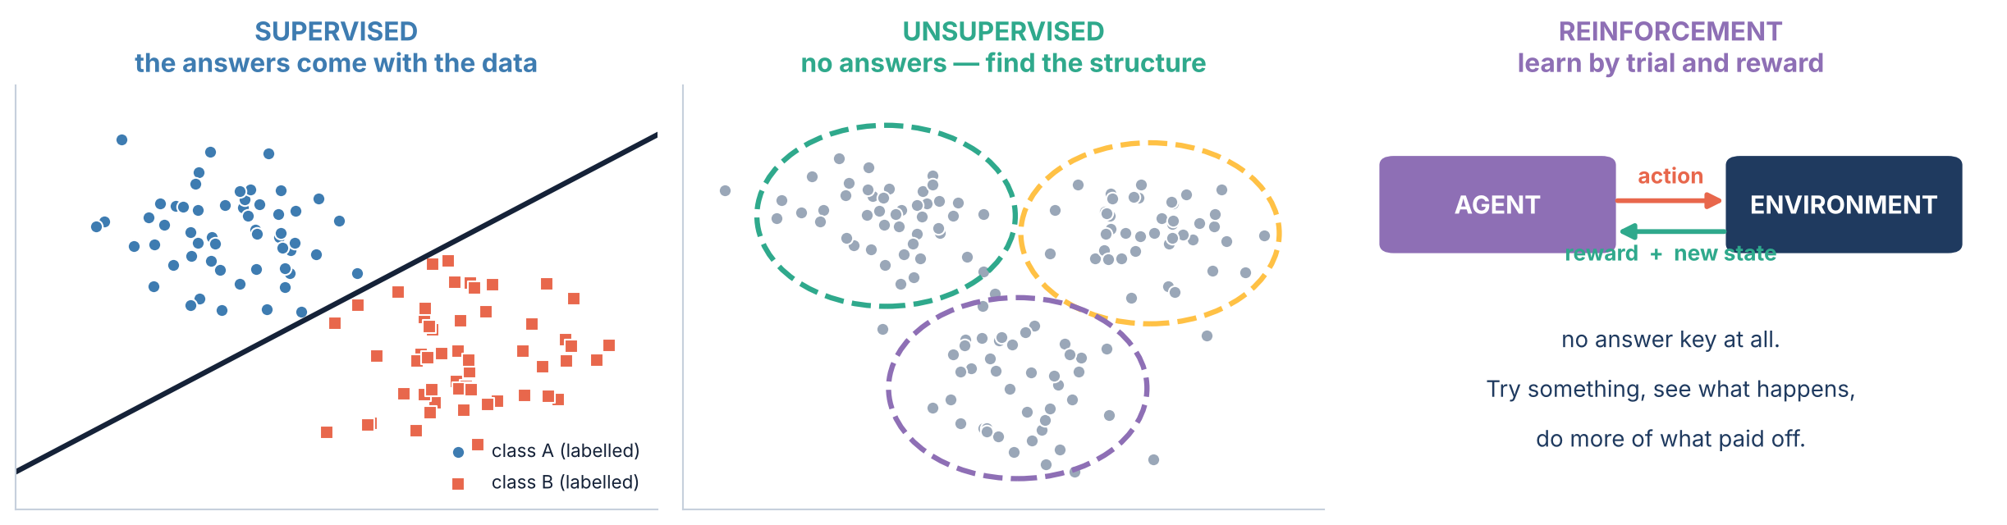
2.1 · THE BIG PICTURE
⭐ Three kinds of learning, side by side
SUPERVISED
UNSUPERVISED
REINFORCEMENT
Every example comes with its correct answer attached. The model learns to copy the answer key, then applies it to new rows.
~90% of what industry does.
No answers at all. The model looks for structure that was already in the data — groups, or a simpler description.
There is no “correct” to score against.
No answers either, but there IS feedback: do something, get a reward or a penalty, adjust.
Games, robots, recommendation.
Slides by Srinivasa Sai Chava
Notes:
The distinguishing question is simply: what feedback does the learner get? Full answers, none, or a reward signal. Everything else follows from that.

Slide 11
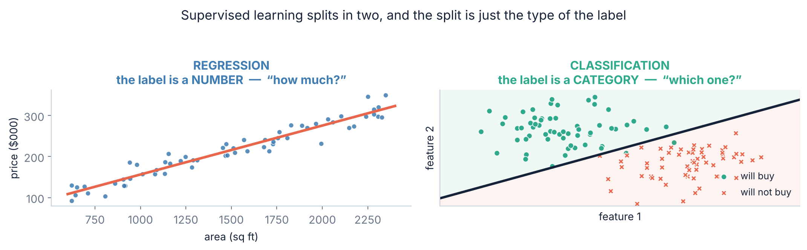
2.2 · SUPERVISED, UP CLOSE
Supervised learning splits in two — and the split is just the label
REGRESSION — the label is a number
CLASSIFICATION — the label is a category
House price · tomorrow's temperature · how many units we will sell · a patient's blood pressure. The answer can be any value on a scale.
Spam or not · which of 10 digits · will this customer leave · is this tumour malignant. The answer is one of a fixed list.
Slides by Srinivasa Sai Chava
Notes:
Give them the test: look at the label column. Numbers on a scale means regression; a fixed list of options means classification. Nothing else decides it.

Slide 12
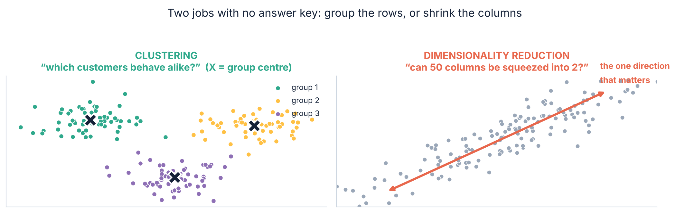
2.3 · UNSUPERVISED, UP CLOSE
Unsupervised: two jobs, no answer key
CLUSTERING — group the rows
DIMENSIONALITY REDUCTION — shrink the columns
“Which of our customers behave alike?” Nobody told the model there were three groups, or what to call them. You name them afterwards, by looking.
“These 50 columns mostly say the same thing — can 2 columns carry it?” Used to plot high-dimensional data, and to speed models up.
Slides by Srinivasa Sai Chava
Notes:
The hardest thing about unsupervised learning is that there is no score. You cannot compute an accuracy, because there is nothing to be accurate against. Judgement replaces the metric.

Slide 13
2.4 · REINFORCEMENT
Reinforcement learning: nobody says what is right, only what paid off
Learning to ride a bicycle
The four pieces
Nobody gave you a table of handlebar angles. You pushed off, you fell over, and falling over was the penalty. You tried again, you stayed up for three seconds, and that was the reward. Nothing supervised the ride — but the world kept score.
agent
the learner — the thing making choices
environment
the world it acts in
action
what it chooses to do
reward
the number the world gives back
Where you have met it without knowing
Game-playing engines that beat world champions at Go and chess · a robot arm learning to grasp · a warehouse robot routing itself · the feed that decides what to show you next and watches whether you keep scrolling · data-centre cooling systems that learn an energy-saving policy.
Slides by Srinivasa Sai Chava
Notes:
RL is not on this course beyond awareness, and that is worth saying so nobody waits for it. It needs an environment you can simulate millions of times, which most business problems do not have.

Slide 14
2.5 · THE TEST
Which kind is my problem? One question decides it.
Look at your data and ask: “Do I have the right answers for the rows I already have?”
What you have | What you want | It is… | Example
Rows WITH the right answer, a number | predict that number | supervised · regression | past sales → next month's sales
Rows WITH the right answer, a category | predict that category | supervised · classification | past emails → spam or not
Rows with NO answers | find natural groups | unsupervised · clustering | customers → segments
Rows with NO answers, too many columns | a simpler description | unsupervised · dim. reduction | 80 survey items → 3 scores
No fixed data — a world you can act in | a good policy over time | reinforcement | a robot learning to walk
⚠ The most common beginner mistake: having no labels, wanting a prediction anyway, and reaching for a supervised model. If nobody has written down the right answer for your existing rows, no supervised algorithm can help you — getting labels IS the project.
Slides by Srinivasa Sai Chava
Notes:
Labelling is usually the expensive part of a real project, and students never expect that.

Slide 15
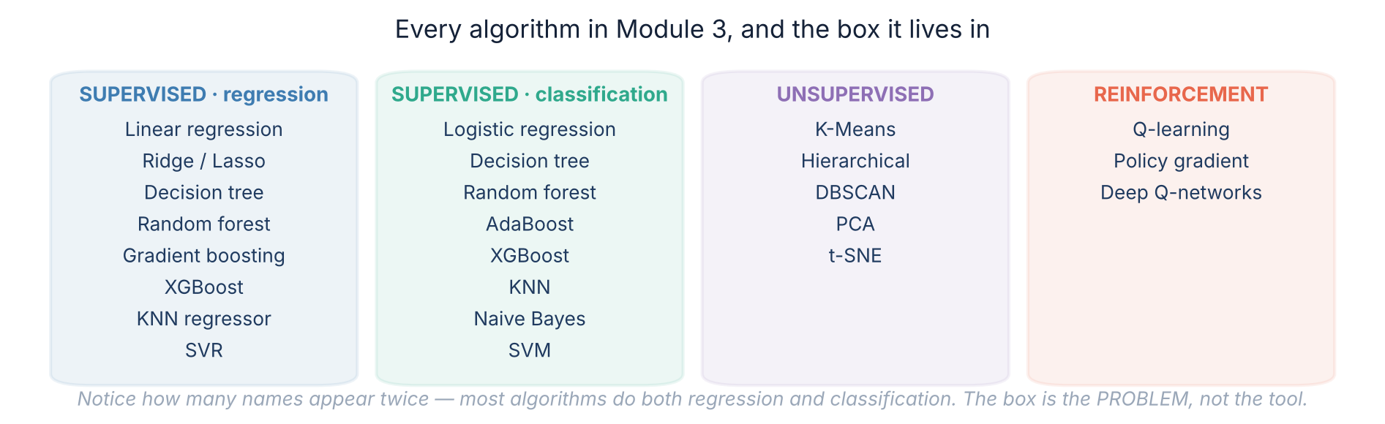
2.6 · THE MAP
Every algorithm in this module, and the box it lives in
Do not memorise this — it is a map to come back to. Two things worth noticing now: most of the famous names do BOTH regression and classification, so the box is set by your problem and not by the tool; and the first six weeks of this module live almost entirely in the first two columns.
Slides by Srinivasa Sai Chava
Notes:
Photograph this slide. It is the table of contents for the next six weeks.

Slide 16
3
How a Project Actually Runs
The eight steps
Train and test
The pipeline, and the one rule you cannot break · 15 minutes
Slides by Srinivasa Sai Chava

Slide 17
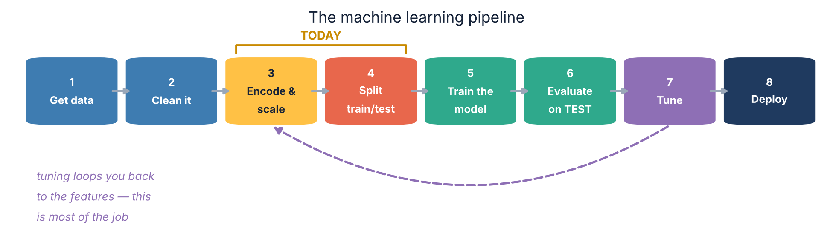
3.1 · THE PIPELINE
The eight steps, every time
Where the time actually goes
Today we do steps 3 and 4
Steps 1 to 3 — getting, cleaning and encoding the data — are routinely most of a real project. Step 5, the part everyone imagines when they say “machine learning”, is often three lines of code.
Encoding, and the train/test split. Steps 1 and 2 you already know — that was Module 1. Step 5 onwards is the rest of Module 3.
Slides by Srinivasa Sai Chava
Notes:
Managing the expectation that ML is mostly modelling is part of the job. It is mostly data preparation, and saying so now saves disappointment later.

Slide 18
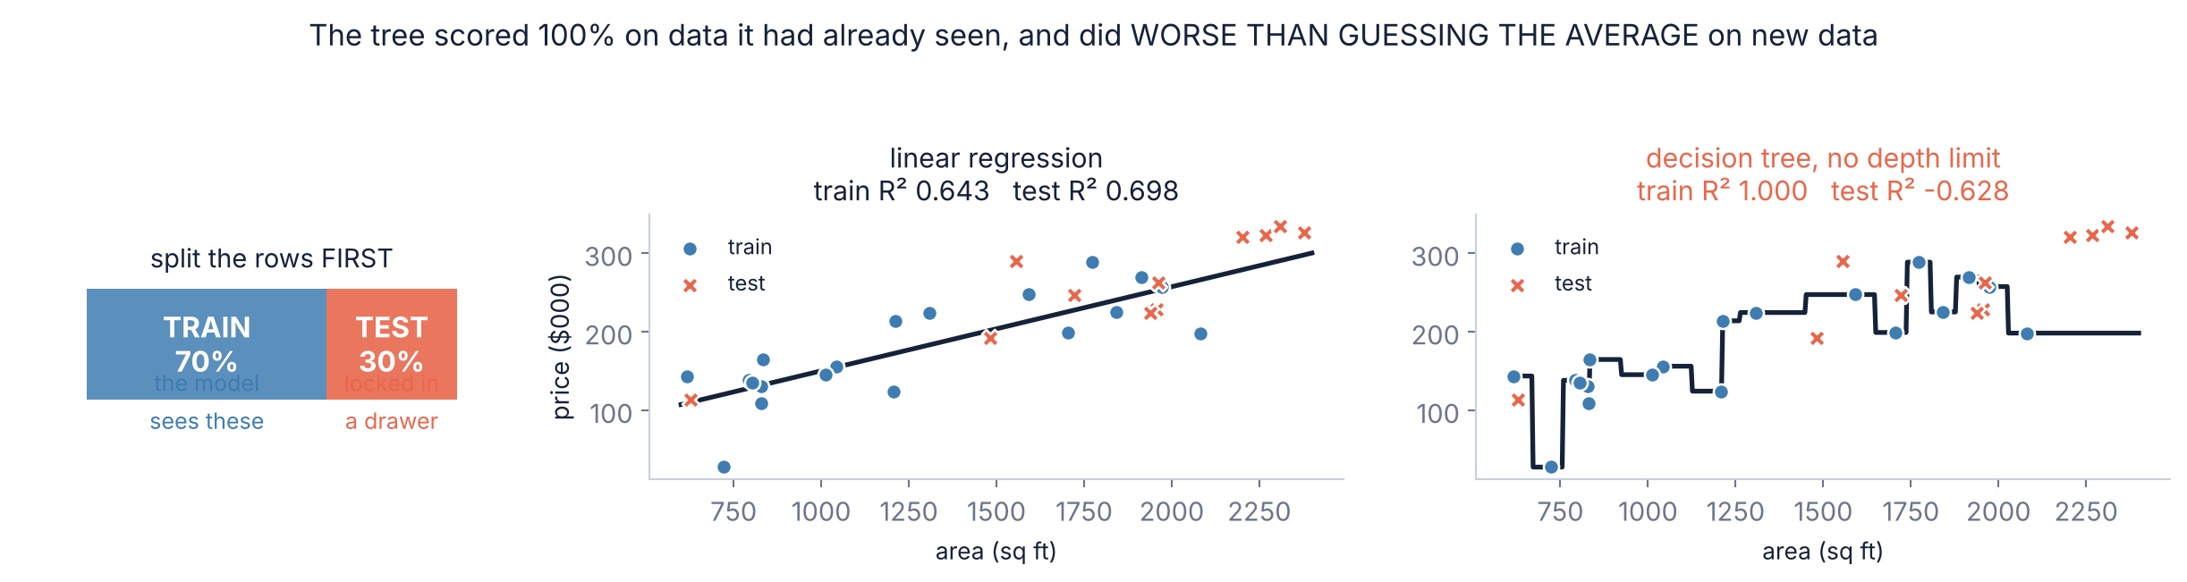
3.2 · TRAIN AND TEST
⚠ The one rule you can never break
What happened on the right
Why we split before we start
The decision tree drew a line through EVERY training point exactly — R² = 1.000, a perfect score. On the held-out test points it scored −0.628: worse than if it had ignored the data and guessed the average price every time.
Memorising the answers is not learning, and from inside the training data the two look identical. Hiding 20–30% of the rows before you start is the only way to tell them apart.
This is called OVERFITTING, and it is the central problem of the whole module.
Slides by Srinivasa Sai Chava
Notes:
The exam analogy lands best: a student who memorises last year's paper scores 100% on last year's paper. The test set is this year's paper.

Slide 19
4
What a Feature Is
The types of column
The problem with words
And why a model cannot read “Boston” · 10 minutes
Slides by Srinivasa Sai Chava

Slide 20
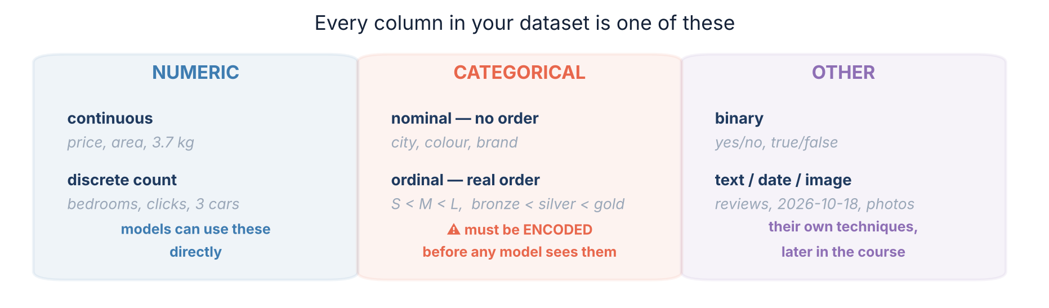
4.1 · TYPES OF FEATURE
Every column in your data is one of these
The distinction that matters today
NOMINAL means the categories have no order — Boston is not more or less than Miami. ORDINAL means they genuinely do — small really is less than large. Getting this one call wrong is the mistake in section 5, and it costs real accuracy.
Slides by Srinivasa Sai Chava
Notes:
Make them classify a few columns out loud before moving on: shirt size, country, star rating, temperature, blood type.

Slide 21
4.2 · THE PROBLEM
Why you cannot just hand a model the word “Boston”
Why it refuses
>>> from sklearn.linear_model import LinearRegression
>>> df[["area", "city"]].head(2)
area city
0 1450 Boston
1 890 Austin
>>> LinearRegression().fit(df[["area", "city"]], df.price)
ValueError: could not convert string to float: 'Boston'
Every model you will meet does arithmetic on its inputs: it multiplies them by weights and adds them up.
There is no sensible value for
“Boston × 0.4”.
So every categorical column must become numbers before training — and HOW you do that changes the answer.
This is not a software limitation you could code around. It is what the model IS: a weighted sum. Turning categories into numbers that the arithmetic can handle honestly is called ENCODING, and it is the rest of this session.
Slides by Srinivasa Sai Chava
Notes:
Run this error live if you can. Seeing the ValueError makes the need for encoding real in a way that describing it does not.

Slide 22
5
Encoding Categorical Data
Label encoding and its trap
One-hot
Ordinal
High cardinality
Leakage
Turning words into numbers, honestly · 20 minutes
Slides by Srinivasa Sai Chava

Slide 23
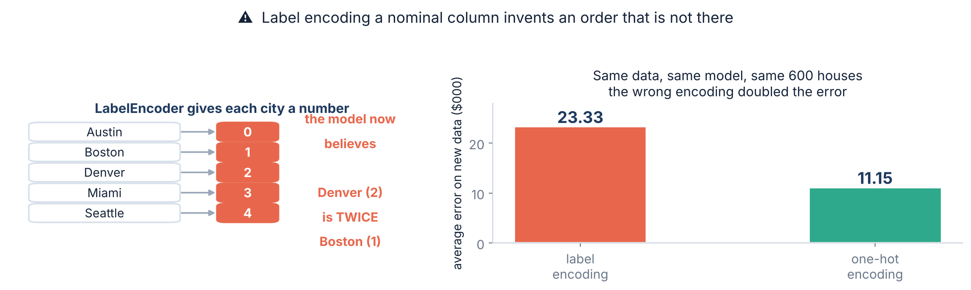
5.1 · LABEL ENCODING
⚠ The obvious idea, and why it is wrong
What the model now believes
Measured, on 600 houses
Austin=0, Boston=1, Denver=2. A linear model multiplies that by a weight, so it is forced to believe Denver is twice Boston and Seattle is four times it. None of that is true.
Same data, same model, only the encoding changed: average error on new houses went from $23,330 down to $11,150. The wrong encoding DOUBLED the error.
Slides by Srinivasa Sai Chava
Notes:
LabelEncoder is genuinely fine for the TARGET column of a classifier, and genuinely wrong for a nominal input feature. Students meet it first in tutorials that use it wrongly.

Slide 24
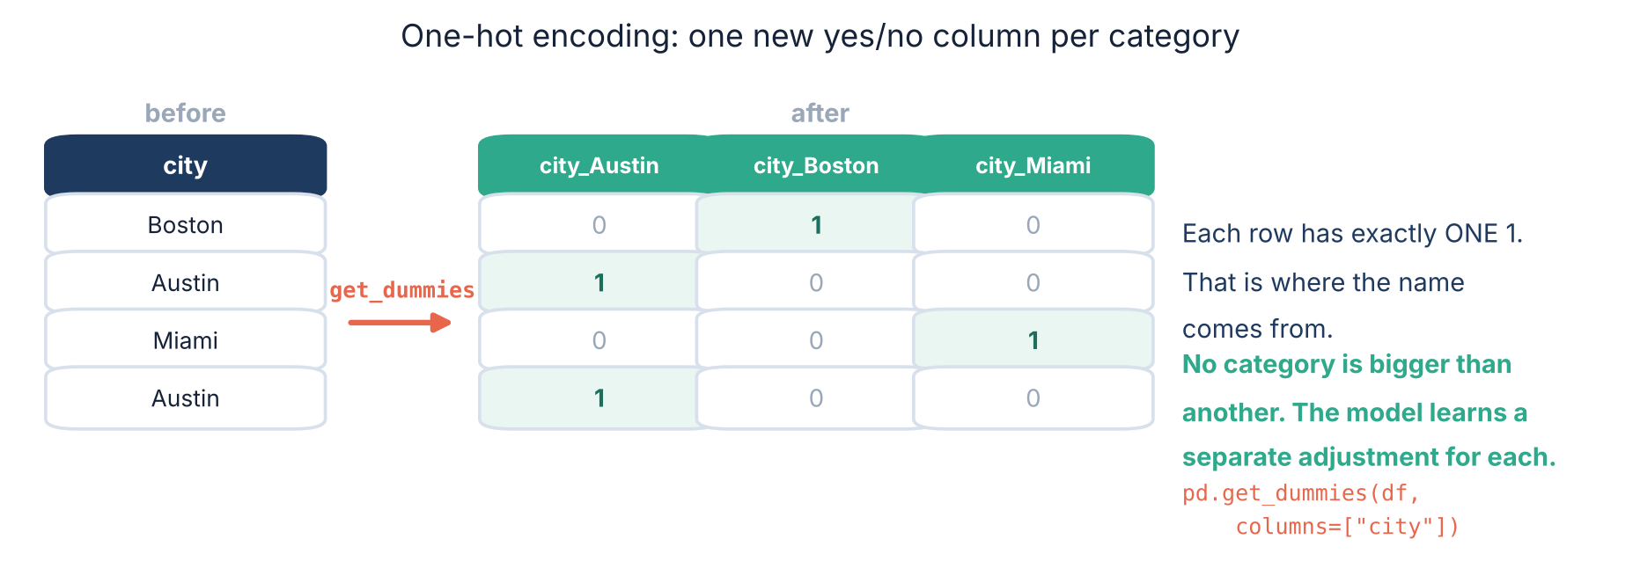
5.2 · ONE-HOT
⭐ One-hot encoding — the right default for nominal columns
Each category gets its own yes/no column. Nothing is bigger than anything else, so no false order can be invented — and the model gets to learn a completely separate adjustment for each city, instead of being forced onto one straight line through them.
Slides by Srinivasa Sai Chava
Notes:
Walk one row across the arrow by hand: Boston becomes 0, 1, 0. Then ask the room what Miami becomes before you show it.

Slide 25
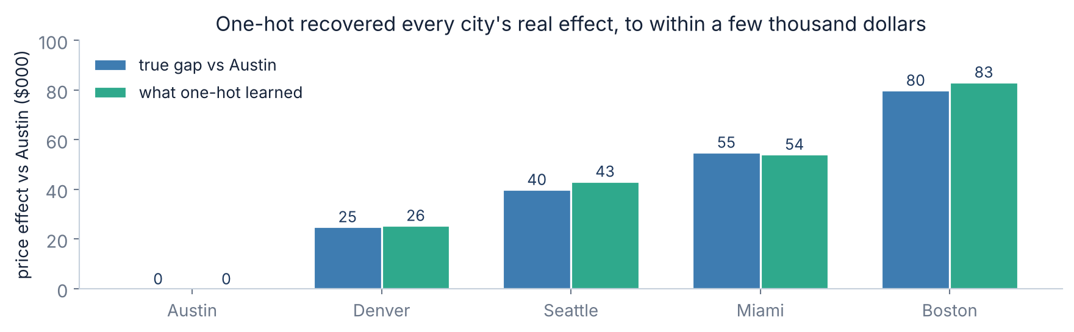
5.3 · DOES IT ACTUALLY WORK?
Proof that it worked: the model found the real answer
How we can check at all
Every city within a few thousand dollars
This data was simulated, so we KNOW the true effect of each city — we built them in. Real data never lets you do this, which is exactly why simulated data is so useful for learning.
Boston's true premium over Austin is $80k; the model learned $83k. Denver's is $25k; it learned $26k. It worked out five separate city effects from nothing but the one-hot columns.
Slides by Srinivasa Sai Chava
Notes:
Explain why we compare GAPS rather than raw coefficients: the intercept soaks up the overall average, so only differences between categories are meaningful.

Slide 26
5.4 · drop_first
The dummy variable trap — and what it really costs
The redundancy
Measured on our 600 houses
If a house is not Austin, not Denver, not Miami and not Seattle, it must be Boston. The fifth column carries no information the other four did not already give you.
The five dummies add to exactly 1 in every row — which is the same thing the model's intercept already is.
design matrix | cols | rank
intercept + all 5 dummies | 7 | 6 ← deficient
intercept + 4 dummies | 6 | 6 ← fine
Condition number with all five: 7.9 × 10¹⁸. statsmodels warns outright.
The honest version of this rule — which most tutorials get wrong
It does NOT break your predictions. We checked: all five dummies and four dummies gave test error of $11,151 either way, identical to four decimal places, because scikit-learn's solver quietly picks one of the infinitely many equivalent answers.
What it breaks is INTERPRETATION — the coefficients are no longer unique, so reading them is meaningless — and classical OLS, which needs to invert a matrix that is now singular. Use drop_first=True whenever you plan to read the coefficients or use statsmodels. For a tree or a random forest it genuinely does not matter.
Slides by Srinivasa Sai Chava
Notes:
Worth being precise here rather than repeating the folklore. The trap is real for inference and for OLS; it is not a prediction bug in sklearn.

Slide 27
5.5 · ORDINAL
Ordinal encoding — when the order IS real
Some categories really are ranked
⚠ But it assumes EVEN spacing
High School < Bachelor < Master < PhD
S < M < L < XL
bronze < silver < gold
never < sometimes < often < always
0, 1, 2, 3 says the jump from Bachelor to Master is the same size as the jump from Master to PhD. Sometimes true, often not.
Both tested on 500 people, test error in $000:
true gaps | ordinal | one-hot
even (0, 8, 16, 24) | 4.98 | 4.97
uneven (0, 6, 9, 34) | 6.04 | 4.64
Here 0, 1, 2, 3 is not a lie — it is the truth, and it costs you ONE column instead of four.
The rule that follows from those two rows
When the spacing really is even, ordinal ties one-hot exactly (4.98 vs 4.97) and uses a quarter of the columns — use it. When the spacing is uneven, ordinal is 30% worse (6.04 vs 4.64), because it is forced to put the four levels on one straight line and the real jump to PhD is nothing like the others.
If you are unsure whether the gaps are even, one-hot is the safe choice: it never assumes anything about spacing.
Slides by Srinivasa Sai Chava
Notes:
This is the nuance most courses skip. Ordinal is not automatically right just because an order exists - it also assumes the gaps are equal.

Slide 28
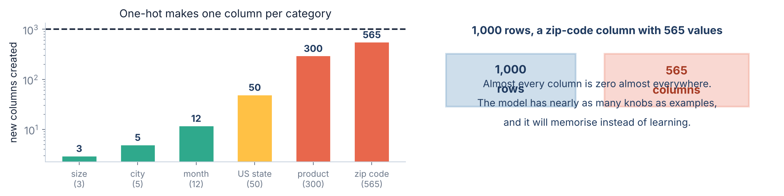
5.6 · TOO MANY CATEGORIES
⚠ When one-hot is the wrong answer
The blow-up
What to do instead
One-hot makes one column per category, so a zip-code column with 565 values turns 1,000 rows into a table with 565 extra columns — almost all zeros, and nearly as many knobs as there are examples to set them with. The model memorises.
Group the rare ones into “Other” and one-hot the rest · use FREQUENCY encoding (replace each category by how often it appears) · use TARGET encoding (replace it by the average label for that category) — with the warning on the next slide · or use a model that handles categories natively, such as CatBoost or LightGBM.
Slides by Srinivasa Sai Chava
Notes:
A practical threshold: under about 15 categories, one-hot without thinking. Over 50, stop and choose. In between, look at how many rows each category has.

Slide 29
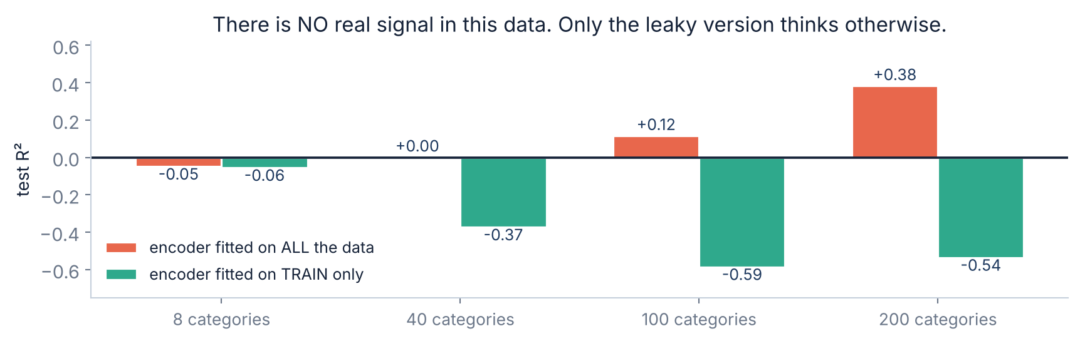
5.7 · LEAKAGE
⚠ Fit the encoder on TRAIN only — or it will lie to you
What the red bars are doing
The green bars are correct
The target encoder was fitted on all the rows, so each test row's own answer helped build its own feature. At 200 categories the model reports a test R² of +0.38 on data containing nothing at all.
Fitted on train only, the model reports a NEGATIVE test R² — correctly saying “this is worthless”. The honest answer looks like failure, and the leaky one looks like success. That is the danger.
Slides by Srinivasa Sai Chava
Notes:
The rule in one line: any step that learns something from the data - an encoder, a scaler, an imputer - is fitted on train and only applied to test. sklearn Pipelines exist to make this automatic.

Slide 30
5.8 · REFERENCE
Which encoder, and when
Your column | Use | Code
Nominal, under ~15 categories | one-hot | pd.get_dummies(df, columns=[c])
Nominal, and you will read coefficients | one-hot, drop one | pd.get_dummies(…, drop_first=True)
Ordinal, gaps roughly even | ordinal — map by hand | df[c].map({"S":0, "M":1, "L":2})
Ordinal, gaps clearly uneven | one-hot (safer) | pd.get_dummies(df, columns=[c])
Nominal, hundreds of categories | group rare → Other, then one-hot | value_counts() then .where()
Still too many after grouping | frequency or target encoding | df[c].map(df[c].value_counts())
The LABEL of a classifier | label encoding is correct here | LabelEncoder().fit_transform(y)
Two rules that cover almost everything: when in doubt, ONE-HOT — it assumes nothing. And whatever you choose, FIT IT ON TRAIN ONLY. The last row is the exception worth remembering: LabelEncoder is the right tool for the thing you are predicting, and the wrong tool for the things you predict from.
Slides by Srinivasa Sai Chava
Notes:
Photograph this. It answers most encoding questions they will have for the rest of the course.

Slide 31
RECAP
Debug corner — eight first-week mistakes
You did | What goes wrong | Fix
fed a string column to .fit() | ValueError: could not convert to float | encode it first
LabelEncoder on a nominal feature | error doubled: $11k → $23k | one-hot for nominal
one-hot on 565 zip codes | 565 columns from 1,000 rows | group rare → Other
scored the model on its training data | R² = 1.000 and useless | always hold out a test set
fitted the encoder before splitting | fake test R² of +0.38 on noise | fit on train, apply to test
ordinal-encoded an uneven order | 6.04 vs 4.64 error | one-hot when gaps are uneven
kept all k dummies, then read coefficients | coefficients are not unique | drop_first=True
no labels, reached for a classifier | nothing to learn from | it is an unsupervised problem
Rows 4 and 5 are the same mistake wearing different clothes: letting the model see, in any form at all, data you intend to grade it on.
Slides by Srinivasa Sai Chava
Notes:
Every one of these eight is something a student will do in the practice notebook within the hour.

Slide 32
6 · MINI BUILD
Putting it together — prepare any dataset for a model
Split is the FIRST step
import pandas as pd
from sklearn.model_selection import train_test_split
def prepare(df, label, ordinal_maps=None, max_cats=15):
"""Split first, then encode. Returns X_train, X_test, y_train, y_test."""
ordinal_maps = ordinal_maps or {}
y = df[label]
X = df.drop(columns=[label])
# 1. SPLIT FIRST - nothing may learn from the test rows
X_tr, X_te, y_tr, y_te = train_test_split(
X, y, test_size=0.25, random_state=42)
# 2. ordinal columns: a map YOU wrote, so order is intentional
for col, mapping in ordinal_maps.items():
X_tr[col] = X_tr[col].map(mapping)
X_te[col] = X_te[col].map(mapping)
# 3. group rare categories, using TRAIN counts only
cats = X_tr.select_dtypes(include="object").columns
for col in cats:
keep = X_tr[col].value_counts().head(max_cats).index
X_tr[col] = X_tr[col].where(X_tr[col].isin(keep), "Other")
X_te[col] = X_te[col].where(X_te[col].isin(keep), "Other")
# 4. one-hot, then align so both frames have the same columns
X_tr = pd.get_dummies(X_tr, columns=list(cats)).astype(float)
X_te = pd.get_dummies(X_te, columns=list(cats)).astype(float)
X_te = X_te.reindex(columns=X_tr.columns, fill_value=0.0)
return X_tr, X_te, y_tr, y_te
everything after it is fitted on train
Ordinal maps are hand-written
an order you chose, not one invented
Rare categories use TRAIN counts
test rows must not vote
Columns are aligned at the end
a city only in test would break it
astype(float)
booleans trip up some models
No label encoding anywhere
except on y, which is not here
In real projects a scikit-learn Pipeline does all of this for you, and refuses to let you leak. We build it by hand first so you know what it is doing.
Slides by Srinivasa Sai Chava
Notes:
The reindex line is the one students always miss. A category that appears in test but not train creates a column mismatch and a crash at predict time.

Slide 33
OVER TO YOU
Practice session — 30 minutes
A
Predict the output
8 questions
Your notebook
Types, encodings, shapes, splits
Day31_Practice_
Questions.ipynb
B
Spot & fix the bug
4 questions
Label on nominal, leak, scoring on train
Split before you encode
Nominal → one-hot
Never score on training data
Solutions shared after class
C
Write the code
5 tasks
Encode, split, prepare, compare
D
Challenge
2 tasks
Classify 8 real problems, then fix a pipeline
No model fitting is required today beyond what is given to you. Today is about getting data into a shape a model can actually use — which, as the pipeline slide showed, is most of the real work.
Slides by Srinivasa Sai Chava
Notes:
Reassure anyone who feels they have not 'done machine learning' yet. They have done the part that decides whether the modelling works.

Slide 34
TODAY IN TWELVE LINES
Recap
1
⭐ Traditional code: rules + data → answers. ML: data + answers → rules.
7
REINFORCEMENT: no answers, but the world pays you a reward.
2
Sample = a row. Feature = an input column. Label = the answer column.
8
⚠ A tree scored R² = 1.000 on its training data and −0.628 on new data.
3
“Learning” = try numbers, measure the error, keep the best. No magic.
9
⚠ Models do arithmetic, so every word column must be ENCODED first.
4
SUPERVISED: the answers come with the data. ~90% of industry work.
10
⚠ Label-encoding a nominal column doubled the error: $11k → $23k.
5
Regression = the label is a number. Classification = it is a category.
11
One-hot: one yes/no column each. No false order. The safe default.
6
UNSUPERVISED: no answers — cluster the rows, or shrink the columns.
12
⚠ Split FIRST, then fit encoders on train only — or your score is a lie.
Homework
Next class — Topics 3.3 + 3.4
Take your Day 21 dataset: list every column and label it numeric / nominal / ordinal · say what a supervised problem on it would predict, and whether that is regression or classification · run prepare() on it and report the shape before and after
Feature scaling, and feature engineering. Why a column measured in thousands drowns out one measured in units, what to do about it, and how to build features that are not in the data you were given.
Slides by Srinivasa Sai Chava
Notes:
End by pointing back at the paradigm slide. If they leave with the rules/answers swap and the train/test rule, the rest of the module has somewhere to attach.

