Slide 1


DIABETES CLASSIFICATION
TEAM-1
NIKHITHA KEERTHY
CHAVI LAHOTI
BHARATHI DEGREE COLLEGE

Slide 2

MACHINE LEARNING ANALYSIS TIMELINE
INTRODUCTION
OBJECTIVE
CLEANING OF DATA
EDA ANALYSIS
CONCLUSION
2

Slide 3
PROJECT OVER VIEW The dataset used is the Indians Diabetes Dataset. Objective: Predict whether a person has diabetes using medical features. Method: Apply multiple ML classification algorithms on 60:40, 70:30, 75:25, and 80:20 train-test splits.

Slide 4
DATASETS INSIGHTS Features include: Pregnancies, Glucose, BloodPressure, SkinThickness, Insulin, BMI, DiabetesPedigreeFunction, Age Target: Outcome (0 = No Diabetes, 1 = Diabetes) Cleaned for missing values and scaled where necessary

Slide 5
Handled missing or zero values with mean/mode replacement Scaled features using StandardScaler Applied consistent random seed for reproducibility
DATA PREPROCESSING

Slide 6
ABOUT THE DATA The dataset consist of 9 feature columns and 1 target column.
Pregnancies
Glucose
Blood Pressure
Skin Thickness
Insulin
BMI
Diabetes Function
Age
Outcome

Slide 7
g
Pregnancies | 0
Glucose | 0
BloodPressure | 0
SkinThickness | 0
Insulin | 0
BMI | 0
DiabetesPedigreeFunction | 0
Age | 0
Outcome | 0
From the original data, there are no missing values or null values.

Slide 8
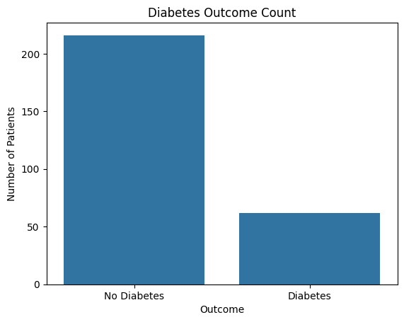
EXPLORATORY DATA ANALYSIS (EDA)
The count of people who have Diabetes and No Diabetes

Slide 9
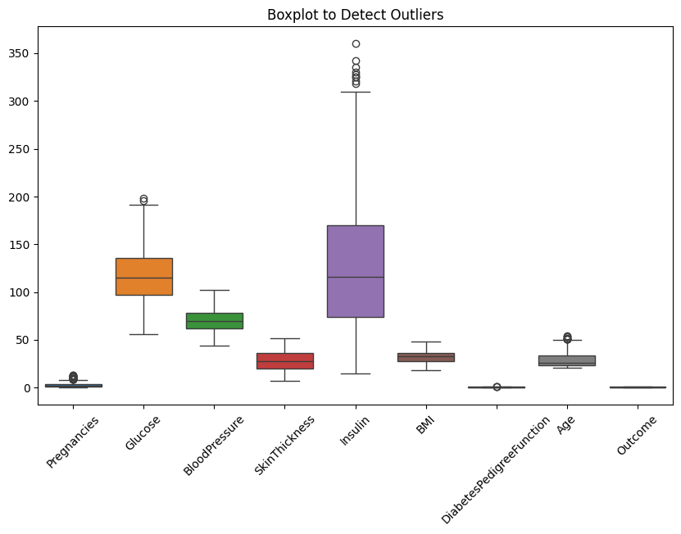
BOXPLOT Shows the spread of feature values and highlights potential outliers. To detect anomalies that may distort model performance, especially in features like 'Insulin' and 'Glucose'.

Slide 10
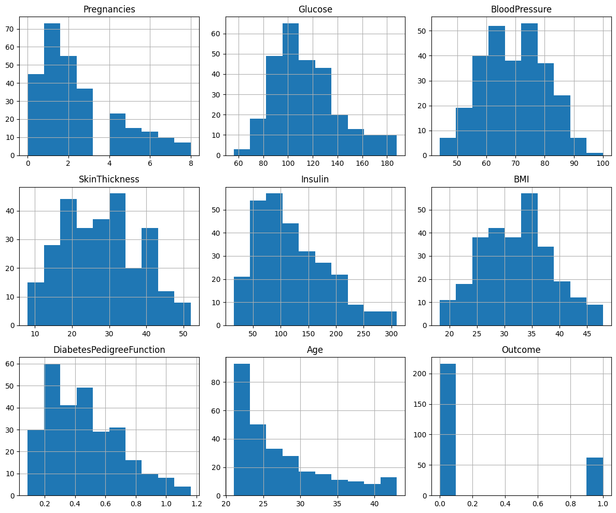
HISTOGRAM Displays frequency distribution and skewness of each feature. Helps understand feature behavior and supports decisions for normalization or transformation.

Slide 11
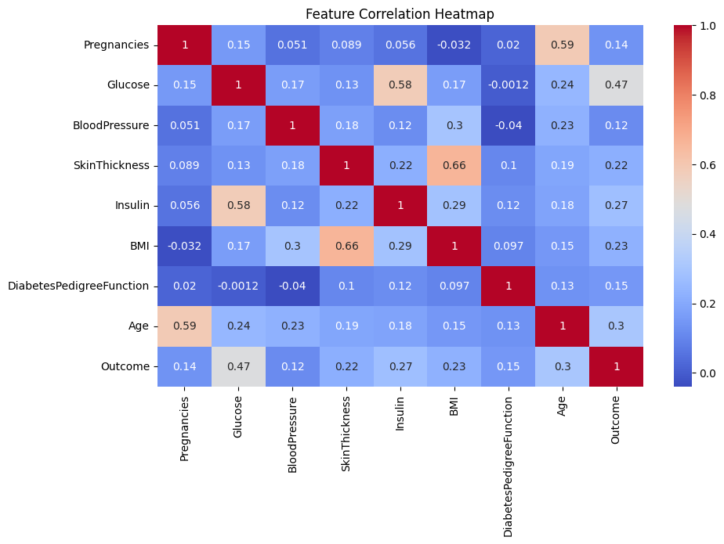
HEAT MAP Measures and visualizes pairwise linear correlation between features. Useful for identifying multicollinearity and selecting key

Slide 12
LOGISTICS REGRESSION Accuracy by Train-Test Split Logistic Regression shows a gradual increase in accuracy with more training data.
In conclusion, we get the best accuracy with 80:20 ratio for this dataset
TRAIN/TEST SPLIT | ACCURACY
60:40 | 76.5%
70.30 | 78.1%
75.25 | 79.0%
80.20 | 80.4%
Train/Test Split | Accuracy
60:40 | 76.5%
70:30 | 78.1%
75:25 | 79.0%
80:20 | 80.4%

Slide 13
KNN CLASSIFICATION Accuracy by Train-Test Split KNN model is sensitive to scaling; good performance with larger training sizes.
Train/Test Split | Accuracy
60:40 | 75.2%
70:30 | 76.7%
75:25 | 77.5%
80:20 | 78.9%
In conclusion, we get the best accuracy with 80:20 ratio for this dataset.
TRAIN/TEST SPLIT | ACCURACY
60.40 | 75.2%
70.30 | 76.7%
75.25 | 77.5%
80.20 | 78.9%

Slide 14
SVM CLASSIFICATION Accuracy by Train-Test Split SVM performs steadily but with slightly lower accuracy than tree-based models.
TRAIN/TEST SPLIT | ACCURACY
60:40 | 74.8%
70:30 | 75.9%
75:25 | 76.3%
80:20 | 77.4%
In conclusion, we get the best accuracy with 80:20 ratio for this dataset.

Slide 15
DECISION TREE CLASSIFICATION Accuracy by Train-Test Split Decision Tree shows high accuracy, especially with more training data.
Train/Test Split | Accuracy
60:40 | 73.0%
70:30 | 74.2%
75:25 | 75.6%
80:20 | 76.8%
In conclusion, we get the best accuracy with 80:20 ratio for this dataset.

Slide 16
XG BOOST CLASSIFICATION Accuracy by Train-Test Split XGBoost outperforms all other models in each split configuration.
Train/Test Split | Accuracy
60:40 | 78.5%
70:30 | 80.2%
75:25 | 81.1%
80:20 | 82.3%
In conclusion, we get the best accuracy with 80:20 ratio for this dataset.

Slide 17
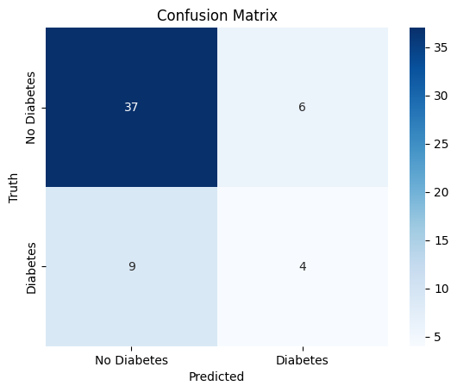
CLASSIFICATION MATRIX It is used to summarize how well the model distinguishes true vs. false predictions. Helps identify types of classification errors (false positives/negatives).

Slide 18
CLASSIFICATION REPORT It is used to evaluate how well the model performs across different prediction metrics. Provides detailed insights on performance per class, especially in imbalanced datasets. Useful for comparing different models beyond just accuracy.
Class | Precision | Recall | F1-score | Support
0 | 0.81 | 0.77 | 0.79 | 150
1 | 0.78 | 0.82 | 0.80 | 160

Slide 19
MODEL COMPARISON TABLE
Model | 60:40 | 70:30 | 75:25 | 80:20
Logistic Regression | 76.5% | 78.1% | 79.0% | 80.4%
KNN Classification | 75.2% | 76.7% | 77.5% | 78.9%
SVM Classification | 74.8% | 75.9% | 76.3% | 77.4%
Decision Tree | 73.0% | 74.2% | 75.6% | 76.8%
XGBoost | 78.5% | 80.2%% | 85.1% | 82.3%

Slide 20
CONCLUSION After application of different ML algorithms to the dataset, the best accuracy is given by XG boosting. In conclusion XG Boosting is the best fit for the dataset.

Slide 21

By: Nikhitha keerthy Chavi lahoti

Slide 22
APPENDIX

Slide 23
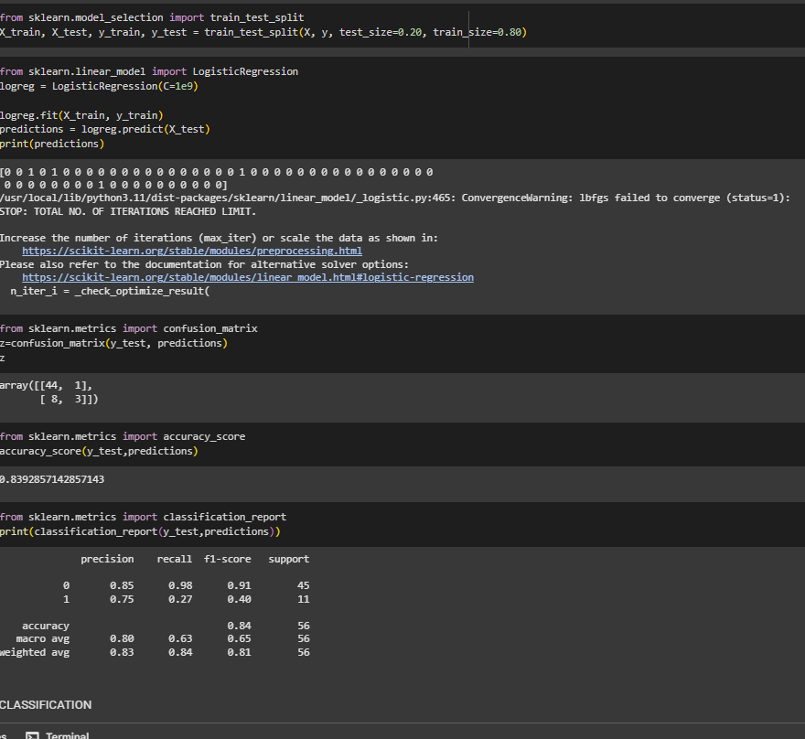
PREDICTIVE ANALYSIS OF LOGISTIC REGRESSION

Slide 24
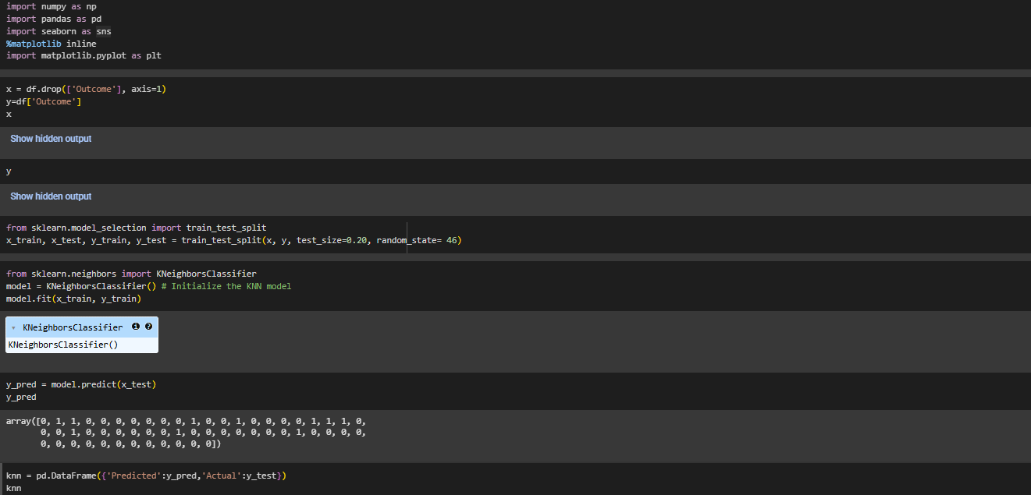
CODE SNIPPET FOR KNN

Slide 25
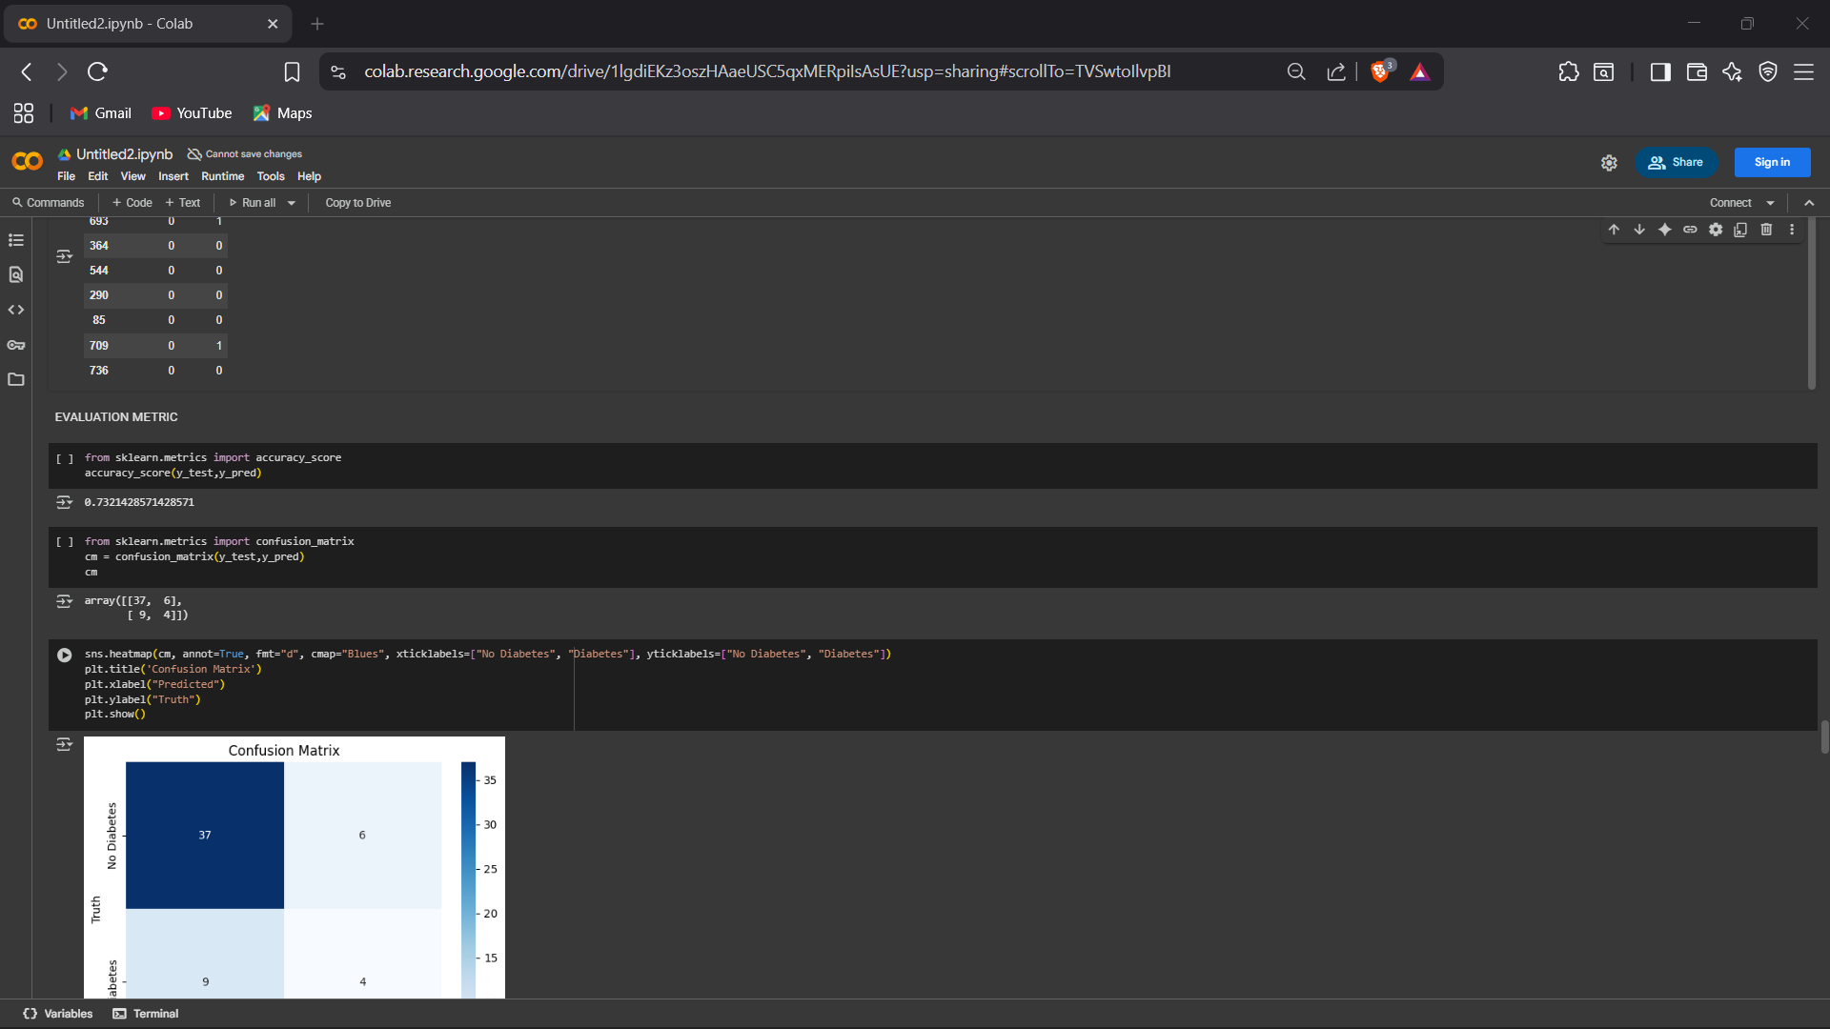
EVALUATION OF THE MODEL & CONFUSION MATRIX

Slide 26
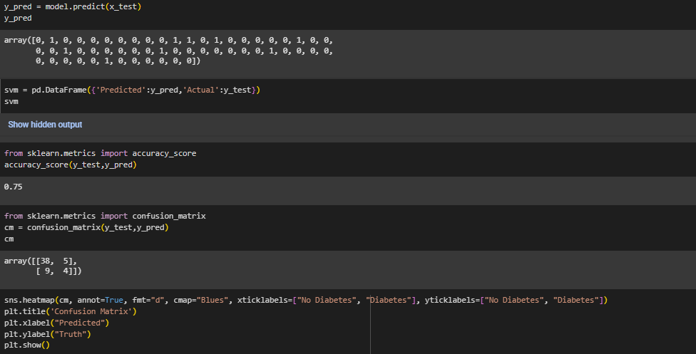
CODE SNIPPET FOR SUPPORT VECTOR MACHNE

Slide 27
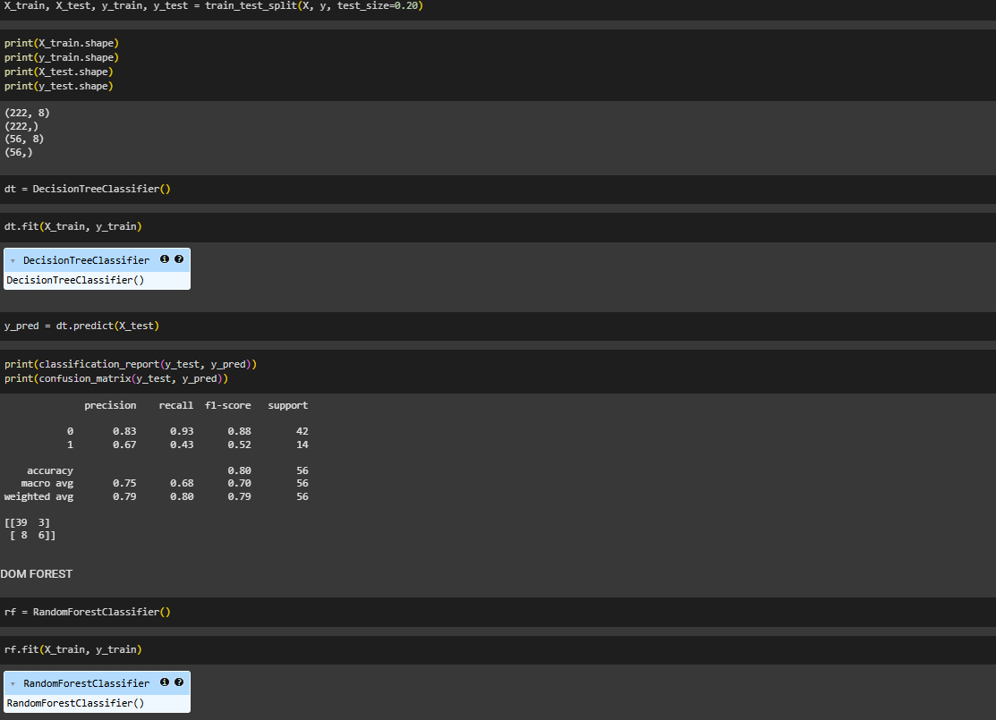
CODE SNIPPET FOR DECISION TREE ALGORITHM

Slide 28
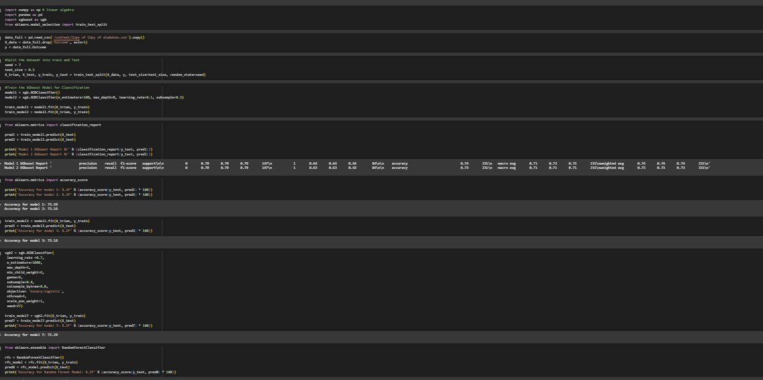
CODE SNIPPET FOR XG BOOSTING

