Slide 1

Major project
Name: Chawhan Bhoomika
College: Saanvi degree college for women
Course: BCA
Roll no: 2096 2286 1012

Slide 2
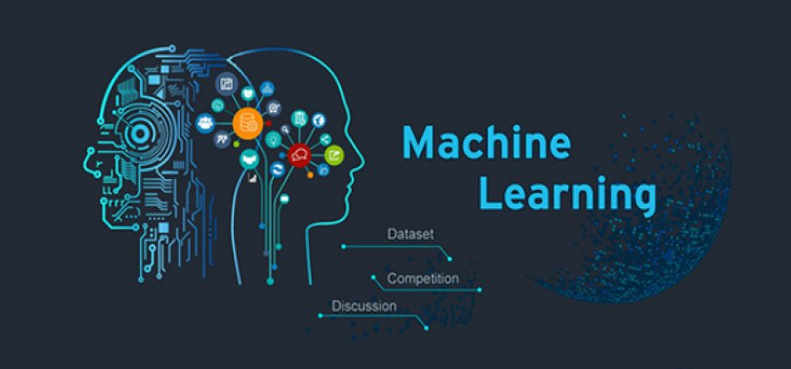
AGENDA
American express user exit
Introduction
Business problems
Dataset Description:
Methodology:
Expected Outcome:
Code implementation
conclusion
This Photo by Unknown Author is licensed under CC BY-SA

Slide 3
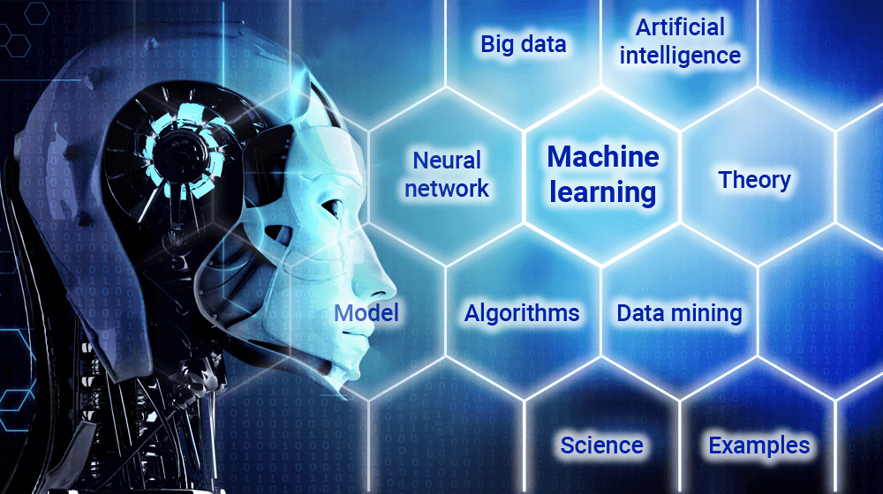
Introduction
This project aims to develop a predictive model using artificial neural networks (ANN) to identify customers who are likely to churn (exit) from american express services. By leveraging machine learning techniques, the goal is to analyze customer behavior, identify key factors influencing churn, and provide insights that can help retain customers.

Slide 4

Business problem:
Customer retention is a crucial challenge for financial institutions. Losing a customer not only impacts revenue but also increases acquisition costs for new customers. By predicting customer churn, american express can implement targeted strategies such as personalized offers, improved customer service, or loyalty programs to retain high-risk customers

Slide 5
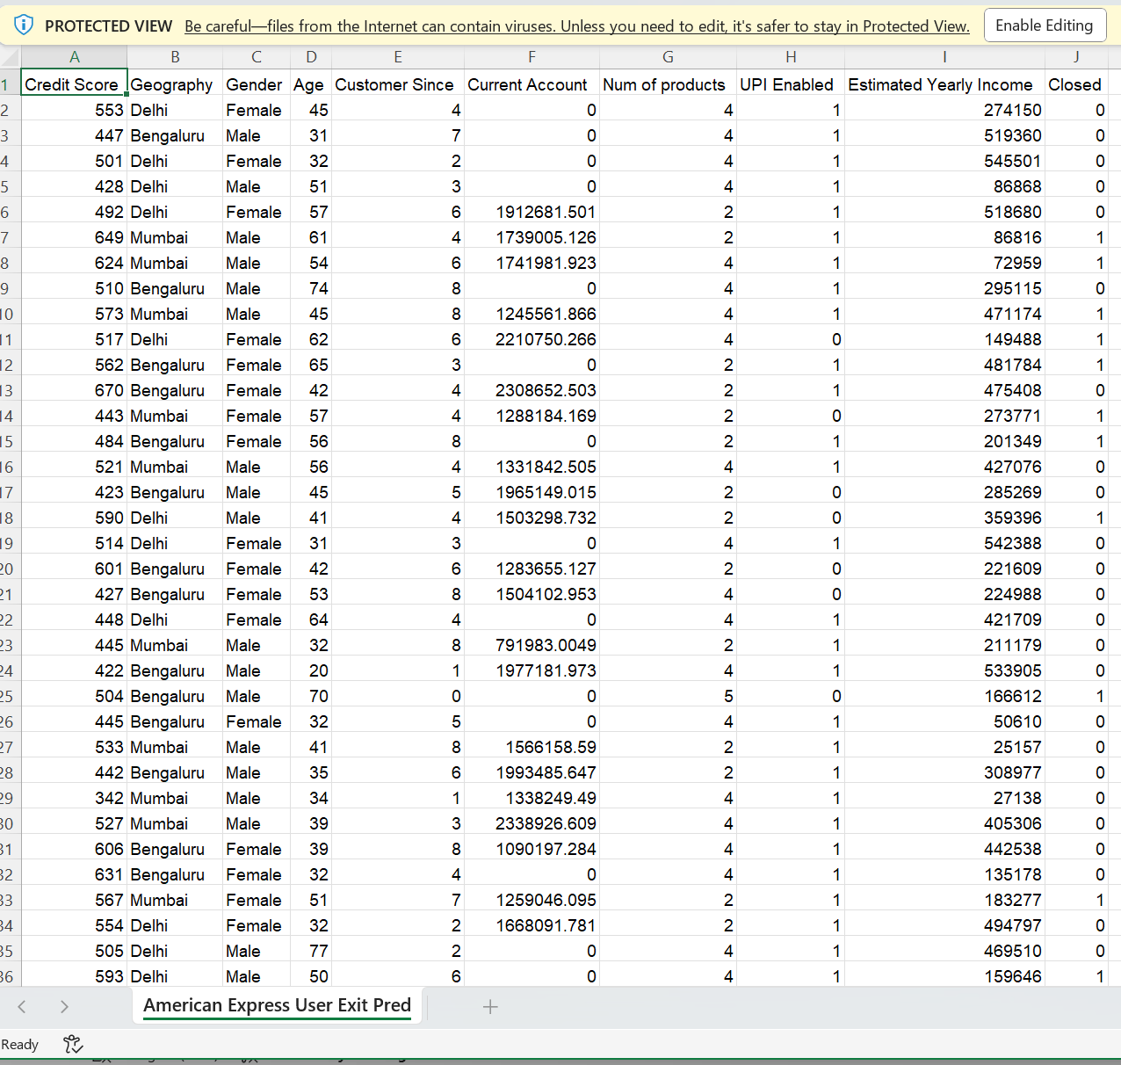
Dataset Description
The dataset consists of customer attributes, transaction behaviors, and historical data, which are used to predict whether a customer will churn or remain with the service. It includes categorical and numerical features, such as:
Demographics (e.g., age, gender, geographic region)
Account Information (e.g., account balance, transaction frequency)
Customer Engagement (e.g., product usage, complaint history)
Target Variable: Exited (1 if the customer left, 0 otherwise)

Slide 6
Methodology:
Exploratory Data Analysis (EDA)
Exploratory Data Analysis (EDA):
  Understanding dataset structure, missing values, correlations, and distributions.
  Visualizing the target variable distribution.
  Data Preprocessing:
  Encoding categorical variables (e.g., gender, region).
  Handling missing values.
  Splitting data into training and test sets (80-20 ratio).
  Standardizing numerical features for optimal model performance.
  Model Development (ANN):
  Constructing an Artificial Neural Network with input, hidden, and output layers.
  Using ReLU activation for hidden layers and Sigmoid for binary classification.
  Model Training & Evaluation:
  Training the model on historical data for 120 epochs using batch gradient descent.
  Evaluating performance using accuracy score and confusion matrix
  Visualizing model accuracy and loss trends over training epochs.
Data Preprocessing
Model Development (ANN)
  Model Training & Evaluation

Slide 7
Expected Outcome:
A trained ANN model that accurately classifies customers into churn or non-churn categories.
Identification of significant factors contributing to customer churn.
Insights that American Express can use to enhance customer retention strategies.

Slide 8
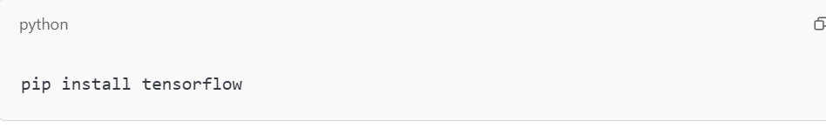
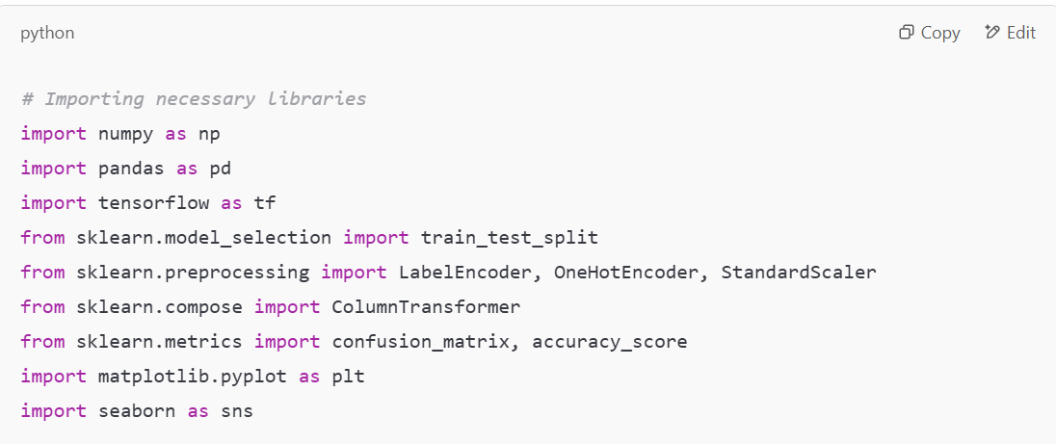
Code implementation
Installing Dependencies
  TensorFlow is an open-source machine learning framework developed by Google for building and training deep learning models.
This installs TensorFlow, a popular deep learning library.
2. Importing Necessary Libraries

Slide 9
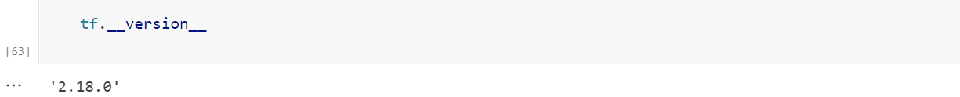
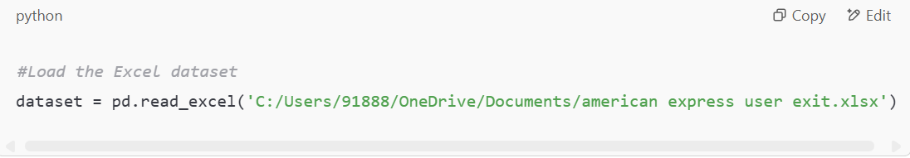
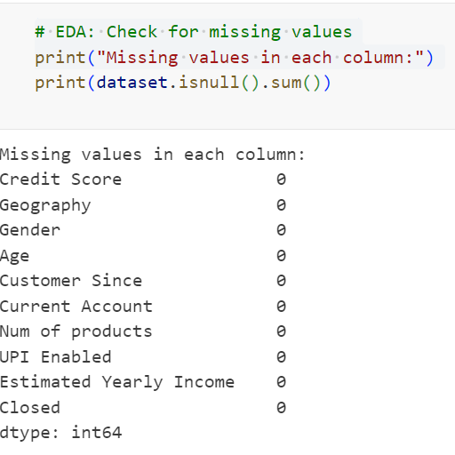
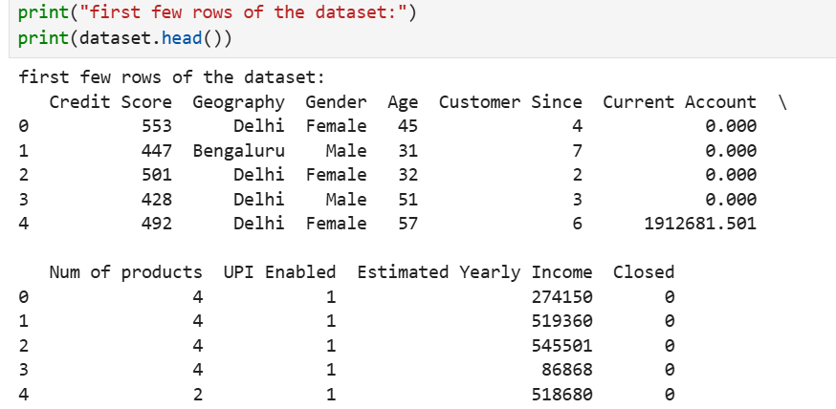
3. Checking TensorFlow Version
4. Loading the Dataset
6. Checking for Missing Values
5. Exploratory Data Analysis (EDA)

Slide 10
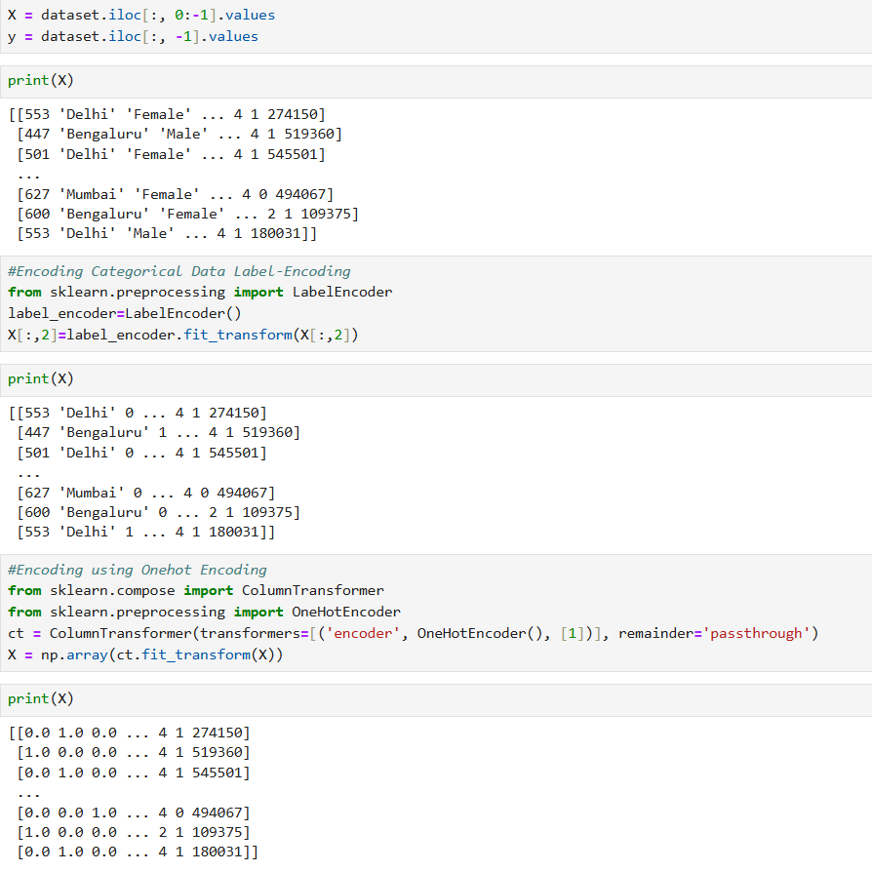
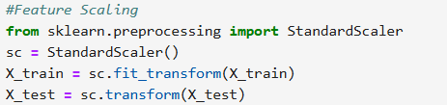
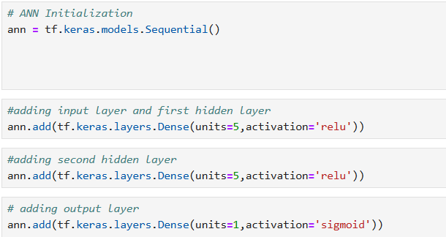
7. Encoding Categorical Data
8. Splitting the Dataset into Training and Testing Sets
9. Feature Scaling
10. Building a Neural Network Model

Slide 11
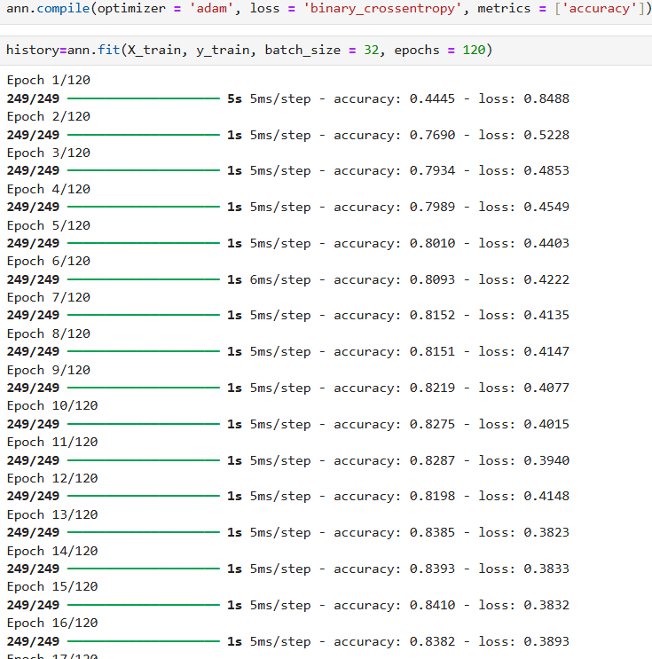
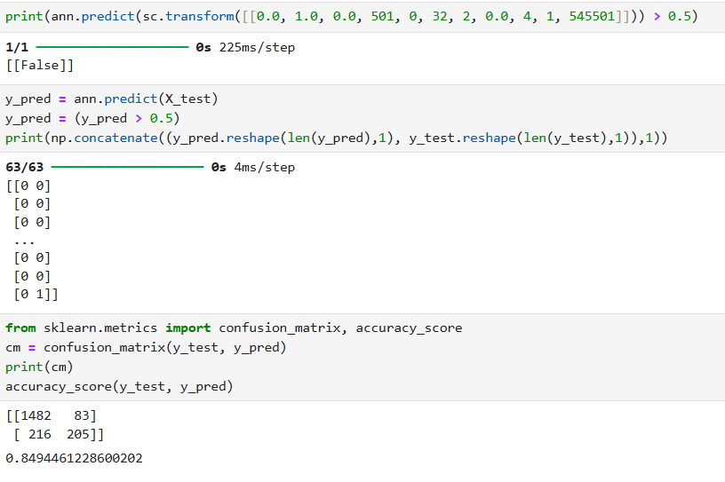
11. Compiling and Training the Model
12. Evaluating the Model

Slide 12
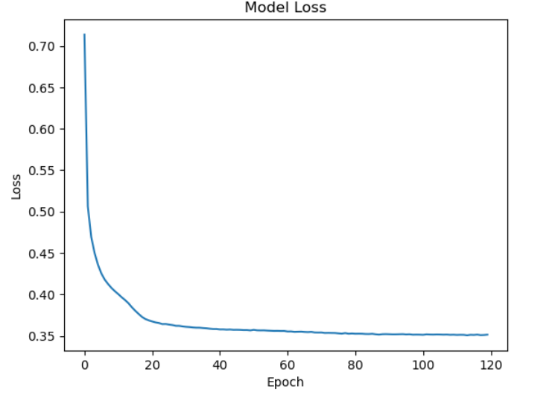
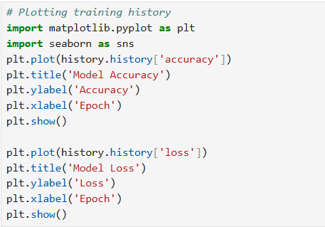
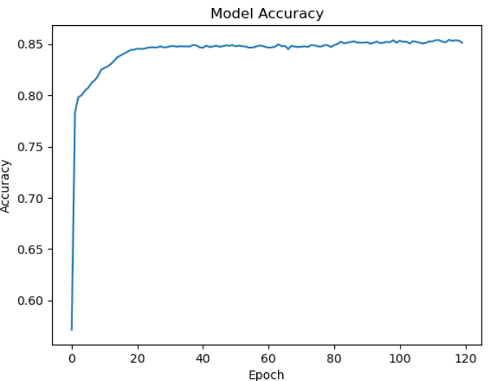
13. Visualizing Results

Slide 13
Conclusion
This project is building a binary classification model using an artificial neural network to predict customer churn in american express users. It includes:
Data preprocessing (handling missing values, encoding, scaling).
Splitting data into training/testing sets.
Defining and training a neural network.
Evaluating model performance.

Slide 14

THANK YOU
Chawhan Bhoomika

