Slide 1
Infinite Loops
An infinite loop is a looping construct that does not terminate the loop and executes the loop forever.
An infinite loop is useful for those applications that accept the user input and generate the output continuously until the user exits from the application manually.
Infinite loops can be intentional and unintentional.
SRH Berlin University of Applied Science
Notes:
An infinite loop is a looping construct that does not terminate the loop and executes the loop forever. It is also called an indefinite loop or an endless loop. It either produces a continuous output or no output.
This type of loop can be used:
All the operating systems run in an infinite loop as it does not exist after performing some task. It comes out of an infinite loop only when the user manually shuts down the system.
All the servers run in an infinite loop as the server responds to all the client requests. It comes out of an indefinite loop only when the administrator shuts down the server manually.
All the games also run in an infinite loop. The game will accept the user requests until the user exits from the game.
Show some examples.

Slide 2
Break and Continue Statements
The break is a keyword in C which is used to bring the program control out of the loop.
The break statement is used inside loops or switch statement.
The break statement breaks the nested loops one by one, starting from the inner-most loop.
The Continue is mainly used for a condition so that we can skip some code for a particular condition.
The Continue statement skips the current iteration and proceeds with the next iteration.
SRH Berlin University of Applied Science
Notes:
The break is a keyword in C which is used to bring the program control out of the loop.
The break statement is used inside loops or switch statement.
The break statement breaks the loop one by one, i.e., in the case of nested loops, it breaks the inner loop first and then proceeds to outer loops.
Examples
The Continue is mainly used for a condition so that we can skip some code for a particular condition.
The Continue statement skips the current iteration and proceeds with the next iteration

Slide 3
The goto Statement
The goto statement is known as jump statement in C.
The goto is used to transfer the program control to a predefined label.
The goto statement can be used to repeat some part of the code for a particular condition.
It can also be used to break the multiple loops which can't be done by using a single break statement.
However, using goto is avoided these days since it makes the program less readable and complicated.
SRH Berlin University of Applied Science
Notes:
The goto statement is known as jump statement in C.
goto is used to transfer the program control to a predefined label.
The goto statment can be used to repeat some part of the code for a particular condition.
It can also be used to break the multiple loops which can't be done by using a single break statement.
However, using goto is avoided these days since it makes the program less readable and complicated.

Slide 4
Type casting
Typecasting allows us to convert one data type into other.
In C language, we use cast operator for typecasting which is denoted by (type).
Note: It is always recommended to convert the lower value to higher for avoiding data loss.
SRH Berlin University of Applied Science
Notes:
Typecasting allows us to convert one data type into other.
goto is used to transfer the program control to a predefined label.
The goto statment can be used to repeat some part of the code for a particular condition.
It can also be used to break the multiple loops which can't be done by using a single break statement.
However, using goto is avoided these days since it makes the program less readable and complicated.

Slide 5
Functions
In C, we can divide a large program into the basic building blocks known as function.
The function contains the set of programming statements enclosed by {}.
A function can be called multiple times to provide reusability and modularity to the program.
SRH Berlin University of Applied Science
Notes:
In C, we can divide a large program into the basic building blocks known as function.
The function contains the set of programming statements enclosed by {}.
A function can be called multiple times to provide reusability and modularity to the C program. In other words, we can say that the collection of functions creates a program.

Slide 6
Advantage of Functions
By using functions, we can avoid rewriting same logic/code again and again in a program.
We can call C functions any number of times in a program and from any place in a program.
We can track a large C program easily when it is divided into multiple functions.
Reusability is the main achievement of C functions.
However, Function calling is always a overhead in a C program.
Solution: Inline functions in C++.
SRH Berlin University of Applied Science
Notes:
There are the following advantages of C functions:
By using functions, we can avoid rewriting same logic/code again and again in a program.
We can call C functions any number of times in a program and from any place in a program.
We can track a large C program easily when it is divided into multiple functions.
Reusability is the main achievement of C functions.
However, Function calling is always a overhead in a C program.

Slide 7
Function Aspects
There are three aspects of a C function.
Function declaration: A function must be declared globally in a C program to tell the compiler about the function name, function parameters, and return type.
Function call: Function can be called from anywhere in the program.
Function definition: It contains the actual statements which are to be executed.
SRH Berlin University of Applied Science
Notes:
There are three aspects of a C function:
Function declaration: A function must be declared globally in a C program to tell the compiler about the function name, function parameters, and return type.
Function call: Function can be called from anywhere in the program. The parameter list must not differ in function calling and function declaration. We must pass the same number of functions as it is declared in the function declaration.
Function definition: It contains the actual statements which are to be executed. It is the most important aspect to which the control comes when the function is called. Here, we must notice that only one value can be returned from the function.

Slide 8
Function types
There are 2 types functions.
Library Functions: The functions which are declared in the C header files such as scanf(), printf(), gets(), puts(), ceil(), floor() etc.
User-defined functions: The functions which are created by the C programmer, so that he/she can use it many times. It reduces the complexity of a big program and optimizes the code.
SRH Berlin University of Applied Science
Notes:
There are 2 types functions:
Library Functions: The functions which are declared in the C header files such as scanf(), printf(), gets(), puts(), ceil(), floor() etc.
User-defined functions: The functions which are created by the C programmer, so that he/she can use it many times. It reduces the complexity of a big program and optimizes the code.

Slide 9
Return value
A C function may or may not return a value from the function.
If you don't have to return any value from the function, use void for the return type.
SRH Berlin University of Applied Science
Notes:
A C function may or may not return a value from the function.
If you don't have to return any value from the function, use void for the return type.

Slide 10
Library functions
Library functions are the inbuilt function in C that are grouped and placed at a common place called the library.
Such functions are used to perform some specific operations.
The library functions are created by the designers of compilers.
All C standard library functions are defined inside the different header files saved with the extension .h.
We need to include these header files in our program to make use of the library functions defined in such header files.
SRH Berlin University of Applied Science
Notes:
Library functions are the inbuilt function in C that are grouped and placed at a common place called the library. Such functions are used to perform some specific operations.
For example, printf is a library function used to print on the console.
The library functions are created by the designers of compilers.
All C standard library functions are defined inside the different header files saved with the extension .h.
We need to include these header files in our program to make use of the library functions defined in such header files.
For example, To use the library functions such as printf/scanf we need to include stdio.h in our program which is a header file that contains all the library functions regarding standard input/output.

Slide 11
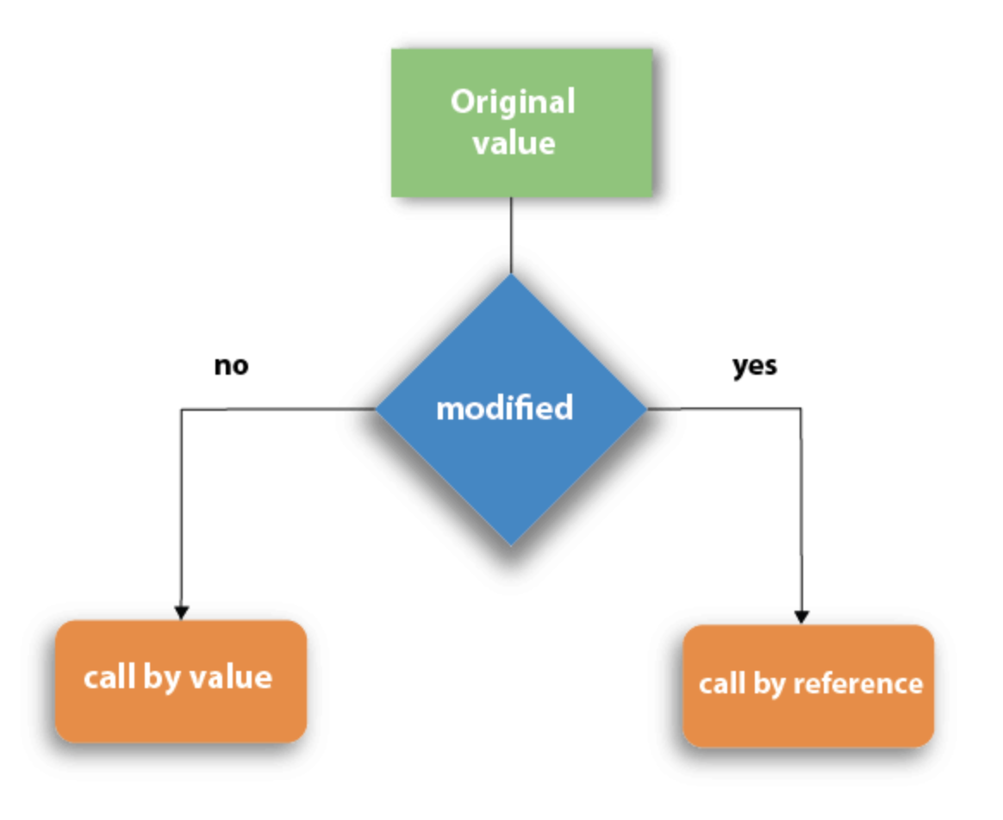
Call by value and Call by reference
There are two methods to pass the data into the function in C language
Call by value
Call by reference
SRH Berlin University of Applied Science
Notes:
There are two methods to pass the data into the function in C language
Call by value
Call by reference

Slide 12
Call by value
In call by value method, the value of the actual parameters is copied into the formal parameters.
We can not modify the value of the actual parameter by the formal parameter.
Different memory is allocated for actual and formal parameters since the value of the actual parameter is copied into the formal parameter.
The actual parameter is the argument which is used in the function call whereas formal parameter is the argument which is used in the function definition.
SRH Berlin University of Applied Science
Notes:
In call by value method, the value of the actual parameters is copied into the formal parameters. In other words, we can say that the value of the variable is used in the function call in the call by value method.
we can not modify the value of the actual parameter by the formal parameter.
different memory is allocated for actual and formal parameters since the value of the actual parameter is copied into the formal parameter.
The actual parameter is the argument which is used in the function call whereas formal parameter is the argument which is used in the function definition.

Slide 13
Call by reference
In call by reference, the address of the variable is passed into the function call as the actual parameter.
The value of the actual parameters can be modified by changing the formal parameters since the address of the actual parameters is passed.
The memory allocation is similar for both formal parameters and actual parameters.
SRH Berlin University of Applied Science
Notes:
In call by reference, the address of the variable is passed into the function call as the actual parameter.
The value of the actual parameters can be modified by changing the formal parameters since the address of the actual parameters is passed.
the memory allocation is similar for both formal parameters and actual parameters. All the operations in the function are performed on the value stored at the address of the actual parameters, and the modified value gets stored at the same address.

Slide 14
Recursion
Any function which calls itself is called recursive function.
it is important to impose a termination condition of recursion.
Recursion code is shorter than iterative code however it is difficult to understand.
Recursion cannot be applied to all the problem, but it is more useful for the tasks that can be defined in terms of similar subtasks.
Generally, iterative solutions are more efficient than recursion.
Any problem that can be solved recursively, can also be solved iteratively.
However, some problems are best suited to be solved by the recursion.
SRH Berlin University of Applied Science
Notes:
Any function which calls itself is called recursive function, and such function calls are called recursive calls. Recursion is the process which comes into existence when a function calls a copy of itself to work on a smaller problem.
it is important to impose a termination condition of recursion.
Recursion code is shorter than iterative code however it is difficult to understand.
Recursion cannot be applied to all the problem, but it is more useful for the tasks that can be defined in terms of similar subtasks. For Example, recursion may be applied to sorting, searching, and traversal problems.
Generally, iterative solutions are more efficient than recursion since function call is always overhead.
Any problem that can be solved recursively, can also be solved iteratively.
However, some problems are best suited to be solved by the recursion, for example, tower of Hanoi, Fibonacci series, factorial finding, etc.

Slide 15
Recursive functions
A recursive function performs the tasks by dividing it into the subtasks.
There is a termination condition defined in the function which is satisfied by some specific subtask.
After this, the recursion stops and the final result is returned from the function.
The case at which the function doesn't recur is called the base case.
The instances where the function keeps calling itself to perform a subtask, is called the recursive case.
SRH Berlin University of Applied Science
Notes:
A recursive function performs the tasks by dividing it into the subtasks.
There is a termination condition defined in the function which is satisfied by some specific subtask.
After this, the recursion stops and the final result is returned from the function.
The case at which the function doesn't recur is called the base case.
The instances where the function keeps calling itself to perform a subtask, is called the recursive case.

Slide 16
Memory allocation of recursive functions
Each recursive call creates a new copy of that method in the memory.
Once some data is returned by the method, the copy is removed from the memory.
All the variables and other stuff declared inside function get stored in the stack.
A separate stack is maintained at each recursive call.
Once the value is returned from the corresponding function, the stack gets destroyed.
SRH Berlin University of Applied Science
Notes:
Each recursive call creates a new copy of that method in the memory.
Once some data is returned by the method, the copy is removed from the memory.
All the variables and other stuff declared inside function get stored in the stack.
A separate stack is maintained at each recursive call.
Once the value is returned from the corresponding function, the stack gets destroyed.
Recursion involves so much complexity in resolving and tracking the values at each recursive call. Therefore we need to maintain the stack and track the values of the variables defined in the stack.

