Slide 1

Predicting tags on Stack Overflow
Chaitanya V S | MY.AC.P2MCA24011

Slide 2
Contents of Presentation
Understanding Problem
Multi-Label-Classification
Frequently Used Terms
Performance Metrics
Natural Language Processing Tools
Strategy

Slide 3
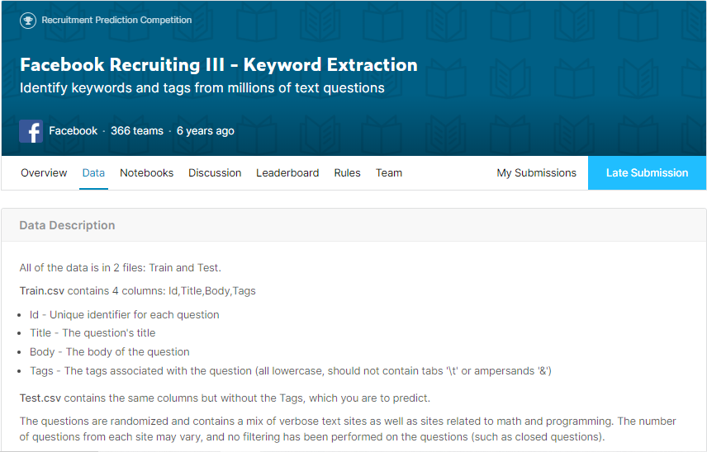
Understanding Problem

Slide 4
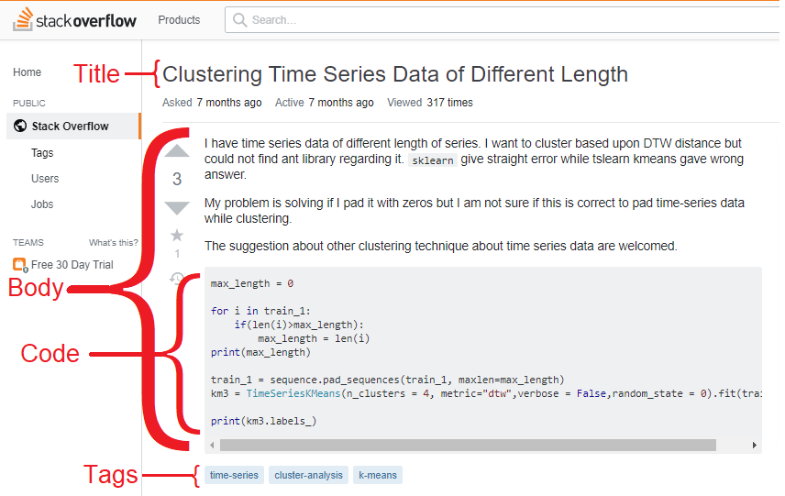
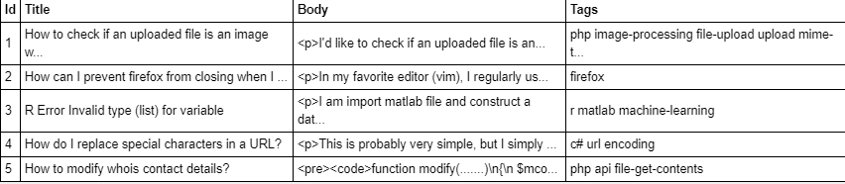
Understanding Problem

Slide 5
Contents of Presentation
Understanding Problem
Multi-Label-Classification
Frequently Used Terms
Performance Metrics
Natural Language Processing Tools
Strategy

Slide 6
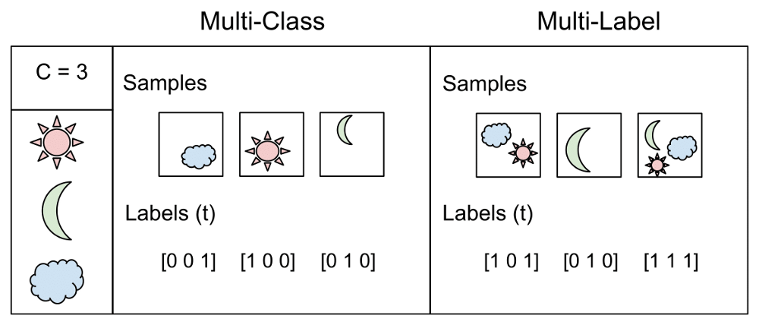
Multi-Label-Classification
Training data | Tag 1 | Tag 2 | Tag 3 | Tag 4
X1 | 1 | 1 | 0 | 0
X2 | 1 | 1 | 1 | 0
X3 | 0 | 0 | 1 | 0
X4 | 1 | 0 | 0 | 1
x5 | 0 | 0 | 0 | 1
Training data | Tag 1
X1 | 1
X2 | 1
X3 | 0
X4 | 1
x5 | 0
Training data | Tag 2
X1 | 1
X2 | 1
X3 | 0
X4 | 0
x5 | 0
Training data | Tag 3
X1 | 0
X2 | 1
X3 | 1
X4 | 0
x5 | 0
Training data | Tag 4
X1 | 0
X2 | 0
X3 | 0
X4 | 1
x5 | 1
Like This we have 500 selected tags and 500 separate models are trained.

Slide 7
Multi-Label-Classification
Difficulty in this problem
Large Data (6GB’s)
Real Challenge was to process and train the data because such a large number of concurrent models (42k is consider all tags) requires huge amount of ram if after using the concept of partial coverage 500 tags i.e. 500 concurrent models makes it difficult for personal computer level hardware.
Saving the Intermediate pre-processed data.
Crash Management
Other Real World Application of the Project
IMDB movie Tagging
Books Tagging
E-Commerce Product Tagging

Slide 8
Contents of Presentation
Understanding Problem
Multi-Label-Classification
Frequently Used Terms
Performance Metrics
Natural Language Processing Tools
Strategy

Slide 9
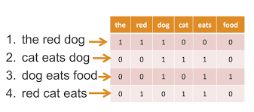
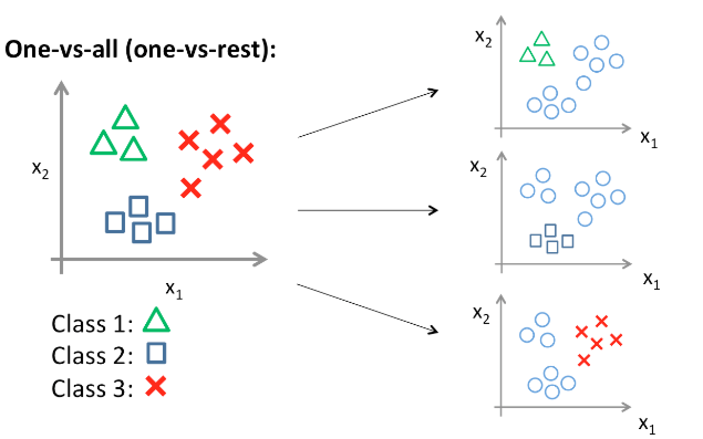
Frequently Used Terms
Count Vectorizer
TF-IDF ( Term Frequency - Inverse Document Frequency)
One Vs Rest SGD Classifier – Machine Leaning Model

Slide 10
Contents of Presentation
Understanding Problem
Multi-Label-Classification
Frequently Used Terms
Performance Metrics
Natural Language Processing Tools
Strategy

Slide 11


Performance Metrics
Accuracy
In the Project if a test question has 4 tags and our model has predicted 3 tags correctly, still it is kept as incorrect prediction as per the challenge guidelines which is also important because accuracy is not only the important thing other parameters like Precision and Recall are also important, they lose the importance as soon as we start using the concept of partial accuracy.
Testing Data | Actual Tags [1,2,3,4] | Predicted Tags [1,2,3,4]
x1 | [1,0,1,1] | [1,0,1,1]
x2 | [1,1,1,1] | [0,1,1,1]
X3 | [1,0,0,1] | [1,1,0,1]
Accuracy
Partial Accuracy

Slide 12
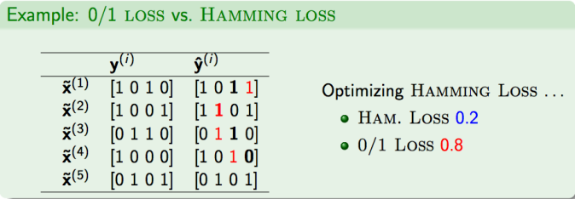
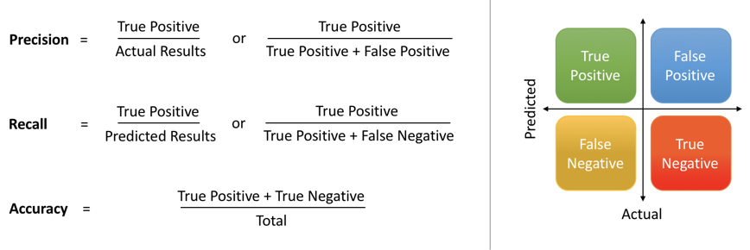
Performance Metrics
Hamming Loss
Precision And Recall
To calculate precision and recall for multilabel classification. You can add the precision and recall separately for each class, then divide the sum with the number of classes. You will get the approximate calculation of precision and recall for them.
To get the Correct Precision and Recall We have to create the binary prediction of each test data and use the Native approach.

Slide 13
Contents of Presentation
Understanding Problem
Multi-Label-Classification
Frequently Used Terms
Performance Metrics
Natural Language Processing Tools
Strategy

Slide 14
Natural Language Processing Tools
Stop word Removal except C & R
Snowball Stemmer
Regular Expression
Html Striping
Code Extraction
Trim numeric values
Trim Links
Word Tokenizer
Word Cloud
2-gram ( In order to keep the training data features less than 100k)

Slide 15
Natural Language Processing Tools
How a single Question is processed ?
Title | Body | Tags
this is title of the question<br> 246? | <p> This is the<br> body <code> code anywhere inside may be present is taken as it as </code> it may have <br>numeric value 234567 with456u7 / without text and <br> may contain useless link like this https://abc.com </p> | Java python-3.1 python 3.2
Applying Cleaning through Regular Expression
Title | Processed Body | Extracted Code
this is title of the question | This is the body it may have numeric value withu without text and may contain useless link like this | code anywhere inside may be present is taken as it as
Tag1 | Tag2 | Tag3 | Tag4 | Tag5 | Tag6 | Tag7
0 | 1 | 0 | 1 | 1 | 0 | 0
Stemming and Stop word removal
Title | Processed Body | Extracted Code
title quest | body may numeric value withu without text may contain useless link like thi | code anywhere inside may be present is taken as it as
Merging all to make single column

Slide 16
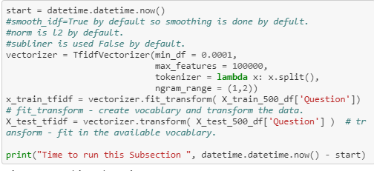
Natural Language Processing Tools
Title | Processed Body | Extracted Code
title quest | body may numeric value withu without text may contain useless link like thi | code anywhere inside may be present is taken as it as
Weighted merger => 3*Title + Processed Body + Extracted Code
Merging all to make single column
Training Ready Data
title quest title quest title quest body may numeric value withu without text may contain useless link like thi code anywhere inside may be present is taken as it as
2 gram Model with TFIDF
w1 | w2 | w3 | W4 | W5 | W1 w2 | W2 w3 | W3 w4 | W4 w5

Slide 17
Contents of Presentation
Understanding Problem
Multi-Label-Classification
Frequently Used Terms
Performance Metrics
Natural Language Processing Tools
Strategy

Slide 18
Strategy
Exploratory Data Analysis - EDA
Machine Learning

Slide 19
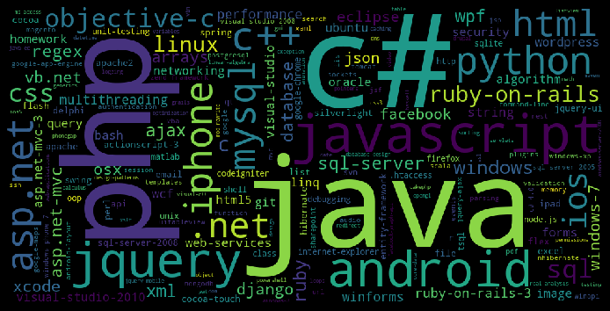
Exploratory Data Analysis - EDA

Slide 20
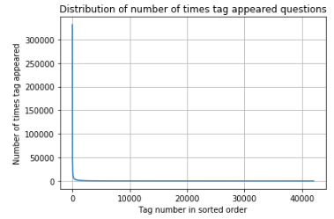
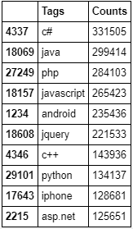
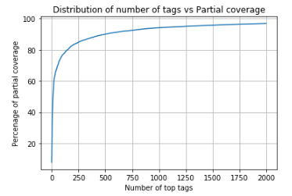

Exploratory Data Analysis - EDA
Number of tags Vs Number of Question
Partial Coverage – Question Covered by at least 1 of the tag
Selected Tags 500 covers the 90.06149992050626 percent of questions.

Slide 21

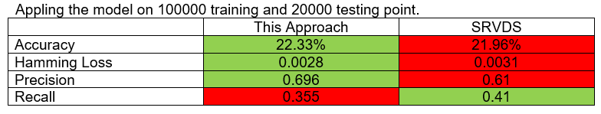
Machine Learning
Type of X: scipy.sparse.csr.csr_matrix
Dimensions of train data X: (3030610, 100000)
Dimensions of test data X: (841262, 100000)
Type of Y: scipy.sparse.csr.csr_matrix
Dimensions of train data Y: (3030610, 500)
Dimensions of test data Y: (841262, 500)
This Project is inspired from project by SRVDS. github.com/srvds/Stack-Overflow-tag-prediction/blob/master/SO_Tag_Predictor2.ipynb

Slide 22
Thank You

