Slide 1
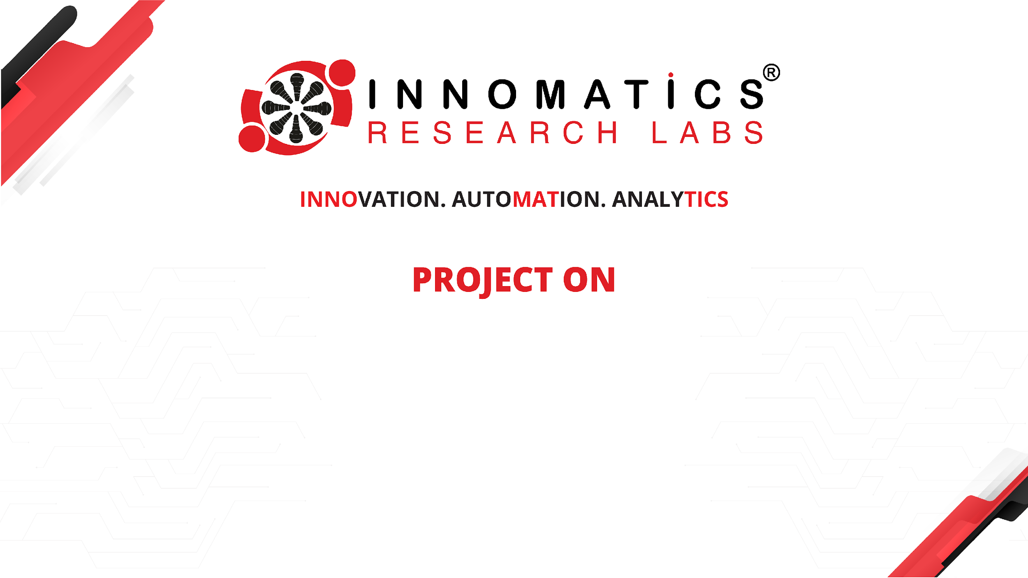
Maths using Hand Gesture
Presented by : Chauhan chayan Batch No : 450
INNOMATICS RESEARCH LABS,
DILSUKHNAGAR, HYDERABAD

Slide 2
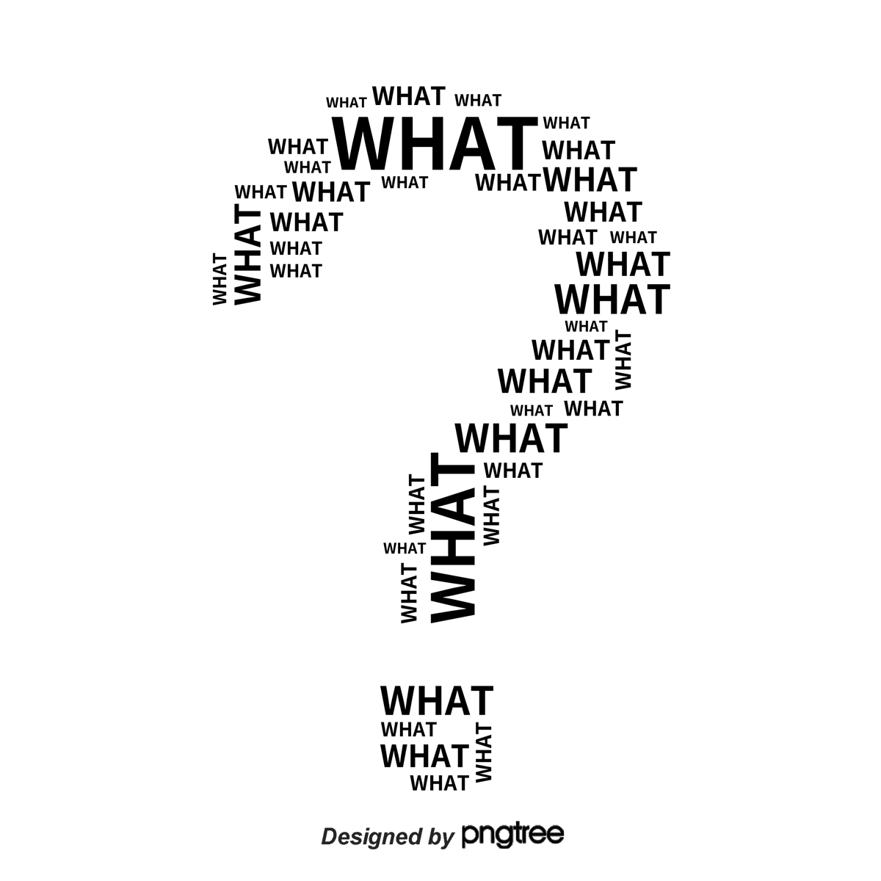
AGENDA
Introduction
Problem Statement
Proposed Solution
Objectives
Technologies Used
System Architecture
Working Process
Features & Advantages
Future Scope
Demo
Conclusion
Limitations

Slide 3
CRISP-ML(Q)
A Standardized Framework: It stands for Cross-Industry Standard Process for Machine Learning with Quality Assurance.
Lifecycle Management: It provides a systematic, six-step approach to ensure that Machine Learning projects are reliable, high-quality, and meets business objectives
Business & Data Understanding
Data Preparation
Modelling & Logic Design
Evaluation & Quality Assurance
Deployment
Monitoring and Maintenance

Slide 4
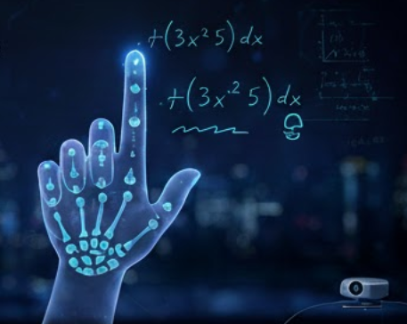
INTRODUCTION
Mathematics problem solving using keyboard or paper is sometimes slow and difficult
Gesture-based technology provides a modern and easy way of input
This system uses a camera to capture hand movements
Users can draw math problems in the air using gestures
The drawn problem is processed and sent to AI for solving
It makes learning faster, interactive, and touchless

Slide 5
PROBLEM STATEMENT
Problem Statement:
Entering mathematical expressions using keyboard is difficult and time-consuming
Not all devices support easy math input
Manual solving of problems takes more time
Existing systems are not interactive or user-friendly
Proposed Solution:
Use hand gestures to input mathematical problems
Camera captures and tracks hand movements
Drawn expressions are processed on a digital canvas
AI model solves the problem and displays the result instantly

Slide 6
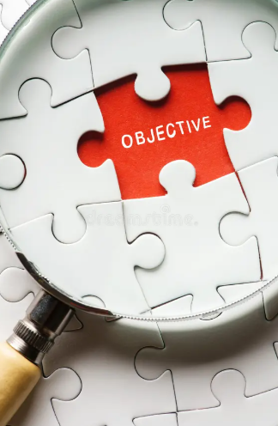
PROBLEM OBJECTIVE
To develop a system that can recognize hand gestures for math input
To provide real-time solving of mathematical problems
To create an easy and user-friendly interface
To integrate AI for automatic problem solving
To make learning faster and more interactive

Slide 7
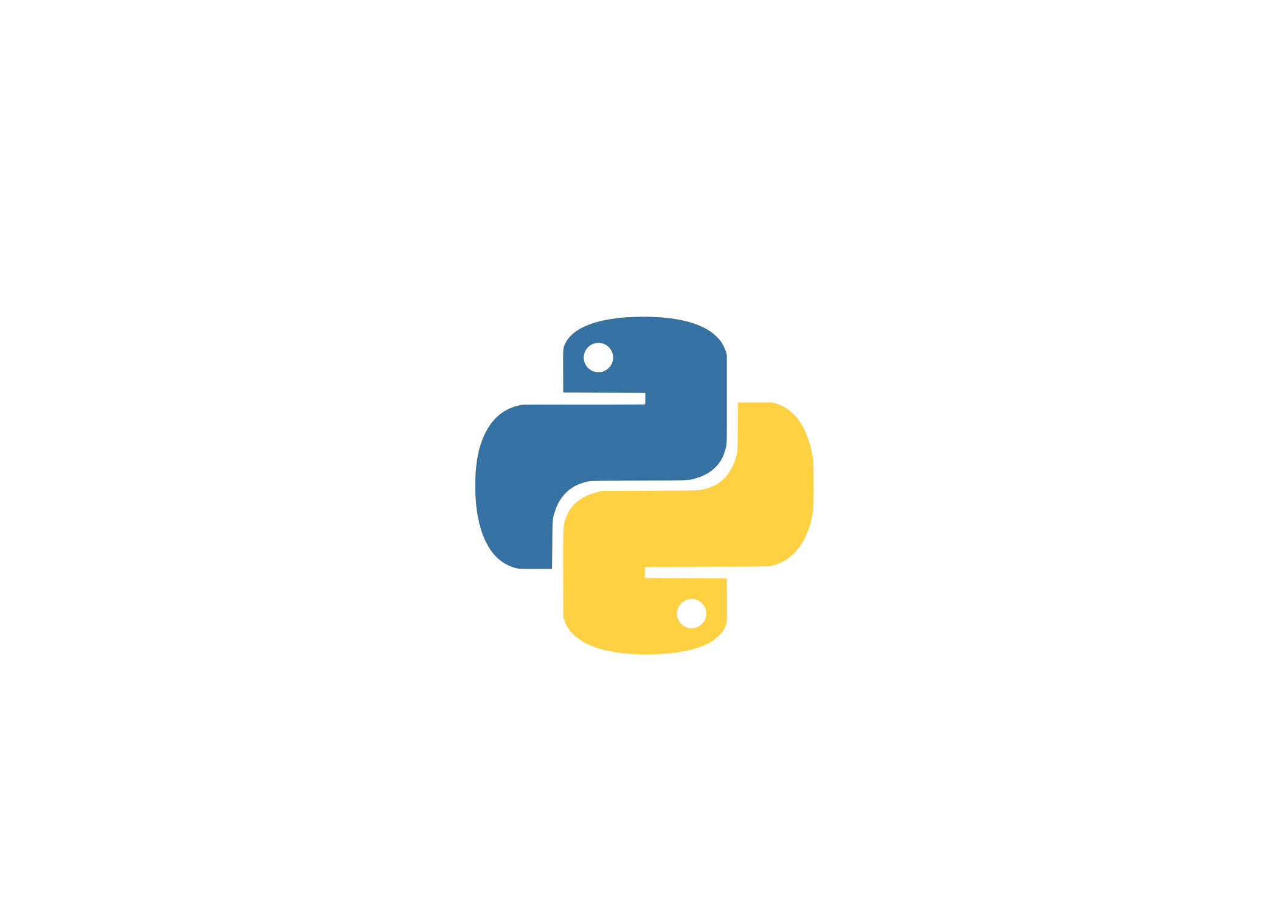



Libraries & Tools used
OpenCV – for image processing and camera handling
cvzone – for hand tracking and gesture detection
NumPy – for array operations
PIL (Python Imaging Library) – for image conversion
Streamlit – for user interface
Google Gemini API – for solving math problems using AI

Slide 8
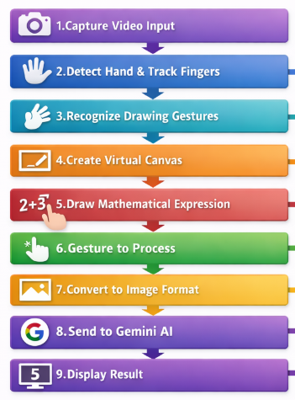
SYSTEM ARCHITECTURE & WORKFLOW
Step 1: The camera captures real-time video input (Input Layer)
Step 2: The system detects the hand and tracks finger positions (Processing Layer)
Step 3: Gesture recognition identifies drawing movements (Processing Layer)
Step 4: A virtual canvas is created to display the drawing (Application Layer)
Step 5: The user writes mathematical expressions using gestures (User Interaction Layer)
Step 6: A specific gesture is used to trigger the processing (Control Layer)
Step 7: The drawn image is converted into a suitable format (Processing Layer)
Step 8: The image is sent to Google Gemini API (AI Processing Layer)
Step 9: The AI processes the input and displays the result (Output Layer)

Slide 9
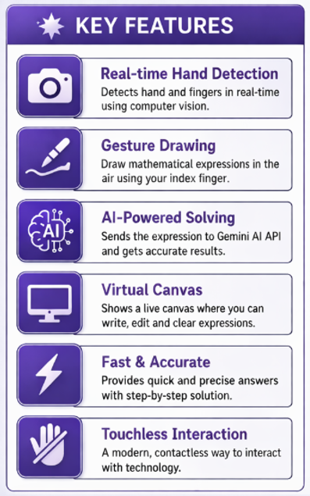
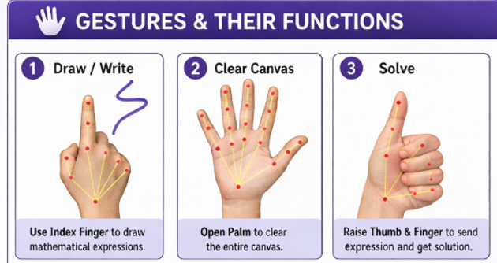
KEY FEATURES & GESTURE LOGIC

Slide 10
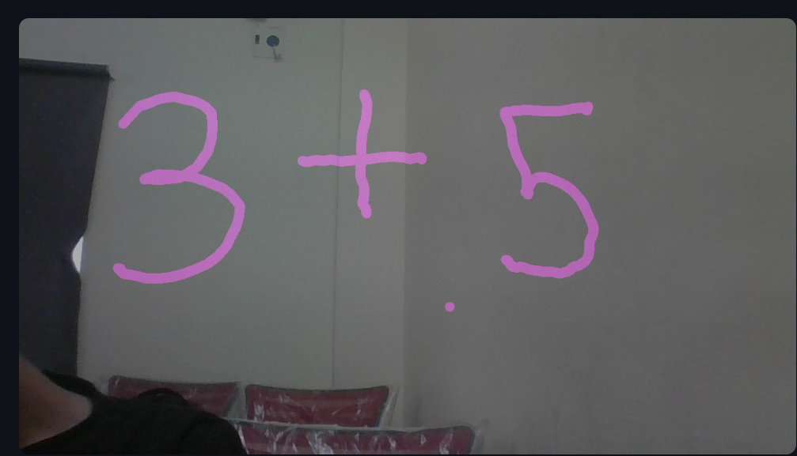
PROJECT OUTPUT

Slide 11
CHALLENGES & CONSTRAINTS
Accurate hand detection is difficult in low lighting conditions
Background noise can affect gesture recognition
Requires a good quality camera for better performance
Continuous API usage may cause quota limitations
Internet connection is required for AI processing
Complex or unclear handwriting may reduce accuracy

Slide 12
FUTURE SCOPE
Multi-Gesture Interaction: Implement multiple gesture combinations to perform advanced actions like erase, solve, and navigate
Advanced Math Recognition: Improve the system to recognize complex equations like integrals, matrices, and graphs
Offline AI Integration: Develop an offline version to reduce dependency on internet and API limitations
Mobile Application Development: Convert the system into a mobile app for easy access and portability
Voice + Gesture Control: Combine voice commands with gestures for better interaction and flexibility
Adaptive Learning System: Use AI to adapt to different handwriting styles, user behavior, and environmental conditions

Slide 13
CONCLUSION
The Maths Gesture system introduces a smart and touchless approach for solving mathematical problems using hand gestures
It combines computer vision and AI to deliver real-time, efficient, and interactive solutions
The system enhances user experience by simplifying input methods and reducing dependency on traditional tools
Overall, it demonstrates strong potential for future applications in education and intelligent human-computer interaction

Slide 14

THANK YOU

