Slide 1
Capstone Project - The Battle of Neighborhoods
Chayan Paul

Slide 2
Introduction
In this study we propose to compare localities in New York City.
The location data are proposed to be collected from various open source data providers like Foursquare.
The location dataset are expected to provide us with various information like the neighborhood, working hours, geographical location etc.
By comparing the different locations we can find out a suitable location.

Slide 3
Downloading and Prepping Data
The location data can be downloaded from different open source locations.
Some of the location data can even be accessed from Wikipedia site.
The other valuable sites from which we can access location data are FourSquare API, Google Location and YELP.
We propose to access the data from Wikipedia from the location from the url: https://en.wikipedia.org/wiki/List_of_postal_codes_of_Canada:_M.

Slide 4
Methodology
In this study we analyze the location data collected from various sources to find a suitable location for opening a restaurant.
We use python as programming tool for analyzing the data.
In Python we will use Folium particularly for creating visualization for map data.
Moreover we have used K-Means clustering algorithm for finding out the similarity among the locations.

Slide 5
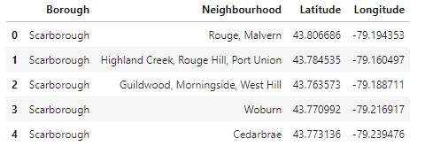
Results
Following is a part of data extracted in data frame format.

Slide 6
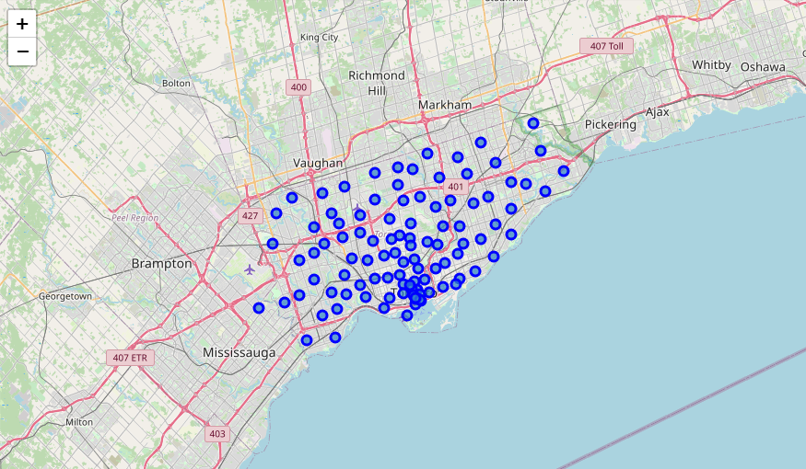
And following is a part of the map drawn from the data.

Slide 7
Discussion
The study proposes some groups or clusters of the localities depending on their activities. These locations may meet the requirements of the business for opening the restaurants.

Slide 8
Conclusion
This is a very preliminary study done with limited open source data. This study will be fruitful for achieving the business objectives. Still further analysis of the data with detailed methodology and toolsa may provide us with better results.

