Slide 1
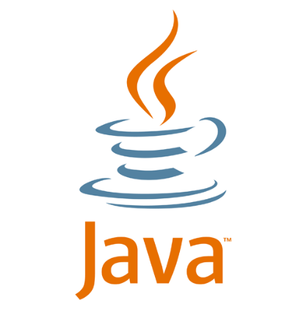
Chapter 1: Introduction to Java Programming
Week 1:
Basic terminology
Simple programs that produce output
Procedural decomposition

Slide 2
COMPUTER SCIENCE: Concept Map
COMPUTER SCIENCE
studies
studies
studies
Software
creates
runs on
is
Programming
Hardware
creates
organized
into
Programs
input into
Data
transformed into
Algorithms
output/return
Useful
Information
solve
written to
solve
Problems
Results
provide

Slide 3
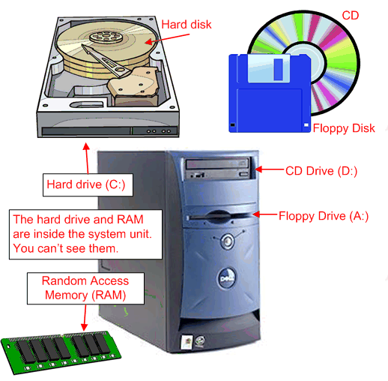
Computer Hardware
CPU (Central Processing Unit):
The “brain” of the computer
RAM (Random Access Memory):
Memory the computer can access at any time
Limited in size
Does not retain its contents when the computer is turned off
Secondary Memory:
Larger, permanent storage area
Examples: hard disk, USB drives, DVDs, etc.
Figure from http://www.coolnerds.com/Newbies/Hardware/hardware.htm

Slide 4
Computer Software
“Software” is a general term used to refer to computer programs
The primary piece of software running on a computer is its OPERATING SYSTEM (OS)
The OS provides an environment in which many programs may be run at the same time
The OS provides a bridge between programs running on a computer, the computer hardware, and the user
Programs that run under the operating system are often called APPLICATIONS
When a program is selected for running (e.g. by clicking its icon), the program instructions are loaded into the computer’s memory from the hard disk. The OS allocates memory for the program to use, instructions to run the program are fed from memory to the CPU and executed sequentially

Slide 5
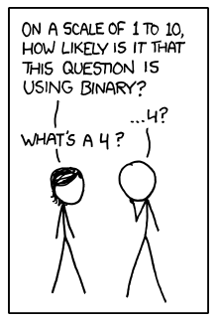
Machine Language and Binary Numbers
Computers understand machine language, composed of BINARY NUMBERS (sequences of 1s and 0s)
Any decimal (base 10) number can be written as a binary number (base 2) as shown below
Decimal | 2³ = 8 | 2² = 4 | 2¹ = 2 | 2⁰ = 1 | Binary
0 | 0 | 0 | 0 | 0 | 0
1 | 0 | 0 | 0 | 1 | 1
2 | 0 | 0 | 1 | 0 | 10
3 | 0 | 0 | 1 | 1 | 11
4 | 0 | 1 | 0 | 0 | 100
5 | 0 | 1 | 0 | 1 | 101
6 | 0 | 1 | 1 | 0 | 110
7 | 0 | 1 | 1 | 1 | 111
8 | 1 | 0 | 0 | 0 | 1000
Bit = a single binary digit
(Can have a value of 0 or 1)
1 Byte = 8 bits
(it takes 1 byte to store a single character of text)
See http://www.wisegeek.org/what-is-the-difference-between-a-bit-and-a-byte.htm for more info
Cartoon from http://xkcd.com/953/

Slide 6
Java Programming Language
Java is an example of a “high-level” programming language:
Designed to be more easily understood by humans
Cannot be understood directly by a computer
Needs to be translated into a different form
A special program known as a COMPILER does this
Compiler:
A program that translates a computer program written in one language into an equivalent program in another language
Often, this means translating from a high-level language into MACHINE LANGUAGE
A compiler translates a program into a machine-language form known as an EXECUTABLE

Slide 7
Java Virtual Machine (JVM)
Each computer has its own native machine language
Consequently, a different compiler is needed to generate different machine language output for every computer you want to run your program on
To get around this issue, the designers of Java decided to have Java programs compile into what are know as Java bytecodes
These bytecodes are able to execute on many different machines, but each machine needs another program (called a Java Runtime) to execute the Java bytecodes
Java Runtime: A program that executes compiled Java bytecodes
Java Virtual Machine (JVM): A theoretical computer whose machine language is the set of Java bytecodes

Slide 8
Why Java?
Reasonably simple to learn
Platform independent: programs written in Java can be executed on many different operating systems
“Object-oriented”
Uses a style of writing programs that can create large and complex software systems
Can take advantage of a large amount of pre-written software in Java class libraries
Extensive online documentation and tutorials, including a reference to the Java class libraries called the API Specifications (API = Application Programming Interface)

Slide 9

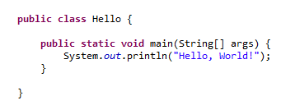
Java Programming Environment
When programming in Java, you need to:
Type in a program as a Java class – your Java program files should have the extension .java
Compile the program file – the Java bytecodes will have the same name and a .class extension
Run the compiled version of the program
Most Java programmers use what is known as an Integrated Development Environment (IDE):
The IDE provides an “all-in-one” environment for creating, editing, compiling, and executing program files
For this class, we recommend using the Eclipse IDE (for instructions on installation, see class website)
Once you have installed the Eclipse IDE, you can create your first program:
FIRST JAVA PROGRAM:

Slide 10
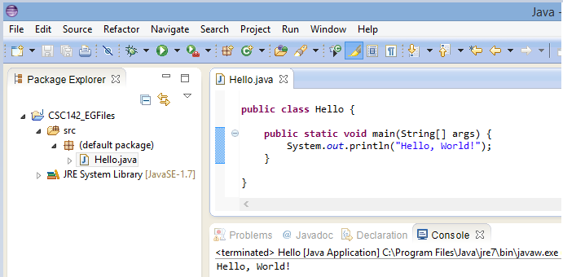
Running a Java Program
In Eclipse, a program is compiled as you type it
This is very convenient, since it allows the compiler to warn you about errors as you are creating your program
When your program is executed, it will typically interact with the user in some way
The short program we created on the last slide displays text to an onscreen window called a CONSOLE
Run your program by clicking this green button
Program output gets displayed here

Slide 11
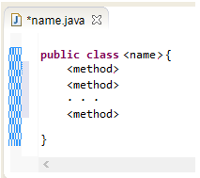
A Closer Look at a Java Program
CLASS: A unit of code that is the basic building block of Java programs
In Java, nothing can exist outside a class
The basic form of a Java class has the following template:
The first line is the class header:
The word public means it is available to anyone to use
The < and > characters are used to indicate items that need to be filled in
The curly braces { and } enclose the program code – they group together related fragments of Java code

Slide 12
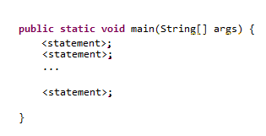
Methods
Our class template indicated that a Java class can contain methods – What is a “method”?
A method is a program unit that represents a particular action or computation.
Simple methods are like verbs – they tell the computer to perform some action.
At a minimum, a complete program requires a special method known as the main method.
The main method has the following syntax:
The first line is the method header
The word public was discussed (slide 11)
The rest of the method header will be explained later, but for now you should know that every part of the main method’s method header is needed

Slide 13
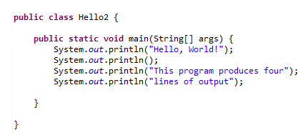
Statements
A statement is an executable snippet of code that represents a complete command
Every statement must end with a semicolon ( ; )
Our main method included only a single statement – a command to produce a line of output
Here is a slightly longer example that displays multiple lines of output:
The command System.out.println() produces a line of output text
In its simplest form, the command will print a blank line
To print output text, include the desired text inside the parentheses and enclosed with quotation marks (to indicate that the contents make up a string literal, i.e. literal text)

Slide 14
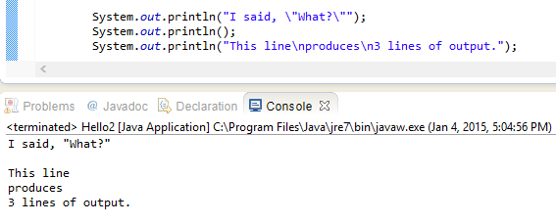
Escape Sequences
There are some situations where the text you want to display presents some problems
How do you include a line break?
How do you include quotes within the quotes surrounding your string literal?
Embedding what are referred to as escape sequences help deal with such situations:
Escape sequences are two-character sequences that begin with a back slash ( \ )
Here are some example commands, along with the output produced
\t = tab character
\n = new line character
\” = quotation mark
\\ = backslash character

Slide 15
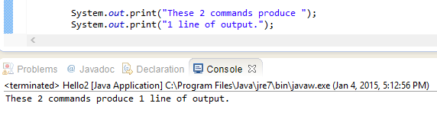
Formatting text output
As you have seen, text output can be displayed over multiple lines using two methods
Using separate println() commands for each line of output text
Using the \n escape character in a single println() command
Java has a variation of the println() command – print()
Whereas println() automatically moves to the beginning of a new line after displaying output, print() does not
print() can thus be used when you do NOT want to advance to a new line
Example:

Slide 16
Identifiers & Keywords
Identifier: A name given to an entity in a program, such as a class or a method
Must start with a letter, an underscore character, or a dollar sign character
May be followed by any number of letters, underscores, dollar signs, or numerical characters
Case-sensitive
Conventions:
All class names begin with a capital letter
Method names should begin with lower-case letters
When joining words in names, capitalize the first letter in each word after the first word
Names of constants (discussed later) are in all capitals, with words separated using underscores
Using these conventions lets users of your programs quickly identify the various code elements
ClassNameExample
methodNameExample
CONSTANT_NAME_EXAMPLE

Slide 17
Identifiers & Keywords (cont.)
Don’t be afraid to use long identifiers – descriptive names add clarity to your programs
There are some words that you may NOT be used as identifiers because they have already been predefined as identifiers in Java.
These special identifiers are referred to as KEYWORDS, and are reserved for particular uses.
JAVA KEYWORDS – do NOT use as identifiers
abstract | case | continue | enum | for | instanceof | new | return | switch | transient
assert | catch | default | extends | goto | int | package | short | synchronized | try
boolean | char | do | final | if | interface | private | static | this | void
break | class | double | finally | implements | long | protected | strictfp | throw | volatile
byte | const | else | float | import | native | public | super | throws | while

Slide 18
Comments & Readability
Java is a free-format language – extra spaces and blank lines are not required in your programs
However, you should FORMAT your programs to be easily read by humans
Guidelines for creating readable programs:
Put class and method headers on lines by themselves
Do not put more than one statement on each line
Indent your programs appropriately:
Indent lines inside an opening brace
Return to the previous indentation level after a closing brace
Indent statements within braces consistently
Use blank lines to separate different parts of your programs (e.g. methods)
Use comments to explain parts of your programs
Comments consist of text meant only for human readers of programs – ignored by the compiler

Slide 19
More on Comments
There are two forms of comments in Java: single-line comments and multi-line comments
Single-line comments
Preceded by two forward slash characters //
// this is an example of how to include a single line comment
Multi line comments (also referred to as block comments)
Contained within the following symbols /* <text> */
/* this is an example
of how to include
a multi-line or block comment */
An additional style of commenting, Javadoc comments, creates program documentation
This is described in Appendix B of the textbook

Slide 20
Program Errors
In the process of writing your programs, you will inadvertently and inevitably introduce errors
There are three main types of errors to be aware of:
Syntax Errors
Created by misusing Java
The programmatic equivalent of bad grammar
Syntax errors are caught by the Java compiler
Logic Errors
The code written is legal, but the program does not perform the task intended
Runtime Errors
Logic errors that are so severe that Java stops the program from executing

Slide 21

Syntax Errors
Humans are very tolerant of odd phrasing
Computers are NOT
The compiler will report syntax errors it encounters in the process of translating your code into Java bytecodes
The Eclipse IDE will underline any errors that break Java syntax rules as you type them, making it easy to locate the errors
Common syntax errors
Not matching the program’s file name and class name (they should be the same)
Forgetting to end a statement with a semicolon – in this case the Java compiler may not indicate the location of the error with 100% accuracy, but it should be close to the actual site of the error
Misspelled words, including incorrect capitalization
Forgetting a required keyword
Forgetting the closing quote in a string literal
Forgetting to end block comments properly
Figure from http://lovetowrite.typepad.com/geeks/

Slide 22
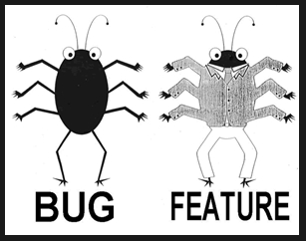
Logic Errors (aka “bugs”)
Logic errors cause unintended results when your program runs
The actual code is entirely “legal”, i.e. the syntax is perfect
The computer correctly performs the instructions included in the program
The process of finding and eliminating logic errors is called “debugging” (term assigned in the 1940s, after an actual moth trapped inside a computer caused program failures)
You will write buggy programs – in fact, it might even be accurate to refer to programming as “The Fine Art of Debugging”

Slide 23
Runtime Errors
Errors that occur during the execution of your program (but that do not prevent the program from compiling)
Examples of runtime errors
Asking your program to read from a file that does not exist
Asking your computer to calculate an invalid values (such as division by 0)
Writing your program in such a way that it cannot terminate correctly
e.g. writing an infinite loop (more on this later): the program will keep running until your machine runs out of memory

Slide 24
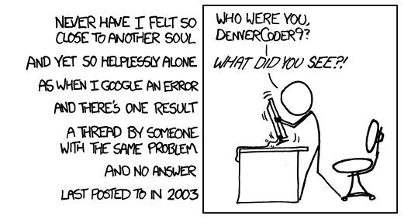
How to fix errors (debugging)
A common method used to locate errors is to include extra print statements to check the output of your program at various stages of its execution
When your program generates error messages, they are not always helpful in figuring out what the problem is. Doing a search on the error may provide clues on how to fix it.
The Eclipse IDE includes features to make debugging your programs easier – these features are not covered in this class, but they are helpful and you can view online tutorials, if interested:
http://www.vogella.com/tutorials/EclipseDebugging/article.html
or
http://agile.csc.ncsu.edu/SEMaterials/tutorials/eclipse-debugger/
Cartoon from http://xkcd.com/979/

Slide 25
Procedural Decomposition
Procedural Decomposition: A technique of dividing a complex task into a series of smaller actions
Some programs, such as C, are termed “procedural languages” – a program is seen as a series of actions to be performed
Java is designed for a different kind of decomposition (an “object-oriented language”) – a program is seen as a collection of objects that have to interact with each other
This will be covered more later in the course
Even in object-oriented languages, procedural thinking plays an important role
Structure Diagram: A graphical representation of how a problem is broken down into subproblems
Make Cake
Make Batter
Bake
Make Frosting
Frost Cake
Subproblems, themselves, should be broken down into smaller subtasks until the subtasks are so simple that they need no further explanation

Slide 26
Advantage of Procedural Decomposition
Planning a program in stages can make a complex task easier to accomplish
Once the tasks required to create the program are subdivided into subtasks, the task can be completed in stages
New functionality is added at each stage and the new code can be tested to make sure it works properly before moving on to additional subtasks

Slide 27
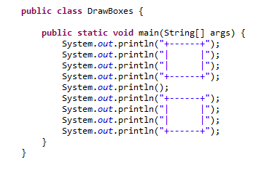

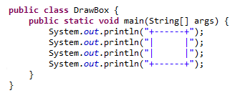
Static Methods
A static method is a block of Java statements that is given a name
The word static indicates that the method is a procedural-style (rather than an object-oriented) method (all the methods you write this quarter, until Chapter 8, will be static methods)
Look at the following code:
The program draws 2 boxes on the console, but contains a lot of redundancy
instead, you can create a static method to draw a box:
OUTPUT:

Slide 28
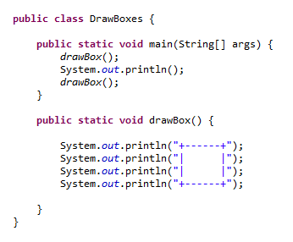
Using Static Methods
You can use your new method that draws ONE box to get rid of the repetitive code present in the DrawBoxes() program – the program output will be the same as with the original code:
The main method now includes two commands of drawBox()
These lines are method calls – commands to execute a specific method, causing all the statements in this newly specified method to be executed
The method call drawBox() causes ONE box to be displayed – to get TWO boxes in the output, the method needs to be called TWICE
The keywords public and static have already been defined. The keyword void indicates that the method does not return any value(s) (more on this later)
OUTPUT:

Slide 29

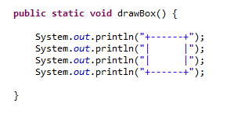
Flow of Control in a Program
Flow of control is the order in which the statements of a program are executed
The main method is always the STARTING POINT for program execution
When a program calls a static method, the execution of the program “jumps” to the static method
The statements in the static method are then executed in sequence
Program execution then returns to the point where the call began to resume execution
The arrows labeled 2,3,5, and 6 represent “jumps” from the main method to and back from the drawBox method
1
2
5
4
3
6

Slide 30
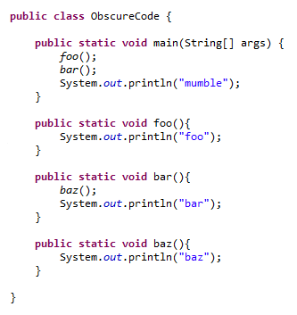

Methods that Call Other Methods
You may have noticed that our main methods have been calling other methods
In fact, ANY method may call other methods
This can make flow of control difficult to follow at times
Look at the following code and try to predict the output of the program:
By starting at the main method and “jumping” to other methods as they are called, you should be able to determine that the output of this program is:

Slide 31
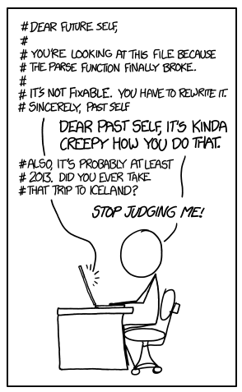
Concluding comments
By creating separate methods for the various subtasks of your program, you can minimize redundant code and maximize the efficiency of your programming
It is useful to define methods that are flexible (whenever possible), so that you can reuse code by adapting already written code to similar tasks in different parts of your program or even in completely different programs
Although Java doesn’t care what order your methods are defined in, you should try to arrange your method definitions in a way that “makes sense” in your program
You should always be striving to make your programs easy for humans to understand
The logic you are using in constructing your programs should be apparent
Comments and formatting can greatly enhance the readability of your code
The hypothetical future user of your code may very well be YOU
Cartoon from http://xkcd.com/1421/ -- in this programming language, comments are preceded by the # character

