Slide 1
World Covid Analysis
STAT614-002
Chaytanya Kumar, Dennis Poludnev, Youjia (Yuka) Chen
Notes:
YUKA

Slide 2
Introduction
Objective :
How countries are faring with COVID19 and what factors might influence the COVID19 death and we can use the result to prevent possible future pandemics.
Regression analysis on COVID related data.
Initial plan was to examine local Montgomery county COVID19 data (Maryland, U.S.) on the government website, but it was already analyzed through Power BI.
Focused on data related to the bigger scope.
Notes:
YUKA: initially we wanted to examine local …..
we focused on

Slide 3
Data
COVID-19 dataset maintained by Our World in Data (OWID) and constantly updated through GITHUB.
Link: https://github.com/owid/covid-19-data/tree/master/public/dataMetric
Updated weekly from a credible sources: John Hopkins and CSSC, ECDC.
Data of over 200 countries on 65 different variables.
Notes:
YUKA

Slide 4
Metrics to measure
Total deaths per million (dependent)
Total vaccinations
GDP per capita
Extreme poverty
Population density
Stringency index
Total Smoker
Male smokers
Female smokers
Notes:
The hypothesis focused total deaths due to covid as the response variable and multiple independent variables
YUKA

Slide 5
Hypothesis
Developing countries had harder time controlling the COVID pandemic than the developed countries.
The country with lower GDP will have more death by COVID19
Notes:
So

Slide 6
Data Project Lifecycle
Data Acquisition
Analysis of Covid Related Data
Acquired data from OWID
CSV format
Data Cleaning
Randomly selected 30 countries
Structured the data
Removed NA values
Filtered Data
Data Modelling
Linear Regression
Multivariate Analysis
Interaction
Model design
Data Visualization
Graphs and plots
Notes:
CHAYTANYA

Slide 7
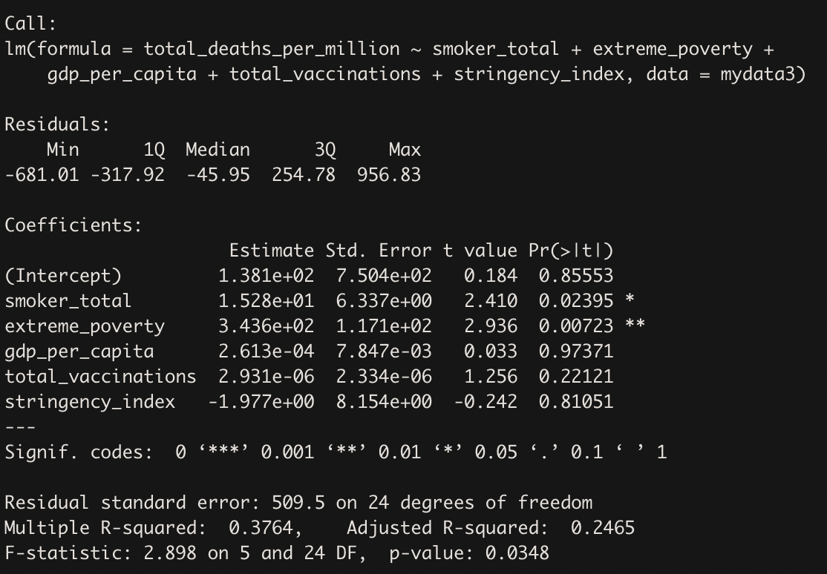
Analysis Results
Regression Analysis
Notes:
CHAYATANYA

Slide 8
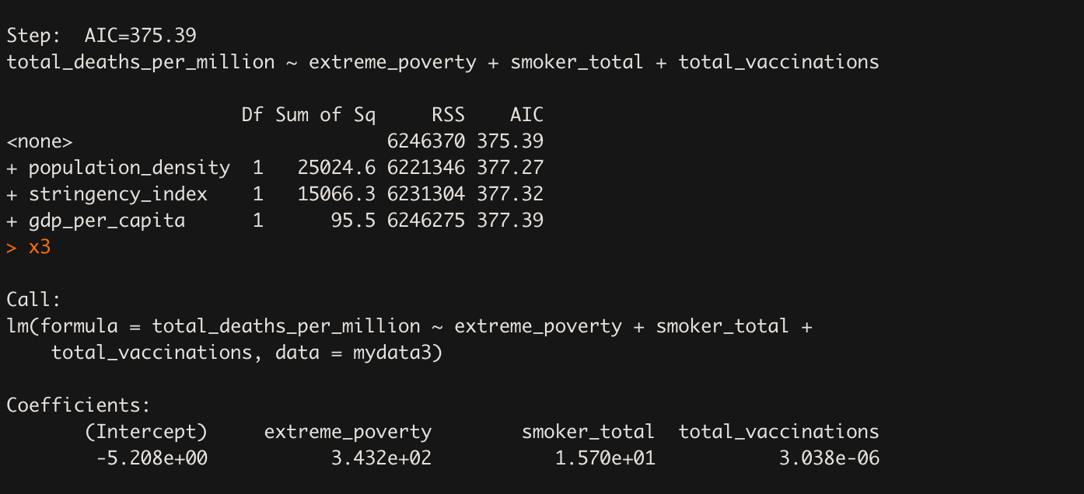
Analysis Results
Stepwise Regression Analysis
Notes:
CHAYTANYA

Slide 9
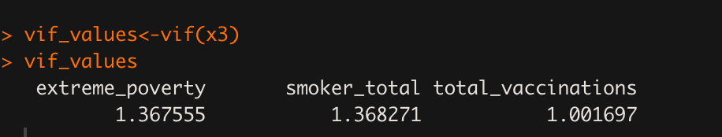
Multicollinearity Test
VIF values < 5 therefore, no Multicollinearity in the model.
Notes:
CHAYTANYA

Slide 10
Predictive Model
Total Deaths per million = 343.2( Extreme Poverty ) + 15.7( Total Smokers ) +
0.000003038( Vaccination Rate )
Notes:
Dennis

Slide 11
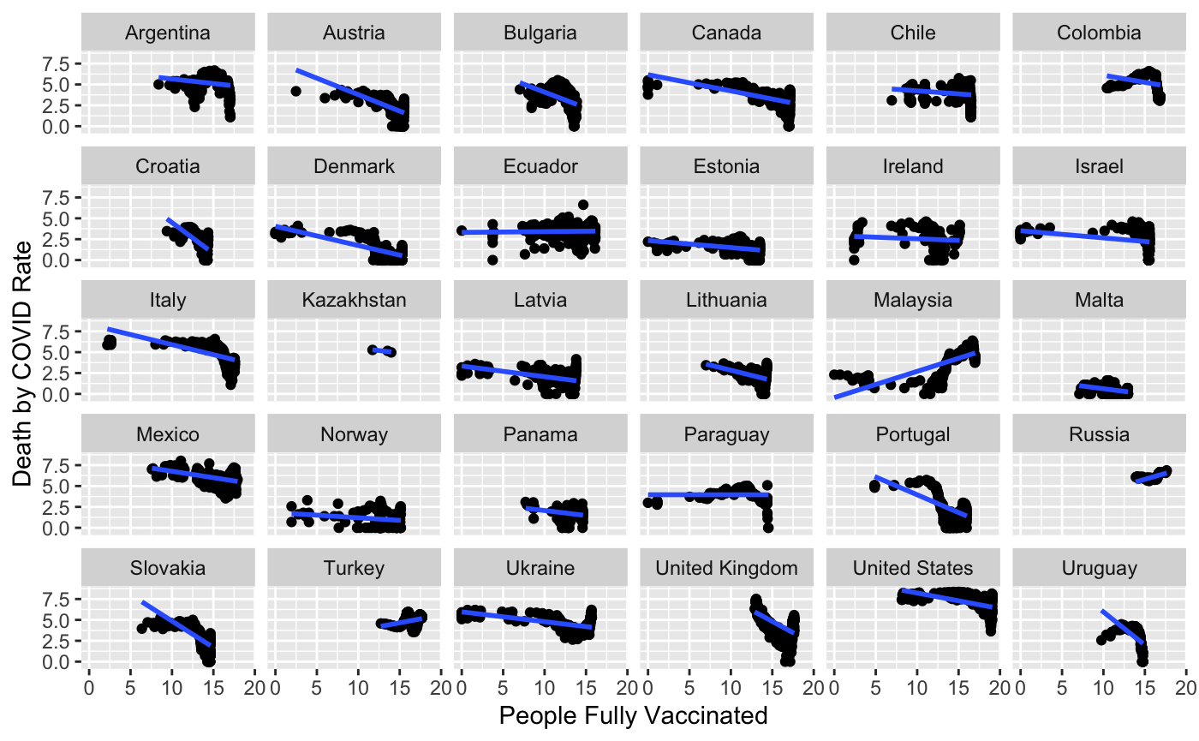
Data Visualization
Notes:
Dennis

Slide 12
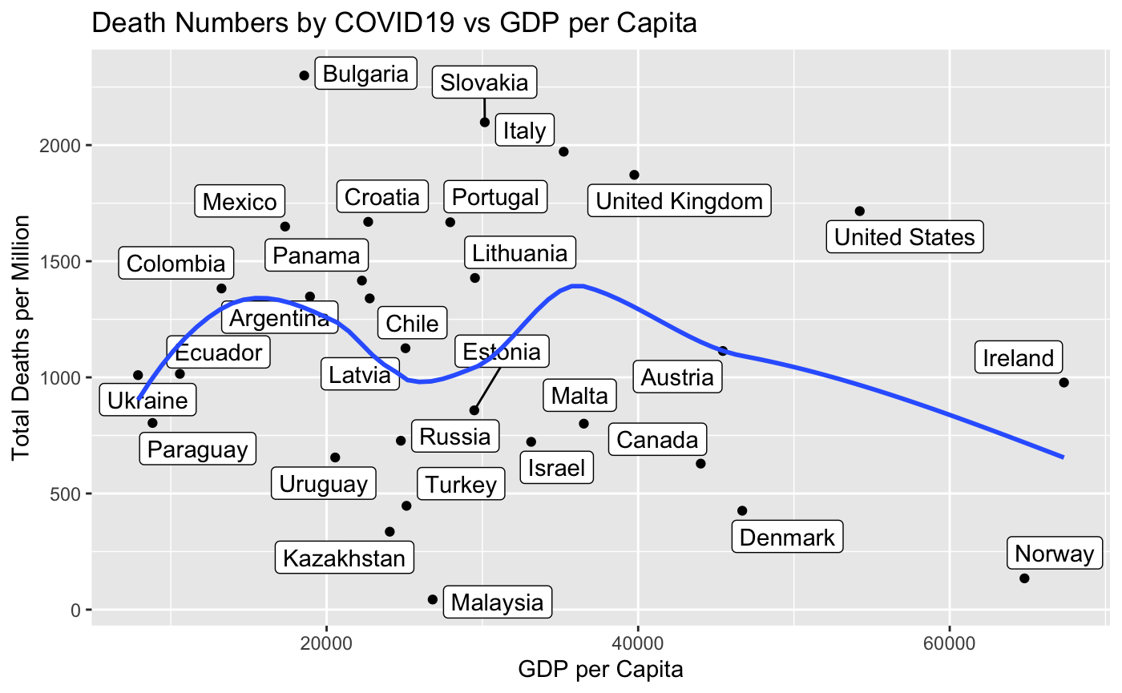
Notes:
Dennis

Slide 13
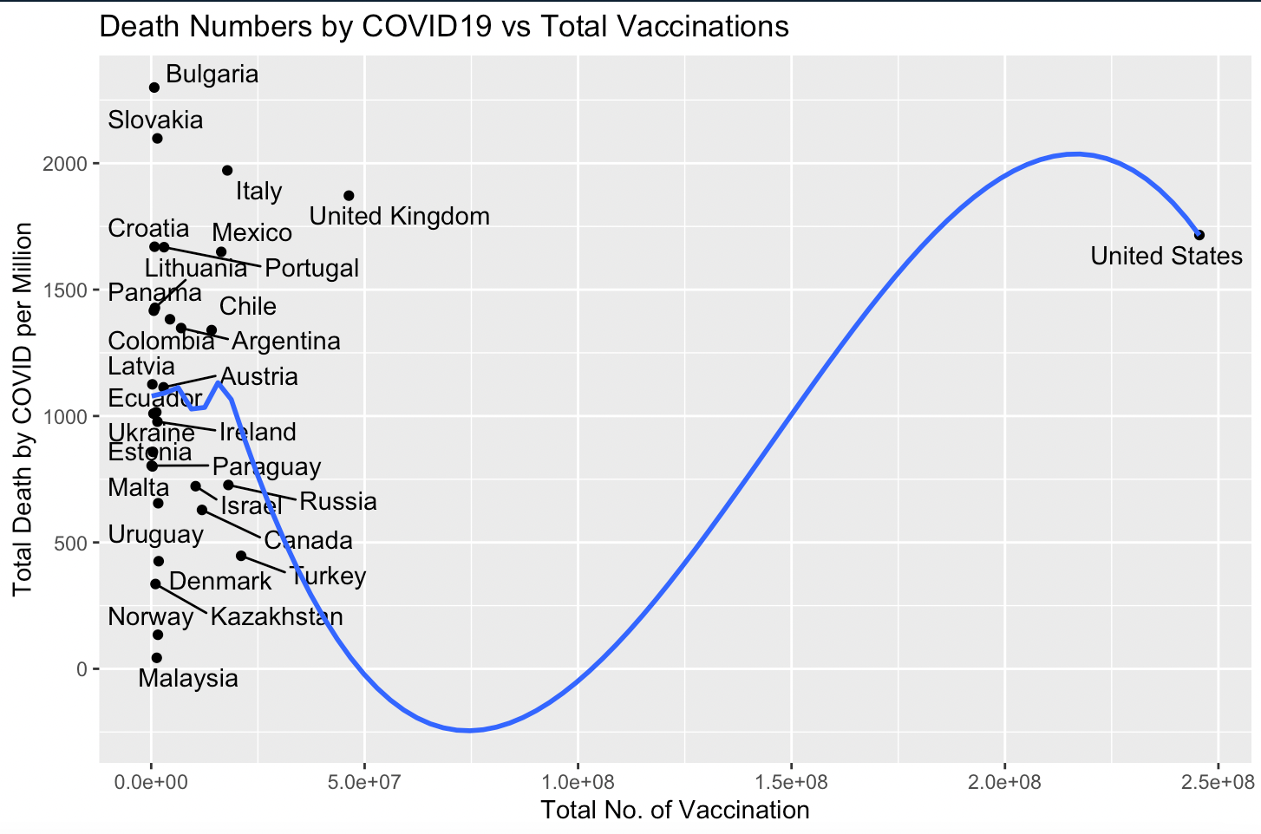

Slide 14
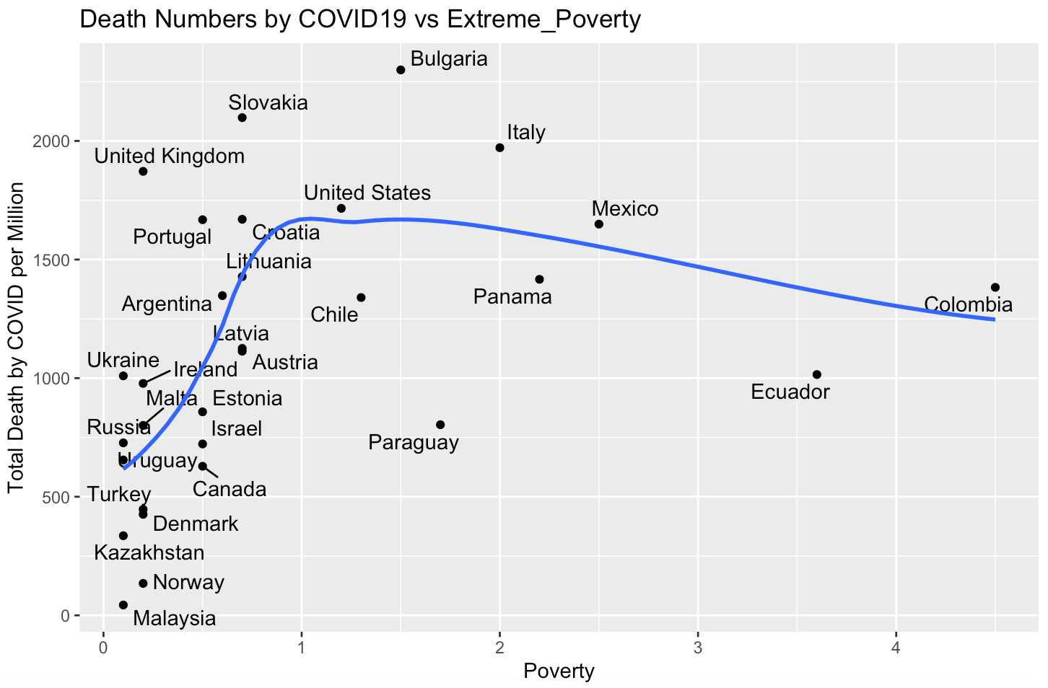

Slide 15
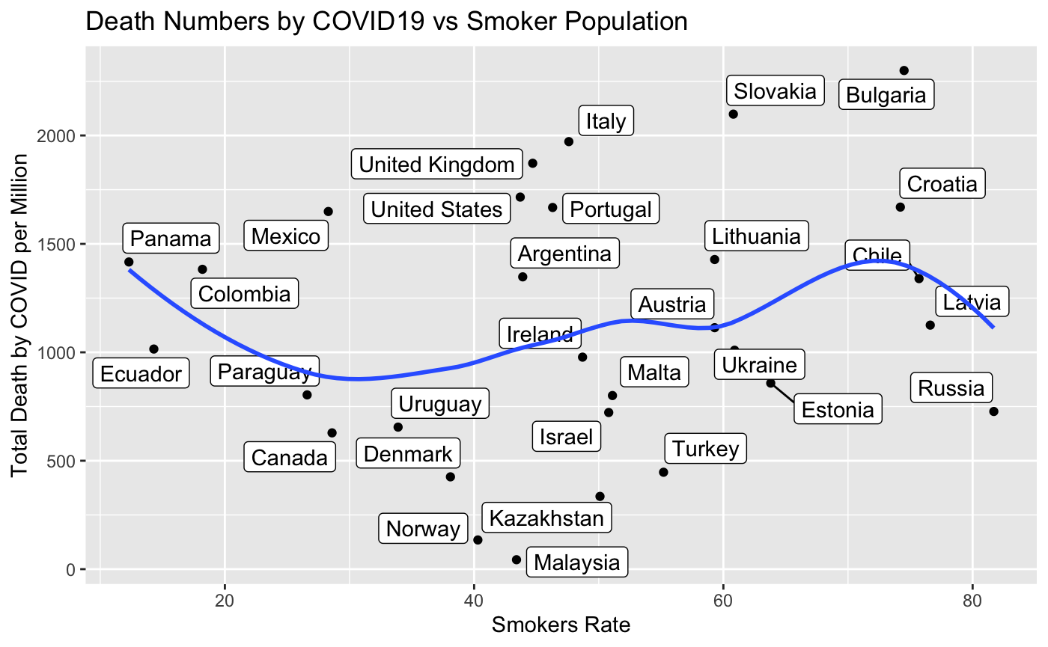
Notes:
DENNIS

Slide 16
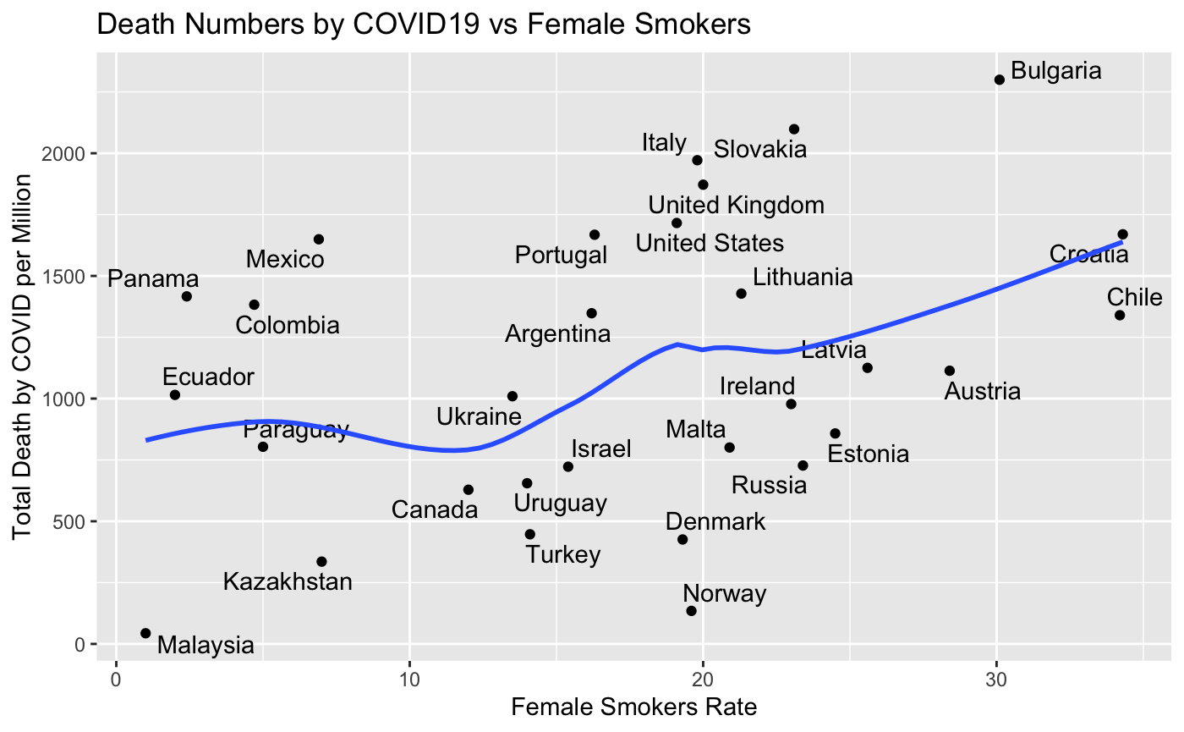
Notes:
yuka

Slide 17
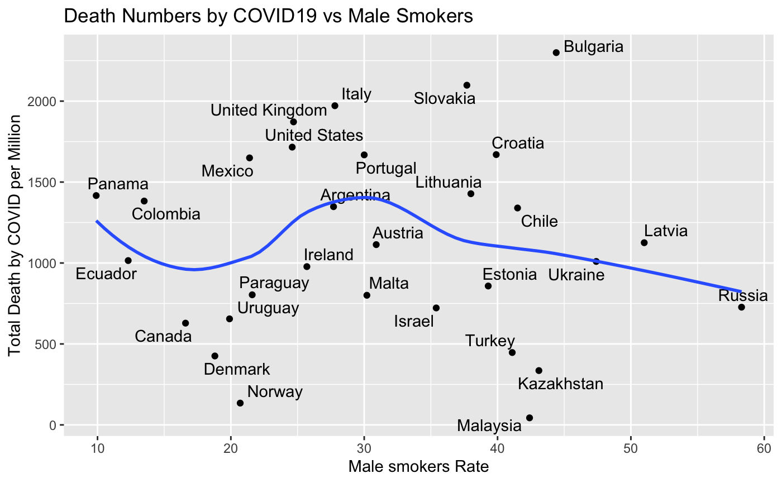
Notes:
yuka

Slide 18
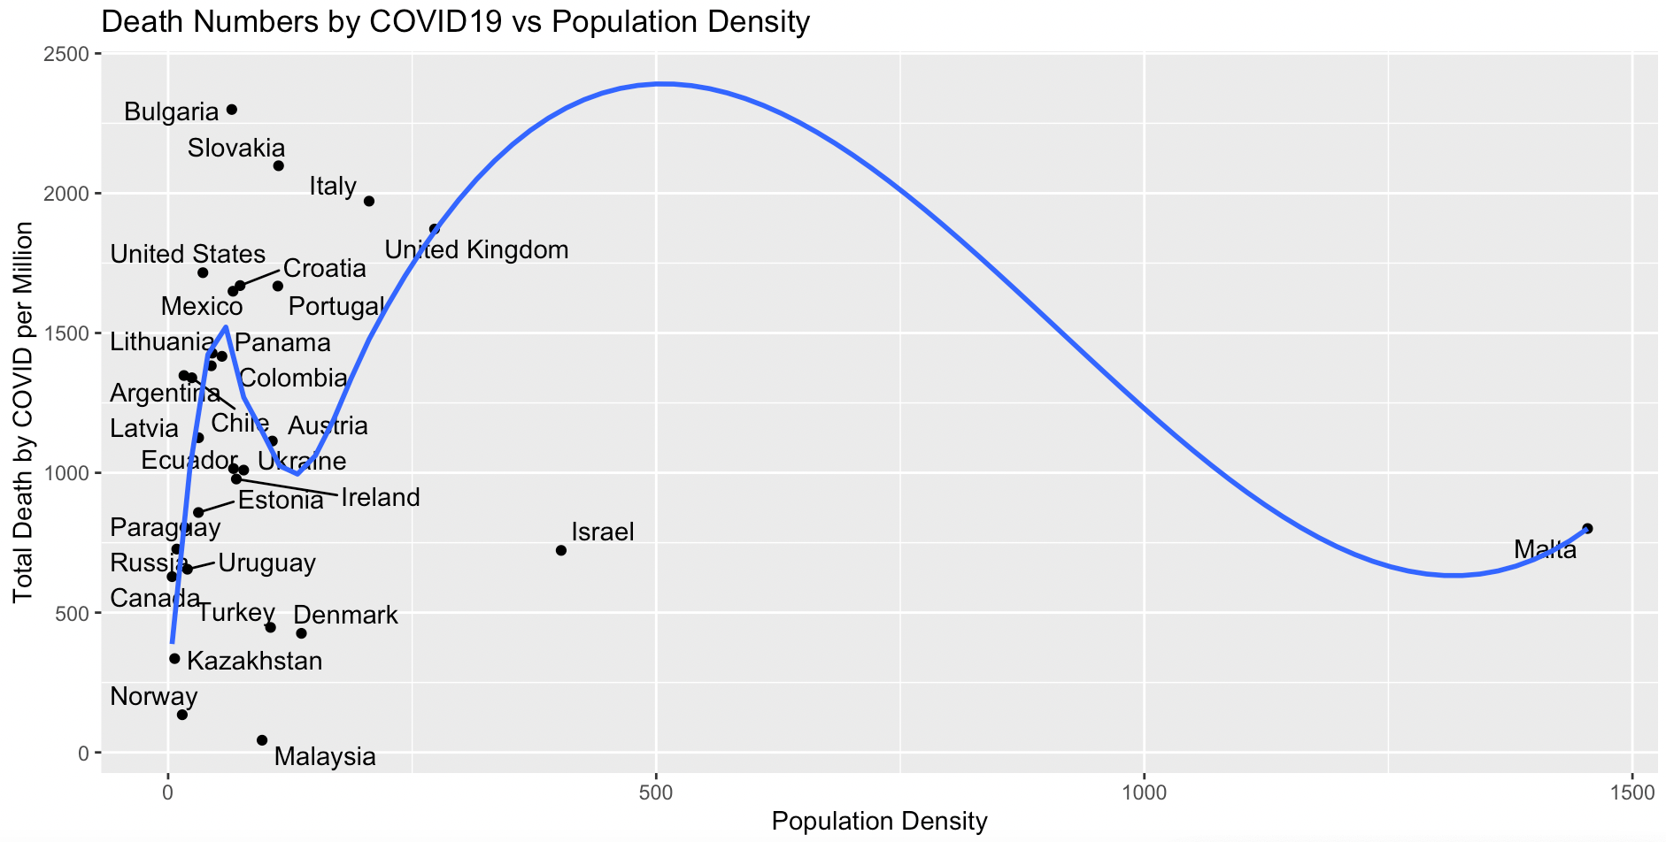
Notes:
Dennis

Slide 19
Conclusion
Based on Statistical Analysis (Regression , Multivariate , Interaction , Stepwise Regression) we found, Total Death per million is significantly dependent on Poverty Rate ,Total Smokers.
Total Deaths per million = 343.2( Extreme Poverty ) + 15.7( Total Smokers ) +
3.038e-06( Vaccination Rate )

