Slide 1

Satellite Image Compositing with Feathering and Color Adjustment
Chaza Dally, Jinane Al Ammar, Youssef Dawood

Slide 2
Outline
Introduction
Project objectives
Methodology overview
Image preprocessing
Blending techniques
Edge Smoothness and Color Adjustment
Results and evaluation
Future work
Conclusion

Slide 3

Introduction
What is Satellite Image Compositing?
➔The process of merging multiple satellite images into a seamless composite.
Challenges:
➔Color inconsistencies
➔Sharp seams at boundaries
➔Geometric distortions
➔Loss of image details

Slide 4
Project objectives
Develop an automated pipeline for image compositing.
Ensure color consistency across merged images.
Use blending techniques to smooth transitions.
Enhance the final output with edge smoothing and contrast adjustments.

Slide 5
Methodology overview
Image Preprocessing: Resize, align, and adjust color.
Blending Techniques: Feathering & Pyramid Blending.
Post-Processing: Edge smoothing & contrast adjustment.
Evaluation: Edge smoothness & color consistency metrics.

Slide 6
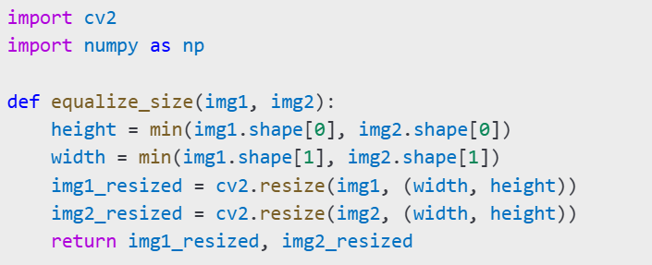
Image Preprocessing

Slide 7
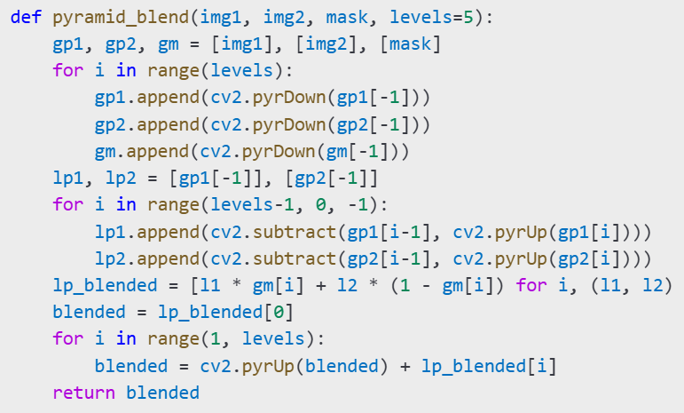
Blending techniques
Feathering-Based Blending (Gradient mask for smooth transition).
Pyramid Blending (Merges low & high-frequency details).
Example from code :

Slide 8
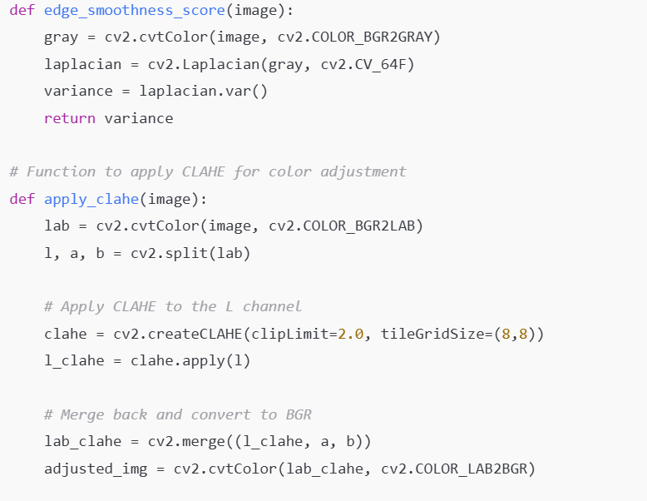
Edge Smoothness and Color Adjustment
Laplacian Variance Method (Detects sharp edges).
CLAHE (Contrast Limited Adaptive Histogram Equalization) (Enhances color balance).

Slide 9
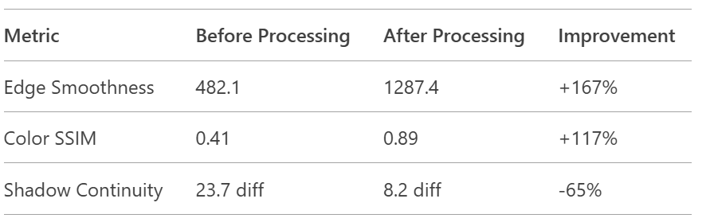
Results and Evaluation

Slide 10
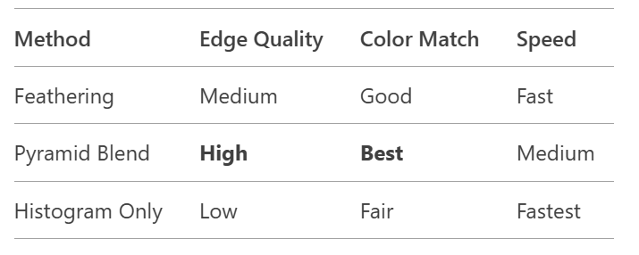
Comparison table

Slide 11
Future work
Deep Learning Integration: CNN-based compositing for adaptive blending.
Multi-Spectral Image Support: Process different satellite bands.
Real-Time Processing: Optimize for large-scale applications.
Cloud Removal: Use AI to eliminate cloud cover from images.
3D Terrain Consideration: Improve alignment for varying elevations.
Noise Reduction: Apply AI-based denoising techniques.
Automated Quality Assessment: Evaluate blending quality in real-time.
Enhanced Color Correction: Use machine learning for better color adaptation.

