Slide 1


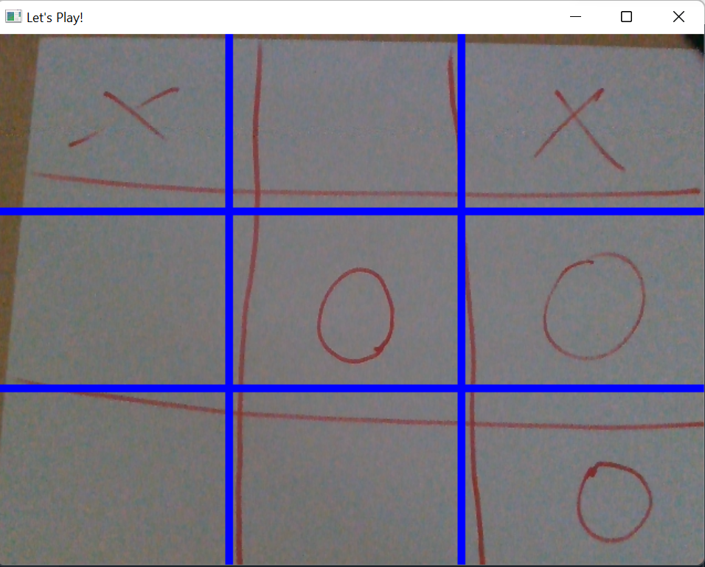
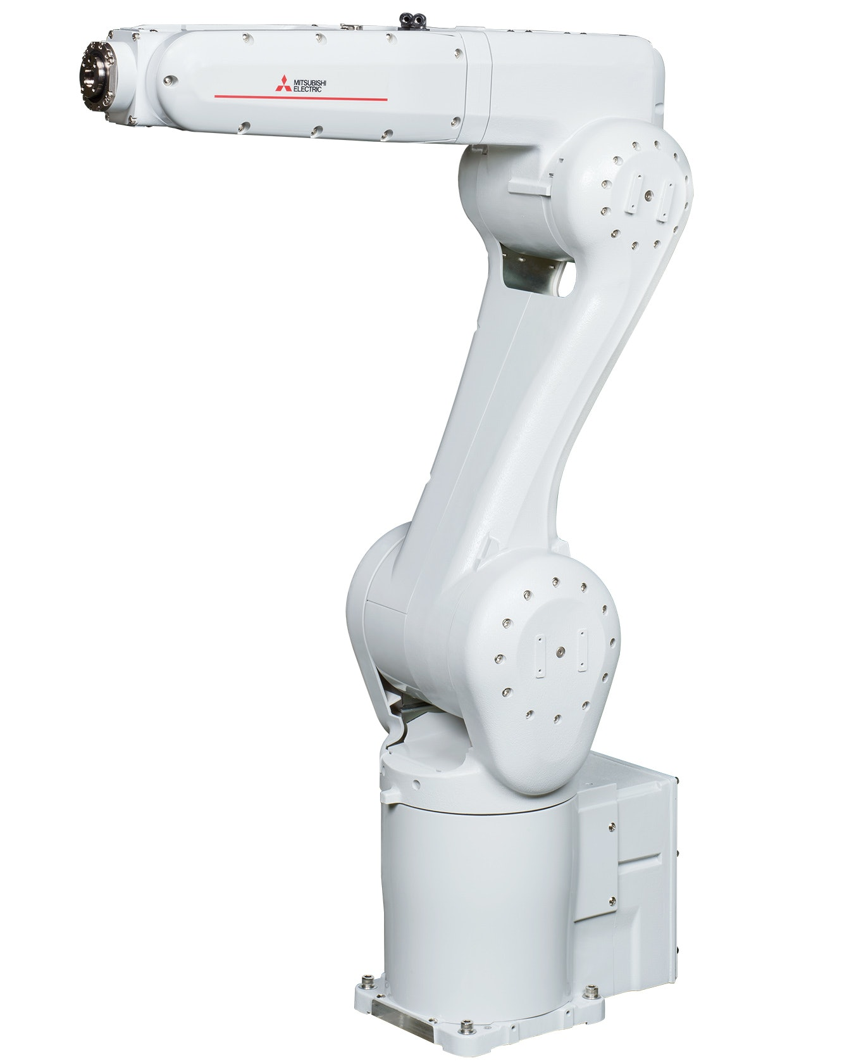
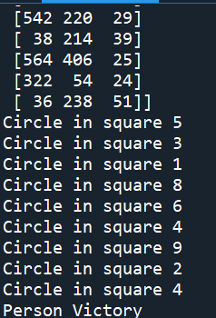
Tic-Tac-Toe Robot
TEAM KRATOS: Ayush Shrestha, Che Justus Kwanga, Nabin Raj Bista, Yan Wang
CSE Senior Design
Executive Summary
Experimental Setup
Experimental Results
Technological innovations have made significant progress in making production and distribution easy and efficient.
There are several robotic solutions available for performing many customizable functions without any problem.
The Mitsubishi RV-8CRL can be programmed to perform required task with min. human intervention.
Can complete high risk tasks without human involvement.
It can make the workforce safer, efficient and reduces the need for hiring workers which may not be profitable to the company.
Computer vision program:
Detects the tic-tac-toe grid
Detects the ‘X’ and ‘O’ required to play the game.
Movement program:
Decides which move to move next
Sends the necessary coordinates that is required to make the move
Human assistance portion:
After each game, human assistance is needed to erase the board
Constraints:
Final prototype demonstration must be completed by August 12, 2022
CSE department budget is $800
Vision program with the grid detects which position the opponent has played.
The python program takes the input and used Min-Max algorithm to decide which move to take next.
If the mark is not detected, the program will indicate that the opponent has not made any moves.
After the move is detected, the robot will decide which move to make with the necessary coordinates for the move.
The robot can detect the moves and decide what move to make next whereas make ‘O’ and ‘X’ on every position on the grid but is unable to communicate to do both the tasks without human assistance.
Requires human assistance to implement the move decided by the python program.
Figure 2. Grid Recognizing shapes on the paper
Background
Experimental Test Plan
Conclusions
We are using the Mitsubishi RV-8CRL is 6-axis industrial robot with a payload of 8kg. It has 931 mm reach with a sleek and compact design. It is only 41 kg and is IP65 rated which means it can be used in various industrial setups.
The Tic-Tac-Toe project consists of:
Mitsubishi RV-8CRLD robot system
Intel RealSense depth camera
Software Application
Python
Mitsubishi RT-Toolbox3 software
Python
OpenCV (cv2)
numpy
rospy
pyrealsense
Human Assistance
The human should check if the robot is making any mistakes
The playing board must be erased after every game.
The marker needs to be fixed in place
Main goal was to use the robot and AI to make it play Tic-Tac-Toe with the opponent
Still needs the communication set-up between the robot and the AI algorithm through TCP.
Has opened the possibility of using AI with the robots in Mitsubishi robot in the future.
Possibility of AI robot doing smart tasks done by humans.
A special thanks to Dr. Chris Conly, Dr. McMurrough, Minh Tram, and the CSE department for sponsoring the project and giving us this wonderful opportunity.
References
Patrickmblack, “OpenCV-Tic-Tac-Toe”
https://github.com/patrickmblack/OpenCV-Tic-Tac-Toe/blob/master/TicTacToe1.0.0.py
2. Futurelearn, ”The future of robotics”
https://www.futurelearn.com/info/blog/general/introduction-robotics-future-robots
Figure3. Input taken after recognizing shapes on the grid
Figure 1. Mitsubishi RV-8CRL robot

