Slide 1
Electronic Voting – Year 11 Awards
Manual
Auto

Slide 2
Downloading the program
Auto
Type into your browser: https://y11awards.page.link/download
The download should begin automatically
Run the file you just downloaded.
OR
Open the pupil drive at P:/Business and Computing/AwardsClient.exe
Run that program
Note that the AwardsClient.exe may have a different, similar, name.

Slide 3
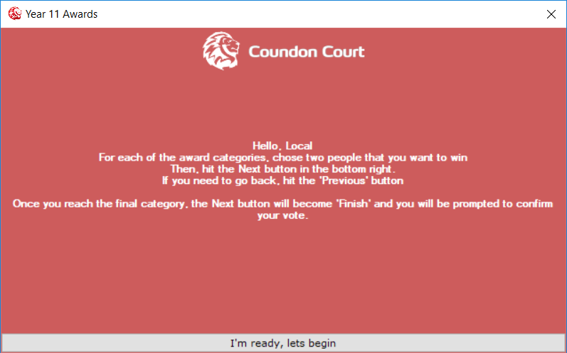
Running the program
Auto
Once you have ran the program, you should find a view similar to that on the right.
Read the instructions, then when you are ready, click the button labelled I’m ready, lets begin
If many people are voting, you may be placed in a Queue. You will have to wait until the people ahead of you have finished voting, then you will be allowed to start as above.

Slide 4
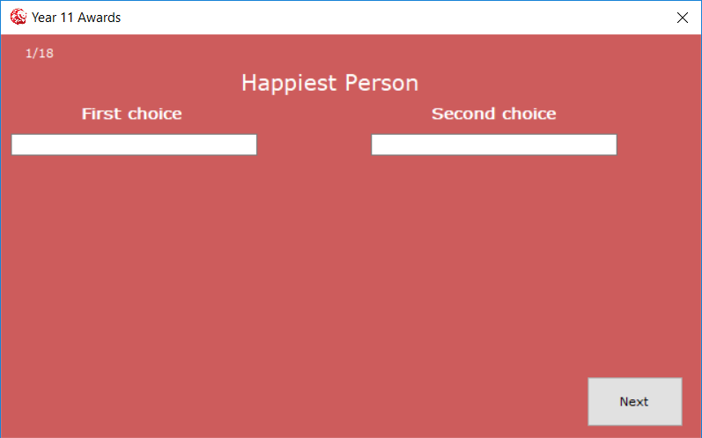

How to vote for people
Auto
For each of the categories, you will be presented with a view similar to the right.
In the white text area, below “First choice” and “Second choice”, you will need to type the name of two people that you are voting for.
You will need to click one of these names to lock that name into place
You may also search by tutor group, last name, first name, etc. Note that the number of names you will see below is limited, so you may need to type more letters before you get the person you want.

Slide 5
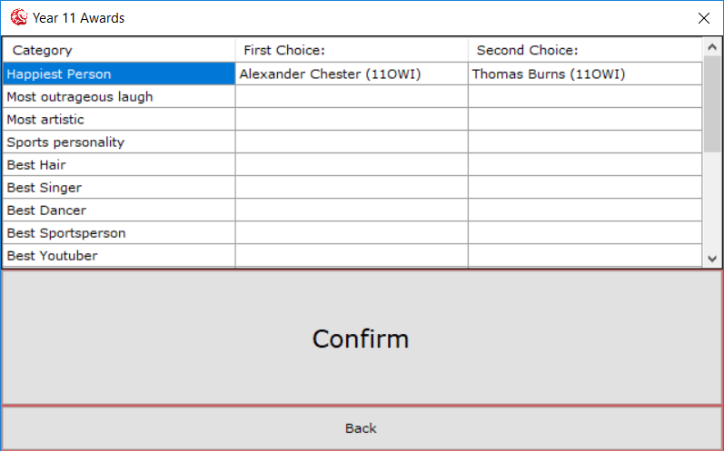
Confirming your votes
Auto
You will need to check through each of the categories and ensure any names you have put (or not put) are correct.
Then, hit the “Confirm” button.

Slide 6

Finished voting
Auto
Once you have confirmed your vote, you should be presented with a screen as on the left.
You are then able to close the program and log-off the computer.

Slide 7
Downloading the program
Type into your browser: https://y11awards.page.link/download
The download should begin automatically
Run the file you just downloaded.
OR
Open the pupil drive at P:/Business and Computing/AwardsClient.exe
Run that program
Note that the AwardsClient.exe may have a different, similar, name.

Slide 8
Running the program
Once you have ran the program, you should find a view similar to that on the right.
Read the instructions, then when you are ready, click the button labelled I’m ready, lets begin
If many people are voting, you may be placed in a Queue. You will have to wait until the people ahead of you have finished voting, then you will be allowed to start as above.

Slide 9
How to vote for people
For each of the categories, you will be presented with a view similar to the right.
In the white text area, below “First choice” and “Second choice”, you will need to type the name of two people that you are voting for.
You will need to click one of these names to lock that name into place
You may also search by tutor group, last name, first name, etc. Note that the number of names you will see below is limited, so you may need to type more letters before you get the person you want.

Slide 10
Confirming your votes
You will need to check through each of the categories and ensure any names you have put (or not put) are correct.
Then, hit the “Confirm” button.

Slide 11
Finished voting
Once you have confirmed your vote, you should be presented with a screen as on the left.
You are then able to close the program and log-off the computer.

