Slide 1
Electronic Voting – Year 11 Awards
Manual
Auto

Slide 2
Downloading the program
Auto
Type into your browser:
https://y11awards.page.link/download
The download should begin automatically
Run the file you just downloaded.

Slide 3
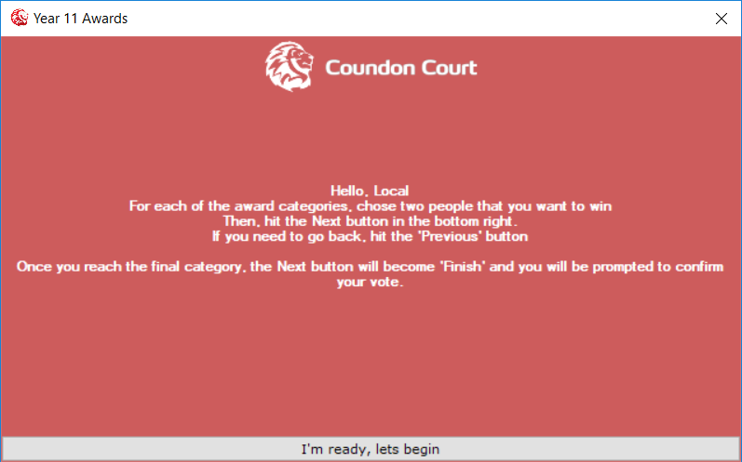
Running the program
Auto
Read the instructions, then when you are ready, click the button labelled I’m ready, lets begin
If many people are voting, you may be placed in a queue. You will have to wait until the people ahead of you have finished voting.

Slide 4
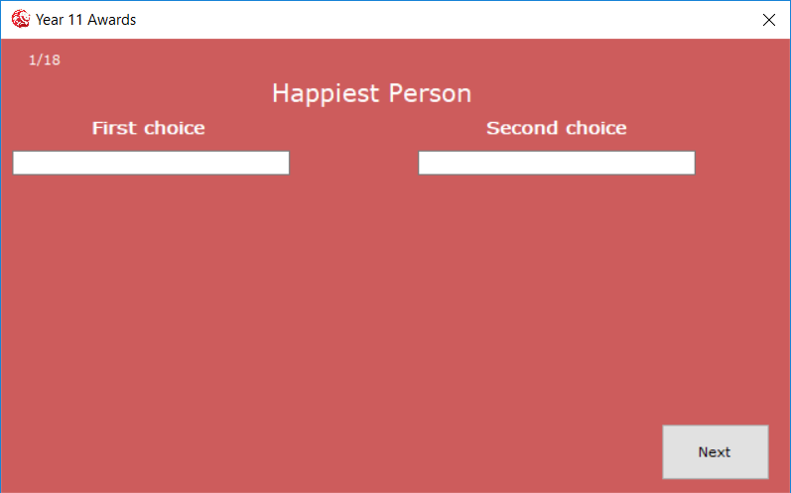

How to vote
Auto
In the white text area, below “First choice” and “Second choice”, you will need to type the name of two people that you are voting for.
You will need to click one of these names to lock that name into place
You may also search by tutor group, last name, first name, etc. Note that the number of names you will see below is limited, so you may need to type more letters before you get the person you want.

Slide 5
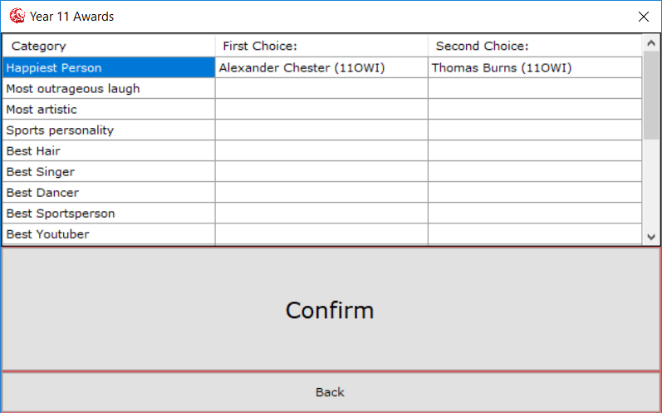
Confirm your votes
Auto
Check that your votes are correct
If they are, hit Confirm to submit them
If not, click “Back” and then use the “Previous” button to go back and re-do your votes.

Slide 6

Finished voting
Auto
Once you have confirmed your vote, you should be presented with a screen as on the left.
You are then able to close the program and log-off the computer.

Slide 7
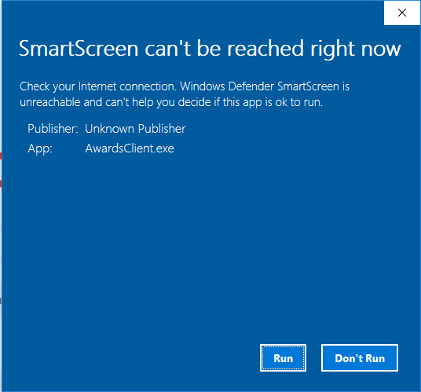
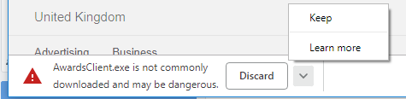
Downloading the program
Type into your browser: https://y11awards.page.link/download
The download should begin automatically
Run the file you just downloaded.
You don’t have to enter 2 people for each category

Slide 8
Running the program
Read the instructions, then when you are ready, click the button labelled I’m ready, lets begin
If many people are voting, you may be placed in a queue. You will have to wait until the people ahead of you have finished voting.

Slide 9
How to vote
In the white text area, below “First choice” and “Second choice”, you will need to type the name of two people that you are voting for.
You will need to click one of these names to lock that name into place
You may also search by tutor group, last name, first name, etc. Note that the number of names you will see below is limited, so you may need to type more letters before you get the person you want.

Slide 10
Confirm your votes
Check that your votes are correct
If they are, hit Confirm to submit them
If not, click “Back” and then use the “Previous” button to go back and re-do your votes.

Slide 11
Finished voting
Once you have confirmed your vote, you should be presented with a screen as on the left.
You are then able to close the program and log-off the computer.

Slide 12
Errors

