Slide 1
Human Aware Re-Identification
and Tracking
Real-Time Biometric Attendance Management System
K. Harshitha (N200373) | CH. Rajeswari (N200427) | B. Chethan (N200518) | SK. Akhil (N200145)
Guide: Y. Kalavathi
Department of Computer Science and Engineering
Rajiv Gandhi University of Knowledge Technologies – Nuzvid

Slide 2
Abstract
Real-time biometric attendance system integrating computer vision, deep learning, and a web-based interface
Combines YOLOv11n person detection, BoT-SORT multi-object tracking, and InsightFace face recognition (512-D embeddings)
Two-tier matching: adaptive session cache (threshold 0.50) + persistent enrollment database (threshold 0.45) via cosine similarity
Consensus-based identity locking reduces false positives; adaptive shadow updates improve in-session accuracy
Heartbeat-driven interval logging records precise entry/exit timestamps for each student every 10 seconds
Django web dashboard with live monitoring, session control, CSV export, and AI-generated narrative reports via Ollama Qwen2.5:1.5b (local — no cloud)

Slide 3
Motivation for Work
Traditional systems (manual rolls, RFID, fingerprint) cannot prevent proxy attendance
No duration tracking — a student who leaves immediately is marked fully present
No real-time visibility for faculty during a live session
Simple face recognition suffers from identity switching due to pose, occlusion, and lighting variation
No support for retrospective video processing or unknown person detection
Goal: eliminate manual effort, provide verifiable time-in-room records, and give faculty complete live visibility

Slide 4
Real-World Applications
Smart Classroom Attendance — automatic face-based tracking with entry/exit timestamps
Workplace Monitoring — employee presence and authorized-zone access tracking
Surveillance & Security — real-time detection and snapshot-logging of unknown individuals
Batch Video Processing — retrospective attendance from pre-recorded lecture videos
Healthcare & Lab Access — movement tracking in restricted zones for compliance
Exam Hall Monitoring — continuous presence verification with timestamped audit logs
Smart Campus Infrastructure — multi-section, multi-session deployment with structured analytics

Slide 5
Related Work & Limitations
Object Detection: HOG+SVM → R-CNN family (accurate but slow) → YOLO (real-time, single-stage)
Multi-Object Tracking: SORT (IoU-only, loses ID on occlusion) → DeepSORT → BoT-SORT (global motion compensation)
Face Recognition: ArcFace / InsightFace — 512-D embeddings, cosine similarity matching
Existing Attendance Systems — key limitations:
Binary present/absent only — no duration intervals or mid-session analytics
No multi-frame consensus — single-frame noise causes misidentification
No unknown person detection, no real-time web monitoring, no AI-driven reporting
SLMs: Qwen2.5:1.5b runs locally via Ollama — novel use for on-device session reporting

Slide 6
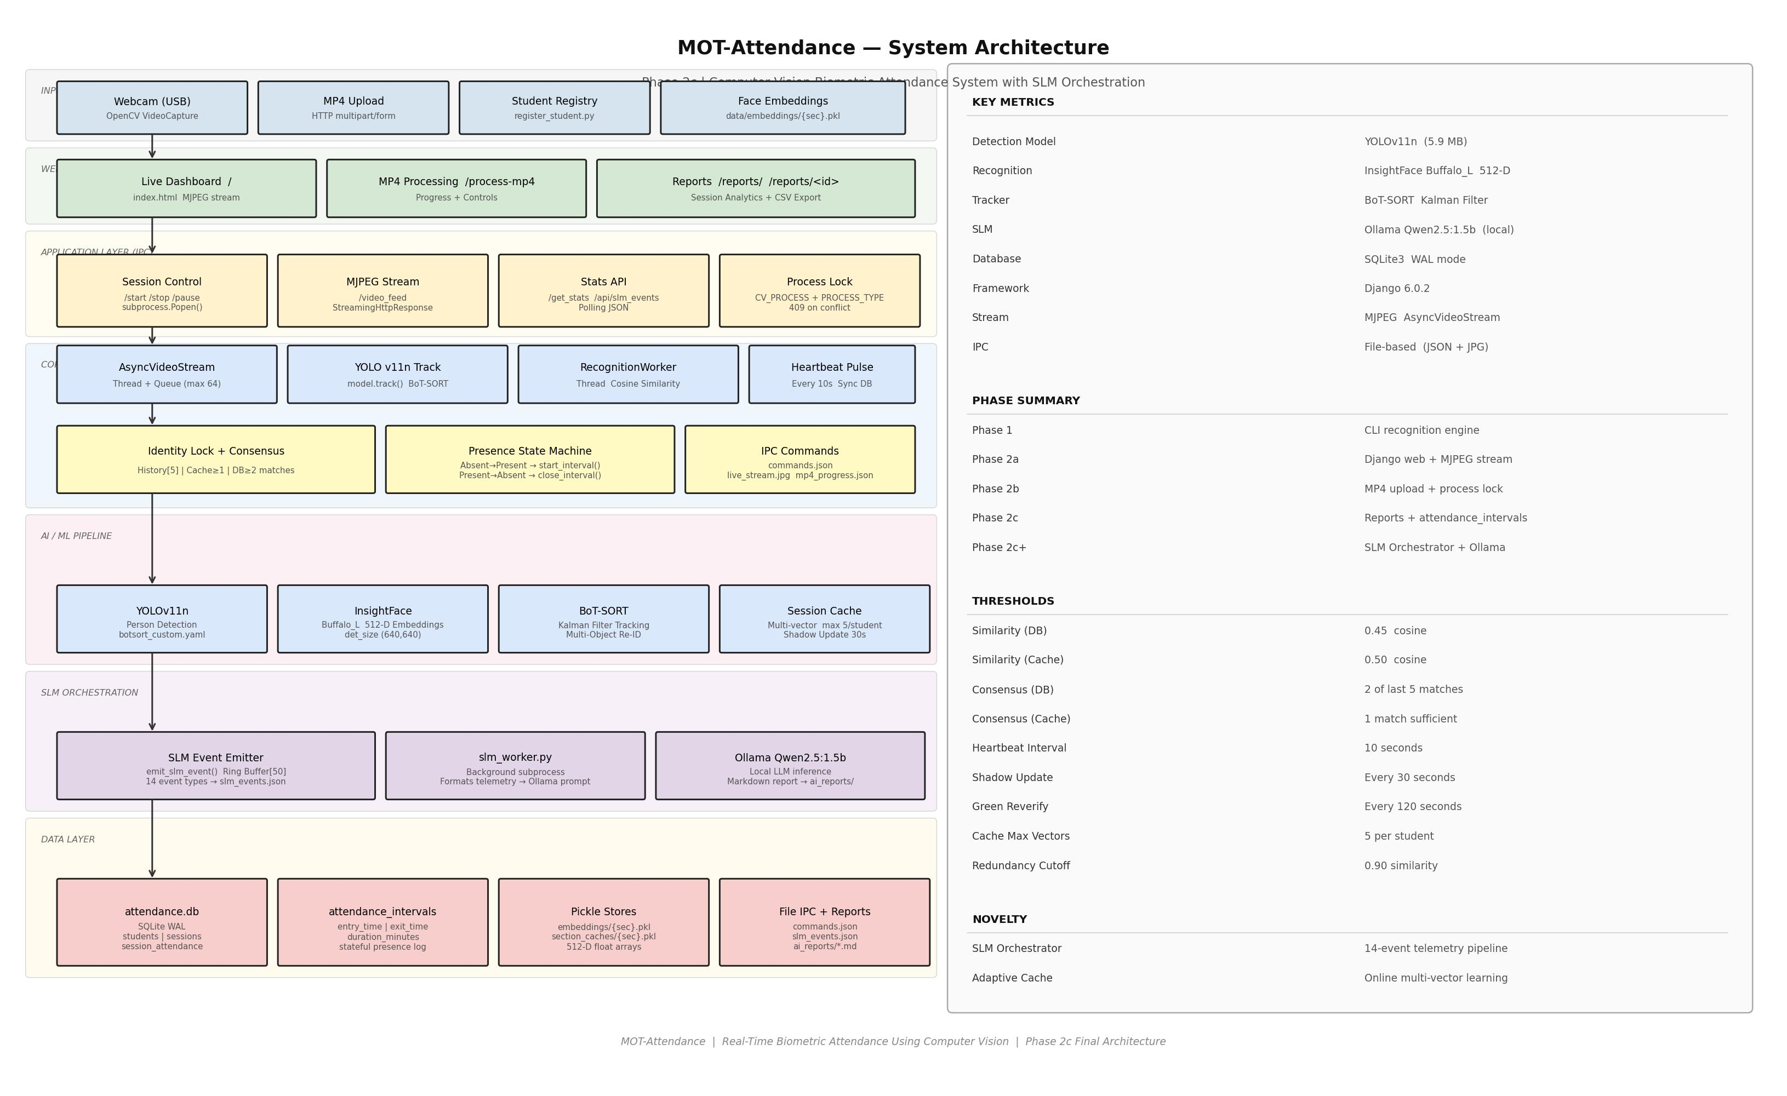
Proposed Architecture

Slide 7
Proposed Approach
Person Detection: YOLOv11n — regional confidence thresholds (0.30 front zone, 0.15 rear zone)
Tracking: BoT-SORT with Kalman filter; custom InsightFace Re-ID replaces built-in appearance features
Face Recognition: InsightFace Buffalo_L — session cache (0.50) → database fallback (0.45) via cosine similarity
Identity Consensus: rolling 5-frame history; 1 cache hit or 2 DB hits required to lock identity
Heartbeat Interval Logging: every 10 s — atomically marks present/absent, opens/closes interval rows in SQLite
Adaptive Shadow Updates: every 30 s — silently diversifies session cache embeddings in background
Session End: SLM worker reads telemetry log → Ollama Qwen2.5:1.5b generates Markdown narrative report on-device

Slide 8
Technologies, Libraries & Dataset
Technologies & Libraries
Dataset & Enrollment
Python 3.12 — core language
Ultralytics YOLOv11n — person detection (~30 FPS on CPU)
InsightFace (Buffalo_L) — ArcFace 512-D face embeddings
OpenCV — video capture, frame preprocessing, MJPEG encoding
Django 6.0.2 — web dashboard and HTTP routing
SQLite3 (WAL mode) — concurrent attendance and interval storage
Ollama Qwen2.5:1.5b — local SLM for AI report generation
NumPy / Pickle — embedding computation and persistence
marked.js — browser-side Markdown rendering
34 students enrolled in section CSE_1 via register_student.py
126 sessions conducted over the academic period
Live enrollment model — no fixed benchmark dataset used
2–3 min enrollment per student; embeddings persist across all sessions

Slide 9
Results
97.1%
3.2 s
126
18 FPS
Recognition Accuracy
Avg. Time to Identity Lock
Sessions Conducted
Live Webcam Speed
33/34 correctly identified — 1 false positive, 0 false negatives across 126 sessions
Average cosine similarity confidence: 0.62 | Average presence duration per interval: 42.3 min
148 unknown persons detected and logged with snapshots | MP4 batch mode: ~24 FPS
Four operational modes: Live Dashboard, Session Report, MP4 Batch Processing, AI Narrative Report
Only system providing proxy prevention + duration tracking + real-time monitoring + AI reporting simultaneously

Slide 10
Conclusion
Production-grade biometric attendance pipeline integrating detection, tracking, recognition, and web interface
YOLOv11n + BoT-SORT ensures consistent identity across frames even through occlusions and re-entries
Two-tier InsightFace recognition with adaptive cache improves speed and accuracy across repeated sessions
Consensus-based locking significantly reduces false positives vs. single-frame approaches
Heartbeat interval logging enables time-in-room analytics not possible with conventional methods
SLM orchestration generates on-device narrative reports — no cloud dependency, full data privacy
Demonstrates that modern computer vision + system engineering yields a scalable, deployable attendance solution

Slide 11
Future Scope
Multi-camera integration with cross-camera re-identification
RTSP/IP camera support for compatibility with existing campus CCTV infrastructure
Role-based authentication and faculty login for the web dashboard
Web-based student enrollment UI — replace command-line register_student.py
Cloud deployment for remote access and multi-institution scalability
Mobile push notifications for absence thresholds and unknown person alerts
Liveness detection / anti-spoofing for high-stakes environments
Advanced SLM reporting: trend analysis, predictive absence flagging, PDF export
Integration with college ERP/LMS via REST API for automatic attendance submission

