Slide 1

Movie Rating Prediction Using the Netflix Dataset

Slide 2
What is the Netflix Challenge ? Objective: Predict movie ratings using the Netflix Dataset
Open dataset and challenge to come up with an algorithm that could improve Netflix’s own ‘Cinematch’ algorithm by a certain threshold (measured by RMSE)
Prize : $1,000,000 !
Winner : Team Bellkor’s Pragmatic Chaos Algorithm (2009)
Blend of 107 individual results. RMSE = 0.8643
Cinematch ? ‘uses straightforward statistical linear models with a lot of data conditioning’
What does the data look like ?
100 million rows !
Customer ID | Movie ID | Date | Rating
1488844 | 12470 | 2005-09-06 | 3
822109 | 5317 | 2005-05-13 | 5
30878 | 15373 | 2005-10-19 | 4
30878 | 16829 | 2005-12-26 | 4

Slide 3
How to go about the prediction ? Different predictive methods used
“Linear models with data conditioning”
Derived Variables
Variable transformations
Interaction Effects
Collaborative Filtering
Item based collaborative filtering
Euclidean distance ? Pearson correlation coefficient ?
Cosine similarity ?
Prediction using ? kNN ? Similarity weighted average ?
Which is more accurate in this scenario ?
Netflix’s Algorithm
Algorithm of the guys to whom Netflix paid $1 M

Slide 4
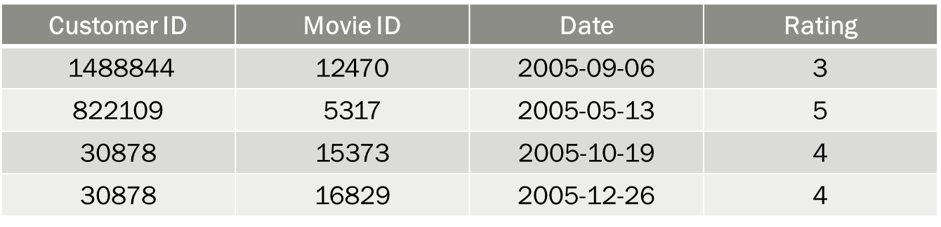
Linear Models
What we should be able to hypothesize :
$y=f(x_{1},x_{2},$ $x_{3},..,x_{n})$
Nominal
Solution : Derived Variables
Average Rating of the User (how nice/stingy is the user)
Average Rating of the Movie (overall how good is the movie)
Frequency of Rating (popularity)
Data Conditioning
Variable transformation to approximate normality for better model fit
Interaction Effects : Does the user rating depend on the popularity of the movie ?

Slide 5
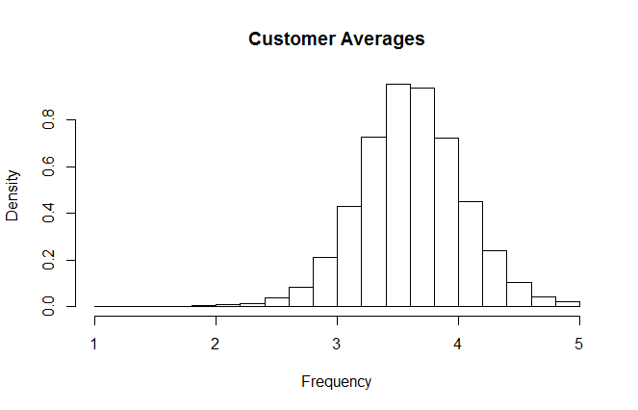
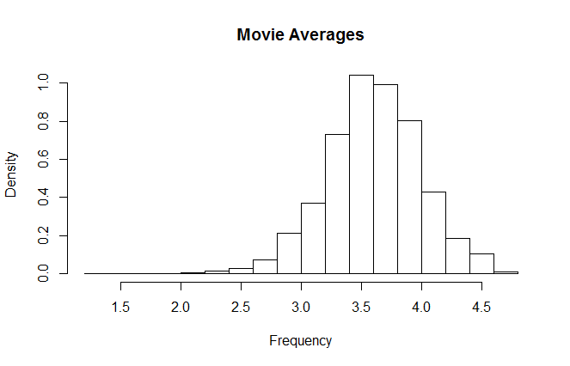
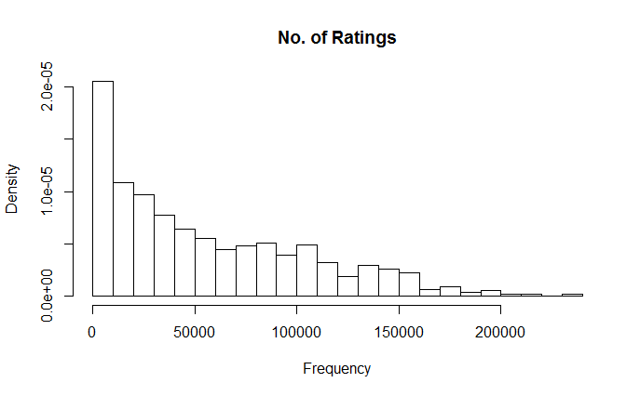
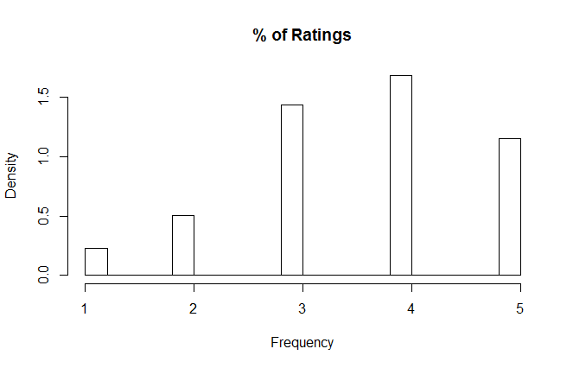
Descriptive Statistics

Slide 6
Collaborative Filtering
Item Based Collaborative Filtering
17770 movies similarity index
vs. 480k users similarity index using User Based Collaborative Filtering
Two stages:
Calculate the similarity index between items (movies)
Euclidean Distance
Correlation Coefficient
Cosine Similarity Index
Predict the rating using the similarity index
kNN – Average of k nearest neighbors
Similarity weighted average of ratings

Slide 7
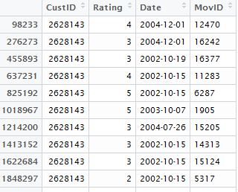
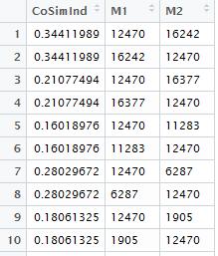
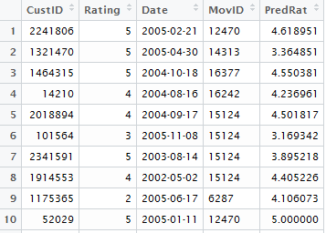
Item Based Collaborative Filtering
Using Cosine Similarity and Weighted Average
Calculating similarity between movies
Similarity Matrix using Cosine Similarity
Sampled Data
(top 10 movies
& top 500 users)
Rating Prediction using weighted average
Original vs. Predicted Ratings

Slide 8
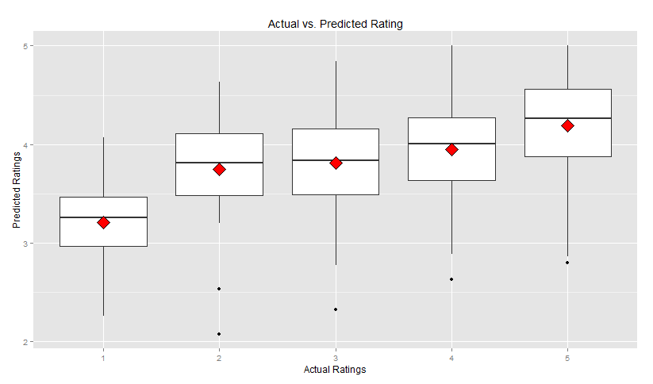
Actual vs. Predicted Ratings
4.191
3.945
3.749
3.809
3.206

Slide 9
Conclusion
Method Used | Method Specification | Sampling Method | Accuracy ? RMSE
Linear Regression | Transformed variables with Interaction effects | 20% random sample (i.e. 20 million observations) | 0.9145
Collaborative Filtering | Item Based: Using Correlation and kNN average prediction (k=3) | Top 10 most popular movies Top 500 users | 0.9547
Collaborative Filtering | Item Based: Using Euclidean distance and kNN average prediction (k=5) | Top 10 most popular movies Top 10 users | 1.0954
Collaborative Filtering | Item Based: Using Cosine similarity and weighted average | Top 10 most popular movies Top 500 users | 0.8875

Slide 10
Challenges
Very few explanatory variables. Except User ID, Movie ID & Date no other parameters available for prediction.
Sparse data set. Very few ratings for some movies.
Due to a very large amount of data, some computations required a long time.
Some other computations were not possible due to memory limitations.
No in-built functions available in most statistical packages like Base SAS & R for collaborative filtering.

Slide 11
THANK YOU !!
QUESTIONS ??

