Slide 1

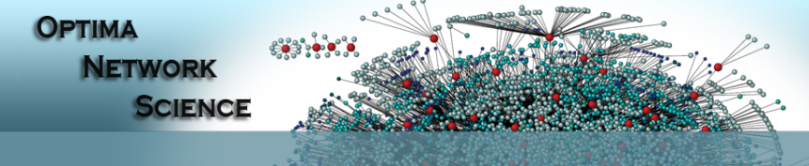

Overlapping Communities in Dynamic Networks: Their Detection and Mobile Applications
Nam P. Nguyen, Thang N. Dinh, Sindhura Tokala and My T. Thai
{nanguyen, tdinh, sindhura, mythai}@cise.ufl.edu
MOBICOM 2011
Notes:
This presentation is presented at Mobicom conference, Las Vegas, Nevada USA, 2011
Created by: Nam P. Nguyen

Slide 2
Motivation
A better understanding of mobile networks in practice
Underlying structures?
Organization of mobile devices?
Better solutions for mobile networking problems
Forwarding and routing methods in MANETs
Worm containment methods in OSNs (on mobile devices)
and possibly more …

Slide 3
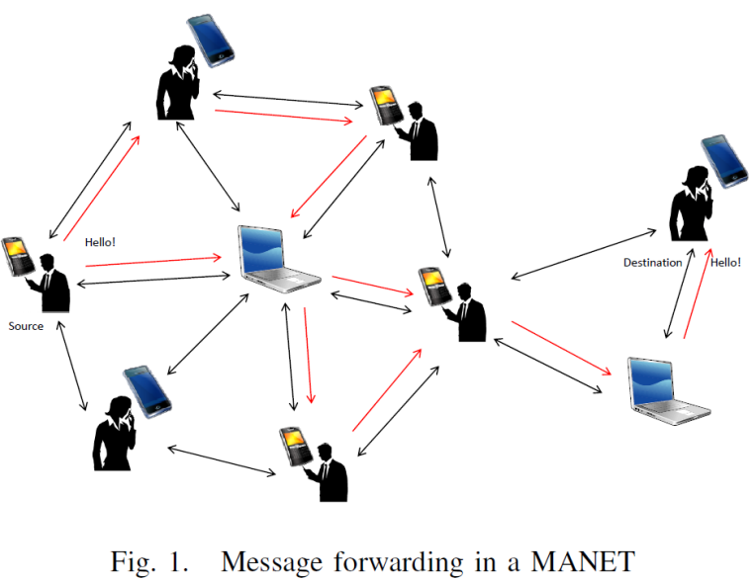
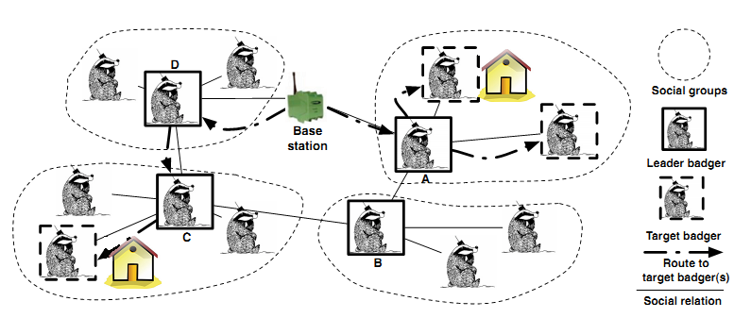
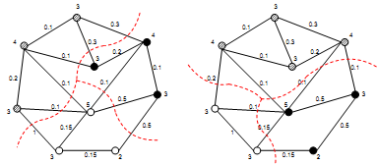
Communities in mobile networks
Forwarding & Routing on MANETs
Sensor Reprogramming in WSNs
Worm containment in Cellular networks
Community Structure
Notes:
Figures
Left: Thang N. Dinh, Ying Xuan, and My T. Thai, Towards Social-aware Routing in Dynamic Communication Networks, in Proceedings of the 28th IEEE International Performance Computing and Communications Conference (IPCCC), 2009
Middle: B.Pasztor,L.Mottola,C.Mascolo,G.Picco,S.Ellwood,and D. Macdonald. Selective reprogramming of mobile sensor networks through social community detection. Wireless Sensor Networks,’10.
Right: Z. Zhu, G. Cao, S. Zhu, S. Ranjan and A. Nucci. A social network based patching scheme for worm containment in cellular networks, Infocom 2009

Slide 4
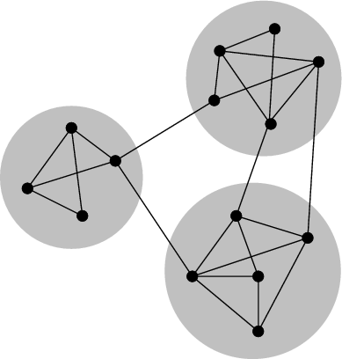
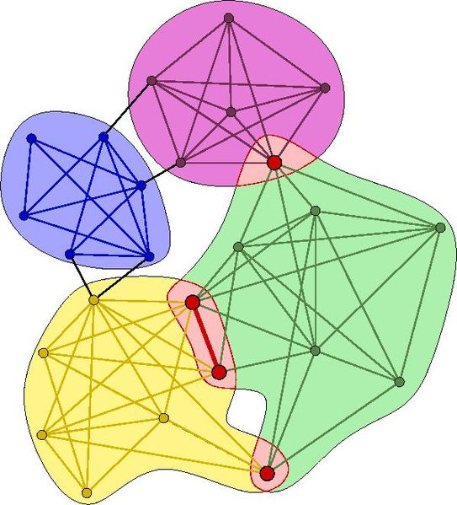
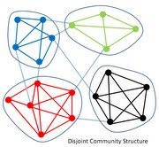
Community structure
No well-defined concept(s) yet
Densely connected inside each community
Less edges/links crossing communities
Notes:
Figure reference
Top: http://en.wikipedia.org/wiki/File:Network_Community_Structure.png
Left: animalsocialnetworks.blogspot.com

Slide 5
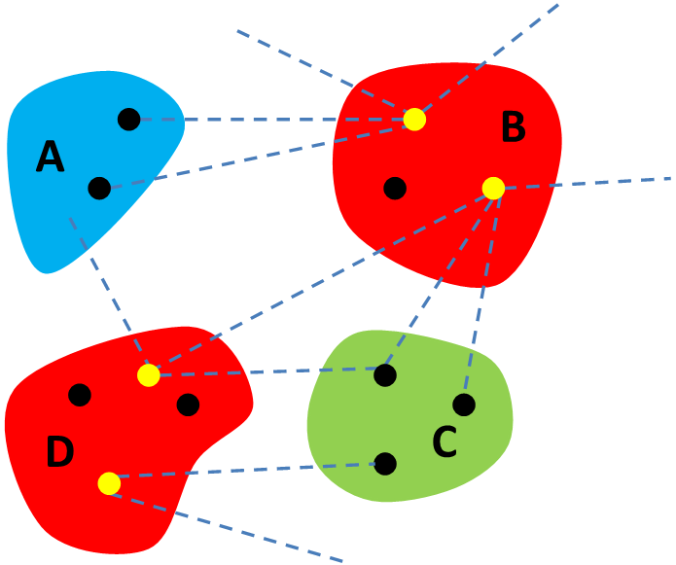
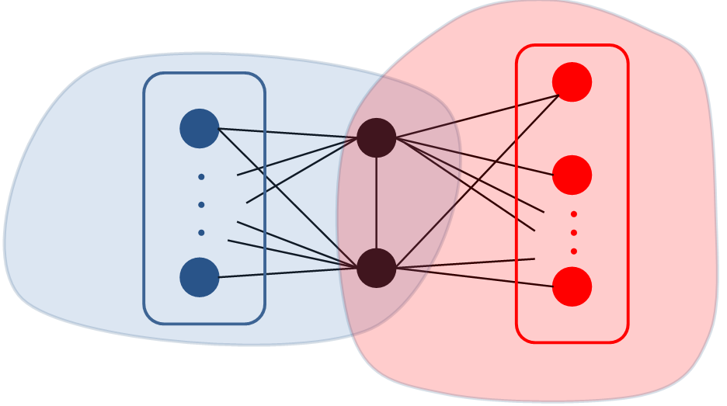
How do communities help in mobile networks?
Forwarding & Routing on MANETs
Sensor Reprogramming in WSNs
Worm containment in Cellular networks

Slide 6
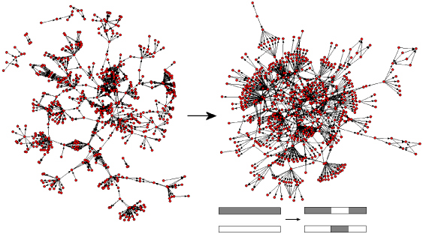
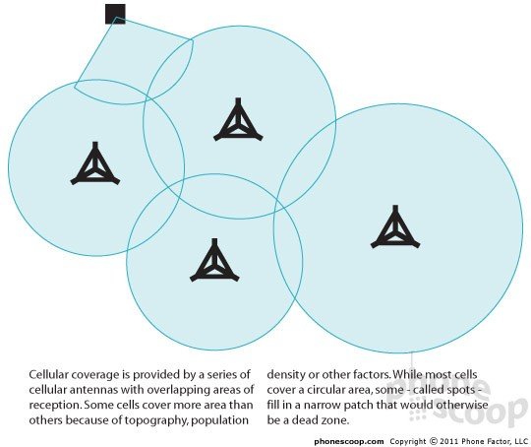
Community detection
The detection of network communities is important
However, …
Large and dynamic Mobile networks
Overlapping communities
Q: A quick and efficient CS detection algorithm?
A: An Adaptive CS detection algorithm
Notes:
Figure References
Dynamic network(Left): http://iopscience.iop.org/1742-5468/2007/11/P11007
Cellular coverage(Right): http://www.phonescoop.com/articles/article.php?a=51&p=1470
When the network is large, any static community detection method will perform slow → time consuming.
When the network is dynamic, one needs to run a static community detection method several times as the network changes

Slide 7






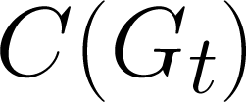
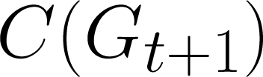
An adaptive algorithm
Input network
Phase 1: Basic CS detection (β)
Our solution:
AFOCS: A 2-phase and limited input dependent framework
Phase 2: Adaptive CS update (β)
Network changes
Basic communities
:
:
Updated communities

Slide 8
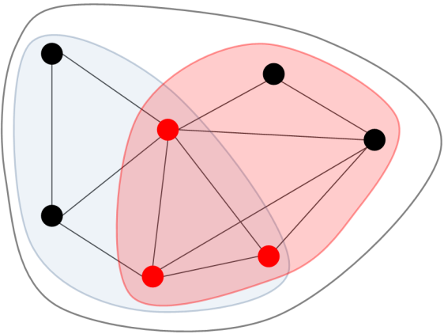
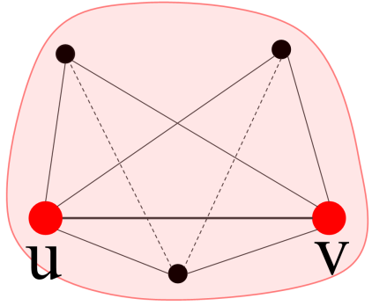
Phase 1: Basic communities detection
Basic communities
Dense parts of the networks
Can possibly overlap
Bases for adaptive CS update
Duties
Locates basic communities
Merges them if they are highly overlapped

Slide 9


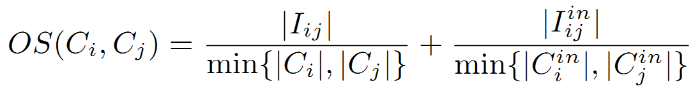
Phase 1: Basic communities detection
Locating basic communities: when Ψ(C) ≥ τ(C)
Ψ(C) = 0.9 ≥ τ(C) =0.725
Merging: when OS(C_{i}, C_{j}) ≥ β
OS(C_{i}, C_{j}) = 1.027 ≥ β = 0.75

Slide 10
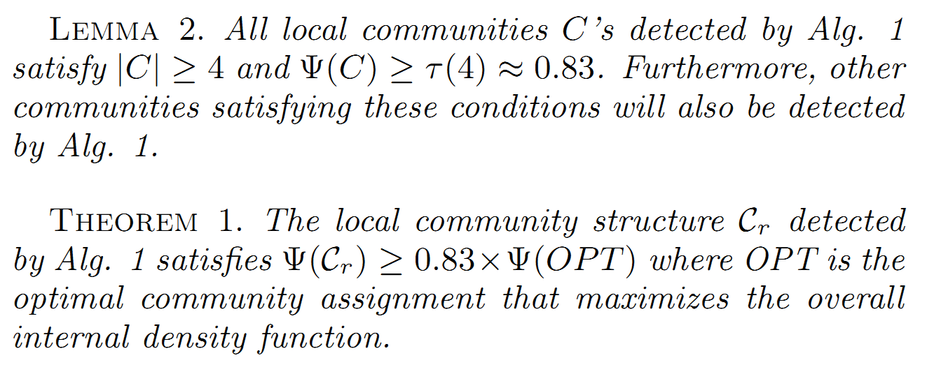
Phase 1: Basic communities detection

Slide 11
Phase 2: Adaptive CS update
Update network communities when changes are introduced
Need to handle
Adding a node/edge
Removing a node/edge
Basic communities
Network changes
Updated communities
+ Locally locate new local communities
+ Merge them if they highly overlap with current ones

Slide 12
Phase 2: Adding a new node
u
u
u
Y(C_{t}) ≥ t(4) × Y(OPT(u)_{t})

Slide 13
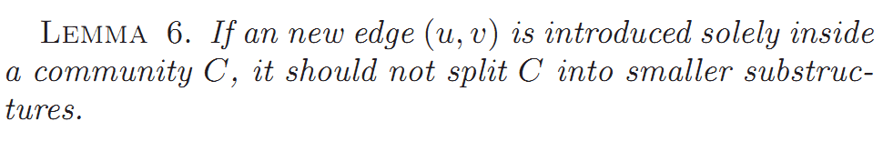
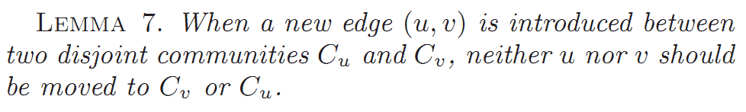
Phase 2: Adding a new edge

Slide 14
Phase 2: Removing a node
Identify the left-over structure(s) on C\{u}
Merge overlapping substructure(s)

Slide 15
Phase 2: Removing an edge
Identify the left-over structure(s) on C\{u,v}
Merge overlapping substructure(s)

Slide 16
AFOCS: Summary
Phase 1: Basic CS detection (β)
Node/edge insertions
Node/edge removals
Phase 2: Adaptive CS update (β)
Network changes

Slide 17
A community-based forwarding & routing strategy in MANETs
Challenges
Fast and effective forwarding
Not introducing too much overhead info
Available (non-overlapping) community-based routings
Forward messages to the people/devices in the same community as the destination.
Our method:
Takes into account overlapping CS
Forwards messages to people/devices sharing more community labels with the destination

Slide 18
Experiment set up
Data: Reality Mining (MIT lab)
Contains communication, proximity, location, and activity information (via Bluetooth) from 100 students at MIT in the 2004-2005 academic year
500 random message sending requests are generated and distributed in different time points
Control parameters
hop-limit
time-to-live
max-copies

Slide 19
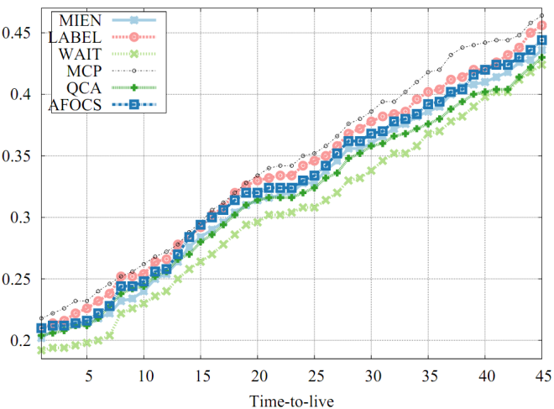
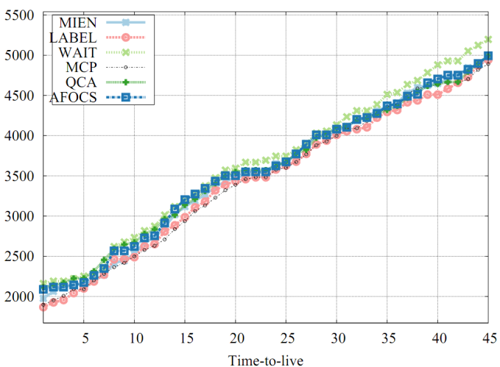
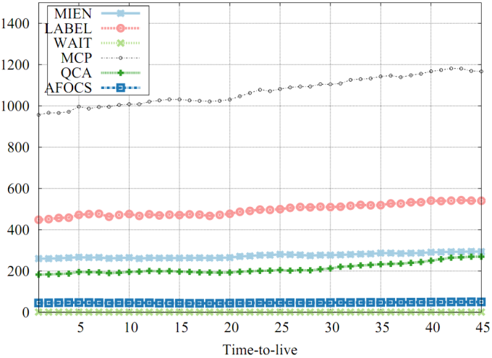
Results
Avg. Delivery Ratio
Avg. Delivery Time
Avg. Duplicate Message
+ Competitive Avg. Delivery Ratio and Delivery Time
+ Significant improvement on the number of Avg. Duplicate Messages

Slide 20


A community-based worm containment method on OSNs
Online social networks have become more and more popular
Worm spreading on OSNs
From computers → computers (traditional method)
From mobile devices → mobile devices (Smart phones, PDAs, etc)
Notes:
Figures
(1): virtualassist.net
(2): mobilemarketingwatch.com

Slide 21
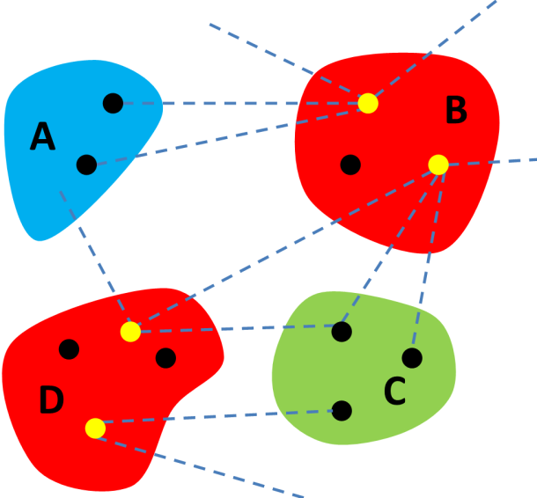
Worm containment methods
Available methods (cellular networks)
Choosing people/devices from different disjoint communities and send patches to them
Our method:
Choosing the people/devices in the boundary of the overlap to send patches & have them redistribute the patches

Slide 22
Experiment set up
Dataset: Facebook network []
New Orleans region
63.7K nodes + 1.5M edges (Avg. degree = 23/5)
Friendship and wall-posts
Worm propagation
Follows “Koobface” spreading model
Alarm threshold
α = 2%, 10% & 20%

Slide 23
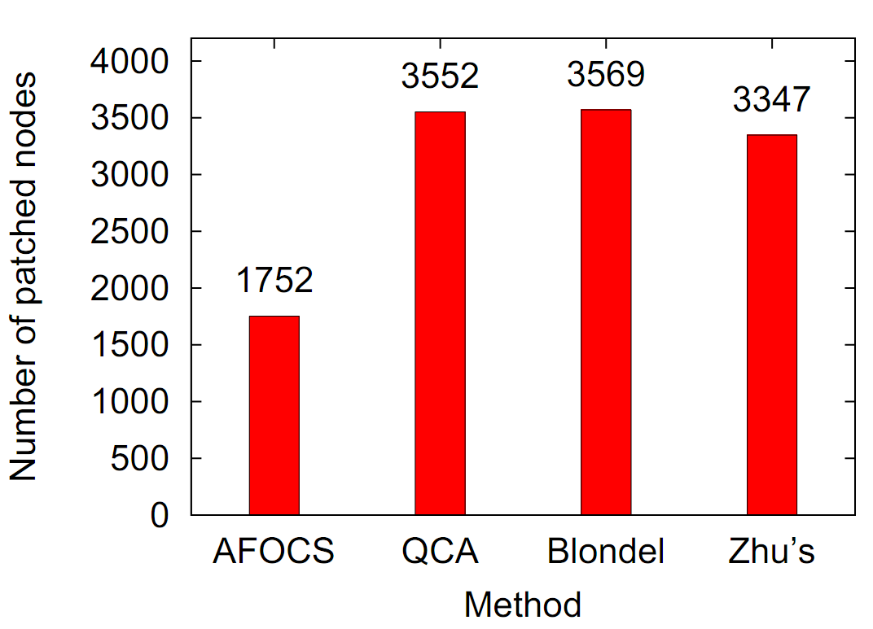
Results

Slide 24
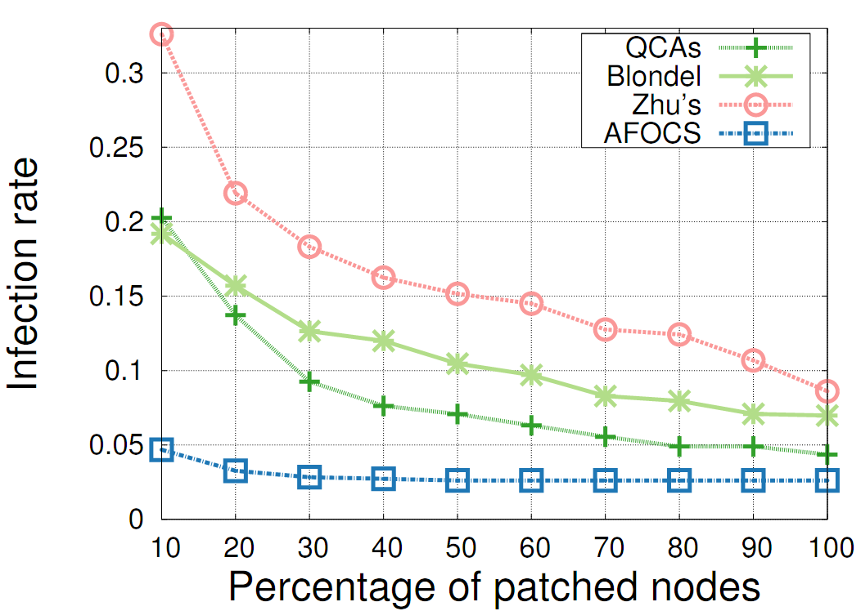
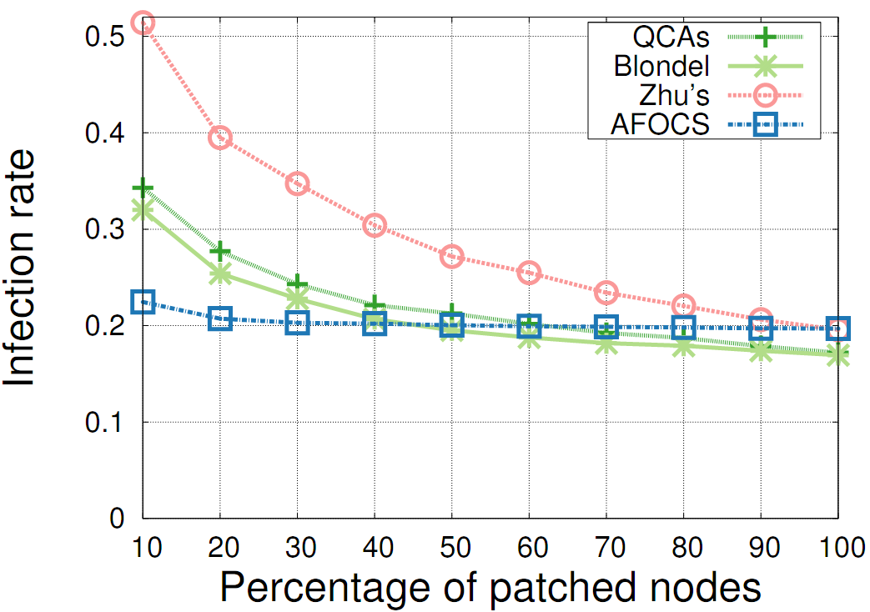
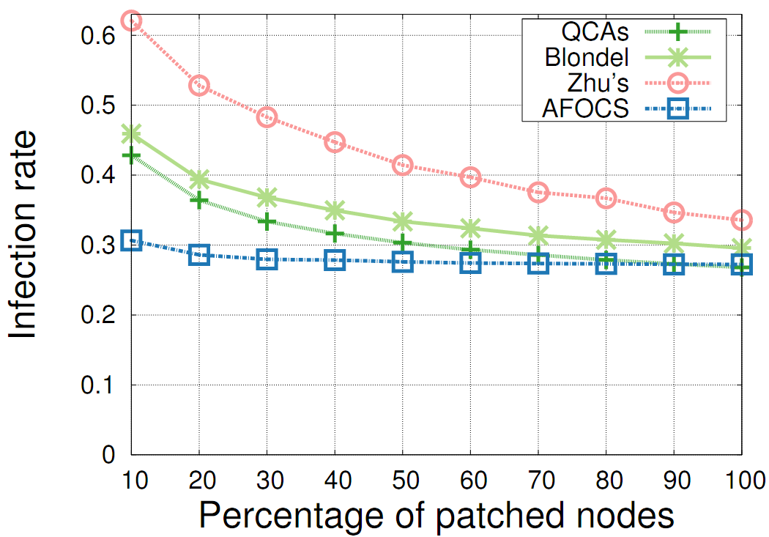
Results
α = 2%
α = 10%
α = 20%
+ Better infection rates
+ Number of nodes to be patched is greatly reduced

Slide 25
Summary
AFOCS
A 2-phase adaptive framework to identify and update CS in dynamic networks
Fast and efficient
Forwarding & Routing strategy on MANETs
Competitive Avg. Time and Delivery Ratio
Significant improvement of number of Avg. Duplicate Messages
Worm containment on OSNs
A tighter set of influential people/devices
Better performance in comparison with other methods.

Slide 26
Acknowledgement
Funding
NSF CAREER Award grant 0953284
DTRA YIP grant HDTRA1-09-1-0061
DTRA grant HDTRA1-08-10.
Shepherd
Dr. Cecilia Mascolo, University of Cambrigde, UK

Slide 27

Q&A
Thank you for your attention
Notes:
Figures: internetbusinessmastery.com

Slide 28
Back-up slides
Additional slides for questions that may arise in the presentation

Slide 29
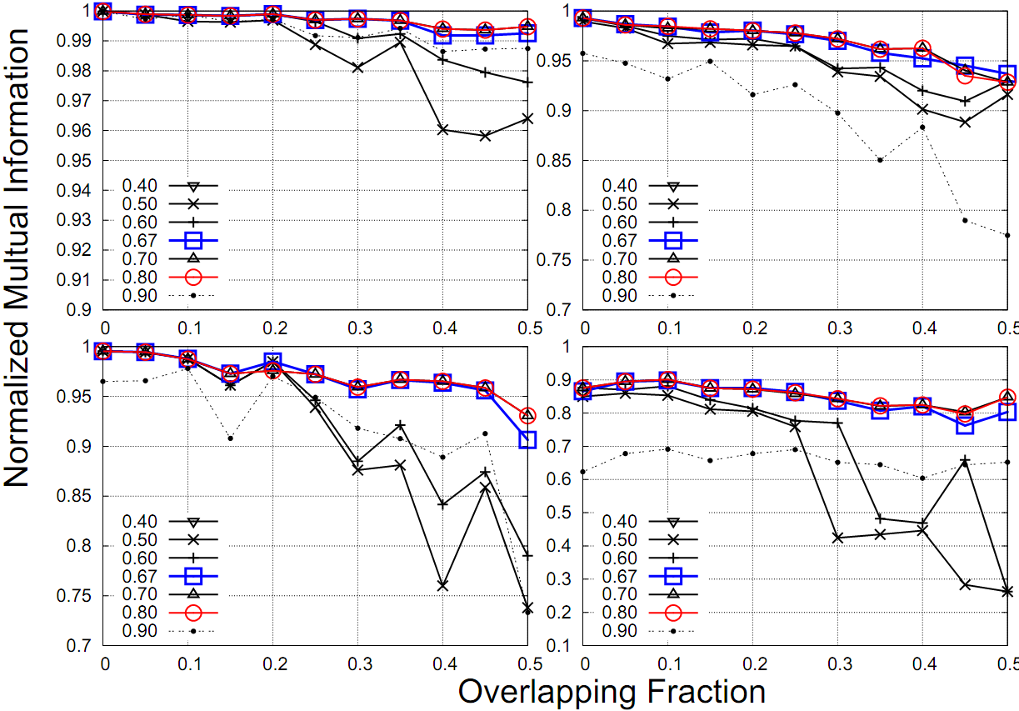
Choosing β

Slide 30
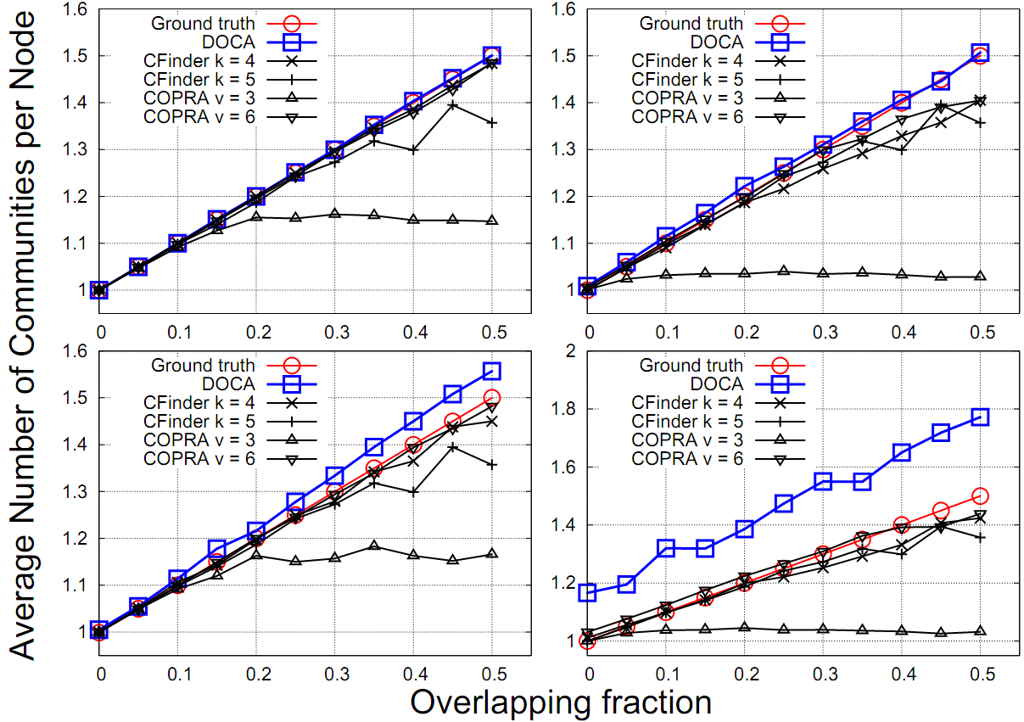
AFOCS performance

Slide 31
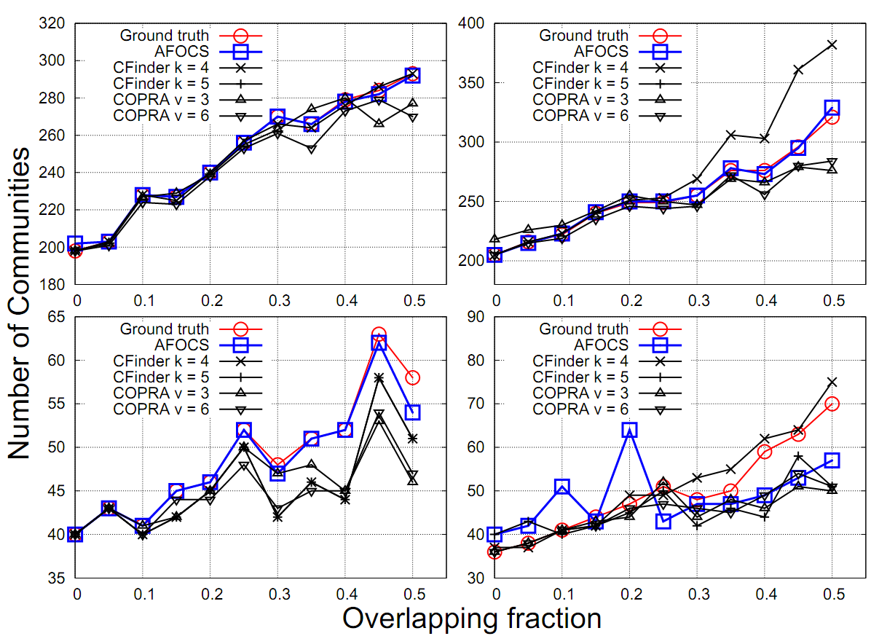
AFOCS performance

