Slide 1
Aiding the Detection of Fake Accounts in Large Scale Social Online Services
Qiang Cao
Duke University
Michael Sirivianos Xiaowei Yang Tiago Pregueiro
Cyprus Univ. of Technology Duke University Tuenti, Telefonica Digital
Telefonica Research

Slide 2

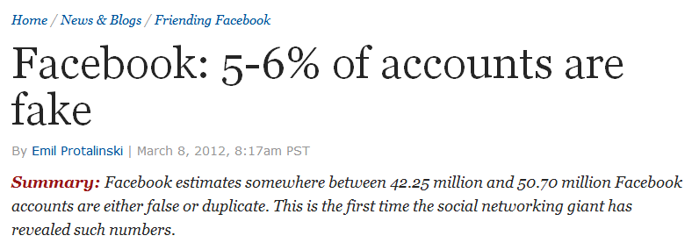
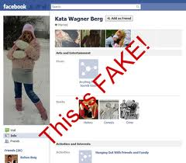







Fake accounts (Sybils) in OSNs

Slide 3
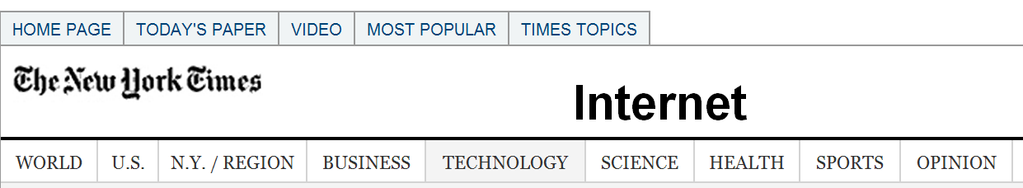
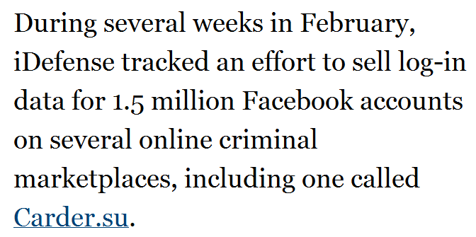




Fake accounts for sale
2010

Slide 4
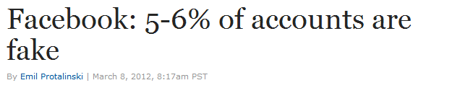

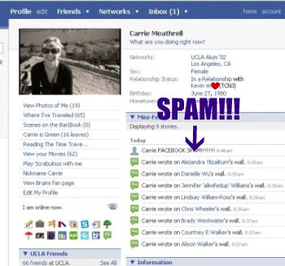
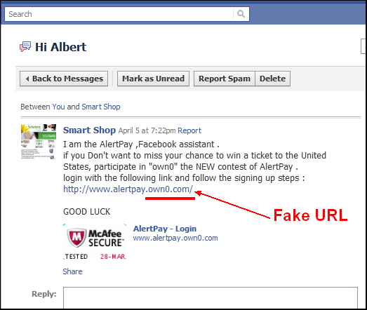
Why are fakes harmful?
Fake (Sybil) accounts in OSNs can be used to:
Send spam [IMC’10]
Manipulate online rating [NSDI’09]
Access personal user info [S&P’11]
…
“the geographic location of our users is estimated based on a number of factors, such as IP address, which may not always accurately reflect the user's actual location. If advertisers, developers, or investors do not perceive our user metrics to be accurate representations of our user base, or if we discover material inaccuracies in our user metrics, our reputation may be harmed and advertisers and developers may be less willing to allocate their budgets or resources to Facebook, which could negatively affect our business and financial results.”

Slide 5
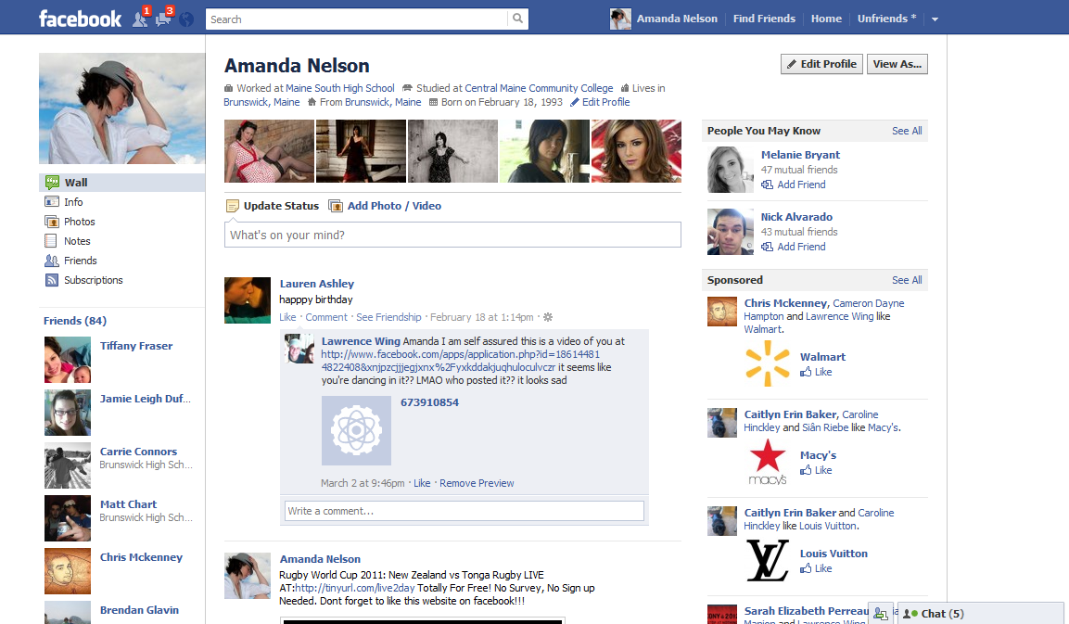
Detecting Sybils is challenging
Sybils may resemble real users
Difficult to automatically detect using
profile and activity features

Slide 6



Current practice
Employs many counter-measures
False positives are detrimental to user experience
Real users respond very negatively
Inefficient use of human labor!
User abuse reports
Human
verifiers
Tuenti’s user inspection team
Reviews ~12, 000 abusive profile reports per day
An employee reviews ~300 reports per hour
Deletes ~100 fake accounts per day
User profiles & activities
Automated
classification
(Machine learning)
Suspicious
accounts
Mitigation
mechanisms

Slide 7
Can we improve the workflow?
User abuse reports
Human
verifiers
User profiles & activities
Automated
classification
(Machine learning)
Suspicious
accounts
Mitigation
mechanisms
Sybil detection

Slide 8










Leveraging the social relationship
The foundation of social-graph-based schemes
Sybils have limited social links to real users
Can complement current OSN counter-measures
Attack edges
Non-Sybil region
Sybil region

Slide 9

Goals of a practical social-graph-based Sybil defense
Effective
Uncovers fake accounts with high accuracy
Efficient
Able to process huge online social networks

Slide 10
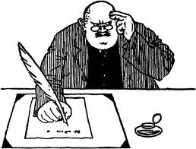
How to build a practical social-graph-based Sybil defense?
SybilGuard [SIGCOMM’06]
SybilLimit [S&P’08]
SybilInfer [NDSS’09]
Traditional
trust inference?
PageRank [Page et al. 99]
EigenTrust [WWW’03]
Sybil*?
Sybil* is too expensive in OSNs
Designed for decentralized settings
PageRank is not Sybil-resilient
EigenTrust is substantially manipulable [NetEcon’06]

Slide 11


SybilRank in a nutshell
Uncovers Sybils by ranking OSN users
Sybils are ranked towards the bottom
Based on short random walks
Uses parallel computing framework
Practical Sybil defense: efficient and effective
Low computational cost: O(n log n)
≥20% more accurate than the 2nd best scheme
Real-world deployment in Tuenti

Slide 12

Primer on short random walks
Short random walks
Trust seed
Limited probability of
escaping to the Sybil region

Slide 13

SybilRank’s key insights
Main idea
Ranks by the landing probability of short random walks
Uses power iteration to compute the landing probability
Iterative matrix multiplication (used by PageRank)
Much more efficient than random walk sampling (Sybil*)
O(n log n) computational cost
As scalable as PageRank

Slide 14
An example
Landing probability of short random walks
Initialization
Step 1
0
0
0
G
B
1/6
5/12
0
0
0
0
A
E
F
I
1/6
1/4
1/6
C
1/4
D
H
1/6
1/2
0
1/6
1/4
1/2
Trust seed
Non-Sybil users
Sybils

Slide 15
An example
Stationary distribution
Identical degree-normalized landing probability: 1/24
Early Termination
Step 4
1/65
1/6
3/24
2/24
G
B
1/5
1/8
1/12
1/81
3/24
3/24
3/24
2/24
A
E
F
I
Non-Sybil users have higher
degree-normalized landing probability
C
D
H
1/6
1/4
1/65
2/24
3/24
3/24
B
C
D
A
E
F
I
G
H
Rankings

Slide 16
How many steps?
O(log n) steps to cover the non-Sybil region
The non-Sybil region is fast-mixing (well-connected) [S&P’08 ]
O(log n) steps
Trust seed
Stationary distribution approximation

Slide 17
Overview
Problem and Motivation
Challenges
Key Insights
Design Details
Evaluation

Slide 18
We divide the landing probability by the node degree
Eliminates the node degree bias
False positives: low-degree non-Sybil users
False negatives: high-degree Sybils
Security guarantee
Accept O(log n) Sybils per attack edge
Theorem: When an attacker randomly establishes g attack edges in a fast mixing social network, the total number of Sybils that rank higher than non-Sybils is O(g log n).
Rankings
Only O(g log n)

Slide 19


Coping with the multi-community structure
Solution: leverage the support for multiple seeds
Distribute seeds into communities
A weakness of social-graph-based schemes [SIGCOMM’10]
Trust seed
False positives
San Diego
San Jose
Los Angeles
Fresno
San Francisco

Slide 20


How to distribute seeds?
Estimate communities
The Louvain method
[Blondel et al., J. of Statistical Mechanics’08]
Distribute non-Sybil seeds in communities
Manually inspect a set of nodes in each community
Use the nodes that passed the inspection as seeds
Sybils cannot be seeds

Slide 21

Evaluation
Comparative evaluation
Real-world deployment in Tuenti

Slide 22
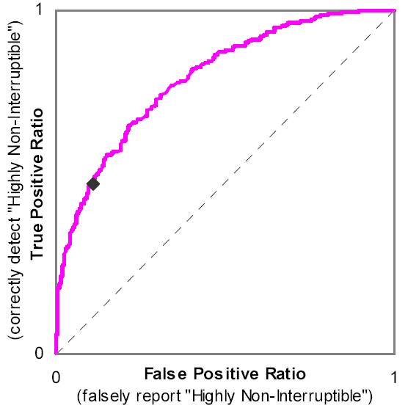
Comparative evaluation
Stanford large network dataset collection
Ranking quality
Area under the Receiver Operating Characteristics (ROC) curve [Viswanath et al., SIGCOMM’10]
Compared approaches
SybilLimit (SL)
SybilInfer (SI)
EigenTrust (ET)
GateKeeper [INFOCOM’11]
Community detection
[SIGCOMM’10]
[Fogarty et al., GI’05]

Slide 23
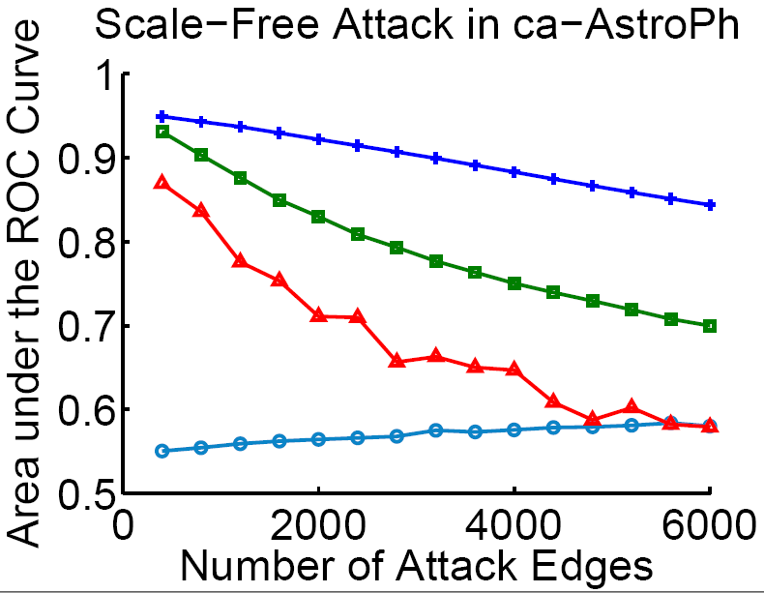
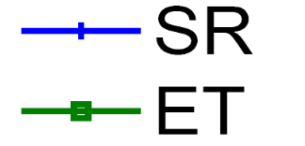


SybilRank has the lowest false rates
SybilRank
EigenTrust
20% lower false positive and false negative
rates than the 2nd best scheme

Slide 24

Real-world deployment
Used the anonymized Tuenti social graph
11 million users
1.4 billion social links
25 large communities with >100K nodes in each

Slide 25
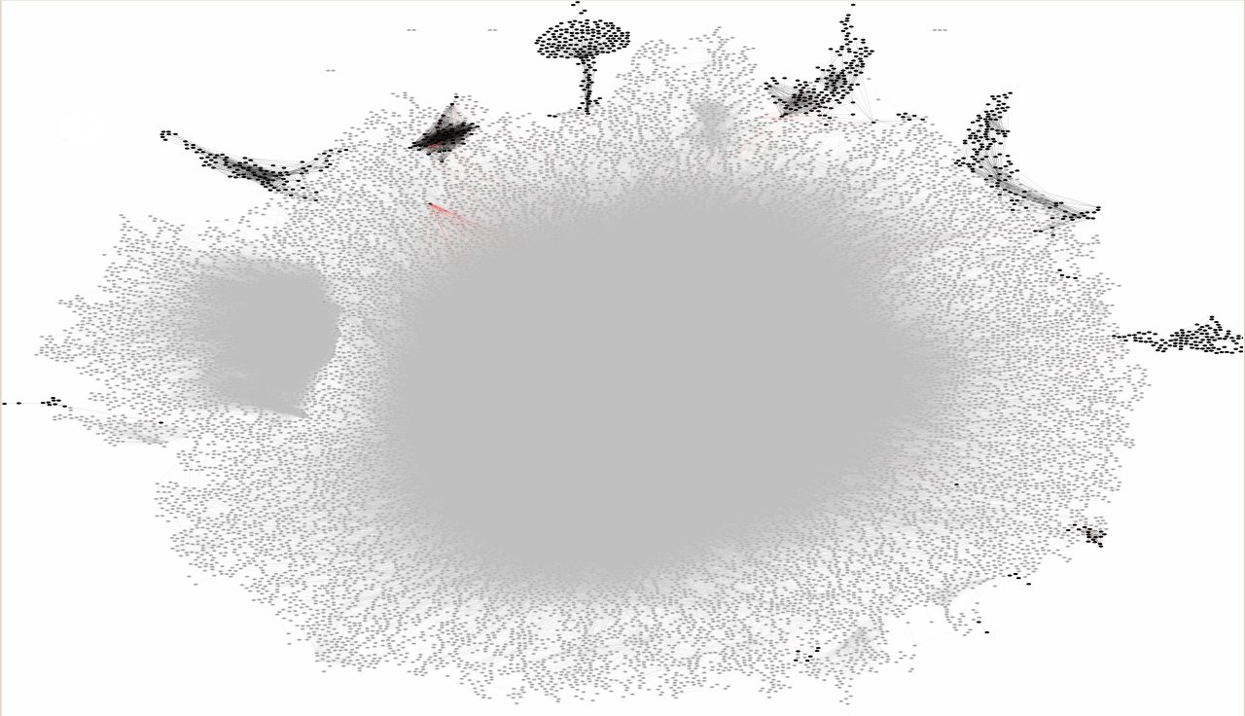
A 20K-user Tuenti community
Fake accounts
A real community of the Tuenti 11M-user
social network
Real accounts

Slide 26
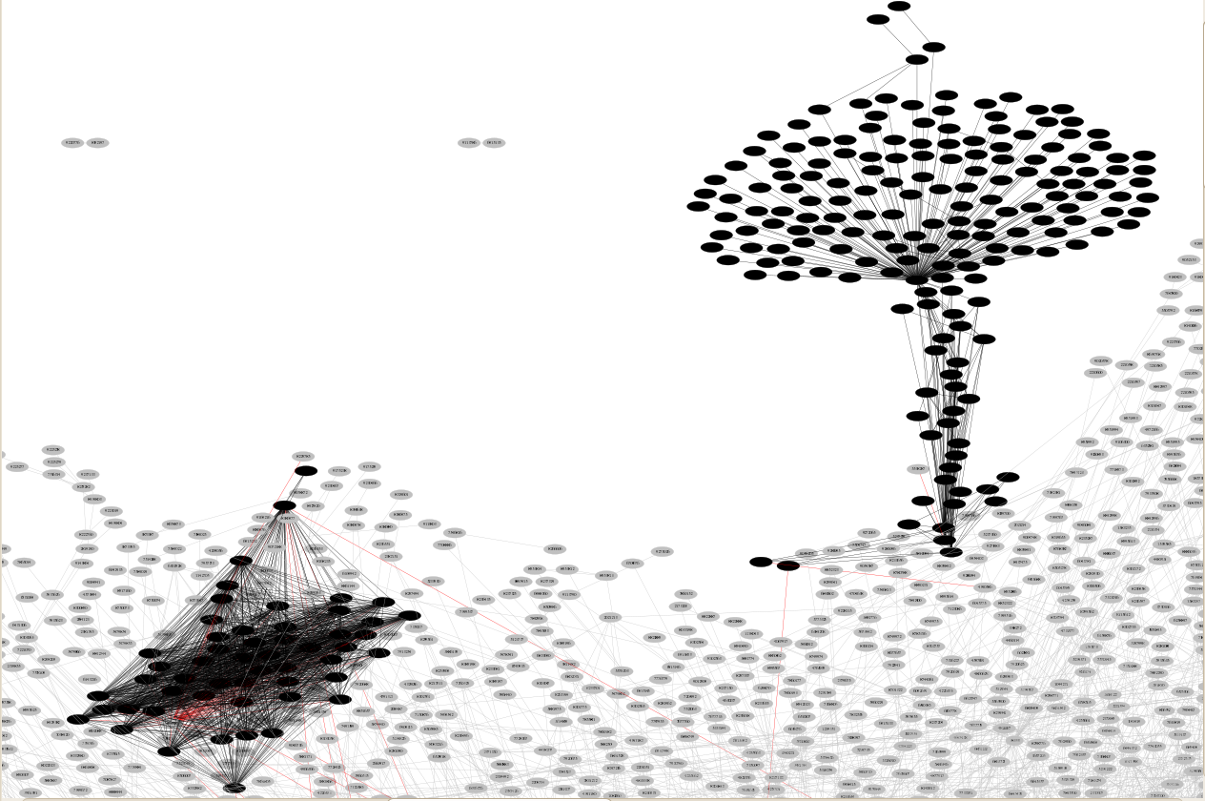
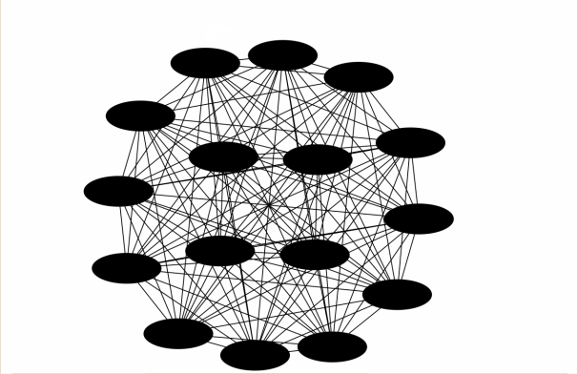
Various connection patterns among suspected fakes
Clique
Tightly connected
Loosely connected

Slide 27
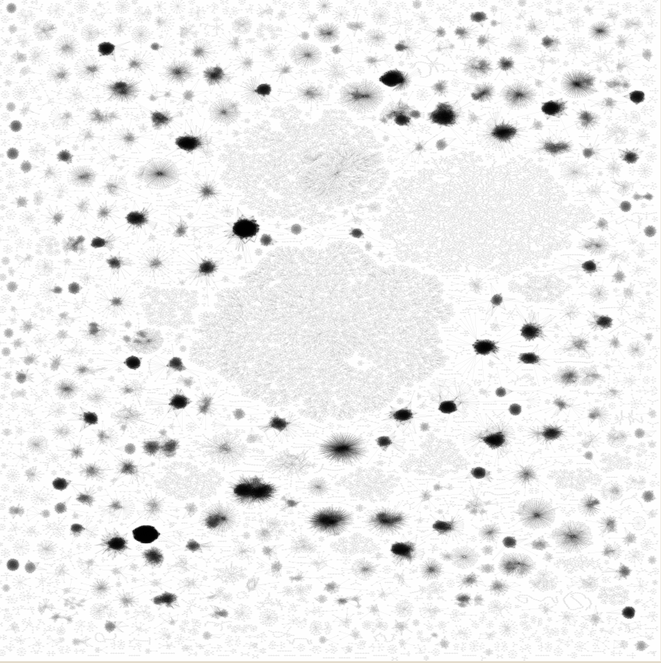
A global view of suspected fakes’ connections
50K suspected accounts
Small clusters/cliques
Controlled by
many distinct
attackers

Slide 28
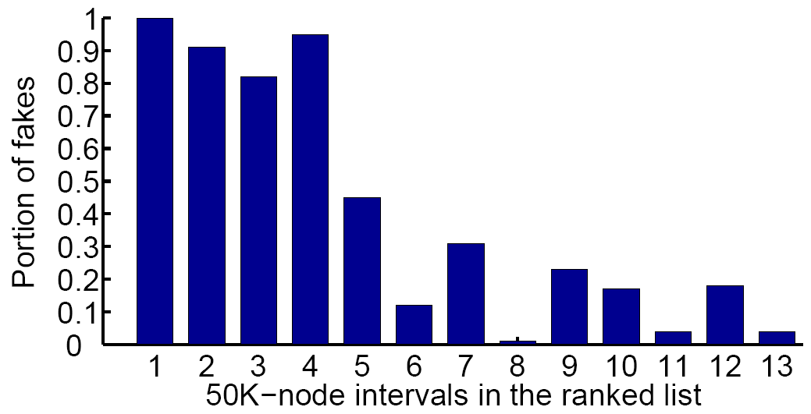
SybilRank is effective
Percentage of fakes in each 50K-node interval
Estimated by random sampling
Fakes are confirmed by Tuenti’s inspection team
Percentage of fakes
High percentage
of fakes
~180K fakes among the lowest-ranked 200K users
Tuenti uncovers x18 more fakes
50K-node intervals in the ranked list
(Intervals are numbered from the bottom)

Slide 29
Conclusion: a practical Sybil defense
SybilRank: ranks users according to the landing probability of short random walks
Computational cost O(n log n)
Provable security guarantee
Deployment in Tuenti
~200K lowest ranked users are mostly Sybils
Enhances Tuenti’s previous Sybil defense workflow

Slide 30
Thank You!
qiangcao@cs.duke.edu
michael.sirivianos@cut.ac.cy
xwy@cs.duke.edu
tiago@tuenti.com
Questions?

