Slide 1
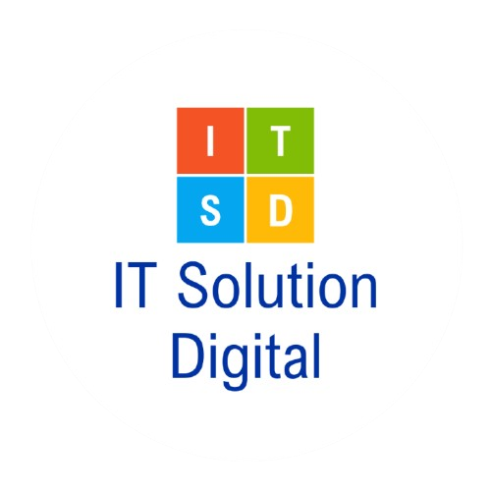

Higher Education
Management Information System
A project for the Ministry of Education, Youth and Sport, implemented by IT Solution Digital
Purpose:
The National Platform for Higher Education Data Management and Ministry Oversight
A project funded by the Royal Government of Cambodia

Slide 2
Table of Contents
1
2
Executive Summary
The Challenge
3
4
The Solution
Key features & Benefits
5
6
User Types & Access Management
Government & National Impact
7
8
Competitive Advantage
Success & Results

Slide 3
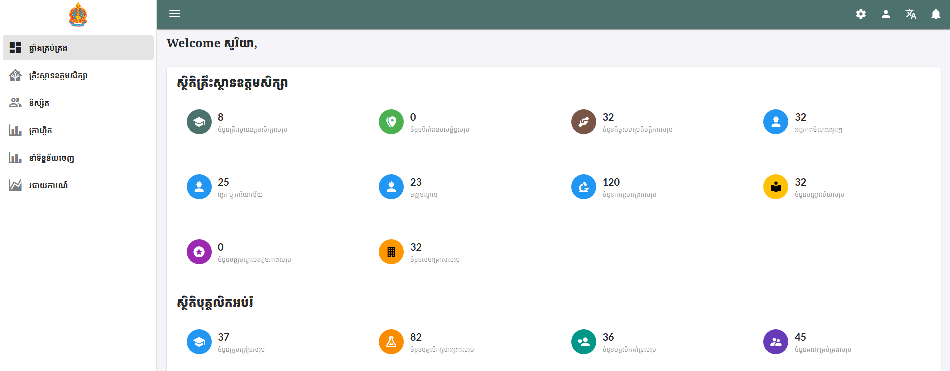
1. Executive Summary: What is HEMIS?
HEMIS: National Higher
Education Data Management
Platform
Strategic National Initiative
HEMIS the official flagship platform of Cambodia's Ministry of Education, Youth and Sports. This strategic initiative was developed to significantly advance the nation's higher education sector. The platform's goal is to set a new standard for excellence in educational governance.

Slide 4
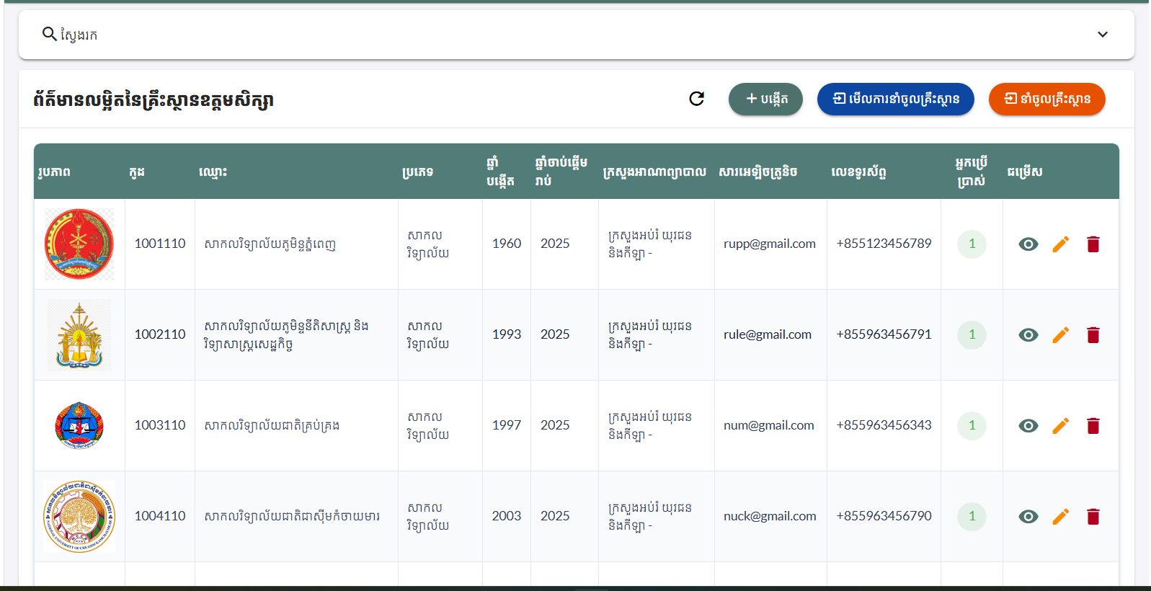
1. Executive Summary: What is HEMIS?
HEMIS: National Higher
Education Data Management
Platform
Unified Data System
It functions as a comprehensive digital platform that addresses data fragmentation by centralizing and standardizing all higher education information into a single, unified national database.

Slide 5

1. Executive Summary: What is HEMIS?
HEMIS: National Higher Education Data Management Platform
Empowered Governance and Decision-Making
The system revolutionizes oversight by modernizing institutional management and enabling evidence-based strategic planning for more effective decision-making.

Slide 6





1. Executive Summary: What is HEMIS?
Strategic Priorities Addressed
HEMIS directly supports key national goals for a stronger, more competitive nation.
National Oversight
Quality Leadership
Evidence-Based Governance
Complete visibility of all higher education institutions.
Systematic monitoring to improve educational standards.
Data-driven policy and resource allocation.
Administrative Efficiency
Transparency & Accountability
Streamlined operations to reduce bureaucracy.
Clear performance metrics for all institutions.

Slide 7

2. The Challenge: A Governance Crisis
Systemic Challenges
Cambodia's higher education potential is undermined by critical, systemic challenges.
Fragmented Data
Government Oversight Limitations
Severe Administrative Burden
Information is siloed in individual institutions, preventing national oversight.
Ministry officials lack timely, accurate data for critical decisions.
Universities spend countless hours on manual data compilation in Excel, leading to errors and delays.

Slide 8
2. The Challenge: A Governance Crisis
The Cost of Inaction
This governance crisis has a direct and damaging impact on Cambodia's national goals.
Critical Challenge
Current Reality
Impact on National Goals
Information Silos
Siloed institutional data
Poor national oversight
Manual Dependencies
Excel reporting delays
Delayed strategic decisions
Quality Blind Spots
No performance monitoring
Declining standards
Resource Inefficiency
Decisions without data
Wasted public investment
Quality Blind Spots
No performance monitoring
Declining standards

Slide 9





2. The Challenge: A Governance Crisis
Strategic Imperatives
To secure its future, the government must achieve these critical objectives.
Establish
centralized oversight for strategic governance.
Implement
systematic monitoring to enhance educational reputation.
Create
a robust data foundation for informed decisions.
Transform
bureaucratic processes for greater efficiency.
Ensure
maximum return on public investment in education.

Slide 10
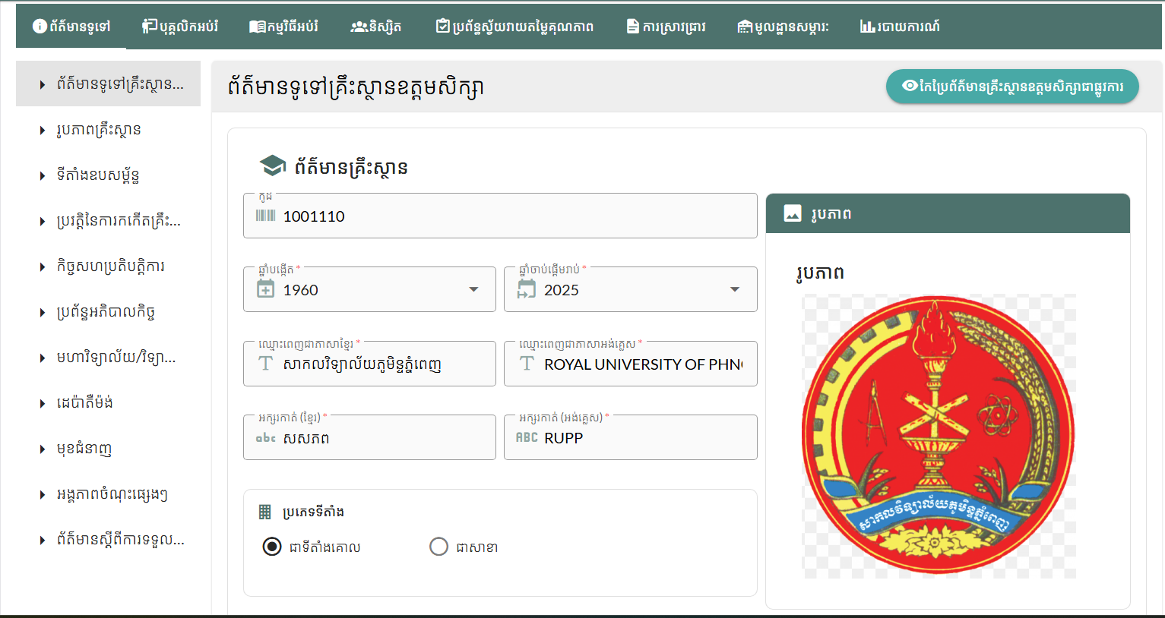
3. The Solution: HEMIS
Cambodia's Answer to Higher Education Governance Excellence
HEMIS is the transformative solution that replaces fragmented manual processes with a unified digital ecosystem.
It empowers strategic decisions and drives measurable improvements in educational quality and administrative efficiency.

Slide 11
3. The Solution: HEMIS
How HEMIS Transforms Government Capabilities
HEMIS provides the tools for modern, effective governance.
National Command Center
Policy Intelligence Engine
Real-time sector oversight
Data-driven strategic insights
Quality Assurance Authority
Resource Optimization Platform
Proactive quality improvement
Evidence-based allocation (ROI)
Administrative Excellence
Stakeholder Confidence
Automated, efficient processes
Transparent operations build trust

Slide 12
3. The Solution: HEMIS
The Government Excellence Framework
HEMIS directly links government priorities to strategic, measurable outcomes.
Government Priority
HEMIS Capability
Strategic Outcome
National Oversight
Real-time monitoring
Informed governance
Quality Leadership
Performance tracking
Enhanced reputation
Resource Stewardship
Data-driven investment
Maximized public value
Admin. Efficiency
Automated processes
Reduced operational costs
Strategic Planning
Sector intelligence
Effective development

Slide 13
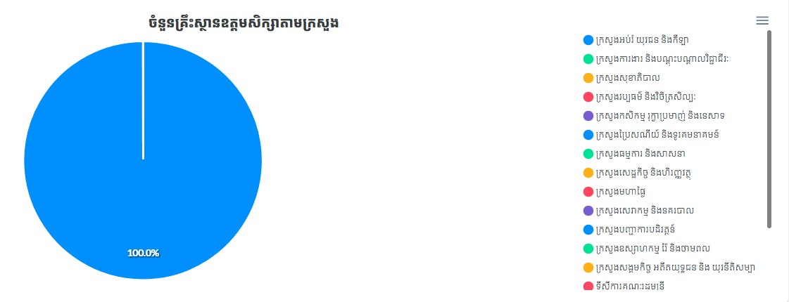

4. Key Features & Benefits
Complete Government Value Ecosystem
🏛️ National Institution Information Management
Centralized data supporting government oversight and information management.
National Institution Registry
A central database with comprehensive profiles of all institutions, including their structure, assets, and history.
Real-time Government Dashboard
Provides a live overview of the sector's performance metrics for direct government oversight.
National Quality & Status Tracking
A unified system to monitor the official recognition and quality standing of all institutions and their programs.

Slide 14
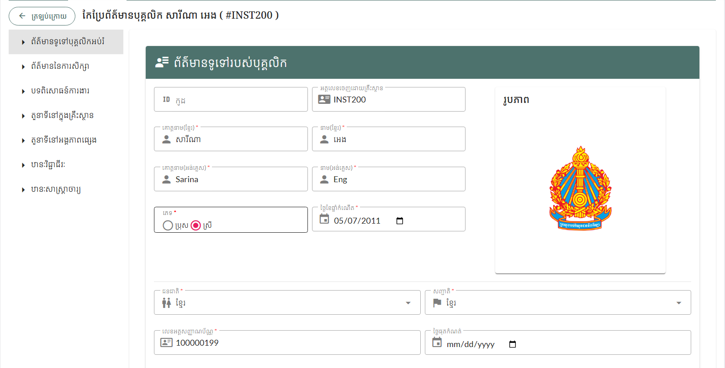
4. Key Features & Benefits
Complete Government Value Ecosystem
👥 National Staff Information Management
Centralized staff data supporting national human resource planning and quality assurance.
National Staff Database
A central database tracks all staff qualifications, positions, and academic rank.
Career Progression Tracking
Strategic HR Analytics
Monitors the complete career history and advancement of all staff members.
Provides national workforce data to drive quality assurance and strategic planning.

Slide 15
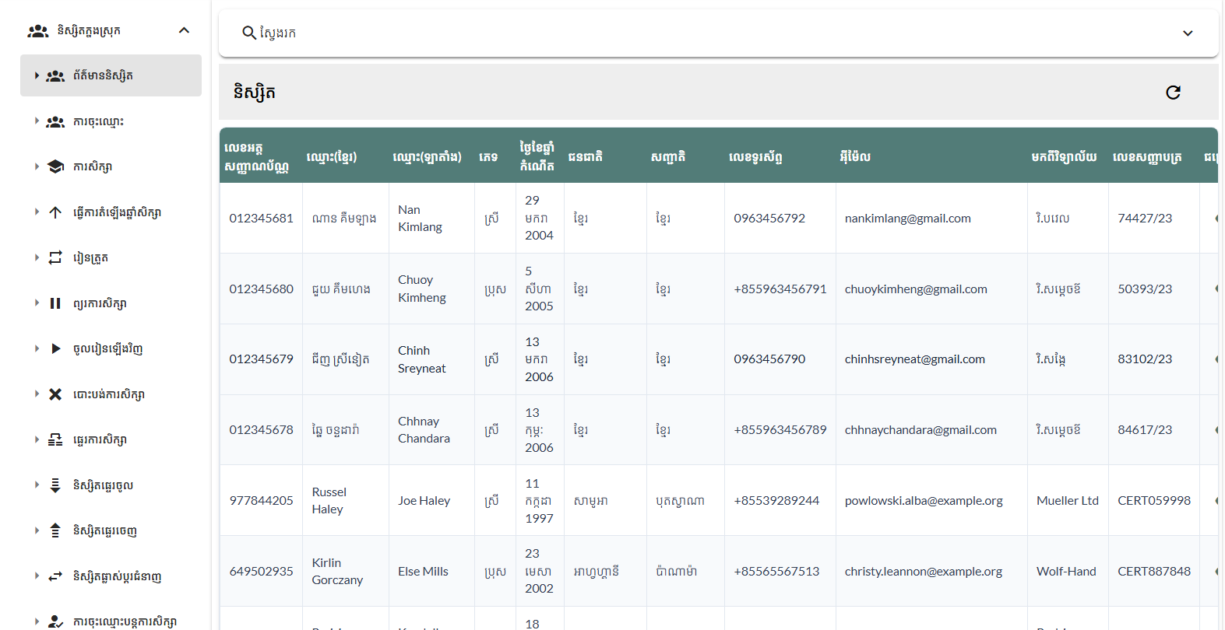
4. Key Features & Benefits
Complete Government Value Ecosystem
🎓 National Student Information System
Centralized student data supporting national education planning and information management.
National Student Database
A central database tracks the complete academic lifecycle for every student.
Strategic Analytics
Centralized Student Oversight
Provides national data for evidence-based education policy and planning.
Manages student academic progression and status changes on a national scale.

Slide 16
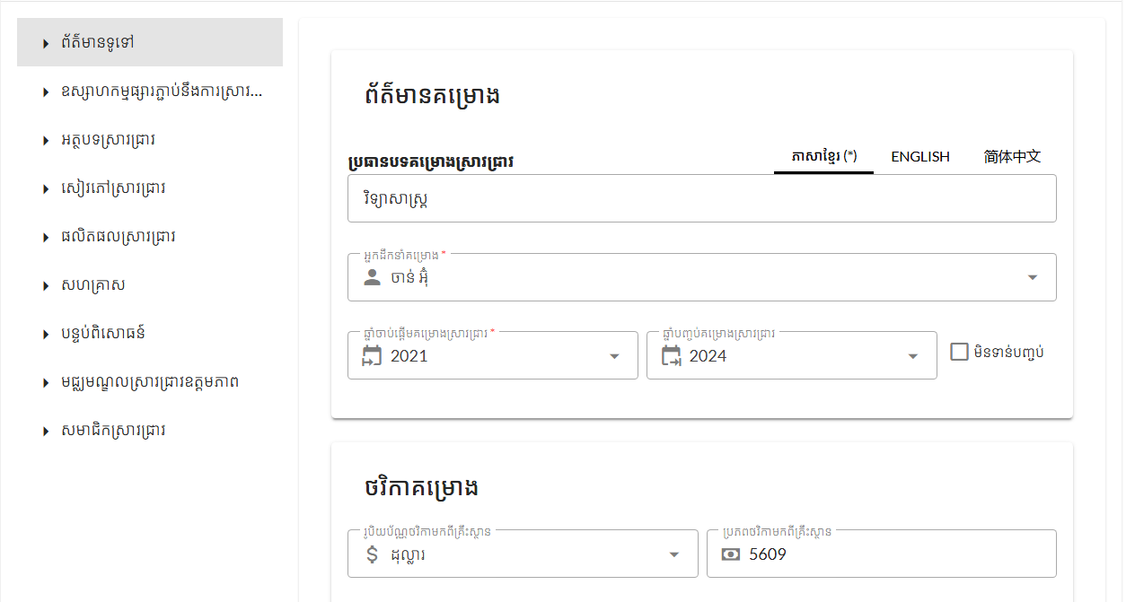
4. Key Features & Benefits
Complete Government Value Ecosystem
🔬 National Research Information Management
Centralized research data supporting national innovation planning and quality monitoring.
National Research Database
A central registry of all research projects, publications, researchers, and infrastructure.
Tracking Research Outputs
Monitors all key research results, including articles, books, conference papers, and research products.
Strategic Innovation Planning
Provides national-level data to guide strategic funding allocation and foster innovation.

Slide 17
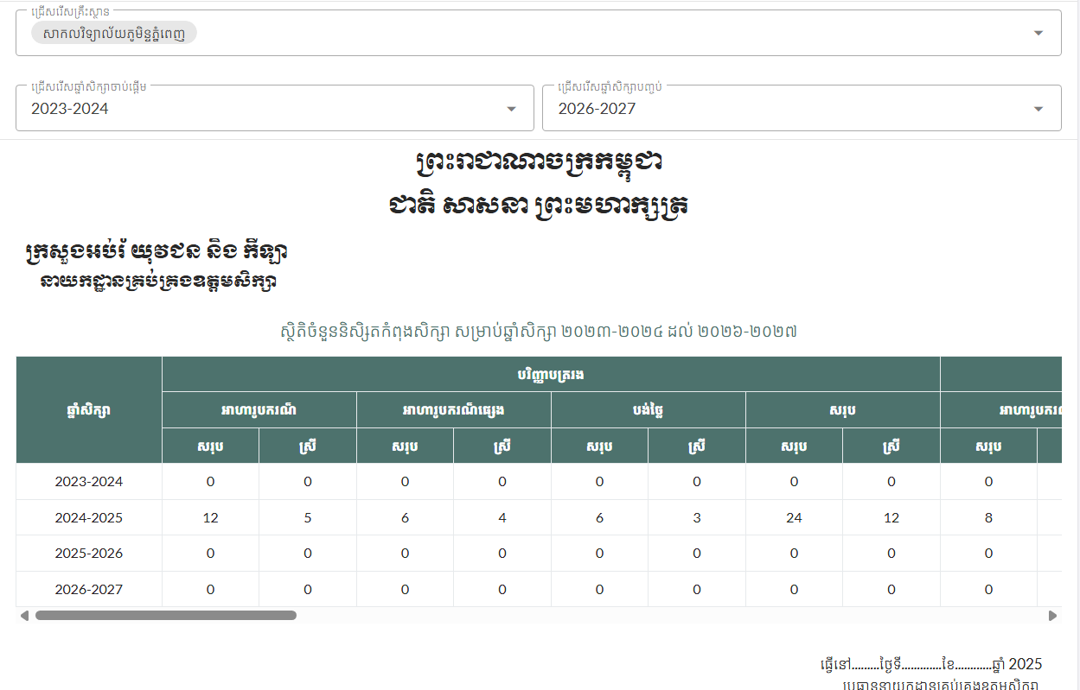



4. Key Features & Benefits
Complete Government Value Ecosystem
📊 National Education Analytics & Reporting Engine
Comprehensive analytics supporting evidence-based decision-making and sector planning.
Real-Time Sector Dashboard
Visualize key performance metrics for the entire education sector with interactive dashboards.
Comprehensive Reporting
A library of over 133 predefined reports covering students, staff, research, and quality assurance.
Strategic Analytics Tools
Utilize raw data exports, cross-institutional benchmarking, and predictive analytics for national planning.

Slide 18

5. User Types & Access Management
System Administrator
National Oversight & Total System Control 🌐
Total System Authority
Centralized Administration
Possesses the highest-level access to view and manage data from all institutions across the entire system.
Manages all high-level user accounts and sets the global system configuration, including national standards and reporting rules.
Sector-Wide Quality Oversight
Monitors, analyzes, and compares performance data across all institutions to ensure national standards are met.

Slide 19




5. User Types & Access Management
Report Viewer / Executive
Strategic Intelligence for Decision-Makers 📈
National Analytics Dashboard
Views real-time dashboards that visualize key performance metrics and trends for the entire sector.
On-Demand Strategic Reports
Generates detailed insights on demand from an extensive library of over 133 predefined reports.
Data-Driven Strategic Insight
Uses cross-institutional benchmarking and direct data access to inform high-level, evidence-based planning.

Slide 20

5. User Types & Access Management
Institutional Administrator
Day-to-Day Institution Management 🏛️
Full Institutional Control
Manages all data and workflows with authority strictly limited to their own institution.
Core Operations Management
Handles the complete student lifecycle and all day-to-day staff administration.
Academic Oversight & Reporting
Oversees academic programs, manages internal quality, and generates official reports for the ministry.

Slide 21

5. User Types & Access Management
Departmental Manager / Staff
Focused Departmental Management 📋
Scoped Departmental Access: Permissions are strictly limited to managing data only within their assigned department.
Student & Program Administration: Manages students within its department and oversees the administration of courses and academic activities.
Data Integrity: Responsible for ensuring the accuracy of all departmental data for institutional reporting.

Slide 22
6. Government & National Impact
Government Impact: Immediate Benefits
HEMIS delivers dramatic and immediate improvements for the Department of Higher Education.
Impact Category
Government Benefit
National Value
Data Centralization
Unified national database
Complete sector oversight
Quality Assurance
Quality Auditing
Enhanced education quality
Resource Planning
Evidence-based allocation
Optimized public investment
Admin. Efficiency
Streamlined operations
Better government service
Statistical Intel.
Comprehensive analytics
Data-driven governance

Slide 23
6. Government & National Impact
National Benefits & Development
HEMIS is a catalyst for national development and excellence.
Enhanced National Oversight
Provides complete, real-time visibility into the performance of the entire higher education sector.
Improved Education Quality
Enables better monitoring and targeted support to elevate institutional standards nationwide.
Digital Acceleration
Accelerates the adoption of modern educational technology across the entire sector.
Stronger National Reputation
The digital transformation of the education sector enhances the nation's international brand and prestige.

Slide 24



6. Government & National Impact
System Sustainability and Growth
HEMIS is a long-term solution built for the future.
Continuous Operation
Scalable Architecture
Regular Enhancements
Designed for ongoing ministry use
and long-term sustainability.
Capacity grows with the
expanding higher education sector.
System improves over time to
meet evolving needs.

Slide 25
7. Competitive Advantage
Implementation Success: An Operational Revolution
HEMIS has successfully delivered immediate, tangible benefits.
Before HEMIS (Manual)
After HEMIS (Digital Solution)
Strategic Advantage
Manual data collection
Instant, real-time data
Faster, informed decisions
High error rate
Error-free validation
Reliable intelligence
Focus on paperwork
Focus on education
Maximized staff value
Outdated information
Current intelligence
Responsive governance
Reactive quality assurance
Proactive monitoring
Consistent standards

Slide 26

8. Success & Results
Implementation Success: An Operational Revolution
HEMIS has successfully delivered immediate, tangible benefits.
100%
↑
↓
Reporting Time Reduced
Productivity Increased
Errors Reduced
Improved data accuracy eliminates costly manual mistakes.
From weeks of manual work to instant automated reports.
Staff shift from data entry to strategic initiatives.
⚡
Decisions Accelerated
Real-time intelligence enables responsive governance.

Slide 27



8. Success & Results
A Proven Government Innovation
HEMIS has established itself as a successful and essential national platform.
Leadership in Data Management
The first platform to centralize Cambodia's higher education information.
Proven Operational Excellence
Significantly improved ministry operations through centralized, reliable data.
High National Impact
All universities participate in a unified system, enhancing government oversight.

Slide 28
Thank You!

