Slide 1


Scholarship Management System
Ministry of Education is a beneficiaries
And
IT Solution is the implementor
Purpose of the system:
the entire scholarship lifecycle—from application to selection
—with enhanced efficiency, transparency, and equity.
Source of Fund by Government of Cambodia

Slide 2
Table of Contents
1
2
Executive Summary
Problem Statement
3
4
Solution Overview
System Architecture
5
6
Key Features & Benefits
Technical Capabilities
7
8
Business Impact
Success Stories

Slide 3

1. Executive Summary
Revolutionizing Education Management
The Scholarship Management System is a comprehensive digital transformation platform that modernizes education funding from the ground up. This complete reimagining of how we discover, nurture, and support talented students delivers unprecedented results, streamlining processes and ensuring equitable access.

Slide 4

1. Executive Summary
Key Achievements
1. End-to-End Digital Solution
eliminating paperwork and bureaucracy.
2. National Scale Impact
reaching all high schools and thousands of students annually.

Slide 5

1. Executive Summary
Key Achievements
3. Automated Selection Process
4. Faster Results
ensuring the best students get opportunities through unbiased algorithms.
delivering decisions significantly faster with improved accuracy and social equity.

Slide 6
2. Problem Statement
The Challenge We Solve
Traditional System Limitations
Problem Area
Current Impact
Solution Needed
Manual Paperwork
3-4 weeks processing, 40% error rates
Complete digitization
Zero Visibility
Black box processes
Full transparency
Geographic Inequality
Rural disadvantage
Equal access platform
Staff Overload
80% time on paperwork
Automated workflows
Bias & Favoritism
Subjective decisions
Objective algorithms

Slide 7

3. Solution Overview
Revolutionary Digital Transformation
The New Way: Complete Digital Experience
Smartphone Applications
Efficient Processing
Apply from anywhere in under 30 minutes.
Smart automation with automated validation.
Full Transparency
Level Playing Field
Live dashboards showing application status, student counts by specialty, and real-time statistics.
Automated fairness ensuring equal opportunities.

Slide 8

3. Solution Overview
Revolutionary Digital Transformation
The New Way: Complete Digital Experience
Efficient Operations
Significant reduction in administrative workload.
Intelligent Matching
Smart algorithms match students to optimal programs.
Data Integration
Import existing student and institutional data seamlessly.
Comprehensive Reporting
Export detailed reports and analytics in multiple formats.

Slide 9




4. System Architecture
Breakthrough Technologies
Auto-Save Technology
Strategic Multi-Choice System
Regular progress saving to prevent data loss.
Students apply for 2 different scholarships, doubling their chances.
Automated Fair Selection
Comprehensive Dashboards
Smart algorithms eliminate human bias and ensure objective evaluation.
Monitoring and tracking of all activities across the entire system.

Slide 10





4. System Architecture
Breakthrough Technologies
Mobile-First Architecture
Data Import System
Designed for smartphones that users already own.
Seamlessly import existing student records and institutional data.
Advanced Analytics Engine
Export & Reporting Engine
Forecasts trends and optimizes resource allocation.
Generate comprehensive reports in Excel, PDF, and other formats.

Slide 11
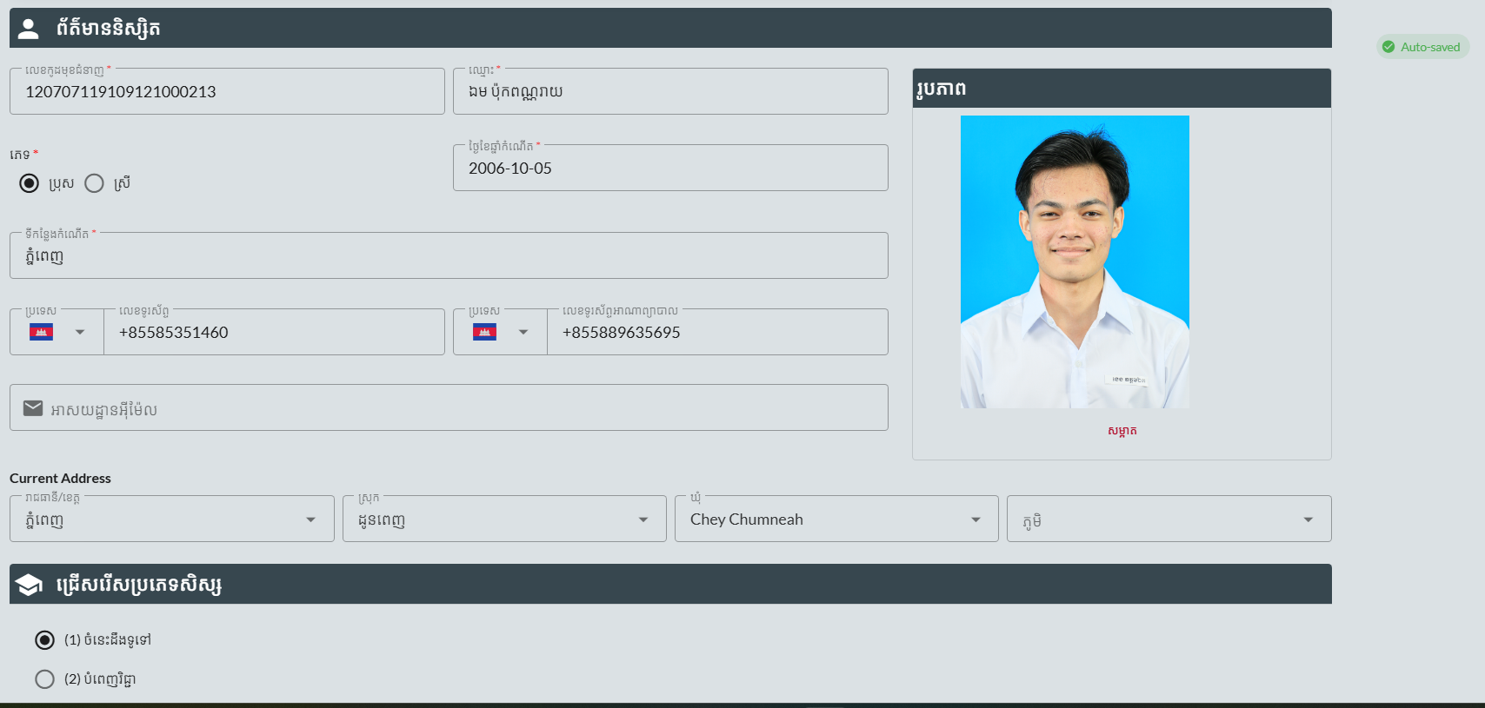
5. Key Features & Benefits
🎓 Student Application Engine
Revolutionary Features for Students
Intelligent Application Builder
Guided, step-by-step process with real-time validation.
Auto-Save Feature
Protect your progress with regular automatic saving.

Slide 12
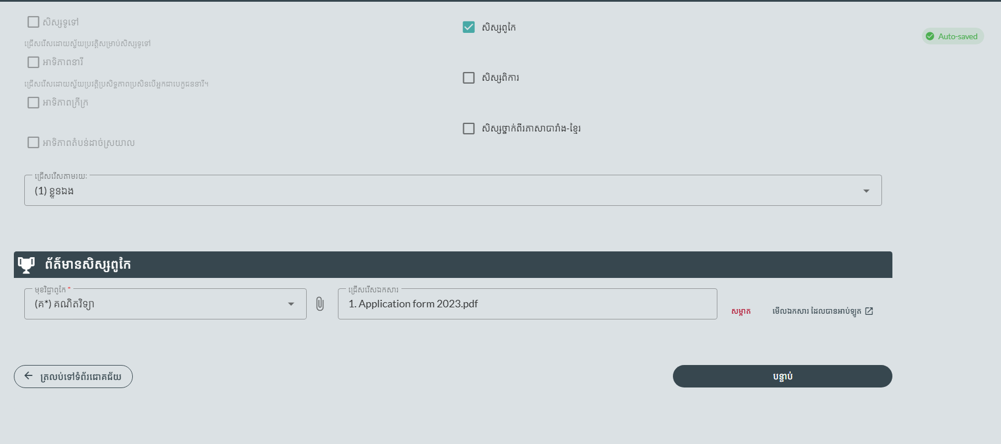
5. Key Features & Benefits
🎓 Student Application Engine
Revolutionary Features for Students
Smart Document Management
Upload photos and certificates with automatic processing.
Mobile-First Design
Complete applications entirely on smartphones.

Slide 13
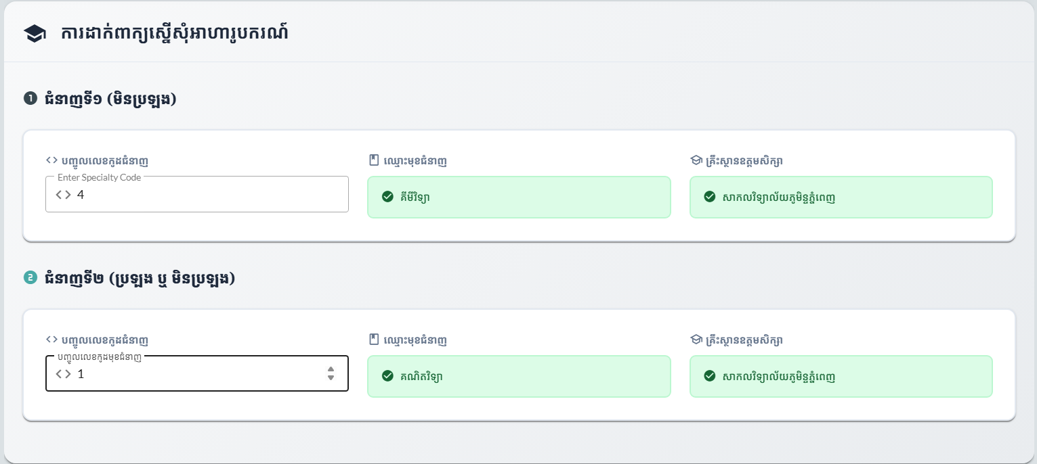
5. Key Features & Benefits
🎓 Student Application Engine
Revolutionary Features for Students
Multi-Choice Strategy System
Apply for up to 2 scholarships with intelligent priority ranking.

Slide 14

5. Key Features & Benefits
🎓 Student Application Engine
User-Friendly Applications
that anyone can complete in under 30 minutes.
Direct Student Benefits
Multiple Chances to Win
with smart preference system doubling success rates.
Never Lose Your Work
with automatic progress saving.
Know Where You Stand
with live status updates, real-time application counts per specialty, and complete transparency.
Fair Shot for Everyone
no matter geographic location or background.

Slide 15
5. Key Features & Benefits
🏫 School Management Portal
Complete Administrative Control Center
Streamlined Application Management
Quality Assurance Dashboard
Efficiently manage individual applications with organized workflows.
Automated checks catch errors before submission.
Student Profile Management
Collaborative Review Tools
Complete candidate information management.
Multiple teachers can review and approve applications.
Basic Statistics Dashboard
Data Import Tools
View candidate counts by gender, program type, and application status.
Bulk import student records and historical data.

Slide 16

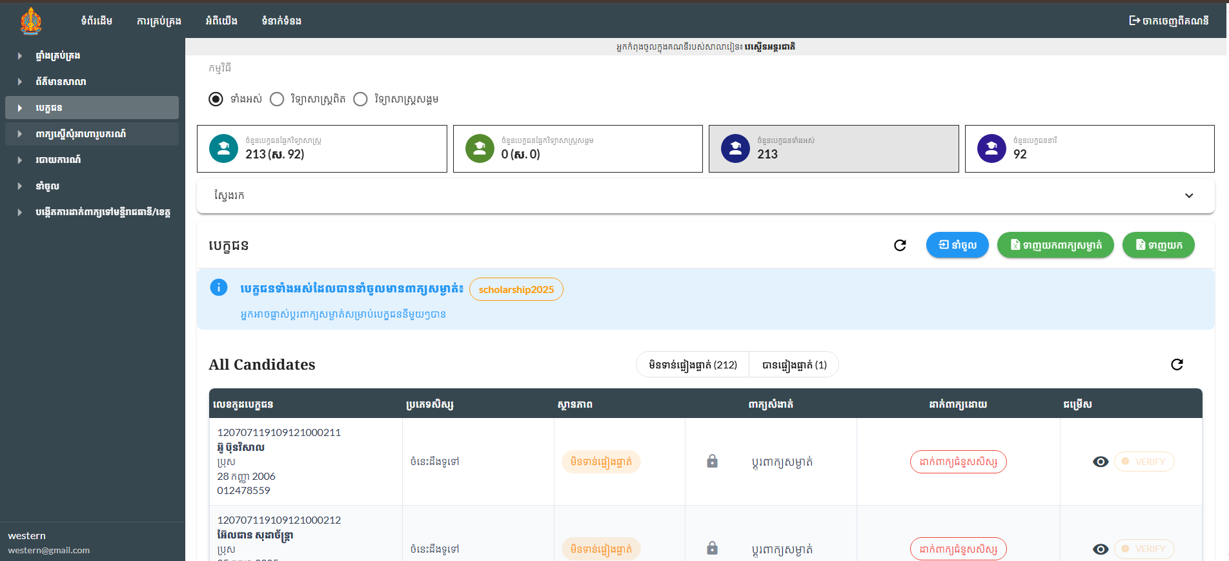




5. Key Features & Benefits
🏫 School Management Portal
Transformational School Benefits
One-Stop Management
for all student applications with digital workflows.
Efficient Application Handling
with streamlined workflows reducing administrative burden.
Catch Mistakes Early
with built-in quality checks preventing delays.
Track Everything Easily
with visual progress indicators and real-time updates.
Go Completely Paperless
enabling teachers to focus 80% more time on education.

Slide 17
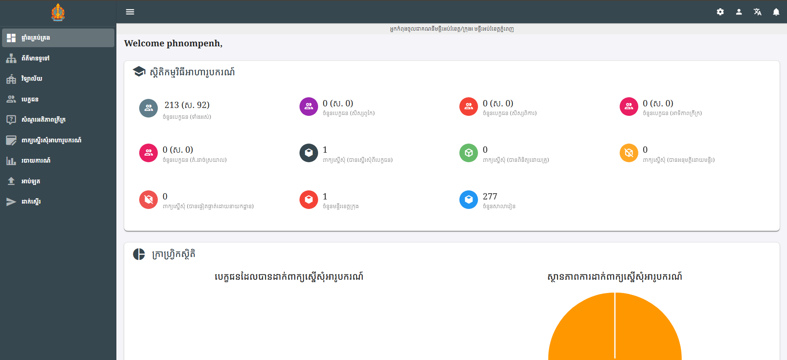
5. Key Features & Benefits
🏛️ Provincial Command Center
Strategic Management Capabilities
1
School Performance Monitoring
Analytics and reporting on all schools in the region.
2
User Management System
Create and manage hundreds of school accounts.
3
Regional Data Dashboard
Overview of educational statistics and regional metrics.
4
Collaboration Platform
Connect schools and share best practices.

Slide 18
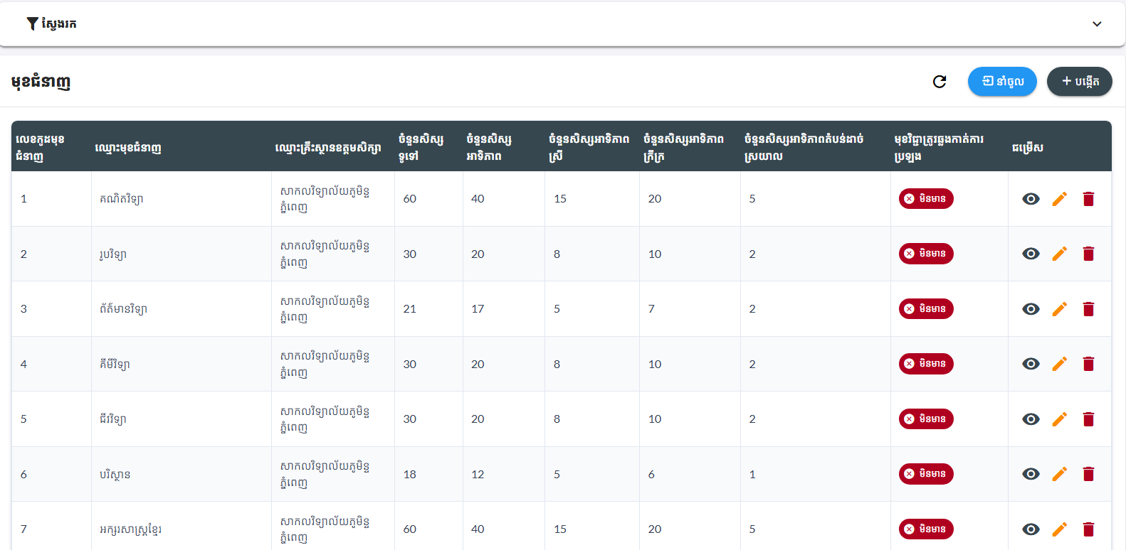
5. Key Features & Benefits
📊 Ministry Leadership Dashboard
National Command Features
Data Import System
Import data from external sources and databases.
University & Program Configuration
Manage multiple institutions and specialties.
System Configuration
Manage national scholarship settings and parameters.

Slide 19
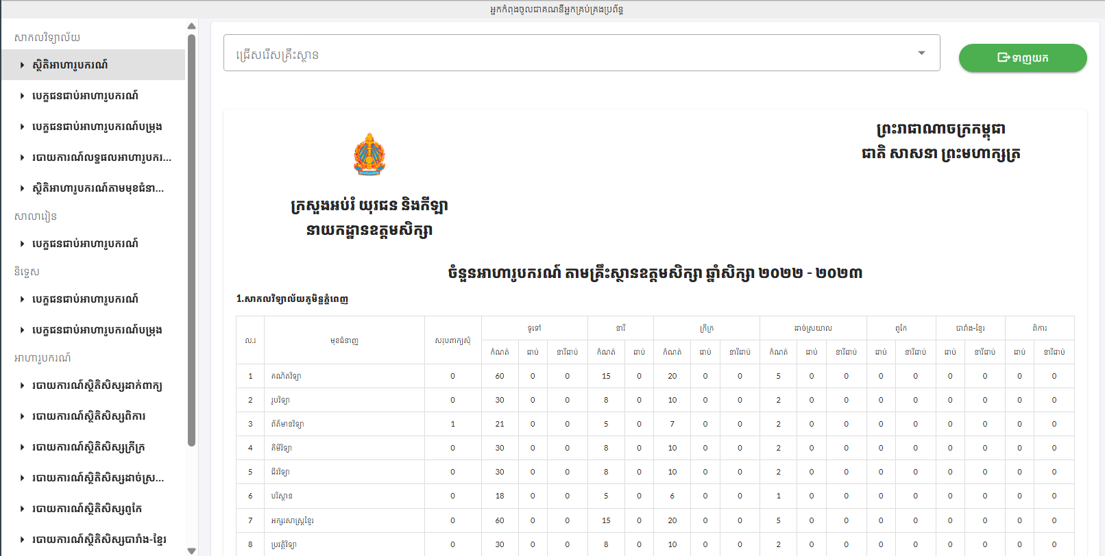
5. Key Features & Benefits
📊 Ministry Leadership Dashboard
National Command Features
Comprehensive National Analytics
Monitor all regions with up-to-date data and reporting.
Advanced Reporting Suite
Generate insights for strategic decision-making.
Student Result Import
Centralized import of student exam results.

Slide 20
5. Key Features & Benefits
📊 Ministry Leadership Dashboard
National Leadership Benefits
100%
↑
↓
↑
Complete National Oversight
Strategic Decision Support
Significant Cost Reduction
Improved Efficiency
with streamlined digital processes reducing administrative burden.
with centralized monitoring of all scholarship activities.
through comprehensive analytics and reporting capabilities.
by eliminating paper-based processes and manual workflows nationwide.
↑
Enhanced Transparency
providing complete visibility into national scholarship distribution.

Slide 21

5. Key Features & Benefits
🤖 Automated Selection Engine
Revolutionary Selection Technology
Multi-Criteria Analysis
1
Evaluates academic merit, socioeconomic need, and geographic equity.
2
Bias-Free Processing
Eliminates human prejudice with objective algorithms.
Dynamic Quota Management
3
Automatically balances quotas across all categories.
4
Selection Analytics
Analyze scholarship application data and selection patterns.
Reserve Pool Intelligence
5
Maintains optimal backup candidates for 100% utilization.

Slide 22
5. Key Features & Benefits
🤖 Automated Selection Engine
Breakthrough Fairness Benefits
100% Objective Selection
Increase in Rural Scholarships
Perfect Quota Distribution
Eliminating all human bias and favoritism.
Through geographic equity algorithms.
Across all demographic categories.
Eliminate Corruption Completely
Maximize Scholarship Utilization
With transparent, auditable processes.
Ensuring no opportunities are wasted.

Slide 23
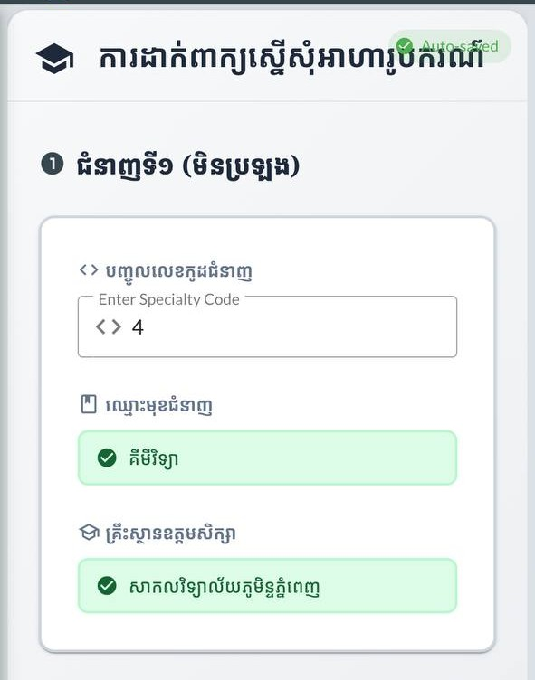

6. Technical Capabilities
Revolutionary Platform Features
📱 Mobile-First Design
Responsive Design working perfectly on all screen sizes.
Auto-Save Feature preventing data loss during application process.
Touch-Optimized Interface designed for smartphone interaction.
Fast Loading optimized for slow internet connections.
Cross-Platform Compatibility supporting all operating systems.

Slide 24

7. Business Impact
System Benefits
📈 Operational Improvements
Reduced Manual Work
Significant decrease in paperwork and manual processing.
Better Data Management
Centralized, organized student and application data.
Improved Accessibility
Students can apply from anywhere with internet access.
Enhanced Transparency
Clear visibility into application status, real-time specialty enrollment statistics, and all processes.

Slide 25




7. Business Impact
System Benefits
📈 Operational Improvements
Reduced Errors
Automated validation reduces common application mistakes.
Streamlined Data Import
Easy import of student exam results and basic records.
Comprehensive Reporting
Detailed analytics and reports for all stakeholders.

Slide 26
7. Business Impact
System Benefits
🌟 Strategic Benefits
1
2
3
Digital Transformation
Scalable Platform
Data-Driven Insights
Modern digital platform replacing paper-based processes.
System can accommodate growth in applications and users.
Better reporting and analytics for decision-making.
4
5
Standardized Processes
Future-Ready Infrastructure
Consistent application and review procedures.
Foundation for additional digital initiatives.

Slide 27

8. Success Stories
Dramatic Efficiency Revolution
95%
80%
Error Reduction
Paperwork Elimination
Near-perfect accuracy with automated validation.
Complete digital transformation saving trees and time.
60%
Much Faster Decisions: Significantly reduced processing time from months to weeks.
Cost Reduction
24/7 Availability: Students apply anytime from anywhere with any device.
Massive operational savings redirected to student support.
100% Scholarship Utilization: Smart reserve pools eliminate wasted opportunities.

Slide 28








8. Success Stories
Unprecedented National Reach
All 25 Provinces Connected
900+ Schools Integrated
Every corner of the nation included and engaged.
Complete network from urban centers to remote villages.
50+ Universities Participating
100,000+ Students Served
Comprehensive coverage of all higher education options.
Scalable platform ready for educational growth.
Efficient National Communication: Fast updates and coordination across the country.
Comprehensive Coverage: Full accessibility across all regions and educational institutions.

Slide 29




8. Success Stories
Measurable Social Impact
Female Participation Up
Rural Access Increased
Family Economic Relief
Breaking barriers for women in higher education.
Remote area students now have equal opportunities.
Average scholarship value: $2,000-5,000 per student annually.
Educational Quality Boost
Teacher Satisfaction Rise
Better student-program matching improves graduation rates.
Reduction in administrative burden means more teaching time.

Slide 30

# Thank You!

