Slide 1


FIT3143 ASSIGNMENT 1
RESEARCH IN PARALLEL & DISTRIBUTED COMPUTING
By : Cheah Meng Yew (30221846) & Bryan Hooi Yu Ern (30221005)

Slide 2
PHYSICAL & LOGICAL CLOCKS

Slide 3
Introduction: Clocks
Microchip present within a motherboard that keeps track and regulates the timing of the computer
Utilizes a quartz crystal oscillator
Flow of time is recorded by the stable vibrations created by the oscillator through electromagnetic pulses
Current date and time calculated using the number of seconds/vibrations elapsed since the epoch

Slide 4
Clock Drift & Clock Skew
Drift: phenomenon experienced by all clocks whereby a particular clock’s tick rate deviates from that of an external reference
Eventually, this divergence has to be fixed through a resynchronization of the clocks involved
Skew: in distributed systems, this can refer to the phenomenon whereby a clock signal’s value is read differently by different processes in their respective nodes

Slide 5
Physical & Logical Clocks
Physical clocks are those that maintain within a fixed bound distance from the real time reference
these have to be consistent between all the nodes within a system
Logical clocks would be those clocks within a group that have synchronized time values
not necessarily synced with real
internal consistency between the clocks is of importance
more focused on the true ordering of events instead of the actual time at which they occur

Slide 6
Problem: Clock Synchronization
Clock drifts & skews eventually leads to the clocks within a group to desynchronize with each other in terms of their clock readings
There are many applications whereby a consistent view of time across all nodes of a distributed system are required
This can be achieved through clock synchronization

Slide 7
Clock Synchronization: External & Internal
External synchronization refers to the maintenance of processor clocks within some maximum gap from a reference time external to the system
Internal synchronization would be the same concept but applied to the processor clocks within the system
Externally synchronized clocks are also internally synchronized, but not vice versa
External synchronization allows for the exchange of information about event timings with other systems and users
Internal synchronization allows for the ordering of distributed events such that they closely resemble their real time precedence

Slide 8
Solutions In Literature
Many solutions to the clock synchronization problem boil down to software and hardware methods
A clock is considered non-faulty if it has a bound on the amount of deviation from real time for any given time interval
Synchronization requires each node to read other node’s clock values

Slide 9
Software Approaches
Requires additional messages being exchanged between nodes
Flexible and economical
Message transit delays refers to the unpredictable communication delays that may occur when two processes share messages with each other
Software synchronization algorithms involve each node either broadcasting its clock value to all nodes at specific intervals or shares its clock values to requesting nodes individually
Errors in software algorithms occur due to variations in message transit delays

Slide 10
Hardware Approaches
Utilizes separate special hardware to achieve tight synchronization
Minimal time overhead but higher cost
Clock signal from each of the other nodes serves as input to the synchronization circuitry at each node
Errors occur mainly due to unpredictable propagation delays for clock signals

Slide 11
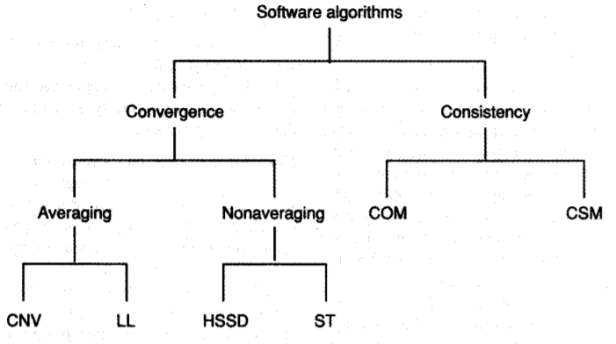
Classification of software synchronization algorithms

Slide 12
Convergence Averaging Algorithms
Clock process at each node broadcasts a resync message at a particular local time determined by the algorithm and then waits for a certain duration
While waiting, the clock process collects resync messages broadcast by other nodes and records the receiving time for those
After waiting, the clock process estimates its skew with respect to the other nodes and computes an average of the estimated skews and uses it to correct its own clock
This process is repeated at the next synchronization interval
One limitation is that this method is not easily scalable

Slide 13
Convergence Non-Averaging Algorithms
A node will periodically become the system synchronizer
A node resynchronizes its clock when:
Its local clock reaches the time for the next synchronization
It receives a signed message from other nodes indicating that they have resynchronized their clocks
Each node performs a validity check for each message to account for faulty nodes
Limitation: worst-case skew greater than the maximum message transit delay between any pair of nodes

Slide 14
Consistency-based Algorithms
Treats clock values as data and uses interactive consistency algorithms to ensure agreement
At the start of each synchronization cycle, each node treats its local time as a private value and conveys it to other nodes
From the clock values obtained from other nodes, each node computes an estimate of the skew with respect to other nodes
Each node then uses the median skew to correct its local clock

Slide 15
Probabilistic Synchronization: Cristian’s Algorithm
Introduced by Flaviu Cristian in 1989
Assumption: the probability distribution of message transit delays is known and each node is allowed to have several attempts to read other clocks
After each attempt, a node can calculate the maximum error possible if the clock value obtained is used for synchronization
With enough attempts, a node can read other clocks to any given precision with probability as close to one as desired
Scheme is particularly suitable for systems with master-slave arrangements

Slide 16
Cristian’s Algorithm: Continued
Each node periodically requests the time from the master node via messages
Upon receiving the request, the master node then sends its local clock value to the requesting node
Once the requesting node receives the response, it calculates the total round trip delay based on its own clock
This process can be repeated until the round trip delay is such that the maximum read error falls below a certain threshold
Once the master node’s clock time to a desired precision is achieved, the node then sets its own clock based on the formula:
New_time = master_time + (round trip delay) / 2

Slide 17
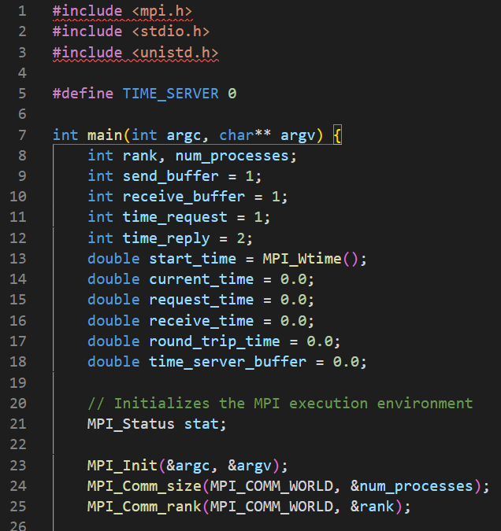
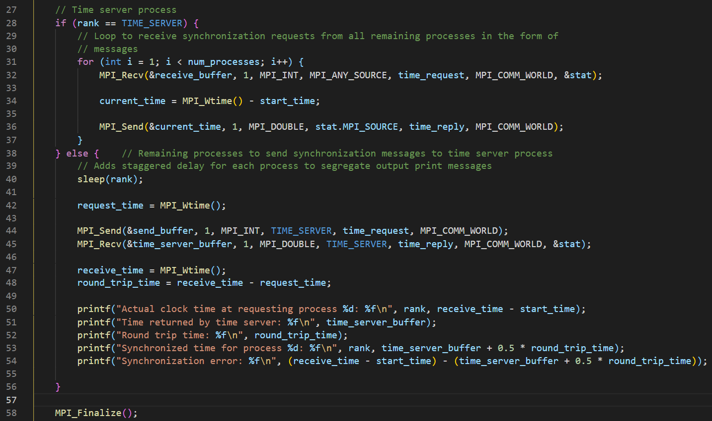
Proof of Concept: Cristian’s Algorithm
Variable & MPI Environment Setup
Master process sharing its time value to requesting slave processes

Slide 18
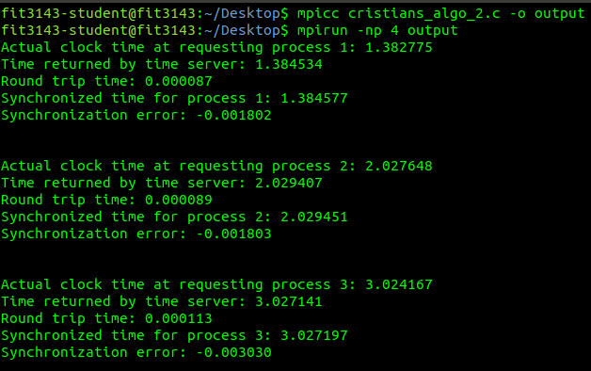
Proof of Concept: Results

Slide 19
Problem Statement
In a distributed system, there is no global clock. Each process have its own local clock.
Causality between event is the precedence relation between events.
Properties we want to maintain between e1 in p1 and e2 in p2.
Monotonicity means that if event a causally effect event b then the timestamp of event a is smaller than the timestamp of event b.

Slide 20
Problem statement
E1
P1
P2
E2
How to Make sure E1 always happens before E2

Slide 21
Introduction to Logical Time
This paper introduce methods of implementation of a logical time – Scalar clock, Vector clock and Matrix clock
Scalar clock - The timestamp of each process is represented by non-negative integers
Vector clock – The timestamp for each process is represented by a vector of non-negative integers
Matrix clock – The timestamp for each process is represented by a matrix.

Slide 22
Introduction to Logical Time
For every message m exchanges between two processes, we have :
Send (m) →msg Receive (m)
The →msg defines the causal dependencies between the pairs of corresponding send and receive event
Defining causality precedence
E1 → E2 , event E2 is directly dependent on E1
E1 -/-> E2 and E2 -/-> E1 then E1 and E2 runs concurrently denote as E1 || E2

Slide 23
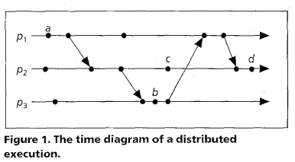
Horizontal line : progression of process
Slanted line : indicates message transfer
Nodes : Events
a → b
a → c

Slide 24
Methodology
Each process pi maintains a data structure that gives it two capabilities
A local logical clock that helps the process itself to measure progress
A global logical clock that represents the process view of the global logical time
Protocols Used in implementation
R1 governs how the local logical clock is being updated
R2 governs how the global logical clock is being updated. This is usually updated with a data that is piggybacked on the message sent to the current process from other processes in the distributed system

Slide 25
Methodology (Scalar time)
The logical local clock of a process Pi and its local view of the global time is squashed into a single integer Ci.
Protocols for managing process’s logical time
R1 : Ci = Ci + d where d is usually 1.
R2 : When Pj send a message to Pi, Cj is piggyback on the message.
Ci = max(Ci, Cj)
Execute R1
Deliver the message

Slide 26
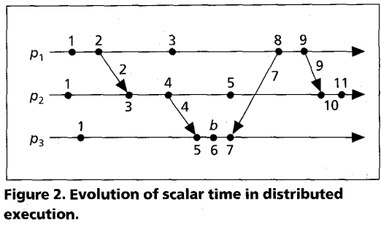
Example

Slide 27
Methodology (Vector time)
The local logical time and global logical time is stored in a vector
Each process Pi maintain a vector vti[1..n] where n is the total number of process in the distributed system
vti[i] stores the local logical time of Pi
Vti[j] where j != i represents Pi’s knowledge of Pj’s local time
Protocols for managing process’s logical time
R1 : vti[i] = vti[i] + d
R2 : When Pj send a message to Pi, vtj is piggyback on the message.
1 <= k <= n : vti[k] = max(vti[k], vtj[k])
Execute R1
Deliver the message

Slide 28
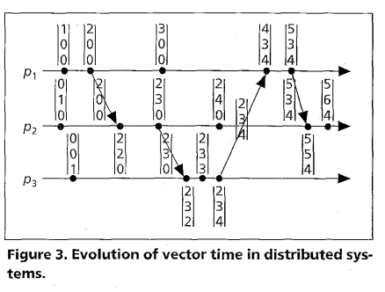
Example

Slide 29
Methodology (Matrix time)
The local logical time and global logical time is stored in a Matrix
Each Process Pi maintains a matrix Mti[1..n][1..n] where n is the number of process in the distributed system
Mti[i,i] stores the local logical timestamp of Pi
Mti[i,j] stores the timestamp of what Pi knows about the local logical timestamp of Pj
Mti[j,k] stores the timestamp of what Pi knows about the local logical timestamp of Mtj[j,k] in Pj.

Slide 30
Methodology (Matrix time)
R1: Mti[i,i] = Mti[i,i] + 1
R2 : When Pj sent a message to Pi, Mtj is piggyback on the message.
1 <= k <= n : Mti[i,k] = max(Mti[i,k], Mtj[j][k])
1 <= k , l <=n : Mti[k,l] = max(Mti[k,l], Mtj[k,l])
Execute R1
Deliver message m

Slide 31
Singhal-Kshemkalyani’s differential techniques
When process Pi sends a message to Pj, Pi piggybacks only those entries of its vector clock that have changed since the last message to Pj.
Advantage :
Low bandwidth and buffer requirement
Disadvantage :
Additional vectors to store the last interaction.

Slide 32
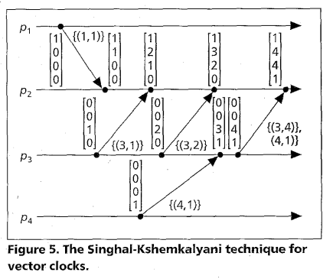
Example

Slide 33
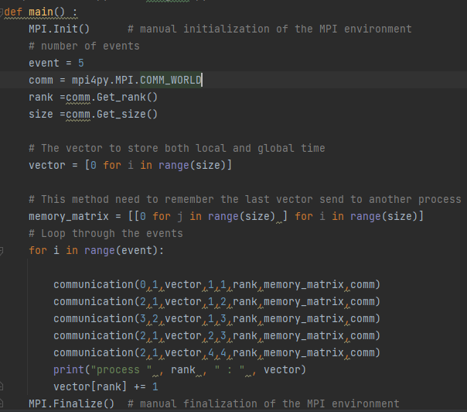
Proof Of Concept
MPI.Init() will create multiple Process to run main ().
vector in this variation is a list of non-negative integer. It stores the local and global timestamp.
memory matrix stores the vector of last known message send by Pi to Pj.
Communication is used to sent message with the timestamp to the events in other process

Slide 34
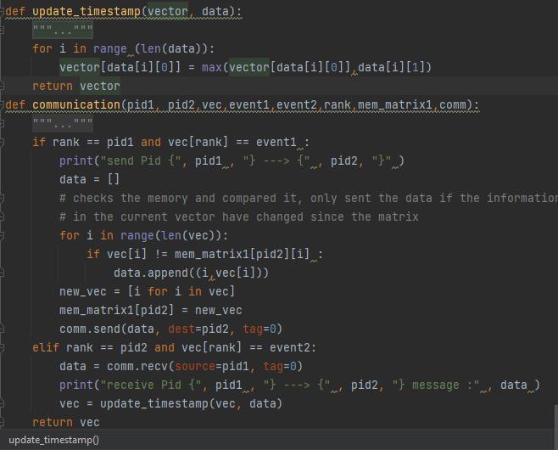
Proof Of Concept
update_timestamp take in the current vector vti from Pi and the piggyback data from the sending process Pj and generate a new vector by taking the maximum timestamp of each process
Communication sends a message from Pi event m to Pj event n. Pj event n will wait for Pi event m. Retrieve the vector that Pi last sent data to Pj from mem_matrix of Pi and compared the value with current vector, if a change in the timestamp have occurred then include the entry in the data.

Slide 35

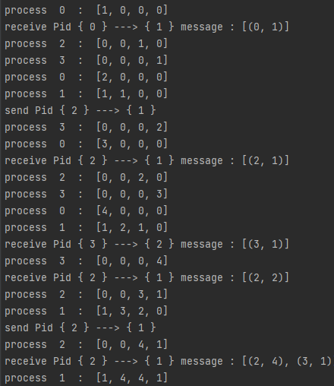
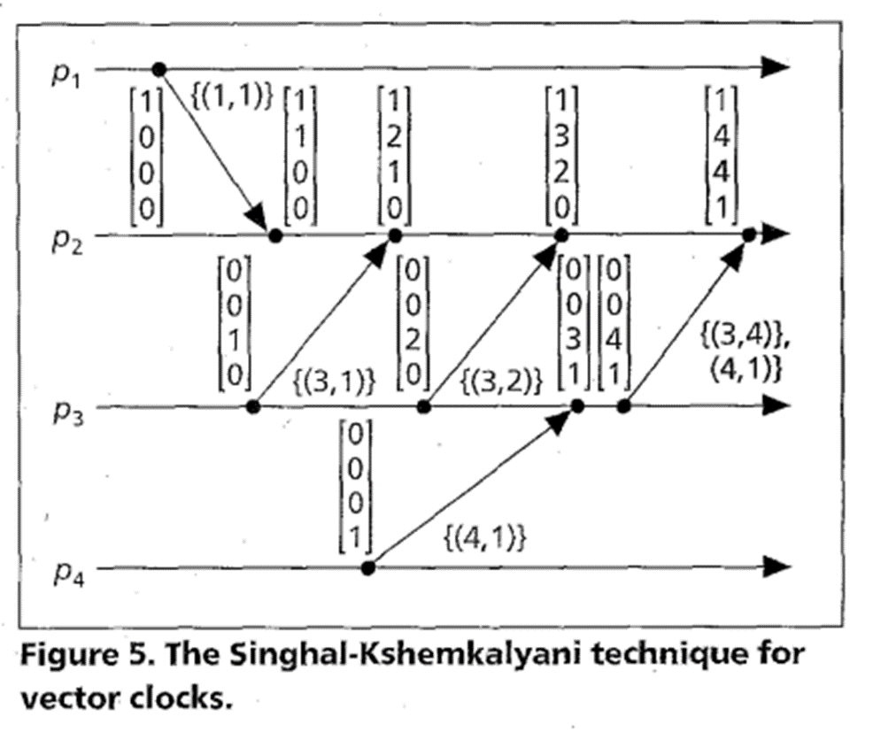
Results

Slide 36
Conclusion: Physical Clocks
Software algorithms require nodes to exchange and adjust their clock values individually
The message passing medium used for sharing clock values introduce substantial time overheads which could therefore be detrimental if tight synchronization is required
These are suitable for systems that can tolerate loose synchronization between its nodes
Hardware algorithms use specialized hardware to achieve tight synchronization with minimal overhead imposed on the system
However, hardware algorithms are expensive to use for anything other than small systems

Slide 37
References
Cristian, F. (1989). Probabilistic clock synchronization. Distributed Computing, 3(3), 146–158. https://doi.org/10.1007/bf01784024
Ramanathan, P., Shin, K. G., & Butler, R. W. (1990). Fault-tolerant clock synchronization in distributed systems. Computer, 23(10), 33–42. https://doi.org/10.1109/2.58235
Raynal, M., & Singhal, M. (1996). Logical time: Capturing causality in distributed systems. Computer, 29(2), 49–56. https://doi.org/10.1109/2.485846
Cristian’s Algorithm Proof of Concept code inspired by:
https://gist.github.com/inJeans/ff0a4e76756989ac270e74047614f67d

