Slide 1
CS342: Artificial Intelligent
Instructor: Sovila Srun
Present by:
Monespiseth LY
Cheang Fou SUY

Slide 2
Anime Search Engine
Where your search should be done
*Anime: Japanese cartoon TV Shows or Movies

Slide 3
INTRODUCTION
01
TECHNOLOGIES USED
02
FEATURES
03
DEMO
04
A brief introduction of the system
What is being used
What can it do
Demonstration of Project

Slide 4
01
INTRODUCTION

Slide 5
Anime Search Engine Bot!
A Command Line Interface ChatBot for recommending Anime.
Who is it for?
We made it specifically for people who loves watching Anime and people who wants to start watching Anime but are not sure what Anime to start with.

Slide 6
02
TECHNOLOGIES
USED

Slide 7
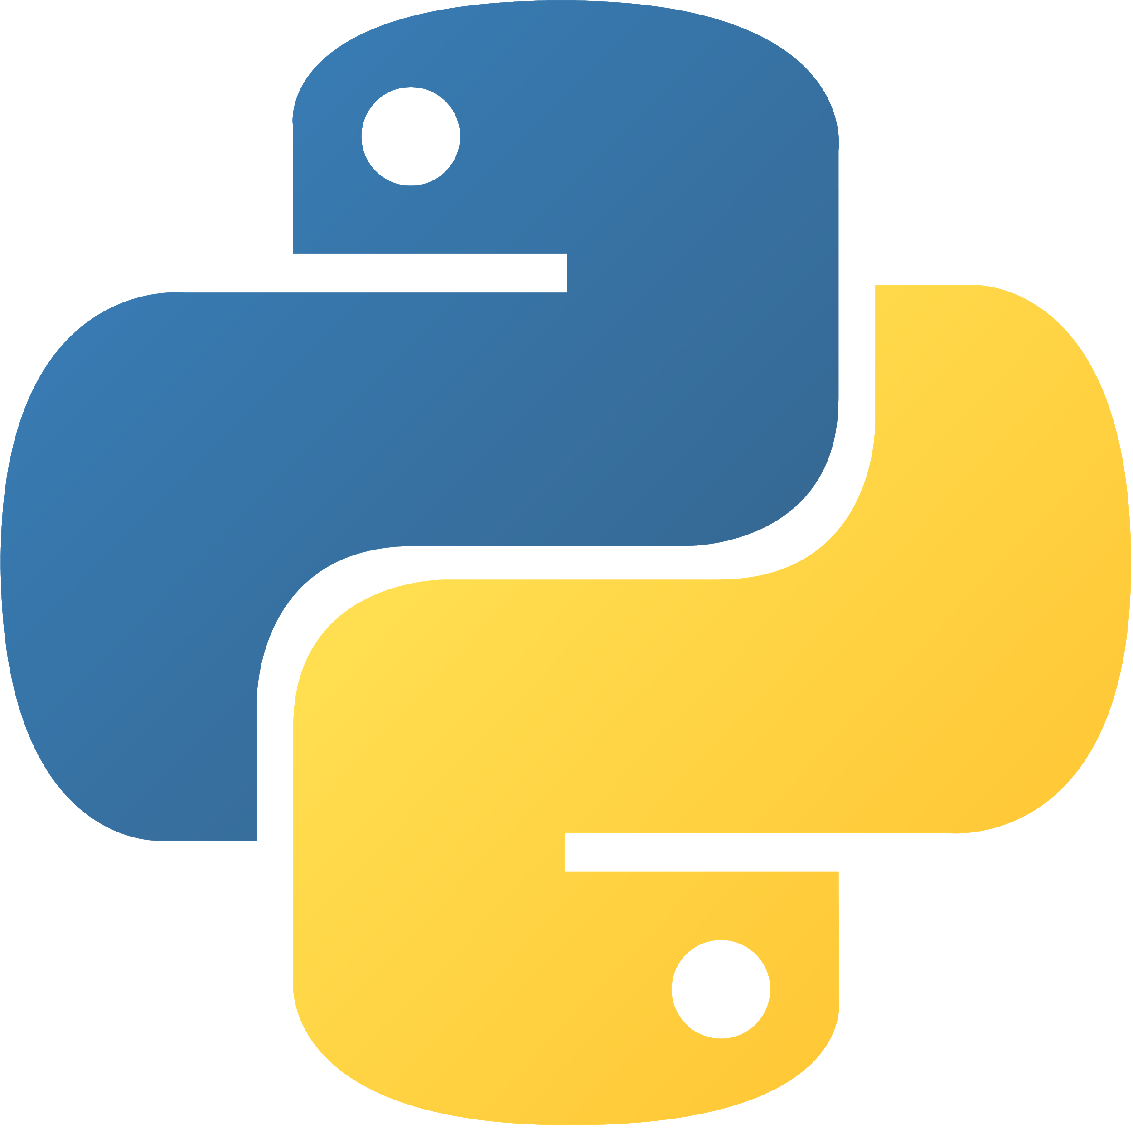



Main Technologies Used
Python
Our choice of programming language. It is simple, powerful and work well with Tensorflow and Keras
Tensorflow
Machine Learning Library. This is what Keras used behind the scene.
Keras
Jikan API
Neural Network Library - We used it to create model and hidden layers for our neural network. We also used its API for training and optimizing the model.
Rest API to find online Anime. We used to it to query data using outputs from our A.I Model

Slide 8
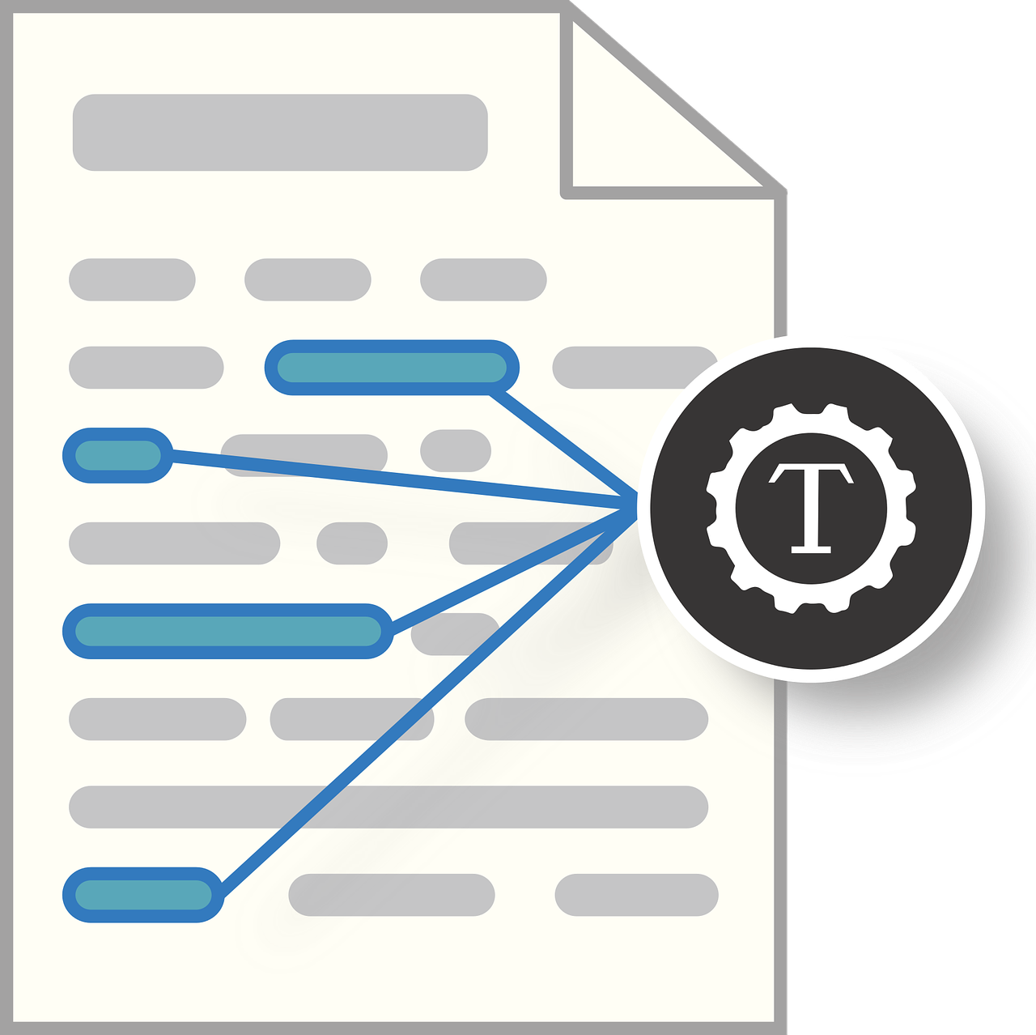
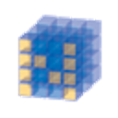


Other Libraries used
NLTK
Numpy
Natural Language Toolkit. We used it to tokenize and lemmatize words to input to our Model
Numerical Python. We used it to work with N-dimensional array so our Model can perform operations
Pickle
Python Library used for converting Python object to byte stream
JSON
We store patterns and classifications to feed to our Model in json format

Slide 9
03
FEATURES

Slide 10
Search Anime by genres
Recommend Similar Anime
Show information about particular Anime
Showing a list of anime with the given genres
Showing a list of anime that are similar to the one that is provided
Giving out the detail of the anime provided

Slide 11
04
DEMO

Slide 12
THANKS!

