Slide 1
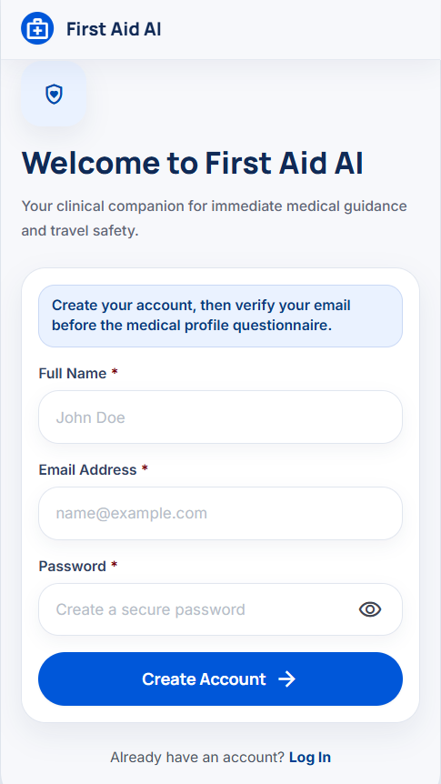
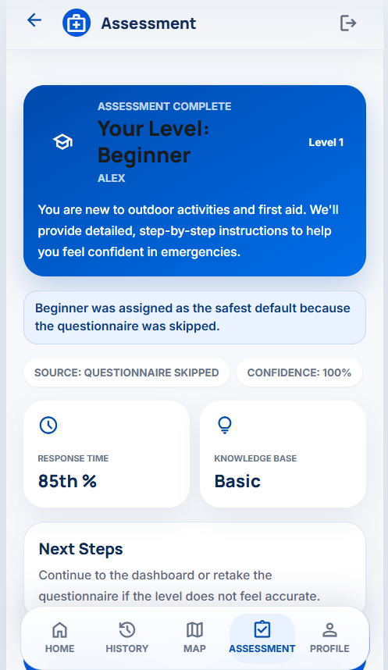
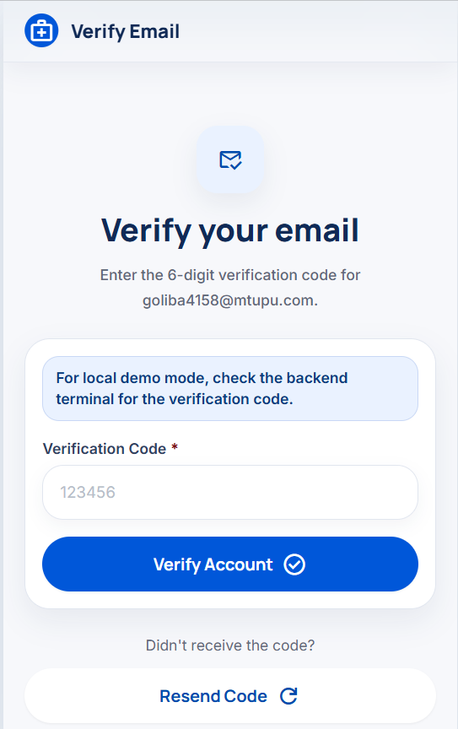
First Aid AI
MY MODULE
Module 1: onboarding, profile and skill assessment
Registration, email verification, questionnaire, readiness level, and dashboard access.
Core idea: pass a verified profile and user_level to later modules.
Register
Verify
Result

Slide 2
First Aid AI
Module role
02
What my module does
01
Creates an account
02
Verifies email
Prepares users for personalized medical features.
03
Collects 6 answers
04
Assigns a level
Level: Beginner / Intermediate / Expert. It allows future guidance to be simpler or more advanced.
05
Saves the result
06
Opens the dashboard
Module 1 · First Aid AI

Slide 3
First Aid AI
User flow
03
Core user journey
From initial registration to the dashboard and assessment retake.
1
Register
2
Verify email
3
Questionnaire
4
Assessment
5
Dashboard
6
Profile / Retake
Public: /, /verify-email, /login
Protected: /questionnaire, /assessment, /dashboard, /profile
JWT tokens protect private screens.
Module 1 · First Aid AI

Slide 4
First Aid AI
Use case stories
04
User stories
In brief: who wants to do what, and why.
Registration
I want to create an account so I can save my profile.
Email verification
I want to verify my email so I can continue securely.
Questionnaire
I want to answer the questions so I can receive a personalized level.
Assessment result
I want to see my level and its explanation.
Profile
I want to update my name, medical data, and password.
Retake
I want to retake the questionnaire if my skills change.
Acceptance focus: valid data, clear errors, state persistence, and protected routes.
Module 1 · First Aid AI

Slide 5
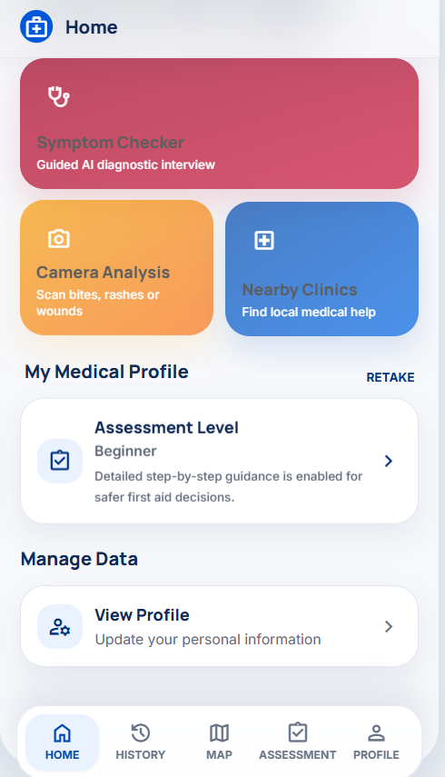
First Aid AI
Success path
05
Success path
What happens when there are no errors.
1 Registration
name + email + strong password
2 Verification
correct 6-digit code → JWT
3 Questionnaire
6 canonical answers
4 Classification
level + confidence + explanation
5 Persistence
user_profiles + assessment row
6 Dashboard
latest level is shown
Assessment
Dashboard
Module 1 · First Aid AI

Slide 6
First Aid AI
Error paths
06
Error paths
An error should not break the flow.
Register
invalid email
weak password
duplicate email
Verify
wrong code
expired code
resend needed
Login
wrong password
unverified account
expired token
Questionnaire
missing answer
invalid value
network error
Assessment
AI unavailable
fallback level
persistence error
Profile
token mismatch
password mismatch
validation error
Recovery pattern: show details → preserve entered data → offer retry / resend / login.
Module 1 · First Aid AI

Slide 7
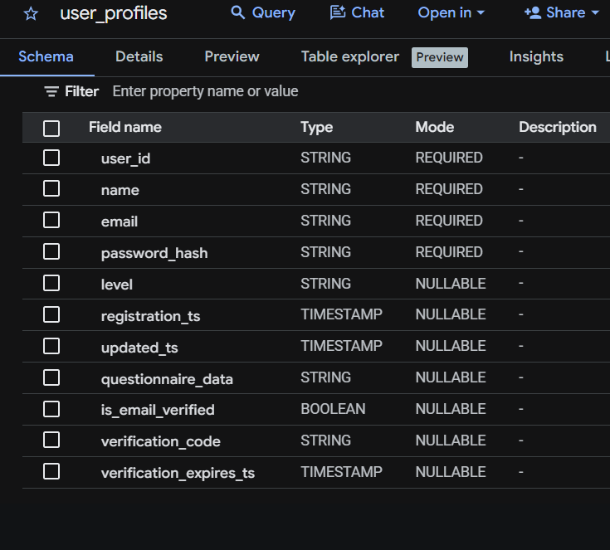
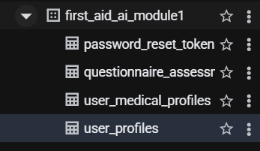
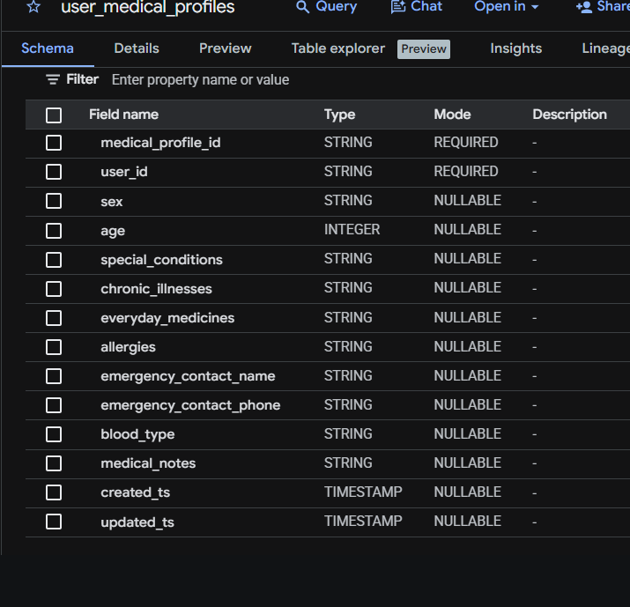
First Aid AI
Database
07
Database: Google BigQuery
Data is stored not only in frontend state, but also in separate database tables.
Dataset
first_aid_ai_module1
user_profiles
Account, email verification, password hash, and current level.
user_medical_profiles
Optional medical data: age, sex, blood type, allergies, and medications.
Core account data and sensitive medical profile data are stored in separate tables.
Module 1 · First Aid AI

Slide 8
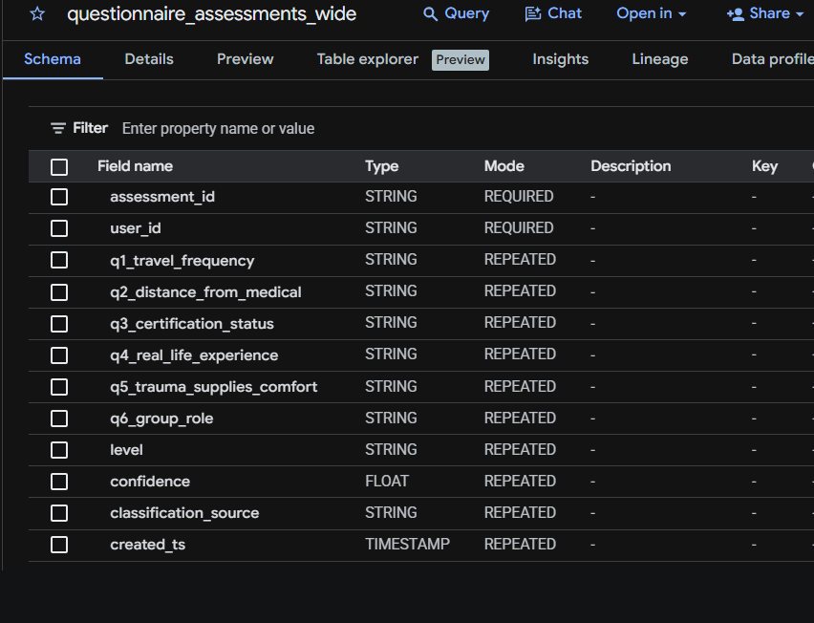
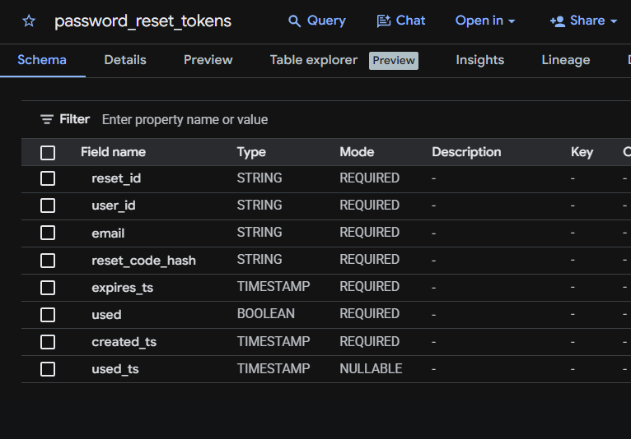
First Aid AI
Database
08
Assessment data
Separate tables store questionnaire results and password-reset data.
questionnaire_assessments_wide
Stores 6 answers, level, confidence, classification_source, and created_ts.
password_reset_tokens
Stores the reset-code hash, expiration time, used flag, and usage timestamp.
Why it matters
• restores sessions and levels
• supports questionnaire retakes
• avoids relying only on browser storage
Module 1 · First Aid AI

Slide 9
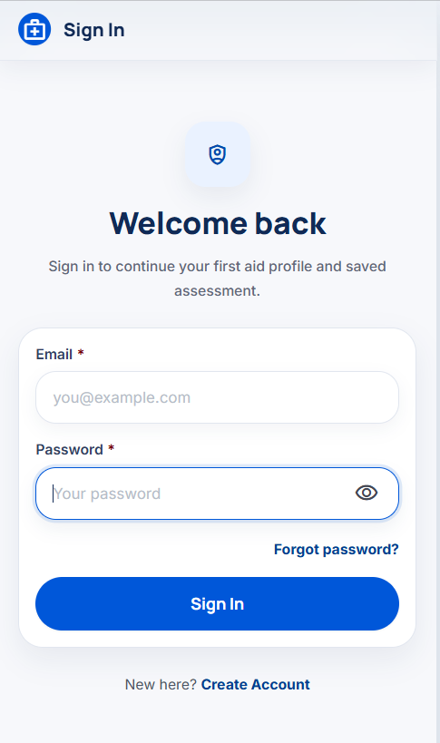
First Aid AI
Core screens
09
Auth screens
Register → Verify Email → Sign In.
Key features: compact cards, fixed top bar, password toggle, resend code, forgot password.
Register
Verify Email
Sign In
Module 1 · First Aid AI

Slide 10
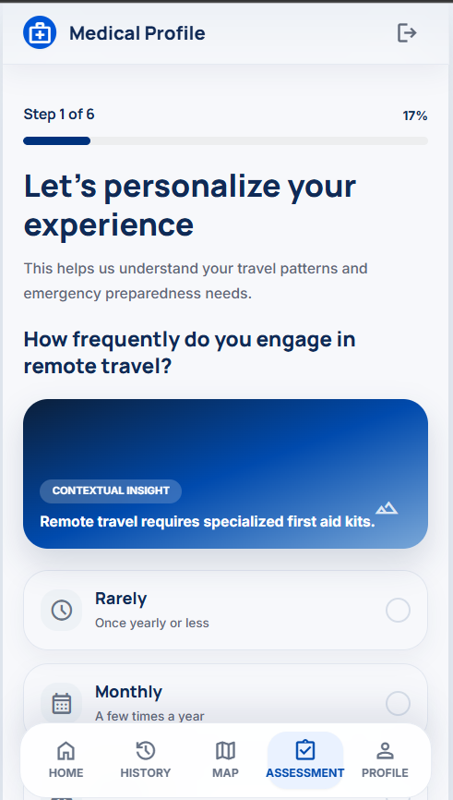
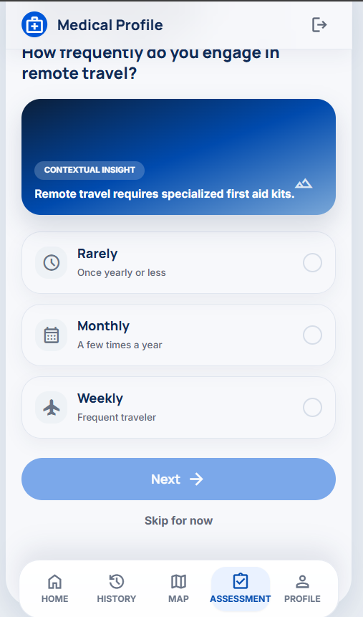
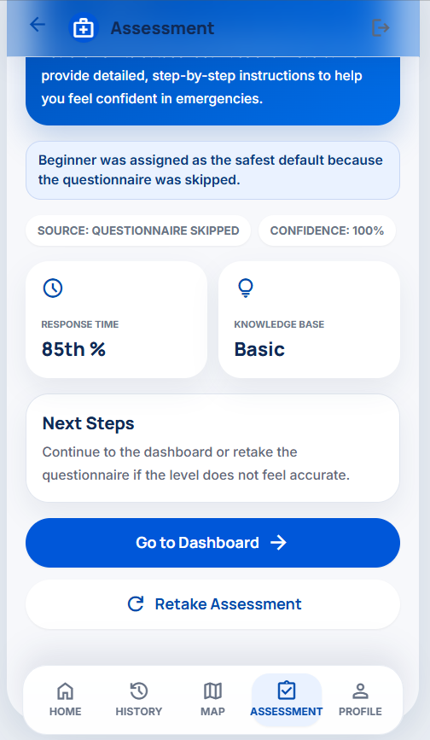
First Aid AI
Core screens
10
Questionnaire + result
6 steps, safe skipping, and a clear result.
Skip → Beginner as the safe default.
Retake → a new result and updated level.
Step
Answer
Result
Actions
Module 1 · First Aid AI

Slide 11
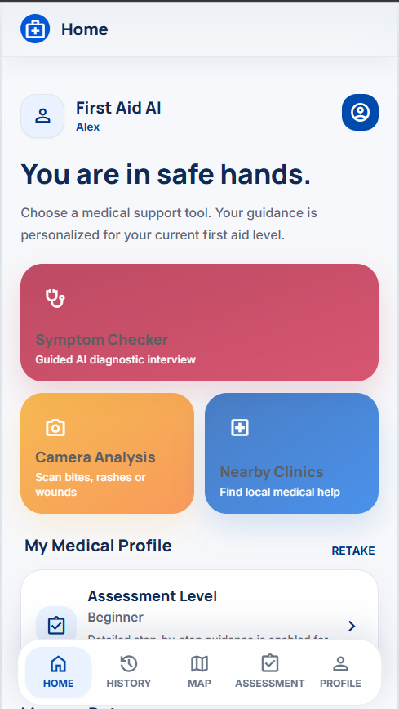
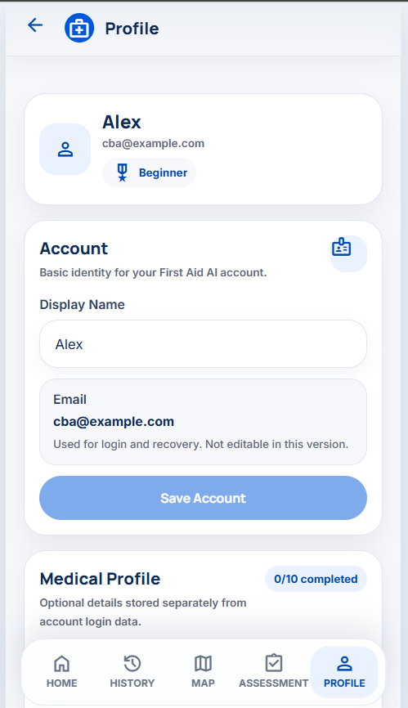
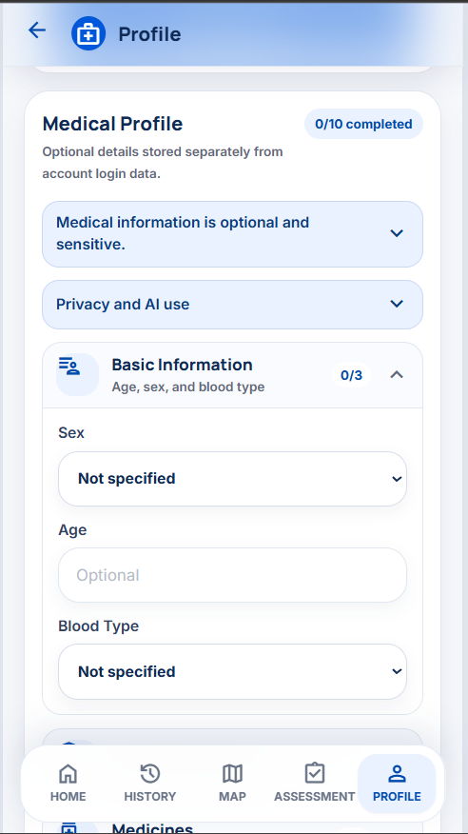
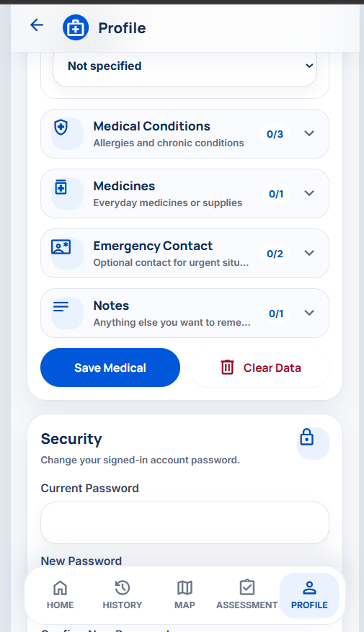
First Aid AI
Core screens
11
Dashboard + profile
After onboarding, users manage their data and continue to other features.
The profile must be easy to use because it contains sensitive medical data.
Home
Dashboard
Account
Medical
Security
Module 1 · First Aid AI

Slide 12
First Aid AI
Technologies
12
Technology stack
Technologies used in the implementation.
Frontend
React
TypeScript
Vite
Backend
FastAPI
Python
REST API
Database
Google BigQuery
user_profiles
questionnaire_assessments_wide
Auth
JWT
PBKDF2 hash
protected routes
Email
SMTP
console demo mode
6-digit code
AI / fallback
Groq API
local rules
deterministic fallback
Testing
pytest
Vitest
React Testing Library
Demo
ngrok
local frontend
local backend
Core principle: external AI never blocks the user because a stable fallback is always available.
Module 1 · First Aid AI

Slide 13
First Aid AI
Potential improvements
13
What else may be needed
Five concise points for the project defense.
1. The module already implements onboarding: registration, email verification, questionnaire, and dashboard.
2. For production, add rate limiting for verification codes and password reset.
3. The medical profile requires explicit user consent before storing sensitive data.
4. Password reset requires complete testing: code, expiration, resending, and used tokens.
5. The next important step is end-to-end testing from registration through assessment retake.
Module 1 · First Aid AI

Slide 14
Module 1
Summary
My module creates a verified account, determines user_level, and establishes a foundation for personalized first-aid guidance.
Core output
verified user • profile • medical context • readiness level • assessment history
Dashboard
Profile
Level

