Slide 1

PROPOSAL: IDENTIFYING LOW-RISK AIRCRAFT FOR THE NEW AVIATION DIVISION Presentation by Linda Temoet

Slide 2

Project analysis slide 3
INTRODUCTION
Task Overview: The company's new aviation division requires a proposal to identify the lowest-risk aircraft for its fleet. This proposal aims to provide insights into the safest aircraft models based on accident data.
Data Source: The analysis uses a dataset from Kaggle containing aviation accident data from 1962 to 2023. The dataset covers civil aviation accidents in the United States and international waters.
Time Period Focus: To ensure relevancy, only data from the years 2000 to 2023 was used, as aircraft technology has significantly advanced in recent decades

Slide 3


Project analysis slide 2
PROPOSAL PROCESS
SPECIFICATION
IMPLEMENT
PROJECT
GET DATA
RECCOMENDATION
ANALYSIS

Slide 4
Project analysis slide 4
OBJECTIVES
Main Objective:
Perform a risk analysis to determine the lowest-risk aircraft..
Determine the number of uninjured passengers for different aircraft types.
Evaluate accident injury severity for various aircraft makes..
Other Objectives.
Calculate injury severity for different aircraft engine types.

Slide 5
Project analysis slide 5
DATA OVERVIEW
Tools
Data Description
Data Used
The tools used for analysis were python pandas. Matplotlib and Tableau were also used for Visualization
The data was obtained from Kaggle. It was Aviation accidents data
There were 8 main columns used for analysis

Slide 6
Project analysis slide 3
DATA PROCESSING
There were 4 main stages of data processing:
Filtering: Removed unnecessary sections of the data.
Cleaning: Organized and cleaned for better analysis.
Analysis: Extracted relevant data to answer objectives.
Visualization: Created visuals using Matplotlib & Tableau

Slide 7
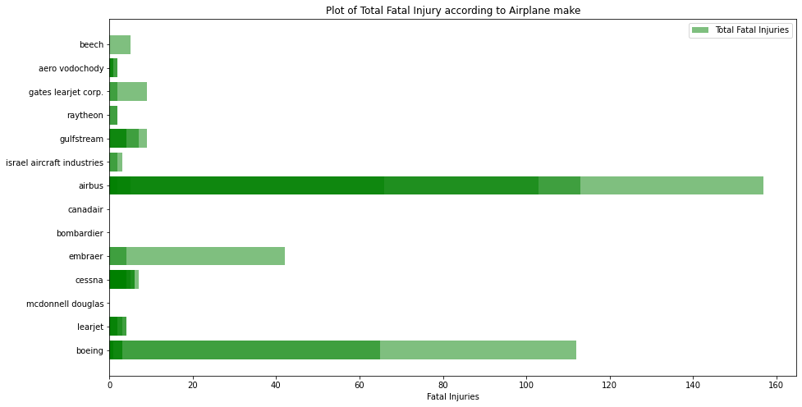
Project analysis slide 6
Risk Analysis Main Objectives
Here we have the visualization of the total fatalities by airplane make. It clearly shows the aircraft makes that have the least number of fatalities.

Slide 8
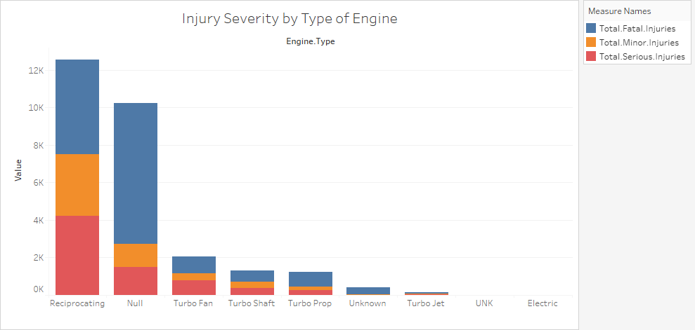
Project analysis slide 7
Fatalities by Engine Type
Here we see that the fatalities were lesser in the Turbo fan Engine type

Slide 9
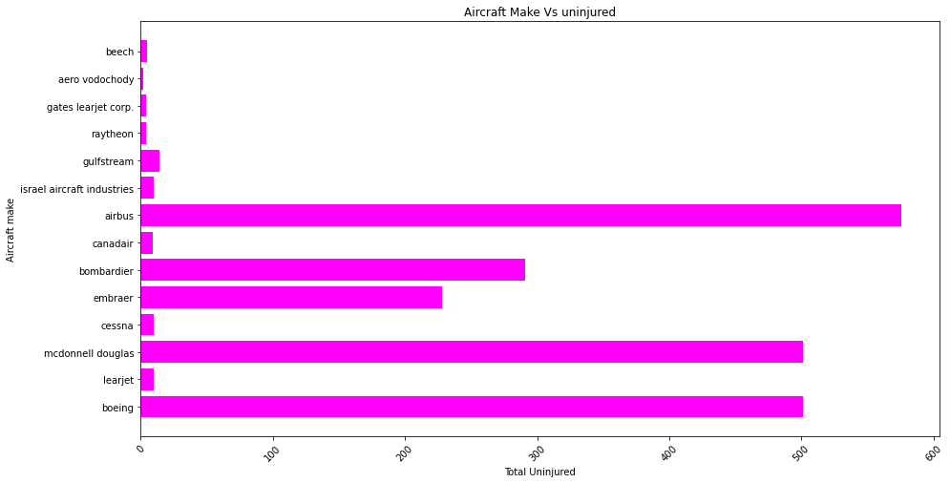
Project analysis slide 8
Passenger Safety
Here we have a graph that showcases passenger safety by the different aircraft makes

Slide 10
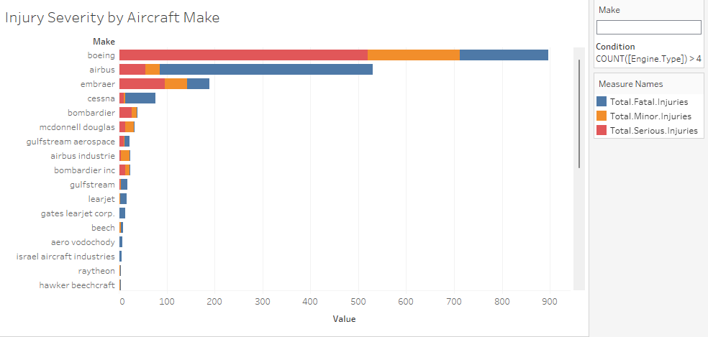
Project analysis slide 10
Recommendations
From this graph, these are the 3 main aircraft recommendations:
Mcdonnel Douglas
Bobardier
Embraer

Slide 11
Thank You
Made by:
Linda Temoet
lindachebet92@gmail.com

