Slide 1

SUBMITTED TO D. ANADHA KUMAR
DEPARTMENT OF INFORMATION TECHNOLOGY
REGISTRATION NUMBER NAME OF THE STUDENT
211FA07068 CH. Manoj Kumar
VIGNAN’S FOUNDATION FOR SCIENCE TND RESEARCH
(NAAC A+ GRADE ACCREDITED)

Slide 2
INTRODUCTION :
WHAT IS DATA STRUCTURE?
A data structure is a group of data elements that provides the easiest way to store and perform different actions on the data of the computer. A data structure is a particular way of organizing data in a computer so that it can be used effectively. The idea is to reduce the space and time complexities of different tasks.
A data structure has also defined an instance of ADT (ABSTRACT DATA-TYPE). It is formally defined as a triplet:
[D,F,A], where
• D: Set of the domain.
• F: the set of operations.
• A: the set of axioms.

Slide 3
VARIOUS TYPES OF LINKED LISTS:
Singly Linked List:
It is the most common. Each node has data and a pointer to the next node.
Doubly Linked List:
We add a pointer to the previous node in a doubly-linked list. Thus, we can go in either direction: forward or backward.
Circular Linked List:
A circular linked list is a variation of a linked list in which the last element is linked to the first element. This forms a circular loop.
Circular Doubly Linked List: The circular doubly linked list is a combination of the doubly linked list and the circular linked list. It means that this linked list is bidirectional and contains two pointers and the last pointer points to the first pointer.
Introduction to Bubble Sort in Data Structure: Bubble Sort in Data Structure is one of the easiest sorting algorithm being used. The idea behind this algorithm is to repeatedly compare the elements one by one and swap the adjacent elements to bring them in the correct sorted order. Thus if there are n number of elements in the array, then each element will undergo n-1 comparisons.

Slide 4
Applications of linked list in computer science:
1. Implementation of stacks and queues
2. Implementation of graphs: Adjacency list representation of graphs is the most popular which uses a linked list to store adjacent vertices.
3. Dynamic memory allocation: We use a linked list of free blocks.
4. Maintaining a directory of names
5. Performing arithmetic operations on long integers
6. Manipulation of polynomials by storing constants in the node of the linked list
7. Representing sparse matrices
Advantages of linked list
Insertion and deletion in linked lists are very efficient.
Linked list can be expanded in constant time.

Slide 5
For implementation of stacks and queues and for representation of trees and graphs.
Linked lists are used for dynamic memory allocation which means effective memory utilization hence, no memory wastage.
Disadvantages of linked lists:
Use of pointers is more in linked lists hence, complex and requires more memory.
Searching an element is costly and requires O(n) time complexity.
Traversing is more time consuming and reverse traversing is not possible in singly linked lists.
Random access is not possible due to dynamic memory allocation.

Slide 6
PART-A
2. Merge k Sorted Lists You are given an array of k linked-lists lists; each linked-list is sorted in ascending order. Merge all the linked-lists into one sorted linked-list and return it.
Example 1:
Input: lists = [[1,4,5],[1,3,4],[2,6]]
Output: [1,1,2,3,4,4,5,6]
Explanation:
The linked lists are: [ 1->4->5, 1->3->4, 2->6 ] merging them into one sorted list: 1->1->2->3->4->4->5->6
Constraints:
• k == lists.length
• 0 <= k <= 104

Slide 7
Source Code:
#include <stdio.h>
#include <stdlib.h>
#include <malloc.h>
struct node
{
int data;
struct node *next;
};
struct node *start = NULL;
struct node *create_ll(struct node *,int data);
struct node *display(struct node *);
struct node *sort_list(struct node *);

Slide 8
void main()
{
int k,n,data,i,j;
printf("enter no of lists:");
scanf("%d",&k);
for(i=0;i<k;i++)
{
printf("enter no of elements:");
scanf("%d",&n);
for(j=0;j<n;j++)
{
printf("enter data:");
scanf("%d",&data);

Slide 9
start=create_ll(start,data);
}
}
start=sort_list(start);
start=display(start);
}
struct node *create_ll(struct node *start,int data)
{
struct node *new_node, *ptr;
new_node = (struct node*)malloc(sizeof(struct node));
new_node -> data=data;

Slide 10
if(start==NULL) {
new_node -> next = NULL;
start = new_node;
}
else {
ptr=start;
while(ptr->next!=NULL)
ptr=ptr->next;
ptr->next = new_node;
new_node->next=NULL;
}
return start;
}

Slide 11
struct node *display(struct node *start)
{
struct node *ptr;
ptr = start;
printf("the sorted data is:\n");
while(ptr != NULL)
{
printf("\t %d", ptr -> data);
ptr = ptr -> next;
}
return start;
}

Slide 12
struct node *sort_list(struct node *start)
{
printf("now sorting the data:\n");
struct node *ptr1, *ptr2;
int temp;
ptr1 = start;
while(ptr1 -> next != NULL)
{
ptr2 = ptr1 -> next;
while(ptr2 != NULL)
{
if(ptr1 -> data > ptr2 -> data)
{

Slide 13
temp = ptr1 -> data;
ptr1 -> data = ptr2 -> data;
ptr2 -> data = temp;
}
ptr2 = ptr2 -> next;
}
ptr1 = ptr1 -> next;
}
return start;
}

Slide 14
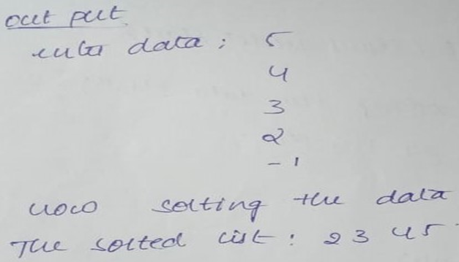
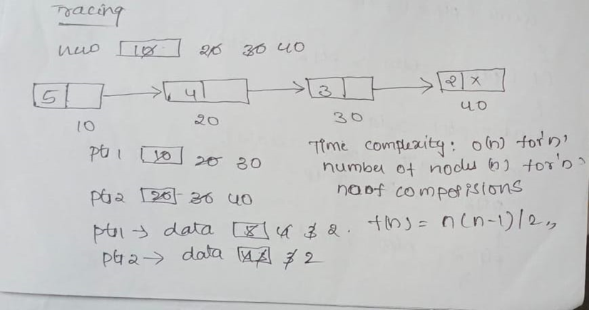
Output:
Tracing:

Slide 15
Part-B
Apply a sample test case and tracing for the following algorithm (write only logical part of c program or algorithm of below function)
a) find the nth term of Fibonacci series using recursion
#Fibo que
Source Code:
#include <stdio.h>
int fibo(int);
int main()
{
int num;
int result;
printf("Enter the nth number in fibonacci series: ");

Slide 16
scanf("%d", &num);
if (num < 0)
{
printf("Fibonacci of negative number is not possible.\n");
}
else
{
result = fibo(num);
printf("The %d number in fibonacci series is %d\n", num, result);
}
return 0;
}

Slide 17
int fibo(int num)
{
if (num == 0)
{
return 0;
}
else if (num == 1)
{
return 1;
}
else
{
return(fibo(num - 1) + fibo(num - 2));
}

Slide 18
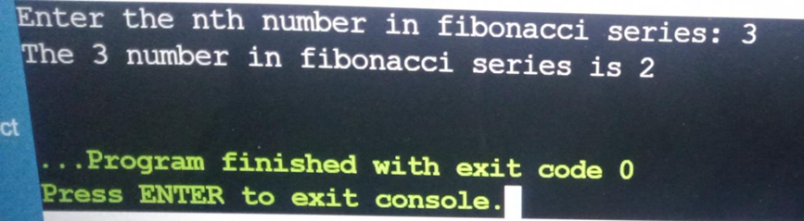
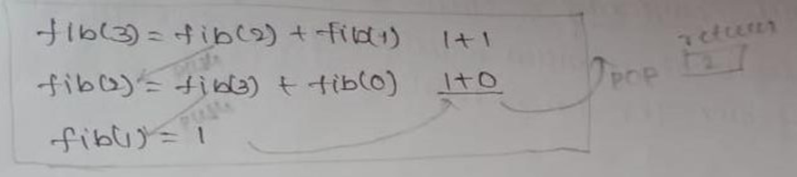
Output:
Tracing:

Slide 19
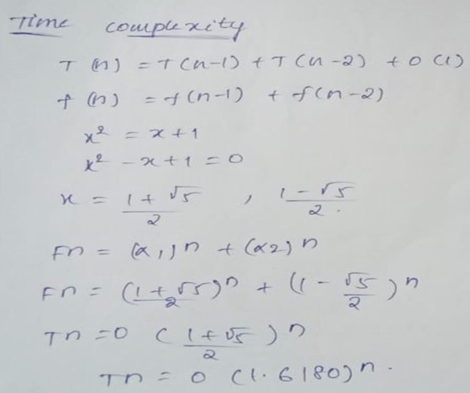

Slide 20
b) Move last node to the front of the linked list #list node
Source Code:
#include <stdio.h>
#include <stdlib.h>
/* A linked list node */
struct Node {
int data;
struct Node* next;
};
void moveToFront(struct Node** head_ref)
{
if (*head_ref == NULL || (*head_ref)->next == NULL)
return;

Slide 21
struct Node* secLast = NULL;
struct Node* last = *head_ref;
while (last->next != NULL) {
secLast = last;
last = last->next;
}
secLast->next = NULL;
last->next = *head_ref;
*head_ref = last;
}
void push(struct Node** head_ref, int new_data)
{
struct Node* new_node= (struct Node*)malloc(sizeof(struct Node));
new_node->data = new_data;

Slide 22
new_node->next = (*head_ref);
(*head_ref) = new_node;
}
void printList(struct Node* node)
{
while (node != NULL) {
printf("%d ", node->data);
node = node->next;
}
}
int main()
{
struct Node* start = NULL;
1->2->3->4->5 */

Slide 23
push(&start, 5);
push(&start, 4);
push(&start, 3);
push(&start, 2);
push(&start, 1);
printf("Linked list before moving last to front\n");
printList(start);
moveToFront(&start);
printf("\nLinked list after removing last to front\n");
printList(start);
return 0;
}

Slide 24
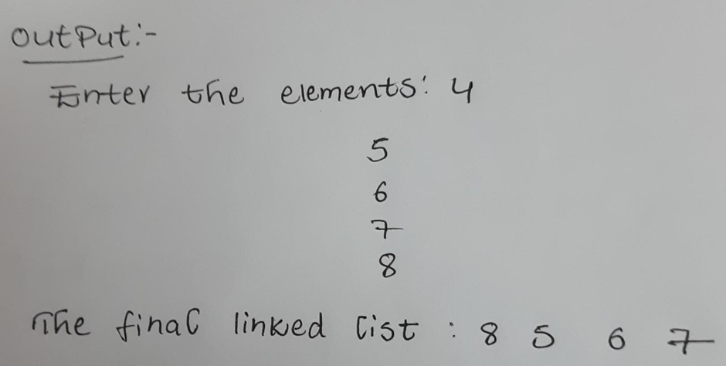
Output

Slide 25
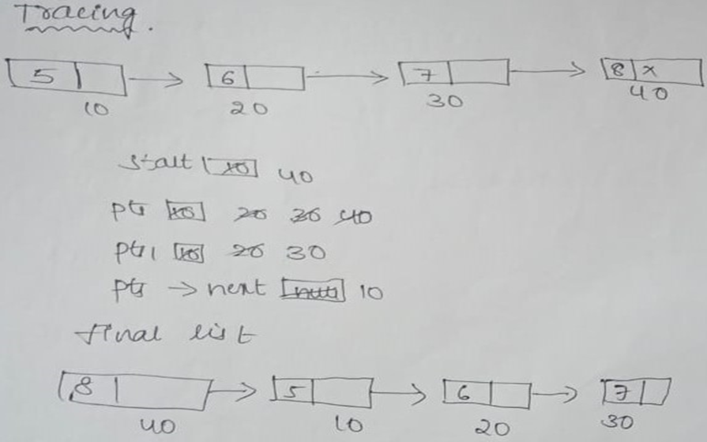
Tracing:

Slide 26
c)parenthesis checker #parenthesis checker
Source Code:
#include <stdio.h>
#include <conio.h>
#include <string.h>
#define MAX 10
int top = -1;
int stk[MAX];
void push(char);
char pop();
void main()
{

Slide 27
char exp[MAX],temp;
int i, flag=1;
printf("Enter an expression : ");
gets(exp);
for(i=0;i<strlen(exp);i++)
{
if(exp[i]=='(' || exp[i]=='{' || exp[i]=='[')
push(exp[i]);
if(exp[i]==')' || exp[i]=='}' || exp[i]==']')
if(top == -1)
flag=0;
else
{

Slide 28
temp=pop();
if(exp[i]==')' && (temp=='{' || temp=='['))
flag=0;
if(exp[i]=='}' && (temp=='(' || temp=='['))
flag=0;
if(exp[i]==']' && (temp=='(' || temp=='{'))
flag=0;
}
}
if(top>=0)
flag=0;
if(flag==1)
printf("\n Valid expression");
else
printf("\n Invalid expression");
}

Slide 29
void push(char c) {
if(top == (MAX-1))
printf("Stack Overflow\n");
else {
top=top+1;
stk[top] = c;
}
}
char pop(){
if(top == -1)
printf("\n Stack Underflow");
else
return(stk[top--]);
}

Slide 30
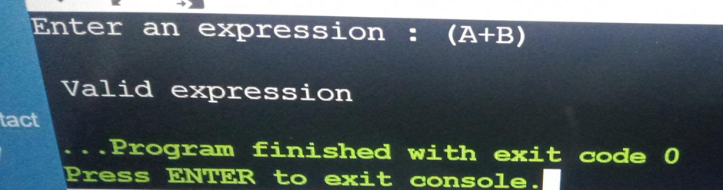
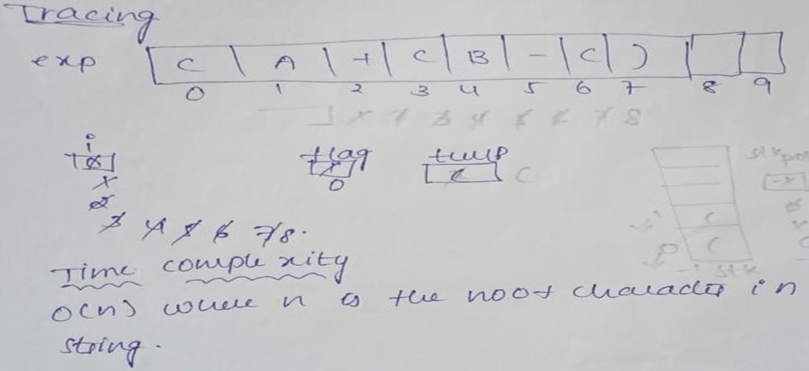
Output:
Tracing

Slide 31
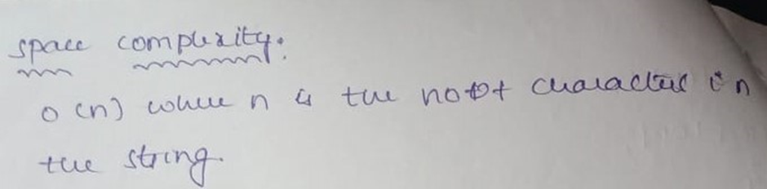
REPORT :
We have completed our target question by implementing it in the form of a c program.
The work was divided among the batch mates

