Slide 1

PURPLE
The Student companion
TEAM - SOTEJ
Sohan
Tejaswi

Slide 2
About our Project
PURPLE , a smart voice assistant to rescue the needs of current day students. This project acts as a friend and assistant to students. It also helps the students in avoiding the major personal issue of procrastination.This projects main functions:
-> Time Management Skills
->Task Management
->Marks analysis
->Smart understanding Companion
->Cures Boredom
Purple stands out from other assistants like alexa and siri which are not specific to students.

Slide 3
How to use?
On running the python application , an interface would be generated on the screen.
We can give commands by clicking on the microphone button available.
From there on it is very easy to talk to purple as it is a user friendly voice assistant.

Slide 4
Difficulties we faced
While connecting database to python.
Sending notifications of important deadlines which are approaching based on data in database was little trickier.
Also while integrating the files to manage the tasks in to do list of user was challenging.
Sensitizing speech recognition.

Slide 5
Future enhancements possible
Enhancing the AI concept of project
Efficiency can be improved.
We can add few other functions.

Slide 6
INSIGHTS OF OUR PROJECT
Additional features:
Taking screenshot
Google and wikipedia searches
Remembering things said by user
Welcoming and closing messages
And many more
The Student companion
1.Task manager
2.Assignment deadlines manager
3. Relaxation functions like playing music, narating jokes.

Slide 7
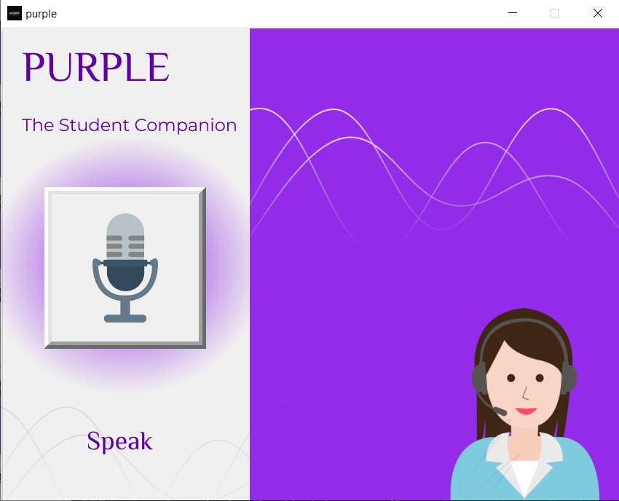
MAIN INTERFACE
Developed using tkinter library.
The Student companion

Slide 8
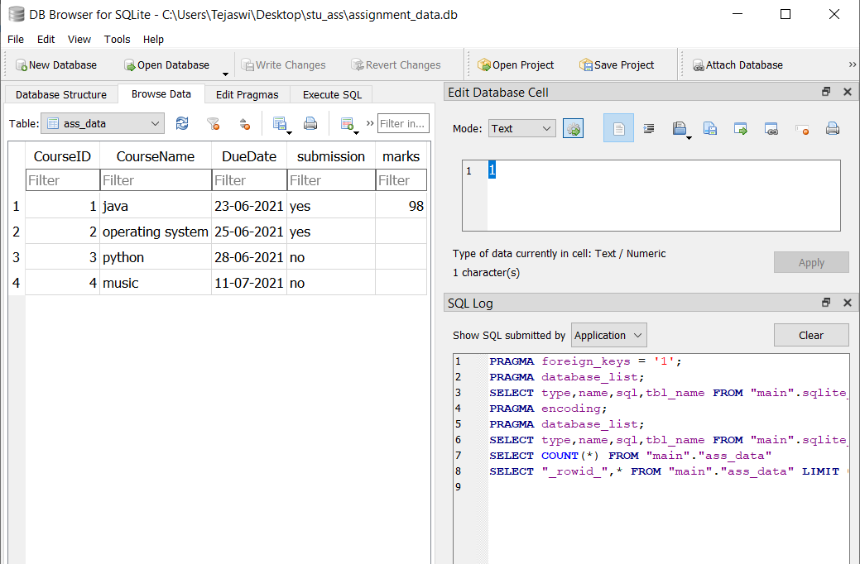
DATABASE

Slide 9
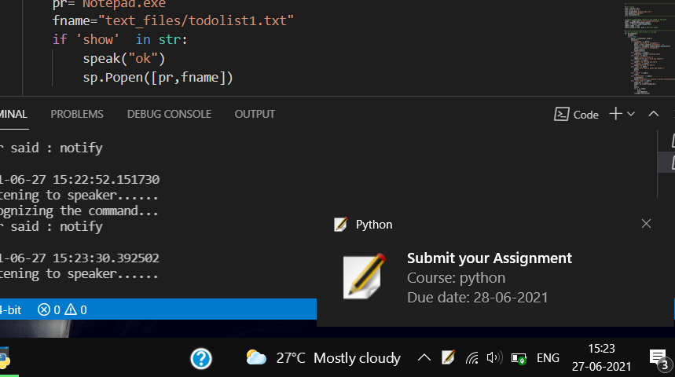
NOTIFICATION
The Student companion
Used plyer library for sending notifications.

Slide 10
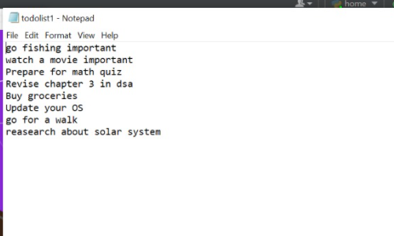
TO DO LIST
It is created based on user commands

Slide 11
THANKYOU

