Slide 1

ParkinsonPal
Your friendly IoT companion who will help you with the coexistence of the disease.
Partecipants: Luca Barotto, Marta Bono, Francesco Calice, Candela Muzas

Slide 2
What is ParkinsonPal?
ParkinsonPal is an innovative system that aims to improve the quality of life of patients affected with Parkinson’s Disease.
Retrieve data
Analyze data
Statistical evaluation
Deal with symptoms or emergencies

Slide 3
How ParkisonPal is useful?
2° most common neurodegenerative disease
1.1 to 1.3 billions of euros paid by the italian NHS yearly
Disease progression not constant
Incidence: 8-18/100’00
Age of onset: >60 (for 70% of the cases)
10% of cases with age between 20-50 years old.
Both the percentage of young and elderly cases is expected to increase
Annual cost of one patient, paid by NHS and the society: 13000-22000 euros
Annual cost of treatment, to be paid by the patient: 1500-2700 euros
This is due to many factor, such as:
Natural progression of the disease.
Response to therapy no longer effective.
Without a continuous monitoring, it is not possible to slow the progression the disease.

Slide 4



Retrieve data
The data are retrieved by three sensors, positioned on the body of the patient.
Tremor of the patient’s wrist, by their smartwatch.
Stride of the patient, by their sensorized belt.
Pressure of the patient, by a sensorized insole.

Slide 5
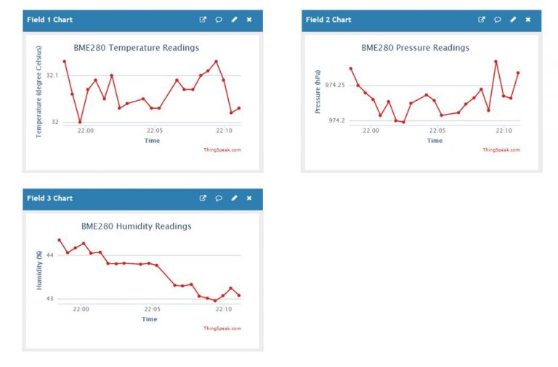
Analysis of data and statistical evaluation
For each measure, on the application ThingSpeak are available:
A graph that represents the trend over time.
A counter for each adverse event over the time.
It is also possible to retrieve this statistical information via Telegram dedicated channel.

Slide 6
Adverse events
Tremor
Definition: Uncontrolled tremor all over the patient’s body.
Possible consequences: fall, self harm.
Prevented by: Activation of the device «Deep Brain Stimulation» or by the injector of medicine L-DOPA.
Freezing
Definition: Sudden inability to move, take a step, turn around, or cross narrow spaces like a door.
Possible consequences: fall.
Prevented by: Emission of a rhythmic sound from the smartwatch.

Slide 7



Emergency events
Fall
Possible consequences: broken bones, incapabilty to rise, head trauma, fainting …
Emergency response: Warning of falling to emergency contacts via Telegram Bot.

