Slide 1
VOLVO CAR CORPORATION CUSTOMER SERVICE
Graanmolen 9 - 11
6229 – PA Maastricht
THE NETHERLANDS
RETURN SHIPPING DATE
DISTRICT 2178 Nº dealer
RETURN PERMISSION NO. CASE NO. NUMBER OF CASES

Slide 2
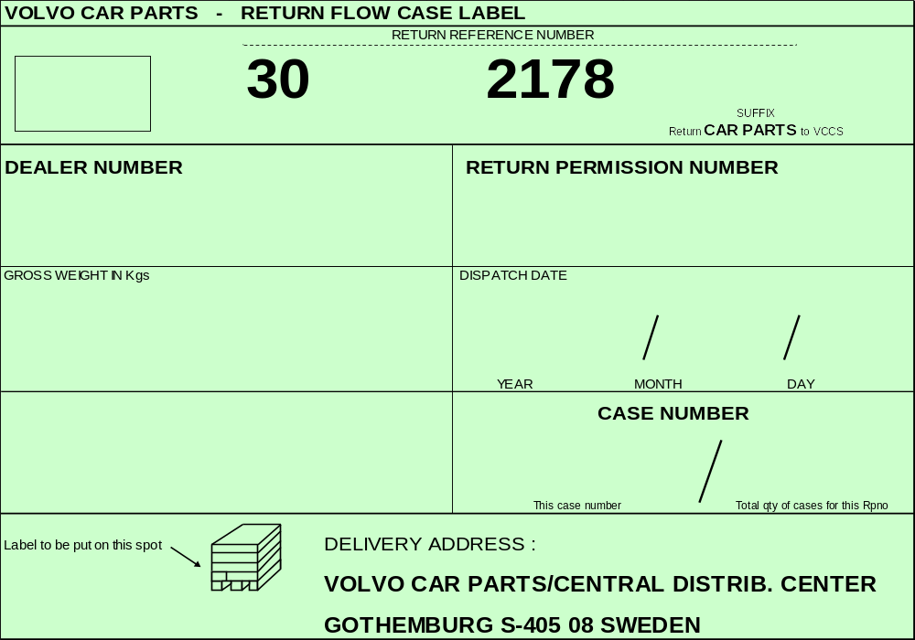
Notes:
AFTERSALES AWARENESS
Training Programme
Volvo Car Corporation
Aftersales

Slide 3
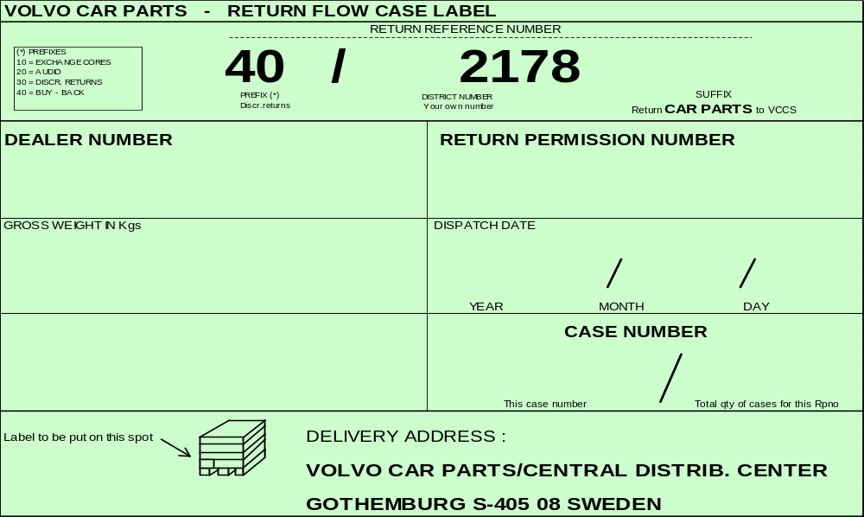
Notes:
AFTERSALES AWARENESS
Training Programme
Volvo Car Corporation
Aftersales

Slide 4
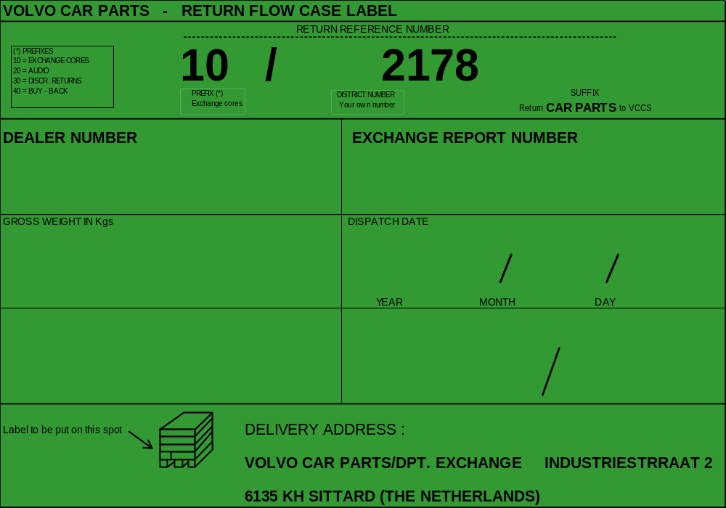
Notes:
AFTERSALES AWARENESS
Training Programme
Volvo Car Corporation
Aftersales

Slide 5
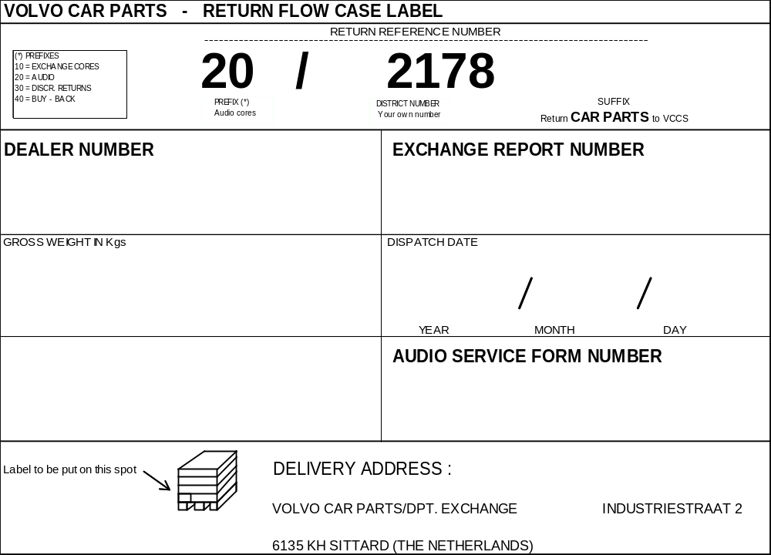
Notes:
AFTERSALES AWARENESS
Training Programme
Volvo Car Corporation
Aftersales

Slide 6


Slide 7
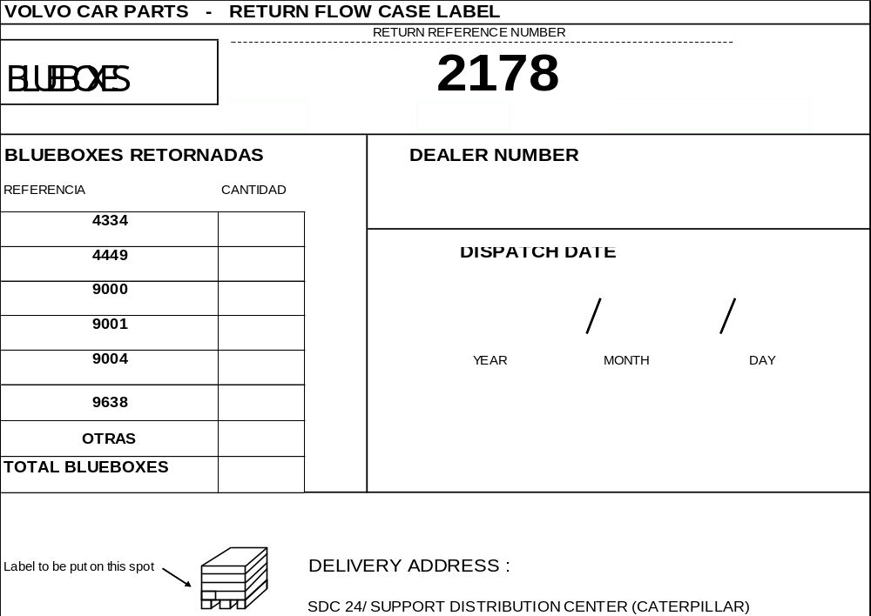
Notes:
AFTERSALES AWARENESS
Training Programme
Volvo Car Corporation
Aftersales

Slide 8
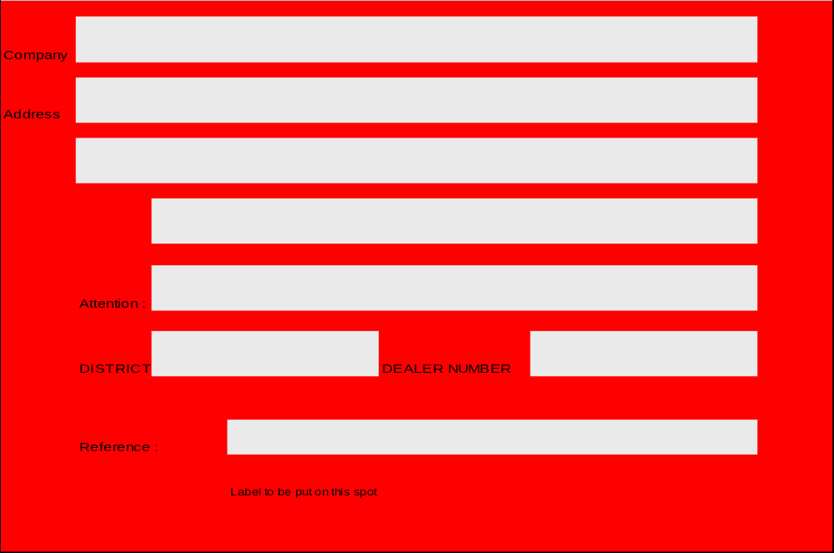
Notes:
AFTERSALES AWARENESS
Training Programme
Volvo Car Corporation
Aftersales

Slide 9
CLASIFICACION EMBALAJES DE MADERA
Pallet Frame Lid Spacer
L 122 x 82 X 15 E-001 E-021 E-071 E-061
K 82 X 61 X 13 E-002 E-022 E-072 E-062
F 162 X 122 X 17 E-005 E-025 E-075 E-065
G 145 X 81 X 15 E-006 E-026 E-076 E-066
H 181 X 85 X 15 E-009 E-029 E-079 E-069
Conceptos
Pallet: Suelo
Frame: Tablas
Lid: Tapa
Space r: Separador
Notes:
AFTERSALES AWARENESS
Training Programme
Volvo Car Corporation
Aftersales

