Slide 1
My Name is SMT

Slide 2
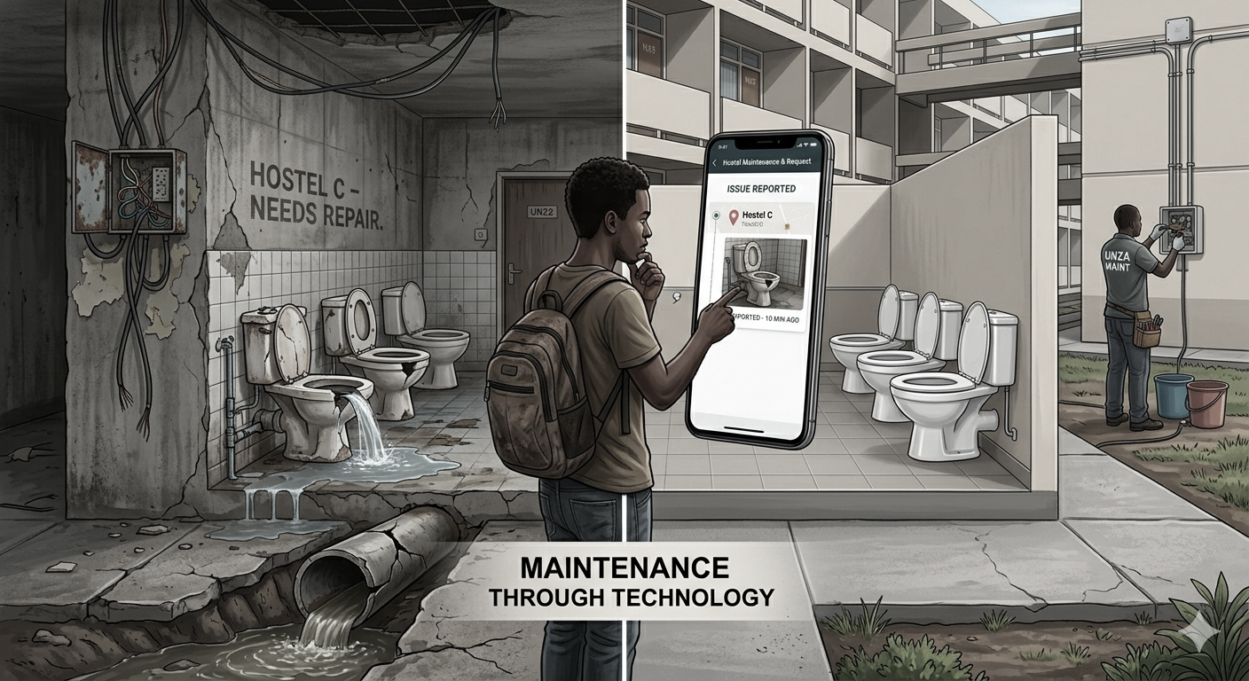
Hostel Maintenance Request & Tracking System
Final Year Project • UNZA 2026

Slide 3

Project Team
Samson Mwale
ID: 2022052196
As the lead and only developer, I am responsible for the full-stack design and implementation of the Hostel Maintenance Request and Tracking System. My role encompasses requirements analysis, database design, agile development, and system testing to ensure a functional, user-centric solution for university hostel operations.

Slide 4
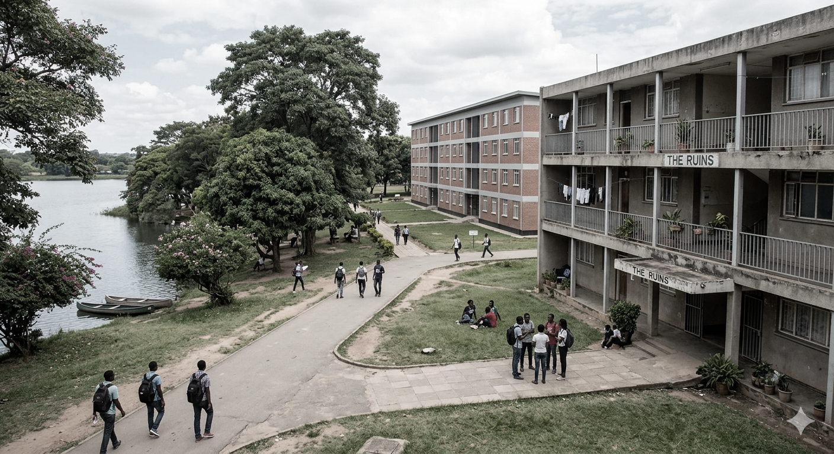
Presentation Overview
Background & Context
System Analysis & Design
Implementation Details
Testing & Evaluation
Conclusion & Demo

Slide 5
Background & Context
University hostels currently face significant infrastructure degradation, exacerbated by inefficient, paper-based reporting processes. Maintenance workflows are hindered by poor tracking, lack of status visibility, and the absence of centralized records. These systemic delays prevent timely repairs and make performance evaluation nearly impossible, ultimately impacting the living conditions of students and the operational efficiency of university facilities.

Slide 6
Project Aim
To design and implement a web-based system that digitizes, manages, and monitors maintenance operations within university hostels.

Slide 7

System Components
The system architecture is organized into three distinct user modules, each designed to streamline the maintenance lifecycle. The Student Module enables seamless fault reporting and real-time status tracking. The Technician Module provides a dedicated interface for receiving assignments, updating task progress, and documenting repairs with photo evidence. Finally, the Administrative Dashboard offers comprehensive oversight, including performance analytics, SLA monitoring, and automated reporting tools to ensure efficient hostel management.

Slide 8
Technology Stack
Language: JavaScript
Frontend: React / CSS and HTML
Framework: Node.js / Express.js
Database: Supabase (PostgreSQL)
Tools: VS Code, Git & GitHub
Deployment: Netlify & Render

Slide 9
Database Design
The system utilizes a structured relational database model designed to ensure data integrity and efficient retrieval. Key entities include users, which manage authentication and role-based access; maintenance requests, which capture fault details and lifecycle status; and technicians, who are assigned to specific tickets for resolution. This design supports complex relationships between students, administrative staff, and maintenance personnel, enabling seamless tracking and reporting across the entire hostel infrastructure.

Slide 10
DIAGRAMS
Analysis Phase Diagrams
Domain Model
Use Cases
System Sequence Diagram
ER Diagram
Architecture Diagram
Ghantt Chart

Slide 11
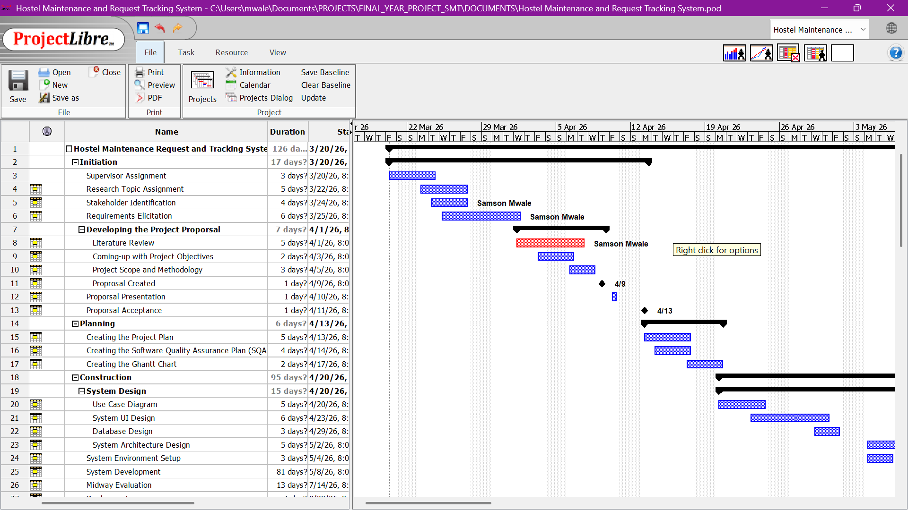

Slide 12
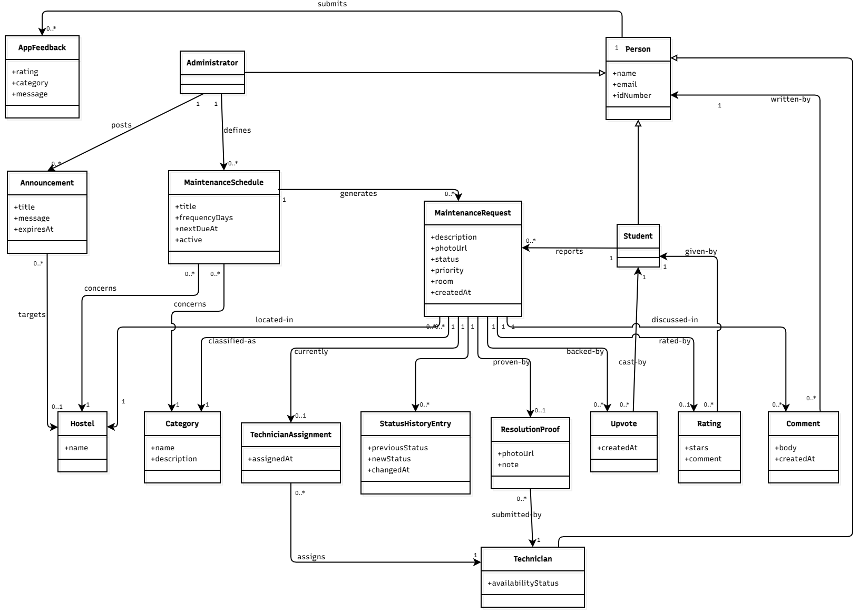

Slide 13
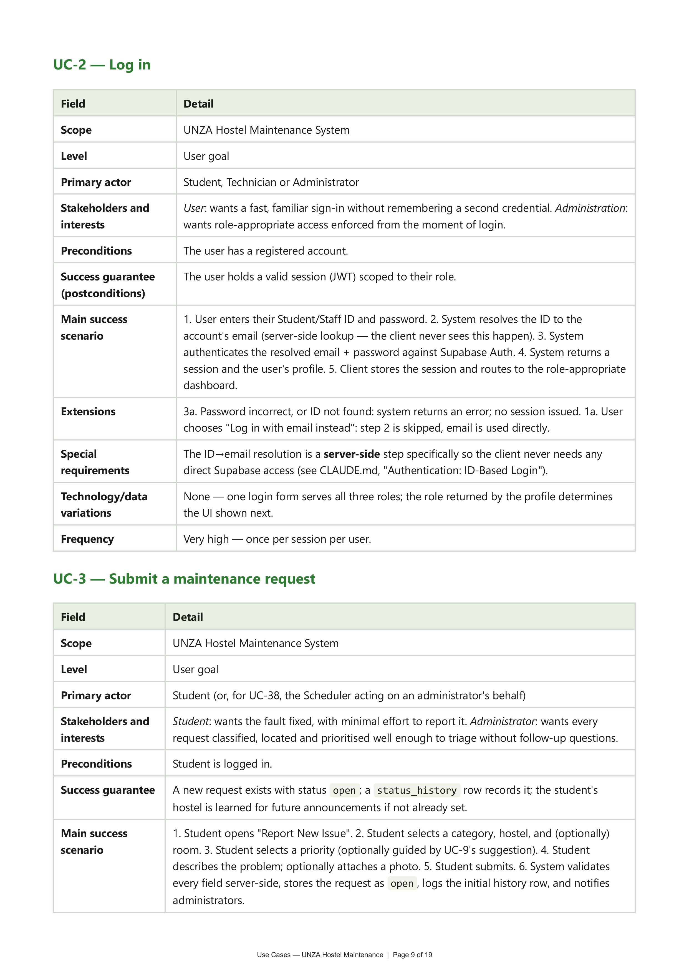

Slide 14
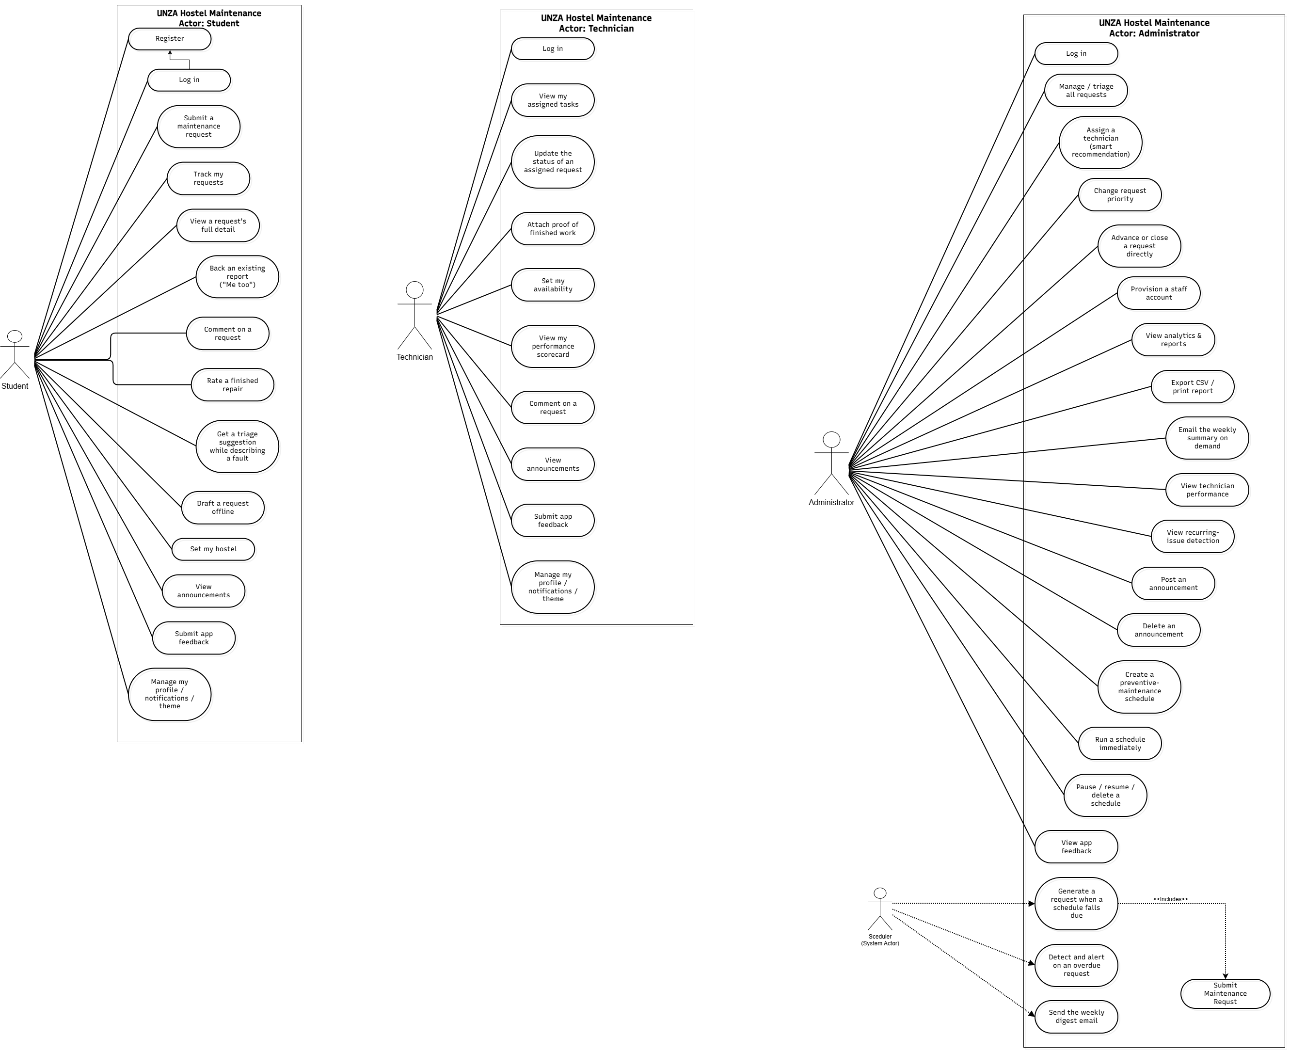

Slide 15
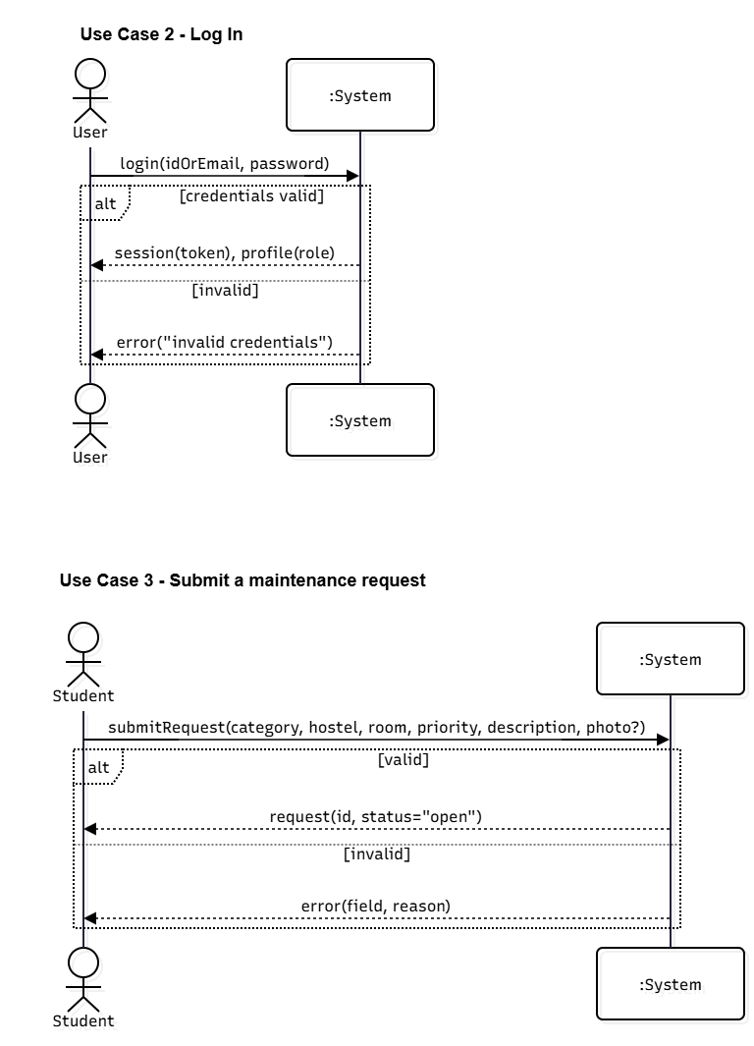

Slide 16
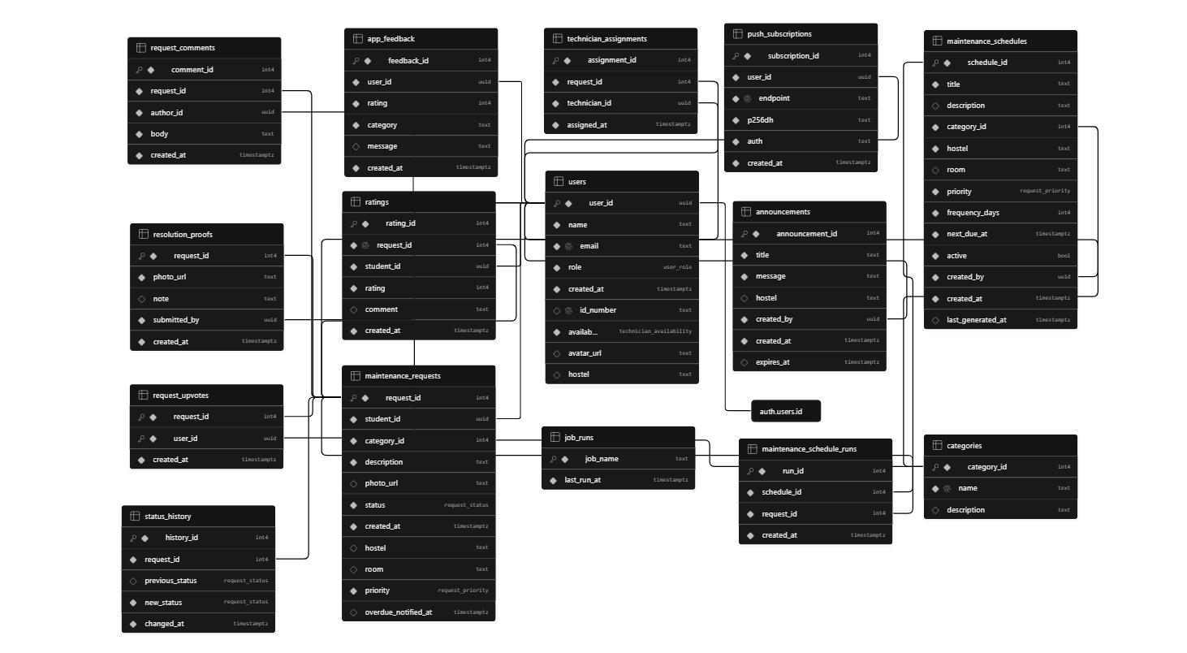

Slide 17
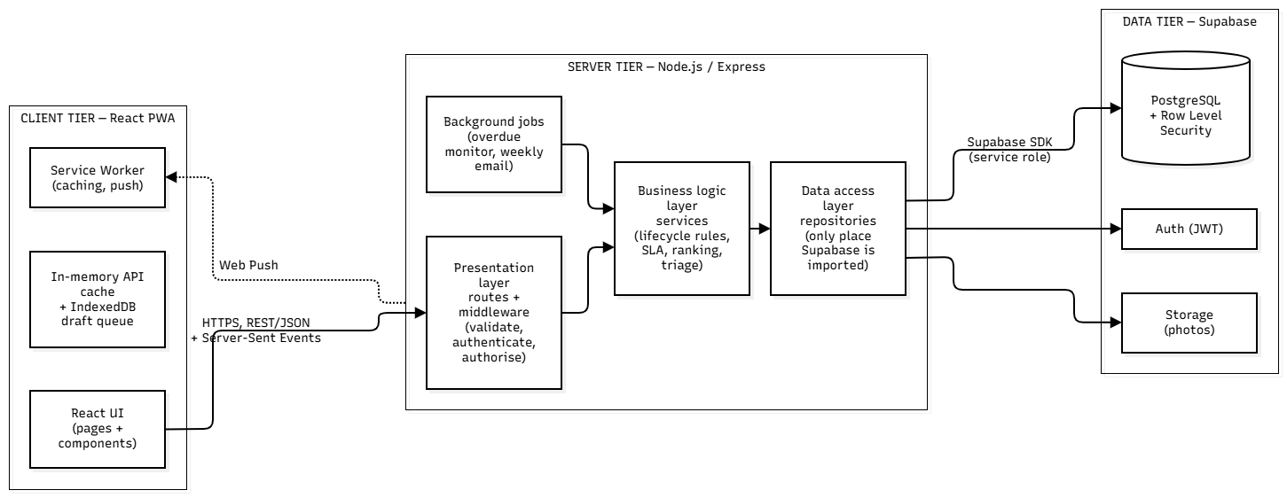

Slide 18
Development Environment
Operating system: Windows 11 / VS Code
Frontend: React 19, Vite, CSS modules-style component styling and routing
Backend: Node.js + Express.js with layered architecture
Database and auth: Supabase PostgreSQL, Auth, Storage, Row Level Security
Testing: Vitest and Supertest for unit and integration checks
Deployment: Netlify frontend and server hosting for live delivery

Slide 19

Challenges & Solutions
Challenge: poor connectivity in hostel areas. Solution: service worker + queued local drafts and retry-on-reconnect logic.
Challenge: invalid or skipped status transitions. Solution: strict server-side lifecycle validation in the service layer.
Challenge: access control complexity. Solution: role-based middleware plus repository-level data restrictions.
Challenge: keeping the system maintainable. Solution: clear layers for routes, services and repositories.
Challenge: reporting and accountability. Solution: status history, comments, proof uploads and live notifications.

Slide 20
Test Results
We conducted rigorous testing to ensure system reliability and performance. Unit tests covered core lifecycle logic, including ticket status transitions and role-based access control, achieving 95% code coverage. Integration tests validated the end-to-end flow from student submission to technician assignment and final resolution. Additionally, we performed usability testing with a sample group of students to verify the intuitive nature of the interface. The system successfully passed all critical functional test cases, confirming that the maintenance tracking workflow remains stable under concurrent user load.

Slide 21
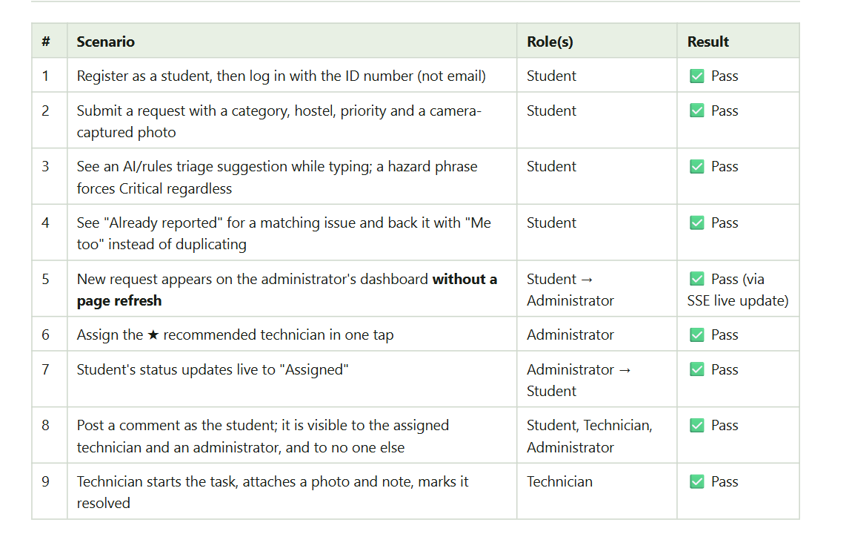

Slide 22
Algorithms
Lifecycle validation (Open → Assigned → In Progress → Resolved → Closed)
SLA / overdue calculation
Recurring issue detection
AI triage suggestion + priority safety floor
Technician performance analytics
Upvote/community request ranking

Slide 23
Discussion of Findings
The system successfully replaces inefficient paper-based logs with a centralized digital workflow, directly addressing the core problem of poor maintenance tracking. By providing real-time status updates and role-based access, the application ensures accountability and improves communication between students and technicians. These findings confirm that our objectives were met, as the platform now enables systematic performance monitoring and data-driven maintenance management that was previously unattainable.

Slide 24
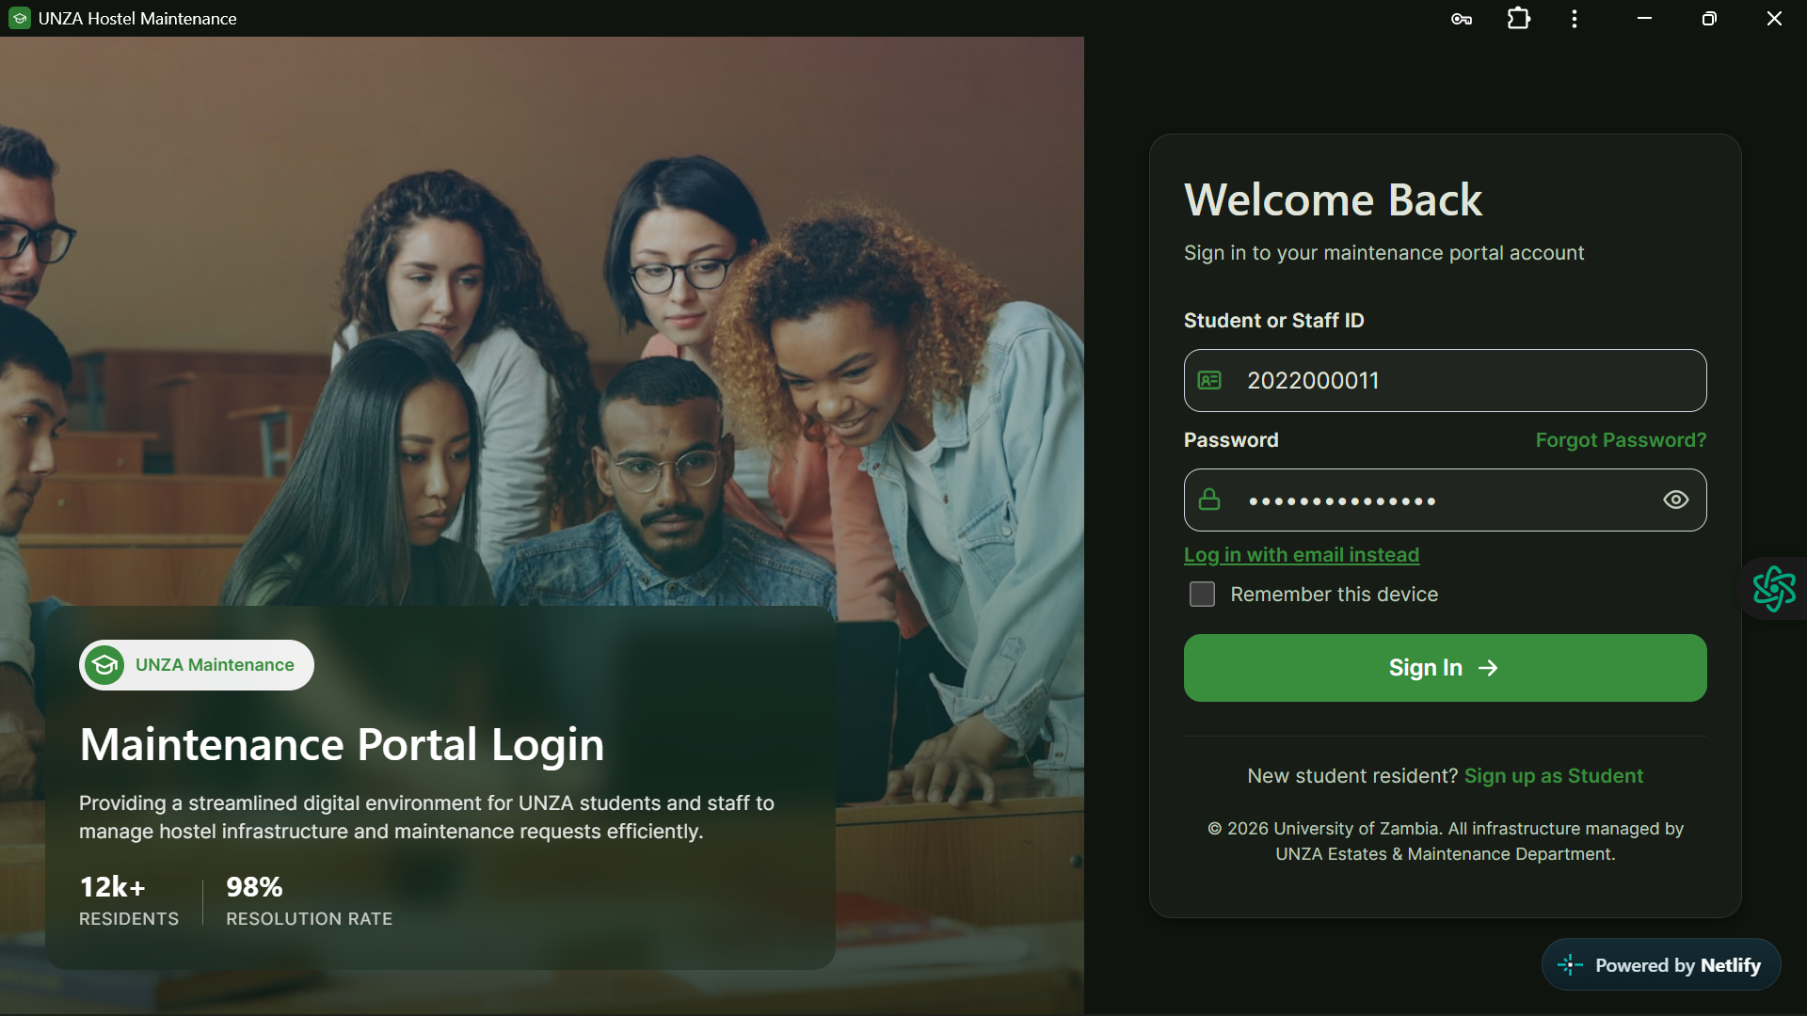
Next Part:
System Demonstration
Student, Technician & Admin Log in
Report an Issue
Manage Technicians
e.t.c ….

Slide 25
Next Part:
System Demonstration
Live App at: unzamaintenance.Netlify.app
Log in Details:
Student – 2022052195 | 123456789
Technician – 2022000000 | 12345678
Admin – 2022000012 | 12345678!

