Slide 1
TCD1103
ICG and SH settings

Slide 2
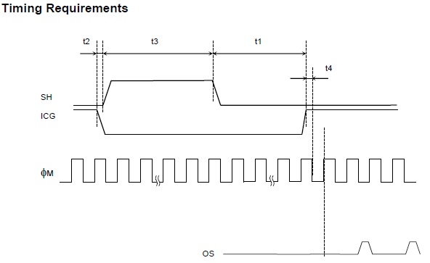
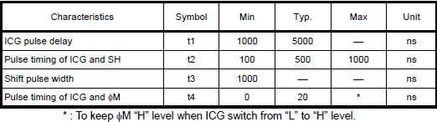
t2
t3
t1
With the HEX inverter, we will need the ICG and SH to be inverted

Slide 3
t2
t3
t1
Read out time (fixed and based on the ADC data rate)

Slide 4
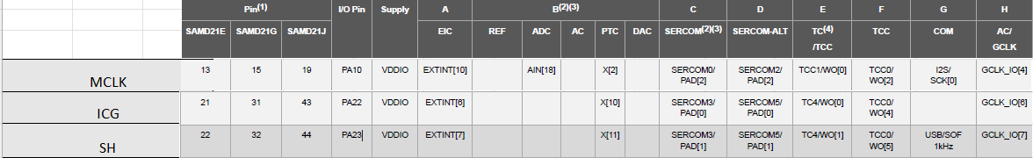
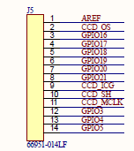
Master Clock (φM)
TCC1/WO[0] can be used for SH or we can use GCLK_IO[4]
Mux function “E” for ICG and MCLK and “F” for SH
Need to check synchronisation with TCC0 and TCC1.
NPWM to be used

Slide 5
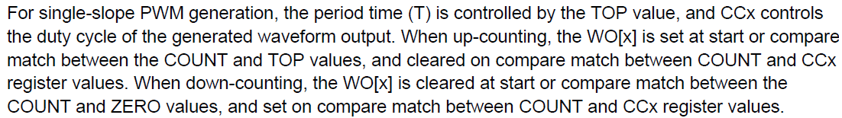
ICG mapped to TC4/WO[0]
t2
t3
t1
Read out time (fixed and based on the ADC data rate)
DIR = 1
Count == 0
Count == CC, Set
Count == 0, Clear
????
Count == 0, SET
Count == 0, SET
Pre-load a value in the counter say 1000 clocks more than CC
Pre-load value should be less than CC

Slide 6
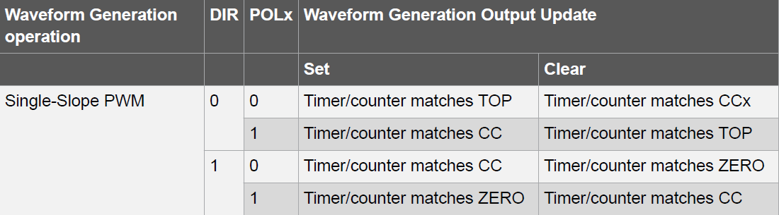
SH mapped to TCC0/WO[5]
t2
t3
t1
Read out time (fixed and based on the ADC data rate)
DIR = 0 and POLx = 1
Count == TOP, Clear
=301895-1000-24
Count == TOP, Clear
Count == CC, Set
Count == CC, Set
Pre-load a value in the counter to have synchronisation & delay with ICG (24 clocks more)
TOP= 301895 for 100 micro second integration time
24 clock cycles for 500ns delay between ICG and SH

