Slide 1
L-SIAMS
Local IoT-Based Multi-Layer Secured Attendance Monitoring System
with RFID and Biometric Authentication
ALPHA VERSION
Week 6 Prototype Presentation · [Group Leader], [Member 2], [Member 3], [Member 4], [Member 5] · Adviser: [Project Adviser]
Notes:
Good morning. We are presenting L-SIAMS, an attendance monitoring system that runs entirely on the school's own network. What you will see today is the Alpha Version — the full attendance path, working end to end.

Slide 2
OVERVIEW
A register that cannot be signed by the wrong person
1
Tap in, tap out
2
The teacher must be there
Students present an RFID card on a classroom terminal. Arrival and departure are separate facts, not one ambiguous word.
A register opens only when the teacher proves presence with a fingerprint on that terminal — and only for a class they are scheduled to teach.
3
The server decides
4
Nothing leaves the school
The terminal reports "this card was presented at this time". Whether that is an arrival, a departure or a refusal is decided server-side.
No cloud service, no external API, no internet dependency at runtime. One machine inside the building runs all of it.
Notes:
Four things define this system. Students tap in and out; the teacher must be physically present to open the register; the server, not the device, decides what a tap means; and none of it depends on the internet.

Slide 3
PROBLEM STATEMENT
What goes wrong with the registers schools keep now
Proxy attendance
A classmate answers for an absent student, or signs the sheet on their behalf. Nothing about a paper register can tell the difference.
!
No departure record
A student marked present at 8:00 may have left at 8:20. One word — "present" — hides it.
!
Records that can be edited afterwards
A spreadsheet register can be changed later by anyone who can open the file, and it will not show that it was changed.
!
Nothing is known until it is typed up
Absences reach an adviser days later, by which time the reason is gone.
!
Systems that stop when the internet does
A cloud attendance system in a school with intermittent connectivity fails exactly when the class is starting.
!
Notes:
These are the five failures we set out to remove. Each one maps to a specific design decision you will see in the next slides.

Slide 4
OBJECTIVES
What the system has to do to fix that
01
02
03
Bind attendance to a physical card
Require the teacher to be present
Record arrival and departure separately
A record cannot be created without the card being present at the terminal.
A fingerprint on the classroom terminal is the only thing that opens a register.
Seven distinct final statuses, so "late and left early" is not flattened.
04
05
06
Make the record permanent
Show it as it happens
Keep working without the internet
Attendance and logs cannot be deleted or re-attributed, at three independent layers.
Live updates to the administrator and the adviser, not a next-day summary.
Every part of the system runs on the school LAN, including the queue for a terminal that loses its link.
Notes:
Six objectives. Each of the five problems on the previous slide is answered by at least one of these.

Slide 5
SYSTEM ARCHITECTURE
Four layers, all of them inside the school
CLASSROOM TERMINALS
Reports what happened. Decides nothing.
ESP32 · MFRC522 RFID reader · AS608 fingerprint sensor
SCHOOL NETWORK
A stolen key is useless from the wrong subnet.
Wi-Fi LAN · per-request HMAC-SHA256 signing · CIDR allowlist
APPLICATION SERVER
Decides every tap. Holds every rule.
PHP 8.1+ · 35 services · 13 middleware · realtime WebSocket server
DATABASE
The last word on what is true.
MariaDB 10.6+ · 60 tables · 13 triggers · invariants as UNIQUE keys
No Composer packages. The XLSX writer, the PDF writer, the WebSocket server and the autoloader are all in the repository — the target network may have no route to the internet at all.
Notes:
Four layers. Note the division of responsibility: the terminal reports, the server decides, the database has the last word. That is what makes a tampered terminal harmless.

Slide 6
SYSTEM ARCHITECTURE
What happens between the card and the record
1
Card presented
2
Request signed
3
Ten checks
Terminal reads the UID and takes a timestamp at the moment of the tap.
HMAC-SHA256 over method, path, device id, timestamp, nonce and body hash.
Source address, rate limit, key, device state, allowlist, timestamp, nonce, signature, idempotency.
4
Intent resolved
5
Written once
6
Pushed live
Server decides: time in, time out, or refusal — from session state and schedule windows.
A UNIQUE key over generated columns makes a duplicate row impossible, even under a race.
The event reaches every open screen through the realtime server, with sequence replay.
Measured on the Alpha Version: 6.5 ms median, 7.7 ms at the 95th percentile, against an 800 ms budget.
Notes:
Six stages. Stage three is where a forged or replayed request dies; stage five is where a double-record becomes impossible.

Slide 7
DATABASE DESIGN
The schema is the specification
60
13
19
7
tables
triggers
migrations
final statuses
Invariants live in the schema, not in application checks
One open session per classroom
A second register cannot be opened in a room that already has one.
One active card per student
A reissued card deactivates the old one in the same statement.
One attendance row per student per session
Enforced by a UNIQUE key over generated columns — a check-then-insert in code would lose the race.
Attendance identity is immutable
A trigger rejects any update that changes the student, session, subject, teacher, room or card. Times and statuses can be corrected; a row can never become somebody else's.
Notes:
The database enforces the rules that matter, rather than trusting the application to remember them. Under fifty simultaneous taps, a UNIQUE key holds where a PHP check would not.

Slide 8
SYSTEM FEATURES
Attendance and session control
Session opens on a fingerprint
Separate arrival and departure
Nothing else opens one — no password, no button, no administrator action on the web side. A password failover exists only when the reader cannot read a teacher, and it is recorded as such.
Present, late, left early, incomplete, absent, excused and auto-closed — seven distinct final statuses.
Minimum stay enforced
Automatic close
A student who taps out immediately after arriving is refused, with the remaining time shown on the terminal.
A register left open by a terminal that lost power is closed by the maintenance worker; absences and auto time-outs resolve on close.
Offline tolerant by design
Context frozen on the record
Every tap carries its own timestamp and an idempotency key, so a replayed queue can never double-record.
Section, subject, teacher and room are copied onto each row, so a student who transfers in January does not have their October attendance rewritten.
Notes:
The session rules are the heart of the system. The one to emphasise is the first: a register cannot exist without the teacher physically present.

Slide 9
SECURITY MODEL
Each layer assumes the one above it failed
DEVICE
HUMAN
Per-request HMAC-SHA256. Ten checks before any attendance logic runs: source address, rate limit, key, device state, IP allowlist, timestamp within ±30 s, nonce, signature, idempotency.
bcrypt at cost 12, twelve-character minimum, forced change of any shared password, server-side idle timeout that background traffic cannot extend.
RECORD
NETWORK
Immutable three times over: no service method writes twice, database triggers raise SQLSTATE 45000, and the application user holds no privilege to change a log.
The web interface and the device API are each restricted to their own CIDR range. A stolen device key is useless from the wrong subnet.
Verified, not asserted: a forged signature, a stale timestamp and an unregistered card were each refused by the running system during Week 5 testing.
Notes:
Four layers, each assuming the one above it has already failed. Every claim on this slide was tested against the running system, not inferred from the code.

Slide 10
SYSTEM FEATURES
Reporting, live updates and administration
15 report types × 3 formats
Live, with a fallback that always works
Daily, weekly and monthly attendance · per student · per teacher · per subject · section sheets, summaries and comparisons · adviser reports · roster with RFID status · chronic absence · device uptime · audit log · security log.
WebSocket first, then Server-Sent Events, then long polling — whichever the network allows. Every event carries a sequence number, so a screen that reconnects replays exactly what it missed and nothing twice.
Exported as PDF, Excel or CSV — every writer built in this repository.
Verified: sequences strictly monotonic, replay returns exactly the missed events.
Twenty administration modules
Students
Teachers
User accounts
Departments
Grade levels
Sections
Subjects
Classrooms
Schedules
RFID cards
Fingerprints
IoT devices
Attendance
Sessions
Analytics
Reports
Security centre
Audit logs
Settings
Backup & restore
Notes:
Fifteen report types, three export formats, and twenty administration modules — all of which returned live data during Week 5 testing.

Slide 11
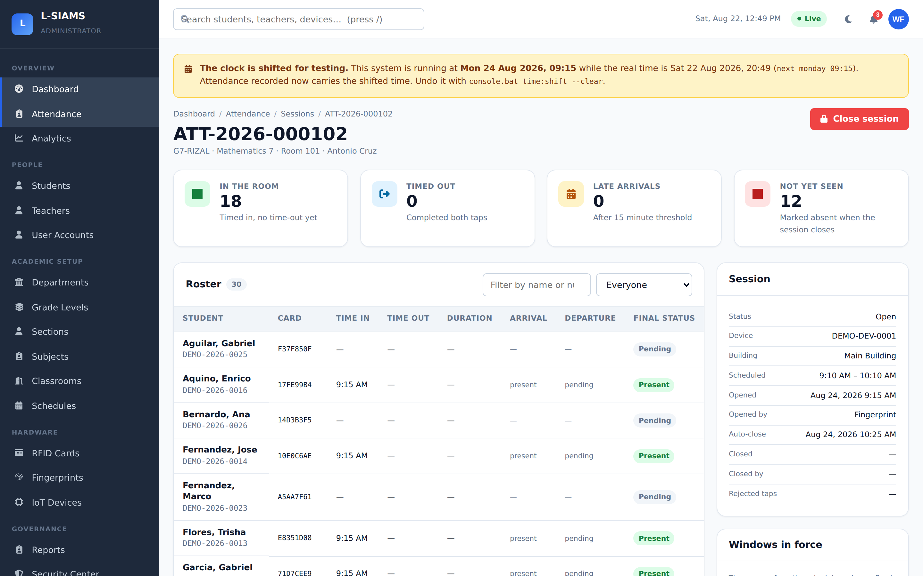
PROTOTYPE
The Alpha Version, running
Session ATT-2026-000102
Opened by fingerprint — the panel records how, not just who.
18 in the room
Live count, updating as each card is presented.
12 not yet seen
Marked absent automatically when the session closes.
Live
The realtime pill: this screen is on a WebSocket, not a refresh timer.
Notes:
This is a real capture from the running Alpha Version during Week 5 testing — a live session with eighteen students recorded.

Slide 12
DEMONSTRATION
What we will show you, in eight minutes
1
2
3
4
Sign in
Show the schedule
Teacher's fingerprint
Students tap
Dashboard with live counts
Terminal bound to Room 101, window open
Register opens — teacher, subject, section named
Rows appear live on the session screen
5
6
7
8
Tap again at once
Unregistered card
Close the session
Generate a report
Refused: TOO EARLY TO EXIT — 0/20 min
Refused: UNKNOWN CARD, and logged
Absences resolved; roster fully accounted for
PDF downloads, built without any library
Notes:
Eight steps. Steps five and six are the ones worth watching — they show that the server, not the terminal, is deciding.

Slide 13
INTEGRATION TESTING
Every claim in this deck was run, not read
44 / 44
45 / 45
20 / 20
7.7 ms
automated cases pass
report exports valid
admin modules live
tap latency (p95)
Automated suite
Runs against a real MariaDB server, not a mock — the guarantees under test belong to the database.
Device API over HTTP
Driven with genuinely HMAC-signed requests: claim, clock sync, heartbeat, sync, and start / tap / end.
Every screen fetched
All 20 administrator modules and all 45 report exports pulled from the running server.
Notes:
Three independent kinds of checking, and all three had to agree before anything was marked Pass. The suite alone is forty-four cases across eleven groups.

Slide 14
INTEGRATION TESTING
Seven defects found. All seven fixed.
Three of them would have been visible during this presentation.
High
No teacher could open a session on demonstration data
The seeder wrote fingerprint templates but never bound them to a sensor. The demo would have stopped at step three.
High
A terminal with a drifted clock had no way back
The documented cure sat behind the very check that was failing, and the 401 discarded the server clock it carried.
High
The diagnostic command died on a hardened deployment
It required rights the deployment guide deliberately withholds — so it failed exactly when it was needed.
Medium
The security log could be silently rewritten
It had a delete trigger but no update trigger. "Immutable three times over" held only for the audit log.
Medium
The documented database hardening could not be applied
Its REVOKE statements fail with error 1147 — leaving an administrator believing a layer was in place when it was not.
Medium
The shipped schema file was four migrations behind
A phpMyAdmin install got a database missing a whole table.
Low
The documented way to run one test group did nothing
The flag in the README is not the flag the runner parses.
Notes:
We are showing the defects rather than hiding them. Finding these is what Week 5 was for — the seeder defect alone would have stopped this demonstration at its first step.

Slide 15
REMAINING WORK
What is left before deployment
Offline queue in the shipping firmware
The server side is complete and tested. The terminal sketch still needs it before a power cut can be survived without losing taps.
Before Week 6
A rehearsal on the physical hardware
Every result in this deck was produced against the server. The ESP32 path needs its own dry run.
Before Week 6
TLS for the realtime server
It runs plaintext on the bench. Attendance events should not cross a school network in the clear.
Before deployment
A regression test for the fingerprint binding
The seeder defect was invisible to the existing suite. It should not be able to return unnoticed.
Before Week 6
A full run on the presentation machine
Confirms the environment the demonstration will actually run on.
Day before
Notes:
Five items. Four are before Week 6; TLS is a deployment concern rather than a demonstration one.

Slide 16
STATUS
Where the project stands
Complete
In progress
Before deployment
Database, schema and invariants
Authentication and the security chain
Academic structure and scheduling
Students, cards and fingerprints
Device registry and provisioning
Attendance engine and status resolver
Device API
Realtime server
Reporting and export
Web interfaces
Maintenance worker
ESP32 terminal firmware — offline replay queue
Hardware rehearsal on the physical terminals
TLS certificate for the realtime server
Regression test for fingerprint binding
Full suite run on the presentation machine
Notes:
Eleven of thirteen module groups are complete. The two that are not are both on the terminal side, and both are scheduled before Week 6.

Slide 17
The Alpha Version works end to end
A teacher opens a register with their fingerprint. Students tap in and out. The server decides every tap, the record is written once, and it can never be re-attributed. Fifteen kinds of report come out the other end — and none of it needs the internet.
44/44
7
0
tests pass
defects fixed
critical open
Questions
Notes:
To close: the Alpha Version carries the whole attendance path, forty-four of forty-four tests pass, seven defects were found and fixed, and nothing critical is open. We are ready for questions.

