Slide 1
L-SIAMS
A Local IoT-Based Multi-Layer Secured Attendance Monitoring System
with RFID and Biometric Authentication
PROTOTYPE DEFENSE
Ched Nikko P. Pangilinan · Joshkirby Tyler M. Bote · Naph Yvan P. Villamar
BS Information Technology · Isabela State University – Echague Campus
L-SIAMS · Prototype Defense
1
Notes:
Good morning. We are presenting L-SIAMS, a classroom attendance system built for a school LAN, with network security as its focus. The system is built and running; the school evaluation has not yet been conducted, and we will be clear about that boundary throughout.

Slide 2
Attendance at TAPS today
One RFID terminal at the gate — and manual roll call in every classroom
300–500
20–30
5–10 min
0
students tapping
daily
students queued
at peak
lost to roll call
per 40-min class
classroom-level
validation
The gate terminal tells parents a child entered the campus. It cannot say whether that child was in the room when the lesson began — so students bypass it, and teachers still call the roll by hand.
L-SIAMS · Prototype Defense
2
Notes:
These are the observed numbers from the partner school. The key point is the last one: the existing system monitors entry to the campus, not presence in the classroom. That gap is what the study addresses.

Slide 3
And nothing protects the data
The current setup transmits attendance with none of these controls in place
✕
No encrypted transport
✕
No device authentication
Attendance data crosses the network in the clear and can be read by anyone on it.
Any device that can reach the server can claim to be a classroom terminal.
✕
No access control
✕
No audit trail
Nothing distinguishes who may read or change an attendance record.
A record can be altered with no evidence that it ever changed.
Our major is network security. These four gaps define the work.
L-SIAMS · Prototype Defense
3
Notes:
We framed the problem as a security problem, not only an efficiency one. Each of these four gaps maps to a control we implemented, and we will show each one running later in the deck.

Slide 4
What we set out to do
Three objectives are realised in the prototype; the fourth is the evaluation ahead
1
Build the IoT capture device
BUILT
RFID tap at the classroom door, fingerprint verification of the teacher before a session opens.
2
Build the locally hosted system
BUILT
Registration, central database, dashboards and reports — all on the school’s own server.
3
Implement the security mechanisms
BUILT
Encrypted transport, device authentication, access control, network control, audit logging.
4
Evaluate and validate
PENDING
Timing and accuracy against manual roll call, controlled security testing, SUS/TAM with 41 participants.
L-SIAMS · Prototype Defense
4
Notes:
We want to be explicit with the panel: objectives one to three are done and we will demonstrate them. Objective four is the evaluation, which happens on deployment at the school. Nothing in this deck presents evaluation results, because we do not have them yet.

Slide 5
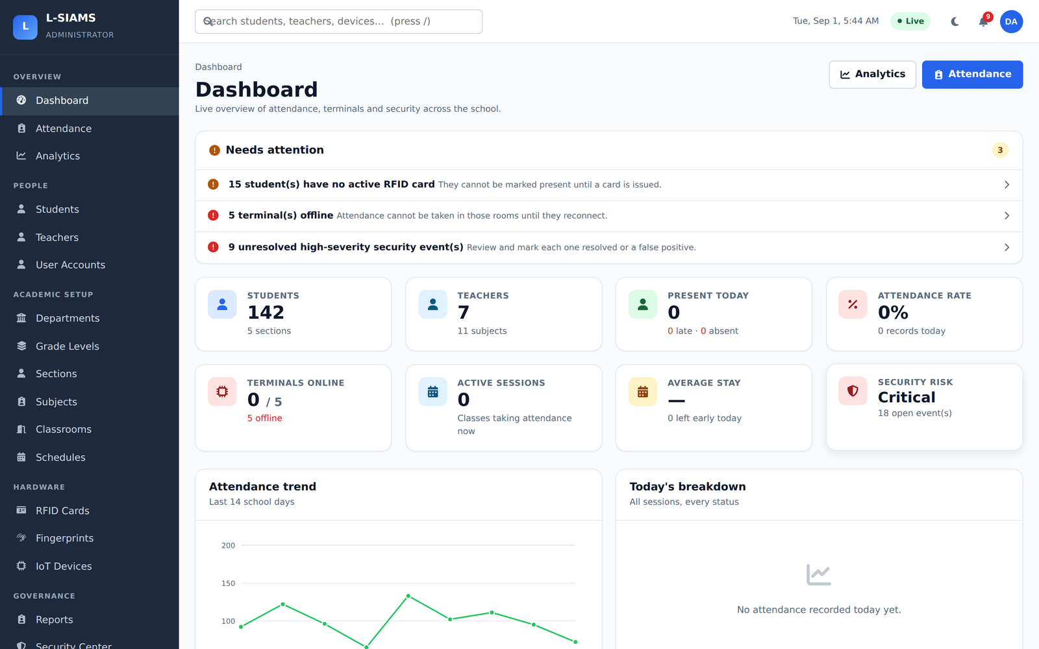
What we built
A complete system running entirely inside the school — no cloud, no internet dependency
Classroom terminals capture tap-in and tap-out; the server decides intent, not the device
A session opens only when an assigned teacher verifies a fingerprint on that terminal
Separate arrival, departure and final statuses — “late and left early” is not flattened
15 report types exported to PDF, Excel and CSV with no third-party library
Live monitoring over WebSocket, with automatic fallbacks and gap-free replay
No Composer packages. The autoloader, report writers, WebSocket server and chart renderer are all written in-project, because the target network may have no route to the internet — which also removes the third-party supply chain as an attack surface.
Administrator dashboard — live system, seeded data
L-SIAMS · Prototype Defense
5
Notes:
This is the running system, not a mock-up. Every screenshot in this deck was captured from the application against a populated database.

Slide 6
A six-layer architecture
Each layer carries its own control, so no single failure grants access to attendance data
Device
RFID reader, fingerprint sensor, ESP32
Signed requests, per-device credentials
Network
The school LAN
Address-range control, firewall, port restriction
Transport
Terminal ↔ server link
HTTPS/TLS from an internal certificate authority
Application
Attendance and session logic
RBAC, CSRF, session binding, rate limiting
Database
Records and credentials
bcrypt hashes, encrypted secrets, append-only history
Monitoring
Accountability
Audit log plus 33 security event types
L-SIAMS · Prototype Defense
6
Notes:
This is the defence-in-depth structure. Read down the right-hand column: each layer contributes an independent control. If one is defeated, the others still stand.

Slide 7
How a class is taken
The teacher proves presence first — no session, no attendance
1
2
3
4
5
Teacher verifies
›
Session opens
›
Students tap
›
Server decides
›
Recorded & logged
Fingerprint on the room’s own terminal, checked against the schedule.
Only for a class that teacher is actually scheduled to teach, in that room.
Each RFID tap is signed, timestamped and bound to the open session.
Arrival or departure, on time or late — the terminal never decides status.
Written to the attendance history and mirrored to the audit trail.
If the fingerprint reader cannot read a legitimate teacher, they may open the session with their own password instead — and that override is recorded as a security event, never silently.
L-SIAMS · Prototype Defense
7
Notes:
The failover matters. A panel will ask what happens when the sensor fails. The answer is that the class still runs, but the bypass is logged and an administrator can see how often it is used and by whom.

Slide 8
The classroom terminal
ESP32 with RFID reader and optical fingerprint sensor, mounted at the door
COMPONENTS
ESP32
Wi-Fi microcontroller
INSERT PHOTOGRAPH
INSERT PHOTOGRAPH
MFRC522
Assembled terminal — front view
Internals: ESP32, MFRC522, fingerprint sensor
RFID reader, 13.56 MHz
AS608 / R307
Optical fingerprint sensor
No display
Server decides and responds
40 taps are held in the terminal’s memory when the server is unreachable, and replayed with their original timestamps once the link returns.
L-SIAMS · Prototype Defense
8
Notes:
Replace the two dashed boxes with your own photographs of the assembled unit before the defense.

Slide 9
Every terminal request passes six checks
Fail any one and the request is refused — and written to the security log
1
2
3
4
5
6
Registered device?
Valid API key?
Valid signature?
Timestamp within ±30s?
Nonce never used?
Bound to this room?
DEVICE_UNKNOWN
API_KEY_INVALID
SIGNATURE_INVALID
TIMESTAMP_EXPIRED
REPLAY_DETECTED
DEVICE_CLASSROOM_MISMATCH
The code returned to the caller is deliberately coarse, so a rejected request never reveals which check failed. The precise reason goes only to the administrator’s log.
Steps 3, 4 and 5 are what defeat a replayed or forged request — this is the core of our contribution.
L-SIAMS · Prototype Defense
9
Notes:
This is the slide to spend time on. Walk left to right. Emphasise that steps three to five are what a key-only scheme cannot do: proving possession of a secret, bounding the reuse window, and making each request single-use.

Slide 10
Why a key alone is not authentication
A key proves you have seen a value; a signature proves you hold a secret
API key only
Key + signed request (implemented)
The key travels with every request
Anyone who observes one can reuse it
A captured request replays forever
Nothing detects a modified request body
The secret never travels — only a signature over the request
A captured request is valid for 30 seconds at most
Each nonce is accepted exactly once, so replay fails
Any change to the body invalidates the signature
The manuscript originally described device authentication as API keys. What we actually built is stronger, and we corrected the manuscript to match the system.
L-SIAMS · Prototype Defense
10
Notes:
If asked why the manuscript and the system differed: we implemented signing during development because keys alone did not meet the threat model, and we have now aligned the document to the build.

Slide 11
Controls at every layer
What actually runs, layer by layer
Network
Transport
Application
Integrity
Address-range allowlist checked before authentication
Separate ranges for staff browsers and terminals
Refusals logged even with valid credentials
HTTPS/TLS on the LAN
Internal certificate authority; root key encrypted at rest
Root certificate compiled into the firmware
Role-based access control per route
bcrypt cost 12; 12-char policy with blocklist
Sessions bound to browser and network prefix
Idempotency keys stop duplicate records
Append-only attendance and audit history
Parameterised queries throughout
Automatic revocation: a device credential is withdrawn on repeated signature failures, or when the same key appears from several addresses within an hour.
L-SIAMS · Prototype Defense
11
Notes:
The automatic revocation line is worth saying aloud — it shows the system responds to compromise rather than only recording it.

Slide 12
Thirty-three things the system watches
Every one carries a severity, a source address, and a resolution state
11
Device & request auth
3
Network access
5
Account & session
Unknown or blocked device, invalid or expired key, bad signature, expired timestamp, replay
Address not allowlisted, blocked IP attempt, rate limit exceeded
Failed login, account locked, suspected session hijack, permission violation
4
Application attacks
4
Biometric integrity
6
Attendance integrity
CSRF failure, SQL injection attempt, XSS attempt, malicious upload
Override used, override refused, failure threshold, cross-device slot
Unknown card, wrong classroom, repeated section mismatch, blocked assignment
L-SIAMS · Prototype Defense
12
Notes:
This slide is the evidence that multi-layer security in our title is real and not a claim. Each of these is a defined event type that the running system records.

Slide 13
STRIDE — threat to control
Every category answered by something that runs in the system
Spoofing
Fingerprint verification; signed requests; terminal address ranges
Tampering
Signature over request content; parameterised queries; append-only history
Repudiation
Audit log; security log with severity and resolution; recorded overrides
Information disclosure
TLS from an internal CA; RBAC; encrypted device secrets; bcrypt hashes
Denial of service
Firewall and address ranges; per-terminal rate limiting; offline capture
Elevation of privilege
Per-route permission checks; session binding; automatic key revocation
L-SIAMS · Prototype Defense
13
Notes:
If the panel asks about threat modelling, this is the answer. We used STRIDE and every row names a control that exists, not one we intend to add.

Slide 14
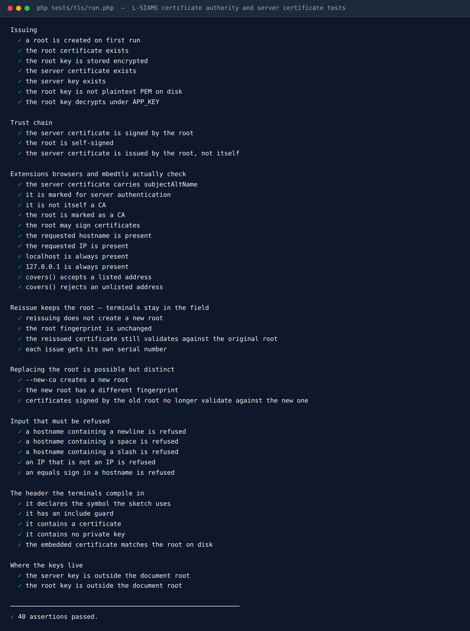
We run our own certificate authority
A school LAN with no internet cannot get certificates from a public CA
The system issues its own root and server certificates
The root private key is stored encrypted at rest
The root certificate is compiled into the firmware, so each terminal validates the server it connects to
Reissuing the server certificate preserves the root — terminals in classrooms keep working without reflashing
This is the one piece of security testing already done. Wireshark, Nmap and Metasploit testing comes in the evaluation phase.
40
assertions passed
Automated certificate test suite, executed against the running system
L-SIAMS · Prototype Defense
14
Notes:
Be precise here: this is development-time verification of the TLS setup, not the full security evaluation. Saying so protects you if the panel asks what has actually been tested.

Slide 15
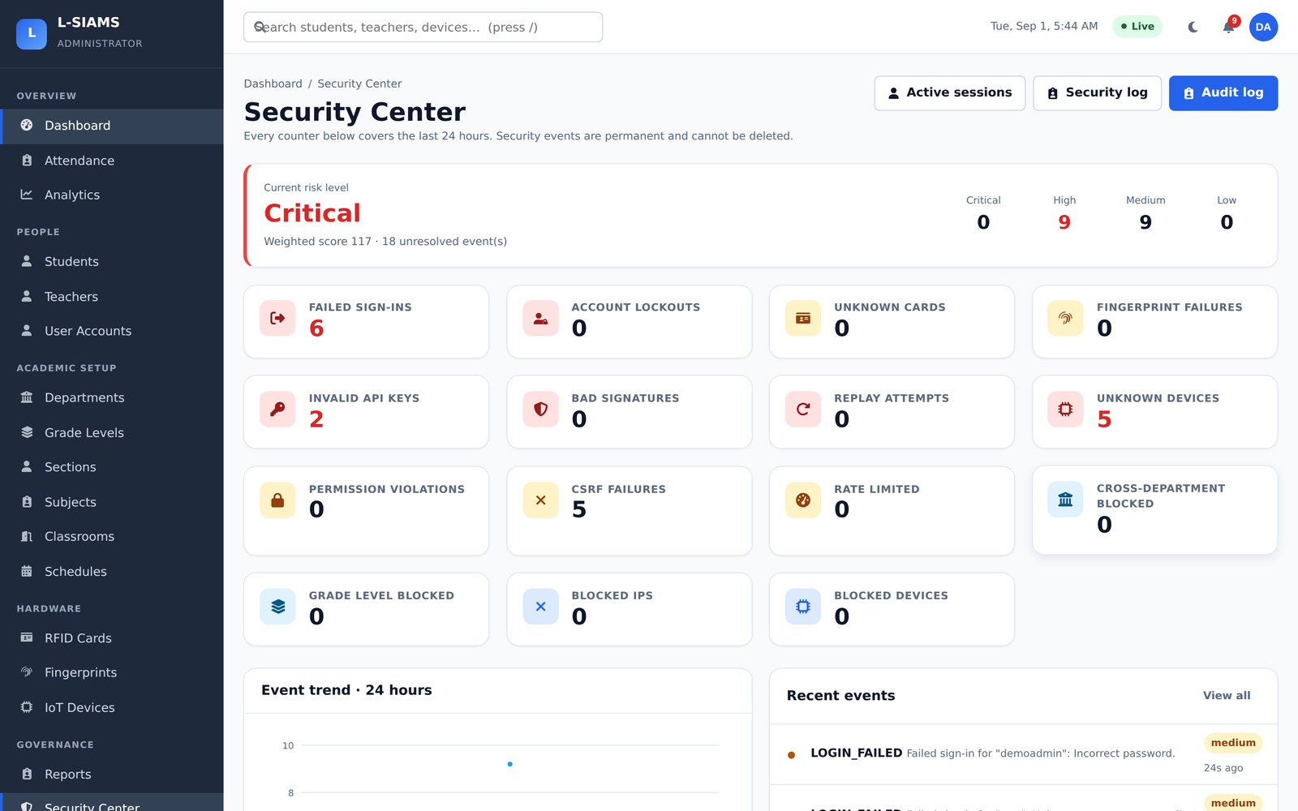
The security centre
Current posture at a glance — failed sign-ins, unknown cards, bad signatures, rate limits
15
Notes:
This is the screen an IT administrator lives in. Everything on it is produced by the controls described earlier.

Slide 16
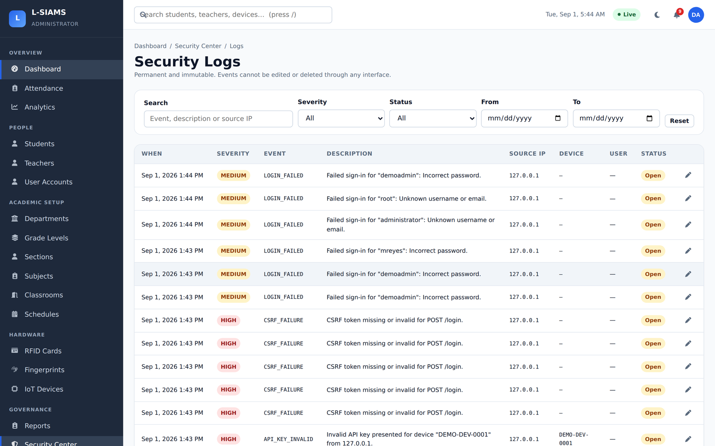
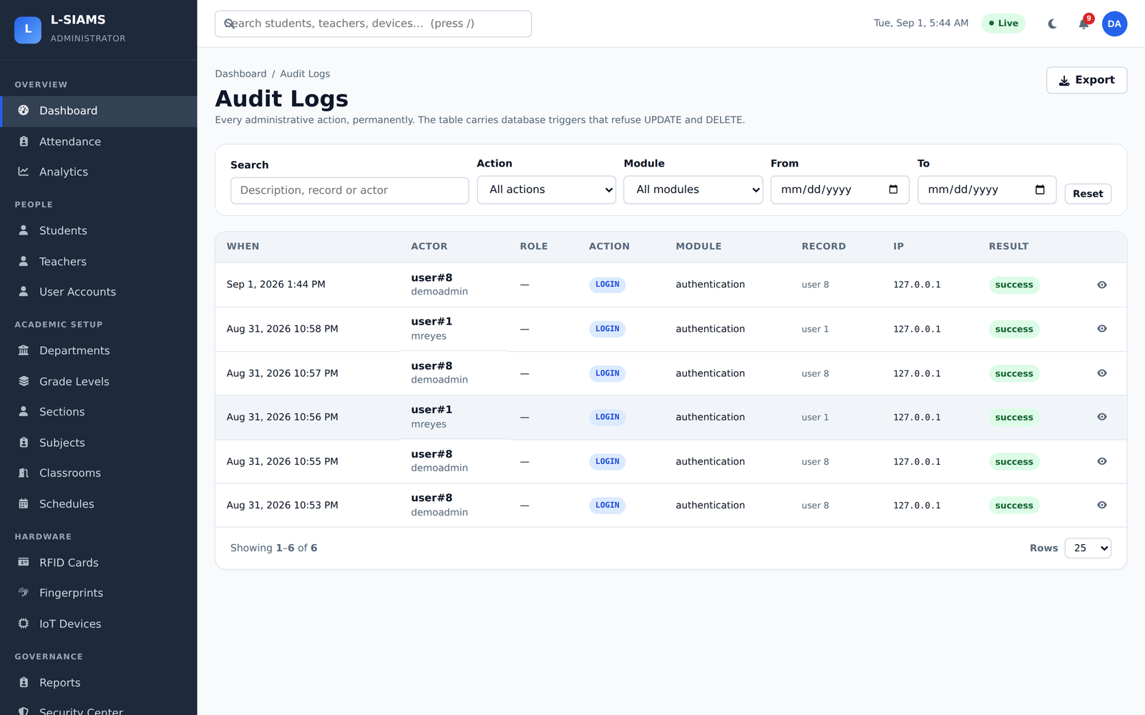
Monitoring and accountability
Two separate records: security events, and the ordinary audit trail
Security event log — severity and resolution state
Audit trail — who did what, and when
L-SIAMS · Prototype Defense
16
Notes:
Point out that these are deliberately separate. The audit log is for accountability; the security log is for investigation and has a resolution workflow.

Slide 17
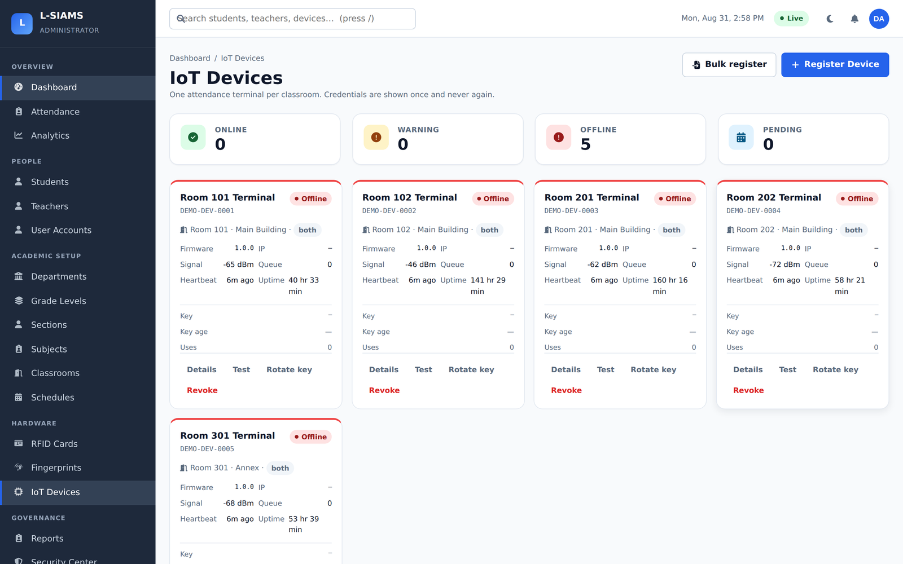
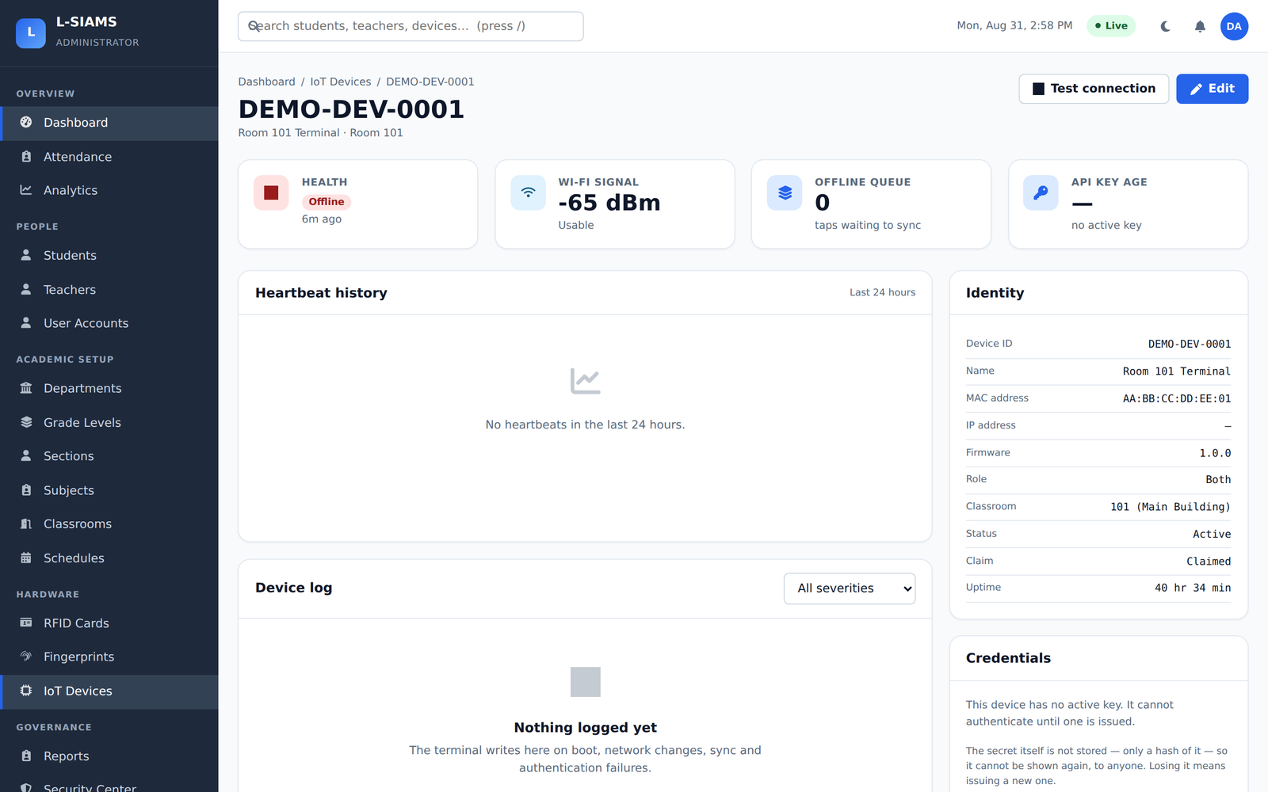
Terminals and their credentials
Registration, connection state, and per-device credential management
Registered terminal registry
Terminal detail — credential issue and rotation
L-SIAMS · Prototype Defense
17
Notes:
Only a registered terminal can transmit. From the detail view we issue, rotate and revoke a terminal’s credentials.

Slide 18
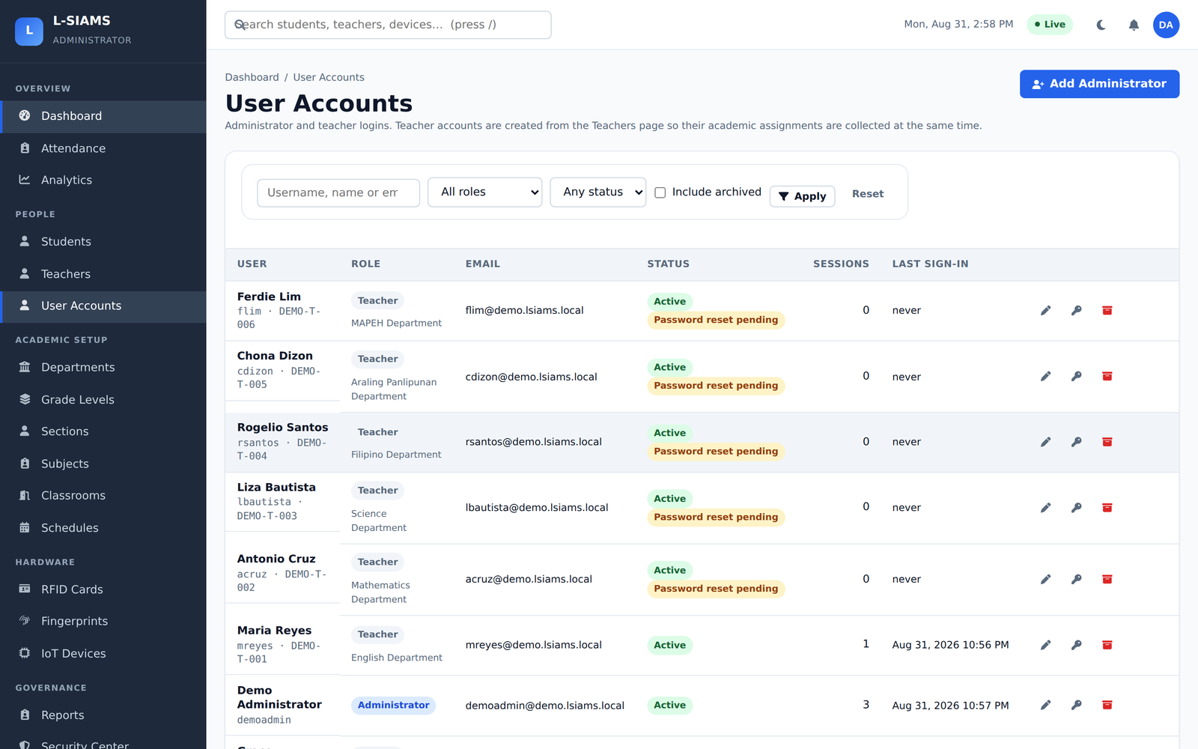
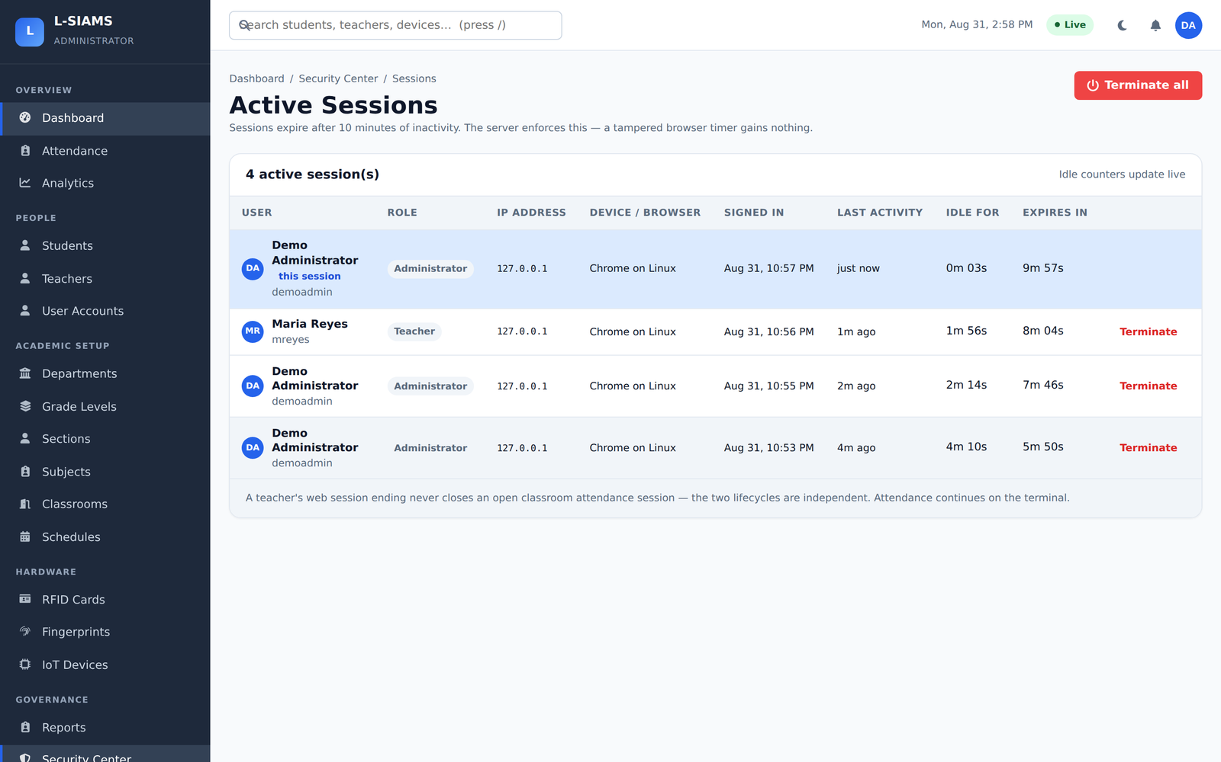
Access control in practice
Roles decide what a user reaches; sessions can be revoked on sight
Accounts bound to roles
Active sessions, terminable individually or in bulk
L-SIAMS · Prototype Defense
18
Notes:
The session termination screen is our direct response capability if an account is believed compromised.

Slide 19
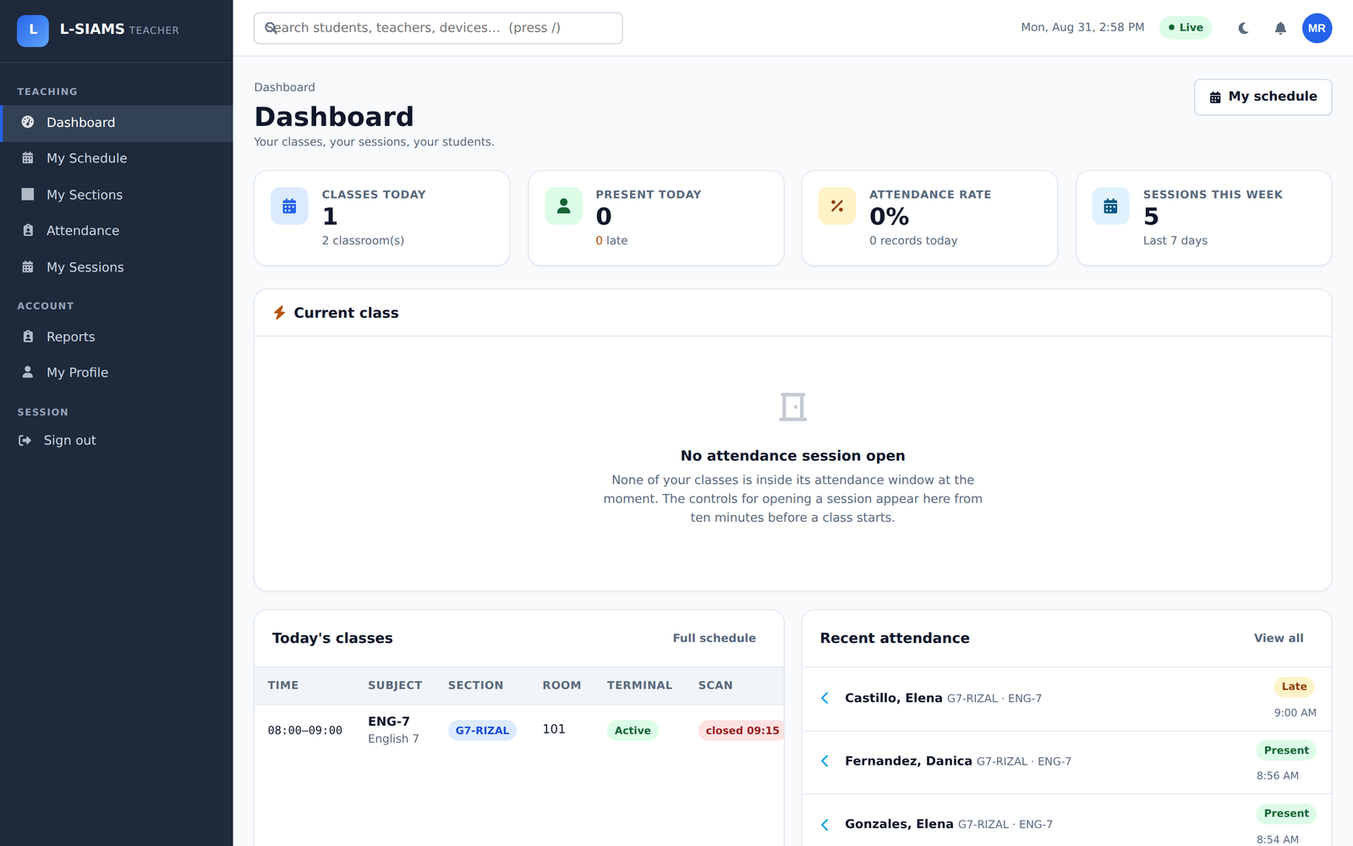
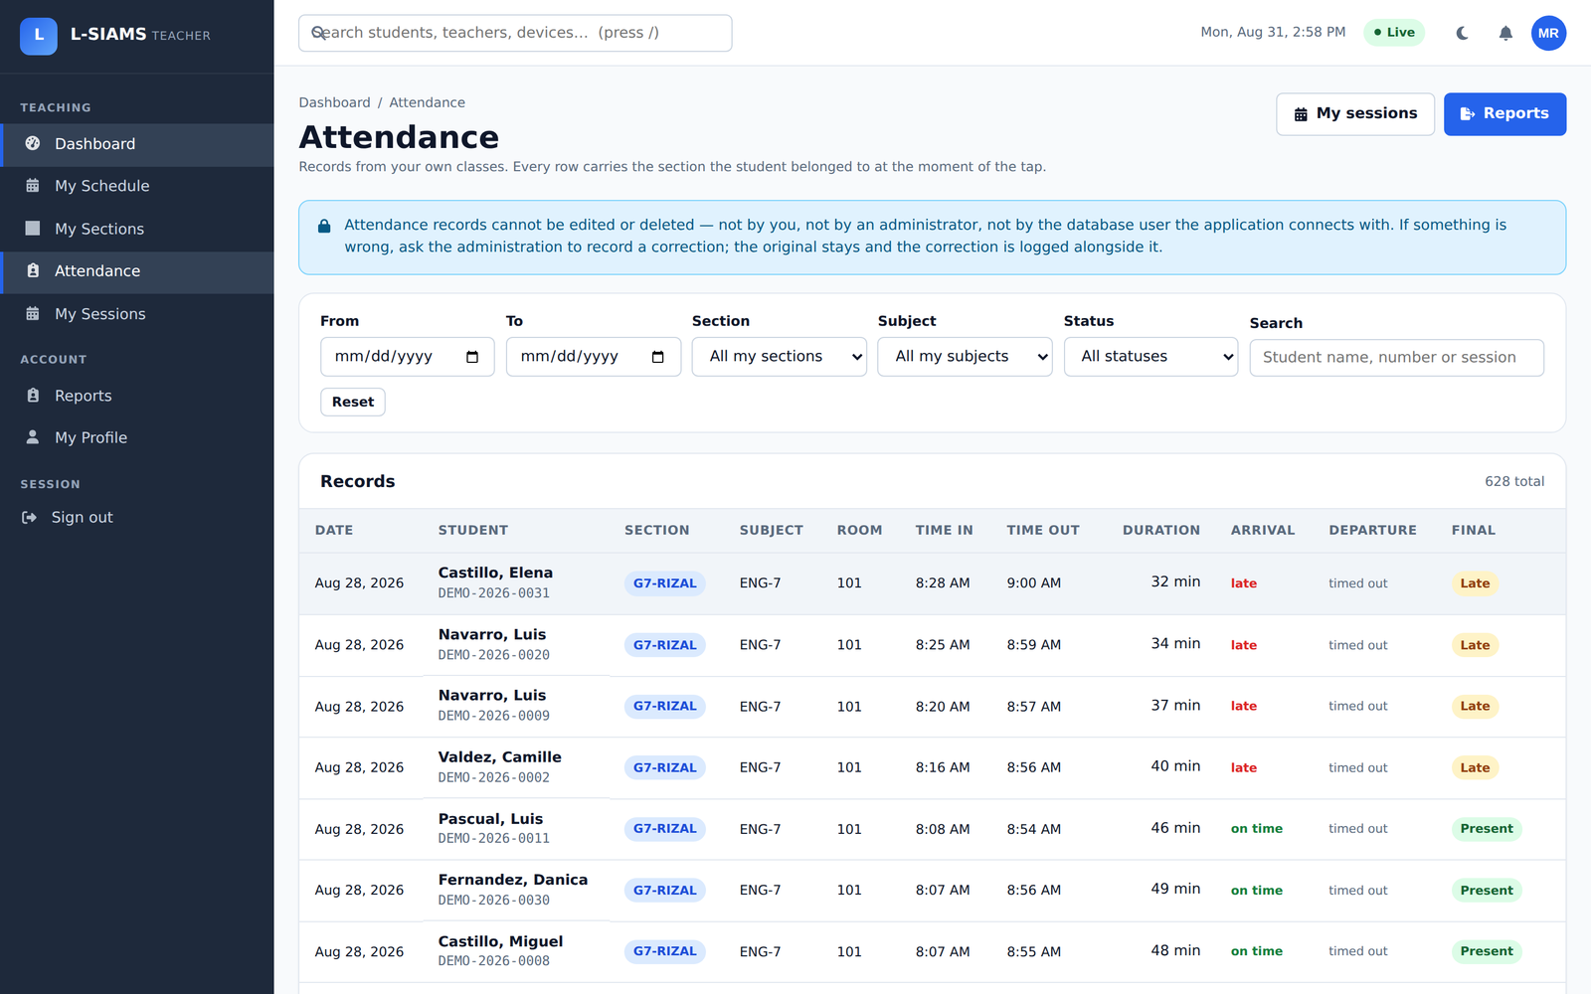
The teacher’s view
Restricted by role to the classes that teacher is actually scheduled to teach
Teacher dashboard
Attendance for the open session
L-SIAMS · Prototype Defense
19
Notes:
A teacher cannot see or act on another teacher’s classes. That is the role-based access control working, not a UI convention.

Slide 20
When the network drops
What the terminal does, and what it cannot do
It keeps working
The limit we will not hide
40 taps held in the terminal’s memory
Each keeps the timestamp taken at the tap
Replayed automatically when the link returns
Idempotency keys make a retry safe — no duplicates
That memory survives a reset or a watchdog reboot. It does not survive a power cut. If a classroom loses power before connectivity returns, the taps held at that moment are lost.
We state this in the manuscript rather than leaving it to be found. An overstated reliability claim that fails under questioning costs more than a declared limitation.
L-SIAMS · Prototype Defense
20
Notes:
Volunteer this before the panel finds it. It reads as engineering judgement rather than a gap, and it is the honest position.

Slide 21
Where the study stands
We are presenting a built system, not evaluation results
Completed
Still ahead
Requirement analysis and system design
Full implementation — hardware, application, database
All security mechanisms in Chapter IV
Development-time verification: TLS suite, 40 assertions passed
Concurrency and correctness suite written
Deployment in selected classrooms at TAPS
Timing and accuracy against manual roll call
Security testing with Wireshark, Nmap, Metasploit
SUS and TAM surveys — 41 participants
Paired t-test on processing time, accuracy, efficiency
L-SIAMS · Prototype Defense
21
Notes:
Say this plainly. Chapters one to four are complete; there is no Chapter five yet because the evaluation has not run. That is the expected shape of a prototype defense.

Slide 22
How we will judge it
Thresholds fixed in advance, so the result is not decided after the fact
Usability
SUS score
≥ 70
Acceptance
TAM, Likert
Mean ≥ 3.0
Performance
Response time
< 2 seconds
Accuracy
vs manual roll call
≥ 95%
Authentication
Success rate
≥ 95%
Reliability
Offline sync success
≥ 95%
Security
Vulnerability severity
No high-risk (CVSS ≥ 7.0)
Access control
Unauthorised requests
100% rejected
L-SIAMS · Prototype Defense
22
Notes:
These come straight from Table 6 of the manuscript. Fixing thresholds before evaluation is the methodological point worth making.

Slide 23
Thank you
We welcome your questions.
BUILT
VERIFIED
NEXT
Hardware, application, database and every security layer
TLS suite passing; correctness suite written
Classroom deployment, security testing, user evaluation
Ched Nikko P. Pangilinan · Joshkirby Tyler M. Bote · Naph Yvan P. Villamar
Notes:
Anticipated questions: why LAN and not cloud; what happens when the fingerprint reader fails; how you know the terminal is genuine; what the offline limit is; and what testing has actually been done so far.

