Slide 1

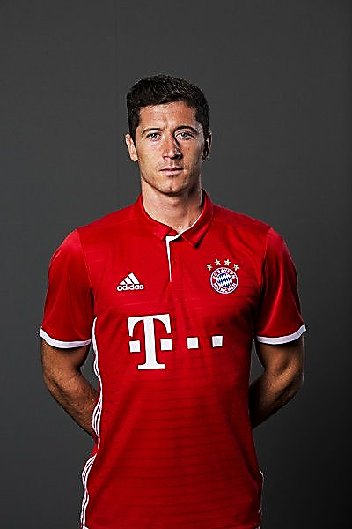






Five Leagues Five Top 1 Goal scorer
PLAYER
LEAGUE
GOALS
BUNDESLIGA
32
SERIA A
23
LA LIGA
21

