Slide 1

UNIT 1 Introduction to Web Technology
Prepared by:
Yachu Shakya

Slide 2

Introduction to Web Technology
Web technology refers to the collection of tools, technologies, protocols, and software that are used to create, publish, and maintain websites and web-based applications.
Web technologies related to the interface between web servers and their clients. This information includes markup languages, programming interfaces and languages, and standards for document identification and display. In general web technology incorporates tools and techniques for web development.

Slide 3

Internet
Network of network, technology where the computing devices globally located are interconnected to each other through some medium in order to communicate, share and control.
It uses TCP/IP protocol
TCP: Transmission control protocol, is connection oriented protocol that guarantees delivery of data packets in accurate form.
IP: Internet Protocol, is set of standards addressing and routing data on internet.

Slide 4
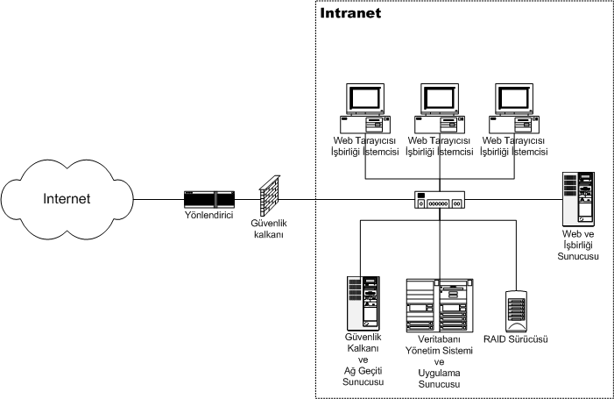
Intranet
An intranet is an internal communications and collaboration platform used by companies of all sizes and industries. It's a secure network for a company's employees and trusted partners to share information, communicate well, and work together effectively.

Slide 5

Questions?
Differentiate between Internet Vs Intranet.

Slide 6

World wide web
It is a system of interlinked hypertext documents(called webpages) contained on the Internet.
A web page can contain text, graphics, animations, sound and video. All of the web pages maintained by an organization or individual are called a web site.
WWW uses Hypertext Transfer Protocol(HTTP) for fetching files (web pages) from internet.
HTTP is set of rules and standards that transmit requests and information between web browsers and web servers.
Web browser is a software application used to locate and display web pages.
Web server is a software application that hosts and delivers web pages according to request of web client. Some popular web servers are Apache, IIS( Internet Information Service)

Slide 7
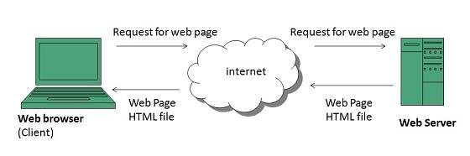
How www works?

Slide 8
How www works?
User enters the URL( Eg. http://www.ntc.org.np) of the web page in the address bar of web browser.
Then browser requests the Domain Name Server for the IP address corresponding to www.ntc.org.np.
After receiving IP address, browser sends the request for web page to the web server using HTTP protocol which specifies the way the browser and web server communicates
The web server receives request using HTTP protocol and checks its search for the requested web page. If found it returns it back to the web browser and close the HTTP connection.
Now the web browser receives the web pages, It interprets it and display the contents of web pages in web browser’s window.

Slide 9
Web page vs Web site
A web page is a single page of content that is displayed on the internet, usually accessed through a web browser. It can contain various types of content, such as text, images, videos, and interactive features.
A web site, on the other hand, is a collection of related web pages that are interconnected and share a common domain name. A website can contain multiple web pages, each with its own unique content, but they are all part of the same website.
In simpler terms, a web page is like a single page in a book, while a website is like the entire book that contains multiple pages.

Slide 10
Static and Dynamic Webpage
A static webpage is a webpage that has a fixed content, meaning that the content of the webpage remains the same until it is manually updated.
The HTML code for a static webpage is created and saved on a server, and when a user accesses the webpage, they are presented with the same content every time.
Examples of static webpages include simple websites that provide information about a company, its products or services, and contact information.
A dynamic webpage, on the other hand, is a webpage that changes based on user input or other variables. The content of a dynamic webpage is generated on the server-side in real-time and is often customized for each user.

Slide 11
Static and Dynamic webpage
Dynamic webpages can use a variety of programming languages, such as PHP, Python, or Ruby, to access databases, run scripts, or retrieve information from APIs.
Examples of dynamic webpages include social media sites, e-commerce sites, online banking sites, and search engines.
Dynamic webpages often have interactive features, such as forms, buttons, and menus, that allow users to input data or make selections that trigger changes in the webpage's content.
Additionally, dynamic webpages can be updated more easily than static webpages since the content is generated automatically based on certain criteria, such as user preferences, device type, or location.

Slide 12
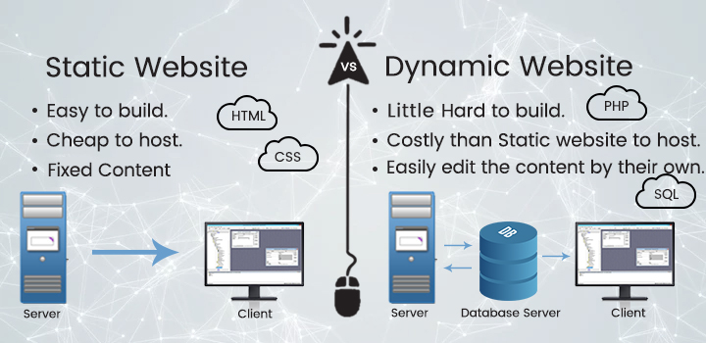
Static and dynamic webpage

Slide 13
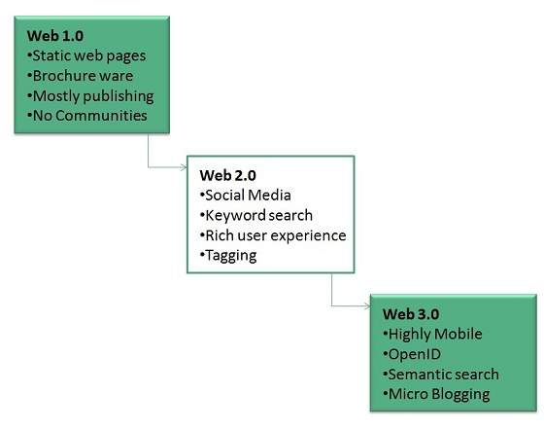
WWW Evolultion

Slide 14
Web 1.0
Web 1.0 (the static web) refers to the first generation of the web, which was largely a one-way communication model. Web 1.0 was characterized by static HTML pages that provided users with basic information and lacked interactivity.
Websites were typically created by businesses and organizations to provide information to their customers or users. There was no social interaction, no user-generated content, and no dynamic web applications. This era of the web lasted from the early 1990s until the mid-2000s.

Slide 15
Web 2.0
Web 2.0 (the social web) represents the second generation of the web, which emerged in the mid-2000s. It was marked by the rise of user-generated content, social media, and dynamic web applications. Web 2.0 allowed for two-way communication between website owners and users, enabling users to contribute their own content and interact with others.
The focus shifted from static web pages to dynamic web applications, such as blogs, wikis, and social media platforms. Web 2.0 made the web more accessible, interactive, and collaborative. It also gave rise to new business models, such as online advertising and e-commerce.

Slide 16
Web 3.0
Web 3.0 (the semantic web) is the third generation of the web, which is still emerging. Web 3.0 is characterized by intelligent and personalized experiences powered by machine learning and artificial intelligence. The focus is on creating a more intelligent and interconnected web that is capable of understanding and processing information like a human being.
Web 3.0 aims to provide users with more personalized experiences and to make it easier to access and use information on the web. It also aims to provide a more secure and decentralized web by using technologies such as blockchain.

Slide 17
Question
Differentiate between static and dynamic webpage.
Define web 1.0. web 2.0, web 3.0 with proper examples.

Slide 18
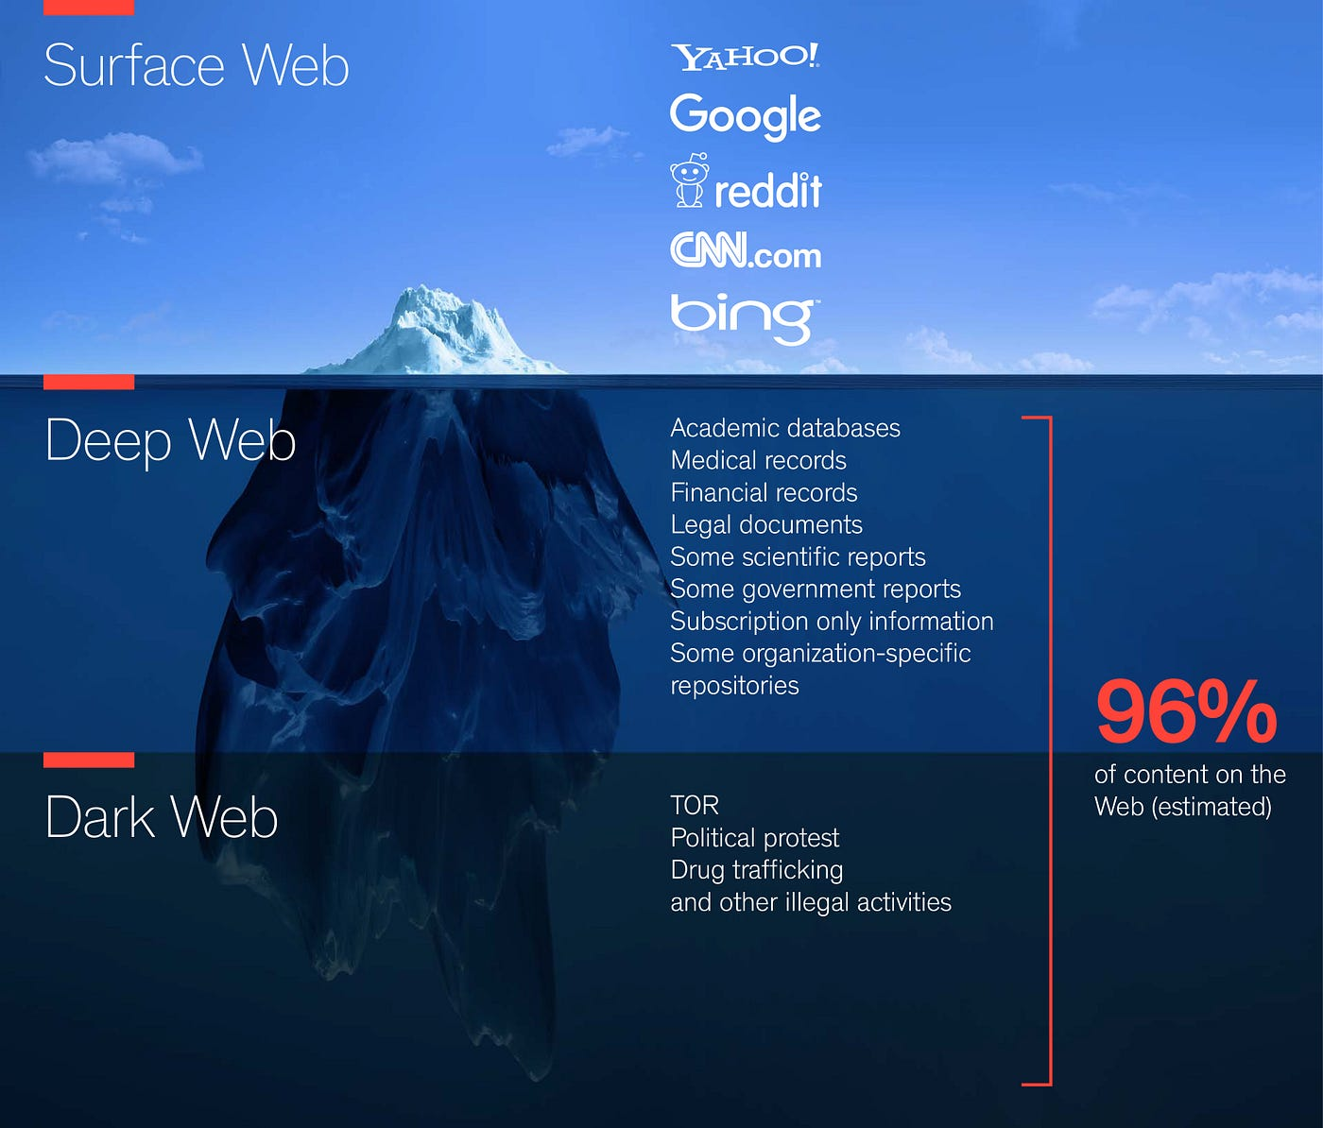
Iceberg of Web

Slide 19
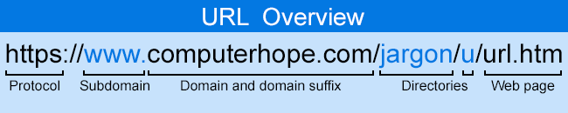
Uniform Resource Locater(URL)
URL is an addressing scheme used by web browsers to locate documents(web pages) and other resources on the World Wide Web.
For example: http://tuservicescommision.edu.np/notice.html
http is protocol
Second part is host name (tuservicescommision.edu.np)
Notice.html resource name.

Slide 20
Client Server architecture
Client-server architecture is a type of computing architecture that divides computing tasks between two distinct types of software: client software and server software. This architecture is widely used in modern computing systems, including web applications, email servers, and file-sharing systems.
In a client-server architecture, the client software runs on the user's device and is responsible for user interaction and presentation. The client software communicates with the server software, which runs on a remote computer or server, to perform specific tasks or access resources.
The server software provides services to multiple client software instances simultaneously, enabling multiple users to access the same resources simultaneously. The server software is responsible for managing resources and performing tasks that require high processing power, storage, or specialized knowledge.

Slide 21

Client Server Architecture

Slide 22
Uniform Resource Locator
URL stands for Uniform Resource Locator, which is a web address that is used to identify a particular resource on the internet. A URL consists of several components, including the protocol, domain name, path, and optional parameters. For example, the URL for the Google homepage is https://www.google.com/ or "https://www.google.com/search?q=pizza"..
Here's a breakdown of the different parts of this URL:
Protocol: "https://" - This specifies the protocol that is used to access the resource. In this case, it is HTTPS (Hypertext Transfer Protocol Secure), which is a secure version of HTTP.
Domain name: "www.google.com" - This is the name of the web server that is hosting the resource. In this case, it is the domain name for Google's website.
Path: "/search" - This specifies the path to the search function on the web server.
Optional parameter: "?q=pizza" - This is the query string that contains the optional parameter. In this case, the key is "q" and the value is "pizza".

Slide 23
Client Server architecture
Client-server architecture is a type of computing architecture that divides computing tasks between two distinct types of software: client software and server software. This architecture is widely used in modern computing systems, including web applications, email servers, and file-sharing systems.
In a client-server architecture, the client software runs on the user's device and is responsible for user interaction and presentation. The client software communicates with the server software, which runs on a remote computer or server, to perform specific tasks or access resources.
The server software provides services to multiple client software instances simultaneously, enabling multiple users to access the same resources simultaneously. The server software is responsible for managing resources and performing tasks that require high processing power, storage, or specialized knowledge.

Slide 24
Client Server Architecture

Slide 25
1-Tier Architecture
In this architecture, the database is directly available to the user. It means the user can directly sit on the DBMS and uses it.
Any changes done here will directly be done on the database itself. It doesn't provide a handy tool for end users.
The 1-Tier architecture is used for development of the local application, where programmers can directly communicate with the database for the quick response.

Slide 26
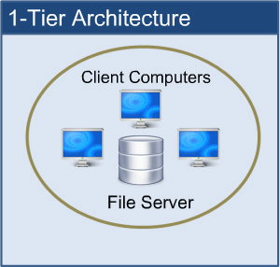

Slide 27
2-Tier Architecture
The 2-Tier architecture is same as basic client-server. In the two-tier architecture, applications on the client end can directly communicate with the database at the server side.
The user interfaces and application programs are run on the client-side.
The server side is responsible to provide the functionalities like: query processing and transaction management.
To communicate with the DBMS, client-side application establishes a connection with the server side.

Slide 28
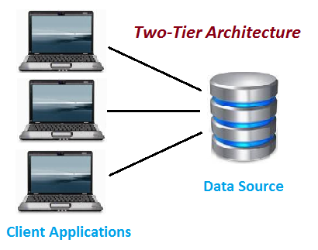
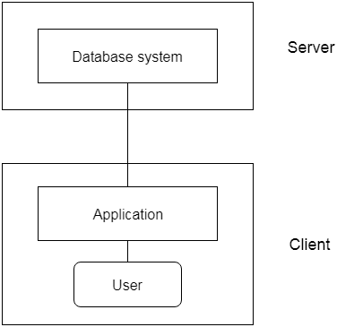

Slide 29
3-Tier Architecture
The 3-Tier architecture contains another layer between the client and server. In this architecture, client can't directly communicate with the server.
The application on the client-end interacts with an application server which further communicates with the database system.
End user has no idea about the existence of the database beyond the application server. The database also has no idea about any other user beyond the application.
The 3-Tier architecture is used in case of large web application

Slide 30
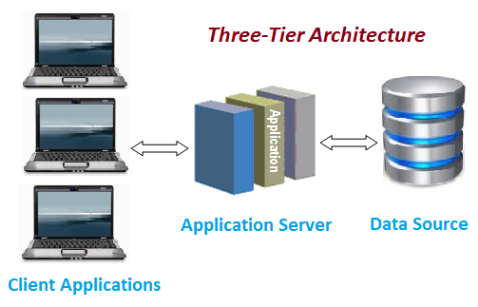
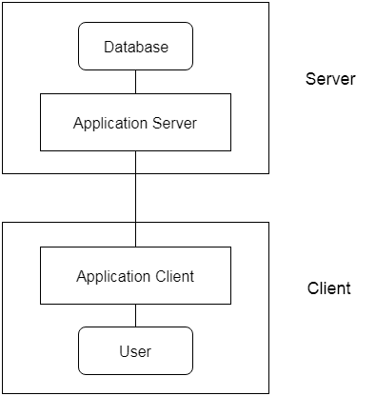

Slide 31
Question:
What is Client server Architecture? Also explain 1 tier, 2 tier and 3 tier architecture with proper figure.

