Slide 1

UNIT 2 Hyper Text Markup Language
Prepared by:
Yachu Shakya

Slide 2
Introduction to HTML
HTML stands for Hyper Text Markup Language
HTML is the standard markup language for creating Web pages
HTML describes the structure of a Web page
HTML consists of a series of elements
HTML elements tell the browser how to display the content

Slide 3
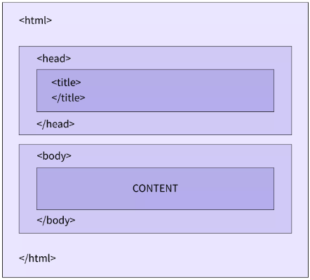
Structure of HTML

Slide 4
Element and Attributes of HTML
HTML (Hypertext Markup Language) is a markup language used to create web pages. HTML documents consist of two main parts: elements and attributes.
Elements: HTML elements are the building blocks of an HTML document. An HTML element is defined by a starting tag, content, and an ending tag. The starting tag consists of the opening angle bracket (<), followed by the name of the element, and a closing angle bracket (>). The content of the element is placed between the starting and ending tags. The ending tag consists of the opening angle bracket, followed by a forward slash (/), the name of the element, and a closing angle bracket. For example, the following code creates a paragraph element:
<tagname>Content goes here...</tagname>
Examples of some HTML elements:
<h1>My First Heading</h1>
<p>My first paragraph.</p>

Slide 5
Element and Attributes of HTML
Attributes: HTML attributes provide additional information about an HTML element. Attributes are used to define the characteristics of an element and are placed inside the starting tag of an element. An attribute consists of a name and a value, separated by an equal sign (=) and enclosed in double quotes (""). For example, the following code sets the width and height attributes of an image element:
Eg: <img src="image.jpg" width="500" height="500">

Slide 6
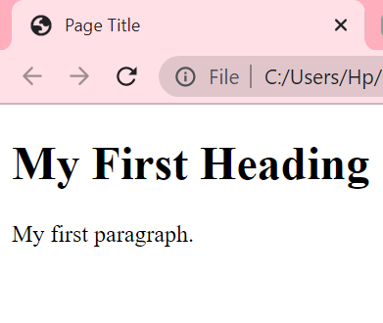
Example 1
<!DOCTYPE html> <html> <head> <title>Page Title</title> </head> <body> <h1>My First Heading</h1> <p>My first paragraph.</p> </body> </html>
Output

Slide 7
HTML Headings
HTML headings are defined with the <h1> to <h6> tags.
<h1> defines the most important heading. <h6> defines the least important heading.
Example:
<h1>Heading 1</h1> <h2>Heading 2</h2> <h3>Heading 3</h3> <h4>Heading 4</h4> <h5>Heading 5</h5> <h6>Heading 6</h6>

Slide 8
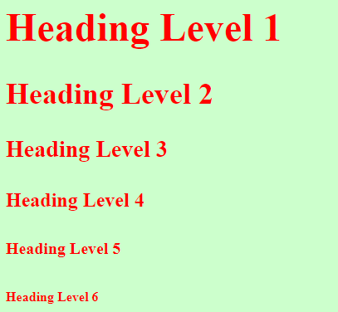
Example: 2
Output
<html>
<head>
<title> Heading Tags </title>
</head>
<body bgcolor="#ccffcc" text="red">
<h1>Heading Level 1</h1>
<h2>Heading Level 2</h2>
<h3>Heading Level 3</h3>
<h4>Heading Level 4</h4>
<h5>Heading Level 5</h5>
<h6>Heading Level 6</h6>
</body>
</html>

Slide 9
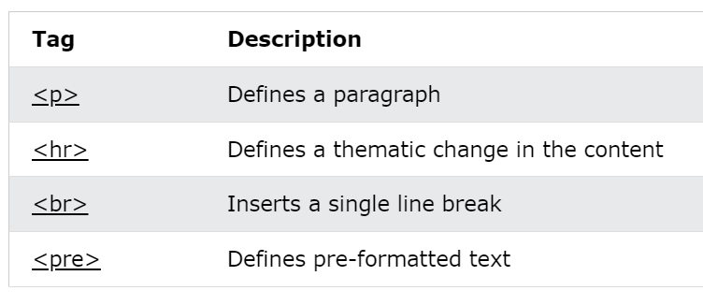
HTML Paragraphs
The HTML <p> element defines a paragraph.
A paragraph always starts on a new line, and browsers automatically add some white space (a margin) before and after a paragraph.
<p>This is a paragraph.</p> <p>This is another paragraph.</p>

Slide 10
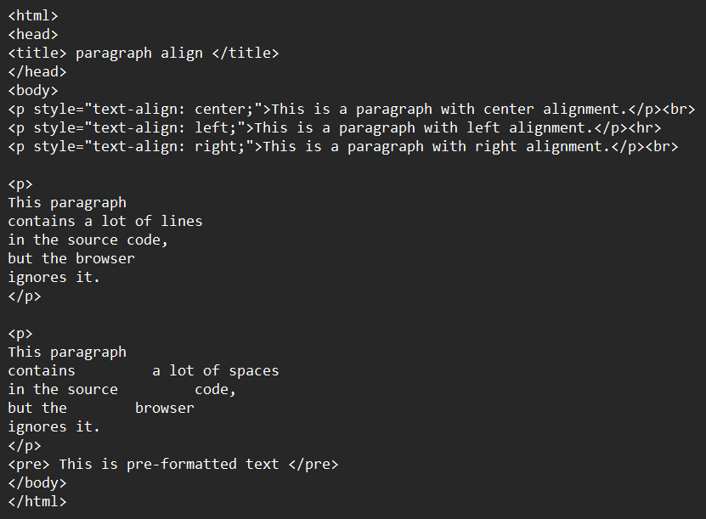
Example 3

Slide 11
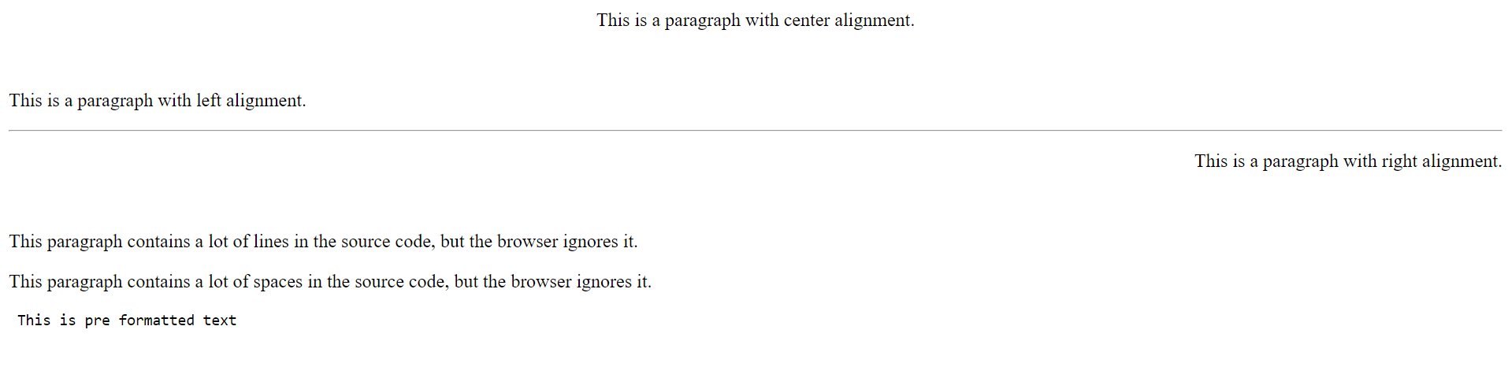
Output

Slide 12
HTML Styles
The HTML style attribute is used to add styles to an element, such as color, font, size, and more.
Setting the style of an HTML element, can be done with the style attribute.
The HTML style attribute has the following syntax:
<tagname style="property:value;">

Slide 13
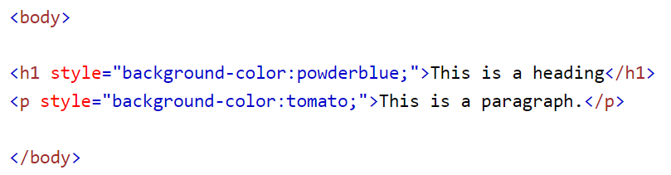
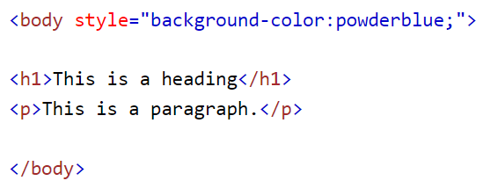
Examples
<h1 style="color:blue;">This is a heading</h1> <p style="color:red;">This is a paragraph.</p>

Slide 14
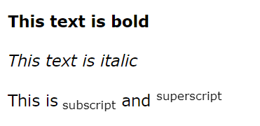
HTML Formatting Elements
Formatting elements were designed to display special types of text:
<b> - Bold text
<strong> - Important text
<i> - Italic text
<em> - Emphasized text
<mark> - Marked text
<small> - Smaller text
<del> - Deleted text
<ins> - Inserted text
<sub> - Subscript text
<sup> - Superscript text

Slide 15
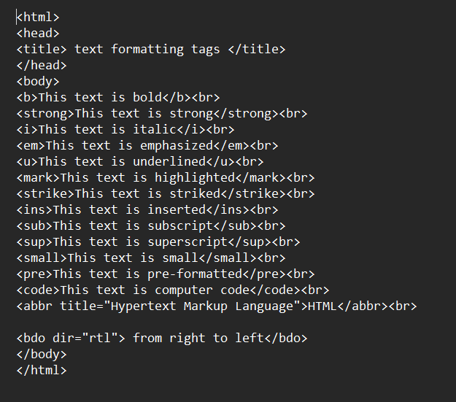
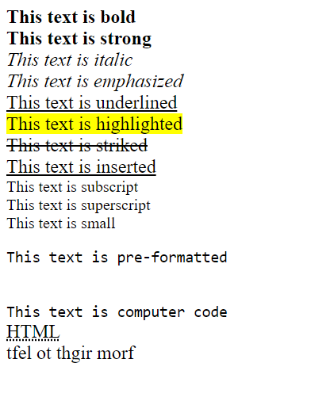
Example
Output

Slide 16
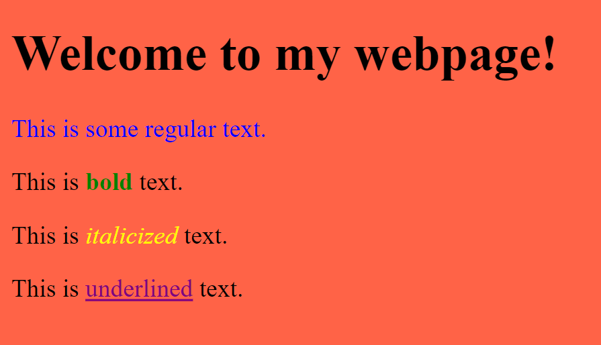
Question 1:
What is HTML? Explain the structure of the HTML. Also List out the tags which we have covered today.
Try to make this using Heading and text formatting with proper attributes:

Slide 17
Hyperlink
A hyperlink, often abbreviated as "link", is a reference or clickable element in a web page or electronic document that, when clicked or activated, takes the user to another document or to a specific location within the same document.
Hyperlinks are used to connect web pages, images, videos, or other digital content on the internet, creating a web of interconnected information.

Slide 18
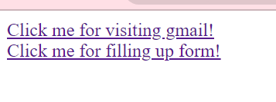
Example:
<html>
<head>
<title> Hyperlink</title>
</head>
<body>
<a href="https://mail.google.com/mail/u/0/#inbox">Click me for visiting gmail!</a><br>
<a href="XYZ.html">Click me for filling up form!</a>
</body>
</html>

Slide 19
Example
<a href="https://example.com" target="_blank">Click me!</a>
This example adds the target="_blank" attribute to the <a> tag, which tells the browser to open the link in a new window or tab.
<a href="#section-1">Go to section 1</a>
This example uses a relative URL (#section-1) to create an internal link that jumps to a specific section of the current page. To create an internal link, use the # symbol followed by the id attribute of the element you want to link to.

Slide 20
Image Tag
In HTML, an image is a graphical element that can be displayed on a web page. An image can be a photograph, a drawing, an icon, a logo, or any other type of graphic that can be saved as a digital file.
To display an image in HTML, you can use the <img> tag, which is a self-closing tag. The <img> tag has several attributes that allow you to specify the URL of the image file, the size of the image, and other characteristics such as the alt text and title text. The most important attribute is src, which specifies the URL of the image file.

Slide 21
Example:
In HTML, you can use the <img> tag to display images on a web page. Here's an example:
<img src="image.jpg" alt="A beautiful sunset">
In this example, "image.jpg" is the URL of the image file and "A beautiful sunset" is the alternative text that is displayed if the image cannot be loaded or if the user is using a screen reader.
The <img> tag has several attributes that you can use to customize the appearance and behavior of the image, including:
src: specifies the URL of the image file
alt: provides alternative text for the image
width and height: sets the width and height of the image in pixels or as a percentage of the container size
title: adds a tooltip when the user hovers over the image
class and id: adds CSS classes or IDs to the image for styling or JavaScript purposes

Slide 22
Example
<img src="image.jpg" alt="A beautiful sunset" width="800" height="600" title="Click to enlarge" class="image">
In this example, the image has a width of 800 pixels and a height of 600 pixels, and a tooltip that says "Click to enlarge" when the user hovers over it. The class attribute adds the CSS class "image" to the image, which can be used to style it with CSS.

Slide 23
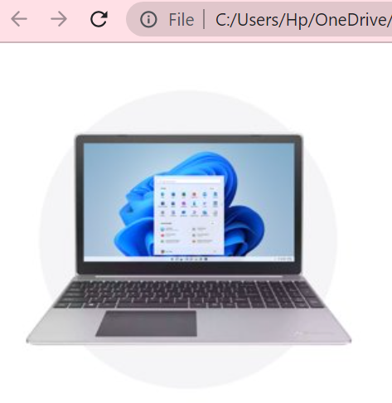
Example
<html>
<head>
<title> Image tag</title>
</head>
<body>
<img src="image1.jpg" alt="laptop" height="300" width="300">
</body>
</html>

Slide 24
Question
What is Hyperlink in HTML? How can we create hyperlink? Give some proper example.
What is Image tag? Give proper example of Image tag.

Slide 25
Favicon
A favicon is a small image displayed next to the page title in the browser tab.
Tip: A favicon is a small image, so it should be a simple image with high contrast.
To add a favicon to your website, either save your favicon image to the root directory of your webserver, or create a folder in the root directory called images, and save your favicon image in this folder. A common name for a favicon image is "favicon.ico".
Next, add a <link> element to your "index.html" file, after the <title> element, like this:

Slide 26

Example:
<!DOCTYPE html> <html> <head> <title>My Page Title</title> <link rel="icon" type="image/x-icon" href="/images/favicon.ico"> </head> <body> <h1>This is a Heading</h1> <p>This is a paragraph.</p> </body> </html>

Slide 27
HTML List Tag
In HTML, a list tag is a type of element used to create lists of items on a webpage. There are several types of list tags, including:
<ul> - Unordered list tag: creates an unordered list of items. Each item is represented by an <li> tag within the <ul> tag.
<ol> - Ordered list tag: creates an ordered (numbered) list of items. Each item is represented by an <li> tag within the <ol> tag.
<li> - List item tag: represents an item within a list, and is always used as a child element of either <ul> or <ol>.
Lists are useful for organizing information on a webpage, especially when there is a lot of information that needs to be presented in a structured and easily readable format. By using list tags, you can create visually appealing and easy-to-read lists that will make your webpage more user-friendly.

Slide 28
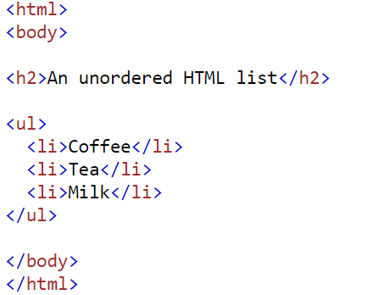
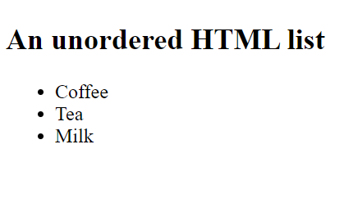
Unordered List
An unordered list starts with the <ul> tag. Each list item starts with the <li> tag.
The list items will be marked with bullets (small black circles) by default:

Slide 29
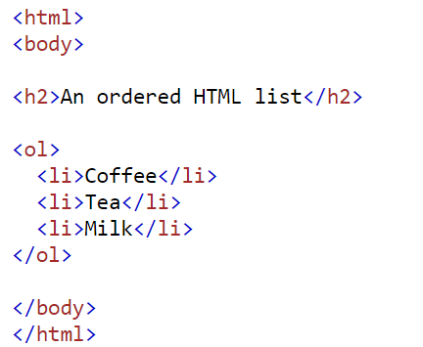
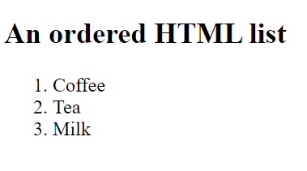
Ordered HTML List
An ordered list starts with the <ol> tag. Each list item starts with the <li> tag.
The list items will be marked with numbers by default:

Slide 30
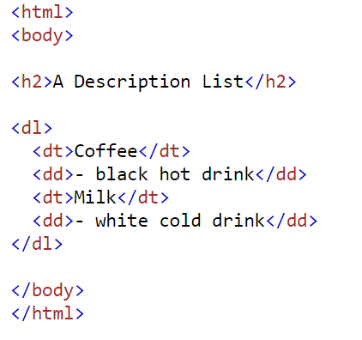
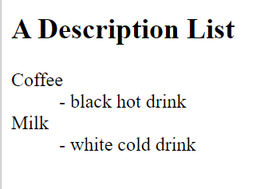
HTML Description Lists
HTML also supports description lists.
A description list is a list of terms, with a description of each term.
The <dl> tag defines the description list, the <dt> tag defines the term (name), and the <dd> tag describes each term:

Slide 31
Question:
What is Favicon in HTML? How can we use it? Give proper example.
What is HTML List tag? What are the types of List tag. Give proper example.

Slide 32
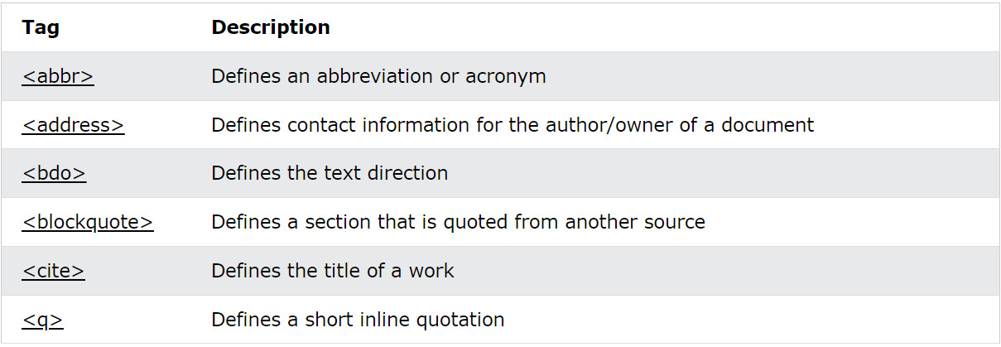
HTML Quotation and Citation Elements

Slide 33
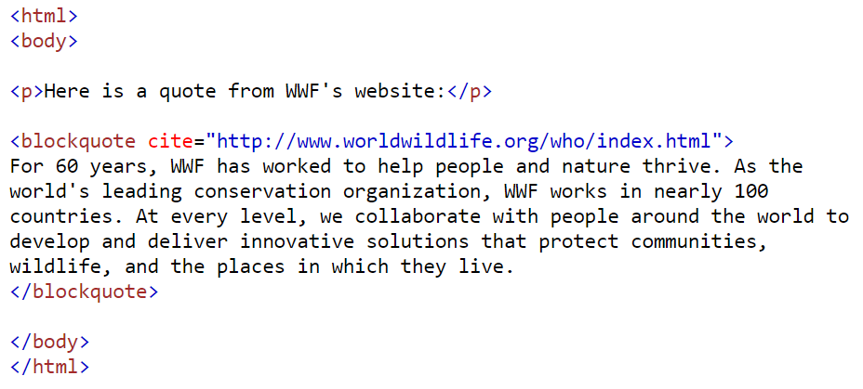
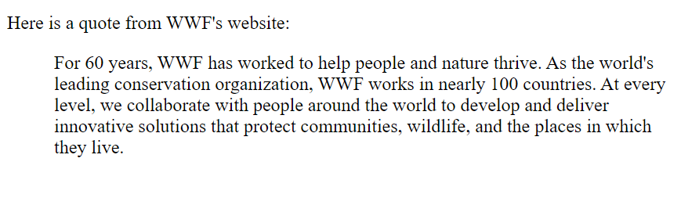
HTML <blockquote> for Quotations

Slide 34
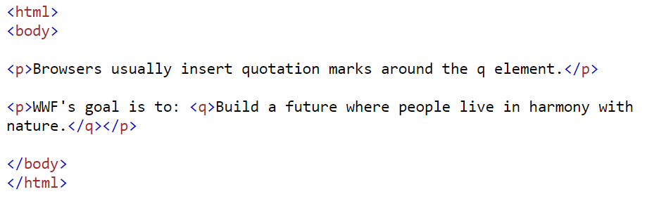
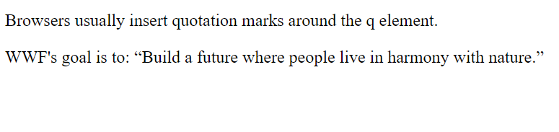
HTML <q> for Short Quotations

Slide 35
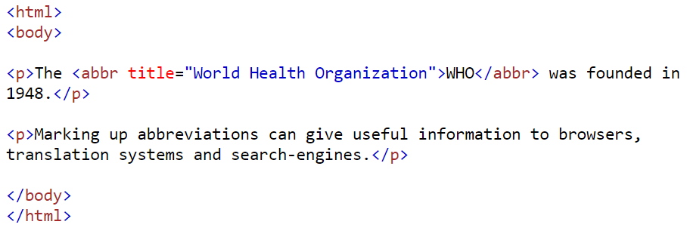
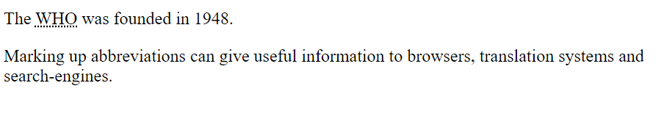
HTML <abbr> for Abbreviations
The HTML <abbr> tag defines an abbreviation or an acronym, like "HTML", "CSS", "Mr.", "Dr.", "ASAP", "ATM".
Marking abbreviations can give useful information to browsers, translation systems and search-engines.

Slide 36
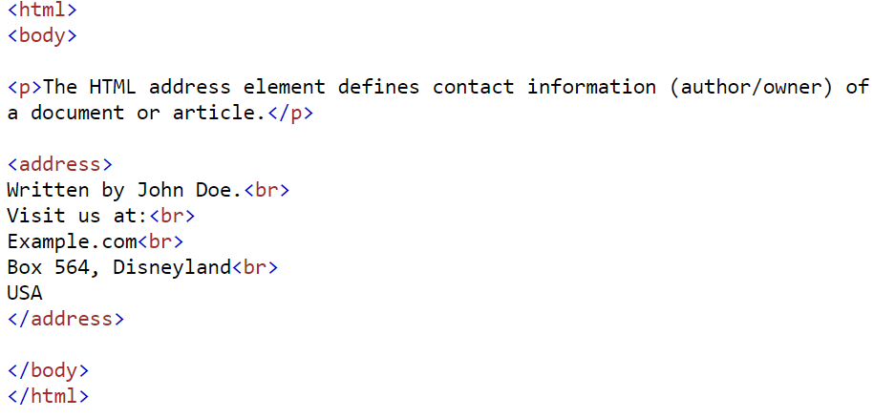
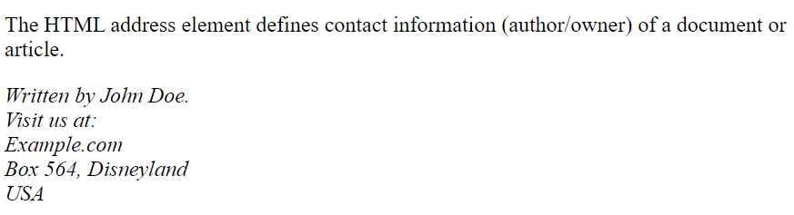
HTML <address> for Contact Information
The HTML <address> tag defines the contact information for the author/owner of a document or an article.
The contact information can be an email address, URL, physical address, phone number, social media handle, etc.
The text in the <address> element usually renders in italic, and browsers will always add a line break before and after the <address> element.

Slide 37
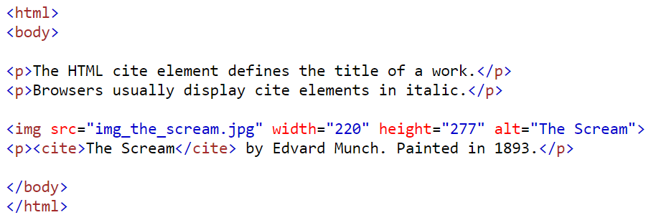
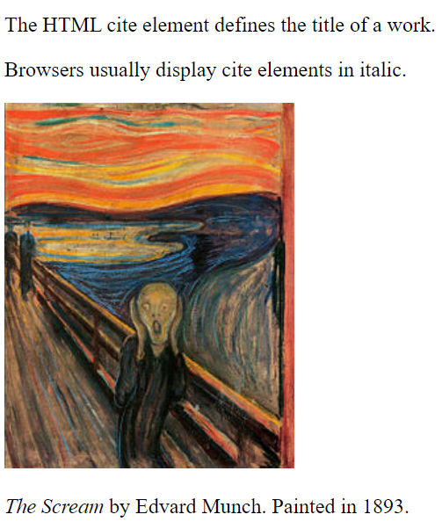
HTML <cite> for Work Title
The HTML <cite> tag defines the title of a creative work (e.g. a book, a poem, a song, a movie, a painting, a sculpture, etc.).
The text in the <cite> element usually renders in italic.

Slide 38
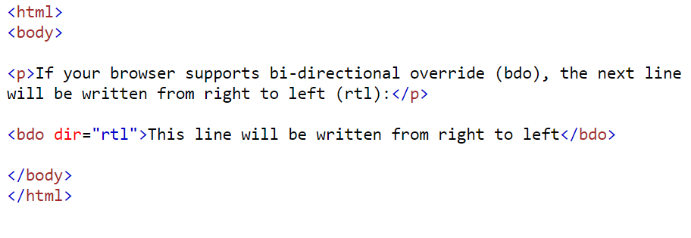
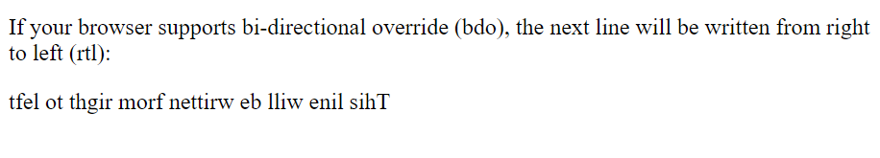
HTML <bdo> for Bi-Directional Override
BDO stands for Bi-Directional Override.
The HTML <bdo> tag is used to override the current text direction:

Slide 39
HTML Table Tag
In HTML (Hypertext Markup Language), the <table> tag is used to create a table on a web page. The <table> tag is used to define the start and end of a table, and everything inside the tags is considered part of the table.
Within the <table> tag, you can use several other tags to create the structure of the table, including <tr> (table row), <th> (table header), and <td> (table data/cell).
Here's an example of how the <table> tag can be used to create a simple table with two rows and two columns:

Slide 40
HTML Table Tag
<table>
<tr>
<th>Heading 1</th>
<th>Heading 2</th>
</tr>
<tr>
<td>Data 1</td>
<td>Data 2</td>
</tr>
</table>
In this example, the first row (<tr>) contains two headers (<th>) for the two columns in the table. The second row also contains two cells (<td>), with the data for each column.

Slide 41
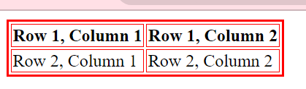
Example
<table border=2 bordercolor="red">
<tr>
<th>Row 1, Column 1</th>
<th>Row 1, Column 2</th>
</tr>
<tr>
<td>Row 2, Column 1</td>
<td>Row 2, Column 2</td>
</tr>
</table>

Slide 42
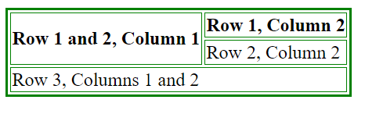
Example
<table border=2 bordercolor="green">
<tr>
<th rowspan="2">Row 1 and 2, Column 1</th>
<th>Row 1, Column 2</th>
</tr>
<tr>
<td>Row 2, Column 2</td>
</tr>
<tr>
<td colspan="2">Row 3, Columns 1 and 2</td>
</tr>
</table>

Slide 43
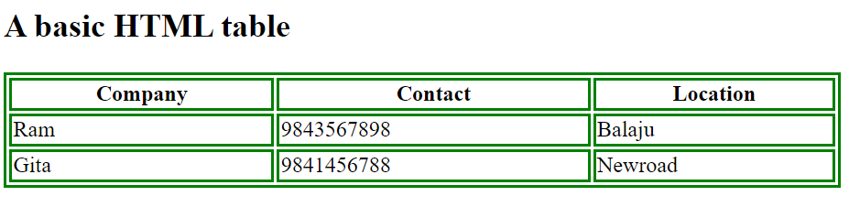
Question
What is HTML Quotation and citation element? List out the tags and describe it.
What is HTML <Table> tag? Try to make table as below:

Slide 44
HTML Form Tag
The <form> tag in HTML is used to create an HTML form that allows users to input data that can be submitted to a web server for processing.
The form element has several attributes that can be used to control its behavior and appearance. Here is a basic example of a simple form tag:

Slide 45
Example:
<html>
<head>
<title> form</title>
</head>
<body>
<form action="submit.php" method="post">
<label for="name">Name:</label>
<input type="text" id="name" name="user_name">
<br><br>
<label for="email">Email:</label>
<input type="email" id="email" name="user_email">
<br><br>
<label for="password">Password:</label>
<input type="password" id="password" name="user_password">
<br><br>

Slide 46
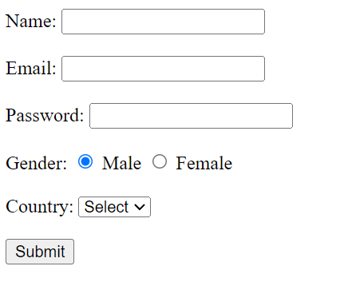
Example
<label for="gender">Gender:</label>
<input type="radio" id="male" name="gender" value="male">
<label for="male">Male</label>
<input type="radio" id="female" name="gender" value="female">
<label for="female">Female</label>
<br><br>
<label for="country">Country:</label>
<select id="country" name="user_country">
<option value="">Select</option>
<option value="USA">USA</option>
<option value="UK">UK</option>
<option value="India">India</option>
</select>
<br><br>
<input type="submit" value="Submit">
</form>
</body>
</html>

Slide 47
iframe (Inline Frame)
An iframe (Inline Frame) is an HTML element used to embed another HTML document within the current document. It allows you to display content from another source or website within your own webpage.
The iframe element in HTML is used to embed external content within a webpage, enabling the display of content from other sources like maps, videos, or widgets. It also facilitates cross-domain communication and modularization of code by allowing the integration of third-party services or the reuse of standalone HTML documents.

Slide 48
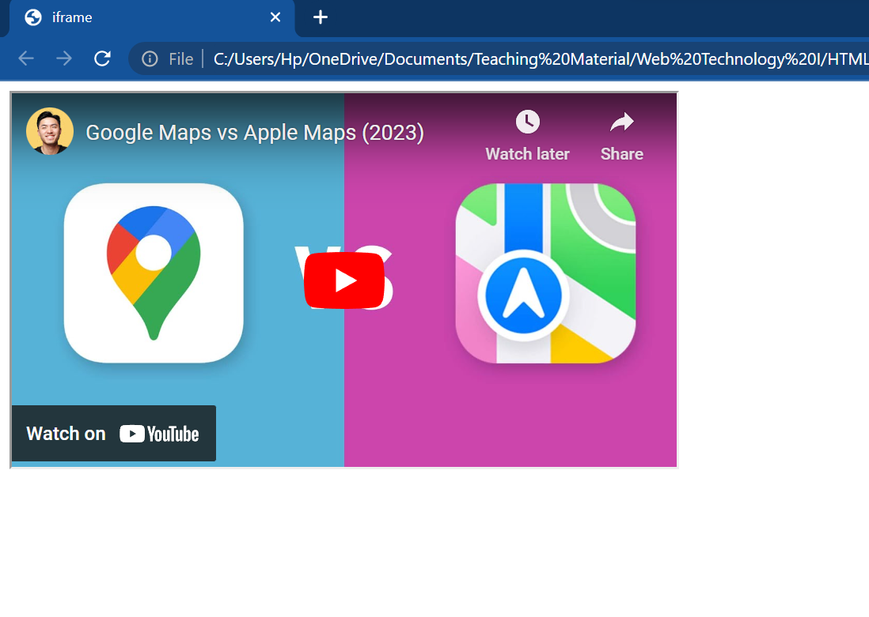
Example
<html>
<head>
<title> iframe</title>
</head>
<body>
<iframe width="560" height="315" src="https://www.youtube.com/embed/JS5iRAxJ-0M" title="YouTube video player"></iframe>
</body>
</html>

Slide 49
Head Tag in HTML
The <head> tag is an HTML element that is used to define the head section of a web page. It is typically placed after the opening <html> tag and before the <body> tag. The content within the <head> tag is not directly displayed on the web page but provides important information and instructions to browsers and search engines.
Some common elements that can be included within the <head> tag are:
<title>: Specifies the title of the web page, which is displayed in the browser's title bar or tab.
Example: <title>My Web Page</title>
<meta>: Defines metadata about the document, such as character encoding, viewport settings, keywords, and descriptions.
Example: <meta charset="UTF-8"> (Specifies the character encoding as UTF-8)

Slide 50
Head Tag in HTML
External resource references: Links to external files like CSS stylesheets or JavaScript files.
Example: <link rel="stylesheet" href="styles.css"> (Links to an external CSS file)
Inline styles: Style definitions that apply only to the current page.
Example: <style>body { background-color: #f2f2f2; }</style>
Inline scripts: JavaScript code that runs on the page.
Example: <script>alert('Hello, World!');</script>

Slide 51
Working with Audio and Video
When working with audio and video on a web page, you can use HTML5's <audio> and <video> elements along with their respective attributes and methods. Here's an example of how to embed audio and video in HTML:
<audio src="audio.mp3" controls> Your browser does not support the audio element. </audio>
In this example, the src attribute specifies the URL of the audio file, and the controls attribute adds playback controls (play/pause, volume, etc.) to the audio player. The text "Your browser does not support the audio element." is displayed if the browser does not support HTML5 audio.

Slide 52
Working with Audio and Video
<video src="video.mp4" controls> Your browser does not support the video element. </video>
Similar to the audio element, the src attribute specifies the URL of the video file, and the controls attribute adds video player controls. The fallback text is displayed if the browser does not support HTML5 video.
Both <audio> and <video> elements support additional attributes such as autoplay, loop, preload, and more. You can customize these elements further by using JavaScript or CSS to enhance their functionality and appearance.

Slide 53
Question
What is Iframe in HTML? Giver proper example of Iframe.
What is <audio> and <video> tag? How can we implement it? Give proper example.

Slide 54
HTML Sectioning/Layout Elements
HTML layout refers to the structure and arrangement of elements within an HTML document. It involves organizing and positioning various HTML elements to create a visually appealing and well-structured web page.
In addition to these semantic elements, HTML also provides elements for creating grids, columns, and other layout structures. CSS (Cascading Style Sheets) is commonly used alongside HTML to control the presentation and styling of the layout elements.
HTML provides a set of elements that are used to define the different sections of a webpage. Some commonly used HTML layout elements include:

Slide 55
HTML Sectioning/Layout Elements
<header>: Defines the top section of a webpage, typically containing the site's logo, navigation menu, or other introductory content.
<nav>: Represents a section of navigation links.
<main>: Defines the main content area of the webpage, containing the primary content.
<section>: Represents a standalone section within a document, such as chapters, articles, or segmented content.
<article>: Defines an independent piece of content that can be distributed or reused on its own.
<aside>: Represents content that is tangentially related to the main content, such as sidebars or pull quotes.
<footer>: Defines the bottom section of a webpage, typically containing information about the author, copyright notice, or links to related documents.

Slide 56
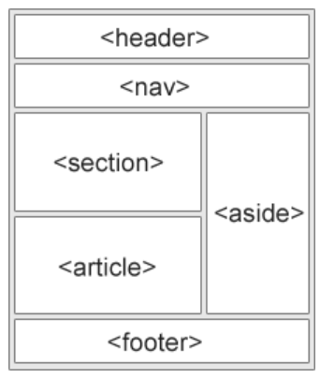
HTML Sectioning/Layout Elements
It's important to note that these tag does not have any specific styling or behavior associated with it by default. Its purpose is to provide a semantic structure for content, and its presentation can be customized using CSS according to the design requirements of the webpage.

Slide 57
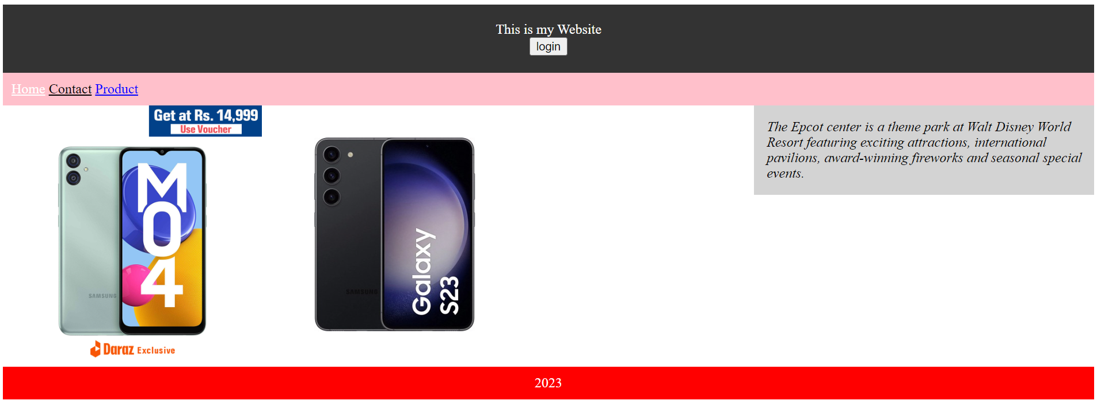
HTML Sectioning/Layout Elements
Try to make this using HTML Layout tags

Slide 58
DIV Tag
The div tag is known as Division tag. The div tag is used in HTML to make divisions of content in the web page like (text, images, header, footer, navigation bar, etc).
Div tag has both open (<div>) and closing (</div>) tag and it is mandatory to close the tag.
The Div is the most usable tag in web development because it helps us to separate out data in the web page and we can create a particular section for particular data or function in the web pages.
Div tag is Block level tag
It is a generic container tag
It is used to group various tags of HTML so that sections can be created and styles can be applied to them.

Slide 59
DIV Attributes
The <div> element in HTML is a versatile container that can have various attributes assigned to it to modify its behavior or provide additional information. Here are some commonly used attributes with the <div> element:
class: Specifies one or more CSS classes to apply to the <div>. It allows you to target and style the <div> using CSS or apply specific behaviors using JavaScript.
id: Assigns a unique identifier to the <div>. This identifier can be used to target the element for styling or scripting purposes. Unlike the class attribute, the id attribute should be unique within the HTML document.
style: Allows you to define inline CSS styles directly on the <div>. You can specify various CSS properties and values to control the appearance and layout of the <div>.

Slide 60
Class Attribute
The class attribute is often used to point to a class name in a style sheet. It can also be used by a JavaScript to access and manipulate elements with the specific class name.
In the following example we have three <div> elements with a class attribute with the value of "city". All of the three <div> elements will be styled equally according to the .city style definition in the head section:

Slide 61
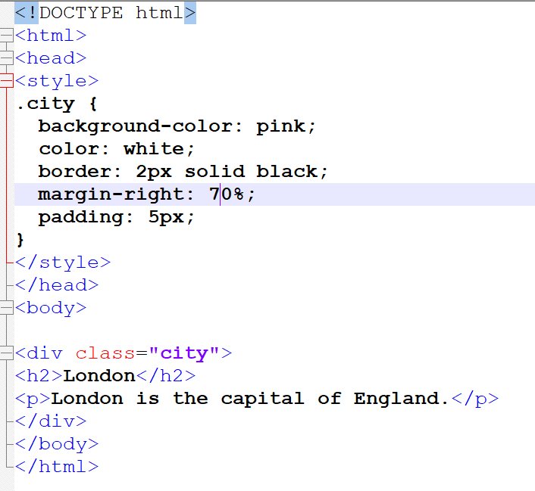
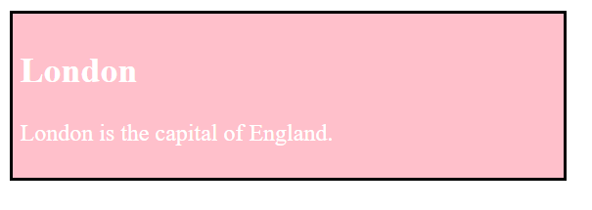
Example

Slide 62
ID Attribute
The id attribute specifies a unique id for an HTML element. The value of the id attribute must be unique within the HTML document.
The id attribute is used to point to a specific style declaration in a style sheet. It is also used by JavaScript to access and manipulate the element with the specific id.
The syntax for id is: write a hash character (#), followed by an id name. Then, define the CSS properties within curly braces {}.
A class name can be used by multiple HTML elements, while an id name must only be used by one HTML element within the page.

Slide 63
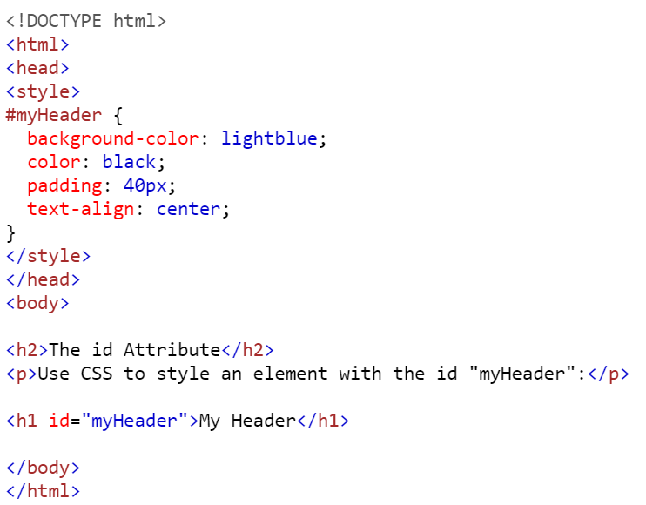
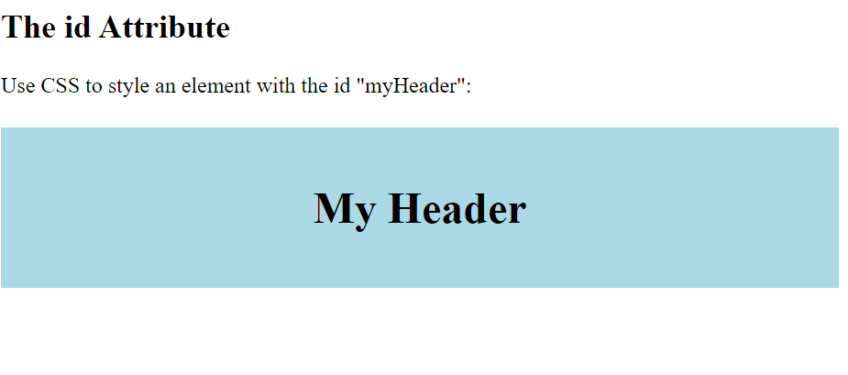
Example

Slide 64
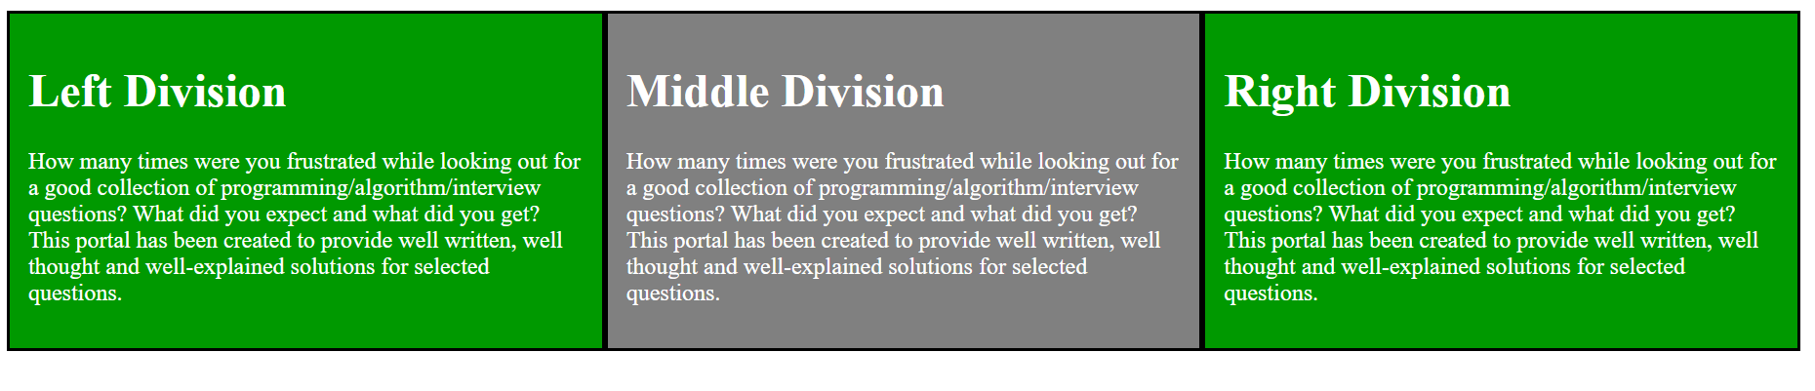
Assignment
Try to make this using <div> tag with class attribute

Slide 65
HTML Events
In HTML, an event refers to an action or occurrence that takes place within the web page or browser.
It can be triggered by various user interactions or system events, such as mouse clicks, keyboard inputs, form submissions, page loading, or timers.
HTML events are used to initiate JavaScript code or execute predefined actions, allowing dynamic and interactive behavior in web applications.

Slide 66
Form Event Attributes
Form event occurs when the user performs some action within the form such as submitting the form, selecting input field, etc.
The form events can be used with any element, but these are mainly used with HTML form elements.
Following is the list of all Form Event attributes:

Slide 67
Form Event Attributes
Attribute | Description
onblur | Executed the script when form element loses the focus.
onchange | Executed the script when the value of the element is changed.
onfocus | Trigger an event when the element gets focused.
oninput | Executed the script when the user enters input to the element.
oninvalid | Executed the script when the element does not satisfy its predefined constraints.
onreset | Triggers the event when user reset the form element values.
onsearch | Triggers the event when a search field receives some input.
onselect | Triggers the event when the user has selected some text.
onsubmit | Triggers the event when a form is submitted.

Slide 68
Keyboard Event Attributes
Keyboard event occurs when a user interacts with the keyboard. Following is a list of the Keyboard event
Attribute | Description
onkeydown | Triggers the event when the user presses down a key on the keyboard.
onkeypress | Trigger the event when the user presses the key which displays some character.
onkeyup | Trigger the event when the user releases the currently pressed key.

Slide 69
Mouse Event Attributes
Attribute | Description
onclick | Trigger the event when the mouse clicks on the element.
ondblclick | Trigger the event when mouse double-click occurs on the element.
onmousedown | Trigger the event when the mouse button is pressed on the element.
onmousemove | Trigger the event when the mouse pointer moves over the element.
onmouseout | Trigger the event when the mouse moves outside the element.
onmouseover | Trigger the event when the mouse moves onto the element.

Slide 70
Mouse Event Attributes
onmouseup | Trigger the event when the mouse button is released.
onwheel | Trigger the event when the mouse wheel rolls up or down on the element

Slide 71
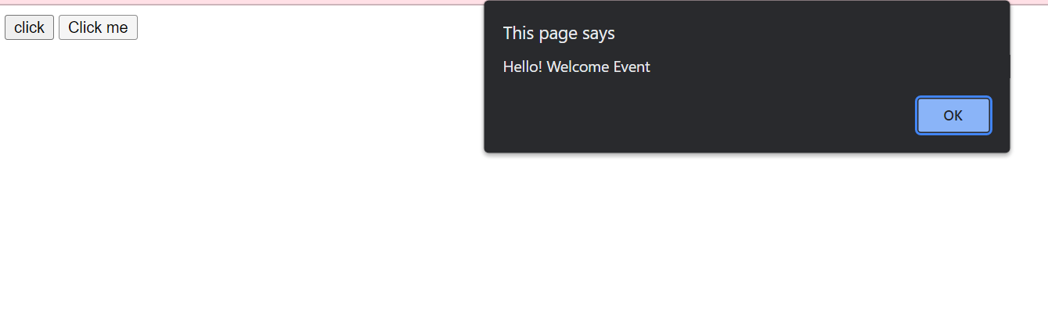
Example
<html>
<head>
<title> html event1</title>
</head>
<body>
<input type="button" onclick="alert('Hello! Welcome Event')" value="click">
<button onclick="alert('Hello! Welcome Event')">Click me</button>
</body>
</html>

