Slide 1
Unit 4 Client Side Scripting language
Prepared By : Yachu Shakya

Slide 2
Introduction to JavaScript
JavaScript was invented by Brendan Eich in 1995.
It was developed for Netscape 2, and became the ECMA-262 standard in 1997.
JavaScript is the scripting language of the Web.
JavaScript is used in millions of Web pages to add functionality, validate forms, detect browsers, and much more.
JavaScript is the most popular scripting language on the Internet, and works in all major browsers, such as Internet Explorer, Mozilla Firefox, Chrome, Opera and many more.

Slide 3
What is JavaScript?
JavaScript was designed to add interactivity to HTML pages
JavaScript is a scripting language
A scripting language is a lightweight programming language
JavaScript is usually embedded directly into HTML pages
Everyone can use JavaScript without purchasing a license
Loosely tightened
Java and JavaScript are two completely different languages in both concept and design!

Slide 4
What can a JavaScript Do ?
JavaScript gives HTML designers a programming tool - HTML authors are normally not programmers, but JavaScript is a scripting language with a very simple syntax! Almost anyone can put small "snippets" of code into their HTML pages
JavaScript can put dynamic text into an HTML page - A JavaScript statement like this: document. write(“<h1>” + name + “</h1>") can write a variable text into an HTML page
JavaScript can react to events - A JavaScript can be set to execute when something happens, like when a page has finished loading or when a user clicks on an HTML element
JavaScript can read and write HTML elements - A JavaScript can read and change the content of an HTML element
JavaScript can be used to validate data - A JavaScript can be used to validate form data before it is submitted to a server. This saves the server from extra processing
JavaScript can be used to detect the visitor's browser - A JavaScript can be used to detect the visitor's browser, and - depending on the browser - load another page specifically designed for that browser
JavaScript can be used to create cookies - A JavaScript can be used to store and retrieve information on the visitor's computer

Slide 5
JavaScript Variables
Variables are "containers" for storing information.
JavaScript variables are used to hold values or expressions.
A variable can have a short name, like x, or a more descriptive name, like carname.
Rules for JavaScript variable names:
Variable names are case sensitive (y and Y are two different variables)
Variable names must begin with a letter or the underscore character
Note: Because JavaScript is case-sensitive, variable names are case-sensitive.

Slide 6
JavaScript Variables
var
let
const

Slide 7
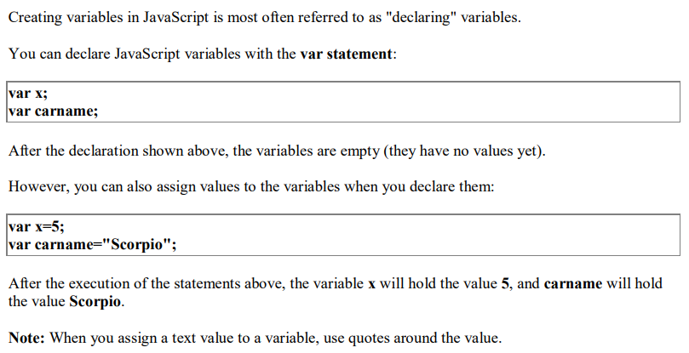
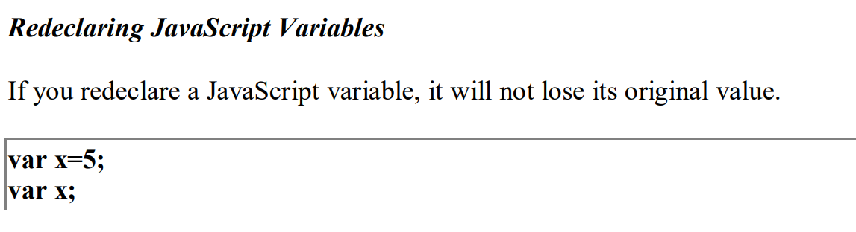
Declaring (Creating) JavaScript Variables using var

Slide 8
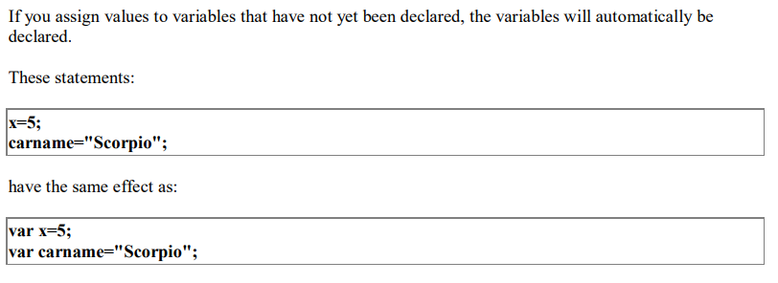
Assigning Values to Undeclared JavaScript Variables

Slide 9
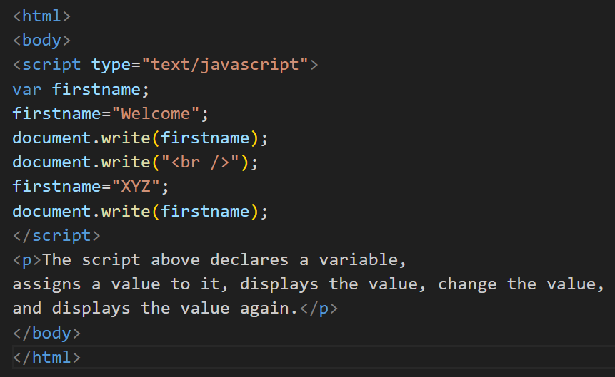
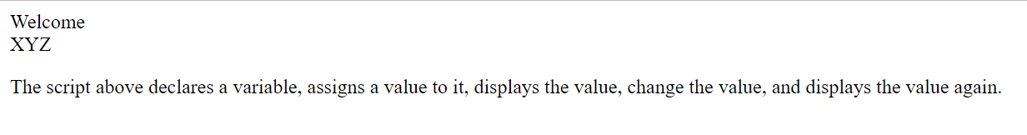
Example

Slide 10
JavaScript Let
The let keyword was introduced in ES6 (2015)
Variables defined with let cannot be Redeclared.
Variables defined with let must be Declared before use
Variables defined with let have Block Scope
With let you can not do this:
let x = "John Doe"; let x = 0;
With var you can:
var x = "John Doe"; var x = 0;

Slide 11
JavaScript Const
The const keyword was introduced in ES6 (2015)
Variables defined with const cannot be Redeclared
Variables defined with const cannot be Reassigned
Variables defined with const have Block Scope

Slide 12
Data Types
Numbers - are values that can be processed and calculated. You don't enclose them in quotation marks. The numbers can be either positive or negative.
Strings - are a series of letters and numbers enclosed in quotation marks. JavaScript uses the string literally; it doesn't process it. You'll use strings for text you want displayed or values you want passed along.
Boolean (true/false) - lets you evaluate whether a condition meets or does not meet specified criteria.
Null - is an empty value. null is not the same as 0 -- 0 is a real, calculable number, whereas null is the absence of any value.
Undefined

Slide 13
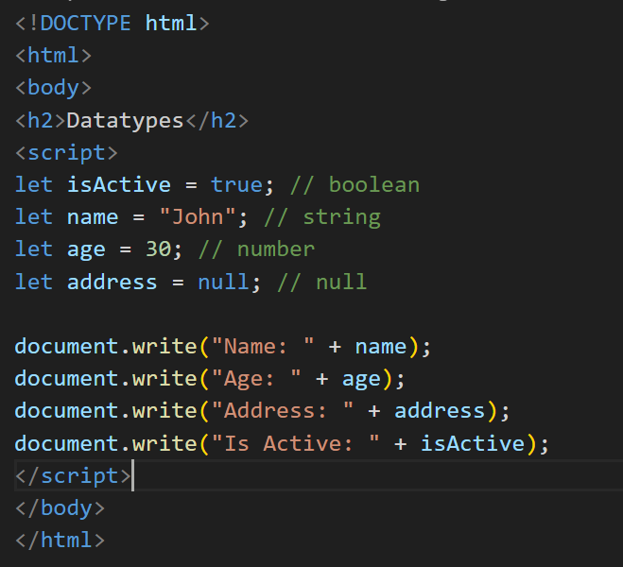
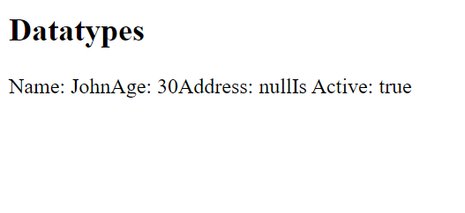
Example

Slide 14
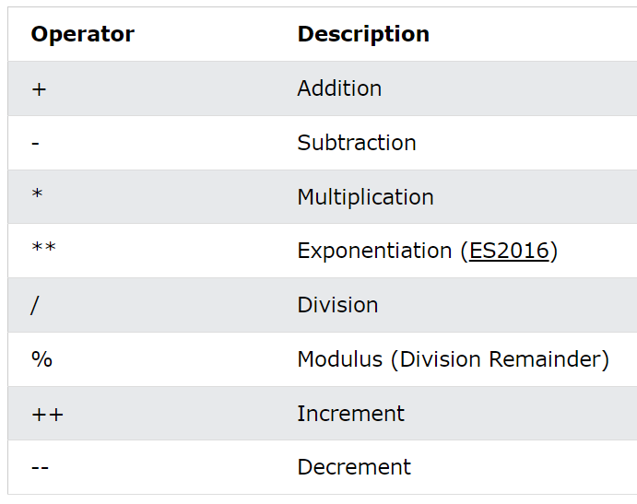
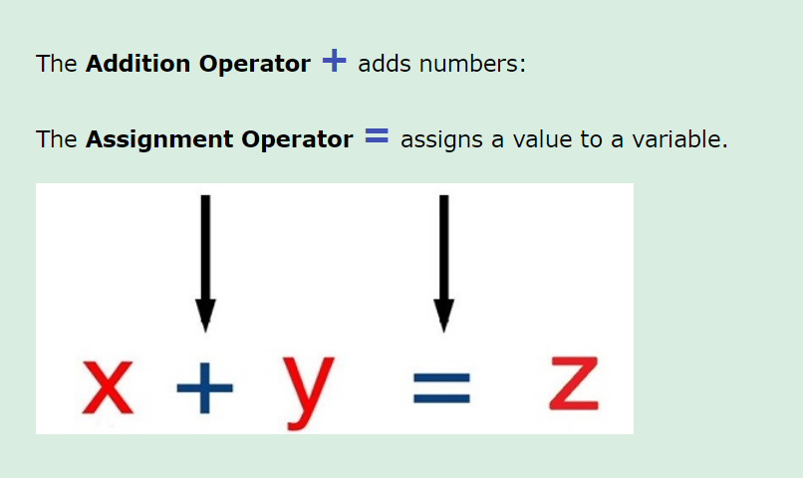
JavaScript Operators

Slide 15
Javascript Statements
A computer program is a list of instructions to be executed by a computer
In programming language, these programming instructions are called statements.
JavaScript program is a list of programming statements
JavaScript statements are composed of:
Values, Operators, Expressions, Keywords and Comments

Slide 16
JavaScript Statements
JavaScript statements are terminated by “;” semicolon.
JavaScript ignores white spaces.
If a JavaScript statement does not fit on one line, the best place to break it is after an operator

Slide 17
JavaScript Expression
JavaScript expression is composed up of values, variables and operators .
Eg. A*5
B=A+B;

Slide 18
JavaScript Keywords
Keywords are reserved words in JavaScript Library
Keyword | Description
var | Declares a variable
let | Declares a block variable
const | Declares a block constant
if | Marks a block of statements to be executed on a condition
switch | Marks a block of statements to be executed in different cases
for | Marks a block of statements to be executed in a loop
function | Declares a function

Slide 19
JavaScript Blocks
In JavaScript, statements can be grouped together in blocks inside curly brackets {……………} .
Motive is to define and execute statements together.
Eg. Using function.

Slide 20
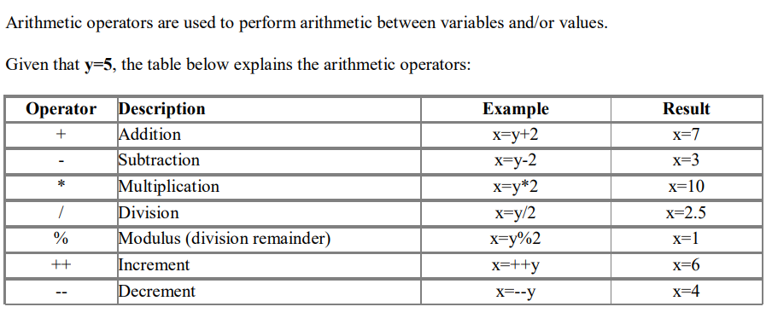
Arithmetic Operators

Slide 21
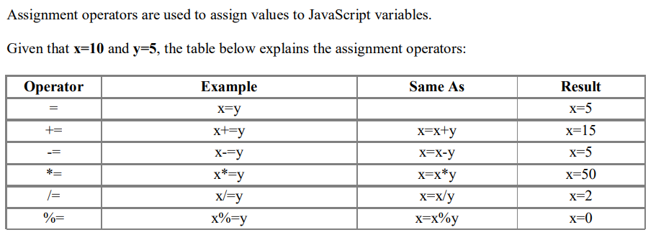
Assignment Operator

Slide 22
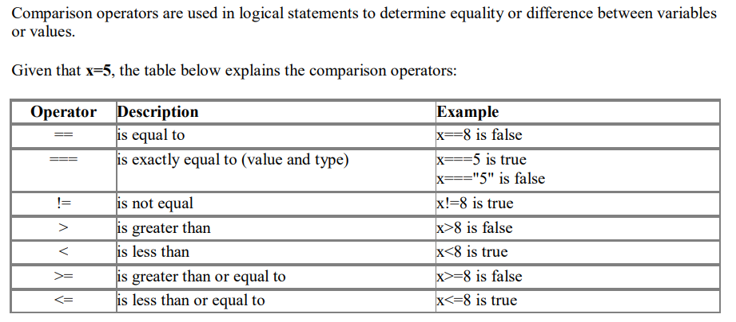
Comparison Operator

Slide 23
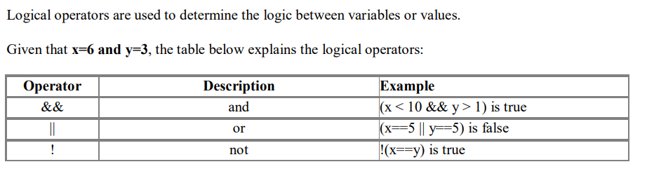
Logical Operators

Slide 24
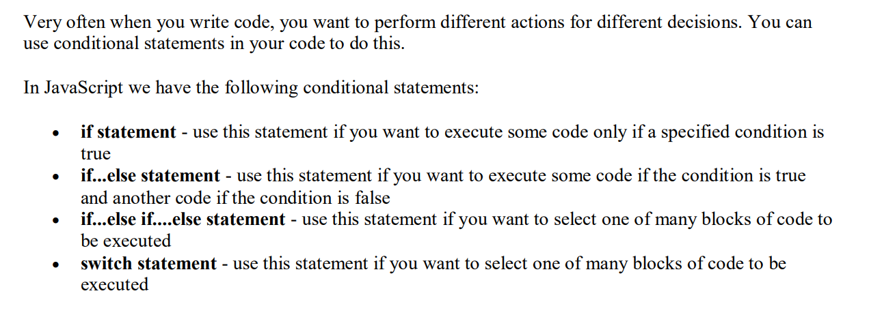
Conditional Statements

Slide 25
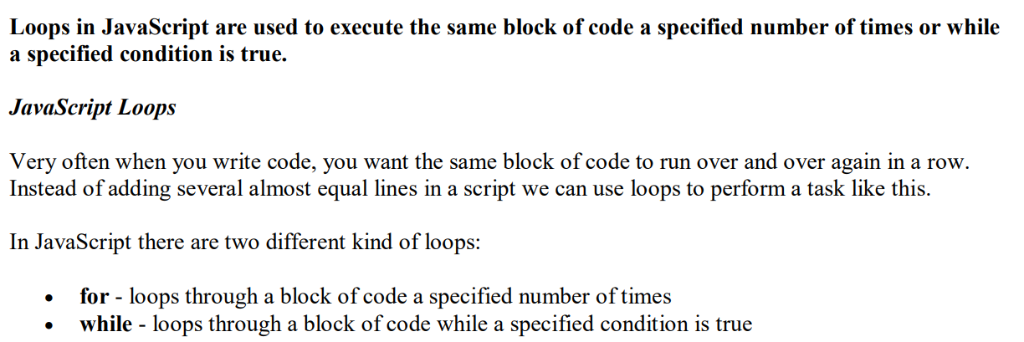
JavaScript Controlling(Looping) Statements

Slide 26
JavaScript function
In JavaScript, a function is a block of reusable code that performs a specific task. It is a fundamental building block of JavaScript programming and allows you to encapsulate a set of instructions that can be executed multiple times throughout your code.
Functions in JavaScript can be defined using the function keyword followed by a name, a list of parameters (optional), and a block of code enclosed in curly braces. Here's a basic syntax for creating a JavaScript function:
function functionName(parameter1, parameter2, ...) {
// Code to be executed
// Optionally, return a value
}

Slide 27
JavaScript function
Let's break down the components of a function:
function: The keyword used to define a function.
functionName: The name of the function, which should be unique within the scope of your code.
parameters: Optional inputs that the function can accept. They are separated by commas and act as placeholders for values that will be passed into the function when it is called.
code: The block of code that gets executed when the function is called. It can perform operations, manipulate data, or perform any other desired actions.
return: An optional keyword that allows the function to send a value back to the caller. If omitted, the function returns undefined.

Slide 28
document.write() function
The document.write() function in JavaScript is used to dynamically generate content and write it directly to the web page. It can be used to display text, HTML, or JavaScript code.
Here's the basic syntax of the document.write() function:
document.write(content);
The content parameter represents the content you want to write to the document. It can be a string of text, HTML tags, or even JavaScript code.

Slide 29
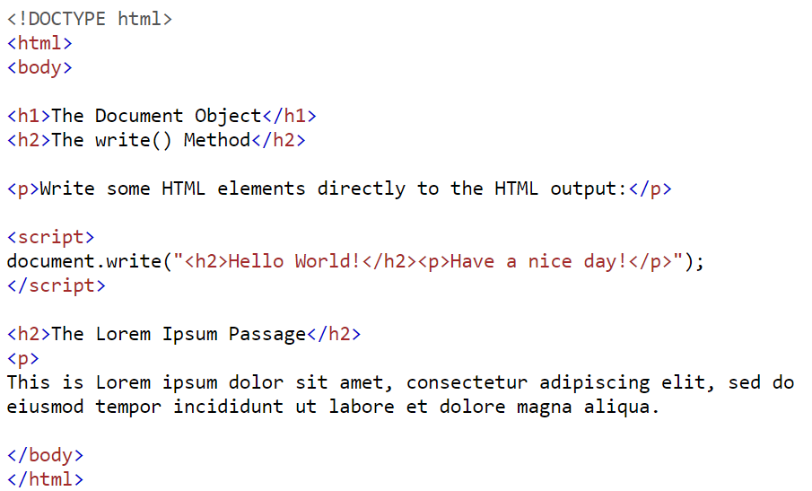
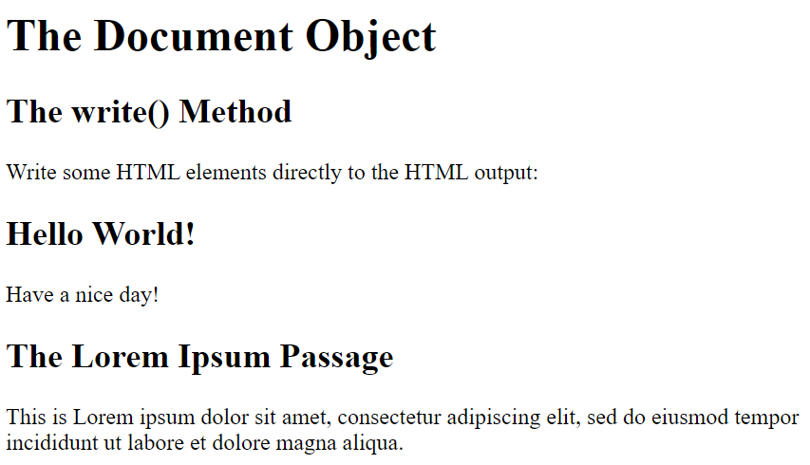
Example

Slide 30
console.log() function
The console.log() function is a method provided by most web browsers' developer tools and JavaScript runtime environments. It allows you to print messages or values to the console for debugging and logging purposes. The output appears in the browser's developer console, which can be accessed by opening the browser's developer tools.
Here's the basic syntax of console.log():
console.log(message)

Slide 31
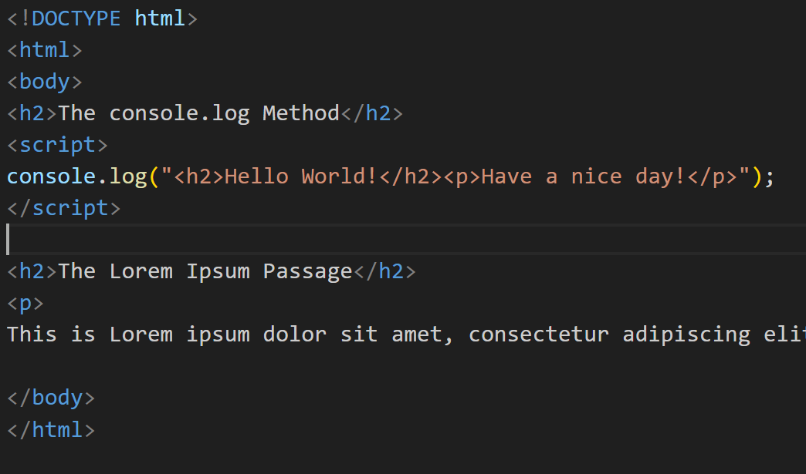
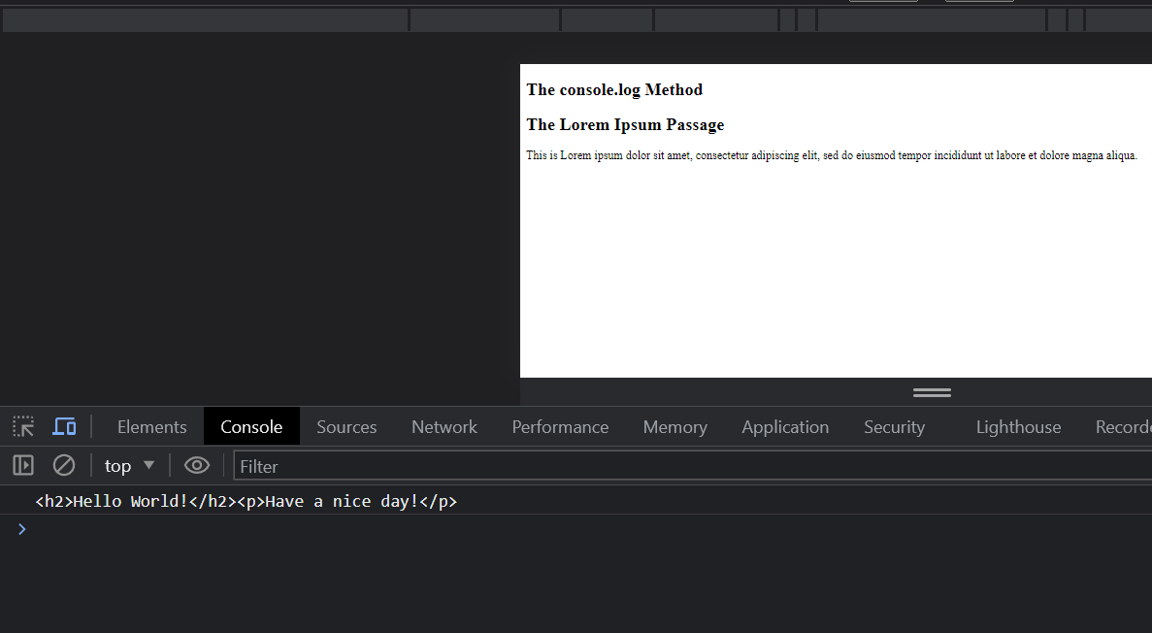
Example

Slide 32
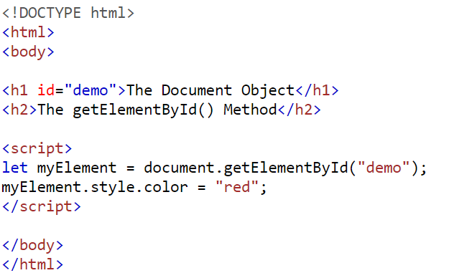
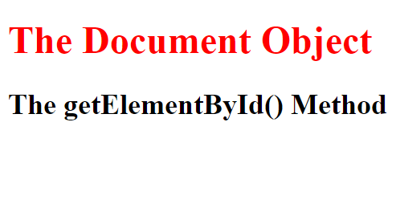
getElementById function
In JavaScript, the getElementById function is used to retrieve an HTML element from the document based on its unique identifier, known as the "id" attribute. Here's an example of how you can use getElementById:

Slide 33
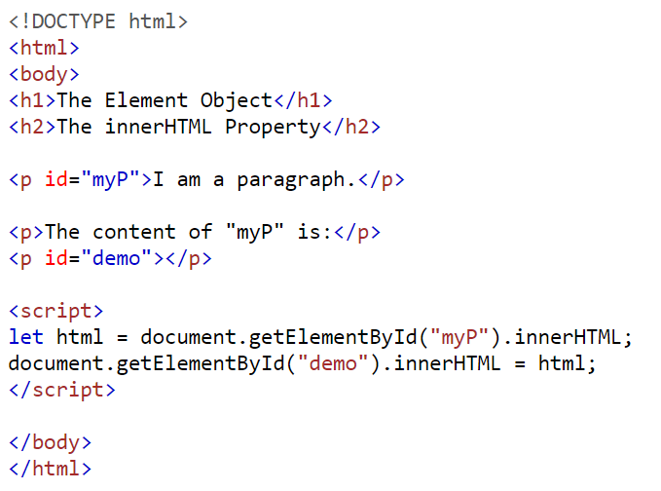
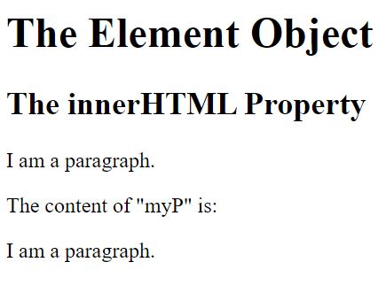
innerHTML property
The innerHTML property in JavaScript allows you to get or set the HTML content of an element. It represents the markup contained within the element, including any child elements, text, or HTML tags.
To get the HTML content of an element using innerHTML, you can access the property as shown in the following example:

Slide 34
parseFloat
parseFloat is a built-in JavaScript function that parses a string and returns a floating-point number. It is commonly used to convert a string containing a numeric value into its corresponding floating-point representation.
The syntax for parseFloat is as follows:
parseFloat(string)
Here, string is the input string that you want to parse into a floating-point number. The function will attempt to extract a numeric value from the string.
The parseFloat function works by examining the characters in the input string from left to right until it encounters a character that is not a valid part of a number. It then returns the numeric value extracted up to that point.

Slide 35
parseFloat
Here's an example that demonstrates the usage of parseFloat:
var numberString = '3.14';
var floatNumber = parseFloat(numberString);
console.log(floatNumber); // Output: 3.14
console.log(typeof floatNumber); // Output: "number“
In this example, the string '3.14' is successfully parsed by parseFloat, resulting in the floating-point number 3.14. The typeof operator confirms that the returned value is of type "number".
It's important to note that parseFloat may return NaN (Not a Number) if the string cannot be successfully parsed into a valid number.

Slide 36
Class and Object
In JavaScript, class and object are fundamental concepts used in object-oriented programming (OOP).
A class is a blueprint or a template for creating objects. It defines the properties and behaviors that objects of that class will have. You can think of a class as a cookie cutter, while objects are the cookies that are created using that cutter.
Here's an example of defining a class in JavaScript:

Slide 37
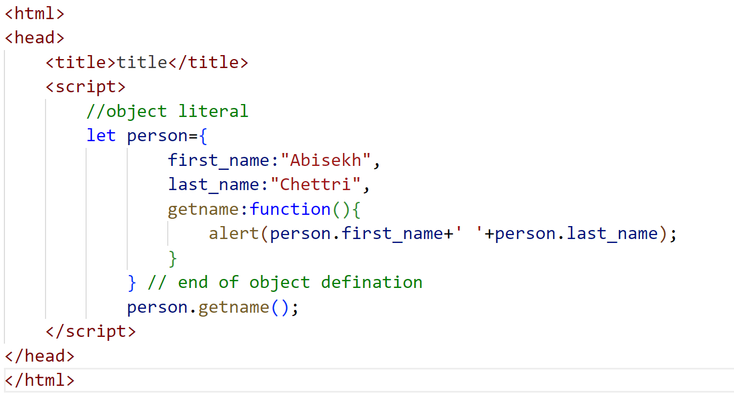
Creating object using object literals
We create object using object literal method
Syntax:
Object={ property1:value1,property2:value2;……………property:valueN}
Here, property and value is separated by :(colon) and two property is separated by comma.
Accessing property
Objectname.propertyname;

Slide 38
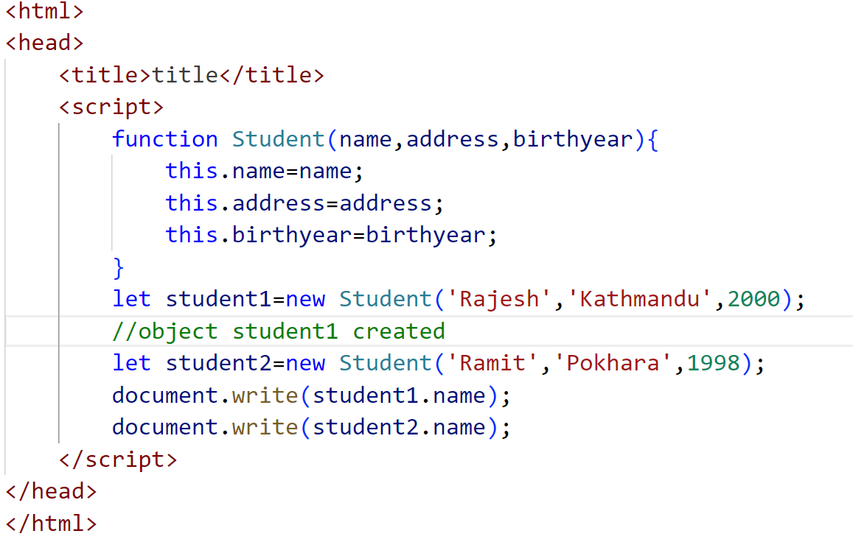
Creating objects with function constructors
Constructors in JavaScript, like in most other OOP languages, provides a template for creation of objects.
In other words, it defines a set of properties and methods that would be common to all objects initialized using the constructor.
For this we need to create function with argument, Each argument value can be assigned in the current object by using the keyword.
This keyword always refer to current object.

Slide 39
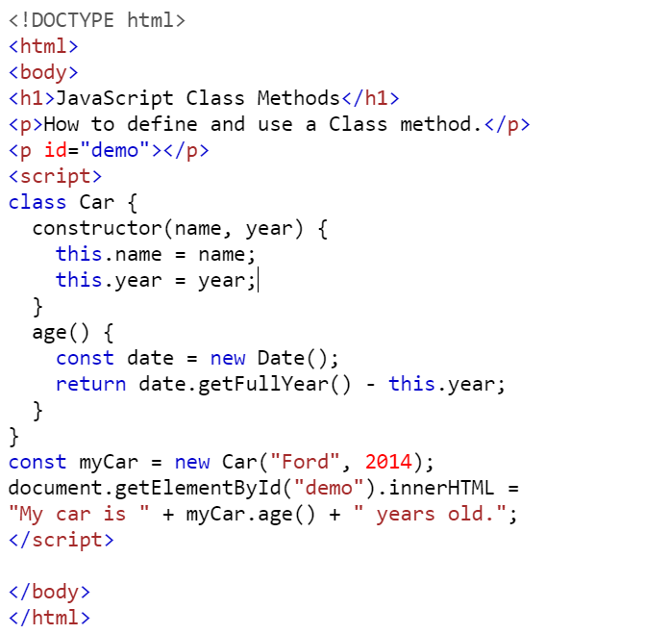
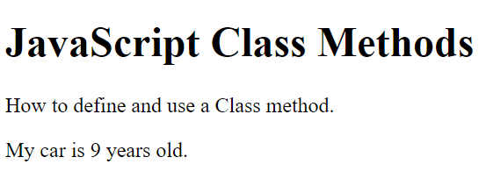
Creating objects with class

Slide 40
Built-in objects in JavaScript
JavaScript has several built-in objects that provide a wide range of functionality. These objects are part of the JavaScript language itself and are available for use without requiring additional code or libraries. Here are some commonly used built-in objects in JavaScript:
Array: The Array object is used to store and manipulate collections of elements. It provides methods for adding, removing, and accessing elements in an array.
String: The String object represents a sequence of characters and provides methods for manipulating and working with strings.
Number: The Number object represents numeric values and provides methods for working with numbers, such as mathematical operations.
Boolean: The Boolean object represents a Boolean value (true or false) and provides methods for working with logical operations.

Slide 41
Built-in objects in JavaScript
Date: The Date object is used for working with dates and times. It provides methods for creating, manipulating, and formatting dates.
Math: The Math object provides mathematical functions and constants. It includes methods for tasks like rounding numbers, generating random numbers, and performing complex calculations.
These are just a few examples of the built-in objects available in JavaScript. Each object has its own set of properties and methods that provide specific functionality. You can refer to the JavaScript documentation for more details on these objects and their usage.

Slide 42
JavaScript Array
In JavaScript, an array is a built-in data structure that allows you to store multiple values in a single variable. Arrays can contain elements of any type, including numbers, strings, objects, and even other arrays. Here's how you can work with arrays in JavaScript:
Creating an array:
const myArray = []; // An empty array
const numbers = [1, 2, 3, 4, 5]; // An array of numbers
const fruits = ["apple", "banana", "orange"]; // An array of strings
const mixedArray = [1, "two", { key: "value" }]; // An array with mixed types

Slide 43
Accessing elements in an array:
const numbers = [1, 2, 3, 4, 5];
console.log(numbers[0]); // Output: 1 (accessing the first element)
console.log(numbers[2]); // Output: 3 (accessing the third element)
console.log(numbers.length); // Output: 5 (getting the length of the array)

Slide 44
Modifying elements in an array:
let fruits = ["apple", "banana", "orange"];
fruits[1] = "grape"; // Modifying the second element
console.log(fruits); // Output: ["apple", "grape", "orange"]
fruits.push("kiwi"); // Adding an element to the end of the array
console.log(fruits); // Output: ["apple", "grape", "orange", "kiwi"]
fruits.pop(); // Removing the last element from the array
console.log(fruits); // Output: ["apple", "grape", "orange"]

Slide 45
Array methods and operations:
JavaScript provides various built-in methods and operations for working with arrays. Some commonly used ones include:
push(): Adds one or more elements to the end of an array.
pop(): Removes the last element from an array and returns it.
shift(): Removes the first element from an array and returns it.
unshift(): Adds one or more elements to the beginning of an array.
concat(): Combines two or more arrays.
slice(): Returns a new array with a portion of the original array.
splice(): Changes the contents of an array by removing, replacing, or adding elements.
indexOf(): Returns the first index at which a given element can be found in the array.
includes(): Checks if an array contains a certain element.
join(): Joins all elements of an array into a string.
sort(): Sorts the elements of an array in place.
reverse(): Reverses the order of elements in an array.

Slide 46
JavaScript String
In JavaScript, a string is a primitive data type used to represent textual data. It is a sequence of characters, such as letters, numbers, symbols, and whitespace, enclosed within single quotes (''), double quotes ("") or backticks (``). Here are some examples of string literals:
let message = "Hello, world!"; // using double quotes
let name = 'John Doe'; // using single quotes
let template = `My name is ${name}`; // using backticks for template literals

Slide 47
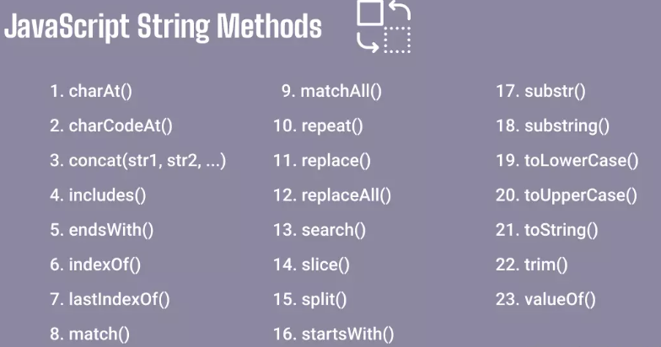
JavaScript String Methods
JavaScript provides a wide range of built-in string methods that allow you to manipulate and perform operations on strings. Here are some commonly used string methods:

Slide 48
String Length
The length property is not a method but a property of a string object in JavaScript. It returns the number of characters in a string. Here's an example:
let message = "Hello, world!";
let messageLength = message.length;
console.log(messageLength); // Output: 13
In the example above, message is a string with the value "Hello, world!". The length property is accessed using dot notation (message.length), which returns the length of the string, i.e., the number of characters in the string.
The resulting value is then stored in the messageLength variable and printed to the console, which will output 13 because the string "Hello, world!" contains 13 characters, including spaces and punctuation.

Slide 49
toUpperCase() and toLowerCase()
The toUpperCase() method is used to convert a string to uppercase. It returns a new string with all alphabetic characters in the original string converted to uppercase. Non-alphabetic characters remain unchanged.
The toLowerCase() method is used to convert a string to lowercase. It returns a new string with all alphabetic characters in the original string converted to lowercase. Non-alphabetic characters remain unchanged.
let str = "Hello, World!";
let uppercaseStr = str.toUpperCase();
console.log(uppercaseStr); // Output: "HELLO, WORLD!"
let lowercaseStr = str.toLowerCase();
console.log(lowercaseStr); // Output: "hello, world!"

Slide 50
concat()
In JavaScript, the concat() function can also be used to concatenate strings. It allows you to concatenate two or more strings and returns a new string containing the concatenated values.
Here's the syntax for using concat() to concatenate strings:
let firstName = "John";
let lastName = "Doe";
let fullName = firstName.concat(" ", lastName);
console.log(fullName); // Output: John Doe

Slide 51
slice()
In JavaScript, the slice() function is used to extract a portion of a string or an array and return a new string or array containing the extracted elements. The slice() function does not modify the original string or array; instead, it creates a new string or array containing the specified portion.
Syntax for using slice() with strings:
string.slice(startIndex, endIndex);
Example
var sentence = "The quickl brown fox jumps over the lazy dog.";
var extracted = sentence.slice(4, 9); document.write(extracted); //output:quick

Slide 52
replace()
In JavaScript, the replace() function is used to replace occurrences of a specified value or pattern within a string with a new value. The replace() function returns a new string with the replacements made.
Here's the syntax for using replace():
string.replace(searchValue, newValue);
Example:
var sentence = "The quick brown fox jumps over the lazy dog.";
var newSentence = sentence.replace("quick", "slow");
console.log(newSentence);
Output: The slow brown fox jumps over the lazy dog.
Visit :https://www.w3schools.com/js/js_string_methods.asp
for more string methods

Slide 53
Boolean objects
JavaScript provides the Boolean and Number as object wrappers for Boolean true/false values and numbers, respectively. These wrappers define methods and properties useful in manipulating Boolean values and numbers.
When JavaScript program requires a Boolean value, JavaScript automatically creates a Boolean object to store the value. JavaScript programmers can create Boolean objects explicitly with the statement.
var b=new Boolean(Boolean value);
var b=new Boolean(true);
Boolean object methods
toString(): This method is used to return a string either “true” or “false” depending upon the value of specifies Boolean object.
var b=true;
var a=b.toString() // returns Boolean value as string “true” to variable a
tovalueOf(): This method is used to return a Boolean value either “true” or “false” depending upon the value of specifies Boolean object.
b.toString() // returns value a Boolean value “true” or “false”

Slide 54
Number objects
JavaScript automatically creates Number objects to store numeric values in a script. You can create a Number object with the statement
var n=new Number(value);
The constructor argument value is the number to store in the object. Although you can explicitly create Number objects, normally the JavaScript interpreter creates them as needed.
Property | Description
EPSILON | The difference between 1 and the smallest number > 1.
MAX_VALUE | The largest number possible in JavaScript
MIN_VALUE | The smallest number possible in JavaScript
MAX_SAFE_INTEGER | The maximum safe integer (2⁵³ - 1)
MIN_SAFE_INTEGER | The minimum safe integer -(2⁵³ - 1)
POSITIVE_INFINITY | Infinity (returned on overflow)
NEGATIVE_INFINITY | Negative infinity (returned on overflow)
NaN | A "Not-a-Number" value

Slide 55
Number object methods
toExponential() :this method returns a string representation of a number with rounded and written in exponential form. The uniqueness of each method is in the arguments it accepts. The toExponential() method has an optional argument that can be used to set how many significant digits to use.
Example:
let n=12.6798;
alert(n.toExponential(2)); // return string 12.68e+0
alert(n.toExponential(3)); // return string 12.679e+0
toFixed() : this method determines the post decimal precision based on the argument passed.
let n=12.6798;
n.toFixed(0); // return 13
n.toFixed(2); // return 12.68

Slide 56
Number object methods
toPrecision(): The toPrecision method determines the significant digits to display based on the argument passed.
let n=12.6798;
n.toPrecision(); // return 12.9798
n.toPrecision(3); // return 12.9
toString() : This method returns a string representation of a number(in this case), but in other objects, it returns a string representation of that object type
let a =298;
a.toString(); // return string 298 from variable a
valueOf() : this method returns the primitive value of object type that calls it in this case, the Number object.
let a=298;
a.valueOf(); //returns 298 from a
(150+148).valueOf(); // returns 298 from (150+148)

Slide 57
Number object methods
ToLocateString(): returns a string value version of the current number in a format that may vary according to a browser’s locate settings.

Slide 58
Math object methods
JavaScript math object is a top level, a predefined object for mathematical constants and functions.
This object cannot be created by the user. It is a predefined object.
Mathematical properties and functions can be calculated by math.property or Math.method
Math.E // returns Euler's number Math.PI // returns PI Math.SQRT2 // returns the square root of 2 Math.SQRT1_2 // returns the square root of 1/2 Math.LN2 // returns the natural logarithm of 2 Math.LN10 // returns the natural logarithm of 10 Math.LOG2E // returns base 2 logarithm of E Math.LOG10E // returns base 10 logarithm of E

Slide 59
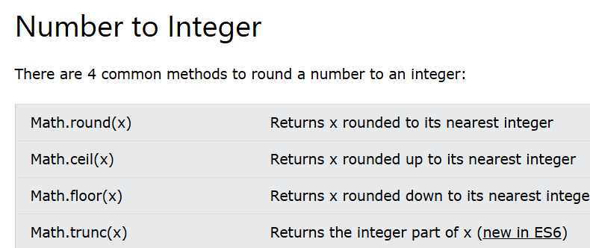
Math object methods

Slide 60
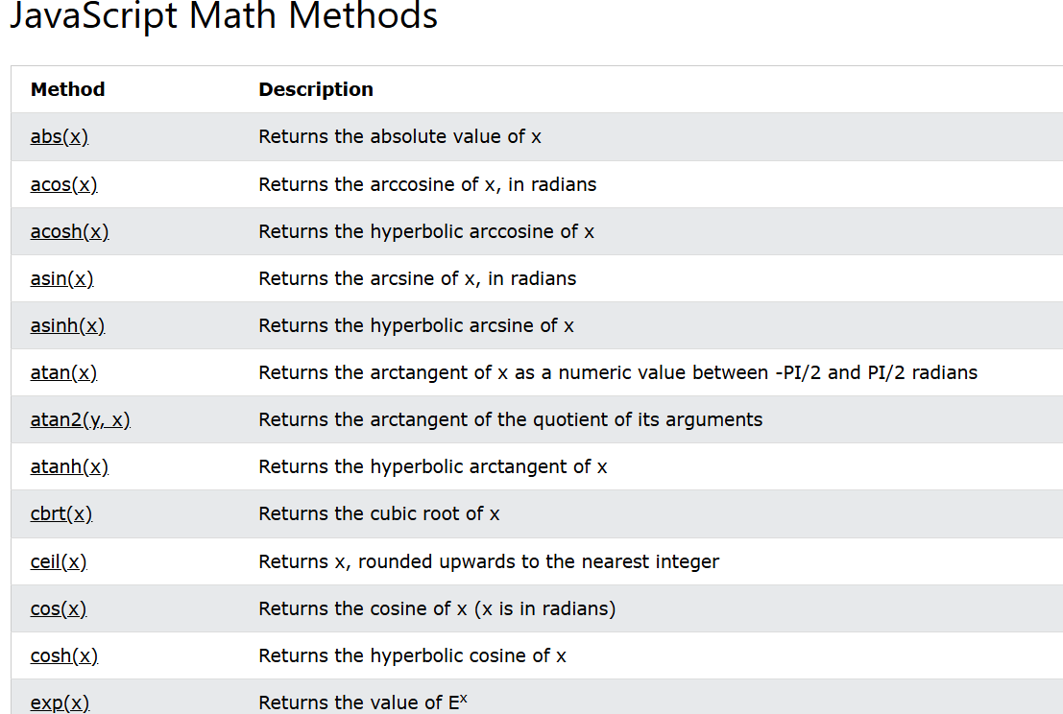
Math object methods

Slide 61
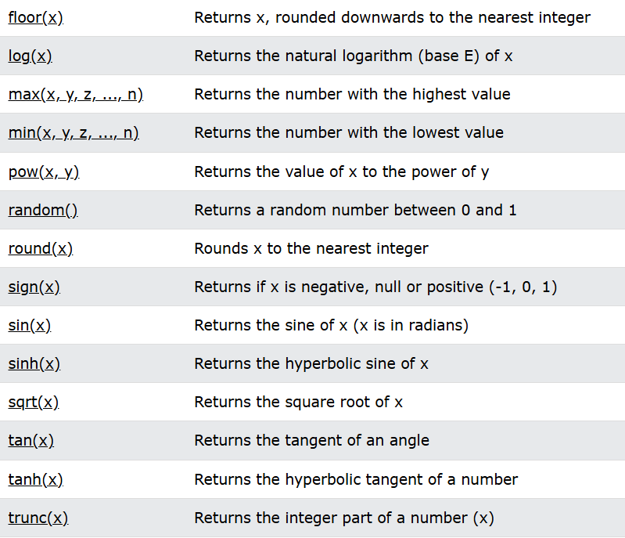
Math object methods

Slide 62
Date object
It is used to work with dates and times. The date object is created by using new keyword. i.e. new Date().
The Date object can be used date and time in terms of millisecond precision within 100 million dates before or after 1/1/1970. But sing another methods we can only get and set the year, month, date, hour, minutes second and millisecond fields using local or UTC of GMT time.
So, we can declare date in different ways, the basic things is that the date objects are created by the
new Date()
new Date(year, month, day, hours, minutes, seconds, milliseconds)
new Date(milliseconds)
new Date(date string)

Slide 63
Date object
new Date(): Date() constructor creates a Date object which sets the current date and time depend on the browser’s time zone. It does not accepts any value.
new Date(milliseconds): this method accepts single parameter milliseconds which indicates any numeric value. This argument is taken as the internal numerNew Date(datastring): this ,method accepts single parameter data string which indicates any string value. It is a string representation of a date and return the datastring with the day.
New Date(year, month, day, hours, minutes, seconds, milliseconds)
This method accepts seven parameters as mentioned above and described below.
Year: integer value which represents the year. Use full year, 2018 instead of 18 only.
Month: integer value which represents the month. The integer value are starts from 0 for January to 11 for December.
Date: integer value which represents the date

Slide 64
Date object
Hour: integer value which represents the hour in 24 hours scale.
Minute: integer value which represents the minute
Second: integer value which represents the second
Millisecond: integer value which represents the millisecond.

Slide 65
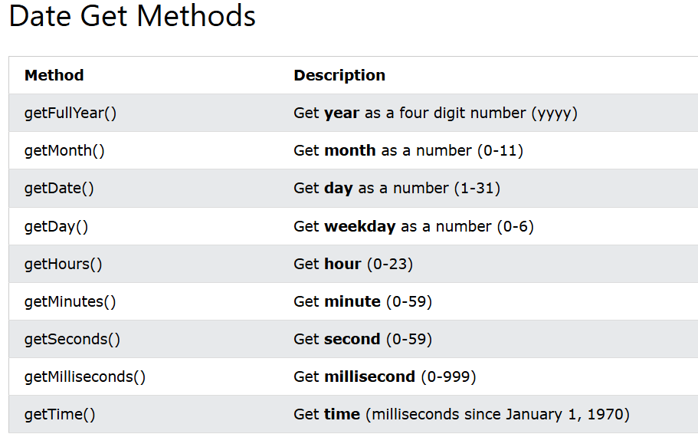
Date object methods

Slide 66
RegExp object
In JavaScript, a Regular Expression (RegEx) is an object that describes a sequence of characters used for defining a search pattern. It provide more precise search pattern.
Create a RegExp object:
There are two ways you can create a regular expression in JavaScript.
Using a regular expression literal:
The regular expression consists of a pattern enclosed between slashes /. For example,
const regularExp = /abc/;
Here, /abc/ is a regular expression.
Using the RegExp() constructor function:
You can also create a regular expression by calling the RegExp() constructor function. For example,
const regularExp = new RegExp('abc');
For example,
const regex = new RegExp(/^a...s$/);
console.log(regex.test('alias')); // true
In the above example, the string alias matches with the RegEx pattern /^a...s$/. Here, the test() method is used to check if the string matches the pattern.

Slide 67
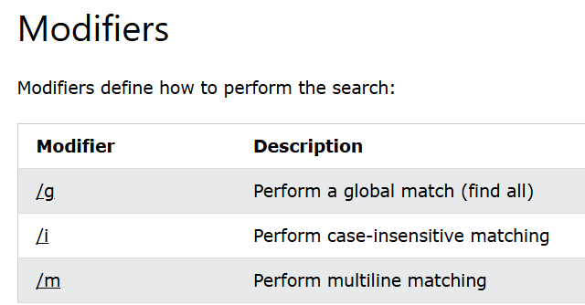
RegEx object methods
Syntax : /pattern/modifier(s);
Let b=/nccscollege/i;
Regexr.com to try and learn all variations of regex

Slide 68
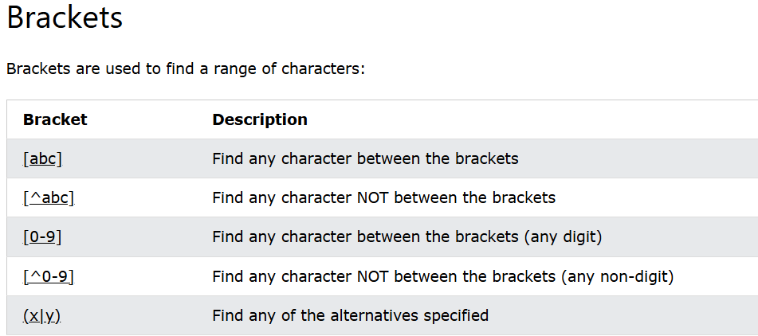
RegEx object methods
Eg. Text=“My favorite number is 7”;
document.write(text.match([0-9]); // selects the numbers between 0 to 9 i.e. returns 7

Slide 69
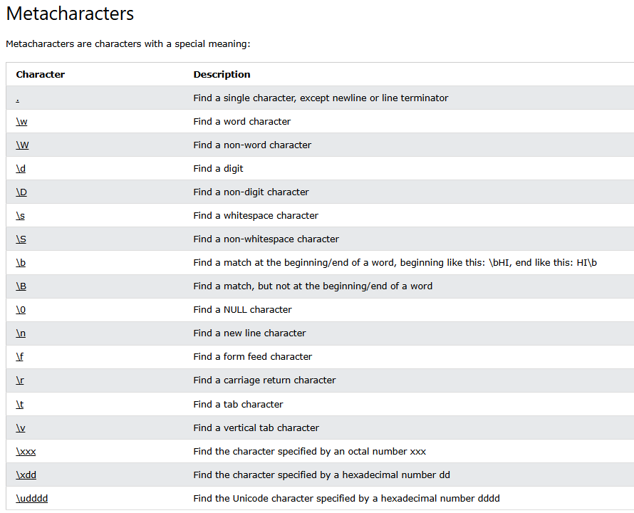
RegEx object methods

Slide 70
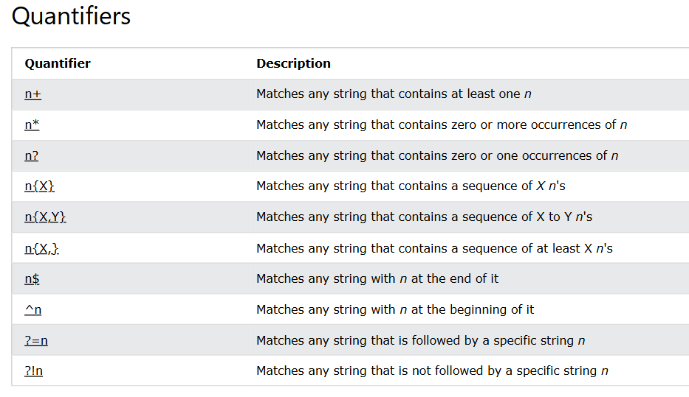
RegEx object methods

Slide 71
Window object
The window object is supported by all browsers. It represents the browser’s window. All global JavaScript objects, functions and variables automatically become members of the window object. Two properties can be used to determine the size of browsers window.
Both properties return sizes in pixels.
window.innerHeight: specifies inner height of browsers window
window.innerwidth: specifies inner width of the browser’s window
Methods Description
window.open() Open a new window
window.close() Close the current window
window.moveTo() Move to current window
window.resizeTo() Resize the current window

Slide 72
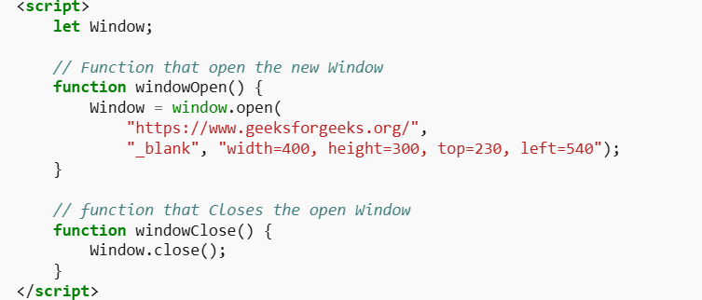
Window object

Slide 73
Event Handling
We can use events in javascript same as CSS. Check CSS slide for that.
JavaScript addEventListener()
The addEventListener() method is used to attach an event handler to a particular element. It does not override the existing event handlers. An event listener is a JavaScript's procedure that waits for the occurrence of an event.
The addEventListener() method is an inbuilt function of JavaScript. We can add multiple event handlers to a particular element without overwriting the existing event handlers.
Syntax
element.addEventListener(event, function);
event: It is a required parameter. It can be defined as a string that specifies the event's name.
function: It is also a required parameter. It is a JavaScript function which responds to the event occur.

Slide 74
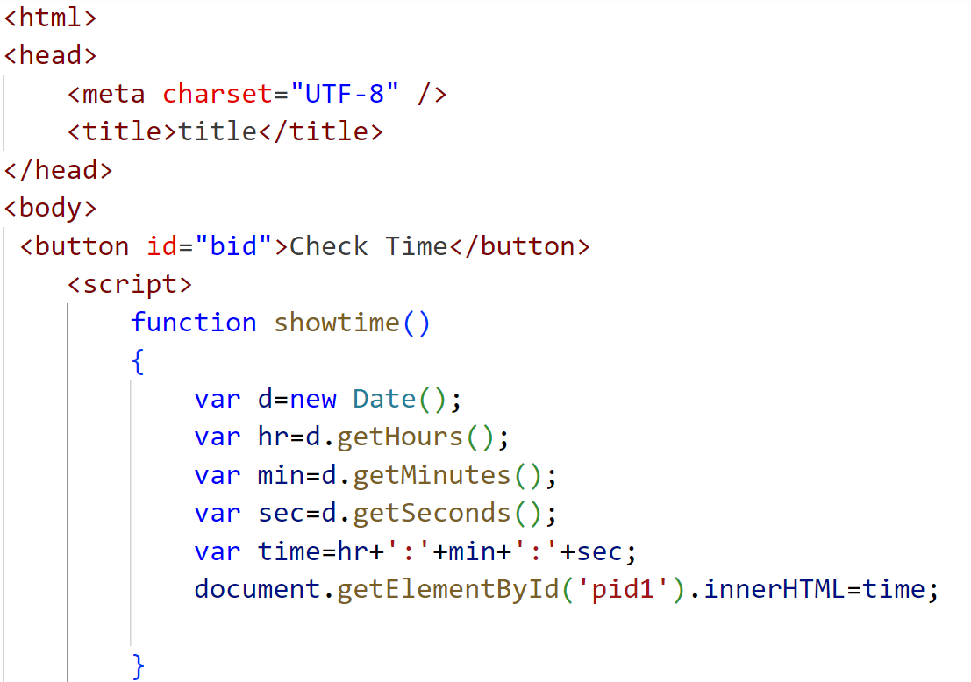
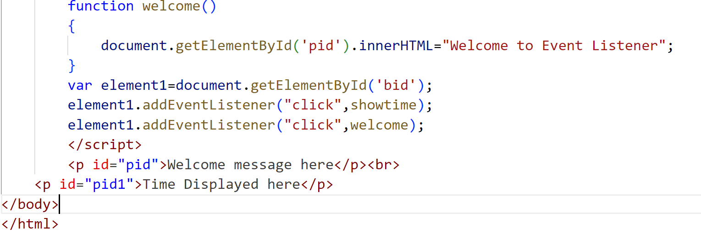
Event handling Eg

Slide 75
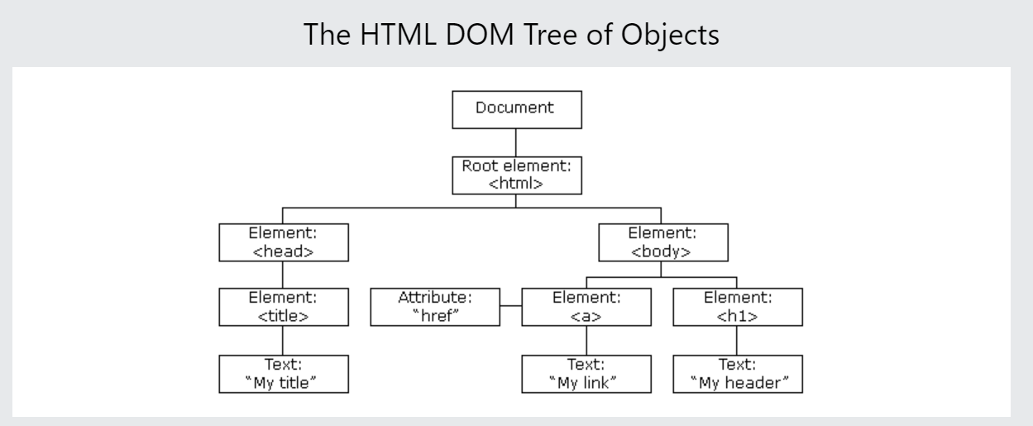
The HTML DOM (Document Object Model)
With the HTML DOM, JavaScript can access and change all the elements of an HTML document.
When a web page is loaded, the browser creates a Document Object Model of the page.
The HTML DOM model is constructed as a tree of Objects:

Slide 76
Here are some key concepts related to the DOM in JavaScript:
Document: The document object represents the HTML document loaded in the browser. It serves as the entry point to access and manipulate the DOM tree.
Element: Elements represent the individual HTML tags within the document. They are nodes in the DOM tree and can be accessed using methods like getElementById, getElementsByTagName, or querySelector.
Node: Nodes are the building blocks of the DOM tree. They can represent elements, text, comments, or other types of nodes. Nodes have various properties and methods to traverse the DOM tree and interact with other nodes.
Event: The DOM provides a way to handle events triggered by user actions or other sources, such as clicks, key presses, mouse movements, and more. You can attach event handlers to elements to respond to these events using methods like addEventListener.

Slide 77
Form validation
Forms in web pages are sent to server for processing. If the data in form are incorrect then it may put lot of burden in server. So JavaScript provides a way to validate forms data on the clients computer before sending it to the web server.
Form validation generally performs two functions:
Basic validation: First of all, the form must be checked to make sure all the mandatory fields are filled in.
Data format validation: Secondly, the data that is entered must be checked for correct form and value.

Slide 78
Error Handling in JavaScript
What is an Error?
An error is an event that occurs during the execution of a program that prevents it from continuing normally. Errors can be caused by a variety of factors, such as syntax errors, runtime errors, and logical errors.
Syntax Errors
Logical Errors
Runtime Error

Slide 79
Error Handling in JavaScript
What is Error Handling?
Whenever any error occurs in the JavaScript code, the JavaScript engine stops the execution of the whole code. If you handle such errors in the proper way, you can skip the code with errors and continue to execute the other JavaScript code.

Slide 80
Error Handling in JavaScript
Throw, and Try...Catch...Finally
The try statement defines a code block to run (to try).
The catch statement defines a code block to handle any error.
The finally statement defines a code block to run regardless of the result.
The throw statement defines a custom error.

Slide 81
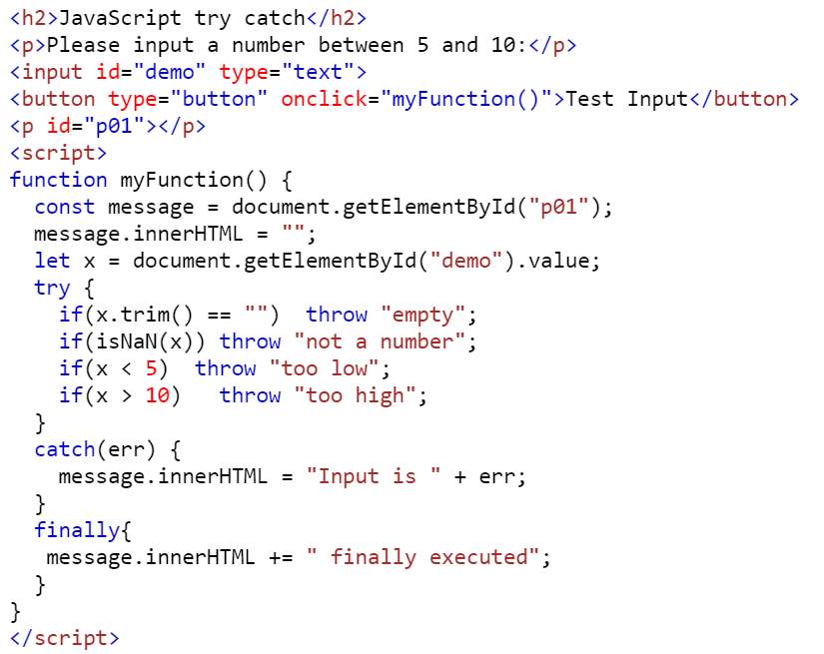
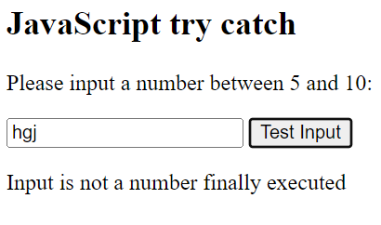
Example

Slide 82
JavaScript Cookies
Cookies are data, stored in small text files, on your computer.
Cookies let you store user information in web pages.
When a web server has sent a web page to a browser, the connection is shut down, and the server forgets everything about the user.
Cookies were invented to solve the problem "how to remember information about the user":
When a user visits a web page, his/her name can be stored in a cookie.
Next time the user visits the page, the cookie "remembers" his/her name.

Slide 83
JavaScript Cookies
Cookies are saved in name-value pairs like:
username = John Doe
When a browser requests a web page from a server, cookies belonging to the page are added to the request. This way the server gets the necessary data to "remember" information about users.
None of the examples below will work if your browser has local cookies support turned off.

Slide 84
How It Works ?
Your server sends some data to the visitor's browser in the form of a cookie. The browser may accept the cookie. If it does, it is stored as a plain text record on the visitor's hard drive. Now, when the visitor arrives at another page on your site, the browser sends the same cookie to the server for retrieval. Once retrieved, your server knows/remembers what was stored earlier.

Slide 85
Create a Cookie with JavaScript
JavaScript can create, read, and delete cookies with the document.cookie property.
With JavaScript, a cookie can be created like this:
document.cookie = "username=John Doe";
You can also add an expiry date (in UTC time). By default, the cookie is deleted when the browser is closed:
document.cookie = "username=John Doe; expires=Thu, 18 Dec 2013 12:00:00 UTC";
With a path parameter, you can tell the browser what path the cookie belongs to. By default, the cookie belongs to the current page.
document.cookie = "username=John Doe; expires=Thu, 18 Dec 2013 12:00:00 UTC; path=/";

Slide 86
Read a Cookie with JavaScript
With JavaScript, cookies can be read like this:
let x = document.cookie;
document.cookie will return all cookies in one string much like: cookie1=value; cookie2=value; cookie3=value;

Slide 87
Change a Cookie with JavaScript
With JavaScript, you can change a cookie the same way as you create it:
document.cookie = "username=John Smith; expires=Thu, 18 Dec 2013 12:00:00 UTC; path=/";
The old cookie is overwritten.

Slide 88
Delete a Cookie with JavaScript
Deleting a cookie is very simple
You don't have to specify a cookie value when you delete a cookie.
Just set the expires parameter to a past date:
document.cookie = "username=; expires=Thu, 01 Jan 1970 00:00:00 UTC; path=/;";

Slide 89

JQuery
jQuery is a JavaScript library that makes web pages quicker, easier, responsive and handler the request.
Often with jQuery you can write a single line of code to achieve what would have taken 10-20 lines of regular JavaScript code.
jQuery allows web developers to plug routine JavaScript features into a web page so they can spend more time focusing on complicated features that are unique to their site.
Things you can do with jQuery:
Adding animated effects to elements like fading in/out, sliding in/out and expanding/contracting.
Making XML requests.
Manipulating DOM. You can easily add, remove and reorder content in the web pages using just a couple of lines of code.
Creating image slideshows
Making Drop-down menus
Creating drag and drop interfaces
Adding complex client side form validation.

Slide 90
JQuery Syntax
$(selector).methodorFunction();
All statements come from a basic template for applying functions and methods to selected HTML elements and their attributes. This method can be easily modified depending on the selector and the action which is the applied method or function.
Document Ready Event
Before jQuery is applied, it is important to make sure that all HTML elements have been loaded and the CSS is fully computed. These conditions are necessary for jQuery to be applied properly. To make sure that is the case, we place all jQuery inside the document ready event. This means that the statements inside the block of code will only be applied once the web page has finished loading.
$(document).ready(()=>{
$(‘.fast’).hide(); //All jQuery statements go here
});

Slide 91
jQuery Selectors
Selectors in jQuery are meant to specify a set of elements based on certain attributes such as ID, class, or the type of tag itself. These elements can then be selected of applying the jQuery method or a function you define.
Selecting by Type:(element name)
$(“a”) // a tag
Selecting by Class:
$(“.example”) // example being class name of HTML element
Selecting by ID:
$(“#example1”) //example1 being ID name of HTML element

Slide 92
jQuery Selectors
Selecting by Possession of Attribute
$(“[href]”) // selects the HTML element(a tag) with href as attribute
Selecting by Attribute Value:
$(“[href=‘index.html’]”)
//selects the HTML element with href attribute and index.HTML as value
Selecting by ID:
$(“#example1”) //example1 being ID name of HTML element
Selecting by Pseudo state
You can also select in jQuery using pseudo states including :first-child, :last-child, :first-of-type, :last-of-type, etc
$(“a:first-of-type”) //will select first a tag element among series of a tags.

Slide 93
jQuery Selectors
Combining jQuery selectors
$(“a.class1.class2#someid[attribute][attribute=‘something’”) OR
$(“a,.class1,#someID”)
Wildcard selection(Universal):
There might be cases when we want to select all elements but there is not a common property to select upon(class, attribute, etc). In that case we can use the * selector that simply selects all the elements.
$(‘#wrapper *’) //selects all elements inside #wrapper element

Slide 94
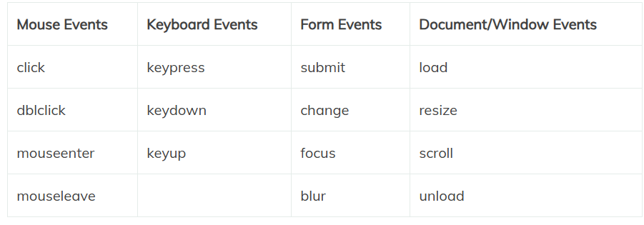
jQuery Events

Slide 95
jQuery Effects
i) hide/show: with jQuery we can hide and show HTML elements with the hide() and show() methods:
Syntax: $(selector).hide(speed, callback);
Syntax: $(selector).hide(speed, callback);
The optional speed parameter specifies the speed of the hiding or showing and can take values : “slow”, “fast” or milliseconds. The optional callback parameter is a function to be executed after the hide() or show() method completes.
Example: $(“button”).click(function(){
$(“p”).hide(1000); //hide content under p tag with 1000 millisecond speed on clicking button
});

Slide 96
jQuery Effects
fade:
With jQuery we can fade an element in and out of visibility. jQuery has fadeIn(), fadeOut(), fadeToggle(), fadeTo() fade methods. Let us take jQuery fadeIn() method.
Syntax: $(selector).fadeIn(speed, callback);
Example: $(“button”).click(function(){
$(“p”).fadeIn(1000); //fades content under p tag with 1000 millisecond speed on clicking button
});

Slide 97
jQuery Effects
Slide:
The jQuery slide methods slide elements up and down. It creates sliding effect on elements. jQuery has slideDown(), slideUp(), slideToggle() methods. Let us take slideDown() method.
Syntax: $(selector).slideDown(speed, callback);
Example: $(“button”).click(function(){
$(“p”).slideDown(1000); //slides content under p tag with 1000 millisecond speed on clicking button
});

Slide 98
jQuery Effects
Animate:
We can create custom animations using jQuery.
Syntax: $(selector).animate({parameter},speed, callback);
The parameters specifies the CSS properties to be animated.
Example: $(“button”).click(function(){
$(“p”).animate({left: ‘250px’});
});

Slide 99
jQuery Effects
stop():
stop() method is used to stop animations or effects before it is finished. This method words for all jQuery effect functions, including sliding, fading and custom animations.
Syntax: $(selector).stop({parameter}, stopAll, goToEnd);
The optional stopAll parameter specifies whether also the animation queues should be cleared or not, default is false. The optional goToEnd parameter specifies whether or not to complete the current animation immediately, default is false.
Example: $(“button”).click(function(){
$(“#div”).stop();
});

Slide 100
jQuery Effects
callback():
stop() function is executed after the current effect is finished.
Syntax: $(selector).hide(speed,callback);
Example: $(“button”).click(function(){
$(“p”).hide(“slow”,function(){
alert(“The paragraph is now hidden”);
});
});

Slide 101
jQuery Effects
chaining():
Chaining allows us to run multiple jQuery commands one after another on the same element(s). To chain an action we simply append the action to the previous action. The following example chains together the css(), slideUp() and slideDown() methods.
Example: $(“button”).click(function(){
$(“#div”).css(“color”, “red”).slideUp(2000),slideDown(2000);
});

Slide 102

Introduction to JSON
JSON (JavaScript Object Notation) is a text-based, human-readable data interchange format used to exchange data between web clients and web servers. The format defines a set of structuring rules for the representation of structured data. JSON is used as an alternative to Extensible Markup Language (XML).
JSON is used in JavaScript on the internet as an alternative to XML for organizing data. JSON is language-independent and can be combined with C++, Java, Python and many other languages. Unlike XML, which is a full markup language, JSON is simply a way to represent data structures. JSON documents are relatively lightweight and are rapidly executed on web servers.

Slide 103
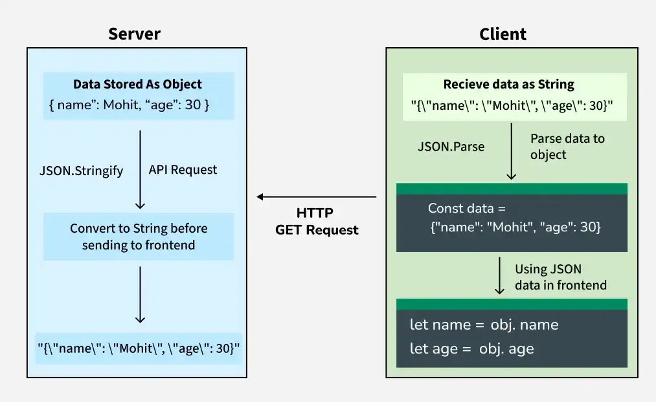
JSON Data Flow: From Server to Client
In a typical web application, the server sends data to the client (frontend) as JSON.
Server Side:
Data is stored as a JavaScript object.
Before sending the data to the client, it's converted to a JSON string using JSON.stringify().
Client Side:
The JSON string is received as part of an API response (e.g., via an HTTP GET request).
The client parses this string back into a JavaScript object using JSON.parse().
The parsed object is then used in the frontend code.

Slide 104
Convert Object into JSON
Transferring Objects from server side to client side
Convert Object into JSON
let obj = {name: "Mohit", age: 30};
let jsonS= JSON.stringify(obj);
console.log(jsonS);

Slide 105
Convert JSON into object
Here’s a JSON string received from the server we need to parse it into a JavaScript object:
const jsonS = '{"name":"Mohit", "age":30}’;
const obj1 = JSON.parse(jsonS);
let name = obj1.name;
let age = obj1.age;
console.log(`Name: ${name}, Age: ${age}`);

Slide 106
Key Features of JSON
Text-based: JSON is a simple text format, making it lightweight and easy to transmit.
Human-readable: It uses key-value pairs, making the structure easy to understand.
Language-independent: While it is derived from JavaScript, JSON is supported by many programming languages including Python, Java, PHP, and more.
Data structure: It represents data as objects, arrays, strings, numbers, booleans, and null.
JSON Structure
The basic structure of JSON consists of two primary components:
Objects: These are enclosed in curly braces {} and contain key-value pairs.
Arrays: Arrays are ordered lists enclosed in square brackets [].
Applications of JSON
APIs: JSON is the most commonly used format for API responses due to its lightweight nature.
Configuration Files: Many software systems use JSON files for storing configuration data.
Databases: Some NoSQL databases, like MongoDB, store data in JSON-like formats.
Data Transfer: JSON is widely used for transferring data between servers and clients, especially in web development.

