Slide 1
NetCache: Balancing Key-Value Stores with Fast In-Network Caching
Xin Jin, Xiaozhou Li, Haoyu Zhang, Robert Soulé, Jeongkeun Lee, Nate Foster, Changhoon Kim, Ion Stoica
in Proc. of ACM SOSP, 2017.
NSLab Seminar
Subin Park
Networking and Systems Lab.
20211128@sungshin.ac.kr
January 5, 2023

Slide 2
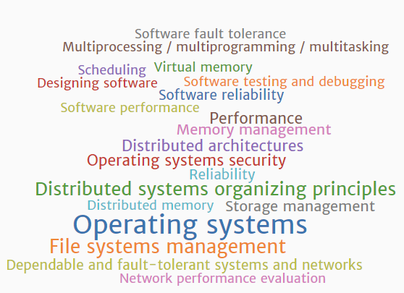

Session
The 10 ACM A. M. Turing Award Winners
2020 Jeffrey D. Ullman
2017 John L. Hennessy
2017 David A Patterson
2012 Silvio M Micali
2008 Barbara H. Liskov
1992 Butler W Lampson
1983 Ken Thompson
1983 Dennis M. Ritchie
1972 Edsger Wybe Dijkstra
SOSP (Symposium on Operating Systems Principles)
Held once every two years since 1967, when the first SOSP conference took place in Gatlinburg, Tennessee
Subject Areas

Slide 3
Contents
Introduction
Motivation
Overview
Design
Discussion
Implementation
Evaluation
Conclusion

Slide 4
Introduction
Popular items receive far more queries than others, and the set of “hot items” changes rapidly due to popular posts, limited-time offers, and trending events
This skew can lead to severe load imbalance, which results in significant performance degradations
The problem of load imbalance is particularly acute for high-performance, in-memory key-value stores
While traditional flash-based and disk-based key-value stores can be balanced using a fast in-memory caching layer, server-based caching does not work for in-memory stores
This paper presents NetCache, a new key-value store architecture that leverages the power and flexibility of new generation programmable switches to cache data in the network(개조식 문장에서는 마침표를 쓰지 않습니다)
Switches are optimized for data input-output
Overall, the entire system is able to guarantee high aggregate throughput and low latency despite workload skew

Slide 5
Motivation
Load balancing for performance guarantees
Key-value stores are expected to provide high performance guarantees to meet strict service level agreements (SLAs)
Ideally, if the throughput of each storage node is T, a key-value store with N nodes should be able to guarantee an aggregate throughput of N · T
The skewed, dynamic workloads make it difficult to provide high performance
The system is bottlenecked by the overloaded nodes, leaving many other nodes not fully utilized, so that the entire system cannot achieve the desired aggregate throughput
This causes the system to have high tail latencies, which violate the latency requirements

Slide 6

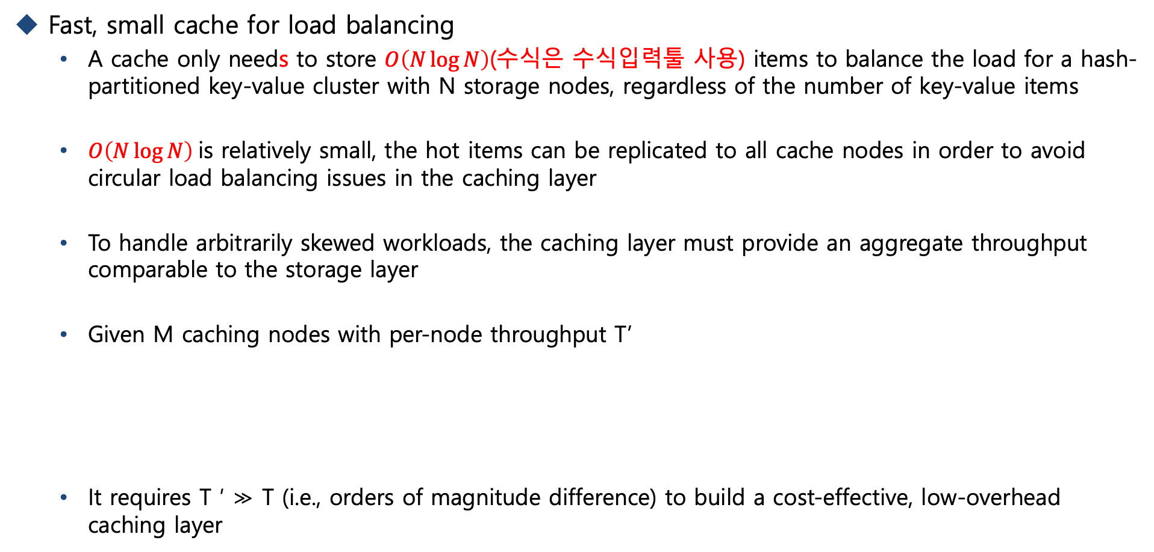
Motivation
Fast, small cache for load balancing
A cache only needs to store $O\left(N\log{N}\right)$(수식은 수식입력툴 사용) items to balance the load for a hash-partitioned key-value cluster with N storage nodes, regardless of the number of key-value items
$O\left(N\log{N}\right)$is relatively small, the hot items can be replicated to all cache nodes in order to avoid circular load balancing issues in the caching layer
To handle arbitrarily skewed workloads, the caching layer must provide an aggregate throughput comparable to the storage layer
Given M caching nodes with per-node throughput T’
It requires T ′ ≫ T (i.e., orders of magnitude difference) to build a cost-effective, low-overhead caching layer

Slide 7
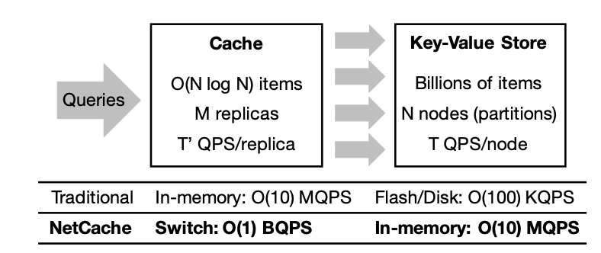
Motivation
In-network caching for in-memory key-value stores
As key-value stores themselves are being moved to the main memory, in memory caches lose their performance advantage and are no longer effective
In-memory caches are effective for flash-based and disk-based key-value stores since DRAMs are orders of magnitude faster than SSDs and HDDs
Building the caching layer into the network is a natural solution for balancing in-memory key-value stores
Switches are optimized for I/O
If we use the ToR switch as the cache for a key-value storage rack, it incurs no latency penalties and no additional hardware cost
어떤 그림인지 그림에 대한 캡션 텍스트 박스로 달아주세요

Slide 8
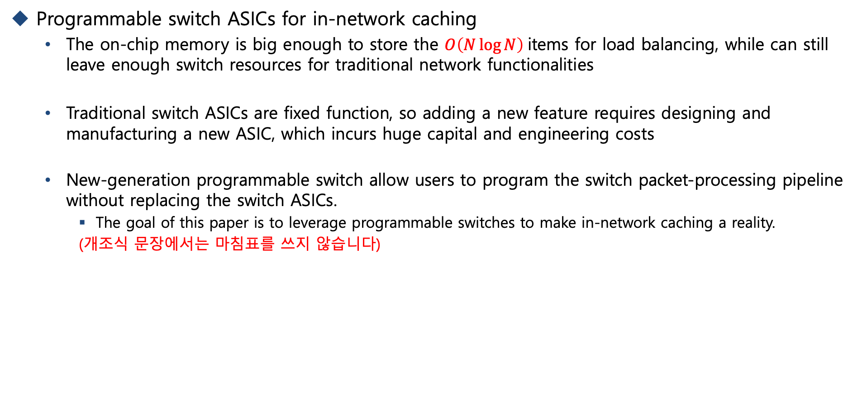
Motivation
Programmable switch ASICs for in-network caching
The on-chip memory is big enough to store the $O\left(N\log{N}\right)$items for load balancing, while can still leave enough switch resources for traditional network functionalities
Traditional switch ASICs are fixed function, so adding a new feature requires designing and manufacturing a new ASIC, which incurs huge capital and engineering costs
New-generation programmable switch allow users to program the switch packet-processing pipeline without replacing the switch ASICs.
The goal of this paper is to leverage programmable switches to make in-network caching a reality.
(개조식 문장에서는 마침표를 쓰지 않습니다)

Slide 9
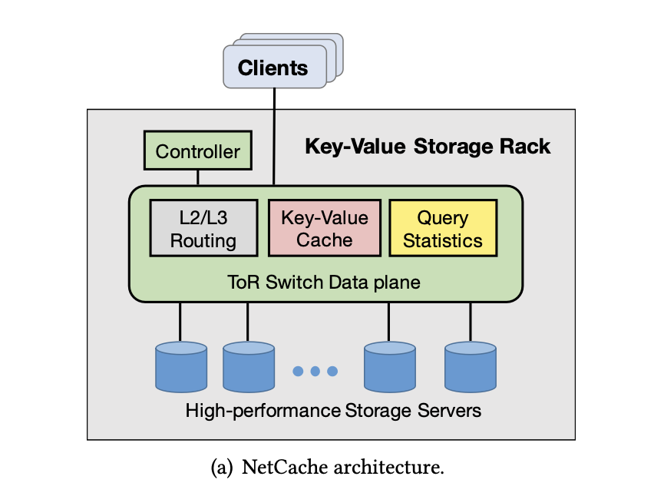
Overview
Switch
We reserve an L4 port to distinguish NetCache packets from other packets
This makes NetCache fully compatible with other network protocols and functions
The key-value cache module stores the hottest items
The query statistics module provides key-access statistics to the controller for cache updates
Controller
The controller is primarily responsible for updating the cache with hot items
It receives HH reports from the switch data plane and compares them with per-key counters of the items already in the cache.
그림 캡션은 텍스트박스로 달아주세요 (전체 발표자료에서의 통일성)

Slide 10
Overview
Storage servers
NetCache servers run a simple shim that provides two important pieces of functionality:
It maps NetCache query packets to API calls for the key-value store
It implements a cache coherence mechanism that guarantees consistency between the caching and storage layers
Clients
NetCache provides a client library that applications can use to access the key-value store

Slide 11
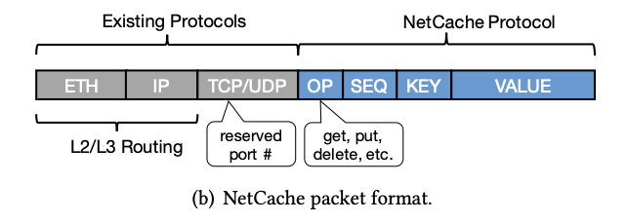
Design
Packet format
NetCache is an application-layer protocol embedded inside the L4 payload
The NetCache fields are inside the TCP/UDP payload and a special TCP/UDP port is reserved for NetCache
Network routing
NetCache leverages existing routing protocols to forward packets and can coexist with other network protocols and functions
그림 캡션은 텍스트박스로 달아주세요 (전체 발표자료에서의 통일성)

Slide 12
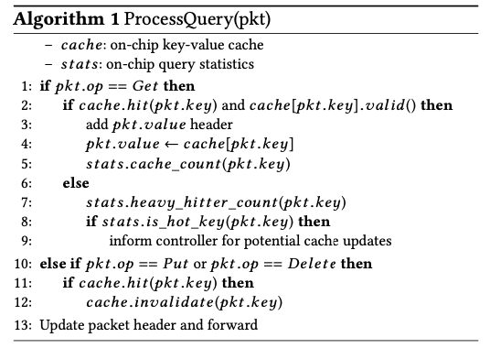
Design
Network routing
NetCache switches process NetCache queries based on Algorithm 1
Other switches simply forward packets based on the destination MAC/IP address according to the L2/L3 routing protocol.
알고리즘에 대한 설명이 그림으로 존재한다면
되도록 알고리즘 사진을 통째로 가져오는 것은
지양하는 것이 좋습니다☺

