Slide 1
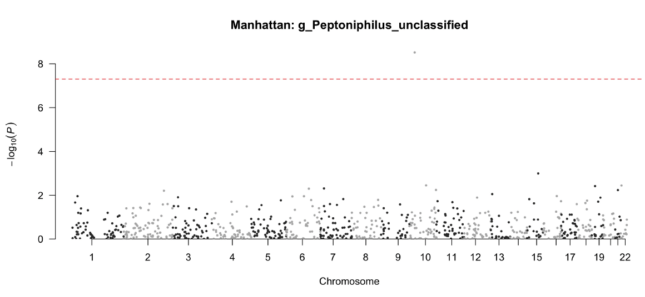
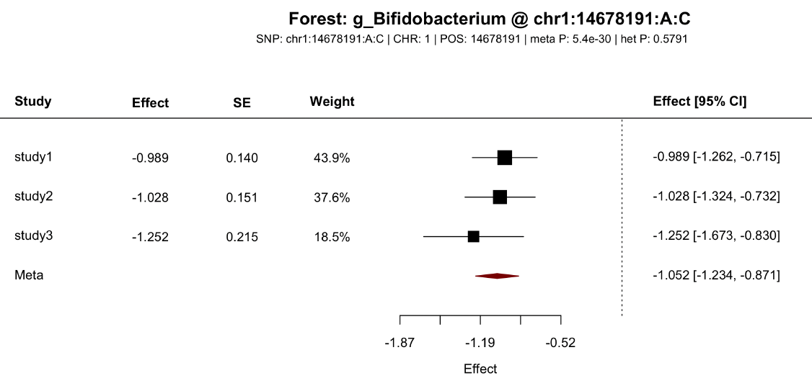
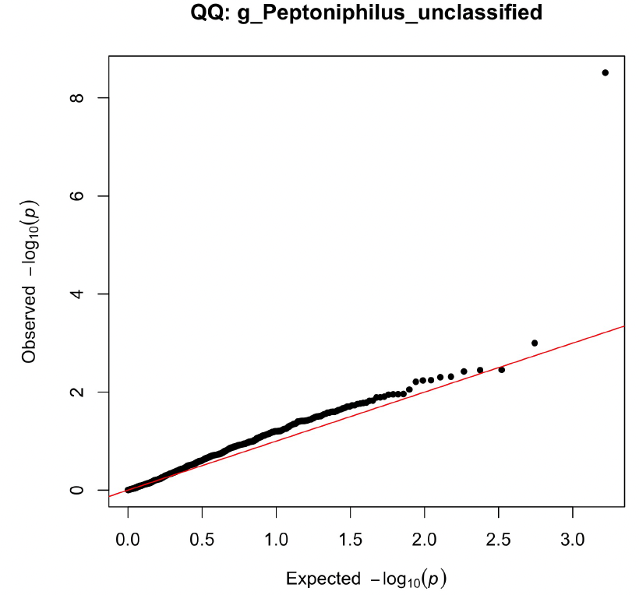
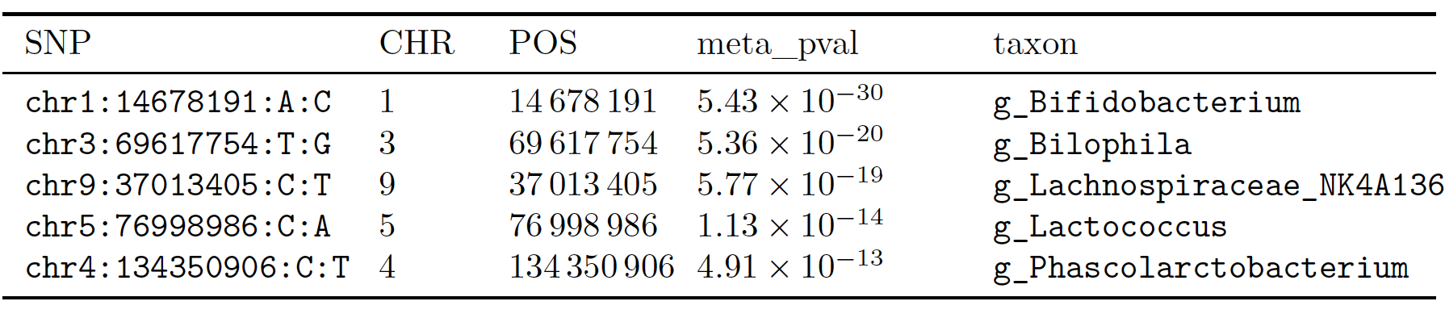
Analysis workflow
Reporting and visualization
Feature abundance
Covariate
SNP genotypes
(in plink/vcf/bgen)
Step 0: ID matching, sample QC, missing check
Abundance aligned
Covariate aligned
Step 1: Fit the null quasi-Poisson model
Null model object
Step 2: Construct AA-level summary statistics
Summary statistics (effect estimate, standard error)
Step 3: Perform cross-study meta-analysis
Feature-SNP association test pvals
Notes:
Fig. 1

