Slide 1

Making A Game With Godot

Slide 2
What Is Godot?
General purpose game engine
  2D & 3D rendering
  Custom shader language
  Python-like scripting language
  Cross platform (Linux, Mac, Win, mobile, console)
IDE
  Code editor
  Scene editor
  Live editing
  Debugger
Free Software

Slide 3
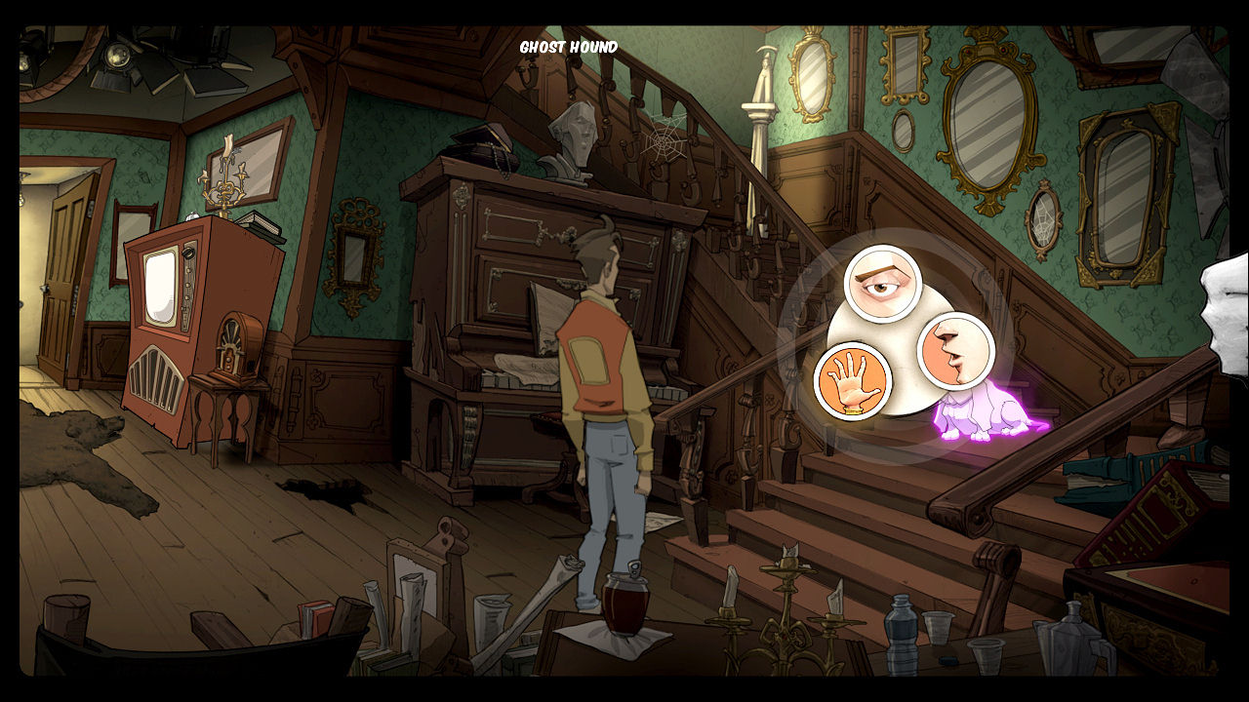
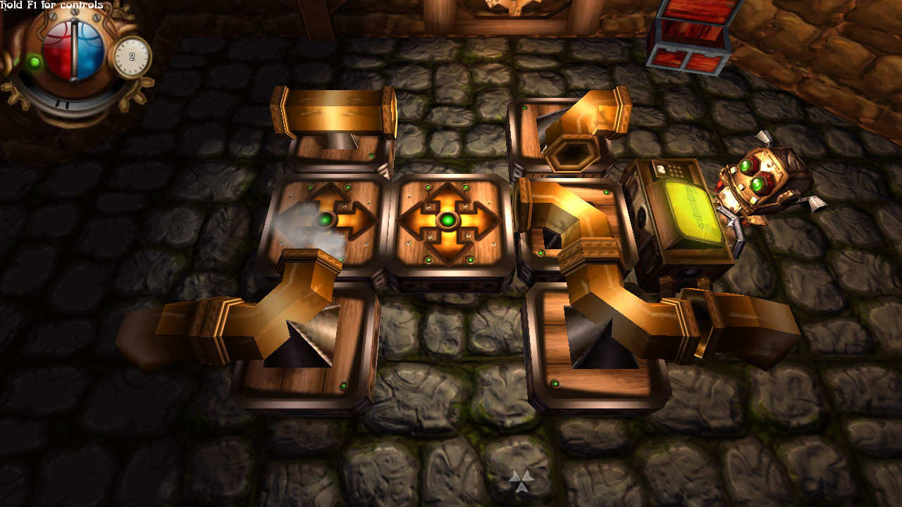
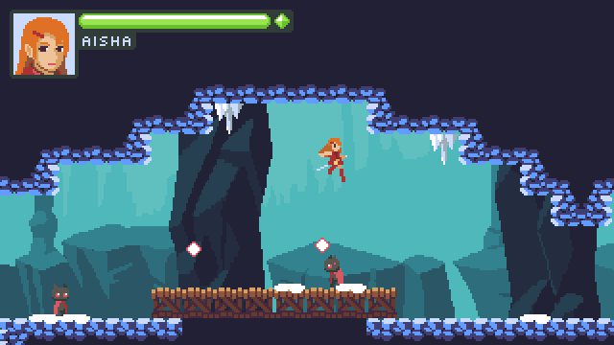
What Games Use Godot?
The Interactive Adventures of Dog Mendonça & Pizzaboy (2016) - OKAM Studio
Steam Quest (2015) - Kivano Software
Dolphin Island 2 (2015) – Jan Marcano
Many others! (including Super Happy Fun Sun)

Slide 4

Who Makes Godot?
Originally developed by Ariel Manzur and Juan Linietsky
Used extensively by OKAM Studio
Released as Free Software in 2014
Continued community development and support from the Software Freedom Conservancy

Slide 5
Planning Out A Game
Identify the core experience
Consider the critical path
Front-load development that provides insight
Identify and design around the impact of late features
Know your skills, know your tools

Slide 6
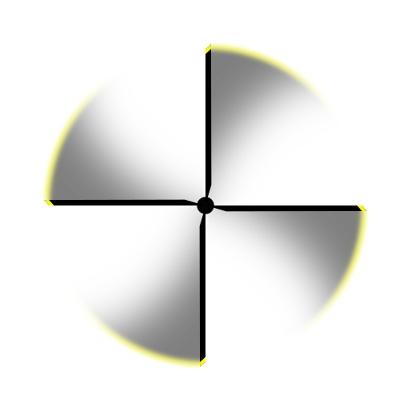
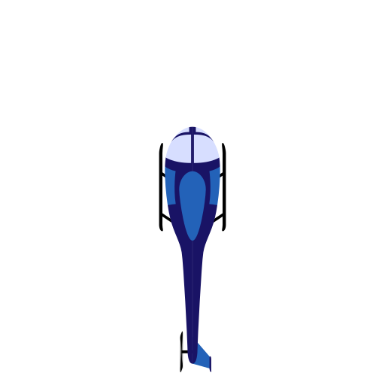
Tiny Chopper Raceway
Top down racing game
Fly helicopters along a track
Guide player progress via checkpoints
Focus on precision flying against inertia

Slide 7
Brainstorming
Track segments for tile map
Chopper chasis sprite
Chopper blade sprite (blurred version?)
Scenery doodads
Pickups
Lighting?
Crash animations? Explosions? Screenshake? Debris?
Collision/render mask change for underpasses?
Checkpoints or pickups to guide gameplay direction?
Dynamic obstacles?
Banking animations?
Banking affects acceleration?
Local multiplayer?
Multiple choppers?
Battery/fuel?
Trails (splines?)
Load maps/choppers from file for modding support?
Drag box style camera movement
HUD
  Battery/fuel
  Time
  Minimap?
  RPM
  Velocity
  Place
  Laps/checkpoints?
Controls
  Directional (SHFS?)
  Bank/Tilt/Power?
  Determined by chopper type?

Slide 8
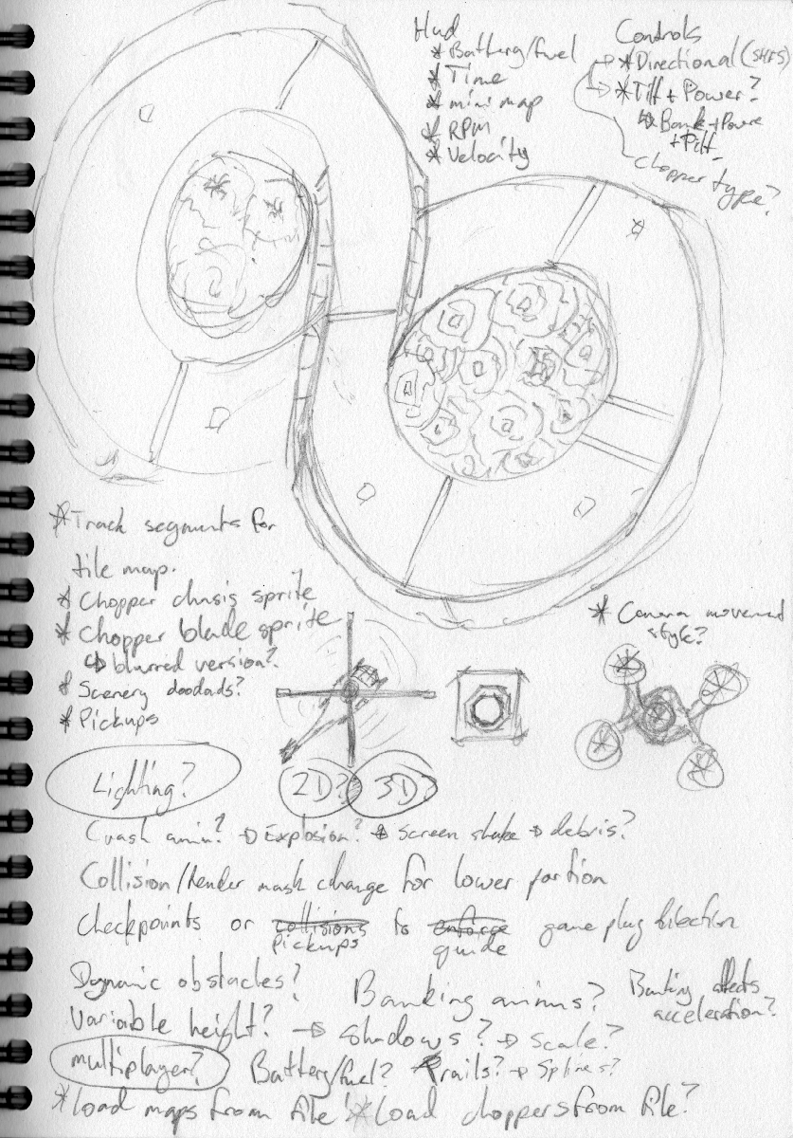
Brainstorming

Slide 9
Broader Design Considerations
Programmatically instantiate levels, players, etc.
Programmatically create event/signal bindings
Design levels with tilemaps, but programmatically replace tiles with complex objects as needed
Store player-specific stuff in the chopper object (leaves room for multiplayer)
Chopper is defined as
  Chassis sprite
  Blades sprite
  collision shape
  some behaviour variables (acceleration, banking speed)
Level contains a list of checkpoints, chopper stores the index of its next checkpoint
Organise project resources
  Scenes
  Objects
  Sprites
  Music
  Tilesets
  Scripts

Slide 10
First Steps
Keyboard input
Inertia
Collisions

Slide 11
Last Steps
Improve graphics
Add menuing
Refine particle effects
Multiplayer (split screen viewports?)
Scoreboards
Keep this stuff in mind so that you don't make development harder for future you.

Slide 12

Let's Do It!

