Slide 1
AI-Powered Project Management Board
Advanced Orchestration with LangGraph & Google Gemini API
Presenter: Project Development Team
Tech Stack: React 19 • FastAPI • LangGraph • SQLite • Telegram Bot API

Slide 2
PROJECT MANAGEMENT
Introducing the AI Task Coordinator
Core Concept
Our platform transcends conventional Kanban tools. It acts as an autonomous coordinator, utilizing an AI Agent constructed via LangGraph state charts to automate management overhead, resolve schedule bottlenecks, and direct workloads seamlessly.
High-Value Innovations
✨ Auto-Allocation: Analyzes developer workload & skill compatibility to distribute tasks.
⚠️ Cascading Timelines: Shifts downstream dependent tasks automatically on delay reports.
🔄 Subtask Status Rollup: Completes parent tasks instantly when all subtasks reach DONE.
🔒 Strict Role Controls: Enforces distinct actions for PM, Developer, and QA views.

Slide 3
ARCHITECTURE
The Smart Tech Stack
FRONTEND INTERFACE
React 19 & TypeScript
• Vite compiler for rapid development & HMR
• Vanilla CSS for clean, lightweight, custom glassmorphic layout
• Lucide Icons for visual consistency
• Multi-View Dashboard (Kanban, Tree, Gantt, Calendar, Health, HR)
BACKEND ENGINE
FastAPI & Python
• Asynchronous handlers using SQLAlchemy & aiosqlite
• FastAPI routers for modular REST endpoints
• APScheduler background runner for active deadline scanning
• Telegram Bot API integration for real-time notifications
AI ORCHESTRATOR
LangGraph & Gemini API
• StateGraph architecture defining logical workflow loops
• Google Gemini API via LangChain integration
• Auto-Allocation & Cascading Shift decision engines
• Task-level Pair Programming chatbot assistant

Slide 4
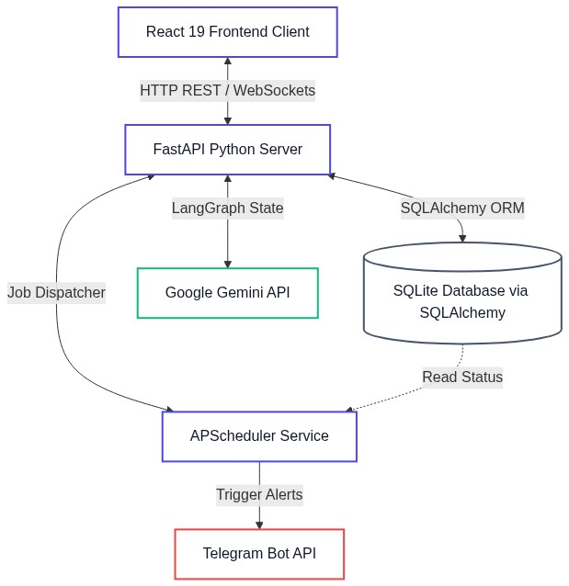
ARCHITECTURE FLOWCHART
System Architecture & Data Flow

Slide 5
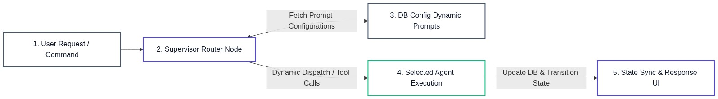
LANGGRAPH STATE FLOW
Supervisor Orchestrator Pipeline

Slide 6
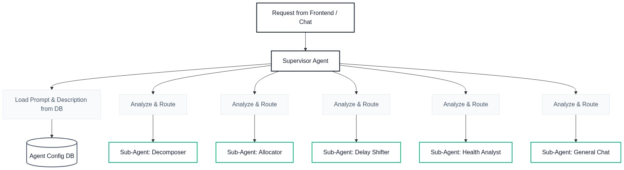
ORCHESTRATOR ROUTING
Sub-Agent Coordination & Dispatch Flow

Slide 7
TEAM RESOURCE PLANNING
Team Composition & Even Task Distribution
MEMBER A
PM & System Architect
Role: Requirements & Config Design
• Responsible for decomposing requirements, configuring agents, and database schema setup.
Assigned Tasks (Balanced workload):
• 1. Req. Decomposition & Planning (5 hrs)
• 2. Agent System Prompt Setup (4 hrs)
• 3. Database Schema & Seed Config (4 hrs)
MEMBER B
Frontend Developer
Role: UI/UX Implementation
• Responsible for building responsive interface components and layout styling.
Assigned Tasks (Balanced workload):
• 1. Dashboard Kanban View & D&D (5 hrs)
• 2. Gantt Diagram SVG Layout (4 hrs)
• 3. Role Switcher & Live Chat Panel (4 hrs)
MEMBER C
Backend Dev & QA
Role: Core Logic & Quality Assurance
• Responsible for FastAPI endpoints, DB engine, and validating task metrics.
Assigned Tasks (Balanced workload):
• 1. FastAPI REST & WebSockets Server (5 hrs)
• 2. LangGraph Routing Implementation (4 hrs)
• 3. APScheduler & Telegram Alerts (4 hrs)

Slide 8
SYSTEM VERIFICATION
Live Demo Scenarios Flow
Part 1: Core Dashboard & Controls
1. Role Switcher & Strict Permissions
Switch from Alice (PM) to Bob (Dev) to prove Bob cannot edit PM fields or approve Done tasks.
2. Real-time Kanban Drag & Drop
Perform task status updates using drag and drop, and fill out the progress transition comment using AI suggestions.
3. Project & Task Auto-Decomposition
Create a new project 'E-Commerce Mobile App' and trigger the AI Agent to generate Epics/Features/Tasks/Subtasks.
Part 2: Intelligent Workflows
4. Auto Allocation & Gantt Cascade
Use the ✨ Auto Allocate prompt. Report a delay on Task 35 to show the dependent tasks on the Gantt chart shift automatically.
5. QA Auto Routing & Task Blocking
Mark all subtasks as Done to trigger auto-assignment to QA. Move a task to Blocked to trigger risk-mitigation banner alerts.
🔔 Telegram Notifications Alert
Every status update, timeline shift, and approaching/overdue deadline automatically tags the corresponding user on Telegram for instant project visibility.

Slide 9
Thank You!
Let's proceed to the Live Demonstration

