Slide 1
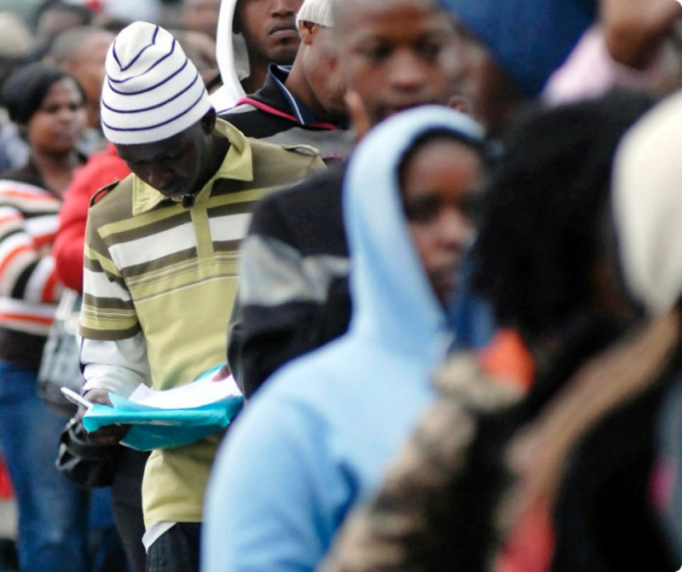
Unraveling the Challenges of Unemployment in Africa:
A Data-Driven Approach
10Alytics Global Hackathon 2023
2 – 3 December 2023
By: Obi-Okonkwo, Chisom

Slide 2
Introduction
General Overview
Unemployment remains one of the most daunting challenges facing African nations today. It is a multifaceted problem with deep roots in socio-economic, educational, and policy-related factors. This case study invites analysts and policymakers to delve into various datasets to uncover insights and strategies that could assist in mitigating the unemployment crisis in Africa.
Objective
The primary goal of this case study is to analyze data, identify patterns, and propose informed, data-driven recommendations that governments and stakeholders can implement to effectively address and reduce unemployment rates, particularly focusing on the African context.
Expected Outcomes
Participants are expected to:
Understand the multi-dimensional nature of unemployment in Africa.
Identify key factors contributing to high unemployment rates.
Propose data-driven solutions and strategies that can be adopted by governments and other stakeholders.
Draw meaningful insights and correlations through data visualization techniques.
We encourage participants to approach this case study with creativity, analytical rigor, and a focus on practical, implementable solutions. The insights derived from this analysis have the potential to inform policy, shape educational and economic strategies, and ultimately contribute to the reduction of unemployment in Africa.
Data Overview
Participants will engage with six diverse datasets, each offering a unique perspective on factors influencing unemployment:
Unemployment Rate (Men vs. Women): This dataset provides a comparative view of unemployment rates between genders.
National Strategy for Youth Employment: This dataset outlines various national strategies adopted across different African countries to combat youth unemployment.
Share of Education in Government Expenditure: Education is a critical factor in employment. This dataset sheds light on how much governments are investing in education.
Population with Access to Electricity: Access to electricity is a fundamental driver of economic development and can influence employment opportunities. This dataset provides insights into the availability of electricity across different regions and its potential impact on employment.
Total Firms (Historical Data): The health of a country's private sector is directly linked to employment rates. This dataset includes historical data on the number of firms.
Country Codes: This dataset is essential for mapping data points to specific African countries, enabling a more precise and geographically contextual analysis.

Slide 3

Africa vs other Regions

Slide 4
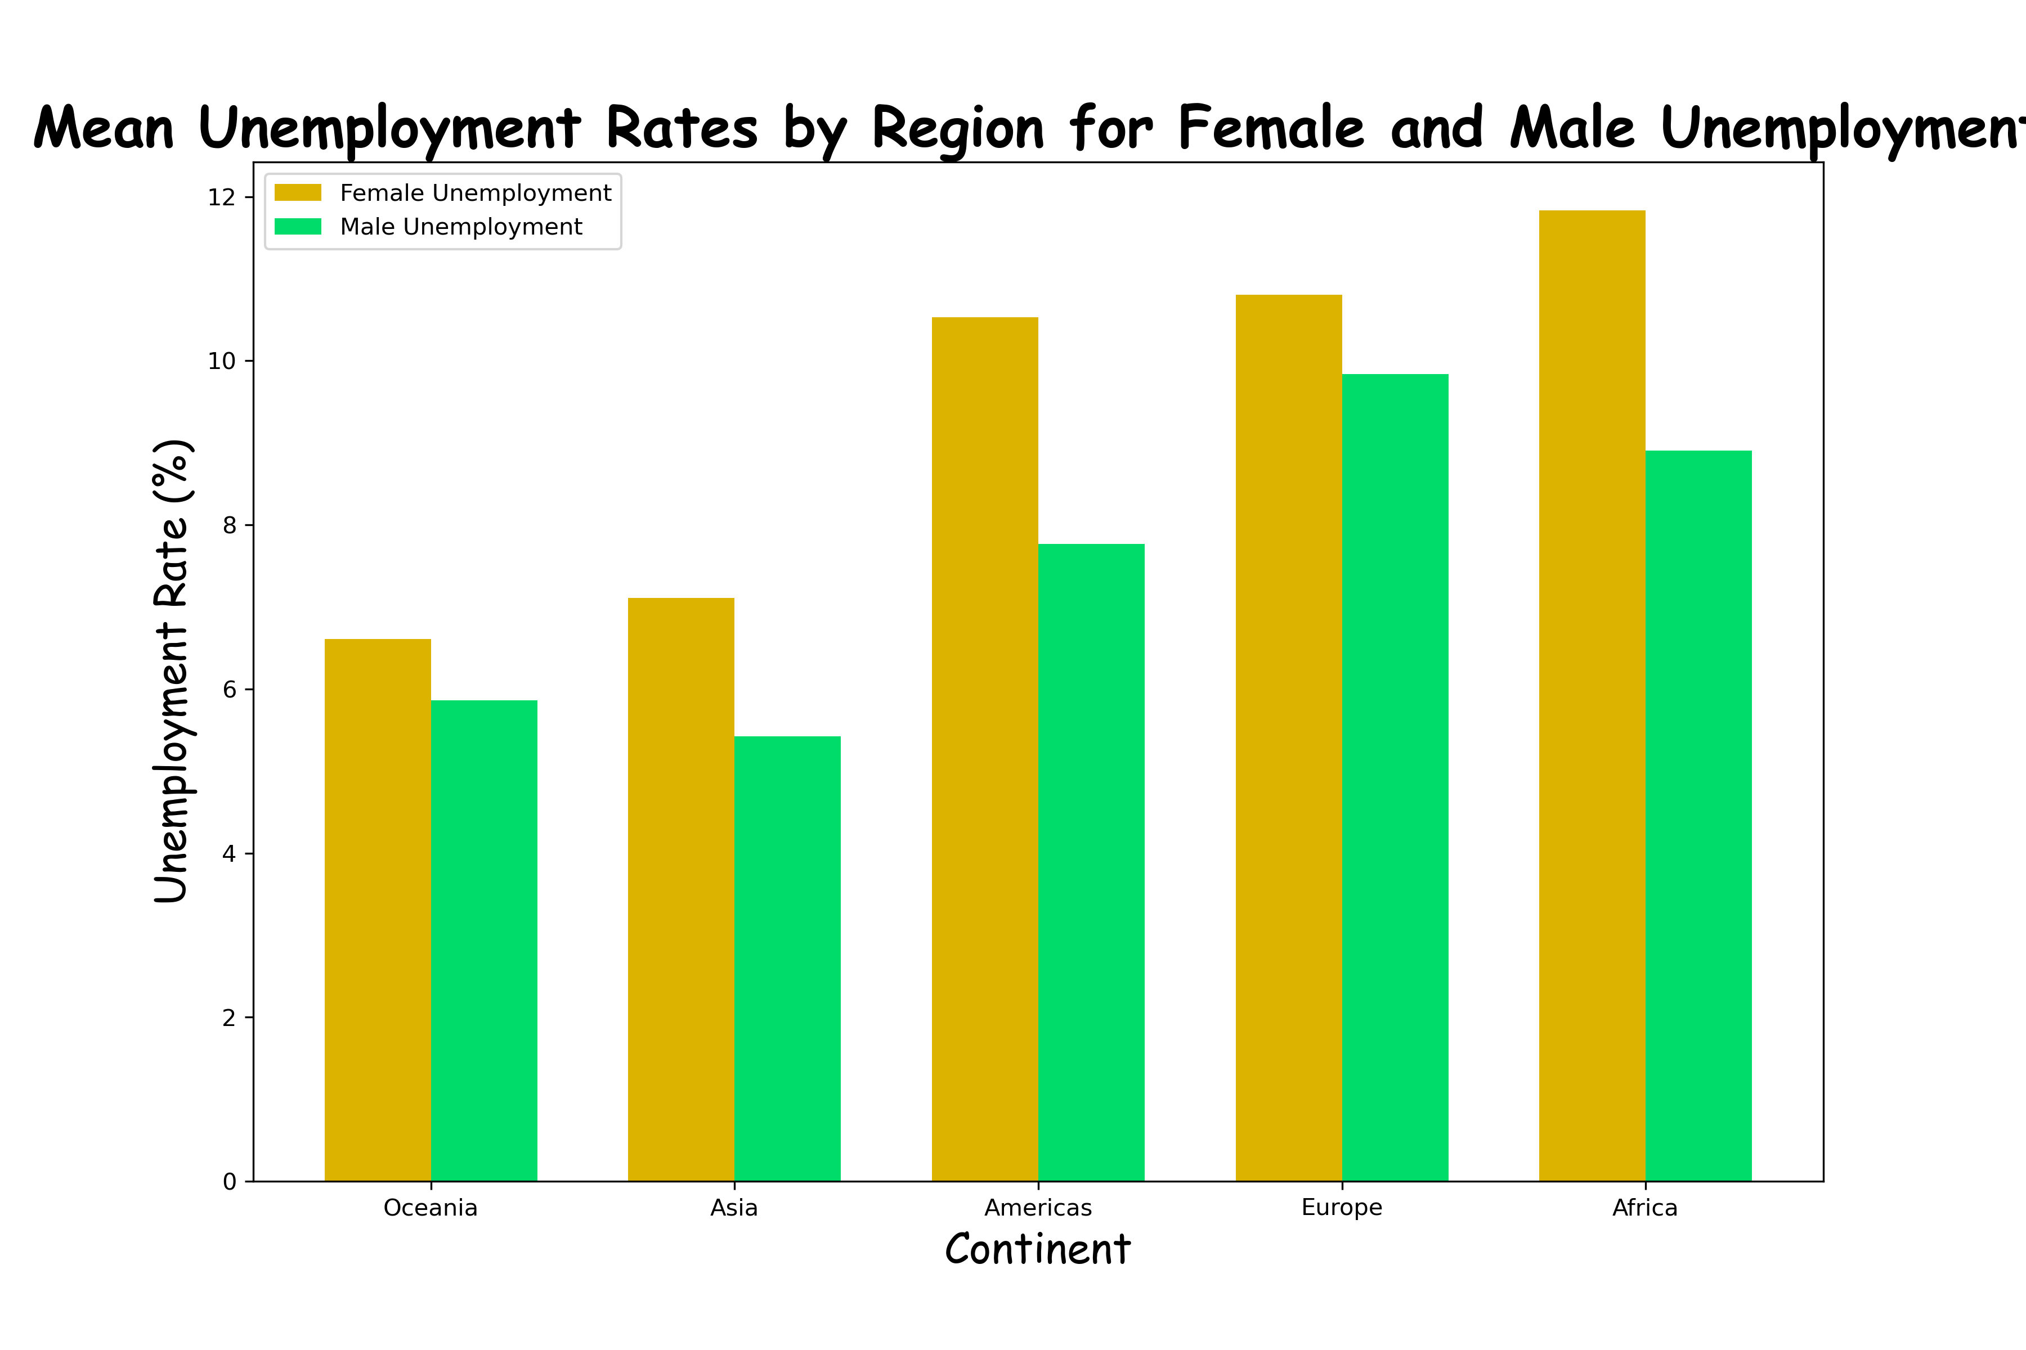

Slide 5
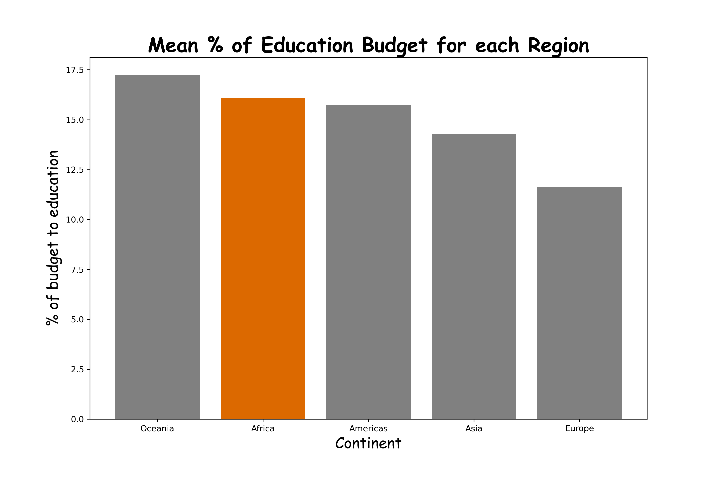
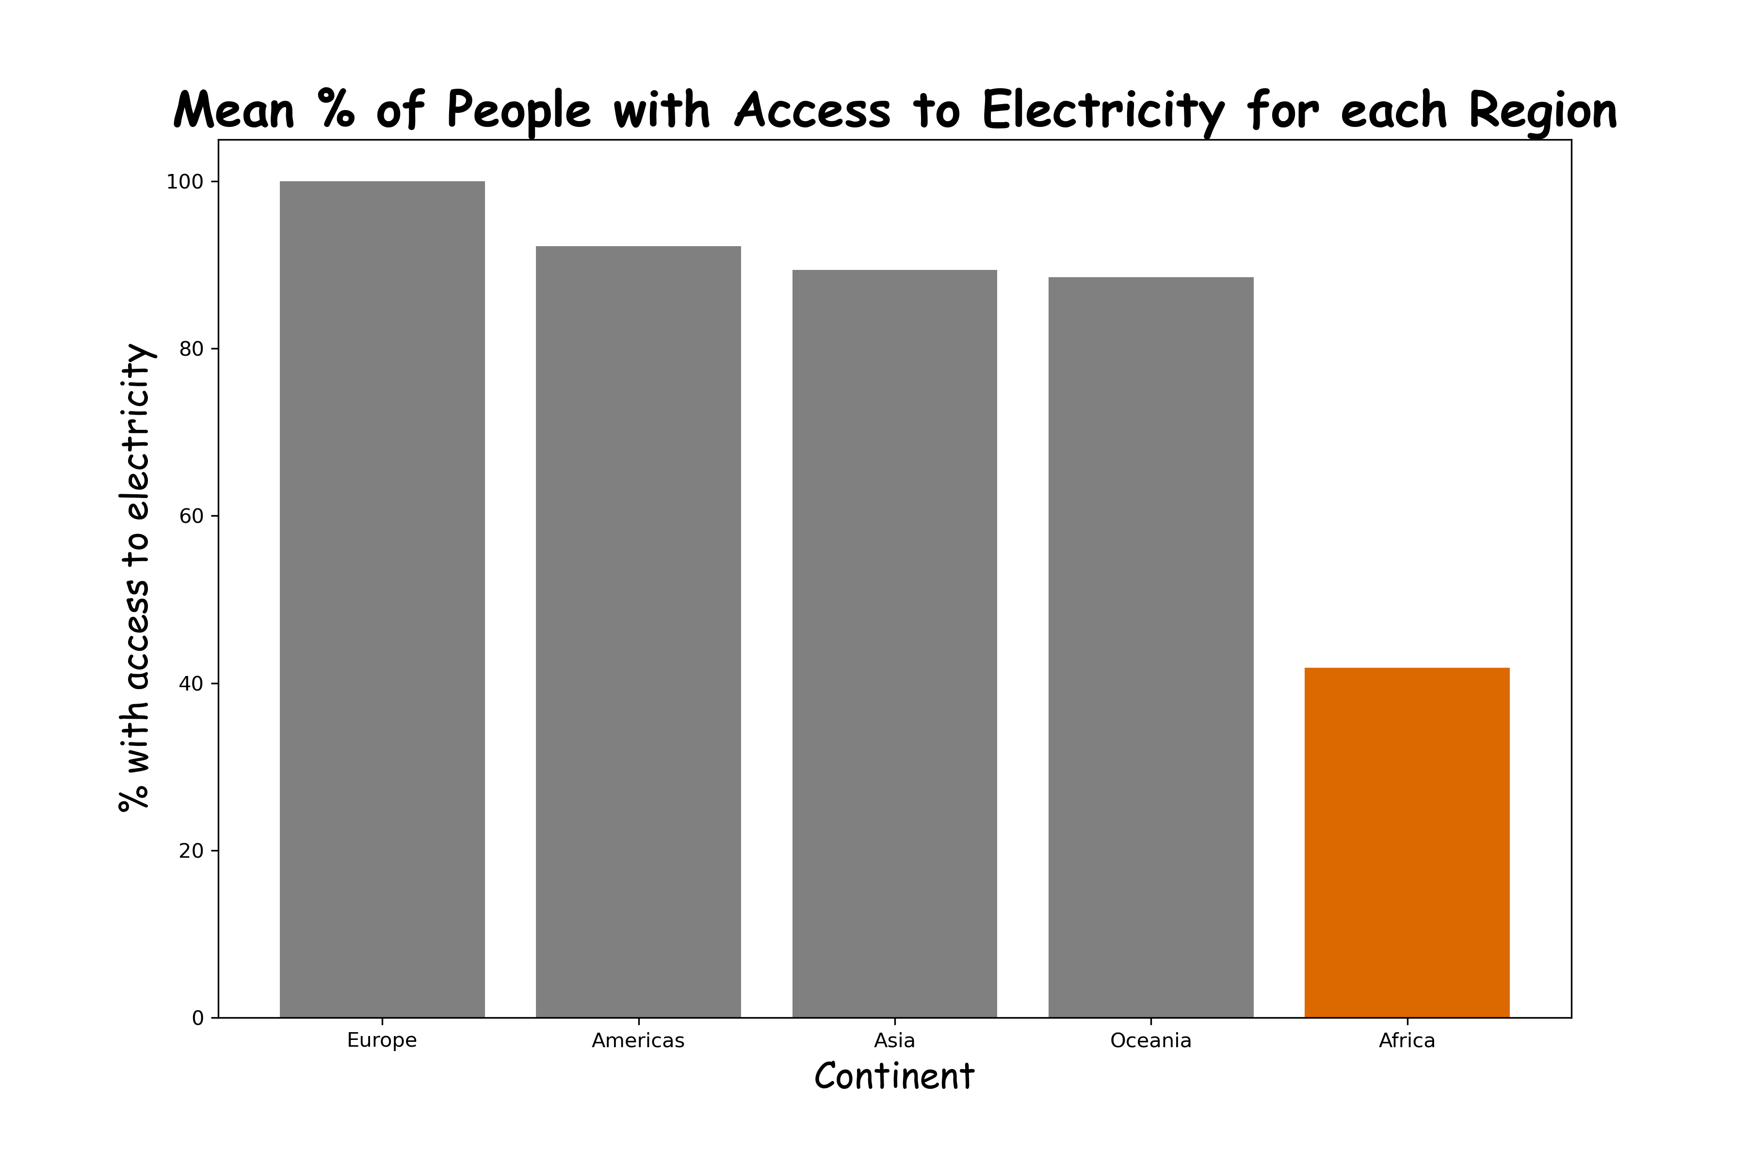

Slide 6
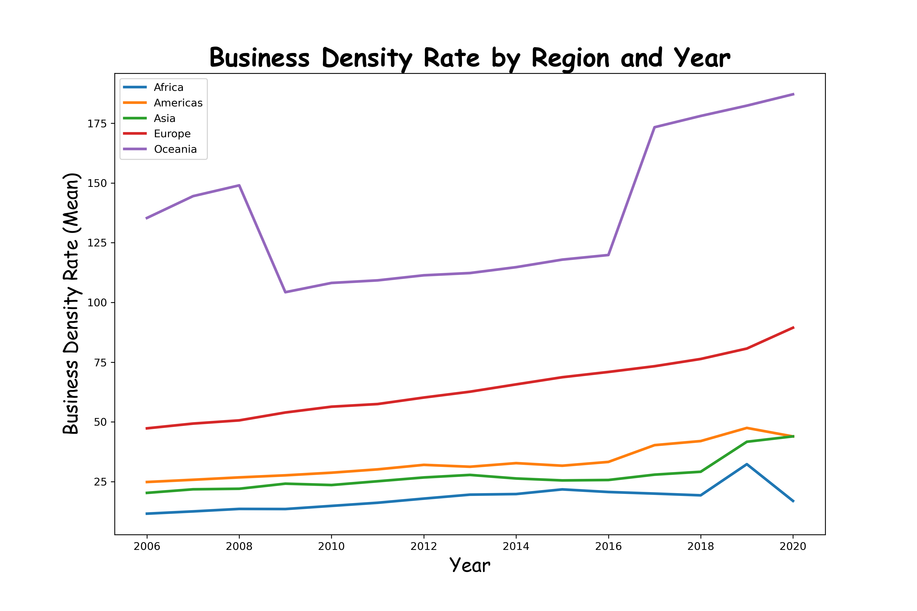
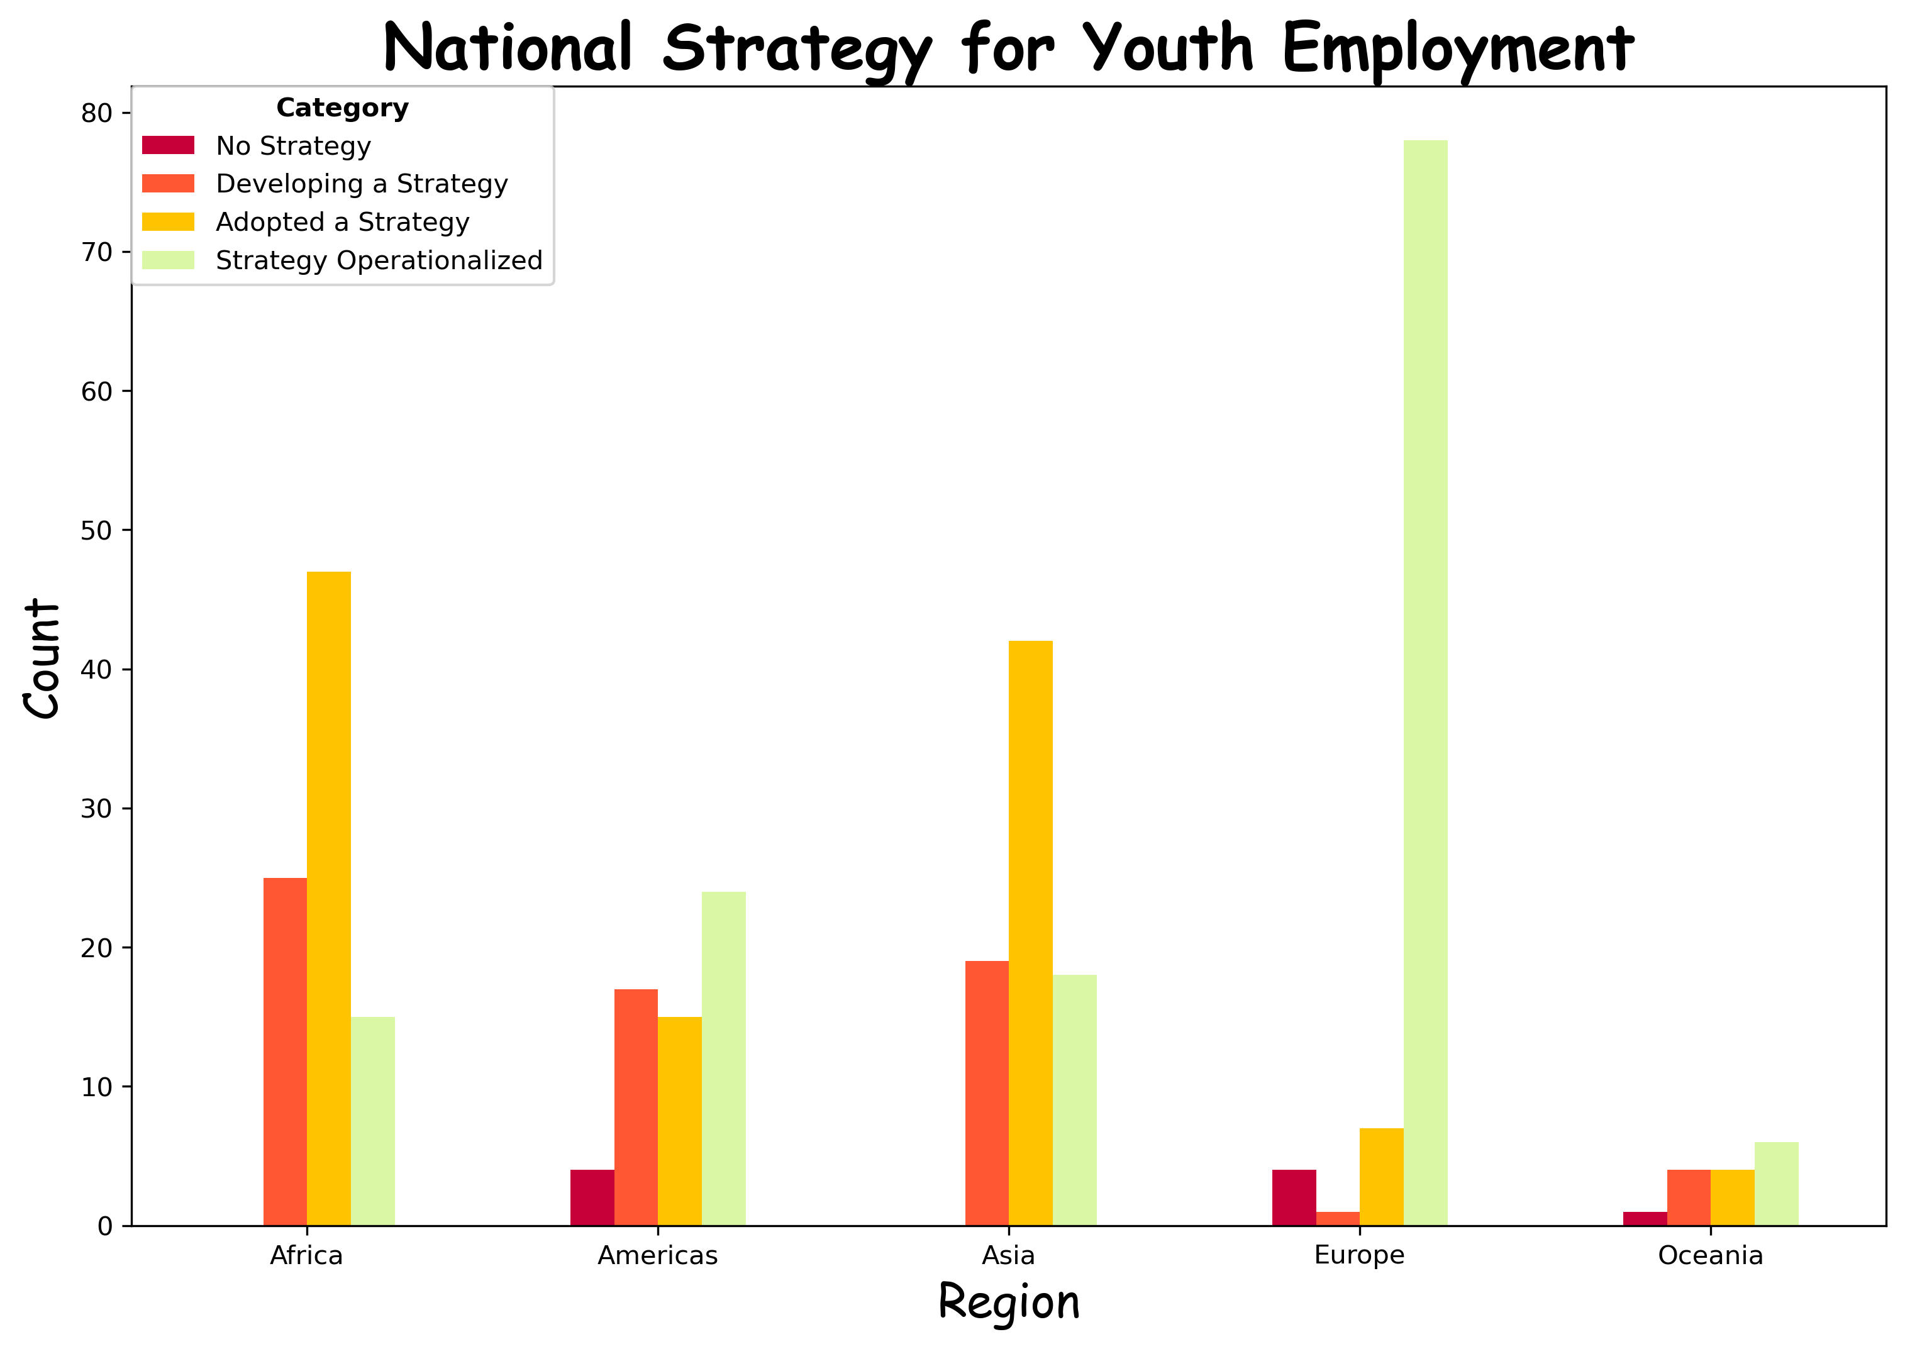

Slide 7
Initial Observations
Unemployment Rates
Budget Allocation to Education
Africa has the highest female and second highest male unemployment rates
Africa allocates a high percentage of its budget to education, without a visible positive impact on employment
Africa's access to electricity is very low & can have an impact on employment
Africa has low employment rates and also low business density rates compared to other continents
National Strategy for Youth Employment
Data on National Strategy for Youth Employment is incomplete but most times, Africa has a strategy adopted but not operationalised
Business Density Rates
Access to Electricity

Slide 8
Within Africa

Slide 9
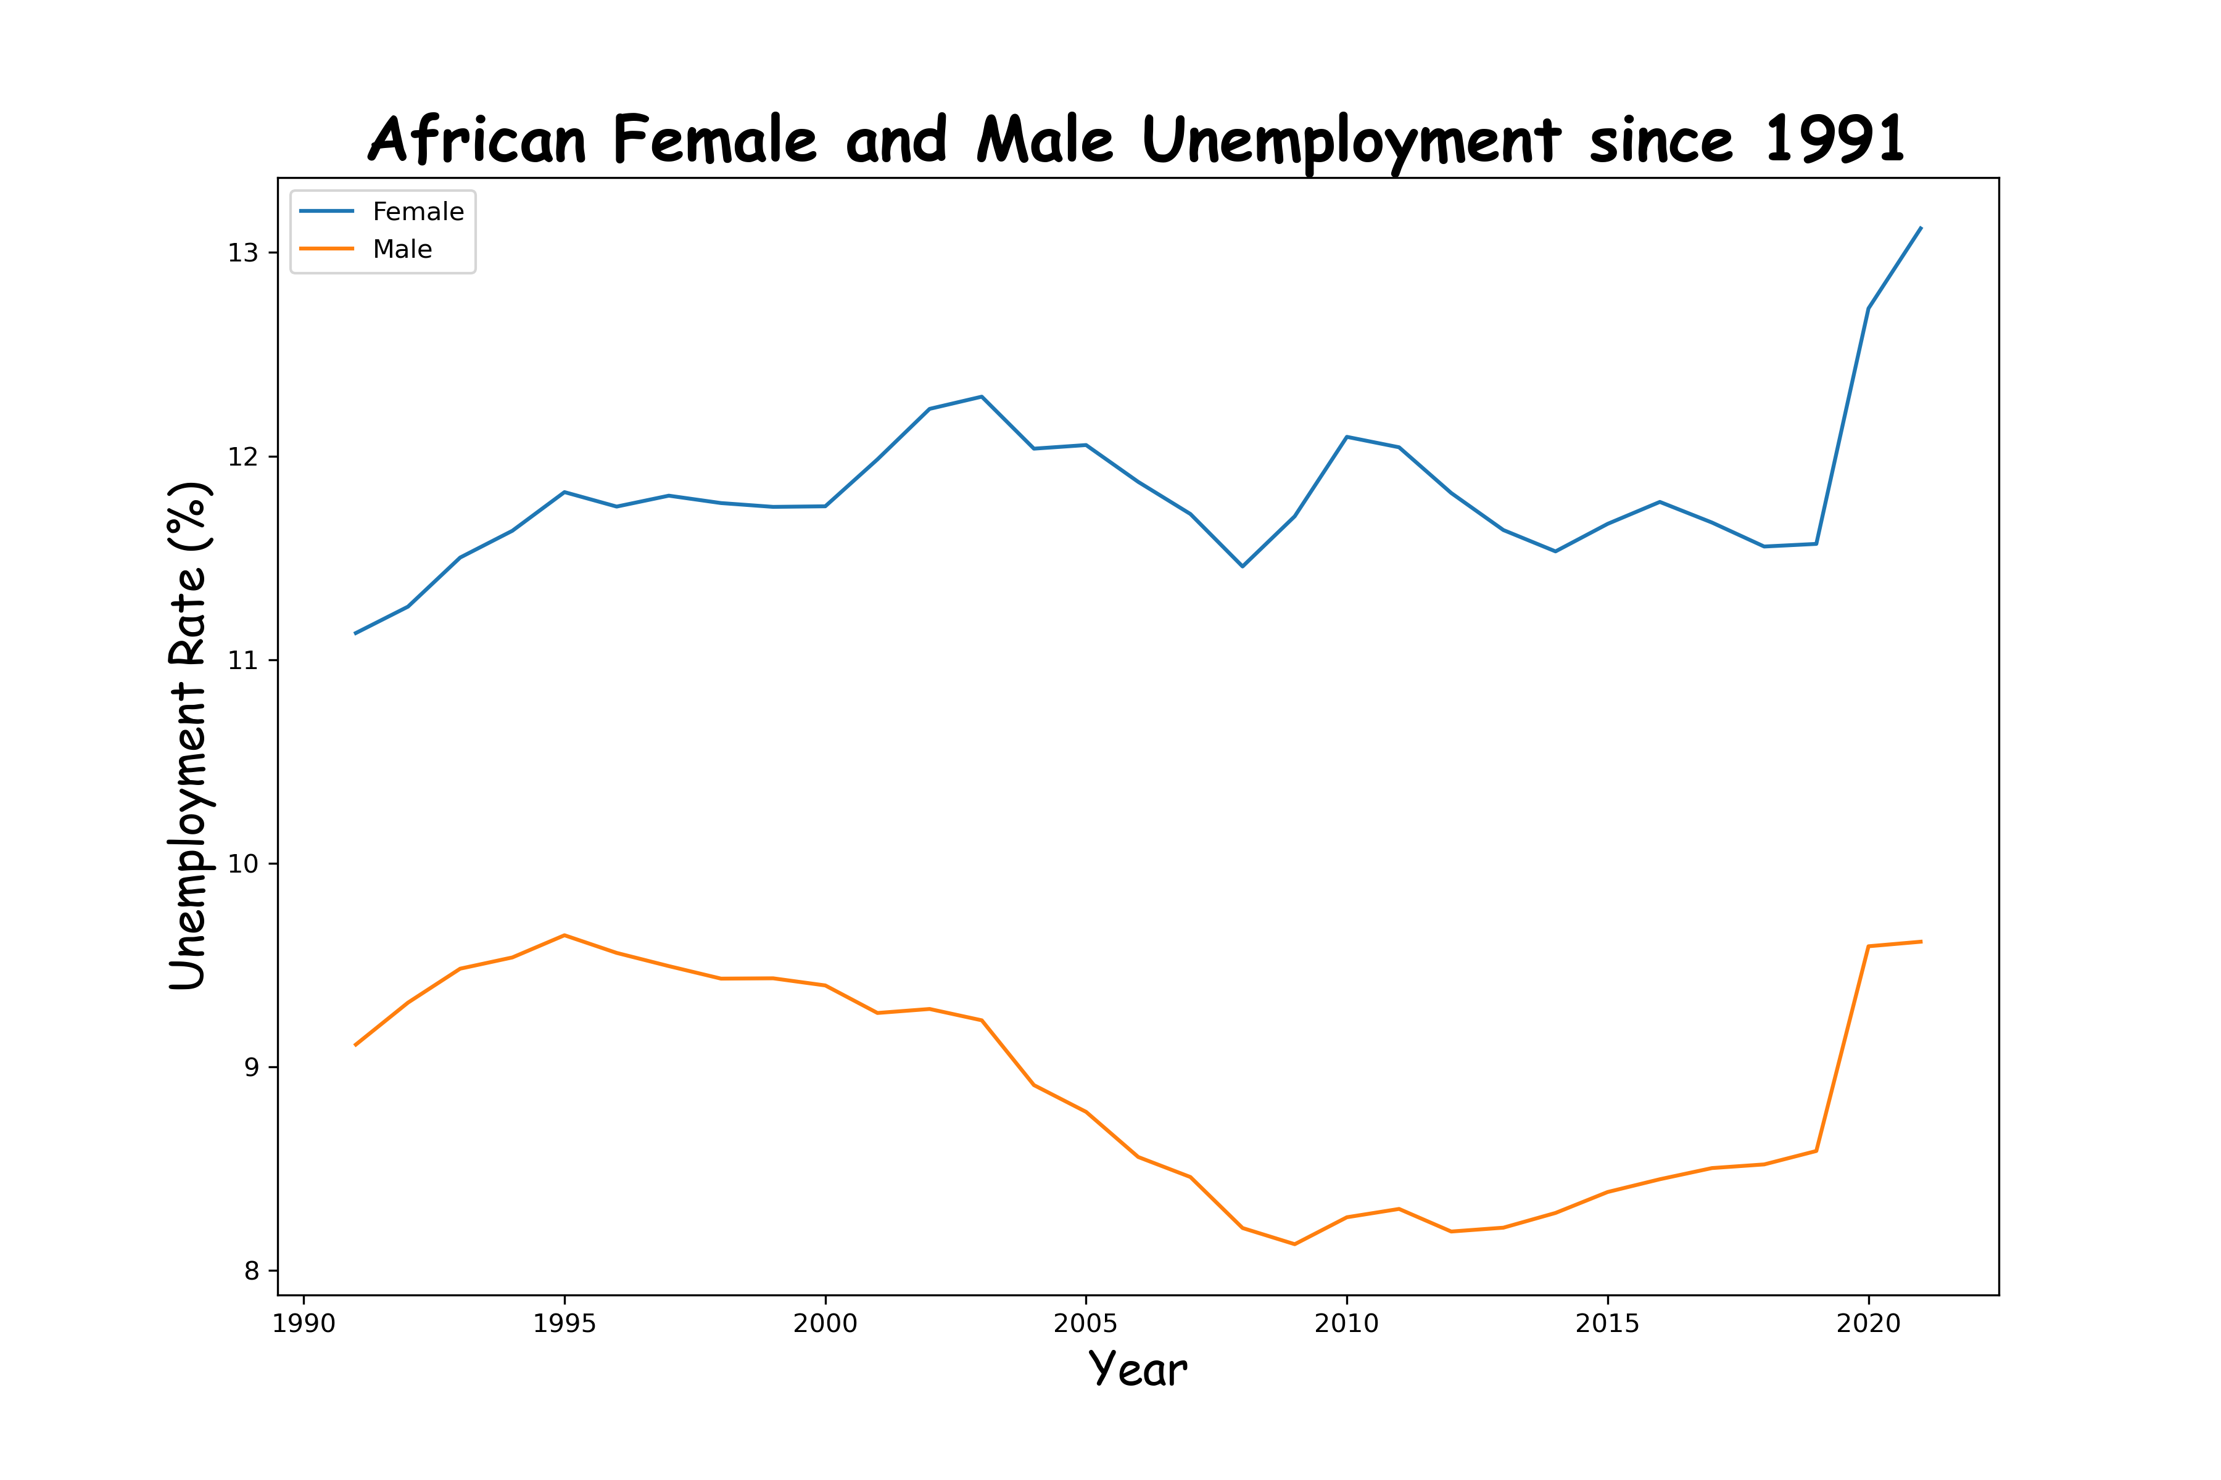
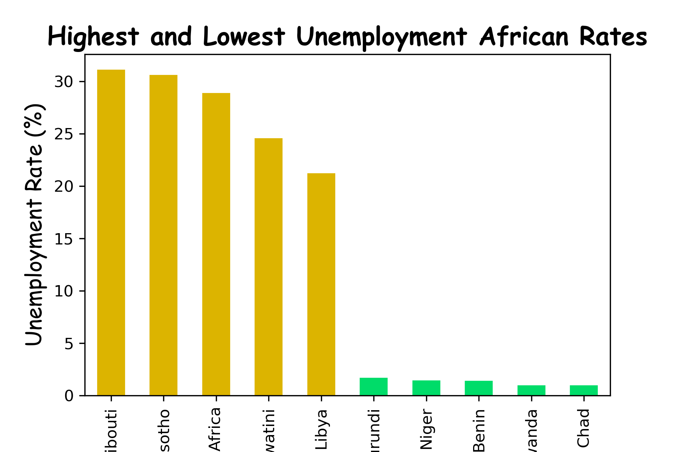

Slide 10
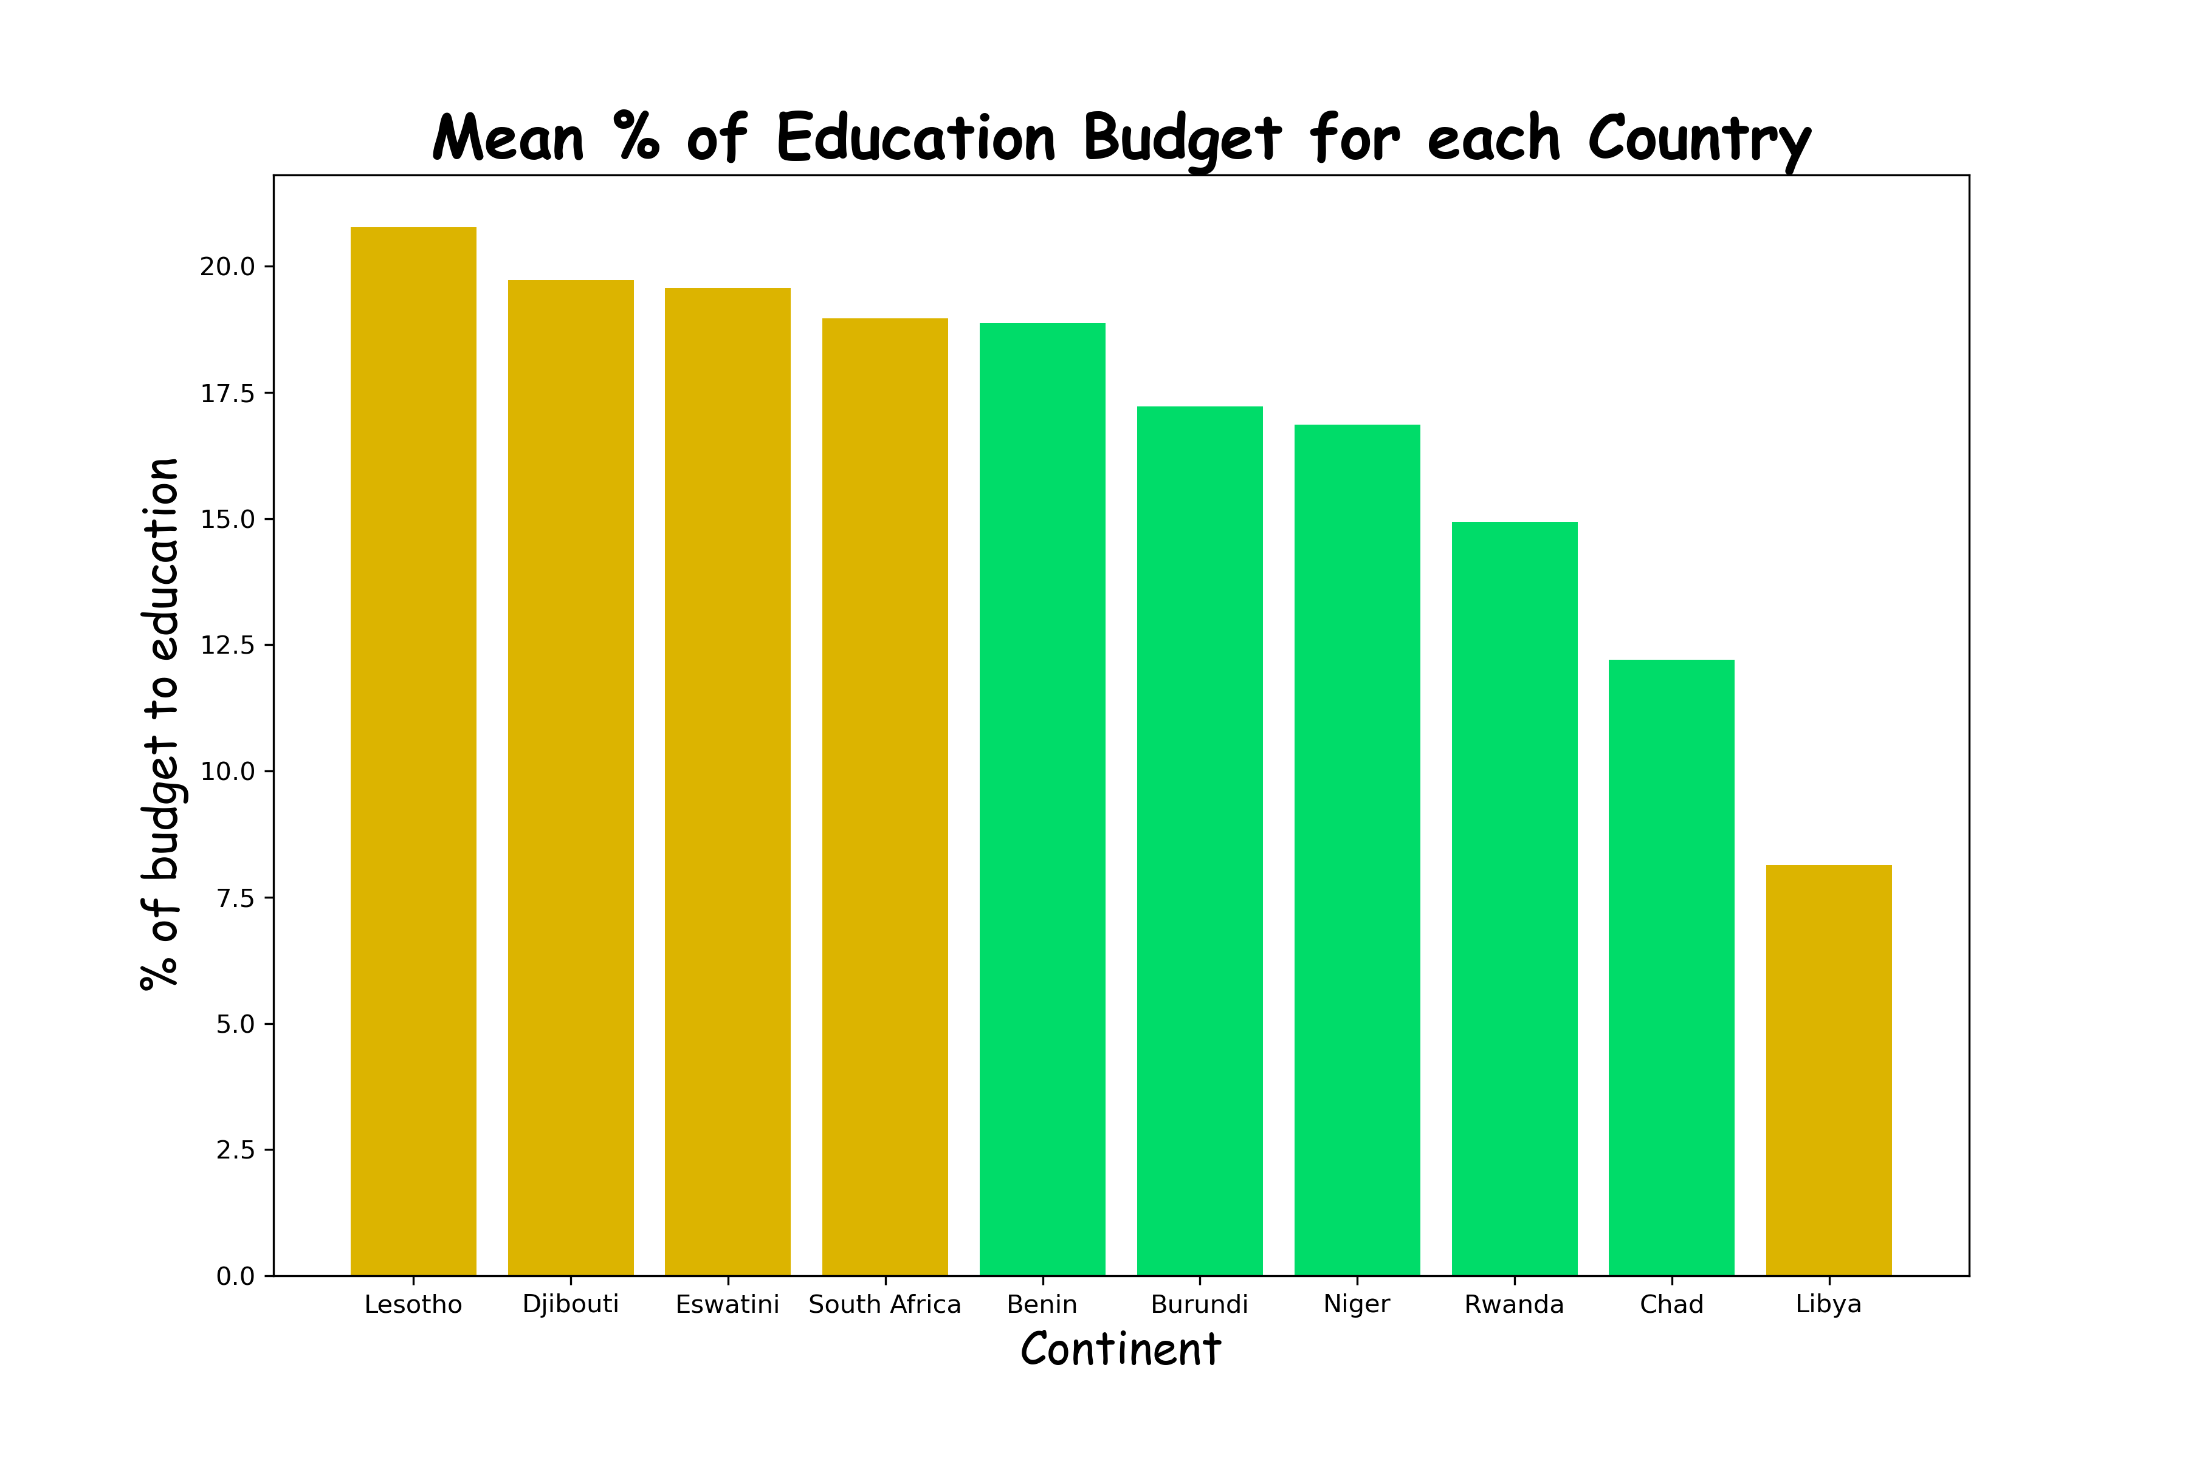
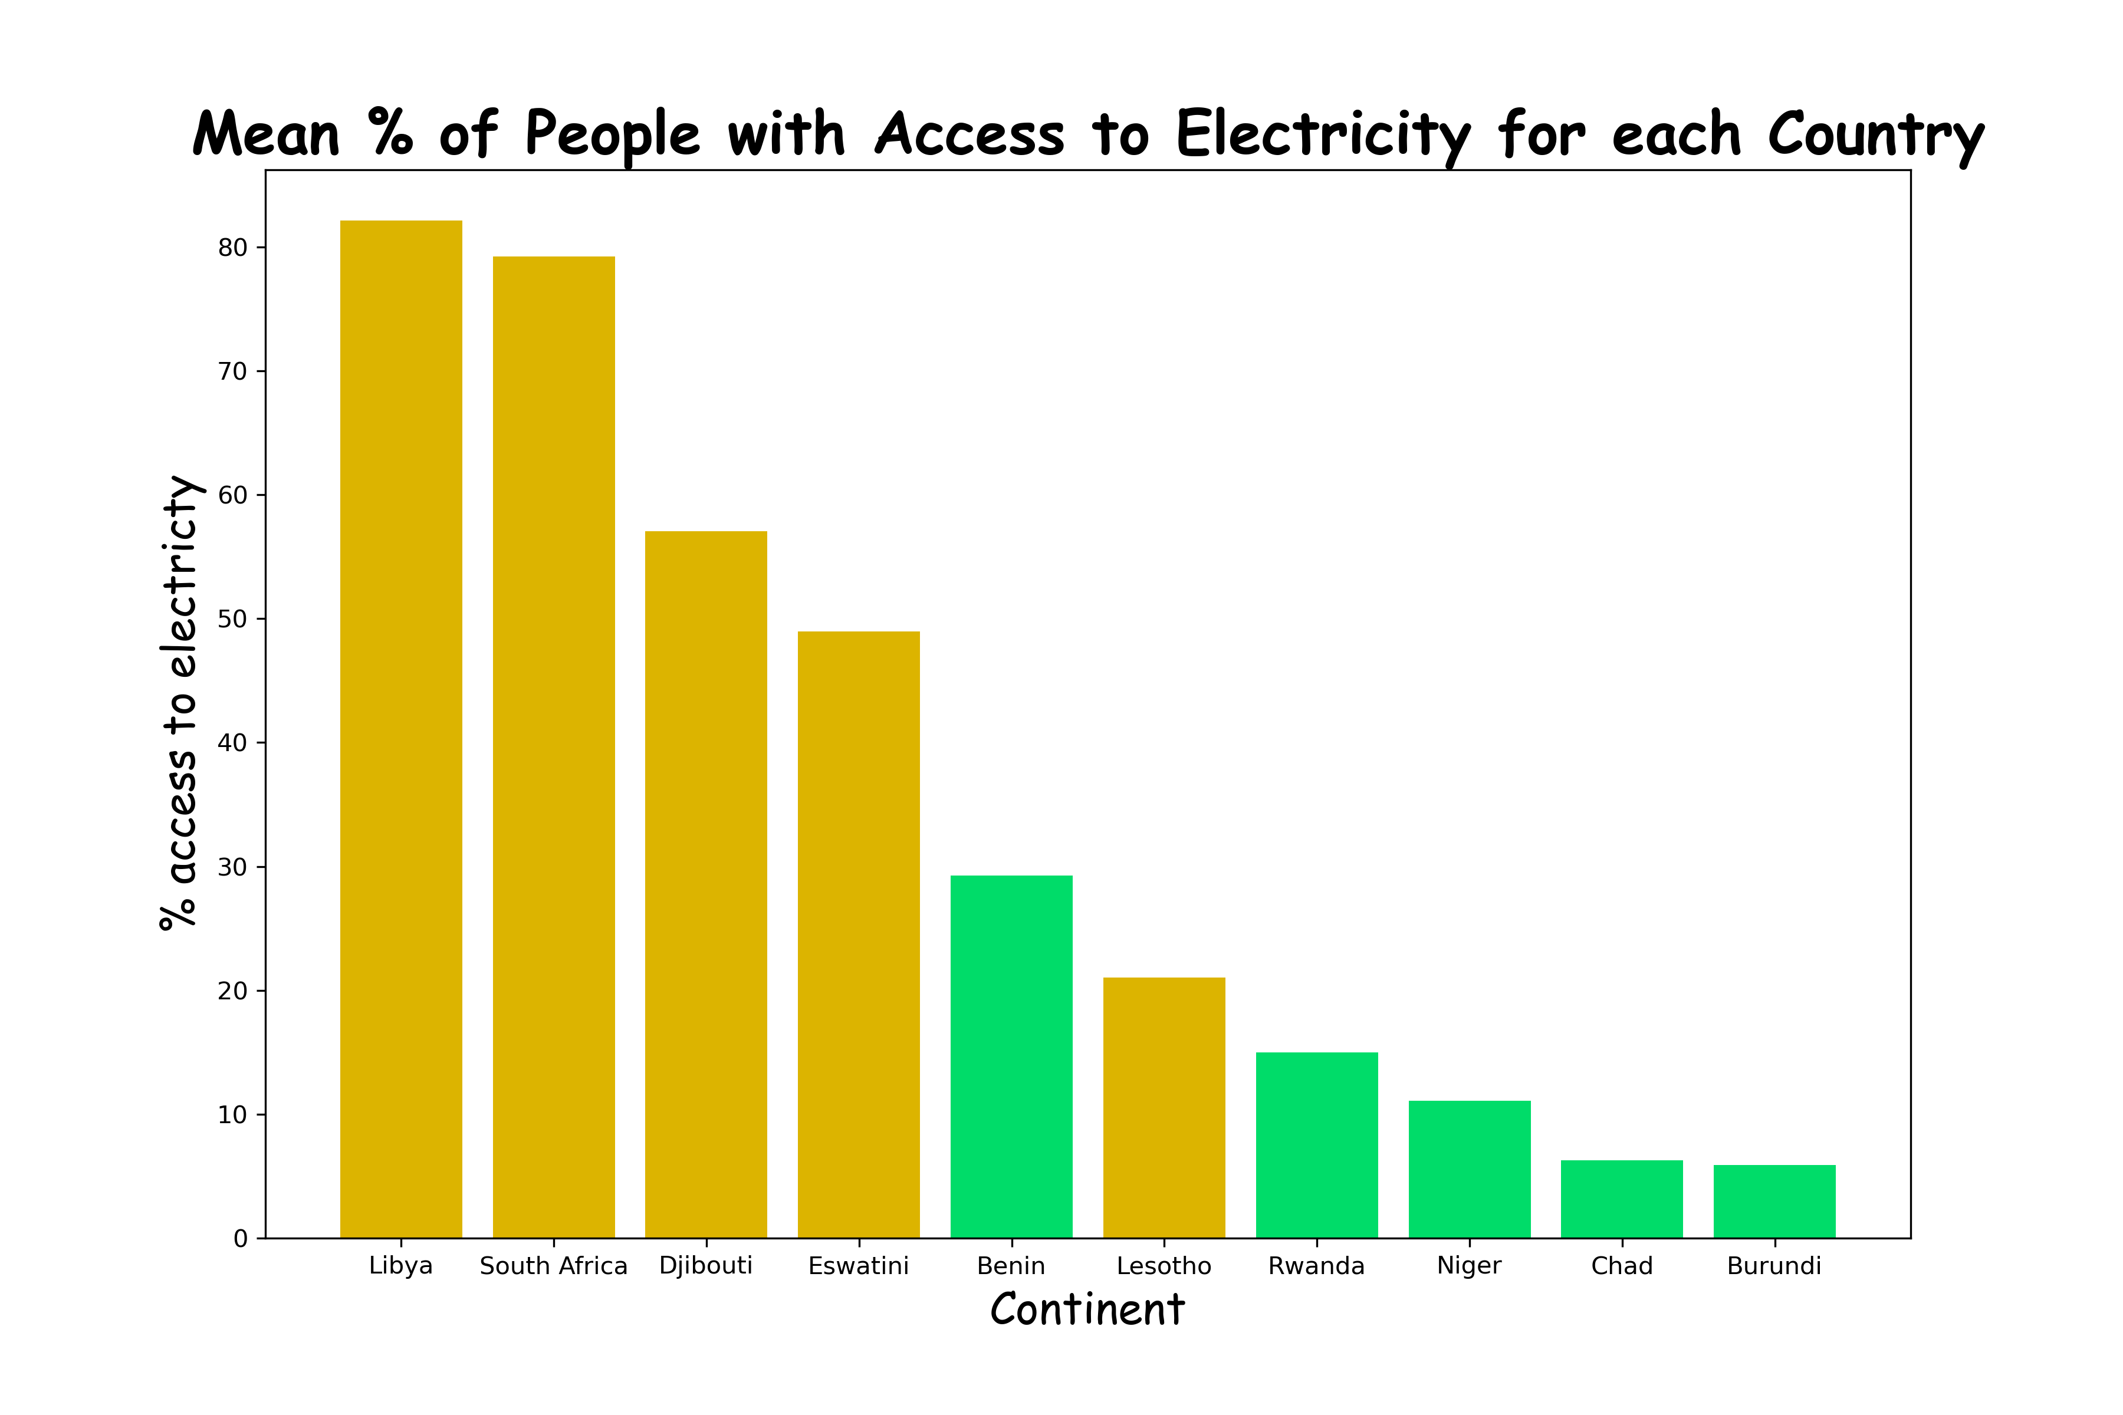

Slide 11
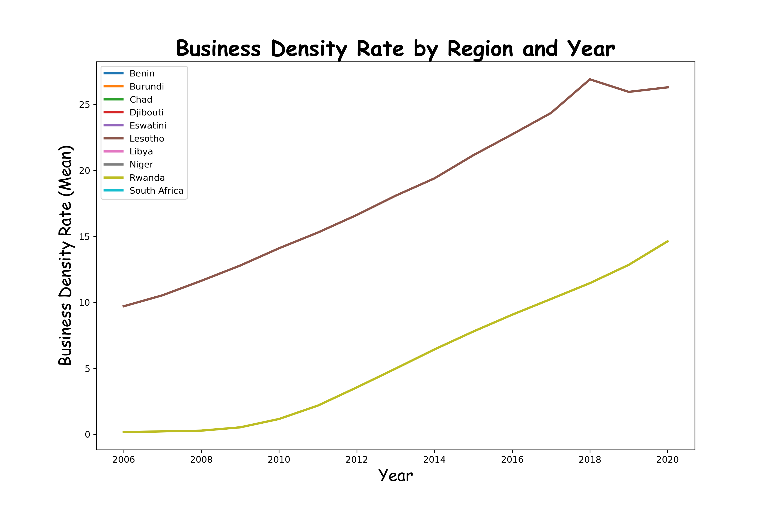
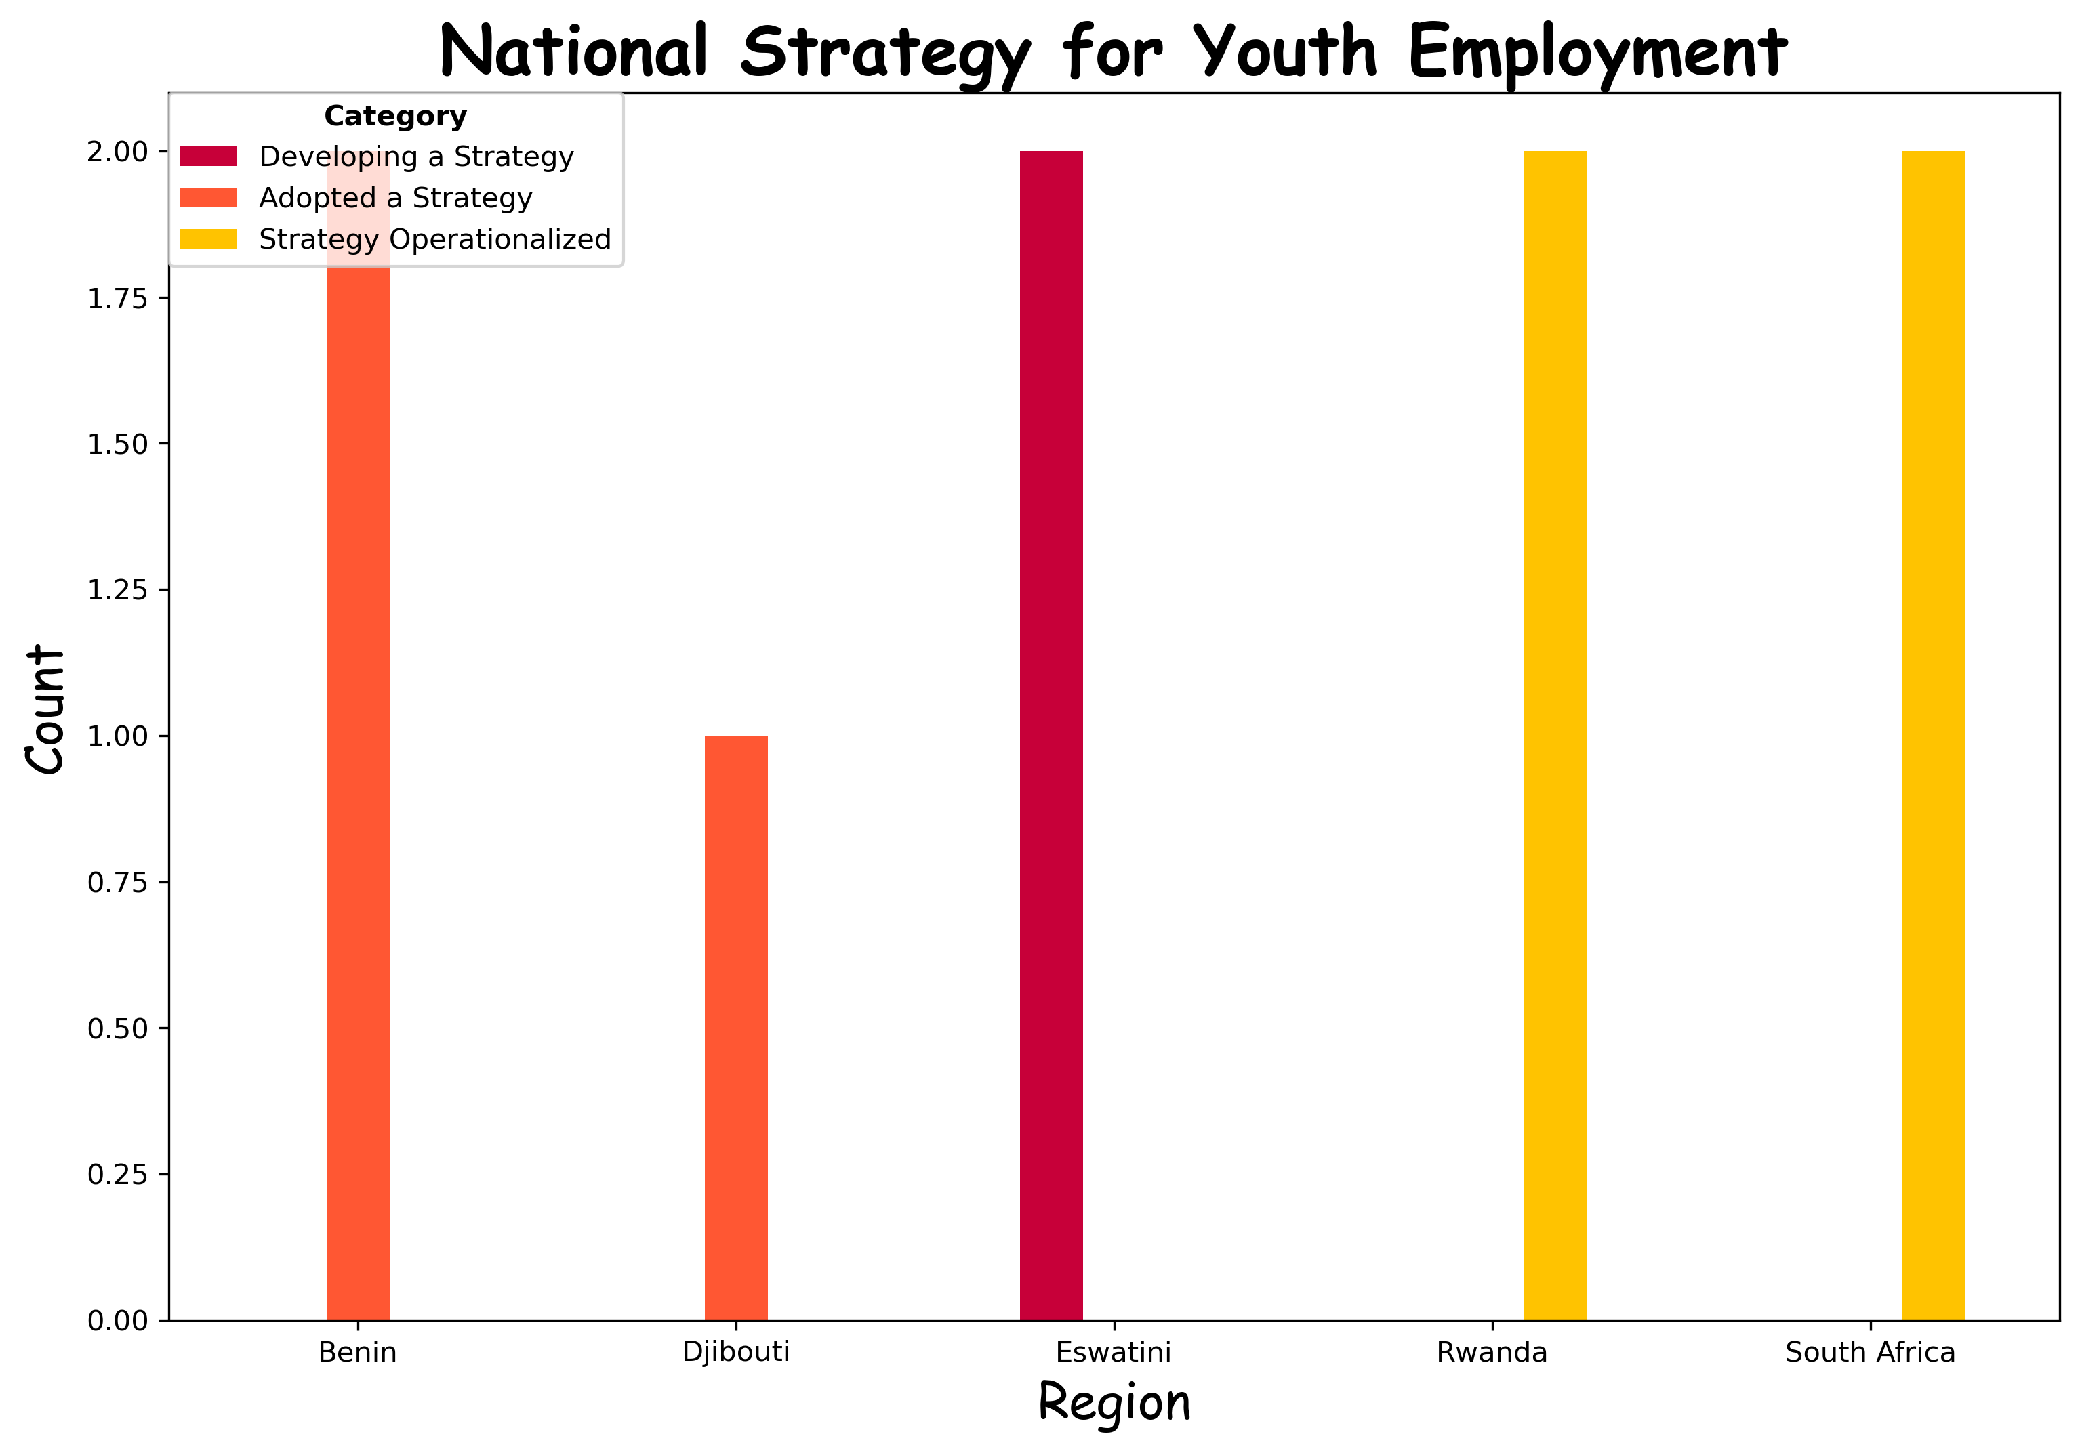
Introduction

Slide 12
More Observations
Gender Unemployment Rates
Budget Allocation to Education
Female unemployment has always been higher than the male’s
The countries with high unemployment spend a good proportion of the budget on education compared with the ones with low unemployment rates
Surprisingly, the countries with high unemployment have a higher number of people with access to electricity
Data is incomplete
Data is incomplete
Business Density Rates
Access to Electricity
National Strategy for Youth Employment
Unemployment rates of both genders follow the same pattern (ie they are susceptible to the same factors)

Slide 13
Recommendations
Gender Disparity
Education Allocation
Target female centric unemployment approaches to deal with the gender disparity
The countries with high unemployment spend a good proportion of the budget on education compared with the ones with low unemployment rates
Business density rate in Africa is so small and govt should help in this regard
There should be better record keeping in the future
Record Keeping
Business Density Rate
Conduct further research to understand the specific challenges contributing to higher female unemployment and tailor policies accordingly.
Implement mentorship programs and internship opportunities to bridge the gap between education and employment for young people.
Provide financial incentives, tax breaks, and regulatory support to encourage entrepreneurship and business development.

