Slide 1



SmartRide
523K0010 – Phạm Lê Anh Khôi
523K0013 – Dương Thành Long

Slide 2
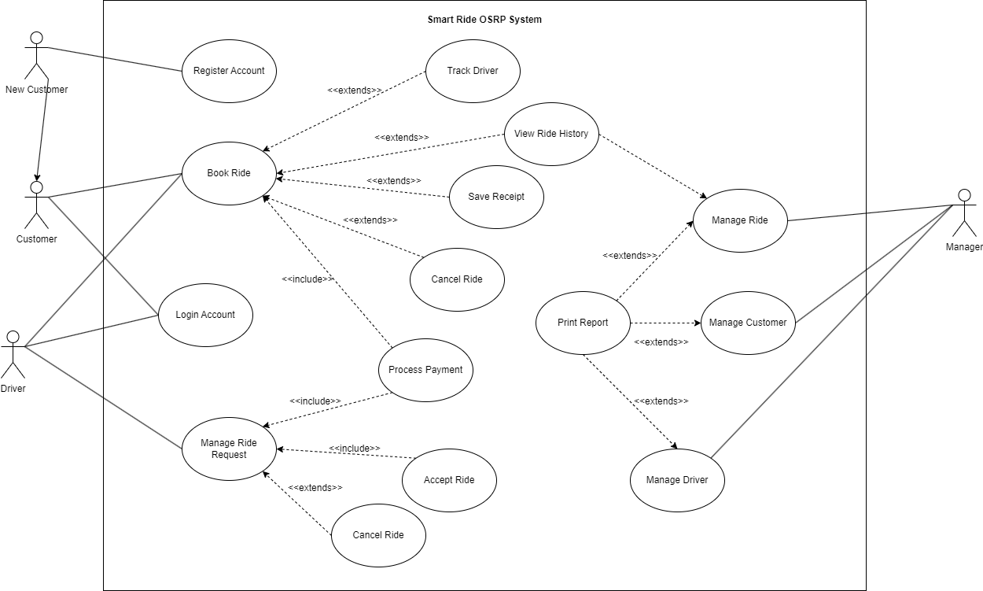
Use case diagram

Slide 3
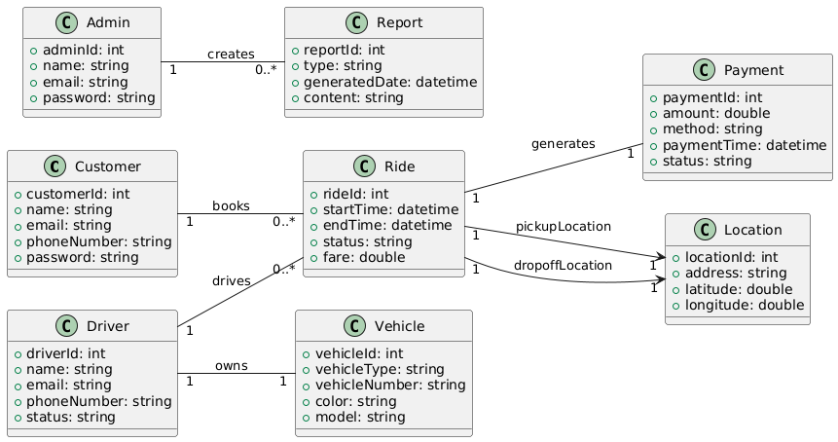
Domain class diagram

Slide 4
Use cases
Register Customer
Book Ride
Process Payment
Track Driver

Slide 5
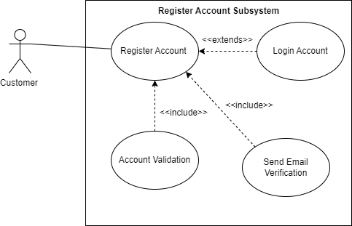
Subsystem use case diagram: Register account

Slide 6
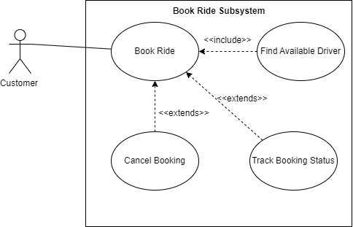
Subsystem use case diagram: Book Ride

Slide 7
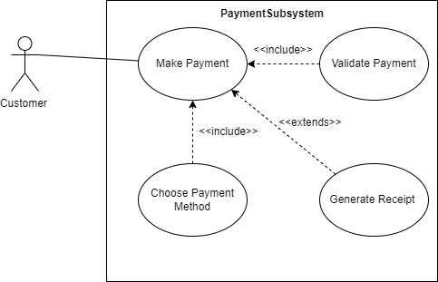
Subsystem use case diagram: Process Payment

Slide 8
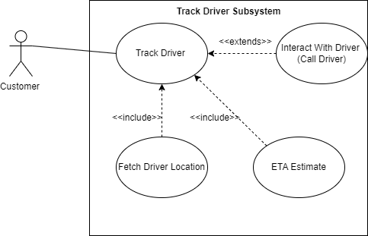
Subsystem use case diagram: Track Driver

Slide 9
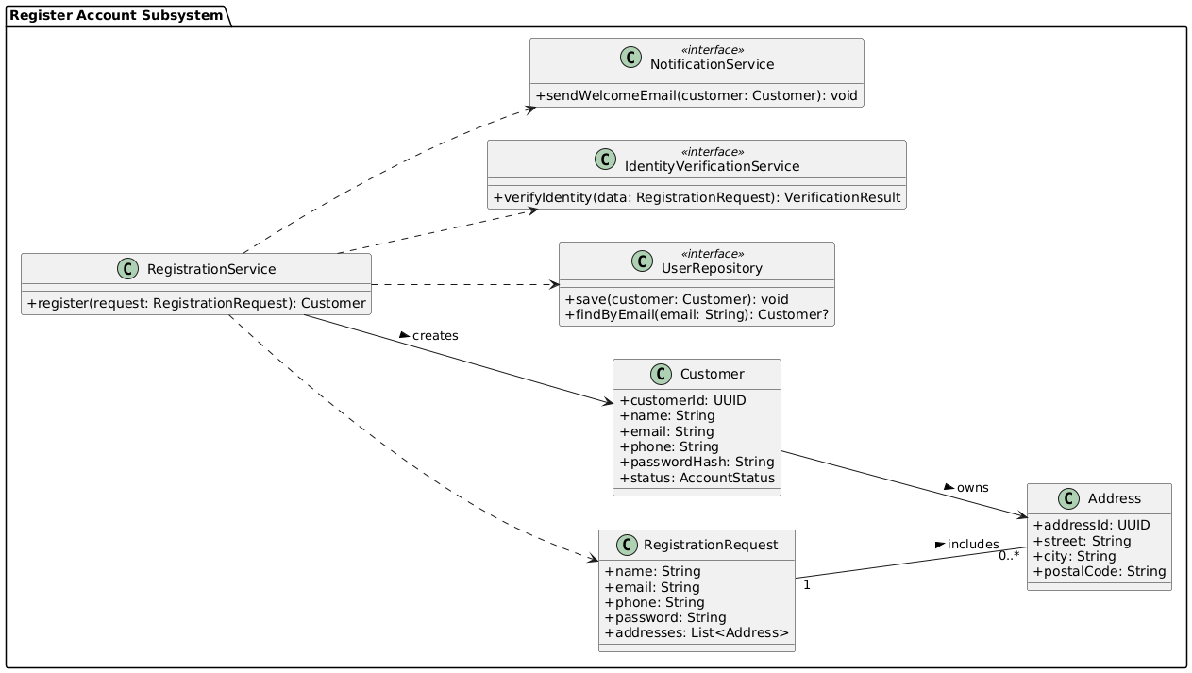
Subsystem domain class model: register account

Slide 10
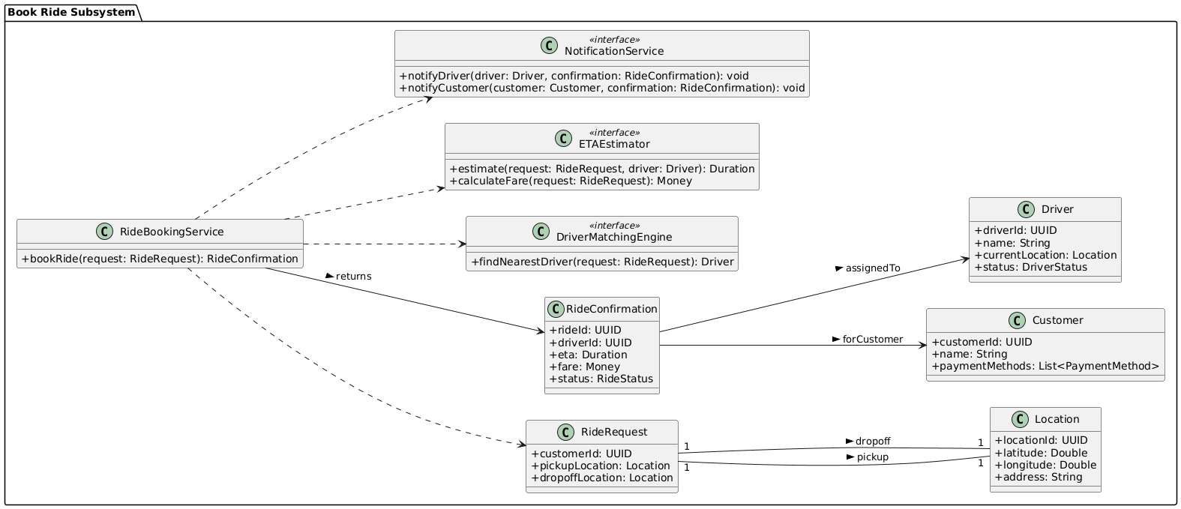
Subsystem domain class model: Book Ride

Slide 11
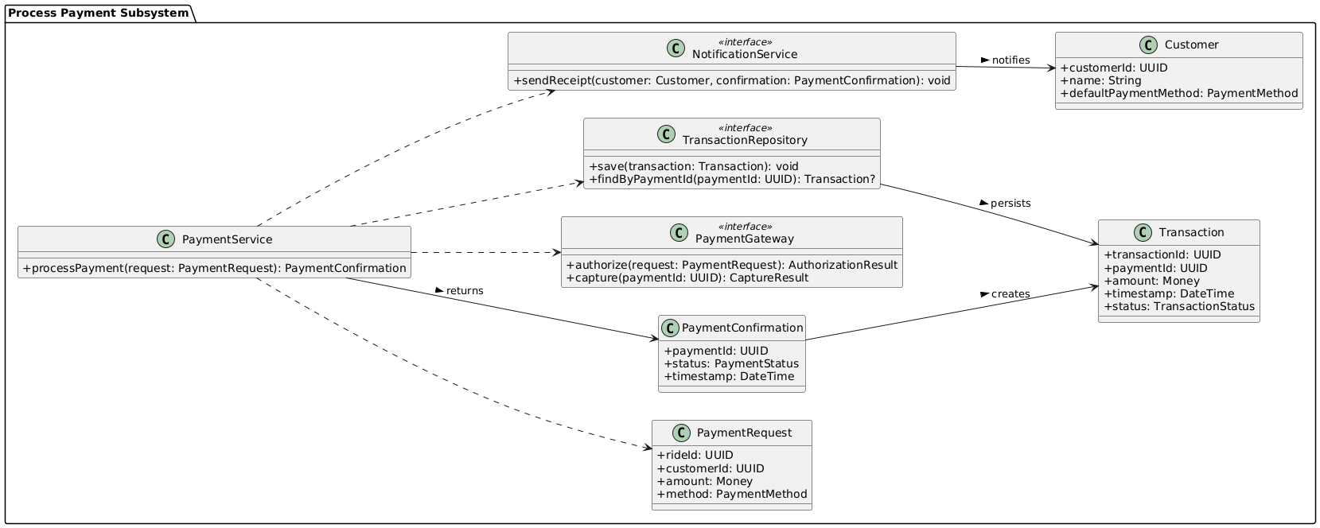
Subsystem domain class model: Process Payment

Slide 12
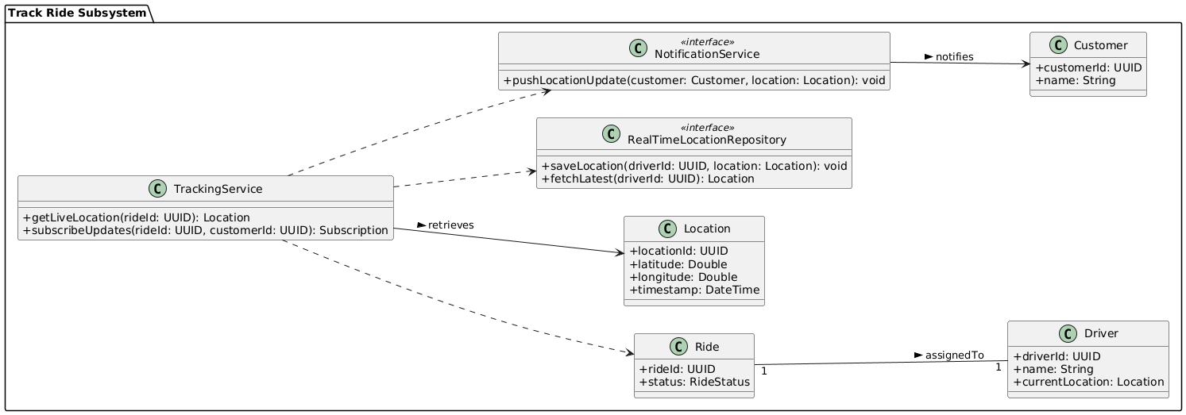
Subsystem domain class model: Track Driver

Slide 13
Analysis Model

Slide 14
Use case 1: Register Account
Use case name: | Register Account
Scenario: | Customer registers for a SmartRide account.
Triggering event: | A new customer wants to use the ride booking service.
Brief description: | Customer provides personal information and login details to create an account.
Actors: | Customer
Related use cases: | Login, Book Ride
Stakeholders: | Customer Support, Marketing
Preconditions: | Registration service must be available.
Postconditions: | Account is created and stored in the system.
Flow of activities:
Actor | System
1. Customer chooses to register. | 1.1 System displays registration form.
2. Customer fills in name, phone, email, and password. | 2.1 System validates input fields.
3. Customer submits registration. | 2.2 System creates new accounts and confirms registration.
Exception conditions: | 2.1 Missing or invalid data. Email already exists.

Slide 15
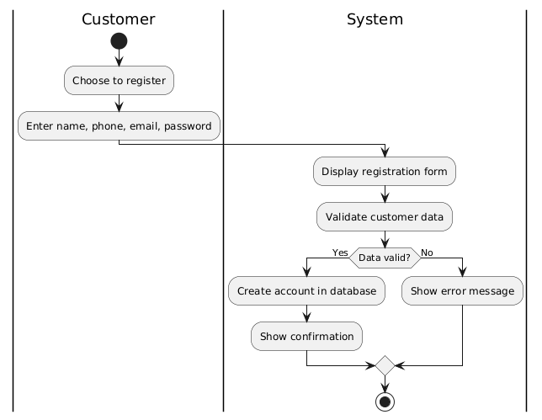
Use case 1: Register Account

Slide 16
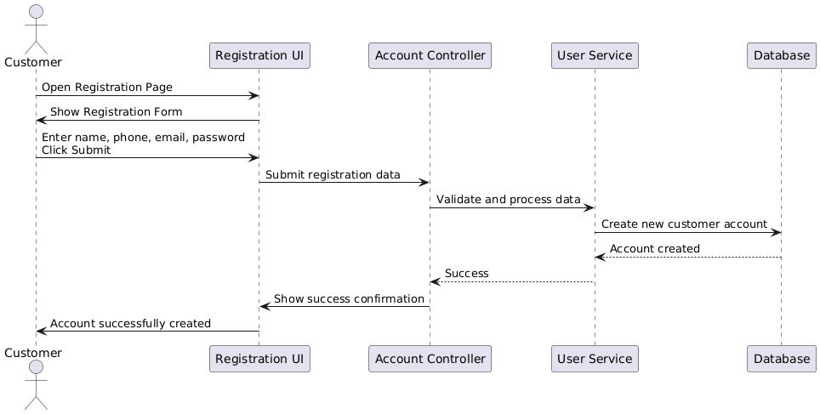
Use case 1: Register Account

Slide 17
Use case 2: Book ride
Use case name: | Book ride
Scenario: | Customer books a ride via the mobile app or website.
Triggering event: | Customer opens the booking screen and enters trip details.
Brief description: | The system processes the ride request and assigns an available driver.
Actors: | Customer, System, Driver
Related use cases: | Track Ride, Make Payment
Stakeholders: | Customers, Operations Team
Preconditions: | User must be logged in. Location services must be available.
Postconditions: | Ride is booked and driver is notified.
Flow of activities:
Actor | System
1. Customer enters pickup and dropoff location. | 1.1 System verifies location validity.
2. Customer confirms ride. | 1.2 System matches with available driver. 1.3 System notifies driver and confirms booking to customer.
Exception conditions: | 1.1 No drivers available. 1.2 Invalid location.

Slide 18
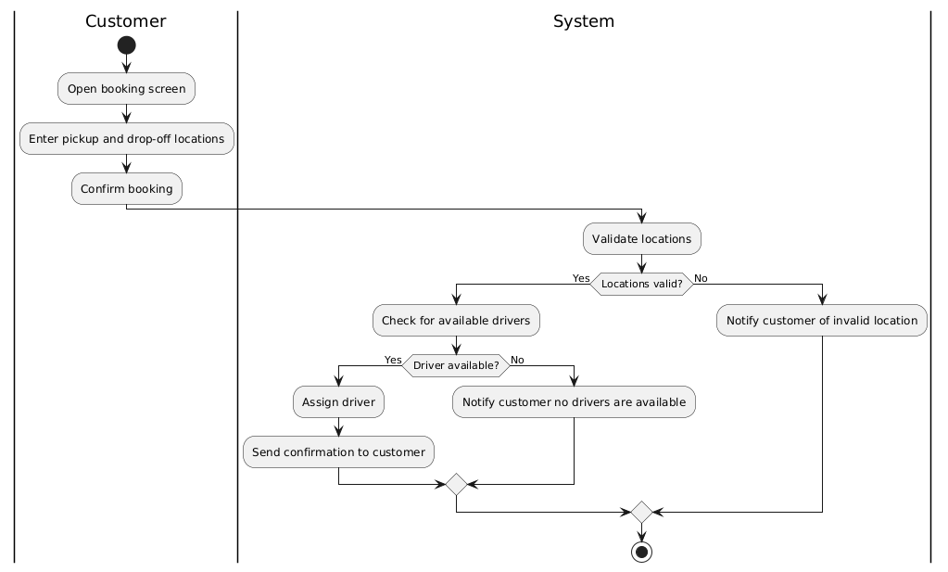
Use case 2: Book ride

Slide 19
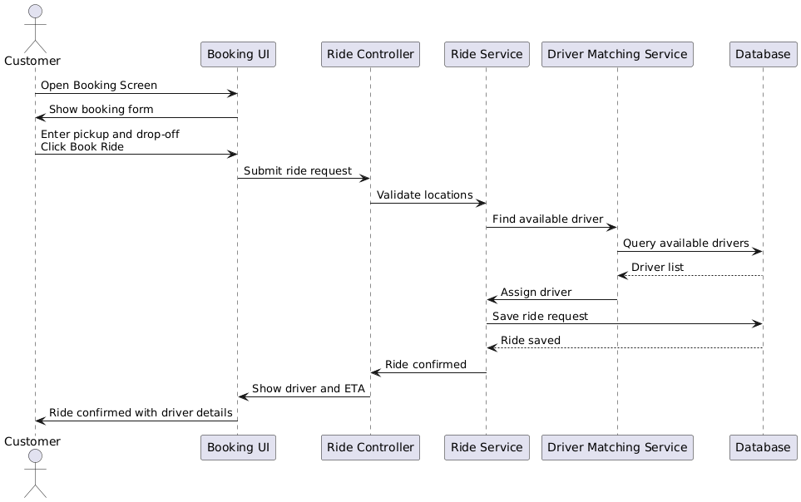
Use case 2: Book ride

Slide 20
Use case 3: process payment
Use case name: | Process payment
Scenario: | Customer pays for a completed ride.
Triggering event: | Ride is completed and fare is calculated.
Brief description: | Customer chooses a payment method and the system processes the transaction.
Actors: | Customer, Payment Gateway
Related use cases: | Book Ride
Stakeholders: | Customers, Finance Department
Preconditions: | Ride must be completed. Payment gateway must be operational.
Postconditions: | Payment is successful and receipt is issued.
Flow of activities:
Actor | System
1. Customer chooses to pay. | 1.1 System displays fare and payment options.
2. Customer selects payment method and confirms. | 1.2 System connects to payment gateway. 1.3 System processes payment. 1.4 System issues receipt.
Exception conditions: | 1.2 Invalid card or insufficient funds. 1.3 Payment gateway fails.

Slide 21
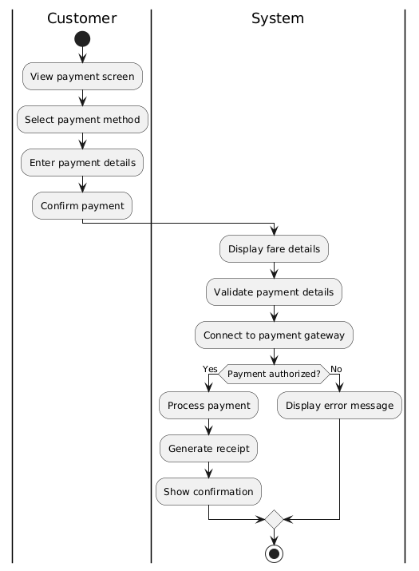
Use case 3: Process Payment

Slide 22
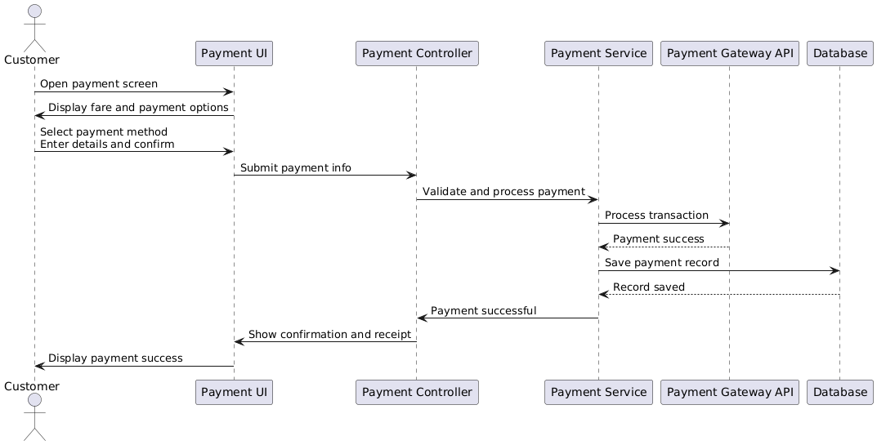
Use case 3: Process Payment

Slide 23
Use case 4: Track driver
Use case name: | Track driver
Scenario: | Customer wants to monitor their ride’s progress.
Triggering event: | A ride has been accepted by a driver.
Brief description: | The system provides real-time GPS tracking of the driver’s location.
Actors: | Customer, Driver
Related use cases: | Book Ride
Stakeholders: | Customers, Operations Team
Preconditions: | A driver has accepted the ride. GPS service is available.
Postconditions: | Customer can view updated driver location until arrival.
Flow of activities:
Actor | System
1. Customer opens track screen. | 1.1 System retrieves and displays current driver location.
2. Customer refreshes or waits. | 1.2 System updates location in real-time using GPS.
Exception conditions: | 1.1 GPS service fails or is unavailable.

Slide 24
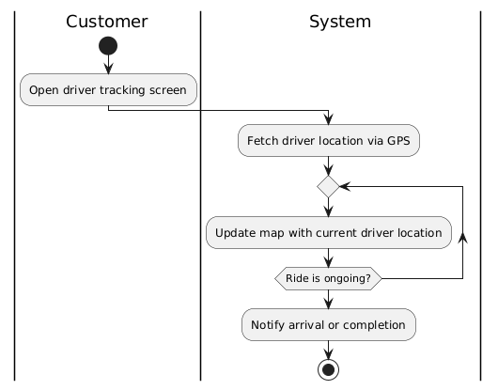
Use case 4: Track driver

Slide 25
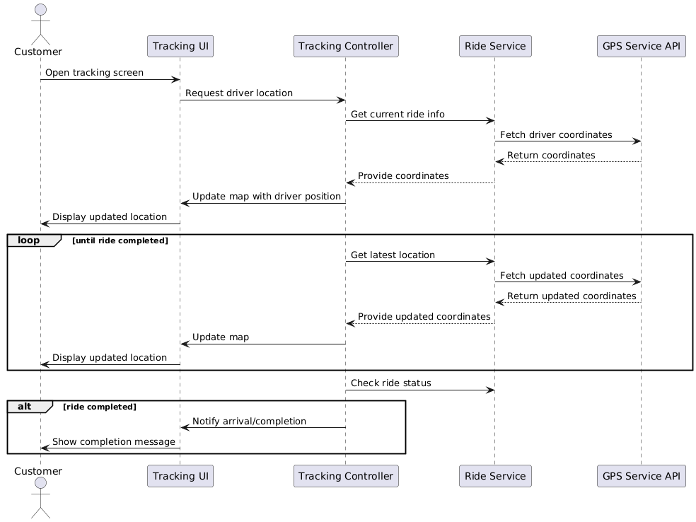
Use case 4: Track driver

Slide 26
Design Model

Slide 27
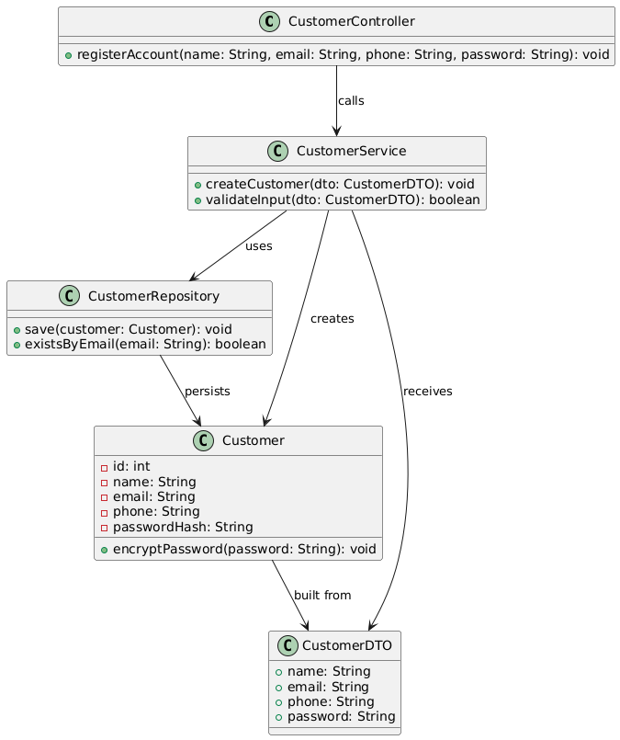
Design class: register account

Slide 28
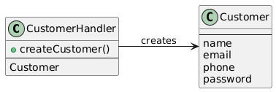

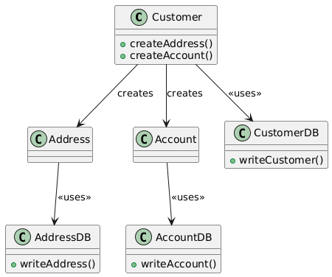
Domain Design class: register account
Controller
UI
Data Access

Slide 29
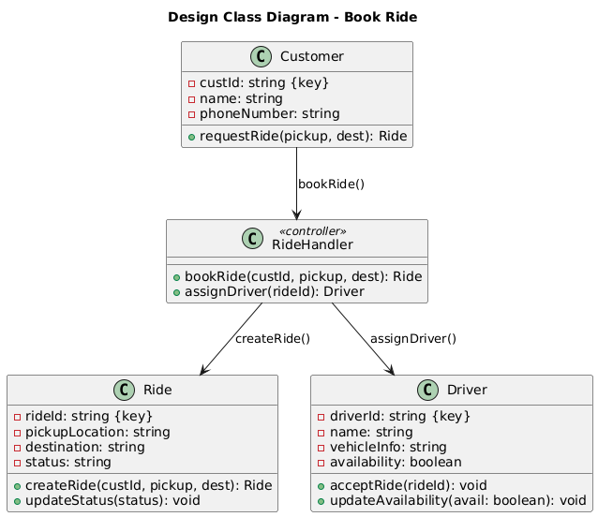
Design class: Book ride

Slide 30
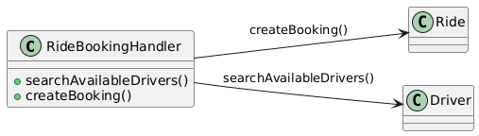
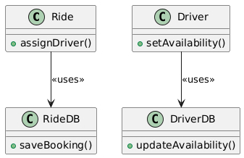
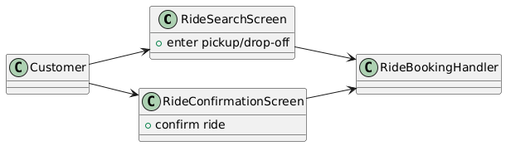
Domain Design class: Book Ride
Controller
UI
Data Access

Slide 31
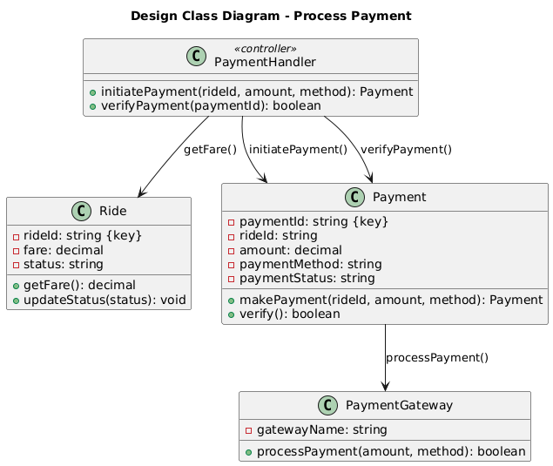
Design class: Process Payment

Slide 32
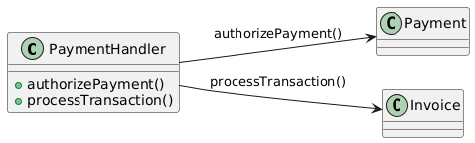
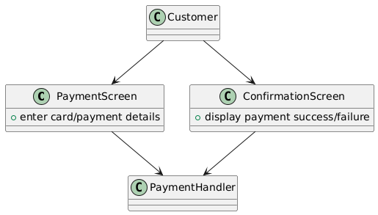
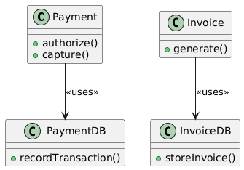
Domain Design class: Process Payment
Controller
UI
Data Access

Slide 33
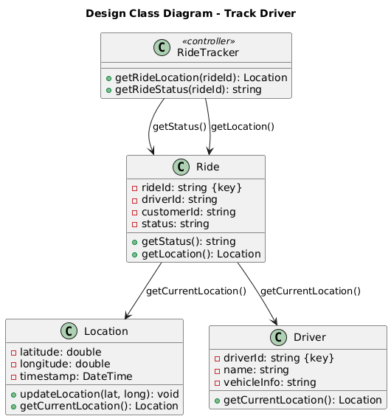
Design class: Track Driver

Slide 34
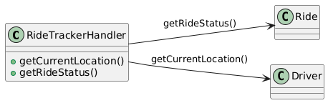
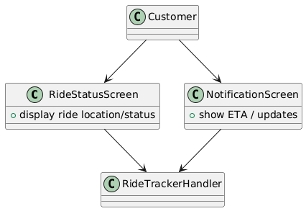
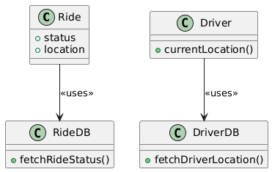
Domain Design class: Track Ride
Controller
UI
Data Access

Slide 35
UI Designs

Slide 36
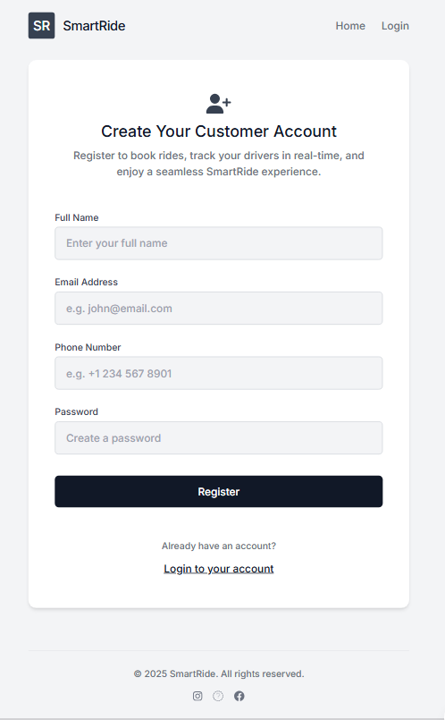
Register account

Slide 37
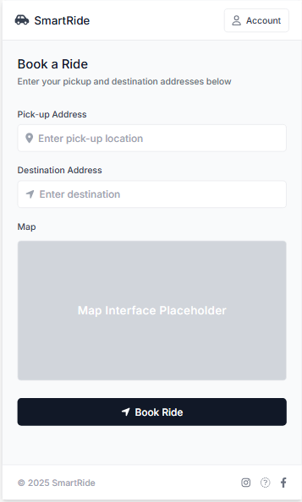
Book Ride

Slide 38
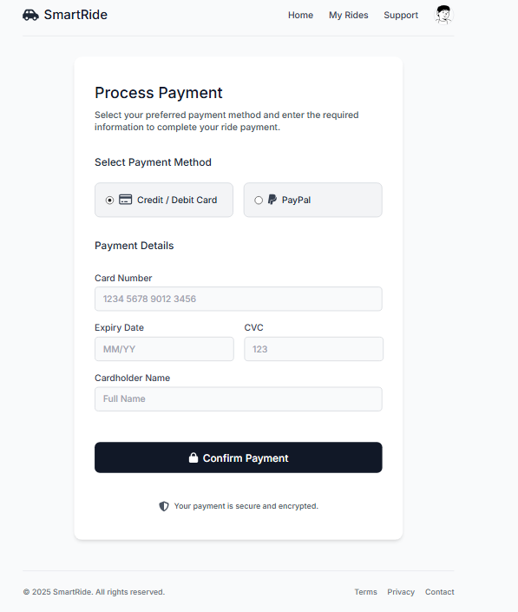
Process payment

Slide 39
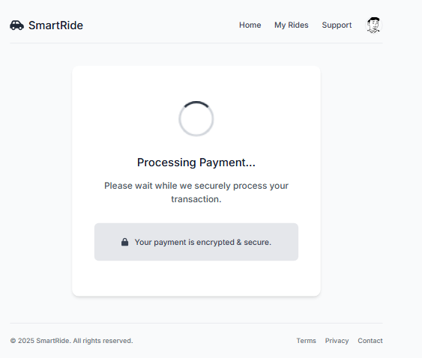
Process payment

Slide 40
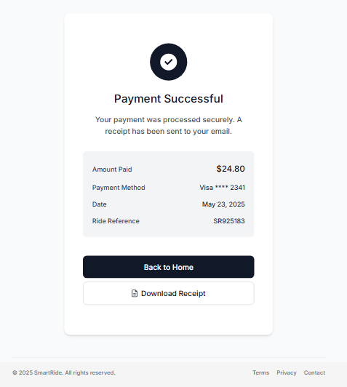
Process payment

Slide 41
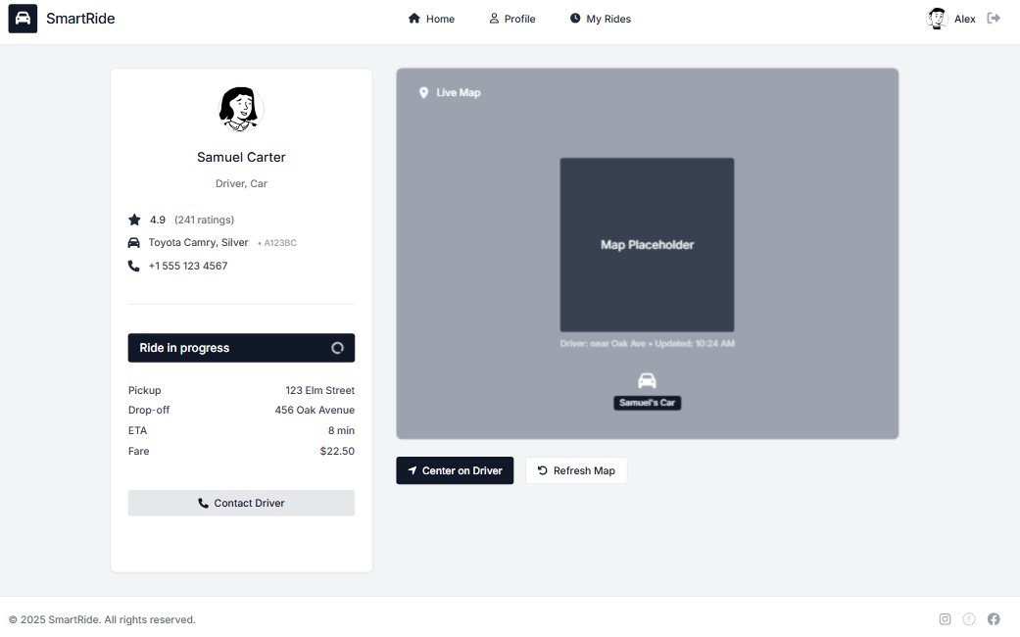
Track ride

Slide 42
Test case

Slide 43
Register account
Field | Value
Test Case ID | TC01
Use Case | Register Account
Description | Verify customer can register with valid details
Preconditions | Customer is not already registered
Test Steps | 1. Navigate to registration page 2. Fill all required fields 3. Submit form
Expected Result | Customer account is created, data is saved to database, confirmation is shown
Postconditions | New Customer, Account, and optionally Address records created in the system

Slide 44
Book ride
Field | Value
Test Case ID | TC02
Use Case | Book Ride
Description | Verify ride booking flow and driver assignment
Preconditions | Customer is logged in and has valid location details
Test Steps | 1. Enter pickup/dropoff location 2. Request ride 3. System assigns a driver
Expected Result | Ride is recorded with Requested or Confirmed status, driver is notified
Postconditions | New Ride record is created with reference to Customer and Driver (if assigned)

Slide 45
Process payment
Field | Value
Test Case ID | TC03
Use Case | Process Payment
Description | Verify that payment is processed after ride completion
Preconditions | Ride has Completed status, and valid payment method is configured
Test Steps | 1. View completed ride 2. Choose payment method 3. Submit payment
Expected Result | Payment is recorded, transaction ID is generated, and status is Paid
Postconditions | New Payment record linked to Ride and Account is created

Slide 46
Track driver
Field | Value
Test Case ID | TC04
Use Case | Track Driver
Description | Ensure customer can track driver’s current location
Preconditions | Ride has been accepted and driver is en route
Test Steps | 1. Open app during active ride 2. View driver's live location on map
Expected Result | System shows updated driver location in real-time
Postconditions | Location data is polled from DriverLocation and presented to the customer

Slide 47
Programing model

Slide 48
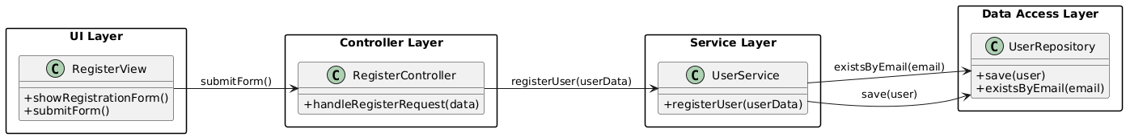
Register account

Slide 49
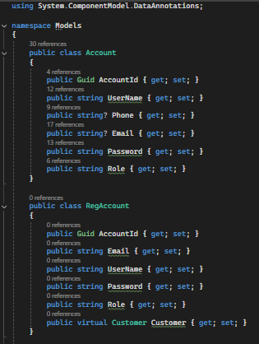
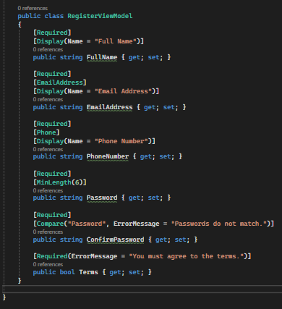
Register account: Account Models

Slide 50
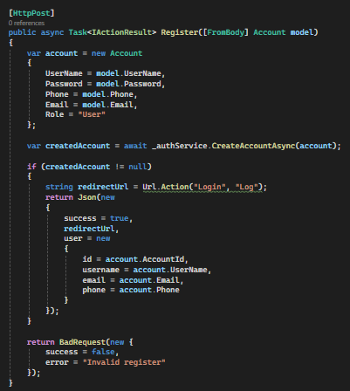
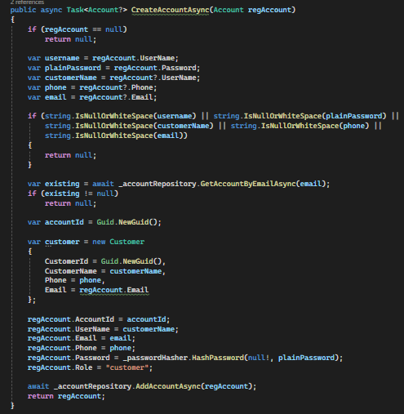
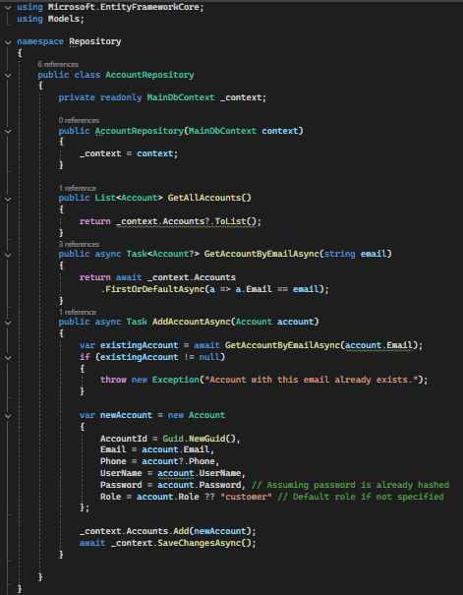
Register account: Back-end logic
Controllers
Services
Repositories

Slide 51
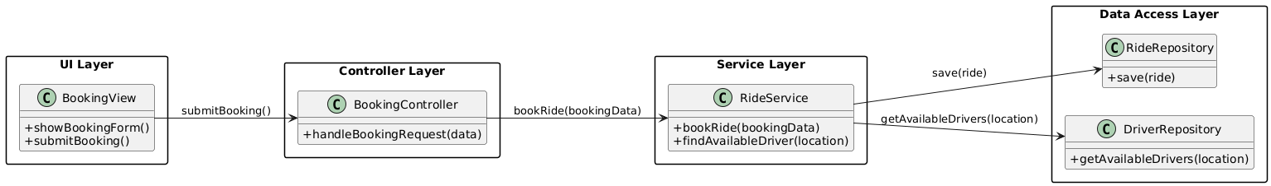
Book ride

Slide 52
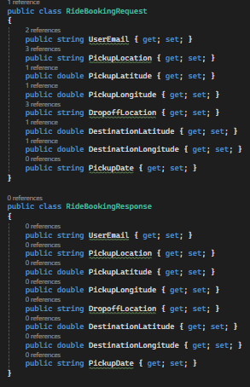
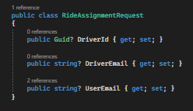
Book ride: Models

Slide 53
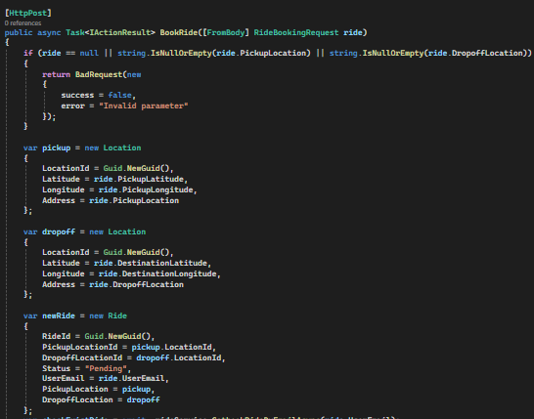
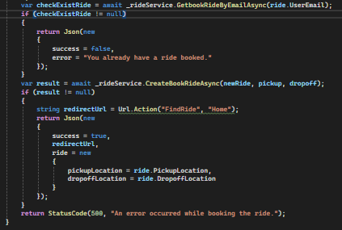
Book ride: Back-end logic
Controllers

Slide 54

Book ride: Back-end logic
Services

Slide 55

Book ride: Back-end logic
Repositories

Slide 56

Process payment

Slide 57

Track driver

Slide 58

Track driver: Models

Slide 59


Track driver: Back-end logic
Controllers
Services

Slide 60


Track driver: Back-end logic
Repositories

Slide 61
Thank you for listening

