Slide 1

6-Day Project Timeline for Smartride ORSP
523K0010 - Phạm Lê Anh Khôi
523K0013 - Dương Thành Long

Slide 2

Agenda
1. Introduction: Overview of Smartride ORSP Project
2. Day 1: Planning and Initialization
3. Day 2: Fact-Finding and Analysis
4. Day 3: Workflow Design
5 . Day 4: Architecture and Database Design
6. Day 5: Development
7. Day 6: Testing and Deployment
8. Conclusion: Key Insights and Next Steps

Slide 3
Project objectives
The project's aims include enhancing user experience, optimizing ride efficiency, and ensuring data integrity while addressing unique market needs.
Importance of planning
A well-structured plan serves as a roadmap, ensuring that resources are allocated effectively and reducing risks associated with unforeseen challenges during project execution.
Overview of 6-day timeline
Each day focuses on specific tasks ranging from planning to deployment, ensuring that deadlines are met and project goals are continuously aligned with stakeholder expectations.

Slide 4
Day 1: Planning and Initialization
Define the core scope for this iteration:
Account creation and login
Ride booking flow (pickup/drop-off + driver assignment logic)
Basic admin view for ride summaries

Slide 5
Day 1: Planning and Initialization
Work Breakdown Structure (WBS)
Requirements Review
Use Case Identification
Basic UI/UX wireframes
Database Schema Drafting
Class Diagram Draft
Development of:
Authentication module
Ride booking flow
Testing Plan Preparation

Slide 6
Day 1: Planning and Initialization
Team Roles
Analyst: Coordinates with stakeholders, gathers requirements
Designer: Prepares wireframes and user flows
Developer: Codes core components (auth, booking, UI)
DB/Tester: Builds schema, performs integration and tests

Slide 7
Day 1: Planning and Initialization
Work Sequence Overview
Day | Task Focus
1 | Planning, Scope, WBS, Team Roles
2 | Requirement Gathering, Use Cases
3 | Use Case Details, UI/UX Sketches
4 | DB + Architecture + Class Diagrams
5 | Component Development + Integration
6 | Testing + Deployment/Demo

Slide 8
Day 2: Fact-Finding and Analysis
Stakeholder Meetings
Interview hypothetical stakeholders:
Operations Manager (for booking workflows and demand challenges)
Driver Representative (for navigation and assignment issues)
Customer Feedback Agent (for user pain points)

Slide 9
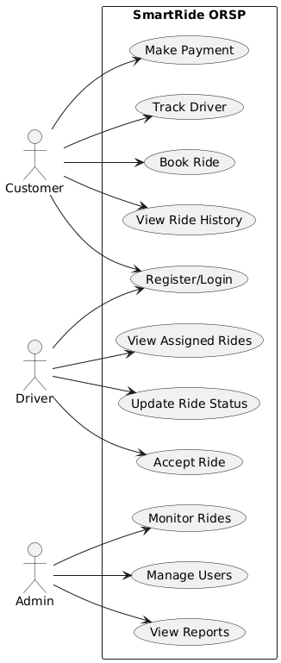
Day 2: Fact-Finding and Analysis
Preliminary Requirements
Actors: Customer, Driver, Admin
Use Cases:
Register/Login
Book Ride
View ETA
Track Ride
Make Payment
View Reports (Admin)
Initial Use Case Diagram

Slide 10
Day 3: Workflow Design
Use Case Workflows
Example: Book Ride
Customer logs in
Enters pickup/drop-off
System lists available drivers
Customer selects or system auto-assigns driver
System shows ETA + driver info
Ride gets booked

Slide 11
Day 3: Workflow Design
UI Sketch Ideas
Login/Register Pages
Ride Booking Form
Real-time Map View
Admin Dashboard (Summary stats)

Slide 12
Day 4: Architecture and Database Design
System Architecture
Frontend: Web UI / Mobile App (Future)
Backend: REST API with core business logic
Database: Relational (e.g., MSSQL or PostgreSQL)
Third Party: GPS API, Payment Gateway

Slide 13
Day 4: Architecture and Database Design
Database Schema Highlights
Users: UserID, Name, Email, Role, PasswordHash
Rides: RideID, CustomerID, DriverID, Pickup, Dropoff, Status, Fare
Payments: PaymentID, RideID, Amount, Timestamp, Status
Vehicles: VehicleID, DriverID, Type, PlateNumber

Slide 14
Day 4: Architecture and Database Design
Class Diagram
Will align with entities and services like:
User
Ride
Payment
DriverService
BookingManager

Slide 15
Day 5: Development
Core Components to Develop
User authentication (register/login)
Basic booking form logic
Ride matching algorithm (simplified, random available driver)
Admin route to view rides

Slide 16
Day 5: Development
Integration Tasks
Connect booking form to backend
Link database queries with ride data
Prepare mock GPS/ETA response

Slide 17
Day 6: Testing and Deployment
Testing Plan
Unit test: login, ride creation
Integration test: booking + database + mock GPS
User test: Simulate booking as customer

Slide 18
Day 6: Testing and Deployment
Deployment/Demo
Demo of:
Login
Booking a ride
Seeing mock ETA
Admin viewing summary
Gather feedback for iteration 2

